Slide 1


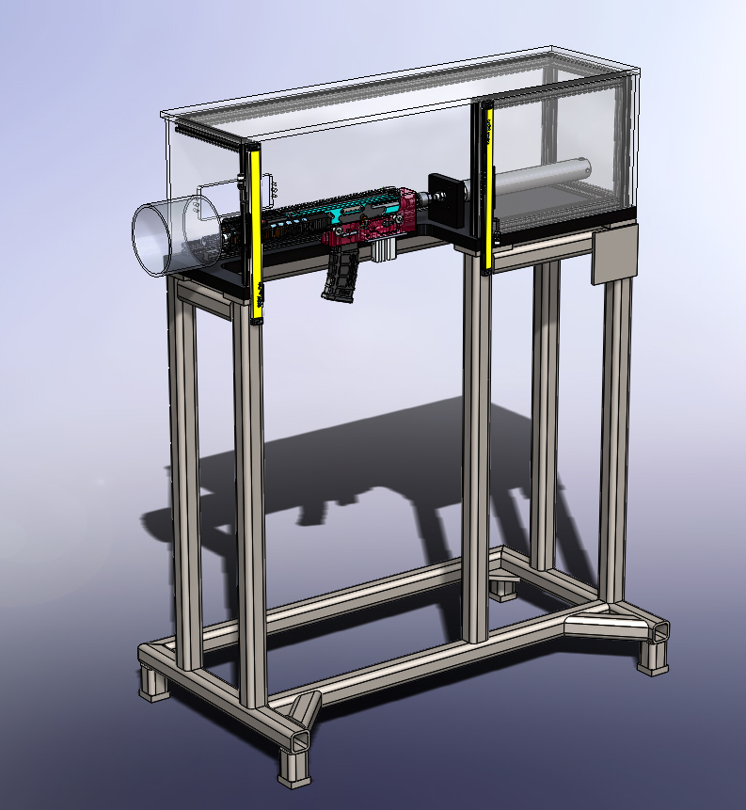
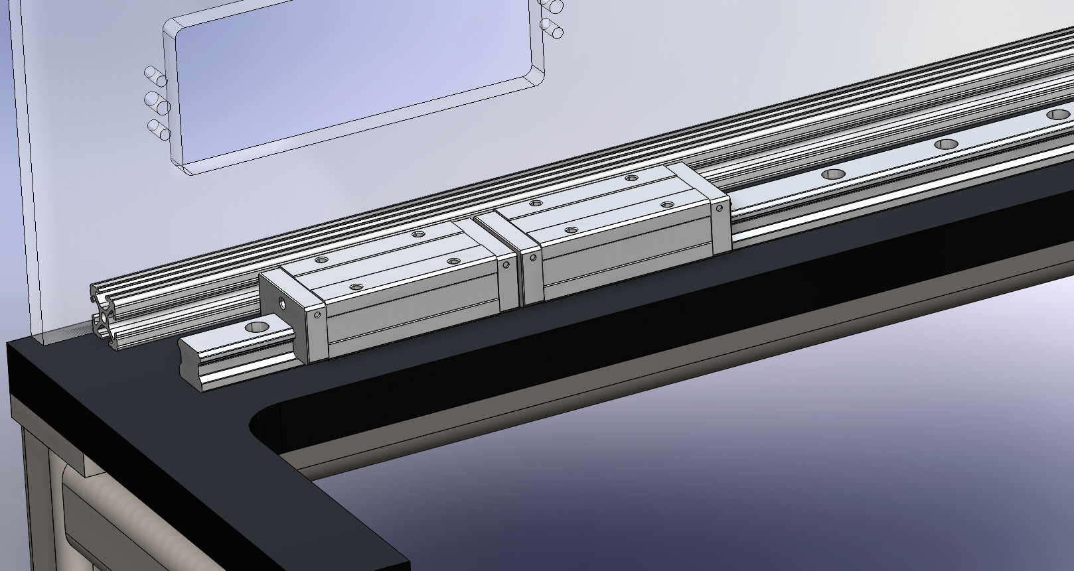
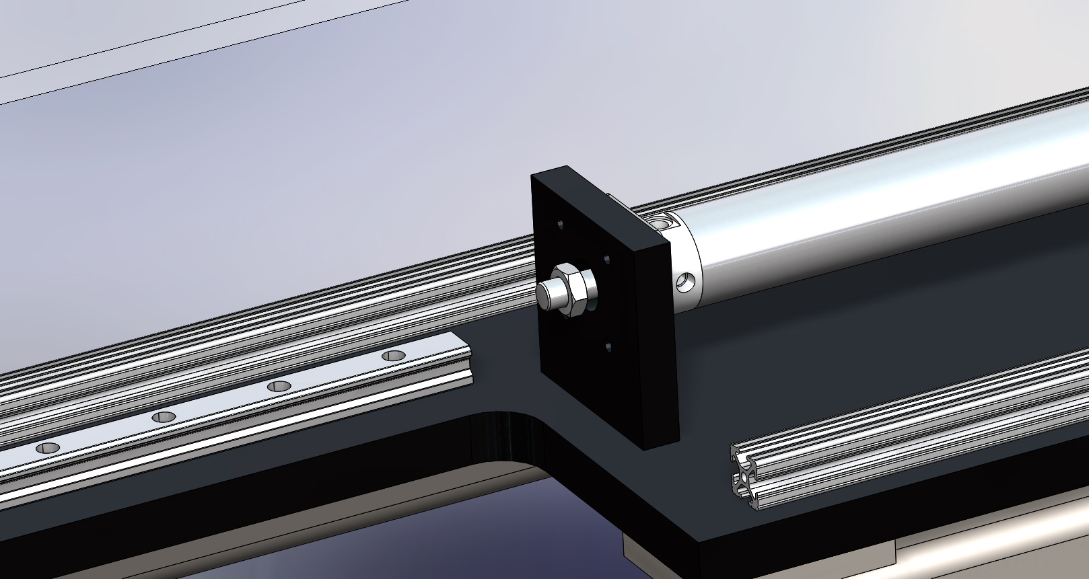
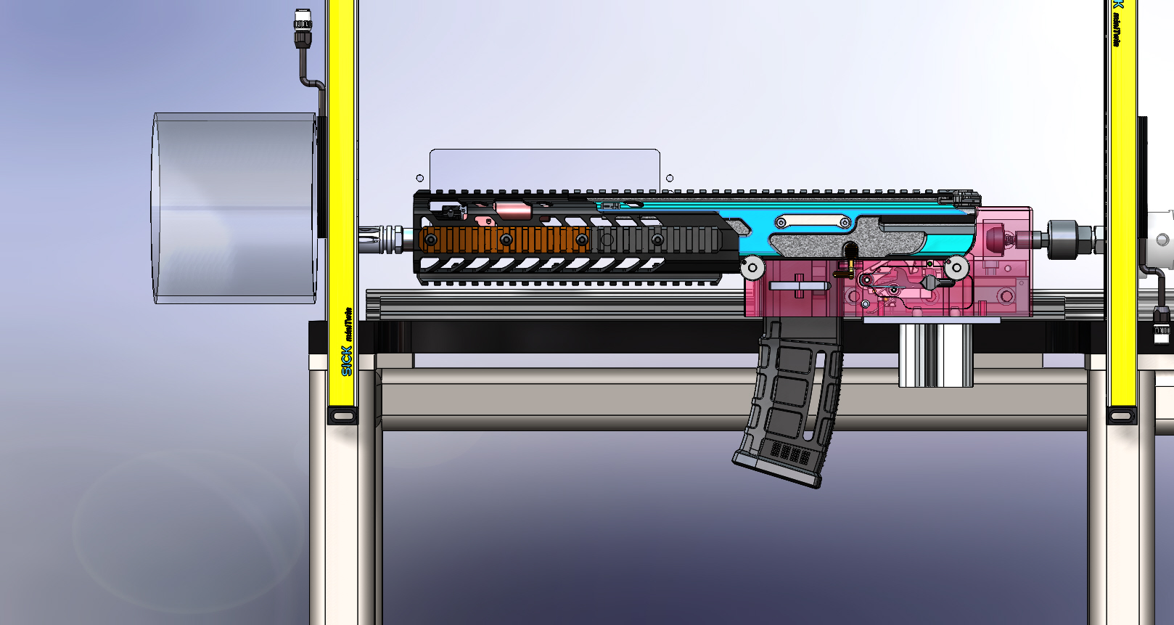
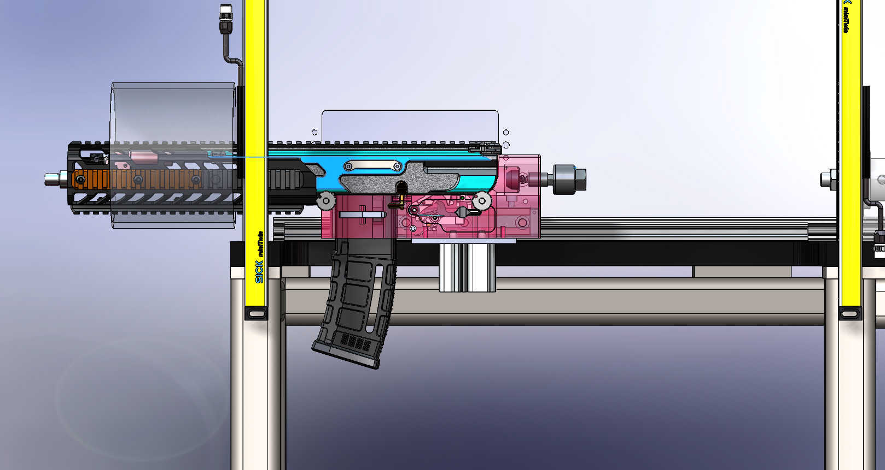
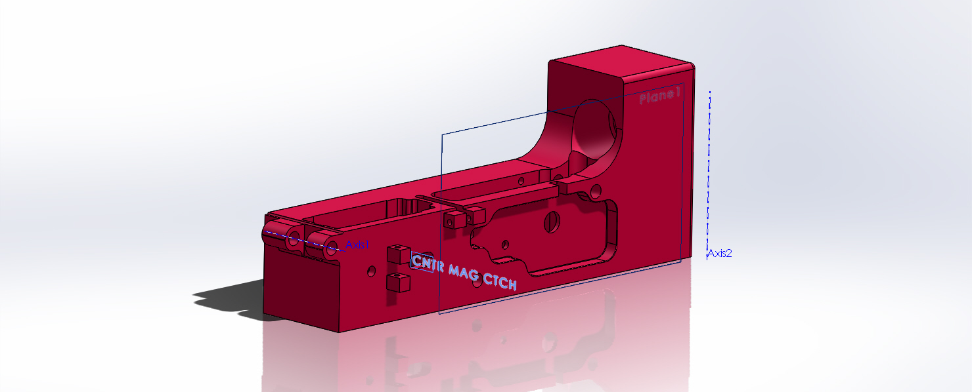
MCX Upper Function and Proofing Fixture
Sig Sauer
Andrew Reid, Department of Engineering Physics, University of New Hampshire
Introduction
Analysis
Conclusions
The Fixture must be strong enough to withstand impact of the firearm being fired.
The Piston must be able to simulate the forward pressure of a human shoulder
Sig Sauer has a design for a plausible way to function and proof their MCX uppers.
Learned a lot about troubleshooting manufacturing designs.
Even though I have produced a solid design, there is always room for improvements
Never be afraid to ask questions!
Ensuring the quality of products leaving the manufacturing floor is one of Sig Sauer’s primary focuses.
With the Sig MCX rifle line being one of their most popular products, making sure it meets quality standards is of great importance.
Currently Sig Sauer is using slave lowers to proof and function the uppers that are shipped from the facility.
This device has been designed to test MCX uppers and ensure they fire and function correctly when coming from the assembly floor.
Next Steps
Criteria
Results
Complete the list of improvements gathered from my meeting with the Sig engineers
Create a control system sequence for the fixture
The fixture was brought before a board of 8 Sig Sauer Engineers
Determined this was a great solution to the problem however needs some structural changes before ordering parts
Required to operate with all models of MCX
Take down and pivot pin must be ergonomic; Must lock into place
Fixture must sit at correct height to fire into the tube in the range
Must include a 3-position safety
Must satisfy safety check list from Sig Sauer
Magazine must be removeable
Special Thanks
Nick Fappiano, Andy Packard, Wayne Wilson, John, Berg, Sid Spreadbury, Don Webb, Pete Card Ben Londrigan and all the Sig Sauer employees who helped me with this project.
Also a special thanks to my advisor through UNH, Marc Lessard.

