Slide 1
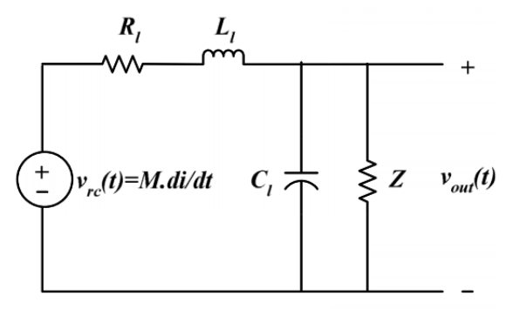
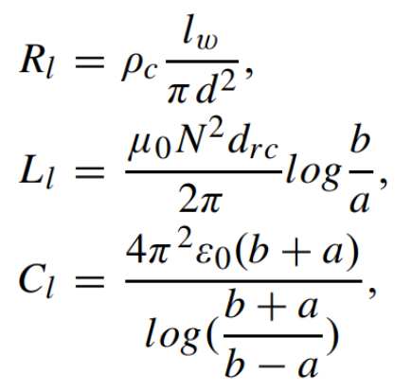
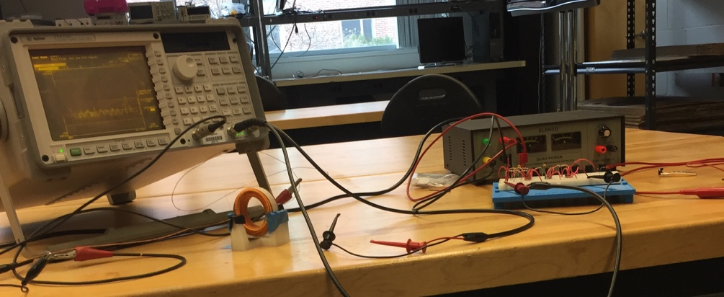
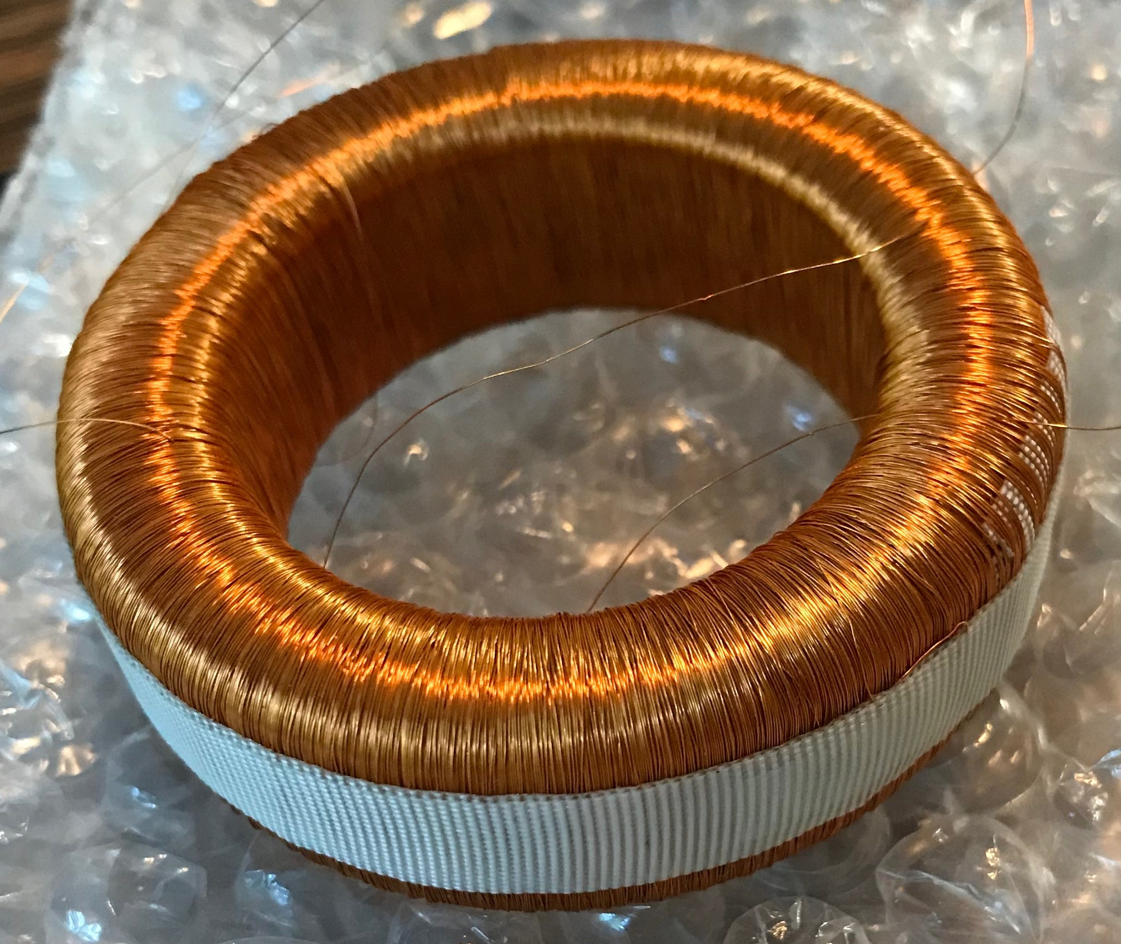
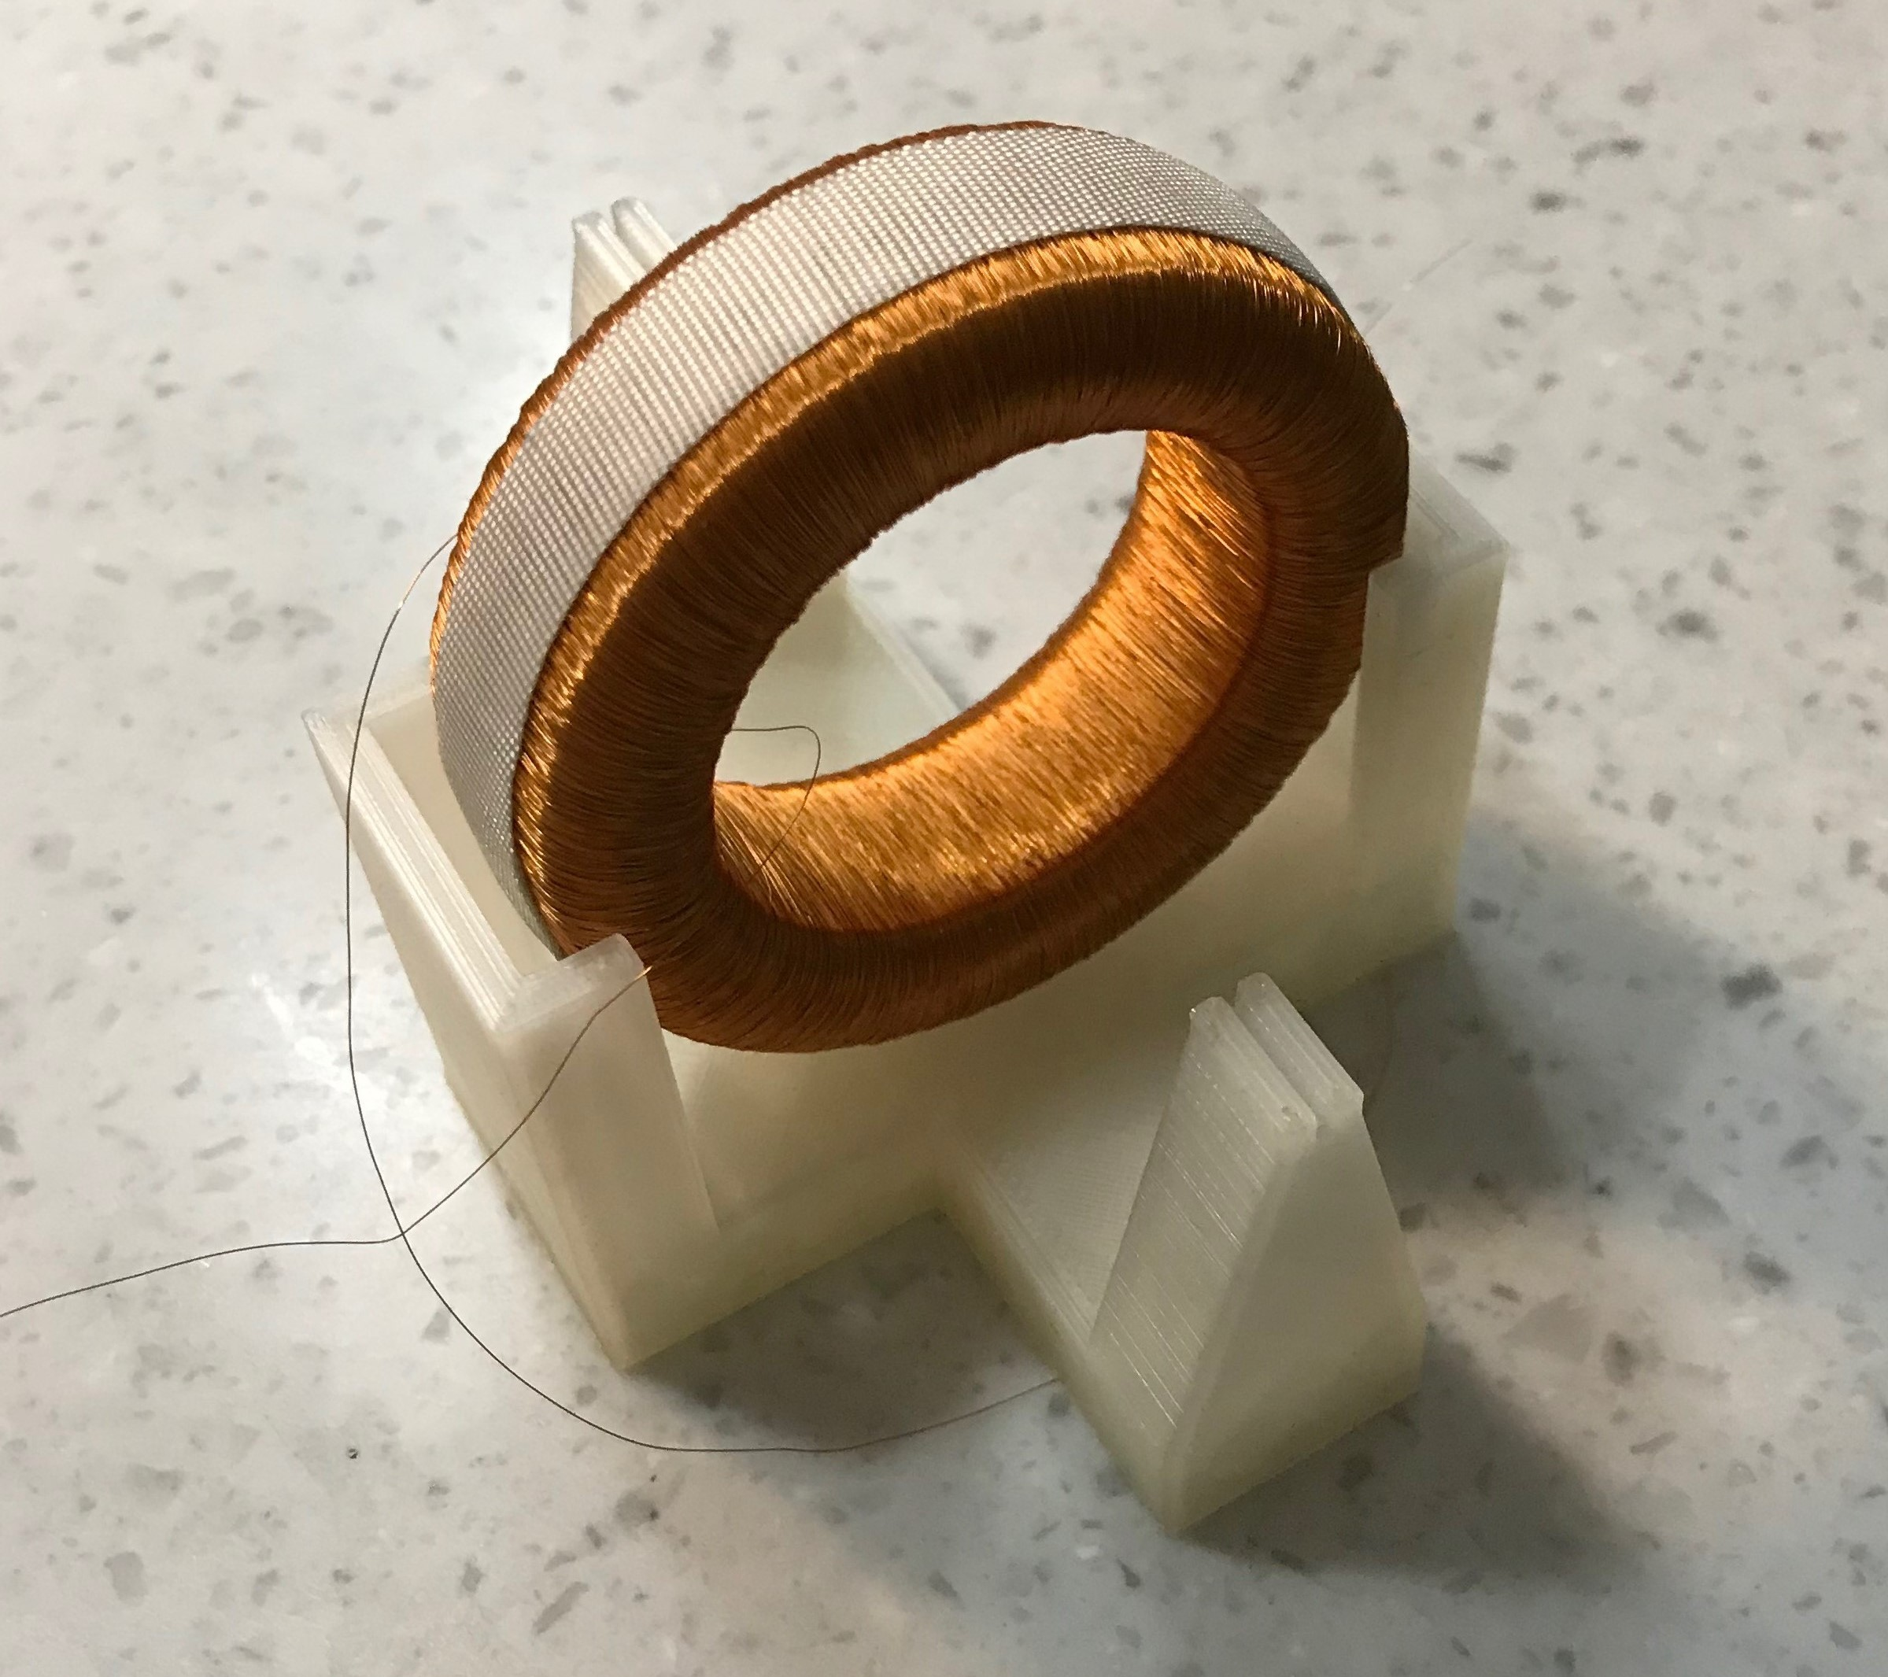
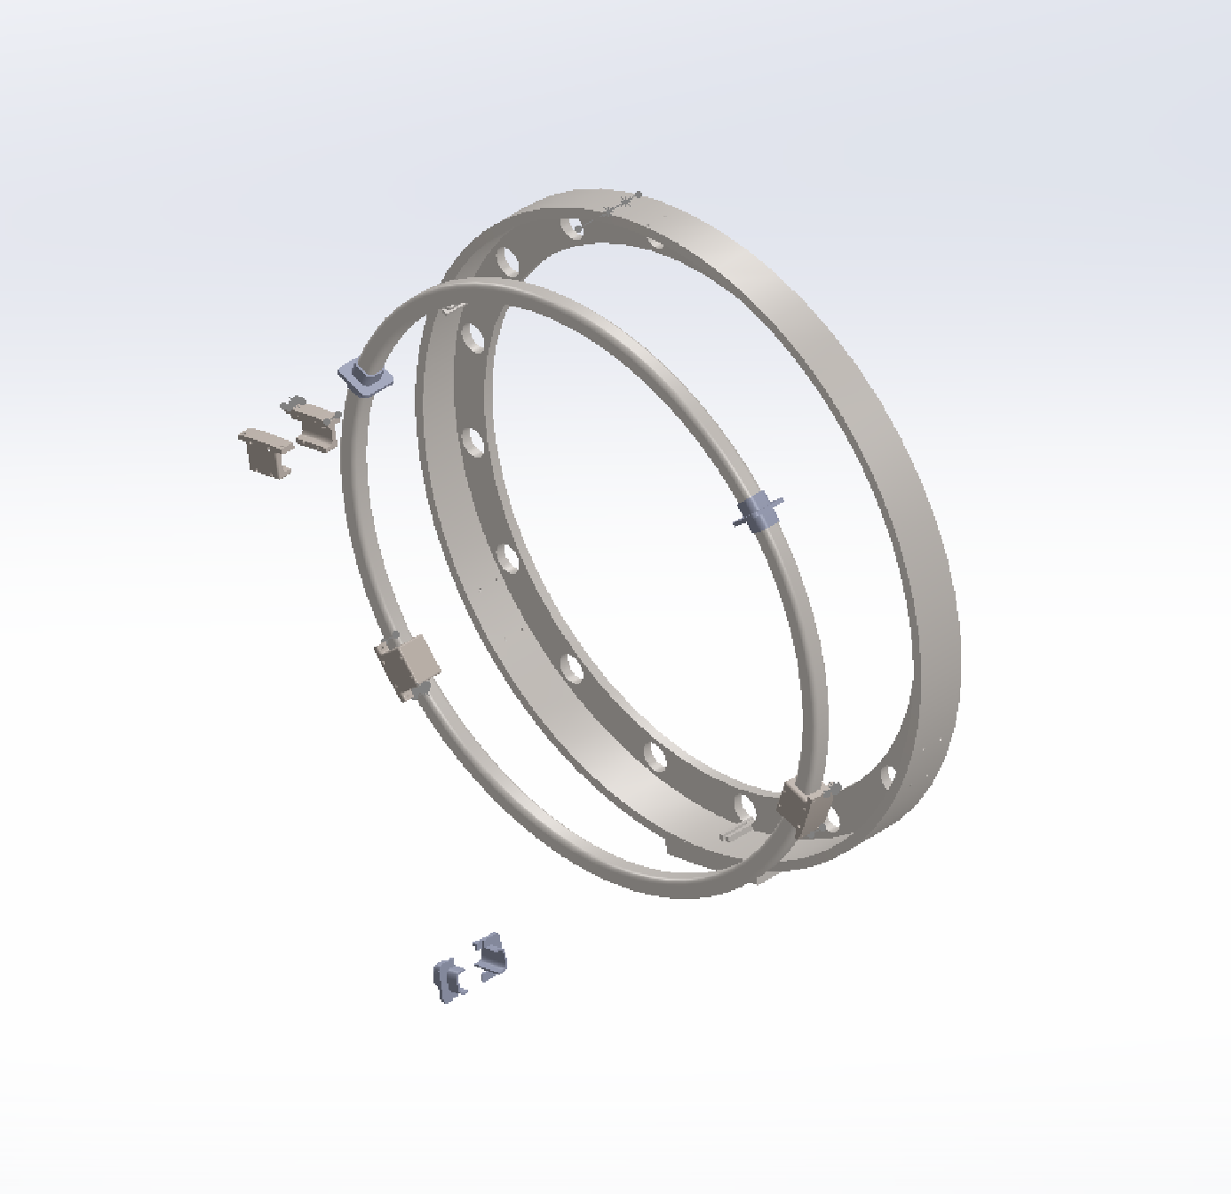
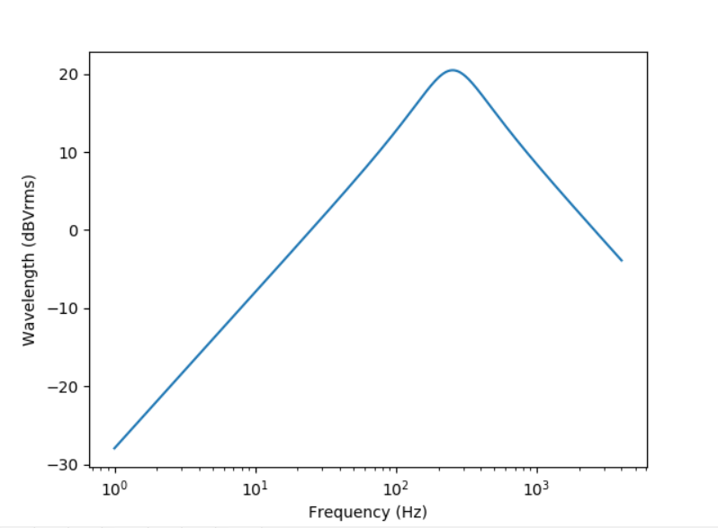
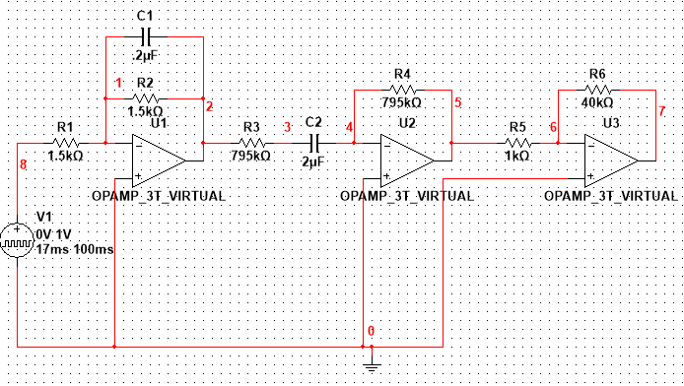
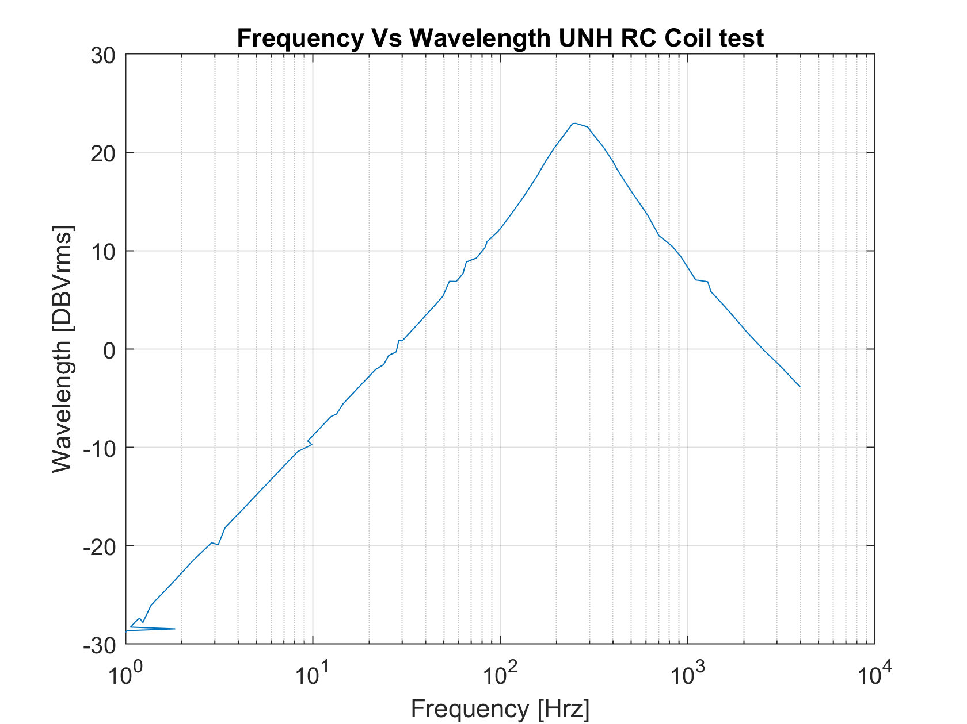
Directly Measuring Electrical Current in the Aurora Borealis Using a Rogowski Coil
Jessie Greenhalgh, Jonathon Amrein and Joe Lazzaro
Advisors: Dr. Wayne Smith, Dr. Matthew Argall
Department of Space Science
University of New Hampshire
Computer Model
Objective
Testing
The goal of the computer model was to predict the response of the coil as it flies through the auroral currents. The Rogowski coil is modeled as an RLC circuit where the resistance, inductance, and capacitance are functions of the coil’s physical dimensions, the permittivity of the core material, and the number of turns of wire. These parameters can be adjusted and optimized for future alterations to the coil design.
The objective of this project was to design a device capable of directly measuring the electrical current in the aurora borealis. This current has never been directly measured and doing so will provide important information on how energy is coupled from the magnetosphere to the ionosphere. The designed device will serve as a prototype for a device that will be on a NASA rocket in 2021.
Testing was completed with the use of an Agilent 35670A Dynamic Signal Analyzer. This had a built in function generator which was used as a source to the coil. This source was set to 1 Vpp and connected to a 1 kilo Ohm resistor which was in series with a foot-long copper wire. The copper wire was run through the middle of the coil and induced a current on the coil. A dual power supply of +/- 5 volts powered the operational amplifiers in the circuit.
Mechanical Design
The goal of the mechanical design was to design a Rogowski Coil that can capture the desired current. This coil is able to directly measure current through its use of wire turns around a magnetic torus. An alternating current passing through the center of the ring induces an AC magnetic field in the torus and thus a current in the copper winding.
RLC circuit and parameter equations used to model the coil where ρ_{c} , l_{w} , d, and N are the resistivity, length, diameter, and turns of the wire, a, b, and d_{rc} are the inner and outer radius of the coil, and the diameter of the core cross-section respectively, and µ˳ has been replaced with the permittivity of the core.
The testing setup is shown above. The signal analyzer is on the left and the power supply is on the right.
Prototype Ferrite Metal Core with 7500 turns of 48-gauge copper wire.
3D Printed Stand used for testing with the coil
3D model of the mechanical support created in SOLIDWORKS
Electrical Design
The goal of the electrical design was to filter, amplify, and digitize the signal coming out of the Rogowski Coil. This was accomplished by using an active bandpass filter and an Arduino with an analog to digital convertor.
The output of the coil was attached as the input to the circuit built on a breadboard. An AC sweep from 1 Hz to 4 KHz was performed and the measurement across the output of the circuit is shown above. These results met all design specifications and proved the designed device worked correctly.
Modeled Frequency Response of the Rogowski Coil
Recommendations for Future Work
Add a feedback winding to the coil to flatten the frequency response so all frequencies are weighted equally
Put the circuit on a printed circuit board and permanently attach it to the coil
Design a casing for the device to protect it from the atmosphere it will face in space
This figure shows the design of the analog circuit used to amplify and filter the signal. The first stage is a low pass filter with a cutoff frequency of 512 Hz. The second stage is a high pass filter with a cutoff frequency of .1 Hz. The third stage is an amplifier with a gain of 40.
Measured Frequency Response of the Rogowski Coil

Slide 2
Rogowski Coil

