Slide 1
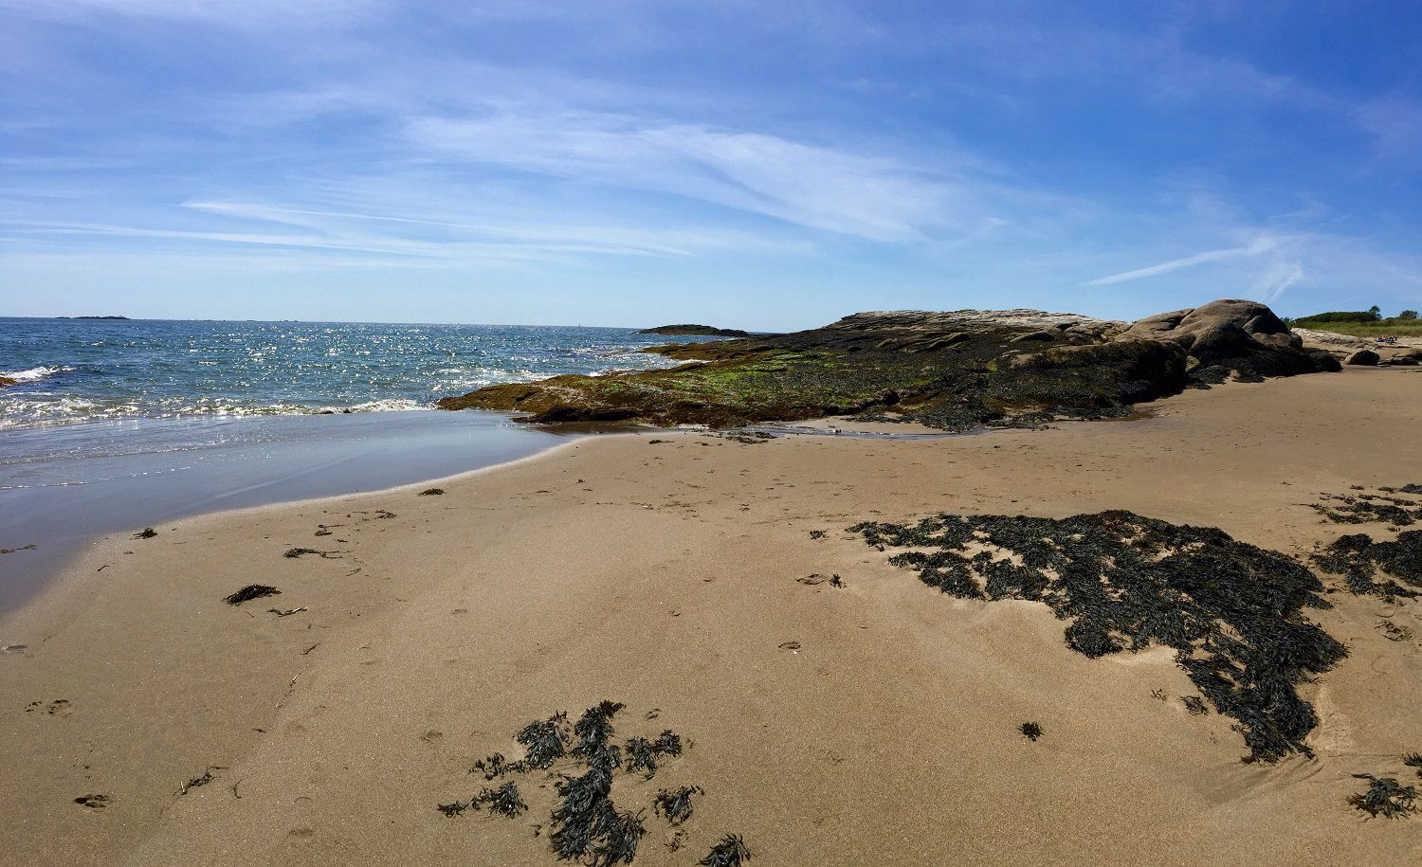
Georgetown, Maine
Culvert Assessment
University of New Hampshire Civil and Environmental Engineering Senior Capstone Presentation
April 27th 2020
Notes:
Anna

Slide 2
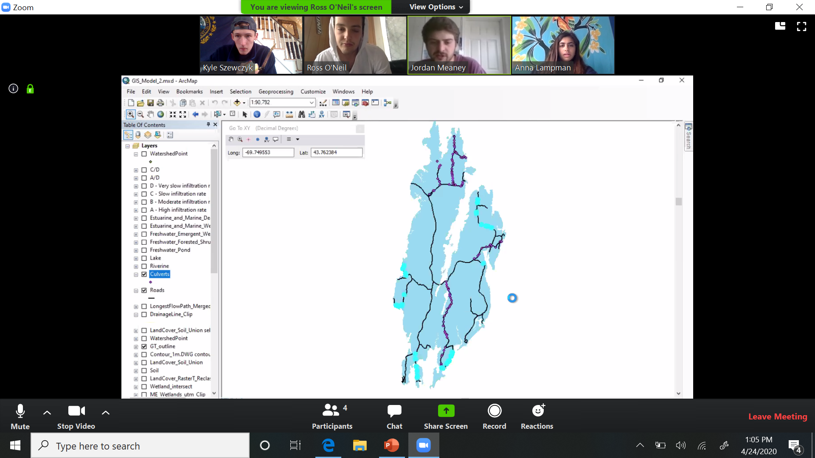
Zoom tutorial
Click here to see our faces
Mute button
Notes:
Anna

Slide 3
Georgetown, Maine
Culvert Assessment
University of New Hampshire Civil and Environmental Engineering Senior Capstone Presentation
April 27th 2020
Notes:
Anna

Slide 4




Introductions
Anna Lampman
Jordan Meaney
Anna Lampman – Project Manager, Environmental Engineer
Jordan Meaney – Environmental Engineer
Kyle Szewczyk – Civil Engineer
Ross O'Neil – Civil Engineer
Nancy Kinner – Faculty Advisor
Charlie Collins – Georgetown Road Commissioner
Kyle Szewczyk
Ross O'Neill
Notes:
Anna

Slide 5
Presentation Outline
Project background and history
2019-2020 Scope of work
Field data collection and culvert modeling
Georgetown citizen scientist program
Tidal culvert research
Conclusion and questions
Notes:
Anna

Slide 6
Project background and history

Slide 7
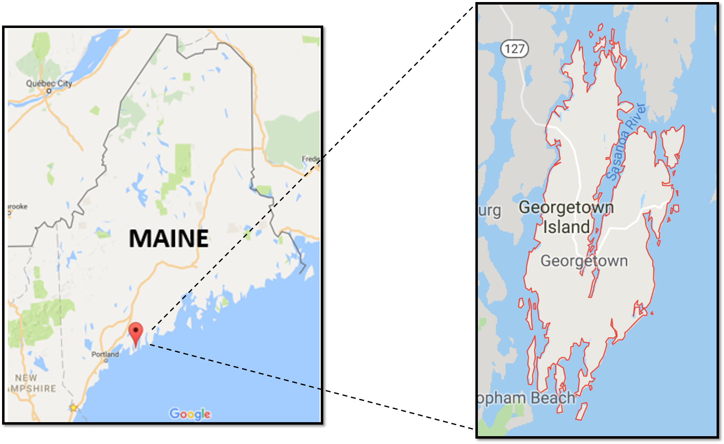
Background
18.7 square miles of land (65 square miles in total)
32 miles of road
Over 200 culverts on the island
More frequent and larger storms New England cause more flooding
Rising sea levels
Notes:
Kyle

Slide 8
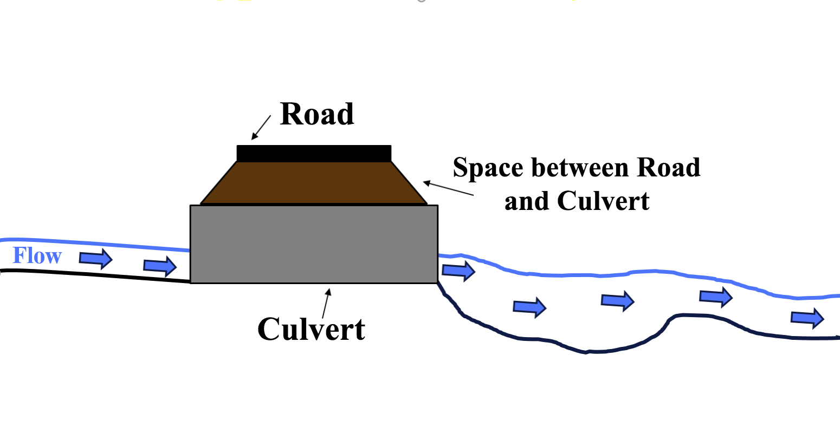
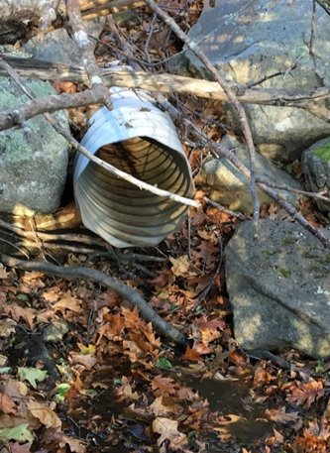
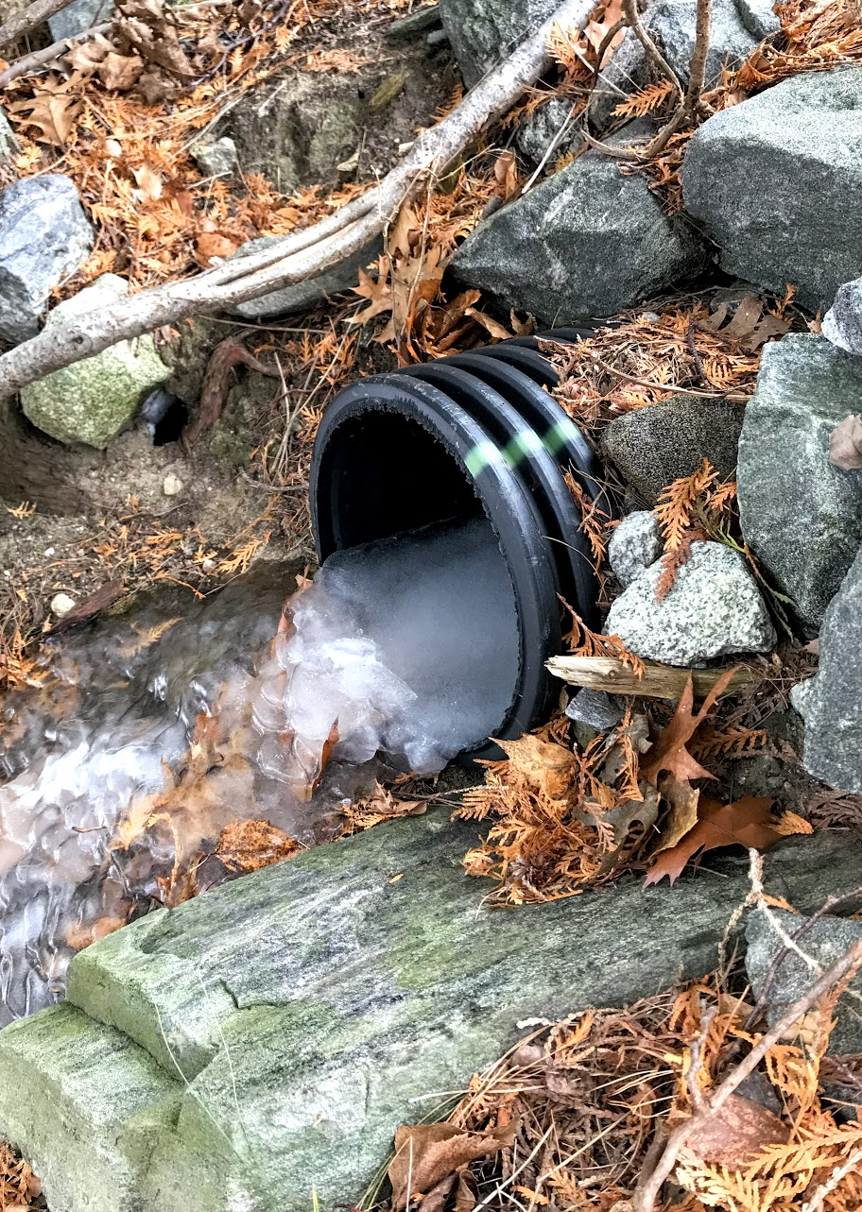
What is a culvert?
Moves water from one side of the road to the other
Smaller than a bridge
Prevents water from streams from going onto the road
Notes:
Kyle

Slide 9
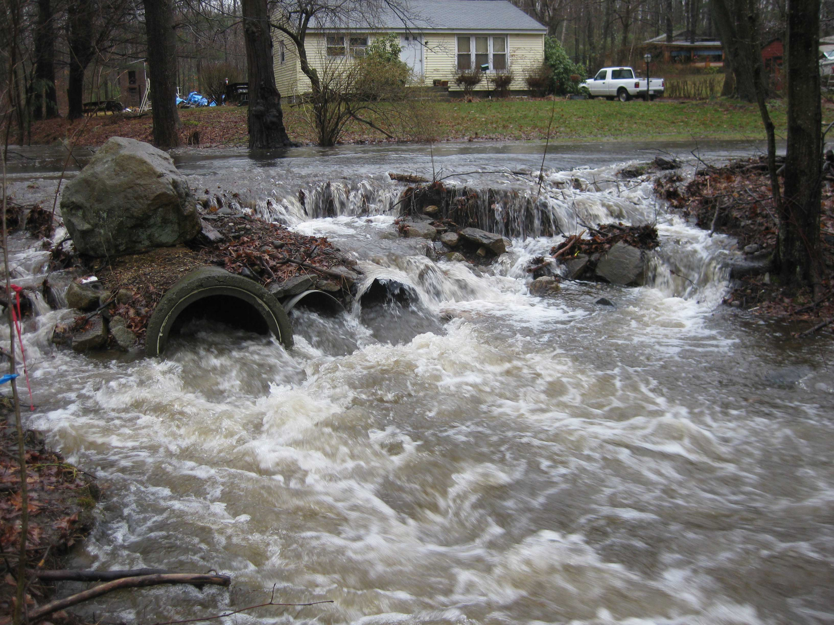
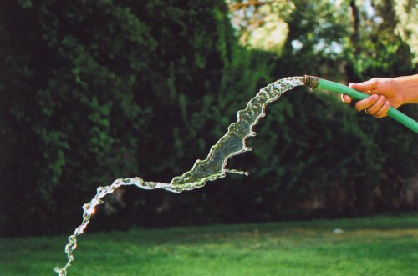
Flooding
Example of a flooded culvert (not Georgetown)
Culverts have certain amount of water they can handle, depending on size
When it rains heavily, amount of water can exceed culvert capability
This causes water to flood onto road
Floods are measured in volume per time – gallons per minute
Your garden hose has 13 gallons per minute
Flooded culvert above has approximately 22,000 gallons per minute!
Notes:
Kyle

Slide 10

What is the n^{th} year flood?
For this analysis, n = 2, 10, 25, 50, or 100
The 2-year flood is a flood with a ½, or 50% chance of occurring in any given year
The 100-year flood is a flood with $1/{100}$, or 1% chance of occurring in any given year
Floods for each “n” are in gallons per minute for each culvert
Year Storm | Percent chance of occurring in any given year | Example from a culvert on Marrtown road in gallons per minute
2 | 50% | 7,092
10 | 10% | 13,600
25 | 4% | 17,730
50 | 2% | 20,380
100 | 1% | 23,830
Notes:
Anna

Slide 11
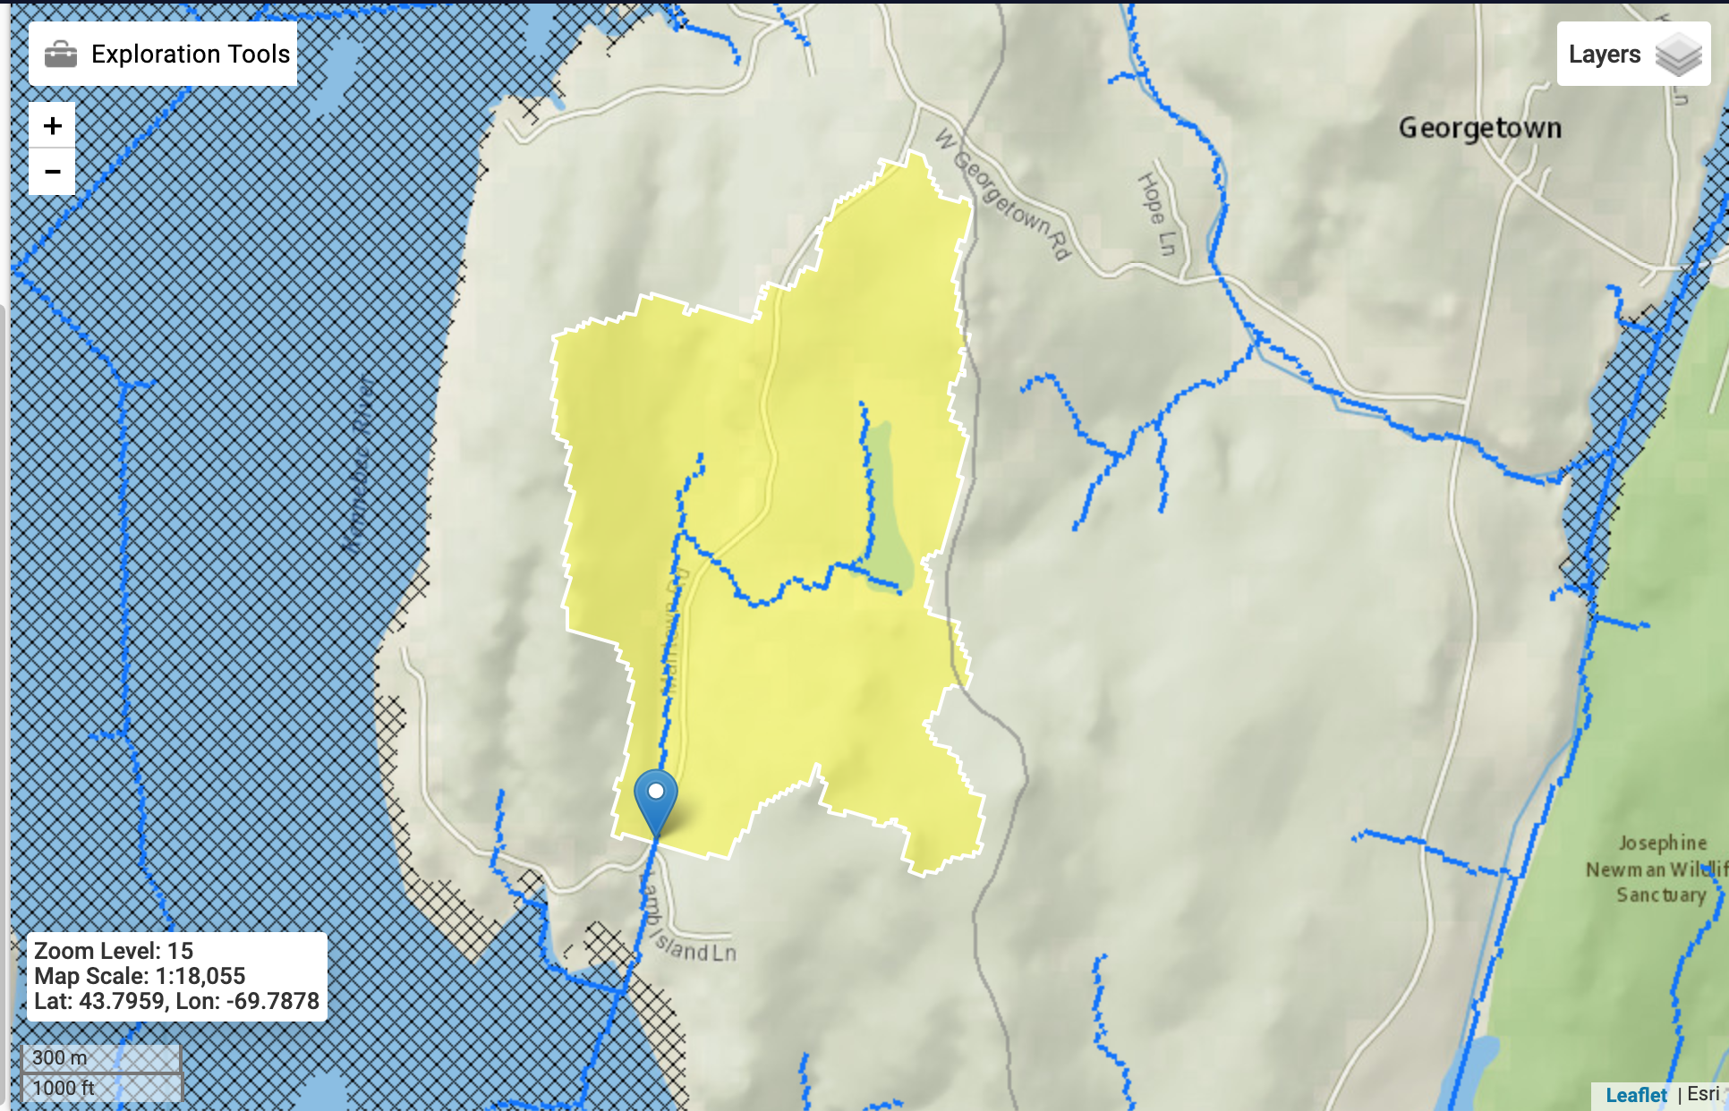
Watershed area
Every stream has a watershed
The boundaries of a watershed are hills, ridges, or mountains
All of the water in the culvert comes from the runoff in the watershed
n^{th} year flood is determined from size of watershed
Bigger watershed – bigger floods
Flow direction
Watershed boundary
Watershed 2
Watershed 1
Culvert
Same size culverts
Notes:
Anna

Slide 12
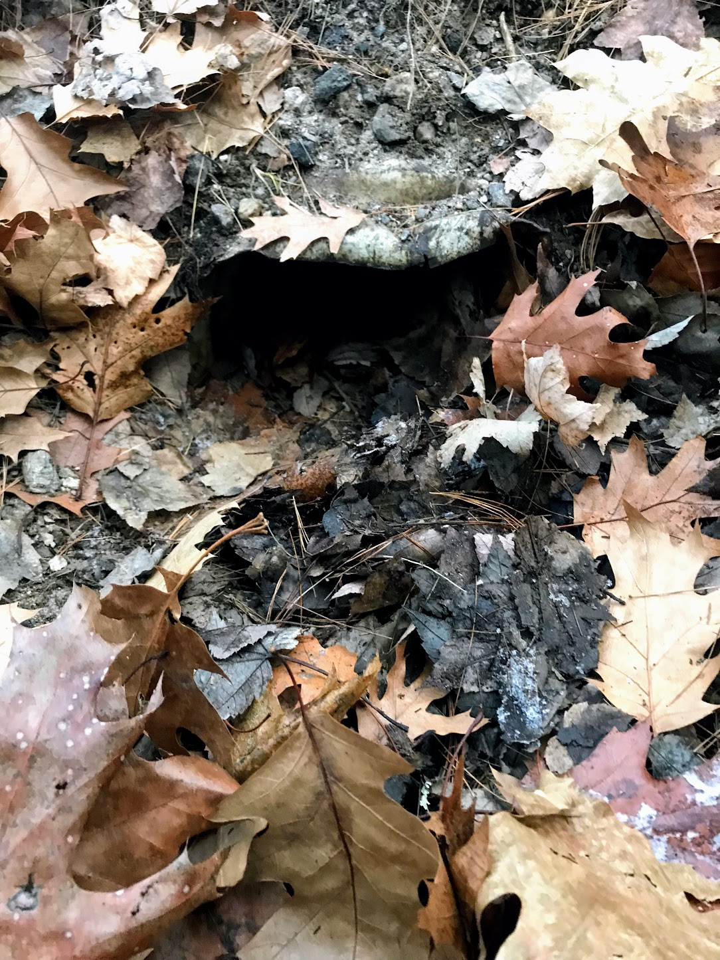
Other reasons for culvert failure
Culverts not properly maintained
  Clogging
  Compression
  Rusting
  Breaking
Climate change increasing the amount of gallons per minute of n^{th} year floods
  Warmer climate – larger storms
  Larger storms – more flooding
  Older culverts installed before effects of climate change known
Culvert
Failure can be from tides if culverts are tidal
  High tides and rising sea levels can flood culverts
  Requires different analysis than freshwater culverts
Compressed, clogged culvert
Notes:
Kyle

Slide 13
Why this project?
Project started in 2014 to assess impacts of increased flooding on Georgetown
Goal was to update town-owned culvert database
Extremely important to have functioning culverts during rainstorms
  Expensive damage to homes and roads
  Loss of access to emergency services
  Cannot use roads
Worked with Road Commissioner Charlie Collins to update town-owned culvert database with culvert locations and information about how likely they are to flood
Notes:
Kyle

Slide 14
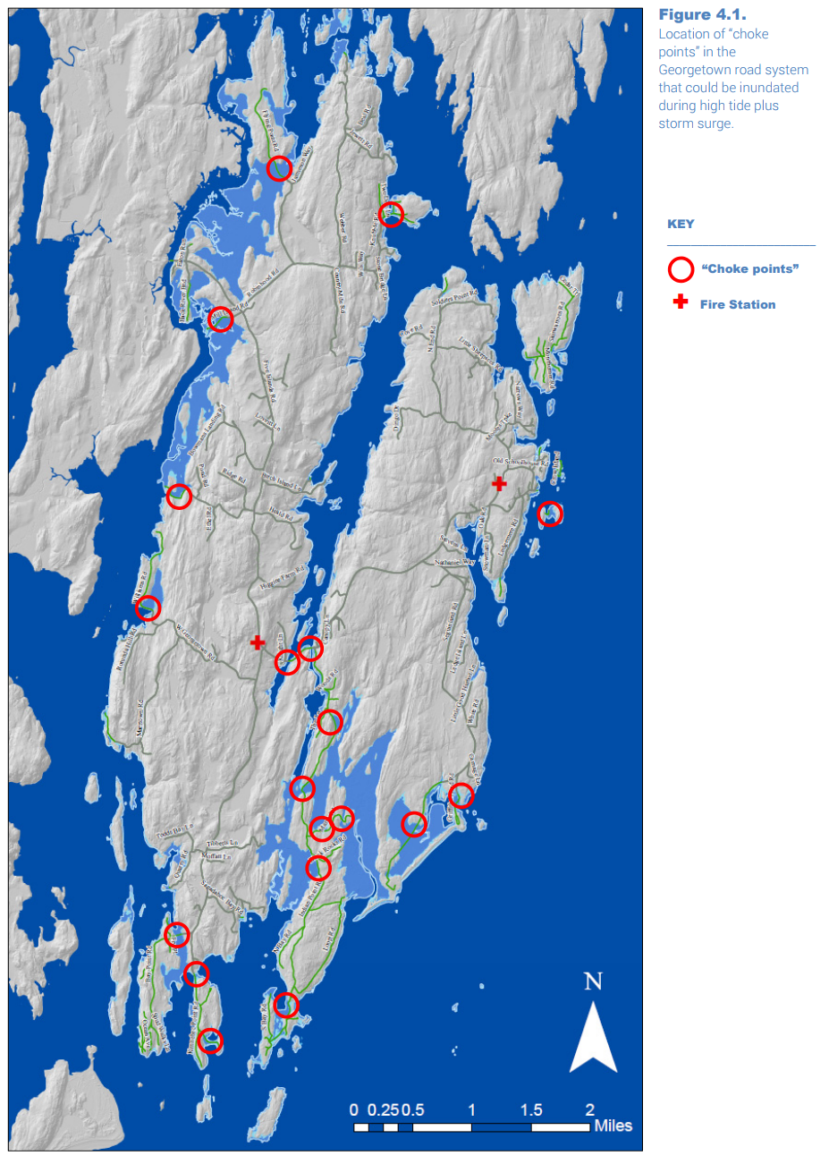
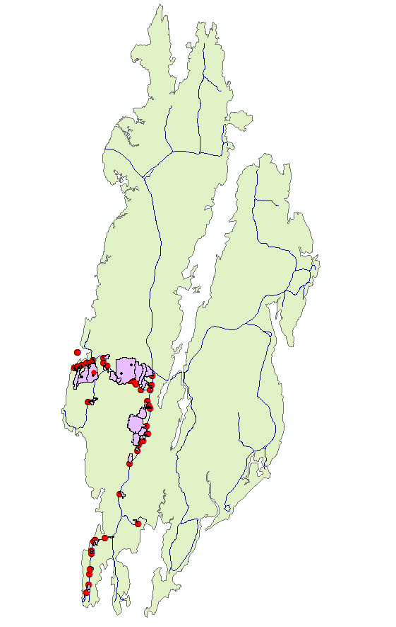
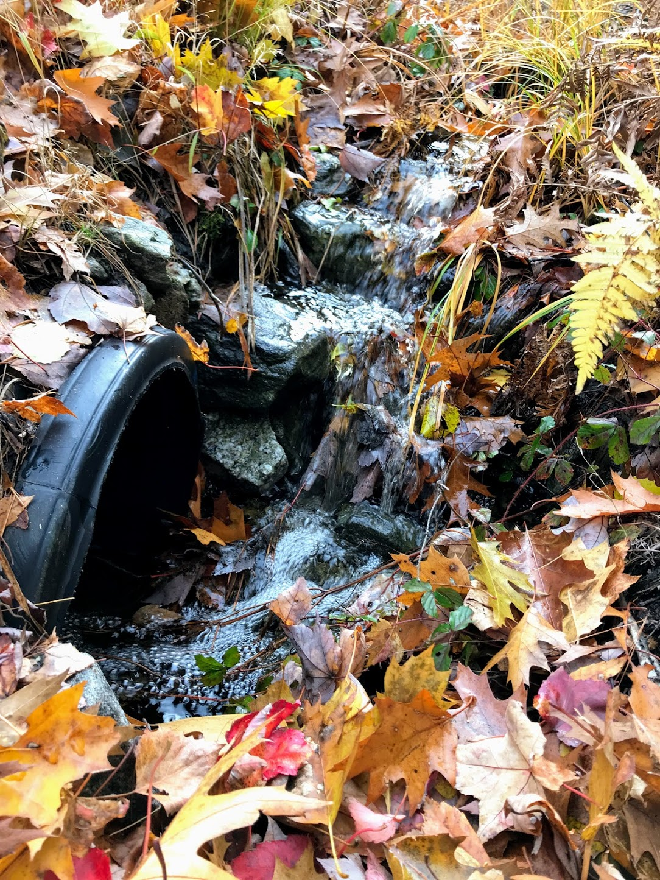
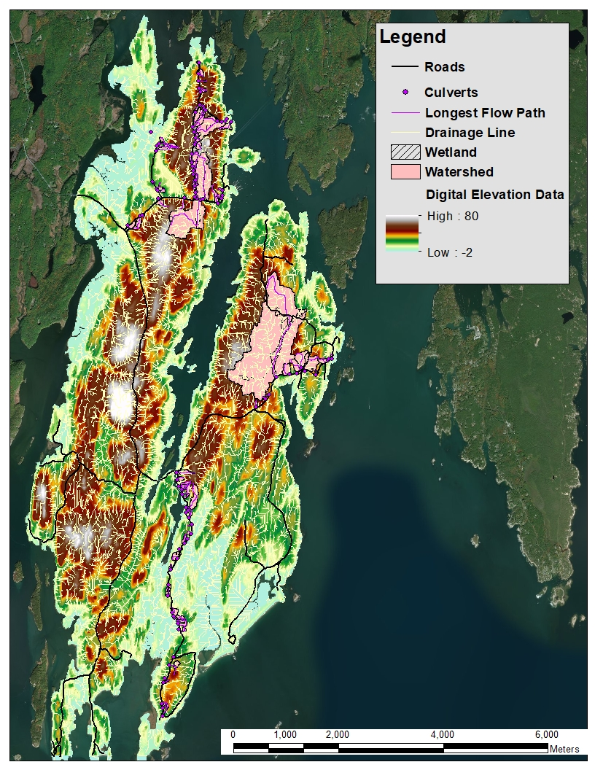
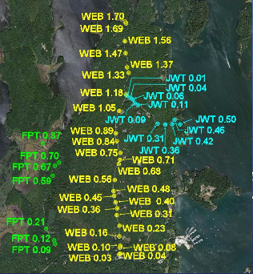
Project History
2014-2015 | 2015-2016 | 2016-2017 | 2017-2018 | 2018-2019
Studied Climate Change adaptation Suggested culvert database | Surveyed 14 culverts Added flooding predictions | Surveyed 42 culverts Added flooding predictions to database | Surveyed 63 culverts Created detailed GIS map of culverts | Surveyed 43 culverts Started citizen scientist program
Notes:
Kyle

Slide 15
2019-2020 Tasks
Survey all remaining town-owned, freshwater culverts on Georgetown not surveyed by other groups
Model culverts to see what n^{th} year floods will cause them to flood
Add information to culvert database
Continue citizen scientist culvert monitoring program to get real world data to see if model is correct
Meet with tidal culvert engineers to determine modeling approach for Flying Point Road and Williams Road tidal culverts
Notes:
Ross

Slide 16
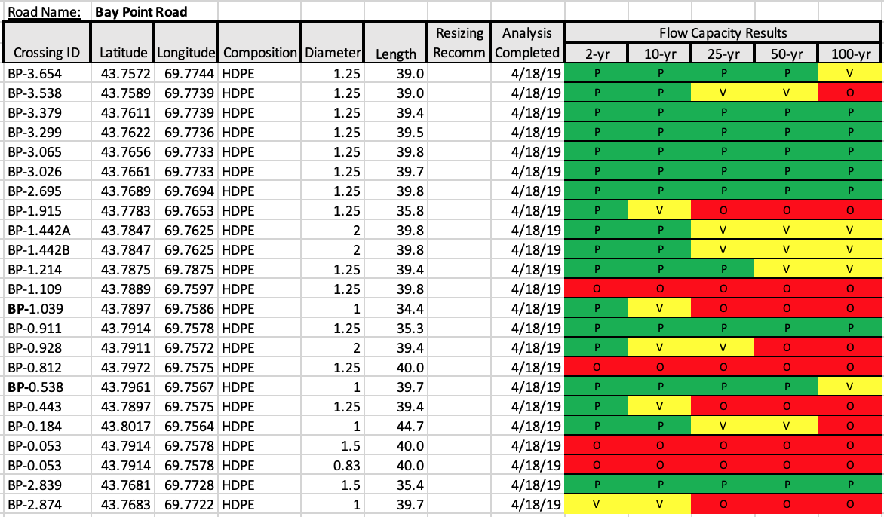
Georgetown Culvert Database
Freshwater culvert database contains information about all town-owned culverts:
  Coordinates for each culvert
  Crossing ID
  Culvert length, diameter, and material
  If the culvert will flood under 2, 10, 25, 50, or 100 year
Database will help road commissioner prioritize culverts that need repairs to keep Georgetown’s roads functioning during storms
Excerpt from Culvert Database
Notes:
Ross

Slide 17
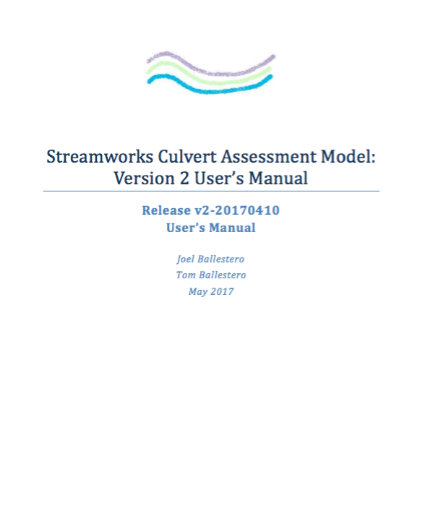
Streamworks model
Developed by UNH faculty for evaluating culverts
Requires field measurements to determine culvert characteristics
Calculates if an existing culvert will fail during n^{th} year flood
Cannot be used to upgrade culverts
Not for tidal culverts
Notes:
Ross

Slide 18
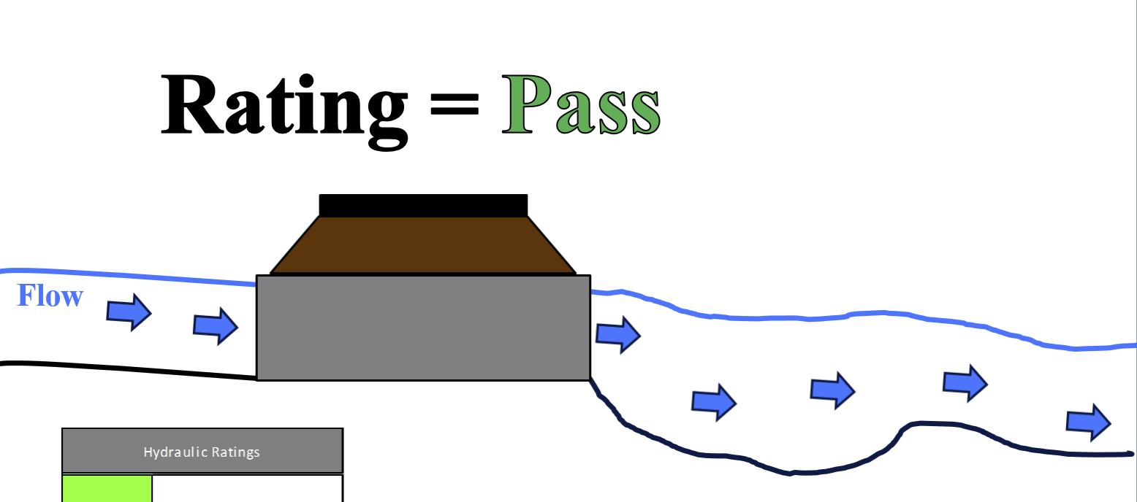
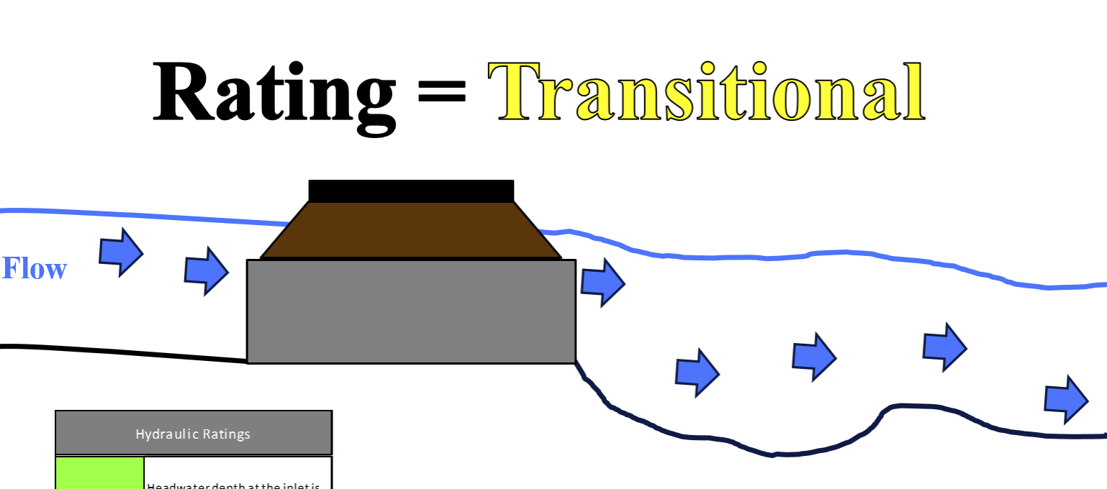
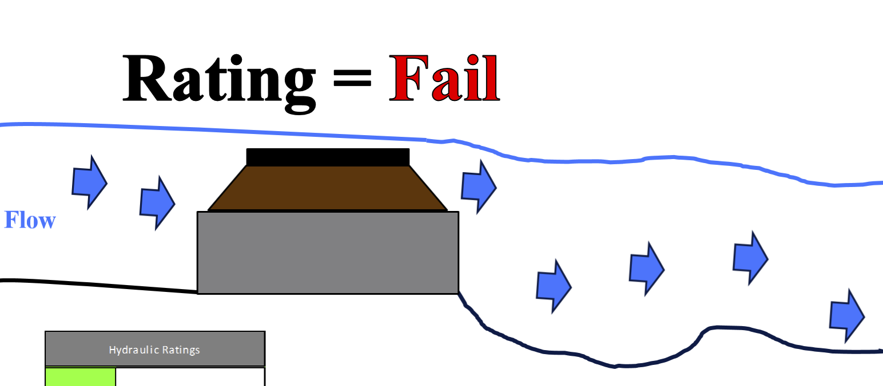
Streamworks Ratings
Road
Water surface
Culvert
Pass | Water depth at the inlet is below the top of the culvert
Vulnerable | Water depth at the inlet is above the top of the culvert but does not overtop the road
Overtop | Water depth at the inlet is above the top of the road
Vulnerable
Overtop
Notes:
Ross

Slide 19
Data collection methods
Notes:
Jordan

Slide 20
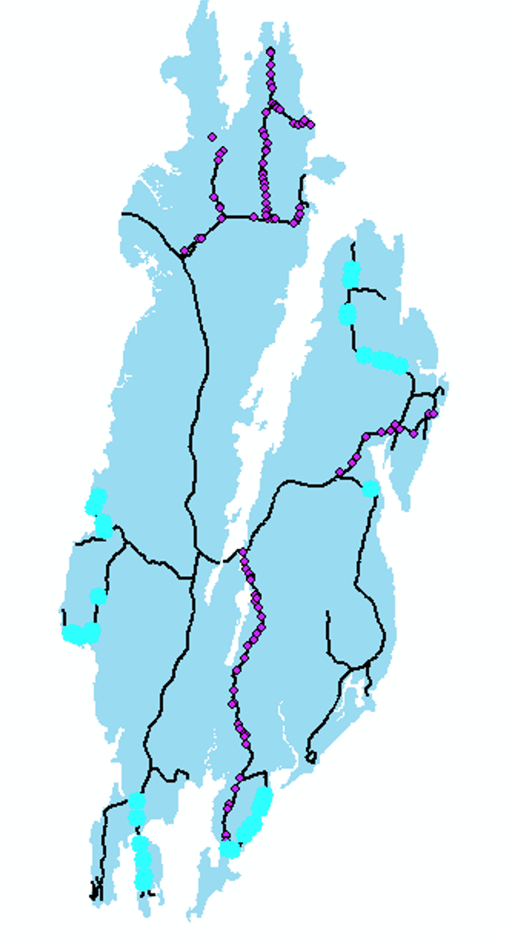
Culverts
33 culverts surveyed
Marrtown Road – 8
Kennebec Point Road – 6
Harmons Harbor Road – 1
North End Road – 8
Loop Road – 10
Culverts surveyed by this group in light blue
Notes:
Jordan

Slide 21
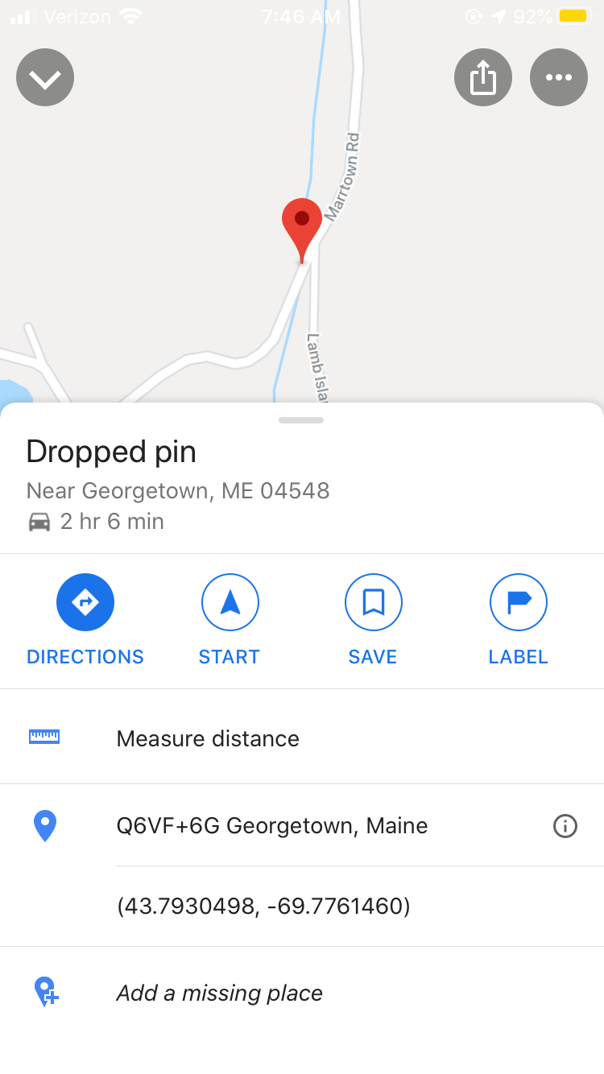
Field Work data collection
Latitude and longitude coordinates from GPS
Physical Characteristics
Relative elevations
Tailwater cross-section
From Google Maps app
Notes:
Jordan

Slide 22
Field Work data collection
Latitude and longitude GPS Coordinates
Physical Characteristics
Relative elevations
Tailwater cross-section
Metal
Plastic
Notes:
Jordan

Slide 23
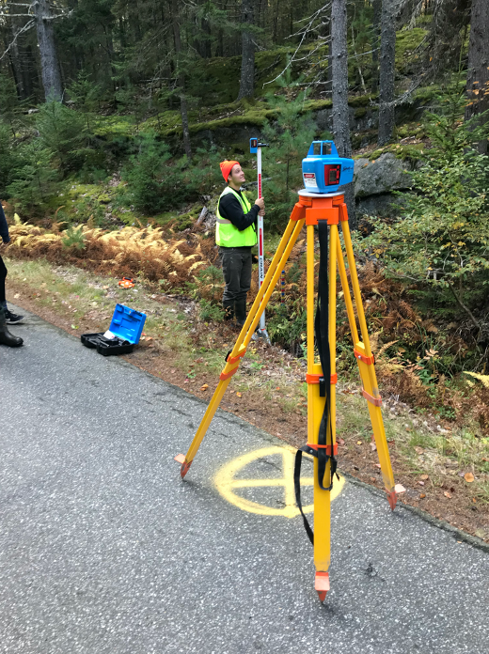
Field Work data collection
Latitude and longitude GPS coordinates
Physical characteristics
Relative elevations
Tailwater cross-section
Notes:
Jordan

Slide 24
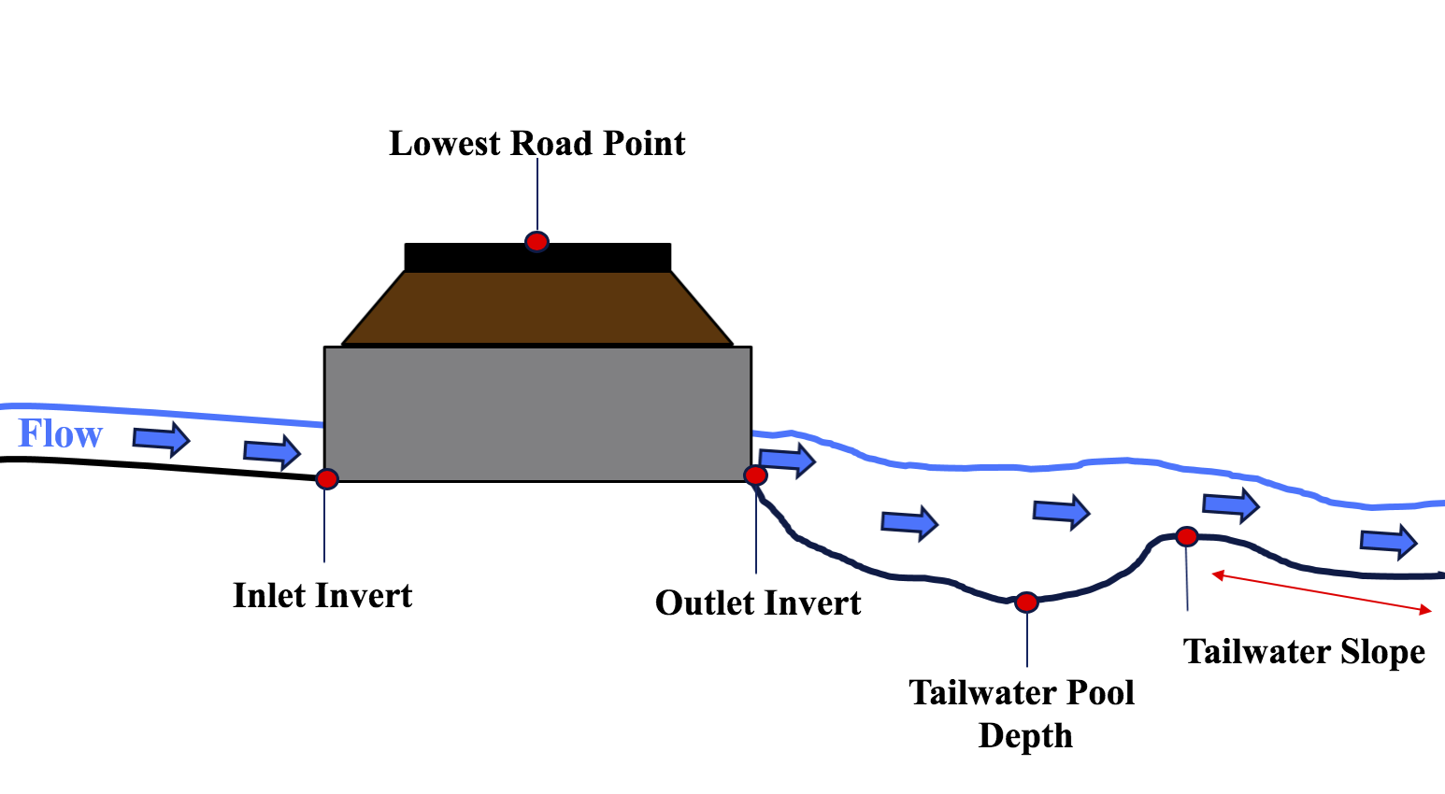
Elevations measured
Road Low Point in the vicinity of the culvert
and cross-section
Notes:
Jordan

Slide 25
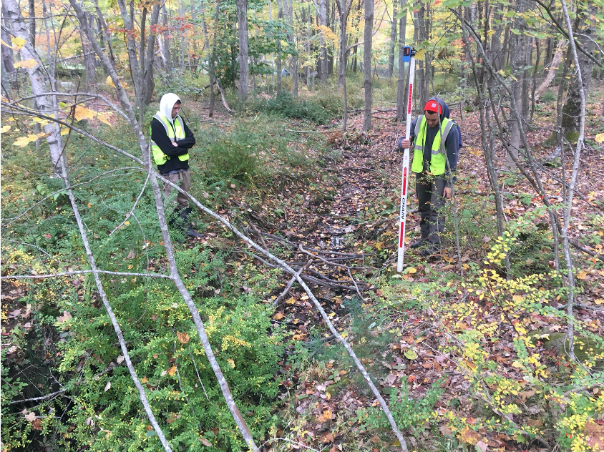
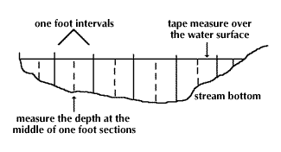
Field Work data collection
Latitude and longitude GPS coordinates
Physical characteristics
Relative elevations
Tailwater cross-section
Notes:
Jordan

Slide 26
Results
Notes:
Anna

Slide 27
Crossing ID | 2-yr | 10-yr | 25-yr | 50-yr | 100-yr
MT-0.974 | Vulnerable | Overtop | Overtop | Overtop | Overtop
MT-1.02 | Pass | Pass | Vulnerable | Vulnerable | Overtop
MT-1.14 | Pass | Pass | Pass | Pass | Overtop
MT-1.15 | Pass | Pass | Pass | Pass | Pass
MT-1.18 | Vulnerable | Overtop | Overtop | Overtop | Overtop
MT-1.21 | Vulnerable | Overtop | Overtop | Overtop | Overtop
MT-1.23 | Pass | Vulnerable | Vulnerable | Overtop | Overtop
MT-0.640 | Pass | Vulnerable | Vulnerable | Overtop | Overtop
KP-0.014 | Pass | Pass | Pass | Pass | Pass
KP-0.178 | Pass | Vulnerable | Vulnerable | Vulnerable | Overtop
KP-0.451 | Pass | Pass | Pass | Pass | Pass
KP-0.600 | Pass | Pass | Pass | Pass | Pass
KP-0.766 | Pass | Pass | Pass | Pass | Pass
KP-0.829 | Pass | Pass | Pass | Pass | Pass
HH-0.066 | Pass | Pass | Pass | Pass | Pass
NE-0.360 | Pass | Pass | Pass | Pass | Pass
NE-0.475 | Pass | Pass | Pass | Pass | Pass
NE-0.565 | Overtop | Overtop | Overtop | Overtop | Overtop
NE-0.730 | Pass | Pass | Vulnerable | Vulnerable | Vulnerable
NE-1.19 | Pass | Pass | Pass | Vulnerable | Vulnerable
NE-1.23 | Pass | Vulnerable | Vulnerable | Vulnerable | Overtop
NE-1.57 | Pass | Pass | Pass | Pass | Pass
NE-1.67 | Pass | Pass | Vulnerable | Vulnerable | Vulnerable
LP-0.031 | Pass | Pass | Pass | Pass | Pass
LP-0.081 | Pass | Pass | Pass | Pass | Pass
LP-0.280 | Pass | Pass | Pass | Pass | Pass
LP-0.354 | Pass | Pass | Pass | Pass | Pass
LP-0.423 | Pass | Pass | Pass | Pass | Pass
LP-0.578 | Pass | Pass | Pass | Pass | Pass
LP-0.628 | Pass | Pass | Pass | Pass | Pass
LP-0.656 | Pass | Pass | Pass | Pass | Pass
LP-0.674 | Pass | Pass | Pass | Pass | Vulnerable
LP-0.721 | Pass | Pass | Pass | Pass | Pass
2019-2020 Culvert Results: Predicted Flooding
Road Name | Crossing ID Abbreviation
Marrtown Road | MT
Kennebec Point Road | KP
Harmons Harbor Road | HH
North End Road | NE
Loop Road | LP
Notes:
Anna

Slide 28
Predicted flooding
Notes:
Anna

Slide 29
Ways to reduce Failure
New culverts should be sized according to their watershed area
Continue scheduled maintenance - removing debris
Install larger culverts in areas of concern
  List of most at-risk culverts
  Depends on road usage, town budget, etc.
  May be more practical to replace problem culverts when roads are repaved, or other maintenance is done
Notes:
Anna

Slide 30
Georgetown Citizen Scientist Program

Slide 31
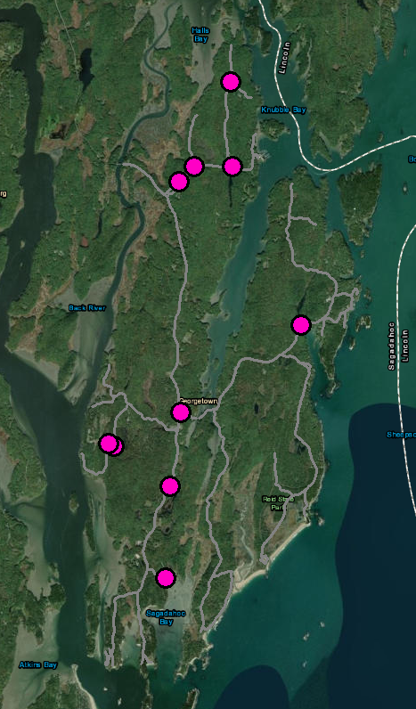
Georgetown citizen scientist program
Data collection began October 2019
Ten non-tidal culverts chosen to be monitored by volunteer citizen scientists from Georgetown
Volunteers took photos of culverts during rainstorms to see if they were vulnerable or overtopped
Compare Streamworks predicted flooding to actual flooding data
  Help validate model results
Jewett Road
Robhinhood Road
Five Islands Road
Marrtown Road
Bay Point Road
Sagadahoc Bay Road
Location of culverts being monitored by citizen scientists
Notes:
Ross

Slide 32
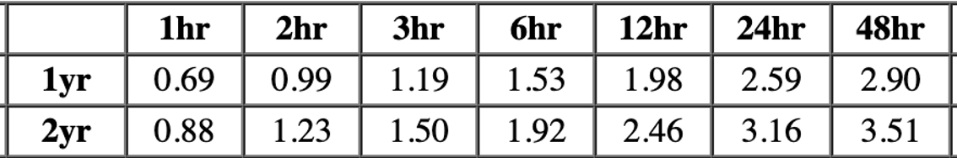
December 14th, 2019 Rainstorm
Storm lasting 13 hours produced 2.39 inches of rain
2-year precipitation amount
Accumulated Rainfall on 12/14
Precipitation amounts in inches for 1- and 2- year events on Georgetown, ME
Notes:
Ross

Slide 33
Volunteer Results
Next slides compare model results to field data collection from volunteers
Culverts on Marrtown road surveyed by our team in 2019

Slide 34
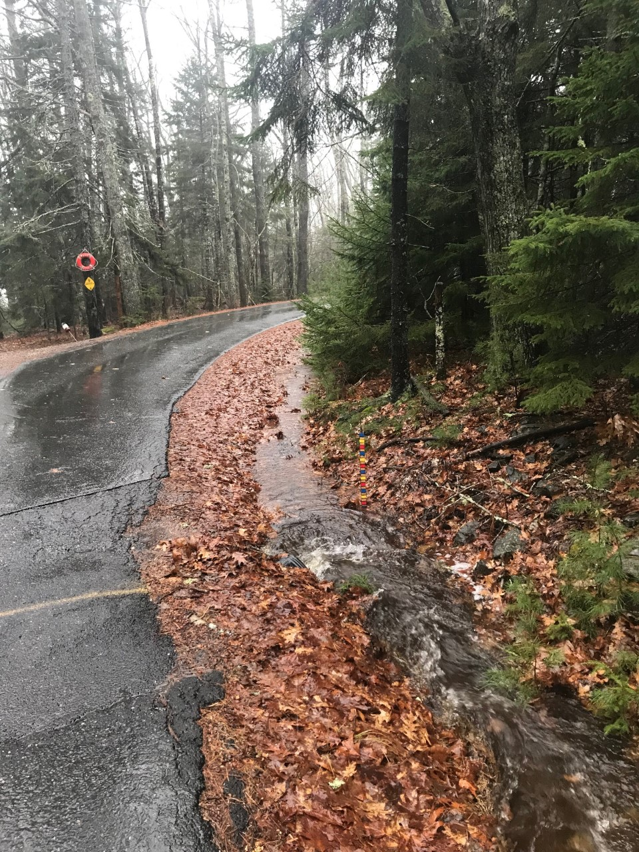
Marrtown Road – 12/14/19
Crossing ID: | MT-0.974
Photos Taken by Jaana Shehan:
Rating Based on Photo: | Vulnerable
Streamworks Rating:
2 | 10 | 25 | 50 | 100
V | O | O | O | O

Slide 35
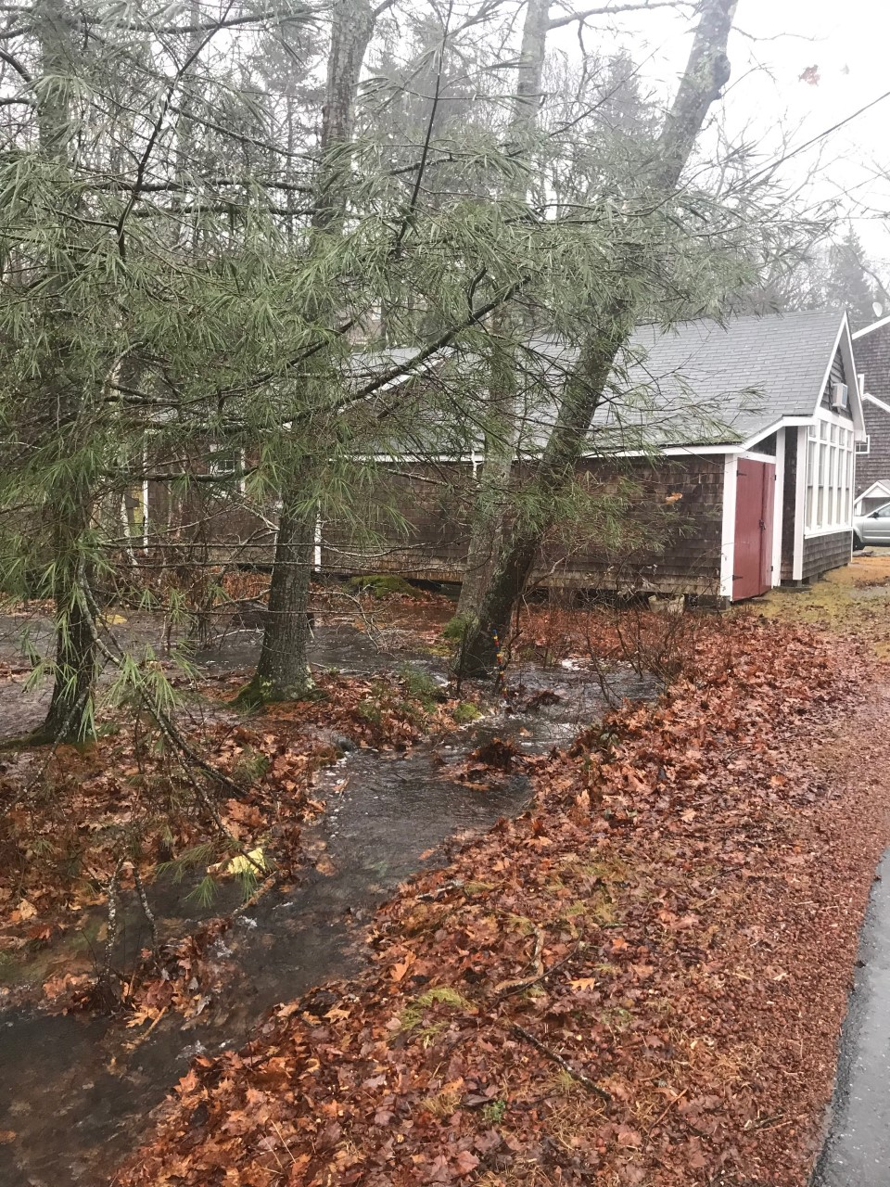
Marrtown Road – 12/14/19
Crossing ID: | MT-1.21
Photos Taken by Jaana Shehan:
Rating Based on Photo: | Vulnerable
Streamworks Rating:
2 | 10 | 25 | 50 | 100
V | O | O | O | O
Notes:
Kyle

Slide 36
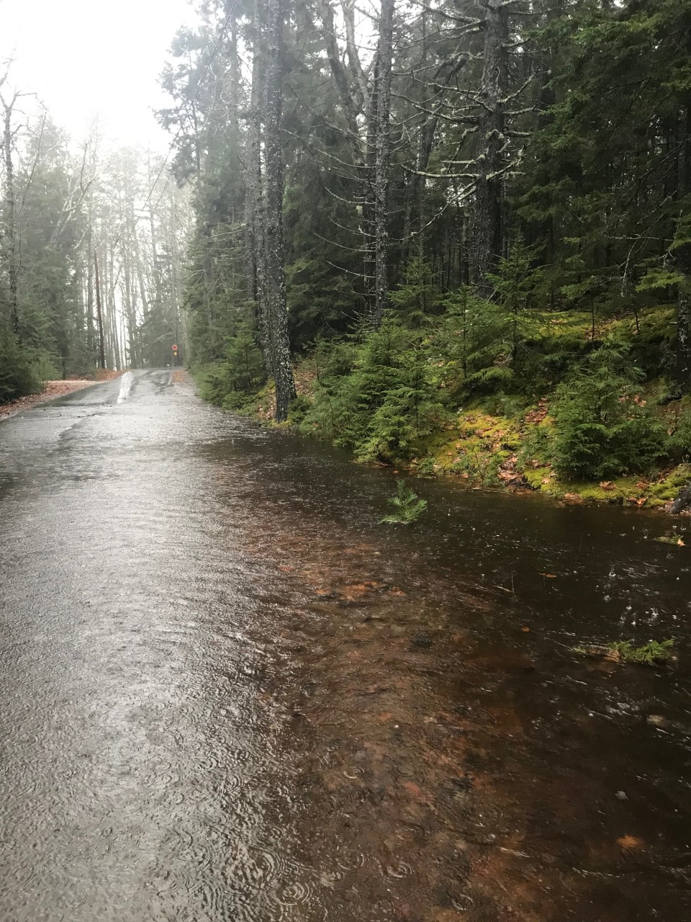
Marrtown Road – 12/14/19
Crossing ID: | MT-0.640
Photos Taken by Jaana Shehan:
Rating Based on Photo: | Overtop
Streamworks Rating:
2 | 10 | 25 | 50 | 100
P | V | V | O | O

Slide 37
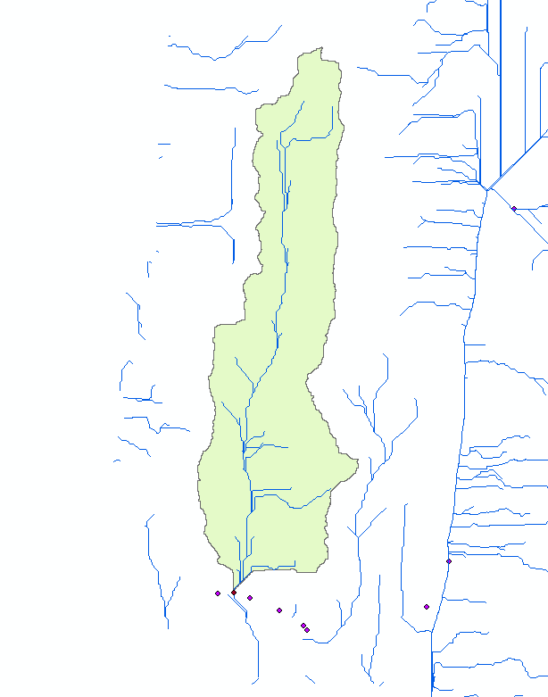
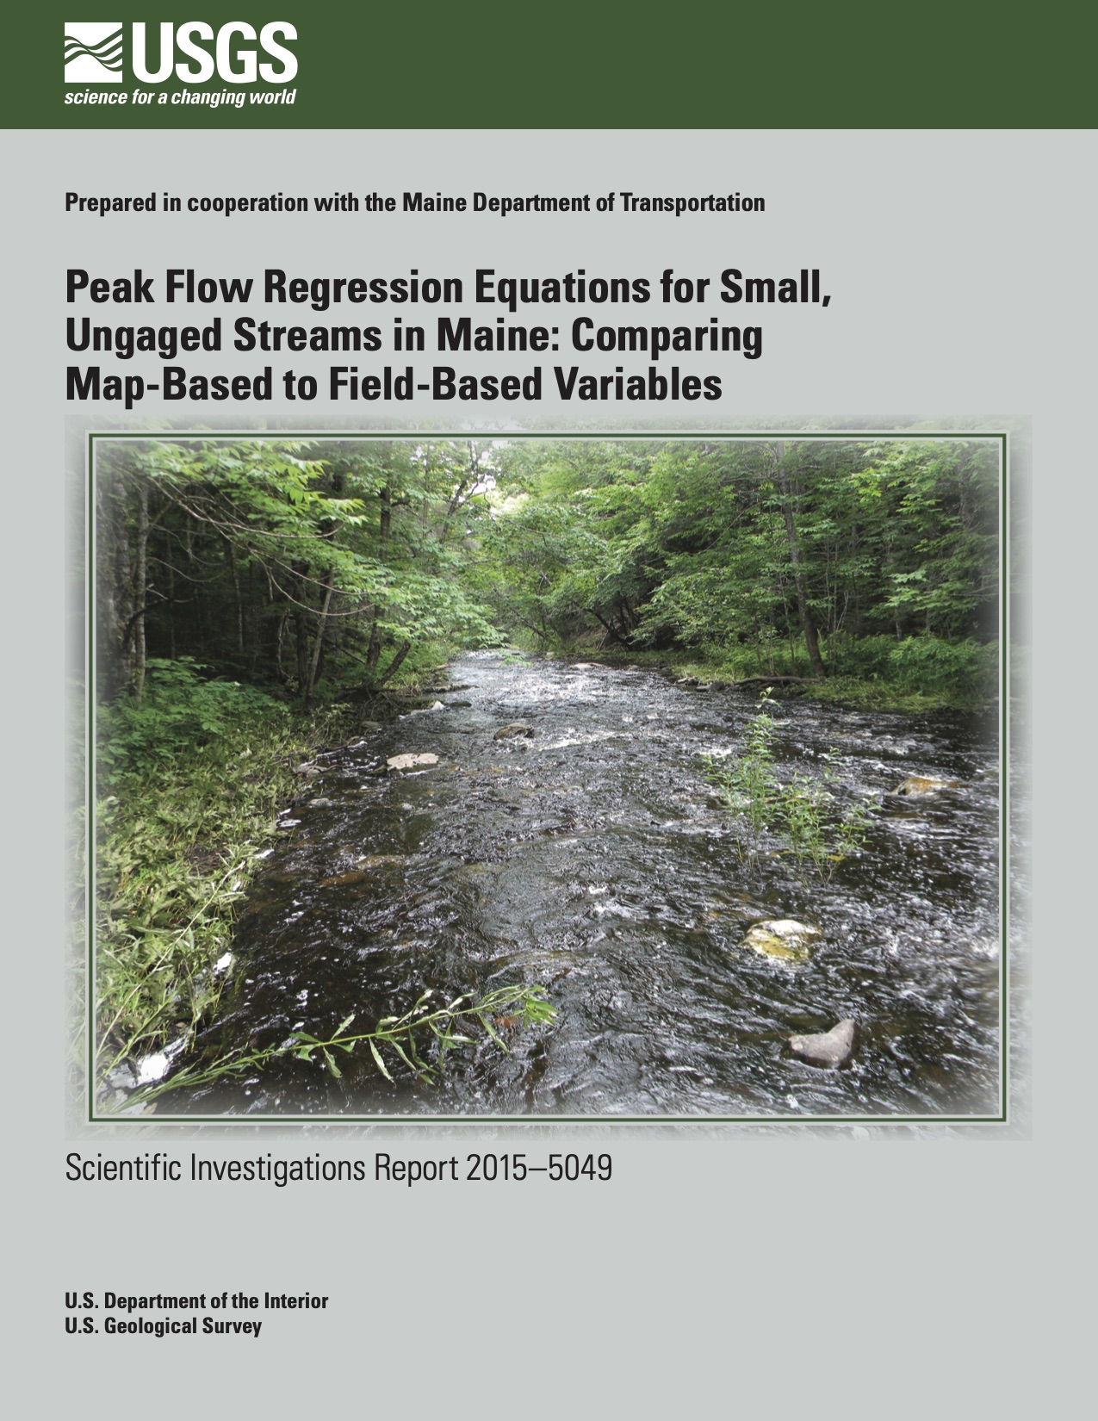
Calculating the water flow of n^{th} year flood:
2019-2020 vs previous years’ methods
We used methods from United States Geological Survey (USGS) for for calculating the gallons per minute for the n^{th} year floods for each culvert
Watershed delineated using USGS application for MT-0.974
Watershed delineated in ArcMap for MT-1.21
Previous groups used standard method for larger watersheds
  Method built into Streamworks

Slide 38
Volunteer Results continued
Next slides compare model results for both methods to field data collection from volunteers
  These culverts surveyed by previous groups
  Streamworks method for larger watersheds vs USGS methods for smaller watersheds

Slide 39
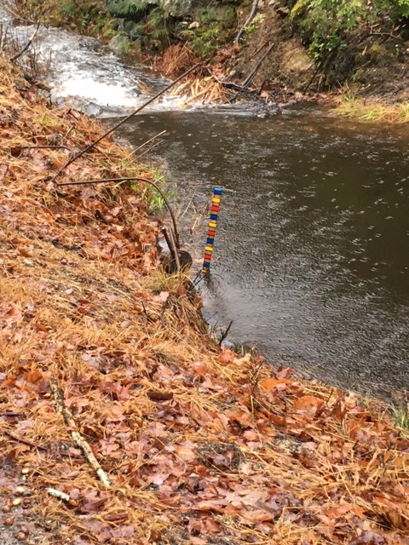
Robinhood Road – 12/14/19
Crossing ID | RH-1.059
Photos Taken by Mara Kruze:
Rating Based on Photo: | Pass
Streamworks Rating (USGS method):
2 | 10 | 25 | 50 | 100
P | P | P | P | P
Streamworks Rating (Streamworks method):
2 | 10 | 25 | 50 | 100
O | O | O | O | O
Notes:
Kyle

Slide 40
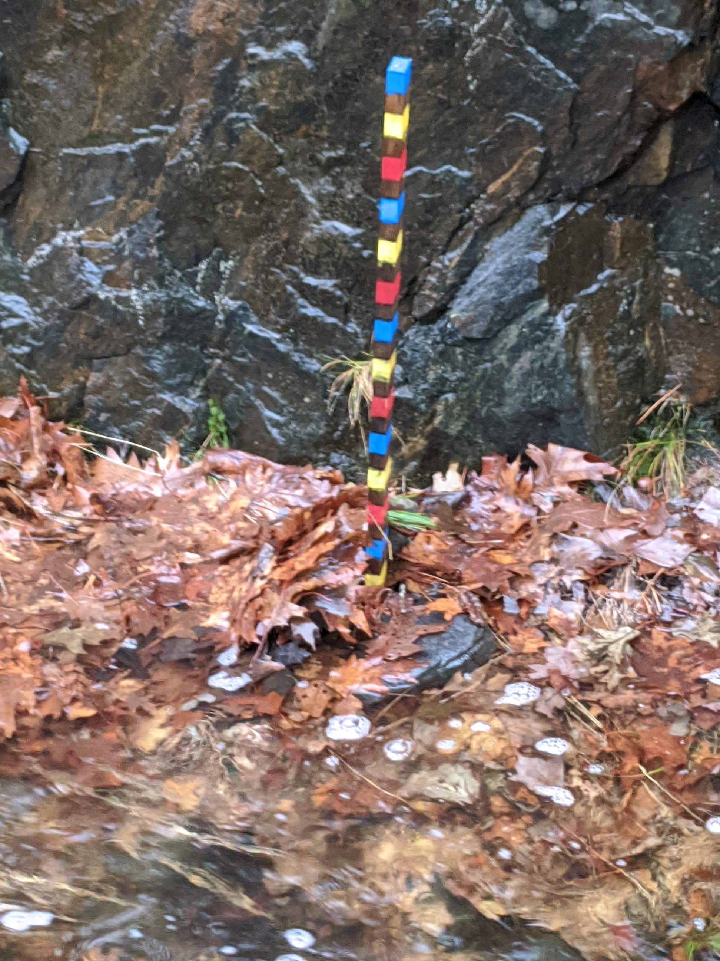
Bay point road – 12/14/19
Crossing ID | BP-0.812
Photos Taken by Roger Bogart:
Rating Based on Photo: | Vulnerable
2 | 10 | 25 | 50 | 100
V | V | O | O | O
Streamworks Rating (USGS method):
Streamworks Rating (Streamworks method):
2 | 10 | 25 | 50 | 100
O | O | O | O | O
Notes:
Kyle

Slide 41
findings
USGS methods correct for 4 out of 5 culverts
Streamworks method was incorrect for 2 out of 2 culverts
Next slides show culverts surveyed by previous groups that were not validated by either method

Slide 42
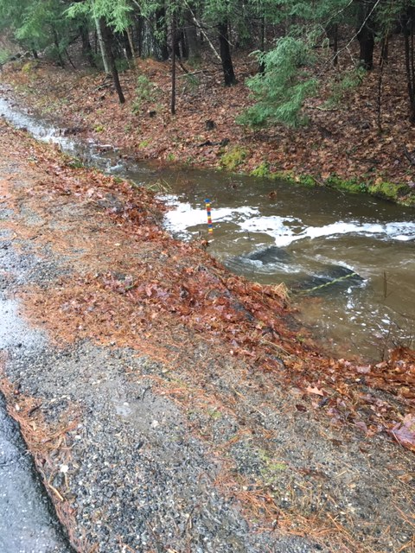
Robinhood Road – 12/14/19
Crossing ID | RH-0.549
Photos Taken by Mara Kruze:
Rating Based on Photo: | Vulnerable
Streamworks Rating (USGS method):
2 | 10 | 25 | 50 | 100
P | P | P | P | P
Streamworks Rating (Streamworks method):
2 | 10 | 25 | 50 | 100
P | V | V | V | V

Slide 43
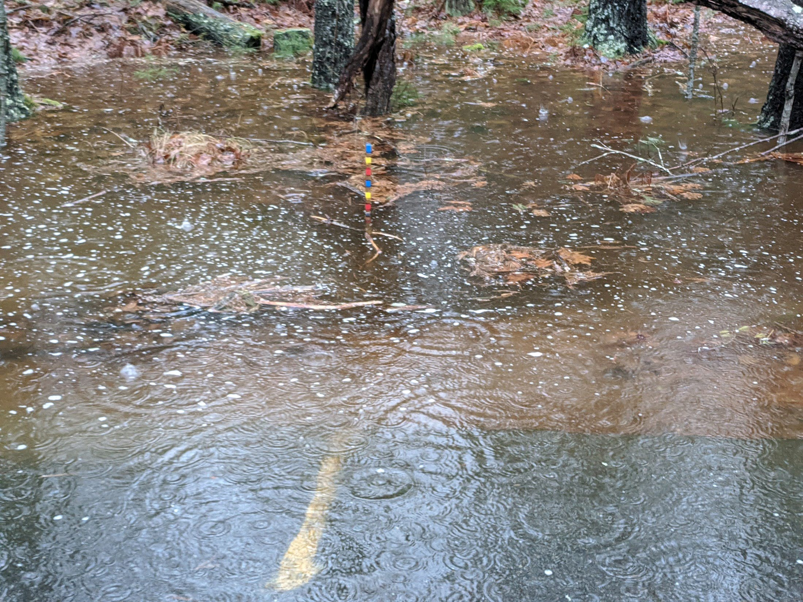
Sagadahoc Bay Road – 12/14/19
Crossing ID: | SB-0.304
Photo Taken by Kathy Gravino:
Rating Based on Photo: | Overtop
2 | 10 | 25 | 50 | 100
P | P | V | V | V
Streamworks Rating (USGS method):
Streamworks Rating (Streamworks method):
2 | 10 | 25 | 50 | 100
P | P | V | V | V
Notes:
Kyle

Slide 44
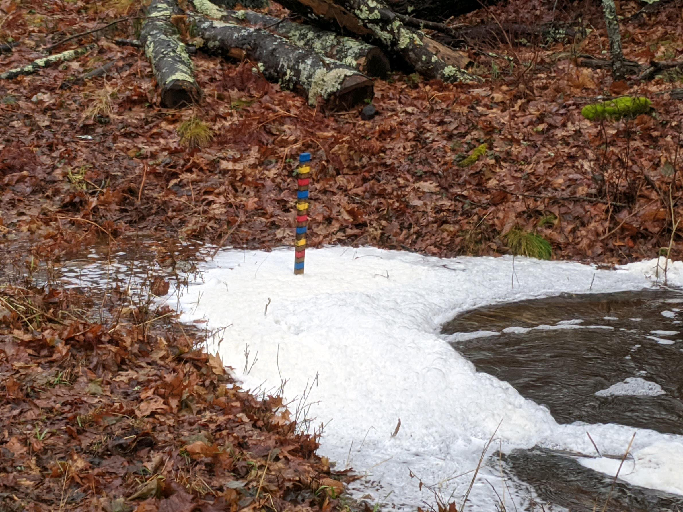
Bay point road – 12/14/19
Crossing ID | BP-0.053
Photos Taken by Roger Bogart:
Rating Based on Photo: | Vulnerable
Streamworks Rating (USGS method):
2 | 10 | 25 | 50 | 100
P | V | O | O | O
2 | 10 | 25 | 50 | 100
O | O | O | O | O
Streamworks Rating (Streamworks method):

Slide 45
Validation Results
Crossing ID | Streamworks results (old method) | Streamworks results (new method) | Volunteer Results | Validated?
RH-1.059 | Overtop | Pass | Pass | Yes
BP-0.812 | Overtop | Vulnerable | Vulnerable | Yes
MT-0.974 | NA | Vulnerable | Vulnerable | Yes
MT-1.21 | NA | Vulnerable | Vulnerable | Yes
MT-0.640 | NA | Pass | Overtop | No
RH-0.549 | Pass | Pass | Vulnerable | No
SB-0.304 | Pass | Pass | Overtop | No
BP-0.053 | Overtop | Pass | Vulnerable | No
Model validated for 4 culverts, not validated for 4 culverts
Clogging, deteriorating, aging
Change in watershed characteristics – urbanization, deforestation
Error in field measurements
Notes:
Kyle

Slide 46
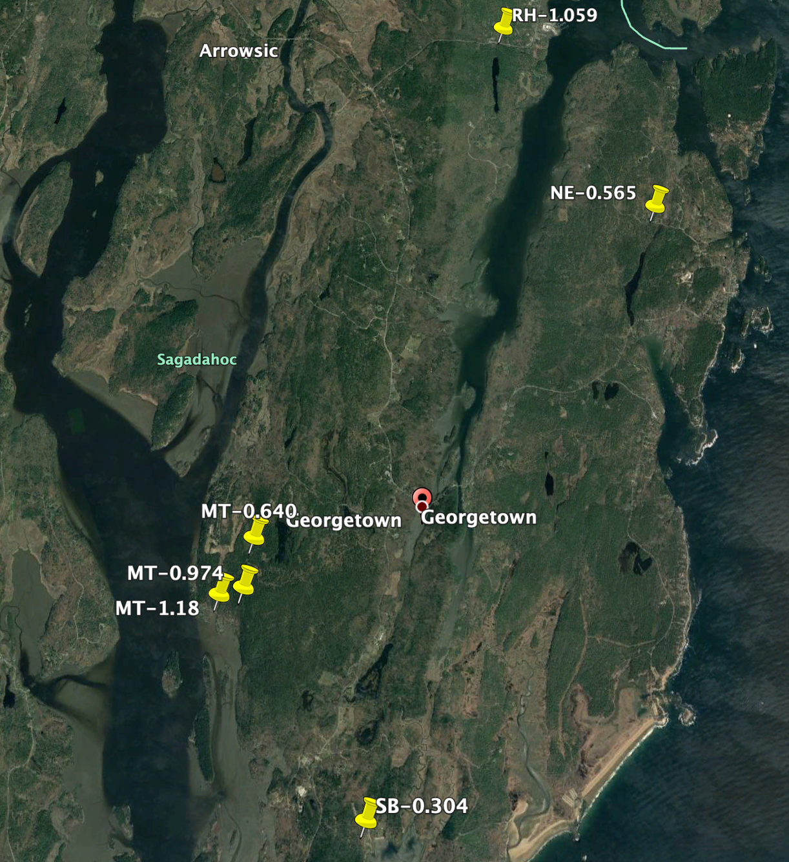
Recommendations
Based on Streamworks and volunteer photos these culverts are highest priority for improvements:
  MT-0.640
  MT-0.947
  MT-1.21
  SB-0.304
  NE-0.565
Volunteer program is extremely successful and helped check model
Location of priority culverts
Notes:
Anna

Slide 47
Tidal Culverts

Slide 48
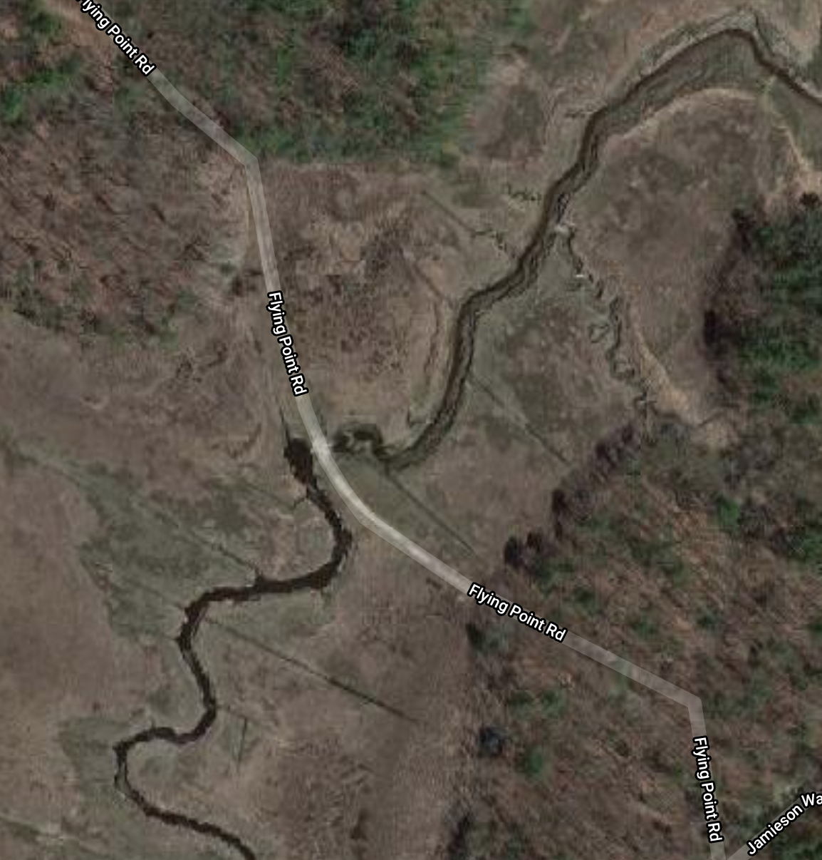
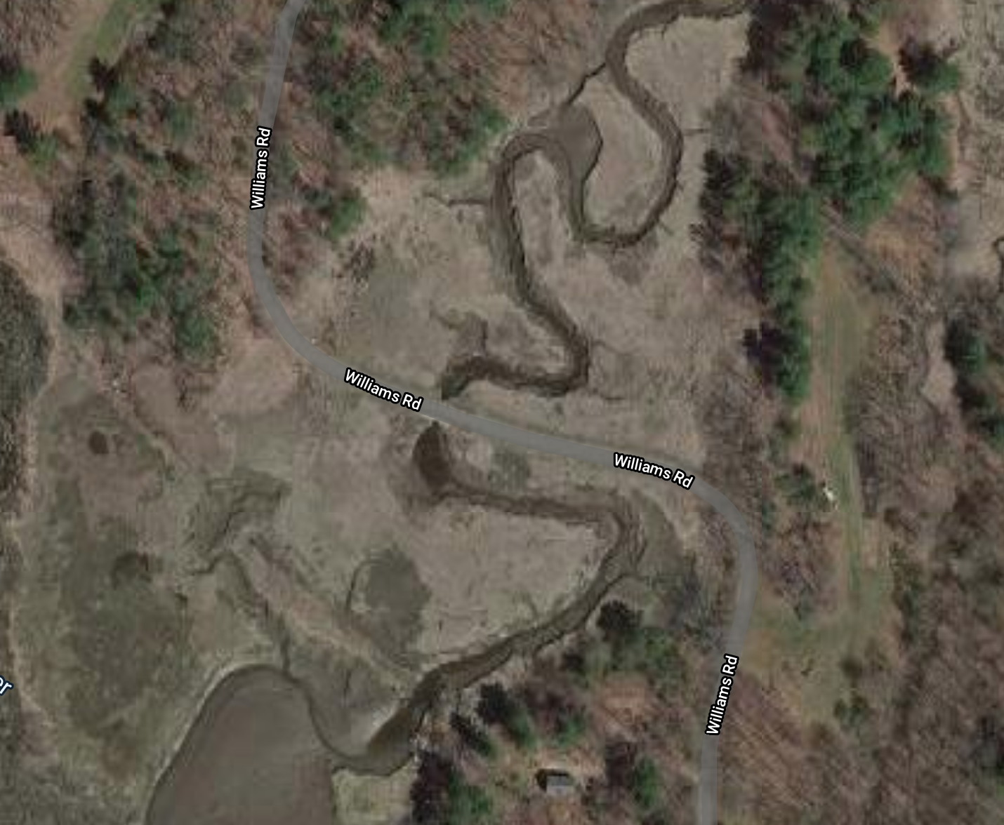
Tidal Culverts of Concern
Williams Road
Flying Point Road
Williams Road
Flying Point Road
Notes:
Jordan

Slide 49
Tidal Culvert Monitoring
Williams Road and Flying Point Road flood frequently
Asked volunteers to monitor these culverts – what tides cause them to flood?
Tidal culverts cannot be modeled using Streamworks
  Tidal culverts have two-way flow
  Freshwater culverts have one-way flow
What causes tidal culverts to flood?
  Rainstorms – just like freshwater culverts
  High tides – very high tides can overtop culvert
  Storm surge – temporary rising of sea level due to a storm
  Sea level rise – climate change
Notes:
Jordan

Slide 50
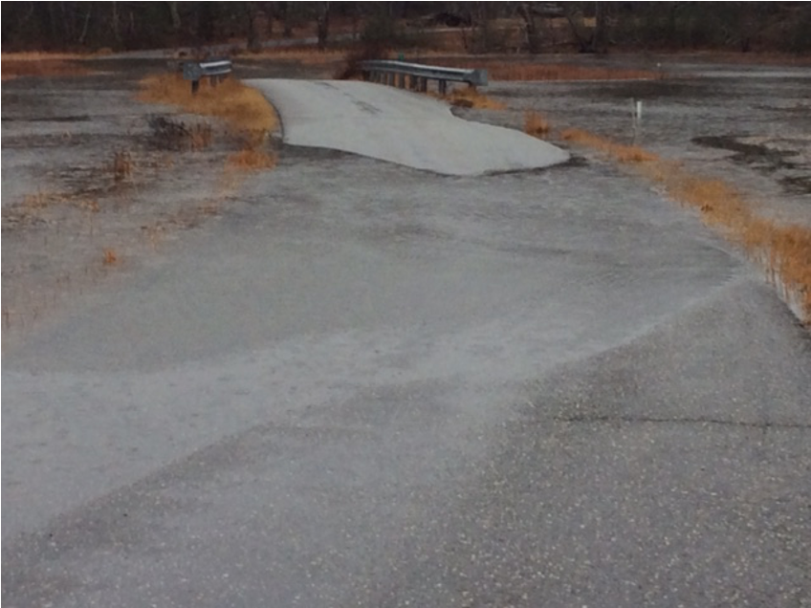
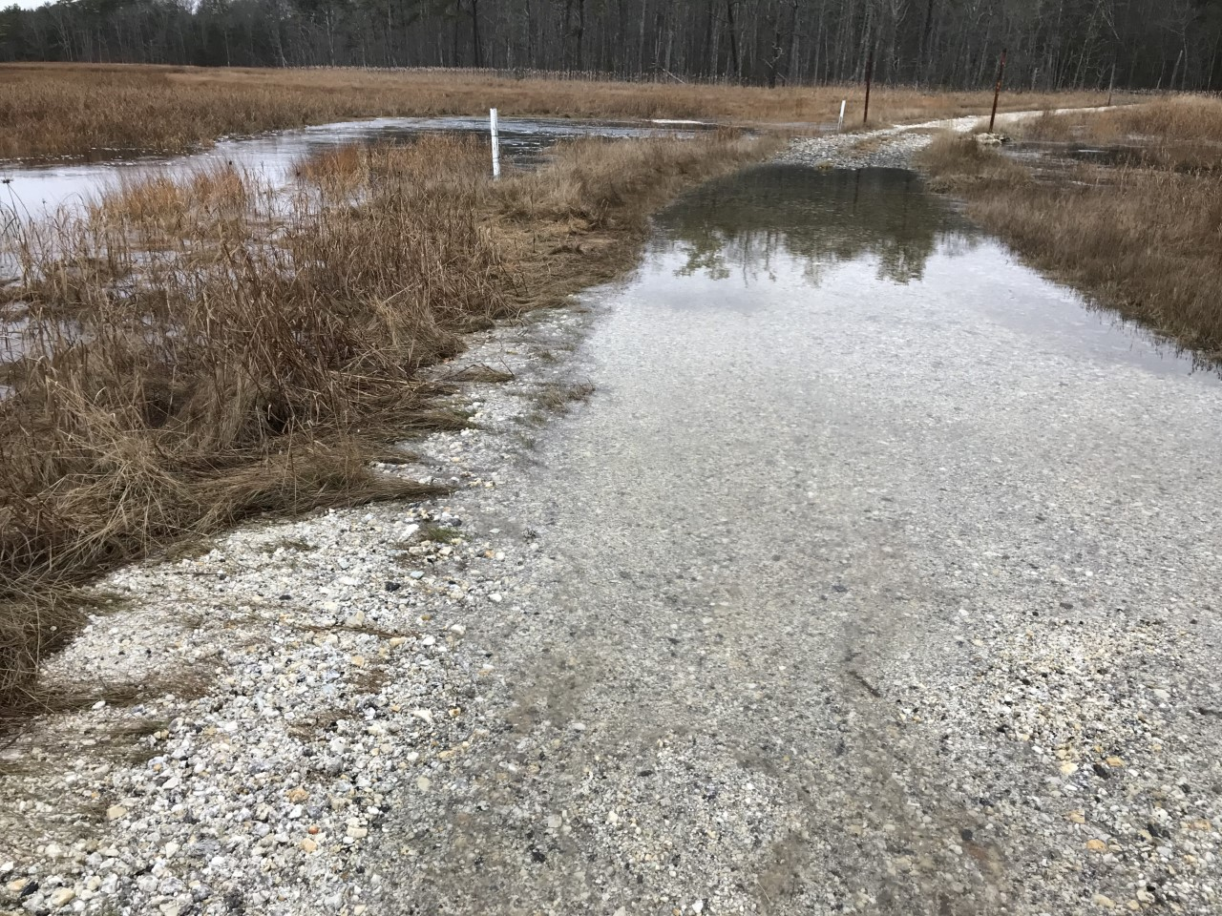
Tidal Culvert Monitoring
Volunteers took photos of two tidal culverts during flooding
Williams Road, Photo from Karren Cowing
Flying Point Road, Photo from John Rand
Notes:
Jordan – Every time volunteers sent photos of flooded roads, Robinhood, ME tide chart was above 10 ft. Essentially, if Robinhood ME tide is above 10 ft both roads will flood.

Slide 51
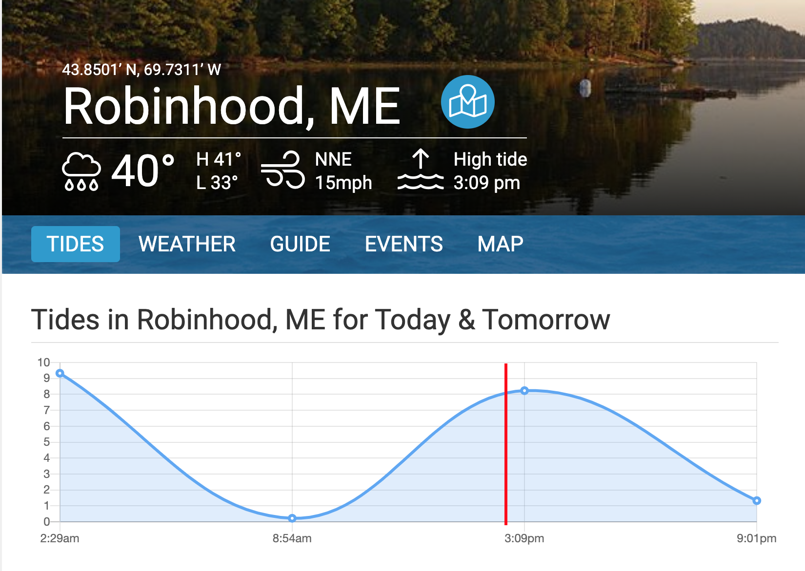
Culvert monitoring results
Flying Point Road and Williams Road flood when tides are above 10 ft MLLW
Check https://www.usharbors.com/harbor/maine/robinhood-me/

Slide 52
Meeting with Tidal Professionals
Joseph McLean from Acadia Civil Works in Leeds, ME
Matt Shultz from Woods Hole Group in Bourne, MA
Considerations for tidal culverts:
  Sea level rise (NOAA climate change prediction curves for Portland ME, closest to Georgetown)
  Flood frequency (using FEMA 100-year flood elevations)
  Tolerable level of impact to marsh habitat
  How tolerant are they towards floods?
  Will emergency vehicles be affected?
Long term observations essential for modeling tidal culverts
Notes:
Jordan

Slide 53
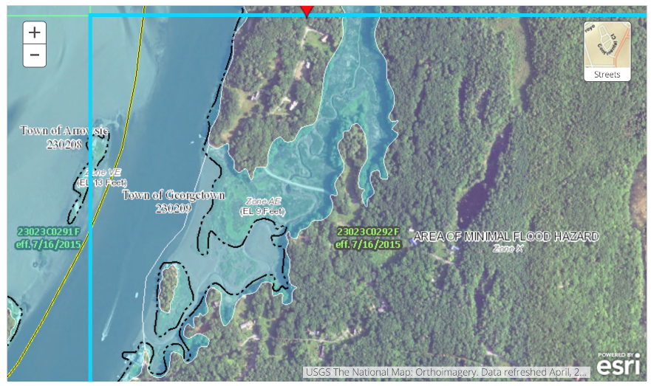
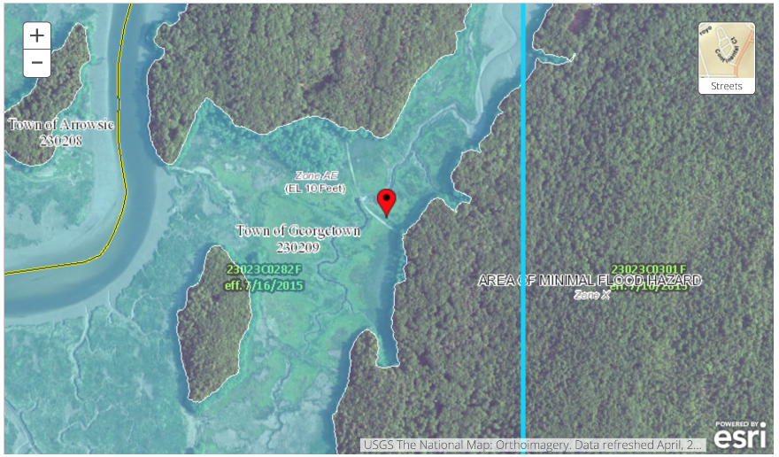
FEMA 100 Year Flood Charts
Williams Road
Flying Point Road
Road Name | 100-year Flood Elevation (MLLW)
Williams | 14.25 feet
Flying Point Road | 15.25 feet
Notes:
Jordan

Slide 54
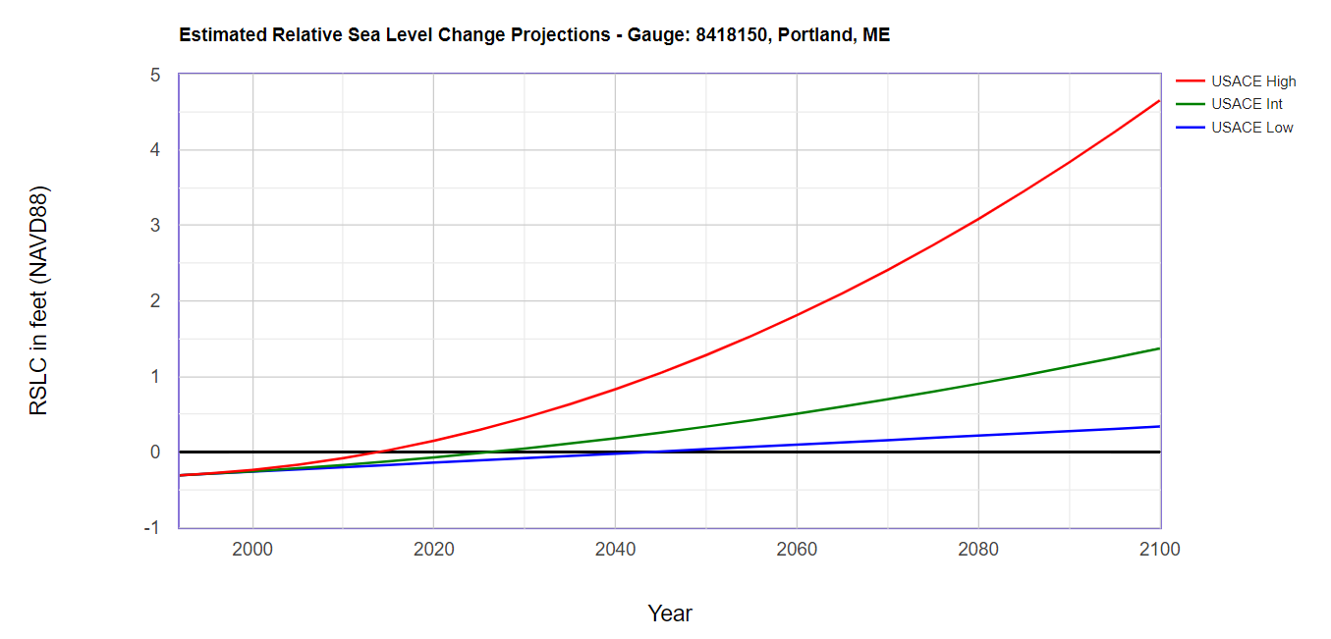
USACE and NOAA Sea Level Rise
 | Relative Sea Level Rise (ft)
Year | Low | Int | High
2060 | 0.096 | 0.507 | 1.81
2080 | 0.215 | 0.904 | 3.086
2100 | 0.375 | 1.372 | 4.659
Notes:
Jordan

Slide 55
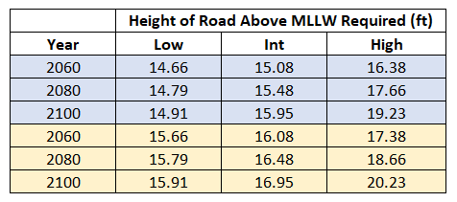
Recommendations
Highest Annual Tide for Georgetown: 11.55 ft above MLLW
  At a minimum, both roads should be raised above this elevation to prevent flooding
  100-year flood elevation and sea level rise accounted for in table below
Williams Road
Flying Point Road
Current elevation of both roads (above MLLW) is unknown – need GPS grade survey of these roads
Ultimate decision comes to budget and tolerance for flooding
Notes:
Jordan

Slide 56
Outcomes and conclusion

Slide 57
Project Outcomes
Surveyed and modeled 33 town-owned culverts
Completed the culvert database for road commissioner
Used citizen scientist data to check Streamworks model
Studied tidal culverts
  Determined when Williams Road and Flying Point Road flood from citizen scientist data
  Made recommendations based on tidal culvert professionals meeting
Notes:
Ross

Slide 58
recommendations
Continue to use alternative methods for calculating n^{th} year flood water flows
  USGS method validated for 4 culverts
Culverts on Marrtown Road, Sagadahoc Bay Road, and North End Road should continue to be monitored
  Need for resizing or maintenance
Research possibility of raising the elevation of Williams Road and Flying Point Road
  Keep in mind impact to budget and tidal habitat

Slide 59
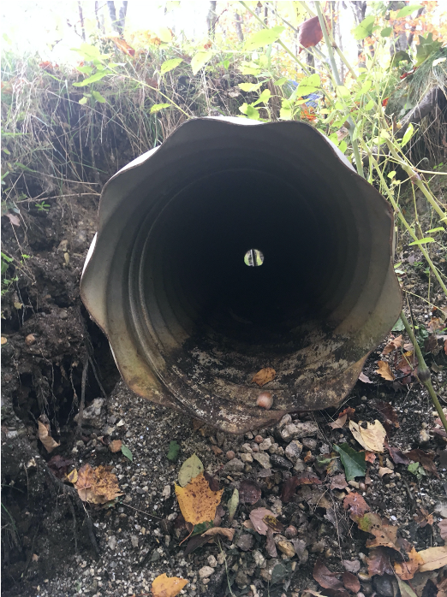
Future Work
Continue to research and compare new n^{th} year flood water flow calculation methods
Consult with UNH faculty to add improvements to Streamworks model
Continue volunteer monitoring program
Add culvert predicted to fail on North End Road to volunteer program
GPS grade survey of Flying Point Road and Williams Road
Notes:
Ross

Slide 60
Acknowledgements
We would like to thank all volunteers from Georgetown who helped with this project
  Kathy Gravino
  Roger Bogart
  Susan Hess
  Lorna Chafe
  Jaana Shehan
  Mara Kruze
  Karren Cowing
  John Rand
  Betsy McIlvain
Also thanks to Charlie Collins for assisting with this project and meeting with us in person and via phone on several occasions
Thank you to Nancy Kinner for being our advisor and hosting us in Georgetown

Slide 61

Questions?

