Slide 1



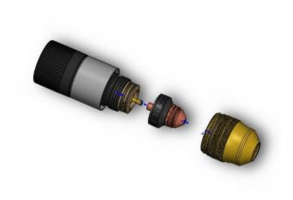
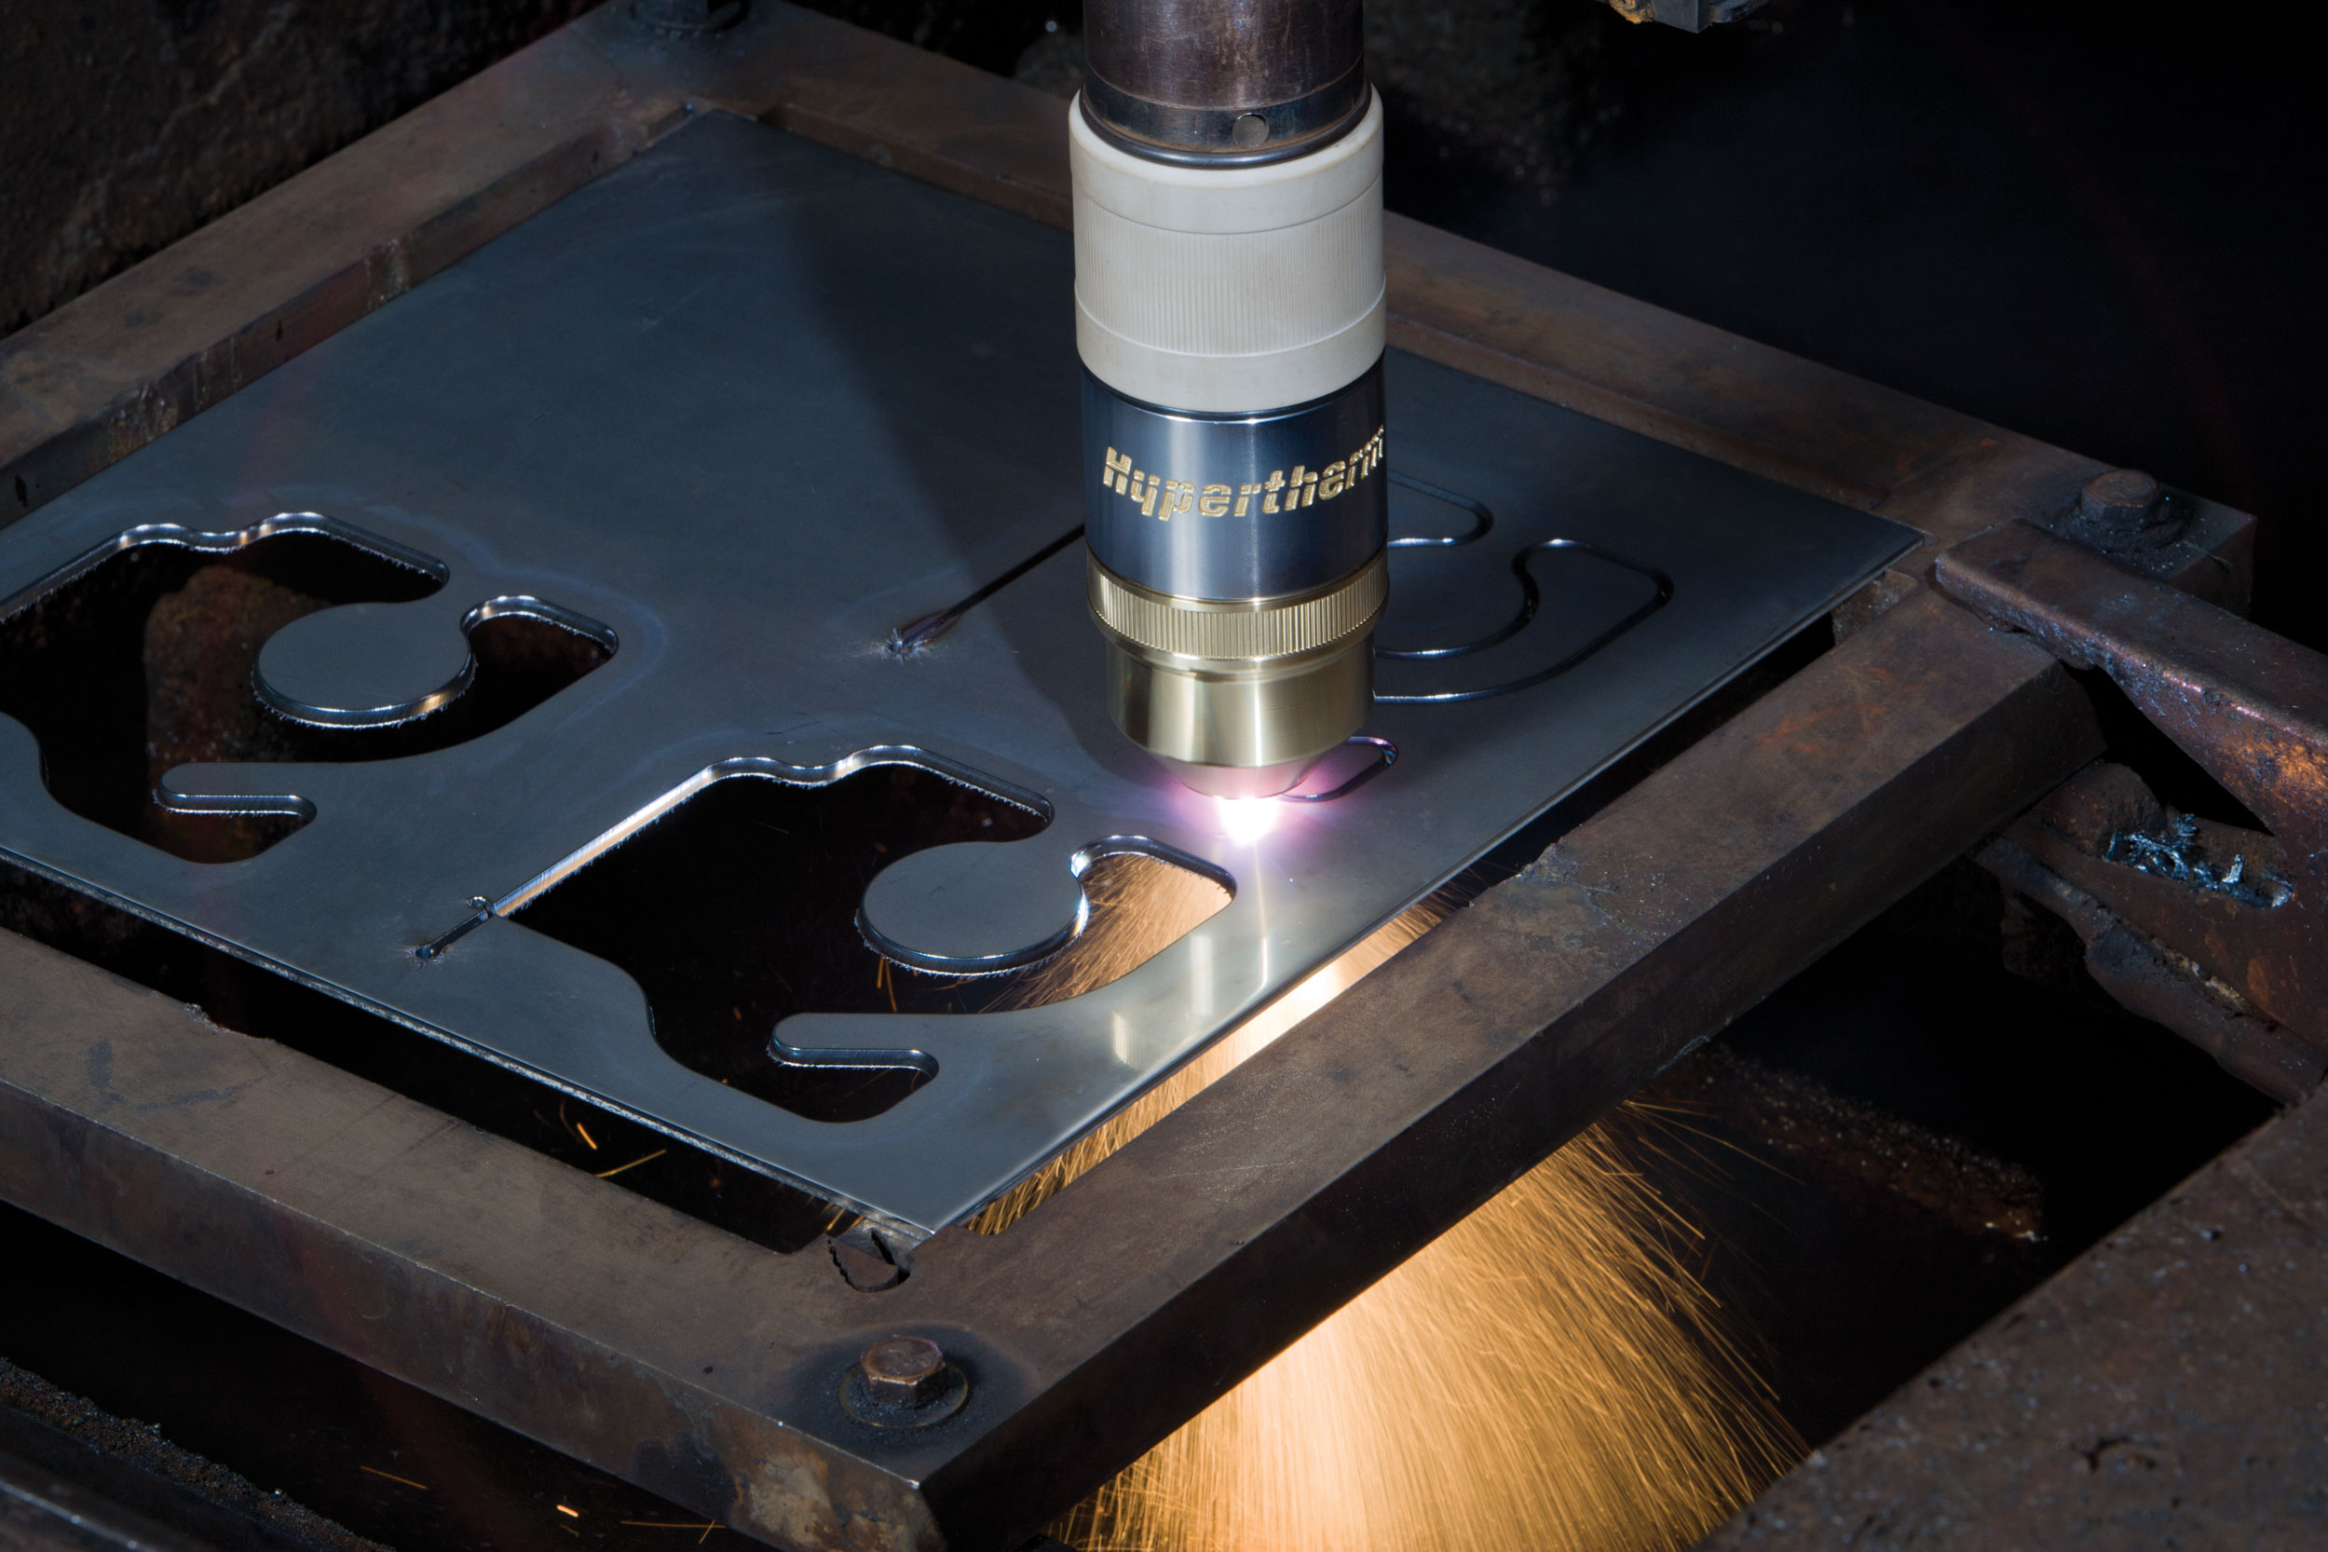
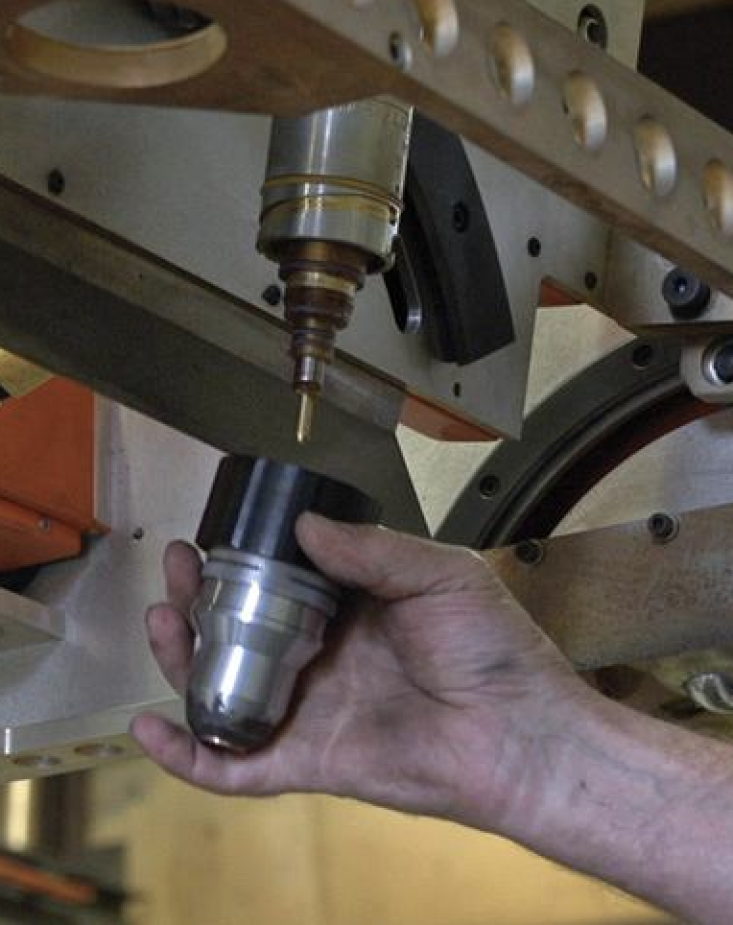
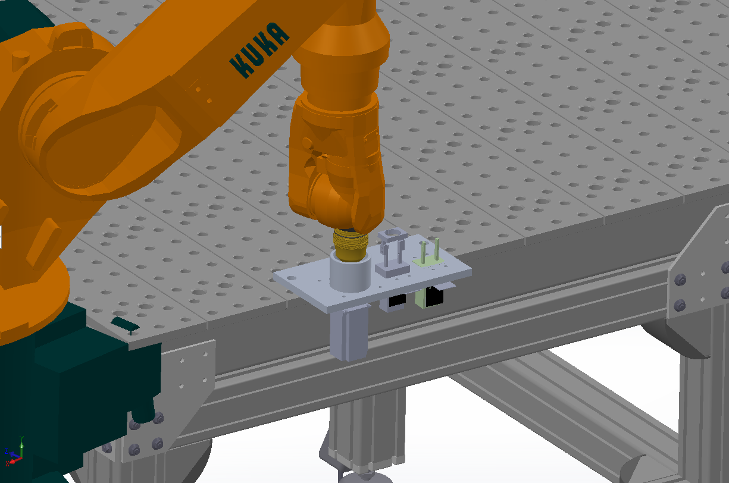
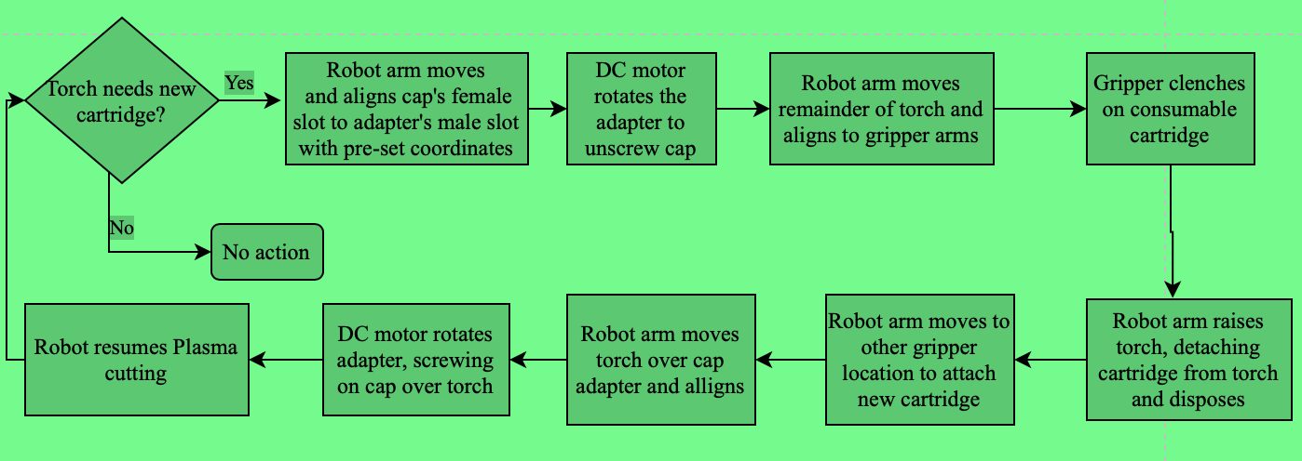
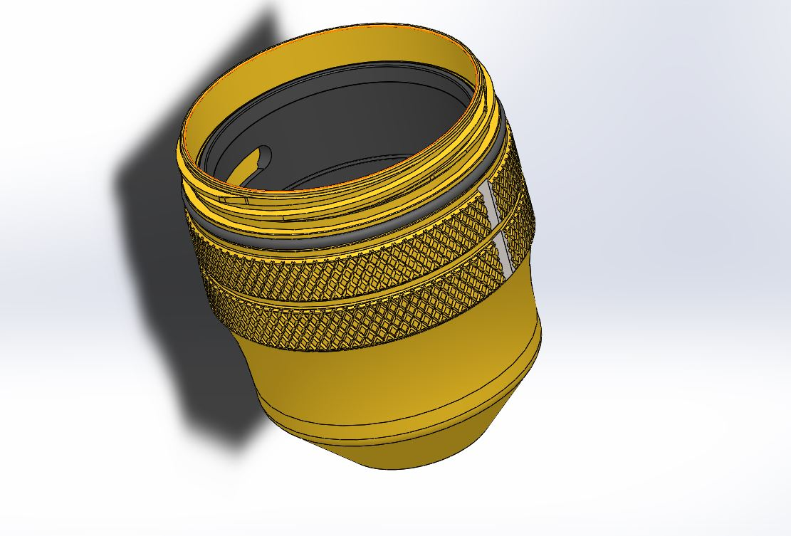
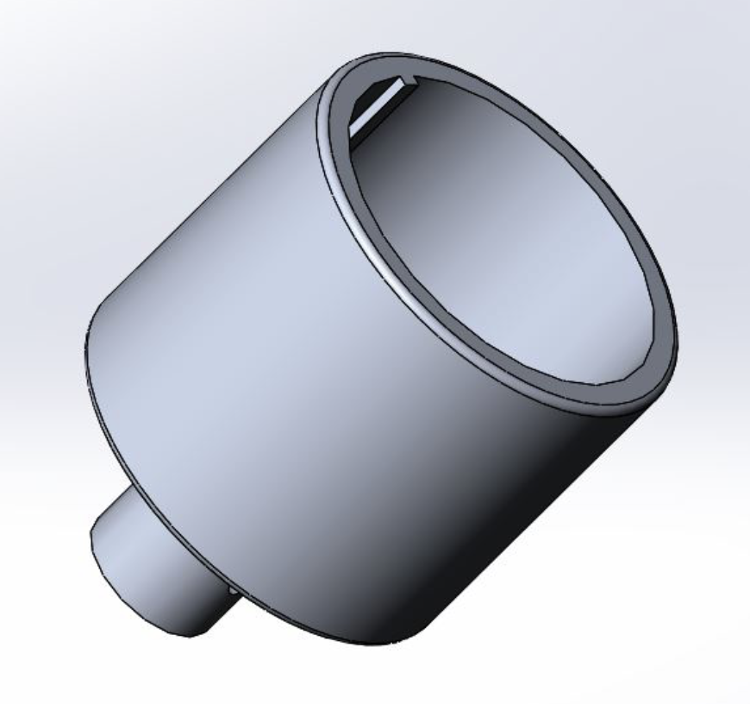

Consumable Cartridge Auto-change for Plasma Cutting
Roffiel Farhat | Azhar Ali
Faculty Advisor: Brad Kinsey Industrial Advisor: Terence O’Neil
Background
Project Overview
Analysis
Company Information:
Hypertherm is a manufacturing company, located in Hanover, NH and founded in 1968.
Hypertherm specializes in manufacturing of Plasma, Laser and Water-Jet cutting systems
Currently, Hypertherm has an upward of 50% market share in cutting solutions.
Plasma Torch
Current process to change cartridge:
Currently, the consumable cartridges are replaced manually by hand, by a technician.
Time intensive replacement process.
Human error in identifying correct cartridge can lead to exhaustion of cartridge and torch.
Equations that were used to analyze the forces and torque required to unscrew and take the cartridge off
$Torque : τ=Force × radius$ , Nm
$Force:F=μ_{f}× N$ , N
$μ_{f}$is the friction coefficient and N is the normal force
Stresses were calculated in each component to make sure the material of choice withstands specified forces
$Stress: σ= \frac{Force}{Area}$, Pa
Torch Cap
Consumable Cartridge
Project Information:
In Plasma cutting of metals, gases are exposed to each other in the torch, with presence of an electrode, this produces vast amount of energy and temperature.
Each cartridge contains an electrode with specific rating, which is related to the material and its thickness
Proposed Process:
The basic process involves screwing off the torch cap and removing the cartridge by pulling it off .
New cartridge is replaced by pushing it up the torch, torch cap is screwed back on.
 | Theoretical or Experimental value | Limit value | Safety Factor
Torque (motor) | 16.05 Nm | 9.151 Nm | 1.92
Stress (consumable cap) | 2.379 MPa | 1.393 MPa | 1.7
Gripping force (gripper) | 311.3 N | 467.06 N | 1.5
Design
KUKA robot arm
Torch Cap, modified by producing a slot on the side to meet rotational and stress requirements.
Gripper attachment designed to hold and take cartridge off.
Steel plate to house components; designed to satisfy stress and moment requirements.
Process Flowchart
Holes for screws (5 mm nut to hold plate & 2 mm nut to hold components to plate
Future work
Add an additional gripper so that cartridge removal and addition locations are available.
Include RFID sensors to track cartridges
Incorporate disposal location to deposit exhausted
cartridges
Integrate light curtains to prevent human interference in robot area
Add bearings to adapter to reduce friction and wear if required
DC Brushless motor (Bi-directional)
L bracket to mount gripper
Gripper
Adapter designed to screw torch cap

