Slide 1
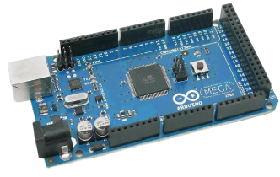
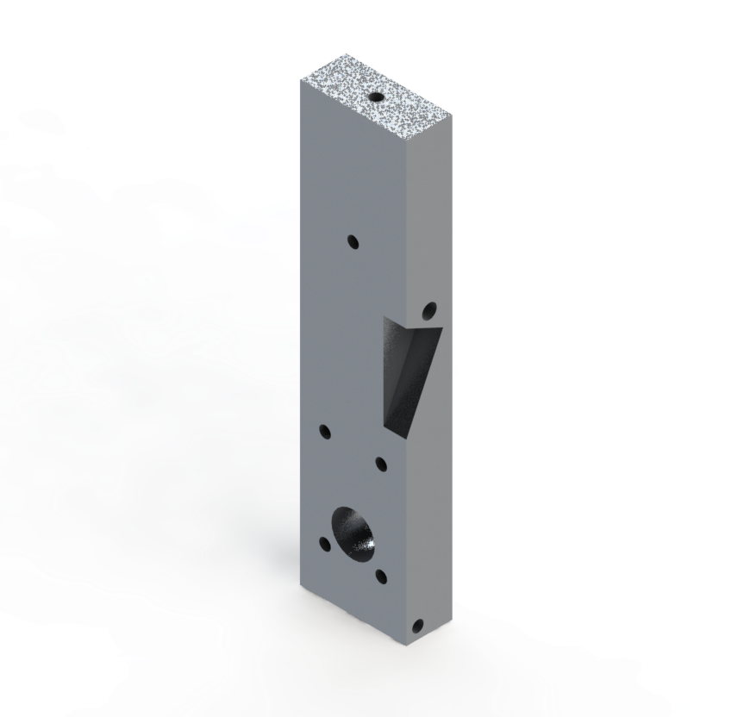
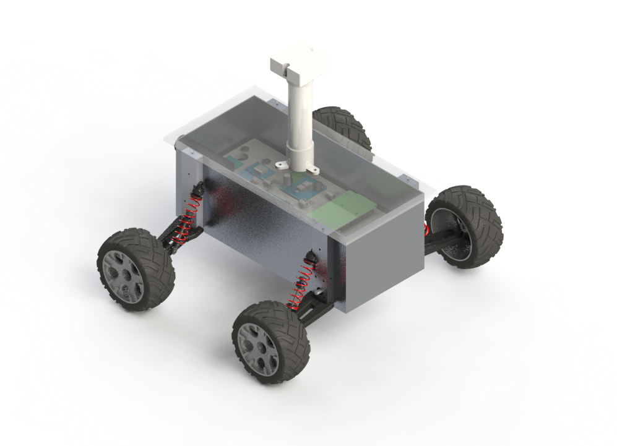
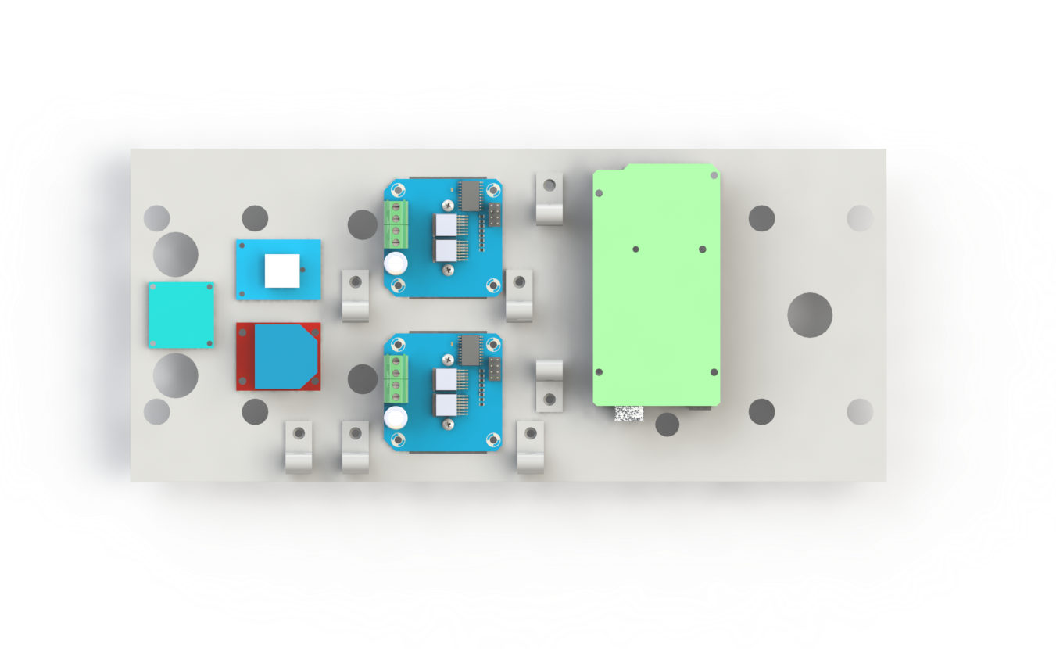
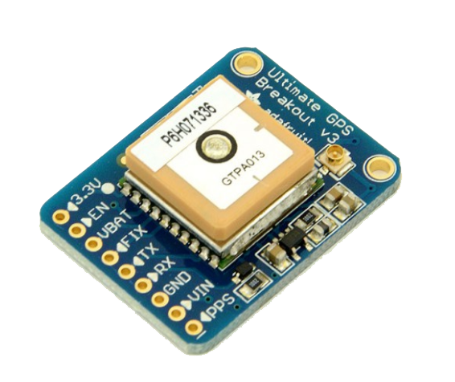
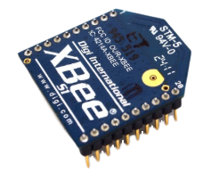
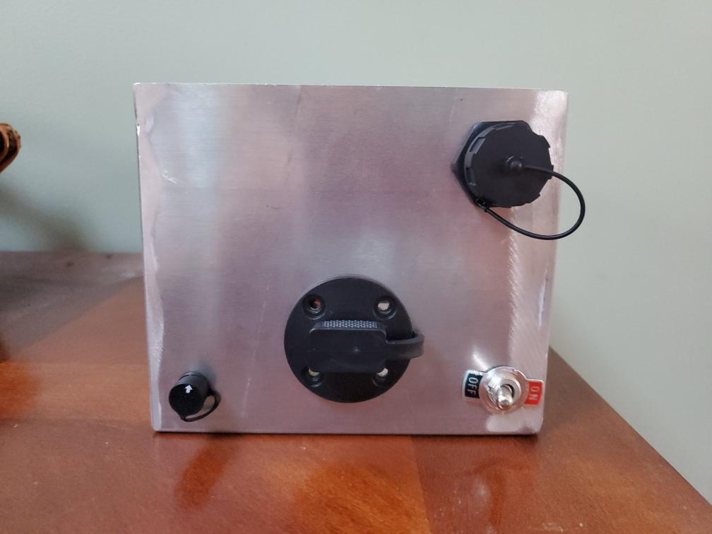
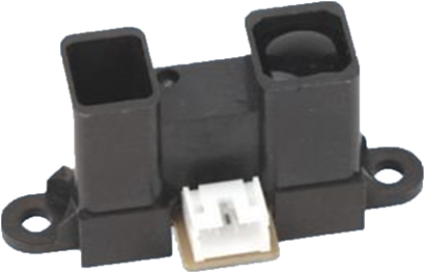
Team Members: Cody Best, Debarpan Bhowmick, Courtney Conway, Olivia Edson, Nha Huynh, Patrick Marquardt, Mitchell Mattice, Jimmy Xu
Advisors: Professor May-Win Thein,
Gregory Hatfield
Electronics
Mission Statement
Capabilities
Rover Design
Arduino Mega Controller 2560
Analog and digital input/output
Reads data for various tasks
Electronic Speed Controller (ESC)
Uses pulse width modulation from Arduino to power motors
One ESC powers two motors, one for each side of the bot
Inertial Measurement Unit (IMU)
Accelerometer, magnetometer, gyroscope
Determines roll, pitch and yaw with 9 degrees of freedom
Global Positioning System (GPS)
Locates up to 22 satellites
Tracks current and future locations of bots
XBee and Shield
2.2 GHz transmitter/receiver
Allows for swarm data communication
Battery
10,000 mAh capacity LiPo pack
Provides overall power to bot
OLED Screen
1” display for troubleshooting messages
Outputs status of bot in real time
The goal is to design and test fully autonomous robots in order to implement a particle swarm optimization (PSO) algorithm. This algorithm will then be tested on an open field where the swarm of bots needs to locate and travel to the highest point of elevation.
2 hour run time
45 degree incline climbing
Robust and impact resistant
Waterproof
Chassis
5052 welded sheet aluminum
5” x 6” x 13”
Drivetrain
4WD, tank steering
DC motors
Suspension
Modified, independent single A-arm RC car suspension
Custom milled suspension mounting block
Mounting Plate
Internal organization of
electronics and wiring
for modular design
Easily removable for
troubleshooting
Lid
Laser-cut acrylic, easy view of internals and GPS communication
Edge gasket for waterproofing
“Unicorn Horn”
Isolated system for IMU to prevent EMF interference
PVC pipe and 3D printed mount for IMU
Rear Chassis Pane
Ports for charging battery, USB for software uploading, and
power switch
Streamlines cable
management and
eliminates need to
open lid
Acknowledgements for their assistance in this project: Jonathan Ells, Jaiden Evarts, Ryan Bergman, and the ET Navswarm Organization
Particle Swarm Optimization (PSO)
Software and Control
Based on Swarm Intelligence by mimicking birds and fish
Mathematical principles for efficient movements and common goals
Searches for parameters that provide a maximum or minimum of a specific target
Swarm locates best/most efficient solution
Requires current velocity, local (personal) best location, and global best location from the search space
Arduino Mega and corresponding software used for all control and PSO calculations
Communication between rovers facilitated through XBee and corresponding software
PSO algorithm outputs direction vector, control system is used to physically map out vector
Control system is designed such that it compensates for low hardware resolution, for example the implementation of thresholds on all control systems output such as direction and velocity
Can incorporate obstacle avoidance in parallel with PSO control output using IR sensors

