Slide 1

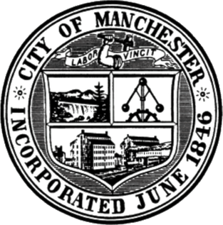
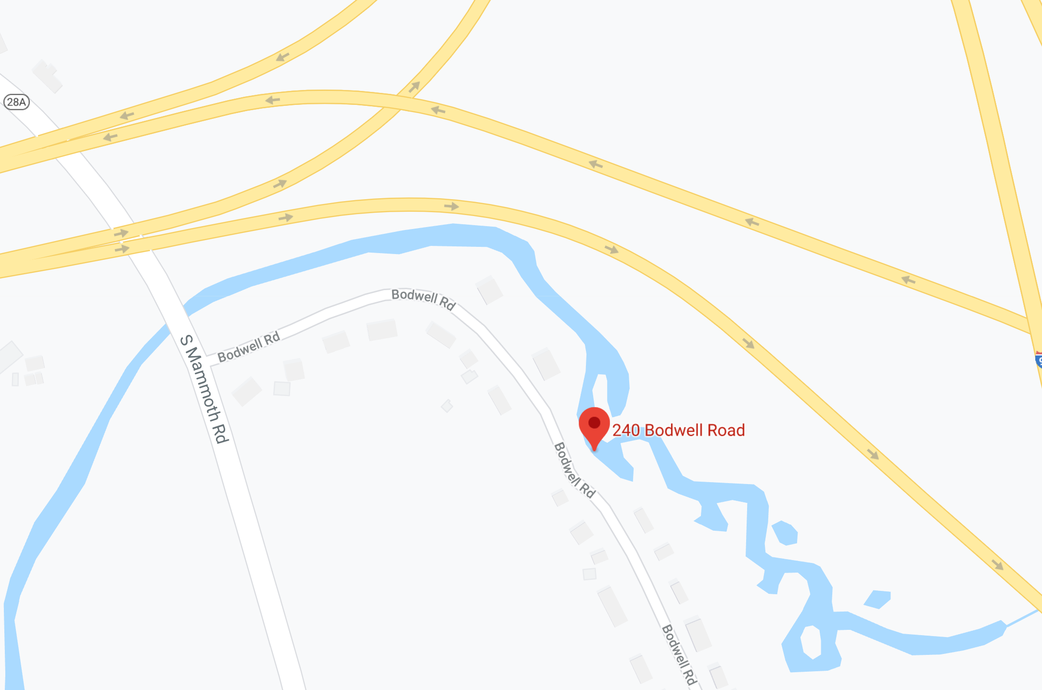
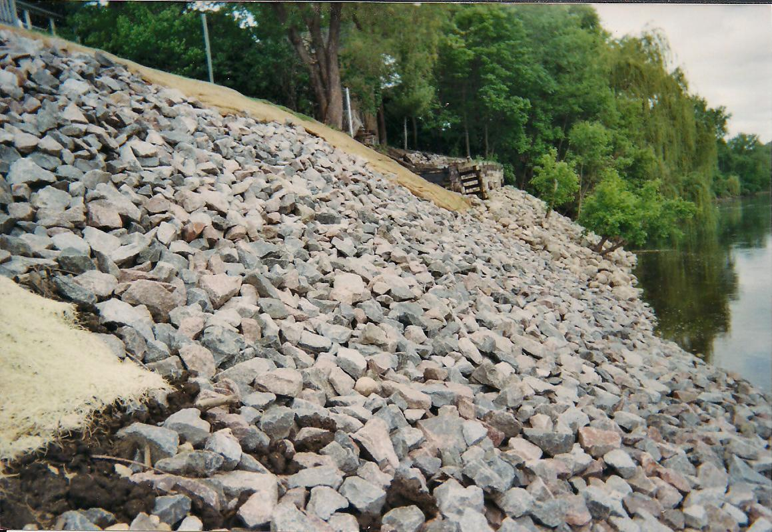
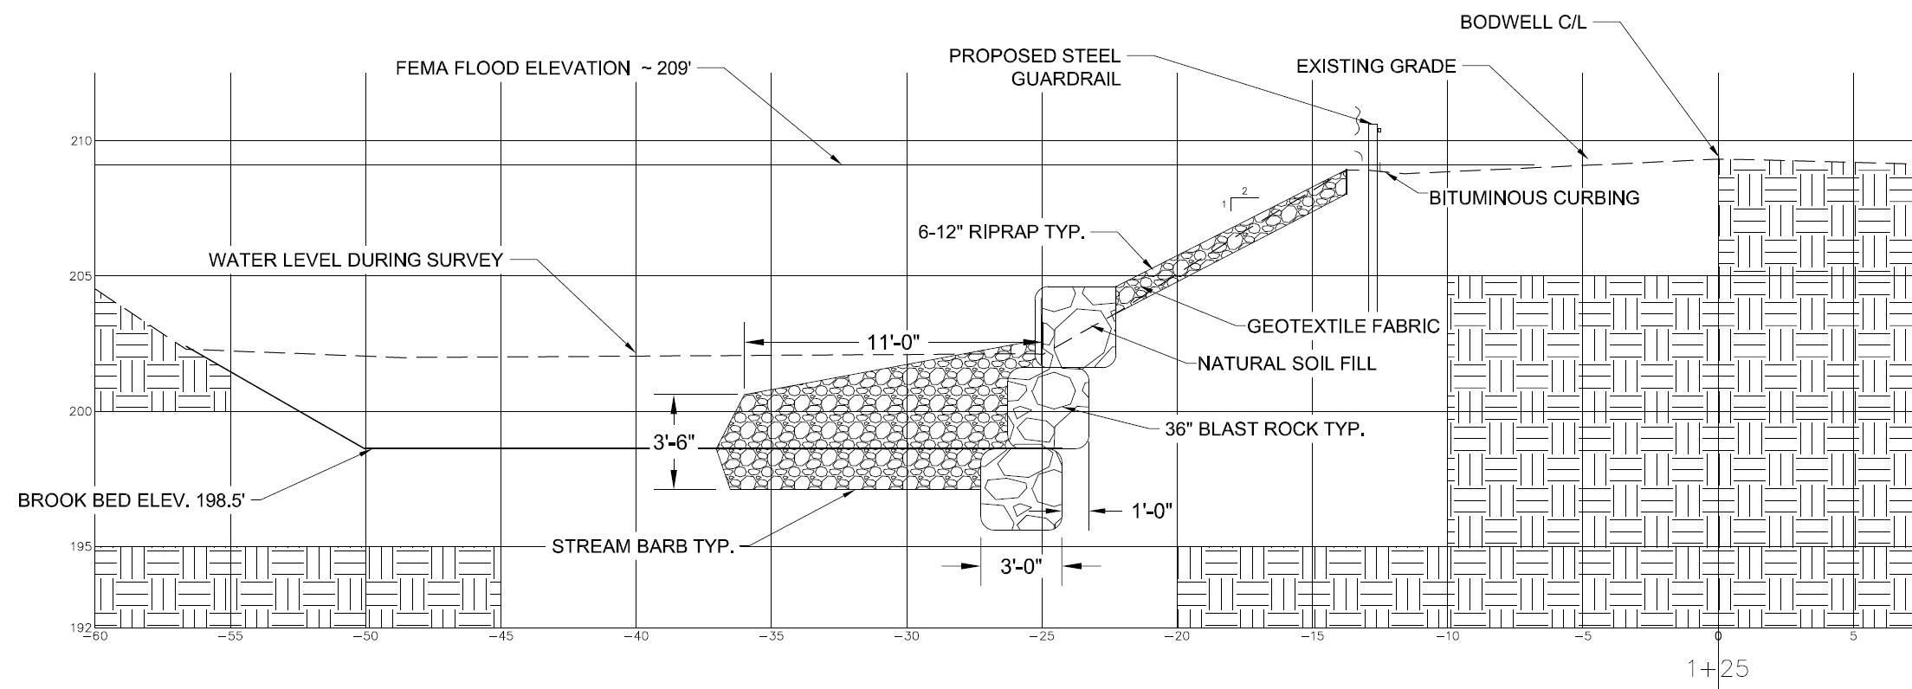


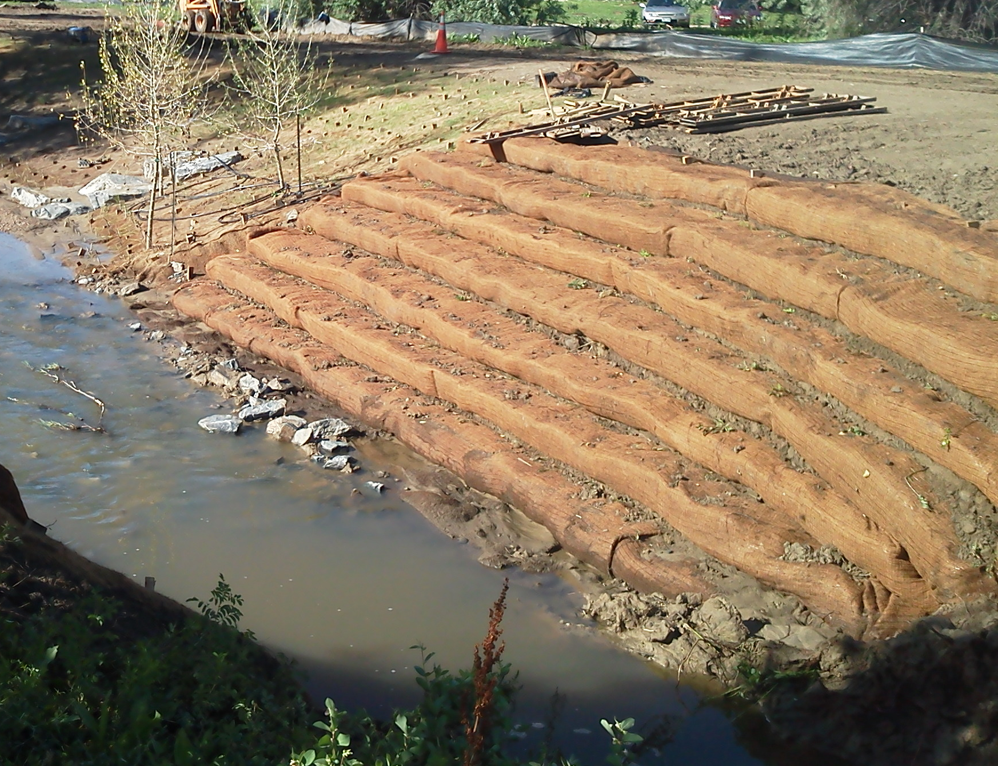
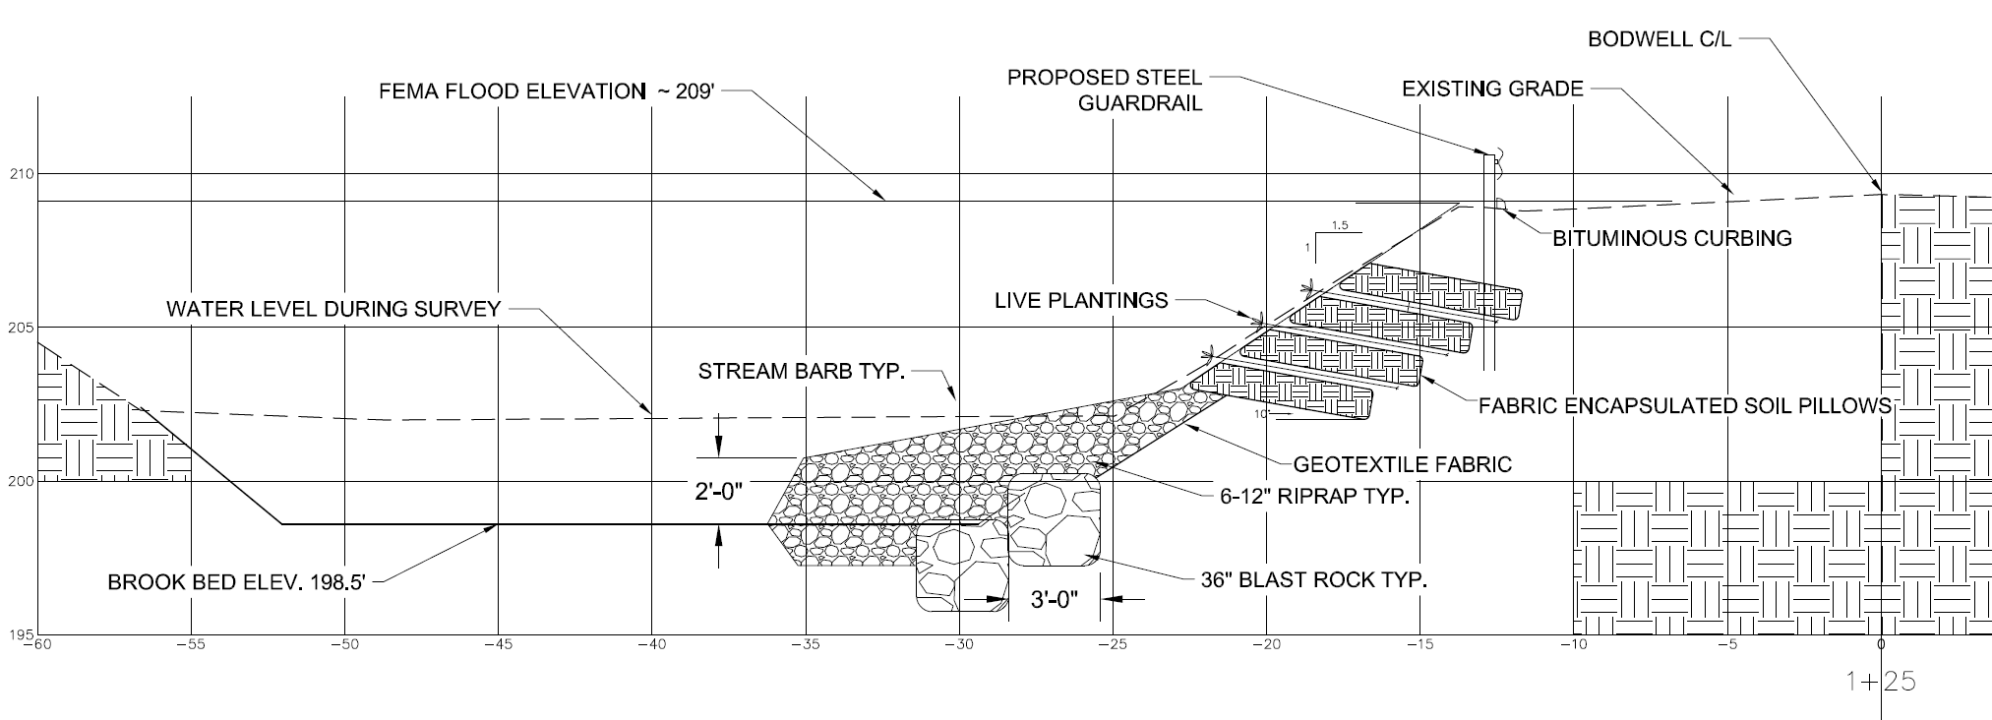
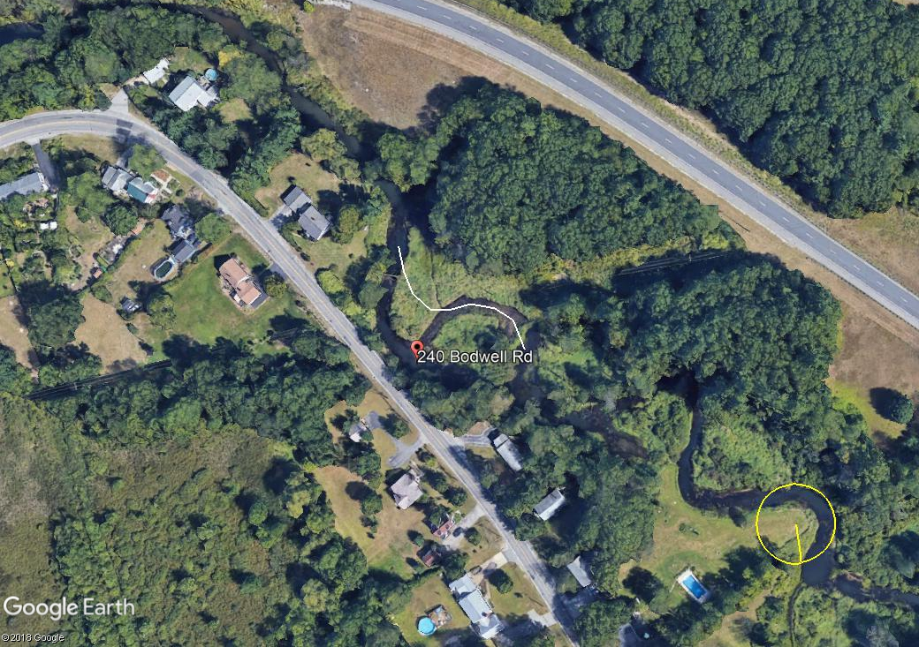
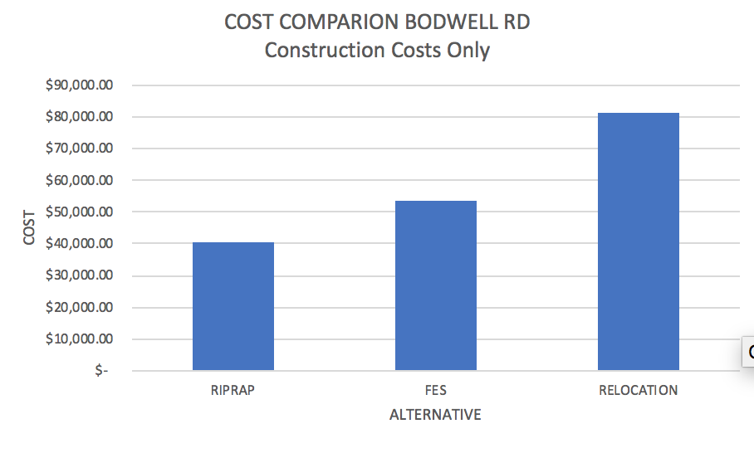
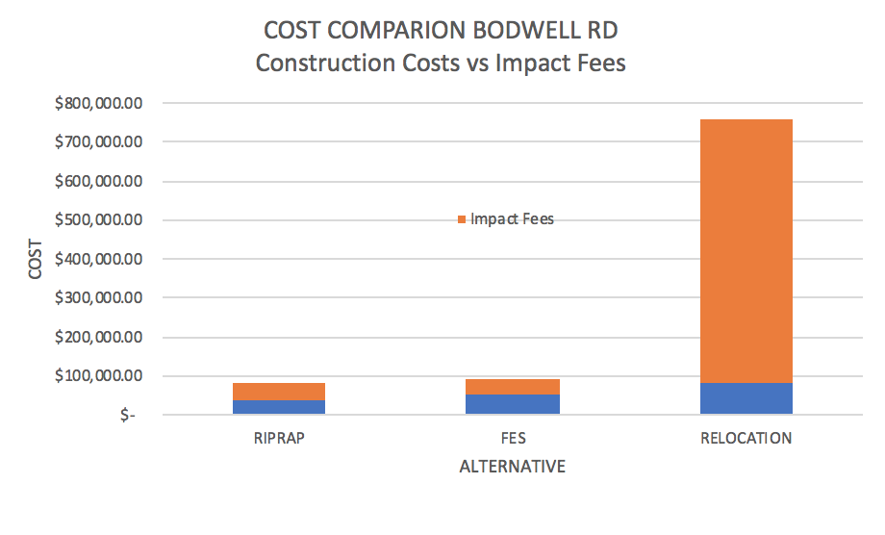
Bodwell Road Bank Rehabilitation
Students: Nick Buonanno, Kyle Hamel, Ben Higgins, Connor Littlefield
Faculty Advisors: Eshan Dave, Majid Ghayoomi, Anthony Puntin
Professional Partners: Todd Connors, Owen Friend-Gray
EXISTING CONDITIONS
ALTERNATIVES
Riprap design
Bodwell Rd is a two way roadway in Manchester NH
Impacted by Cohas Brook
Failing bank, failing guardrail
RipRap Stabilization
Fes design
Fabric Encapsulated Soil
COST COMPARISON
Stream Relocation
additions
Steel Guardrail replacement
MASH approved EAGRT Guardrail ends
Bituminous curbing to direct water
Stream Barbs for deflecting channel flows away from the brook bank

Slide 2
This poster template provided courtesy of
UNH ESRC Poster Printing Services
Trust us to make your poster look GREAT!
Website: http://posters.unh.edu
Poster Guide: http://goo.gl/1E7TJY
DELETE THIS SLIDE BEFORE PRINTING

