Slide 1
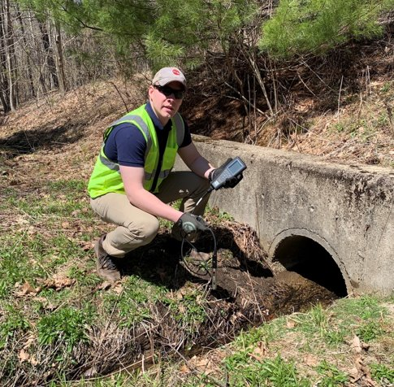
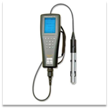
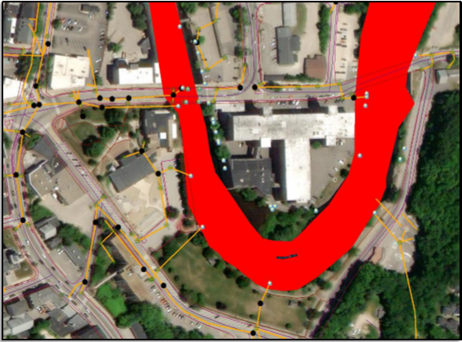
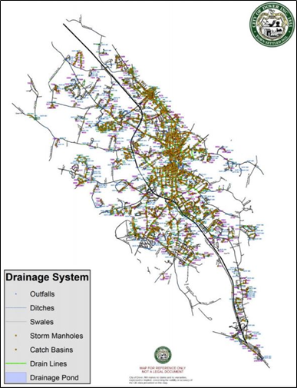
Dover, New Hampshire Stormwater Management Program MS4- IDDE Plan Team 7: Zach Sullivan (Project Manager), Jirias Charabati, Jacob Simpson, Samuel Wojichowski Faculty Advisor: James Houle | Project Sponsor: Gretchen Young Department of Civil and Environmental Engineering, University of New Hampshire
Project Background
Scope of Work
Project Obstacles/Resolutions
Previous stormwater system in Dover NH:
Combined System Overflow - Resulted in raw sewage dispensed into waterbodies from storms
New stormwater system in Dover NH is separated system
Still potential for illicit discharge
Present Permits for City of Dover
MS4 - Stormwater Discharge for Small Municipal Storm Sewer System
NPDES – National Pollution Discharge Elimination System
IDDE – Illicit Discharge Detection & Elimination
SWMP – Stormwater Management Program
Test water quality at 209 known outfalls
Develop dry weather flow sampling kit and procedure to test for:
Ammonia, Chlorine, Conductivity, Salinity, E-Coli or enterococcus, Surfactants, Temperature, Pollutants of concern (phosphorus and nitrogen)
Develop catchment investigation procedure to isolate and confirm sources of illicit discharges
Develop cost estimate for implementation of proposed procedures
Produce instructional video depicting proposed procedure
Dry Weather Collection:
Able to develop/demonstrate procedure regardless of conditions
COVID-19:
Virtual conference meetings held online
Work conducted through online virtual meetings and on own times for review at a later time
Difficulty in contacting third party laboratories for kit component pricing information and possible alternative out of house sample testing facilities
Costing
Costing Assumptions:
"a" Assumed 120 or fewer outfalls test positive for surfactants
"b" Assumed 60 or fewer outfalls have salinity content requiring Enterolert reagent
Product | 1 Time Cost | Total Refill Cost | # of Refills | Cost per Refill
YSI Pro Plus | $2,904 | - | - | -
Incubator | $300 | - | - | -
Surfactant (Inst.) | $431.13 | $384.80 | 5ª | $76.96/20
Surfactant (Visual) | $76.96 | $688.70 | 10 | $68.87/20
Phosphorus | $108 | $32.35 | 1 | $32.35/100
Colilert | - | $774 | 200 | $3.87/1
Enterolert | - | $385.2 | 60^{b} | $6.42/1
Quanti-trays | - | $140 | 2 | $70/100
Total | $3825.09 | $2405.05
 |  |  | Cost/Outfall | $29.81
Graphic shows 209 Known Outfalls in Dover, NH
Graphic shows Clip from Instructional Video
YSI Pro Plus Handheld Device
Kit Components
To Test for Ammonia, Chlorine, Conductivity, Salinity, Temperature, Ammonia, & Nitrate:
YSI Pro Plus (including cables & sensors) - $2904.00
To Test for E-Coli:
Colilert Reagent - $3.87/Test Packet
Enterolert Reagent - $6.42/Test Packet
Quanti-Tray Sealer - $4,700.50
IVYX Lab Incubator - $300.00
To test for Surfactants:
CheMetrics Visual kit - $90.54
CheMetrics Instrumental kit - $431.13
To Test for Phosphate:
Hach O-Phosphate Color Disc Test Kit - $108.00
.
Graphic shows Stormwater Mapping in Dover, NH

