Slide 1

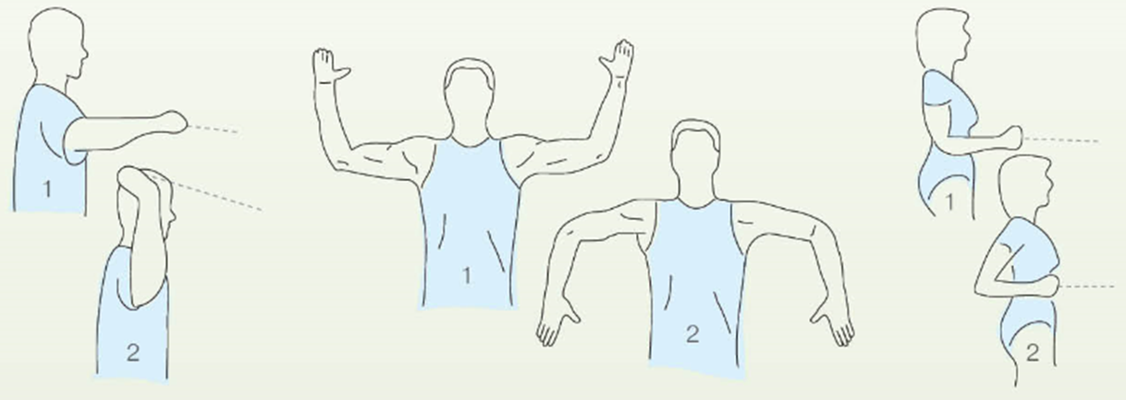
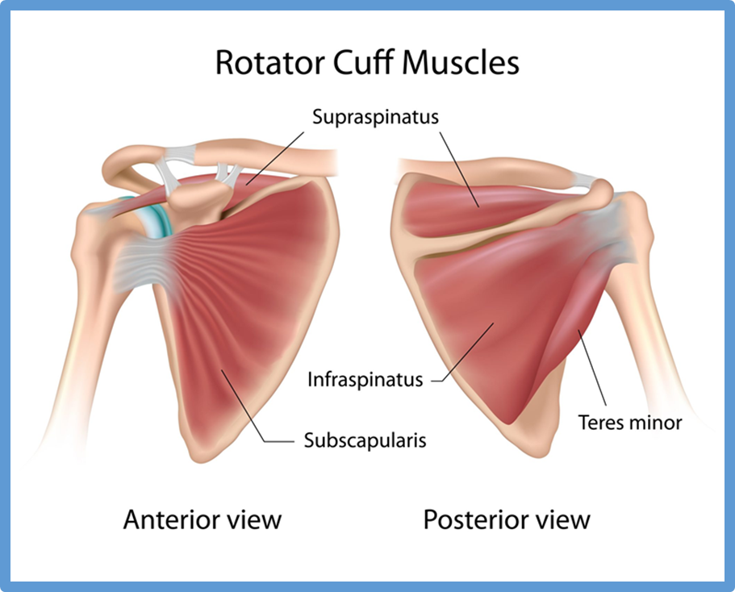
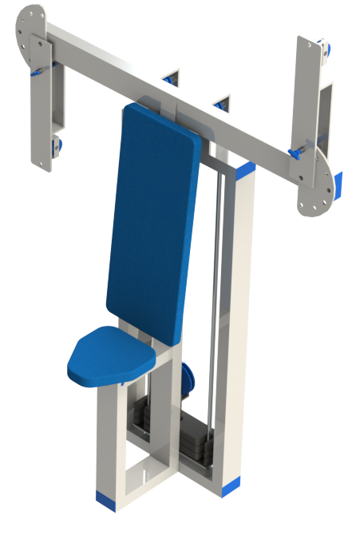
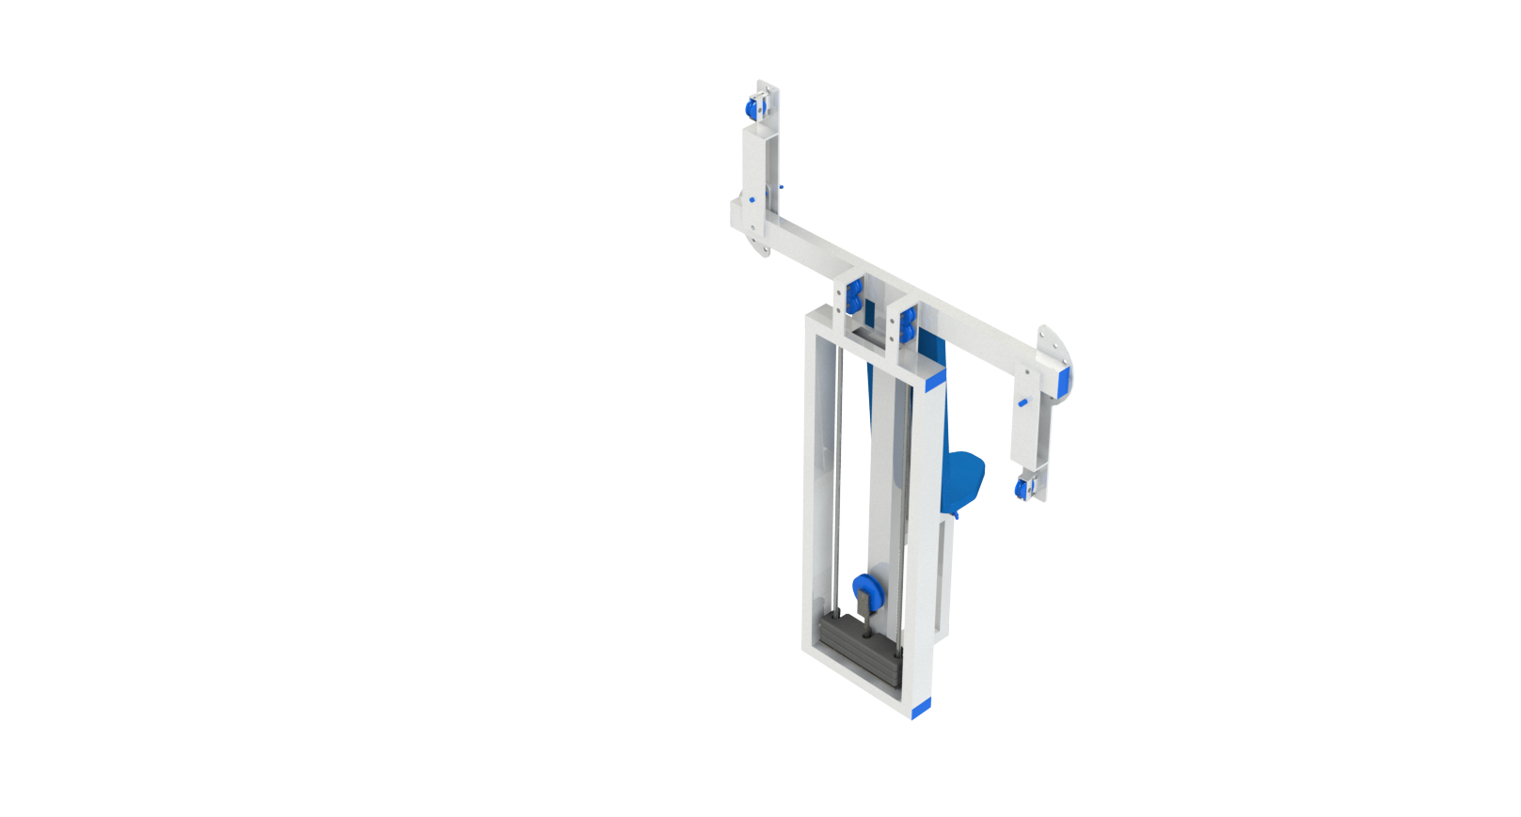
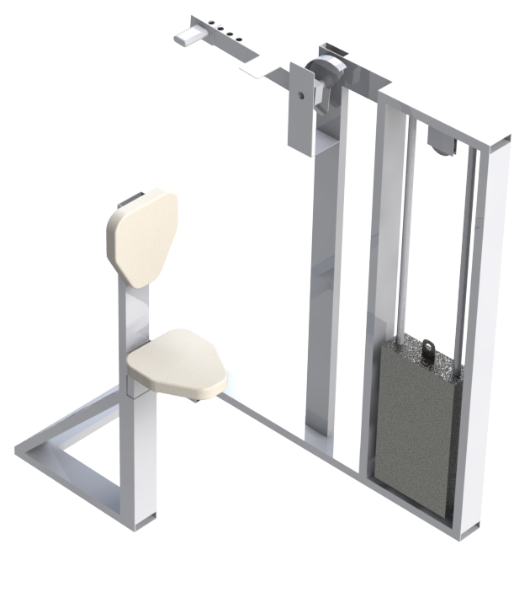
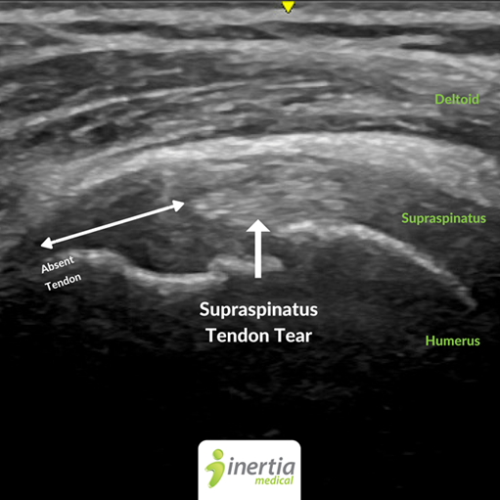
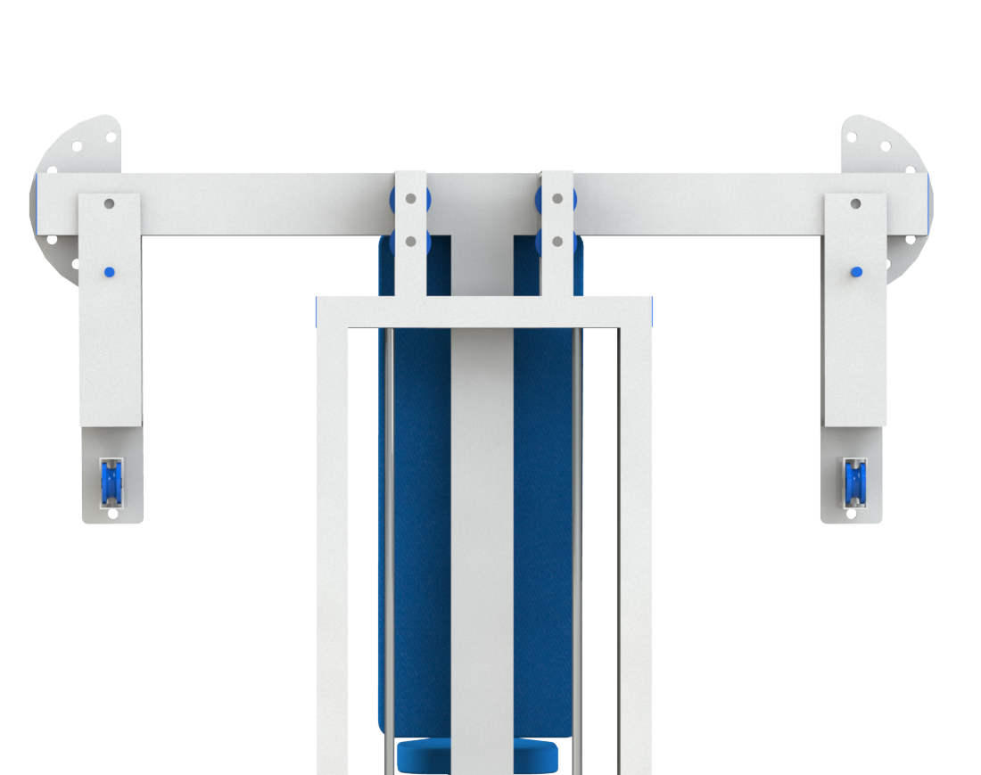
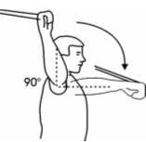
Rotator Cuff Exercise Machine
ME 756 Senior Design
Author: Joseph Williams Advisor: Ivaylo Nedyalkov
College of Engineering and Physical Sciences, University of New Hampshire
Special Thanks to: Matthew Collins and Kyle Lecour
Abstract
Design
Discussion
The supraspinatus, the infraspinatus, the teres
minor, and the subscapularis, are a regularly
forgotten group of rotator cuff muscles, despite
their integral role in shoulder mobility and health.
With the use of a machine designed to exercise
the these muscles, the
rotator cuff can be
strengthened, helping to
prevent shoulder
stresses and strains and
minimize doctor visits.
The final design has two arms capable of rotating 180 degrees, allowing a variety of rotator cuff exercises and movements, both lateral and vertical. It also features a small weight stack sat behind the user, specific for rotator cuff exercise. The design features a small footprint with a familiar presence, allowing the machine to fit in at any gym.
Created for the average gym-goer, this machine creates a familiar environment that allows for effective exercise of the rotator cuff muscles. With a machine dedicated to rotator cuff muscle growth and training, everyone will have the opportunity to strengthen their shoulders and develop otherwise ignored muscles to prevent injuries.
Introduction
Muscle-specific gym equipment provides a safe
and comfortable alternative to other more complicated exercises. An easy to use machine than could be affordable for production and both
non-intimidating and effective for the
gym-goer were the main design criteria.
Considering these parameters design began.
The first iteration of the machine was built.
It targeted one arm, focusing on ensuring
proper form with an individual arm. While
effective, some design concerns were raised. Following this design, a few other iterations were developed, with the final design being the rotating two arm design.
Future
.
Testing is to be underdone to ensure the effectiveness of the machine. Ultrasound can be used to measure the size of the rotator cuff muscles prior to use of the machine. After continued exercise over a period of time using the machine, the muscles can by scanned once more and the growth can be analyzed. Given the testing proofs successful, the machine can be developed further with the end goal being the marketing of the idea to exercise equipment companies.
Operation
      After locking the rotating arm at the desired position
      the user will grab the handles and rotate their
      arm away from the machine either horizontally
      or vertically while keeping their arm at a 90
      degree angle.

