Slide 1



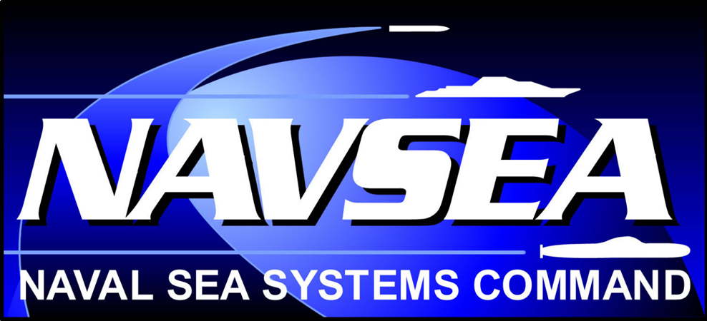
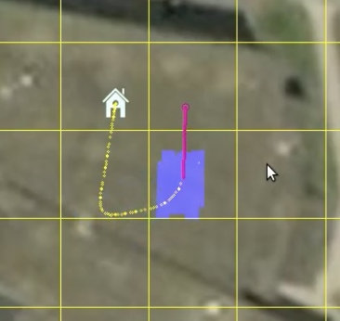
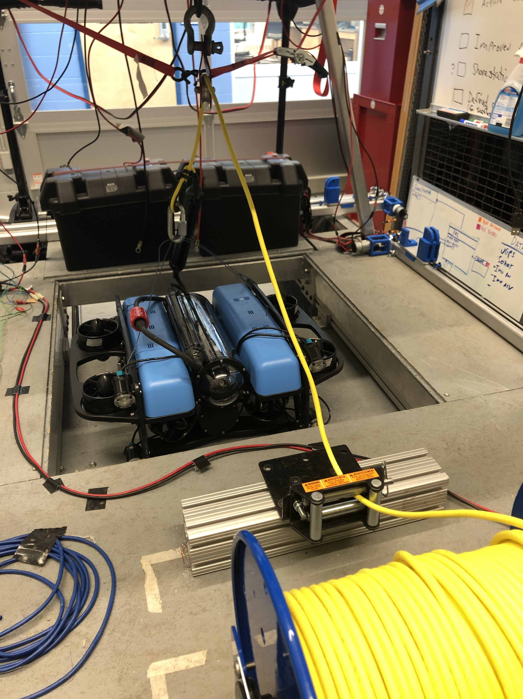
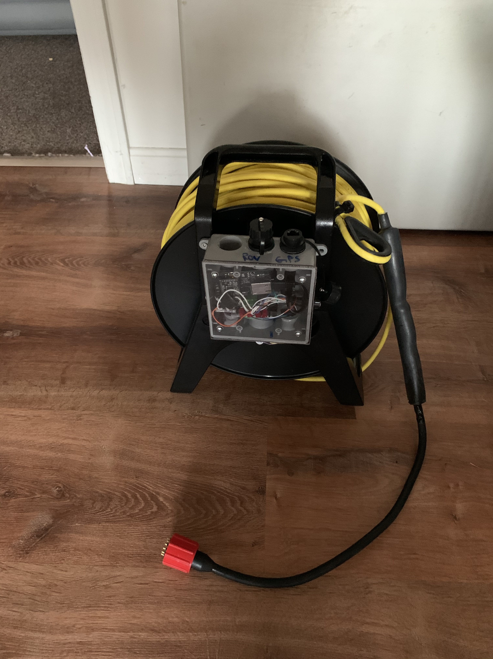
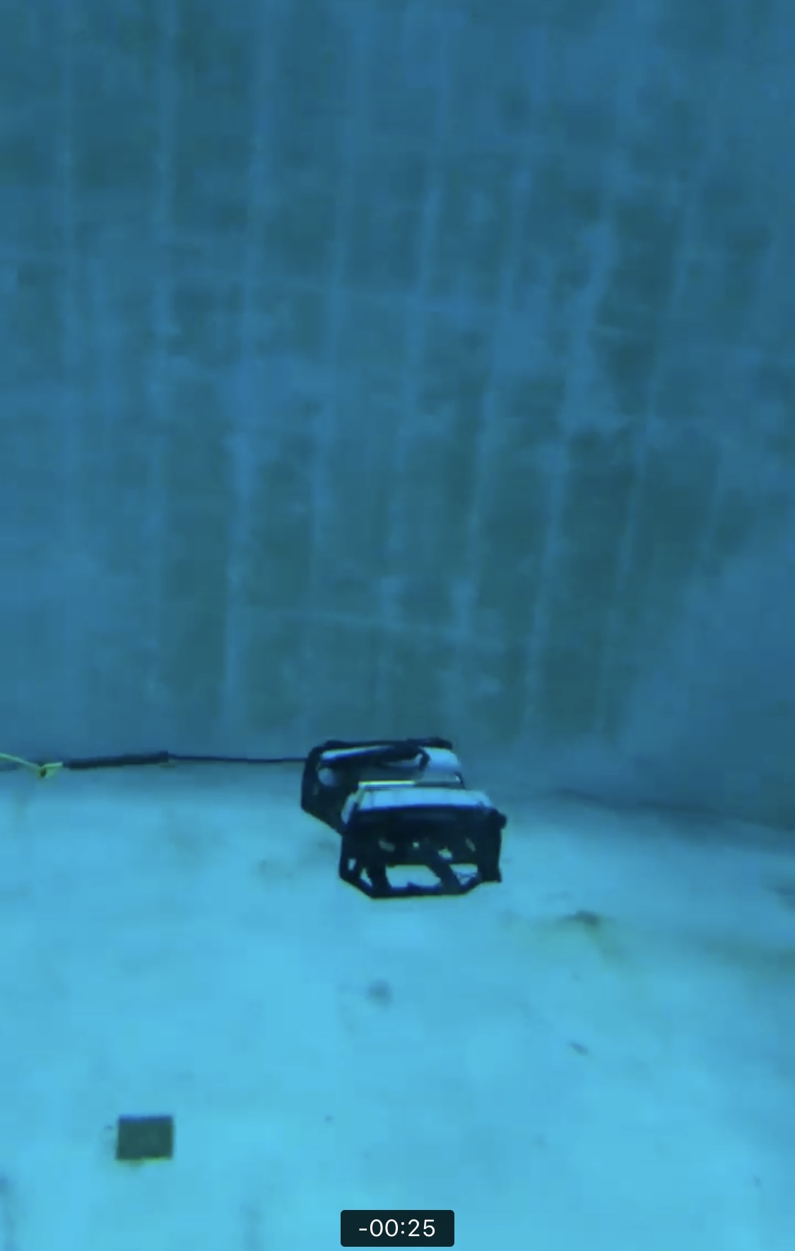
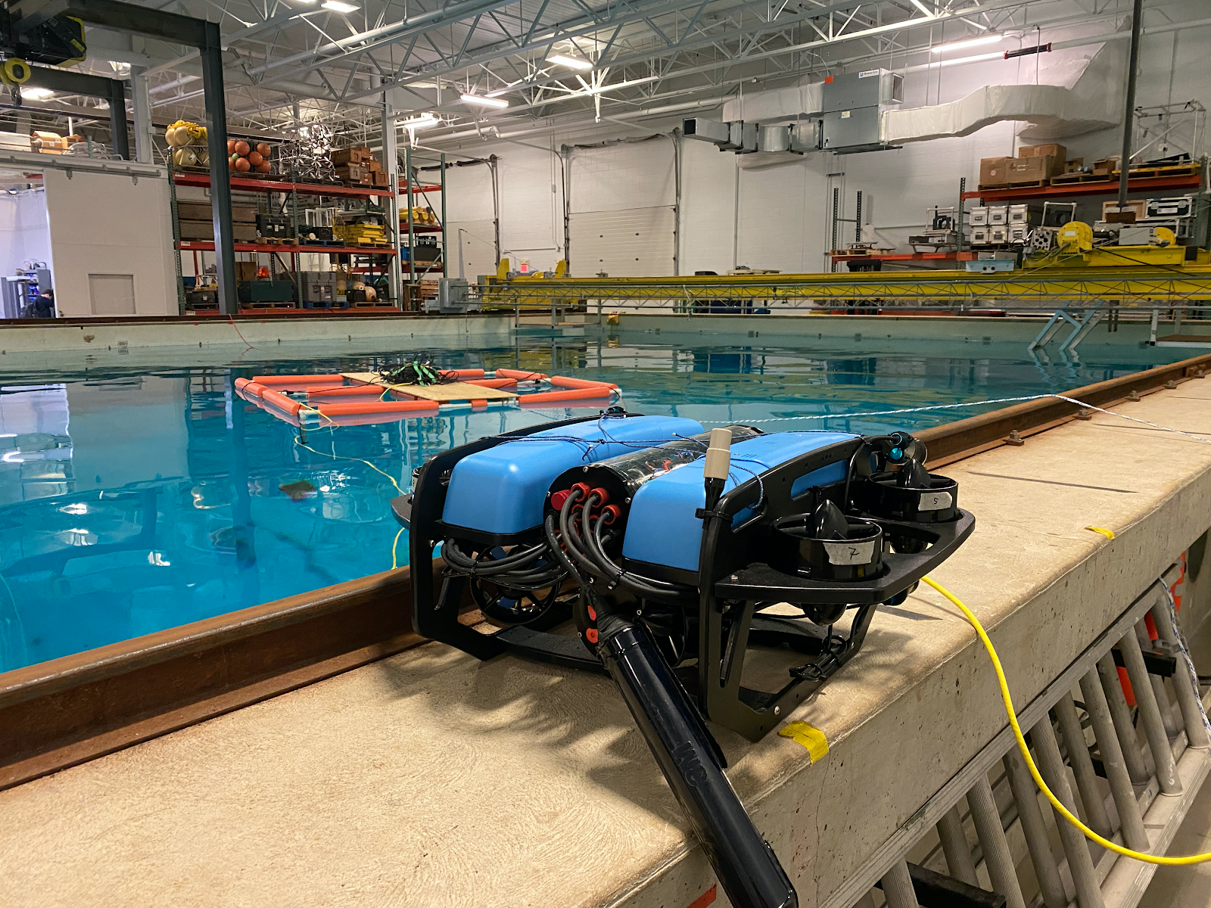
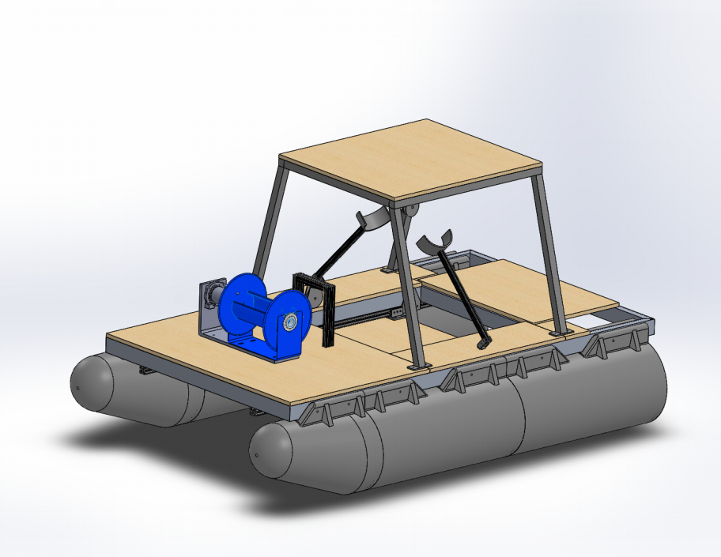
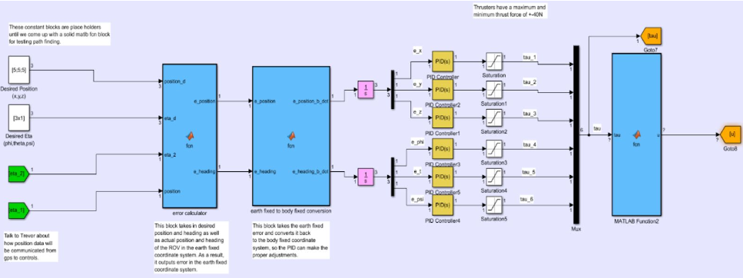
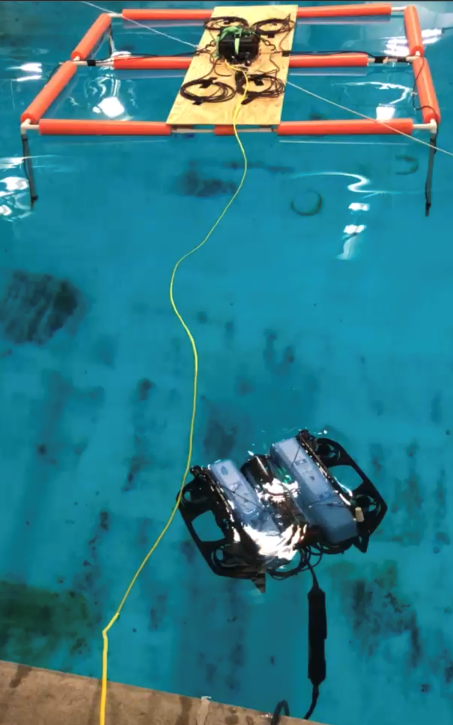
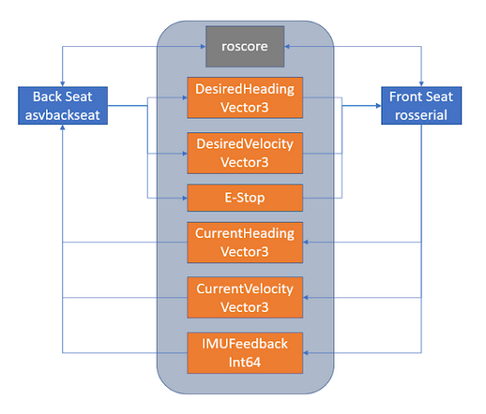
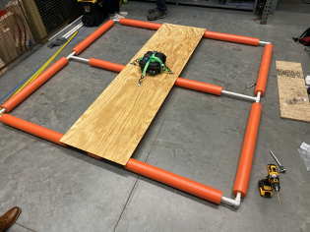
Underwater Remotely Operated Vehicle(ROV)
Team Members: Travis Calley, Timothy Holt, Kevin Johnson, Matt Lemire, Logan Yotnakparian
Project Advisors: Dr. May-Win Thein & Dr. Yuri Rzhanov
Graduate Advisors: Allisa Dalpe, Alexander Cook, & Oguzhan Oruc
In collaboration with the UNH Autonomous Surface Vehicle (ASV) project
Special Thanks to Dr. Martin Renken, the UNH Parents Association, John Ahern, Scott Campbell, Laura Gustafson, Sheri Milllette & Tate Ellinwood (Saint Paul High School)
Tether System
Interchangeable Tether System
ROV Mission
Waypoint Navigation
Goal: To make one tether system that will work with all current and future ROVs
Each ROV has a female SubConn
connector, while the tethers has a male
SubConn connector
ROVs can switch between
tethers
Connections are inline (ROV 008)
or on the end cap (ROV 006 & 007)
The primary goal of the ROV team is to work alongside the ASV to achieve entirely autonomous ocean mapping.
The main focus of the ROV team this year is to establish effective and repeatable testing to create a platform to facilitate the implementation of more advanced control systems in future years.
Goal: to accurately navigate from waypoint to waypoint autonomously
The User Interface Allows us to select waypoints for the ROV to travel to.
Waypoints can be given outside of UI using a python script
The python script allows for the waypoints to be passed to the ROV from another platform since the python script can be executed though the ROS network
Navigation can be improved by tweaking the gains of the PID controllers
Tether is capable of withstanding a tensile load of 300 lbs
New testing reel incorporates quick connections for easy set up
The figure above shows the tether connected to ROV 007.
Deployment
Goal: To autonomously deploy the ROV from the ASV
Strategy consists of custom built tether reel and guided spooling system to control the deployment process
Tether reel has been fabricated out of
a 2000 pound winch motor, a cable
reel, and a slip ring
12 wire slip ring enables the
connection between the ROV, the
tether reel, and the ASV
Rollers will be implemented around the
trapdoor in the deck of the ASV to
prevent the tether from snagging on the
ASV
A cable management system will be implemented to guide the tether onto the spool uniformly to prevent tangling and overflow
Controls
The current controller onboard the ROV is the proportional-integral-derivative controller. QGround control is an interface that allows each of the controller gains to be tuned appropriately from testing feedback.
A rotary encoder will prevent the system from attempting to deploy more tether than what is available
A force gauge and a floating pulley will deploy the tether only when there is tension
The figure above shows the ROV deployment system from the ASV. It is important to note that tether reel is shown in blue.
Underwater GPS
​
ROS System Design
Goal: To locate the ROV underwater using four receivers listening for a set acoustic frequency and a single locater producing a desired acoustic frequency
Robot Operating System, or ROS, is a set of software libraries and tools used for the development of robot applications.
MAVROS is a ROS package used to send MAVLink messages from the ASV to the AUV using the ROS Publisher/Subscriber framework. This package allows for:
Setting mission waypoints
Arming the AUV for a mission
Returning to home (ASV)
WaterLinked Underwater GPS
Accuracy varies at +/- 1% of the distance between the Locator and the Receivers (assuming minimal reflection)
Using the underwater GPS along with controls developed, we are able to have the ROV travel autonomously from a starting location to a desired point of interest
Currently using the QGroundControl system we are able to manually select a point of interest and begin travel
The figure above shows the WaterLinked Underwater GPS MavLink.
New A1 Locator improves the mobility of the ROV and the accuracy of the system while testing indoors
Testing platform provides consistent, reliable node location and UGPS performance
Front Seat/Back Seat design using the ROS framework

