Slide 1
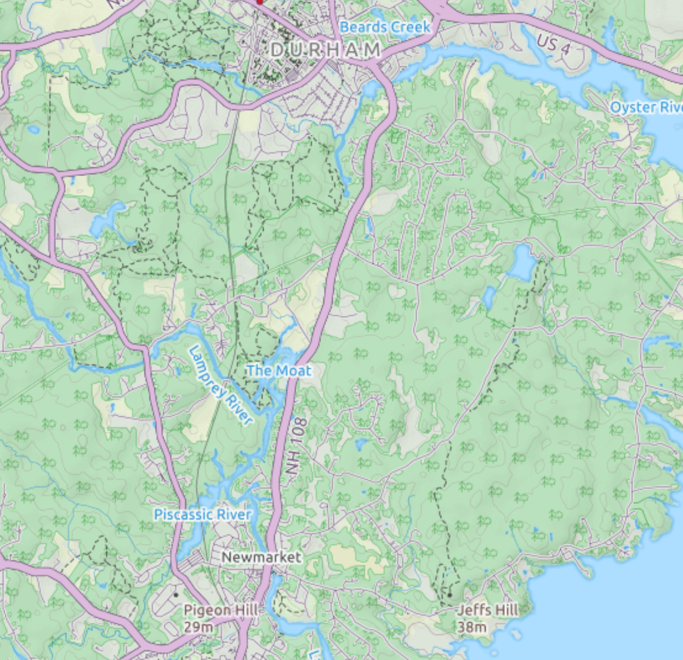
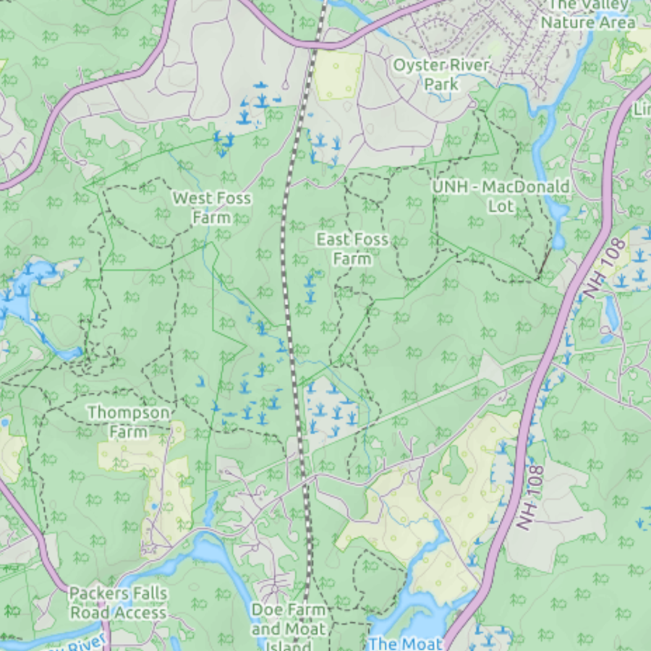
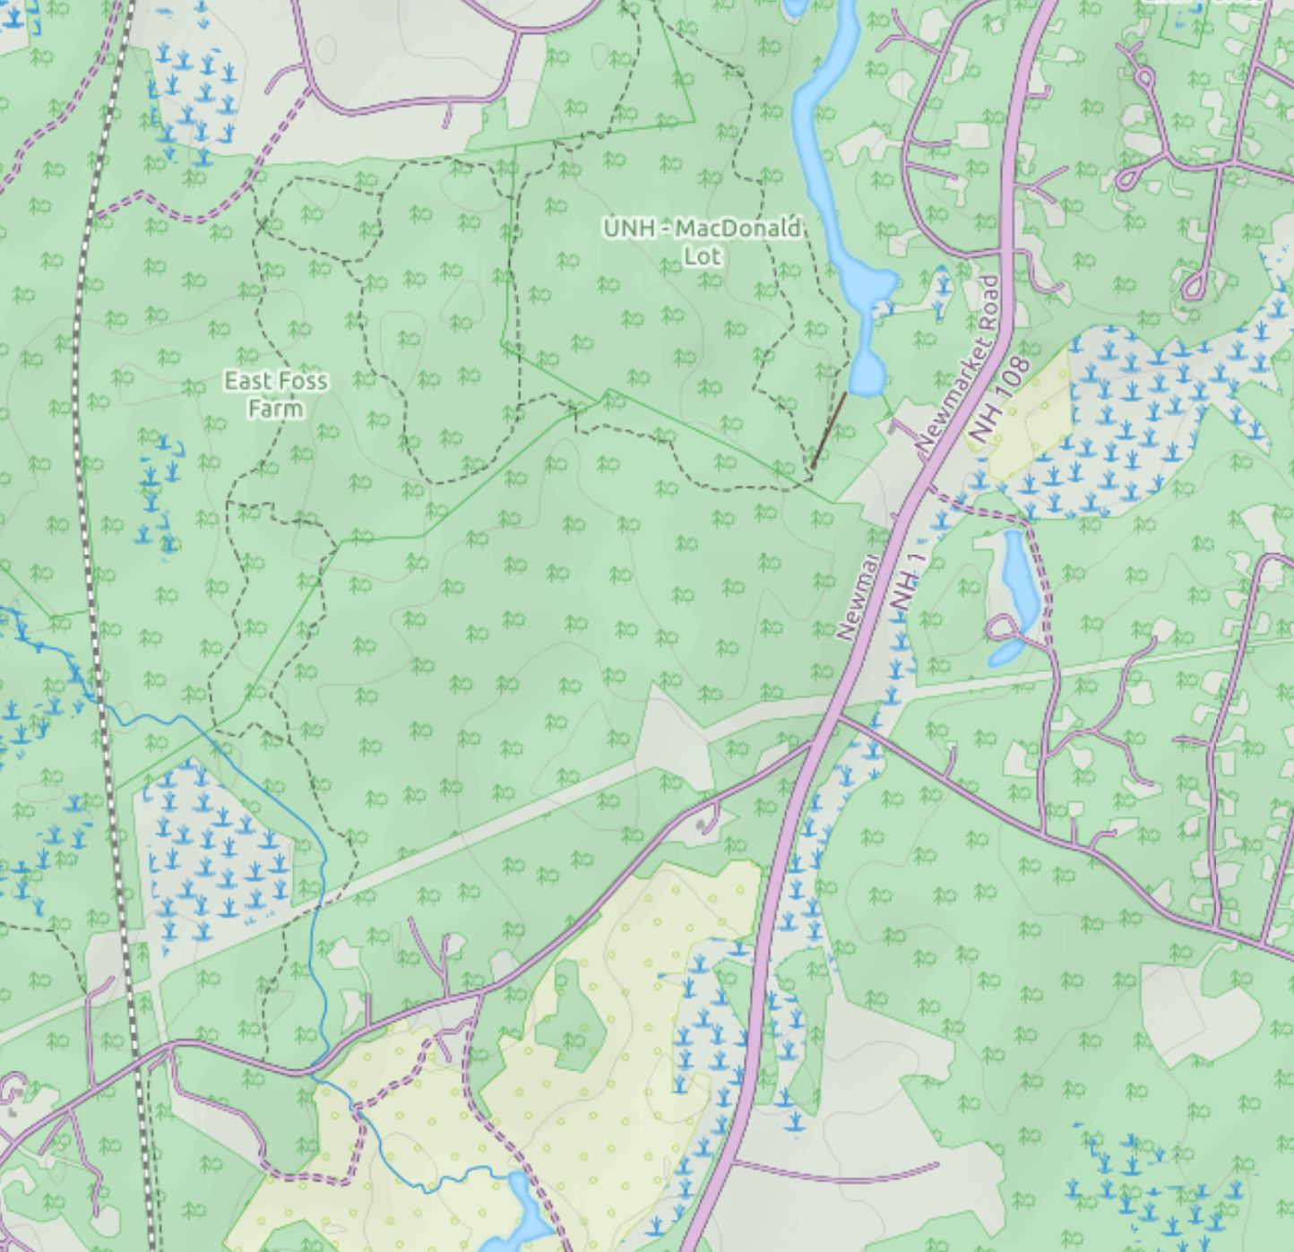
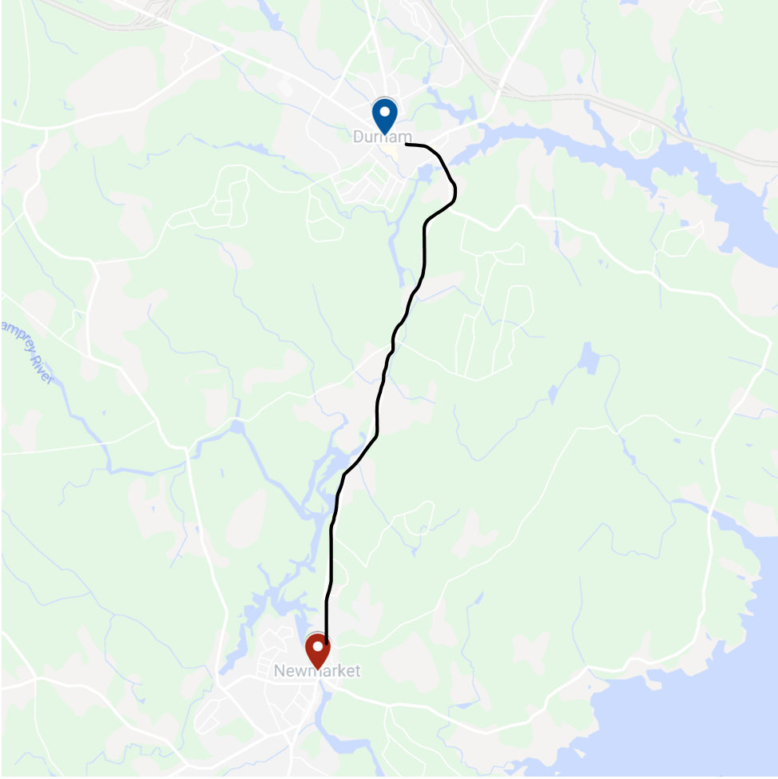
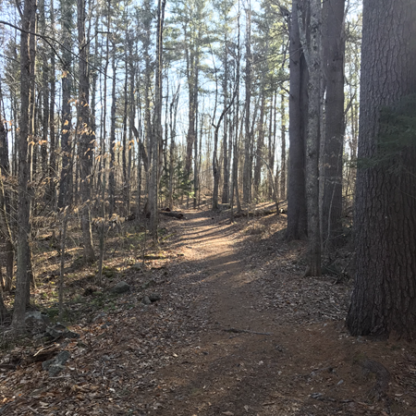
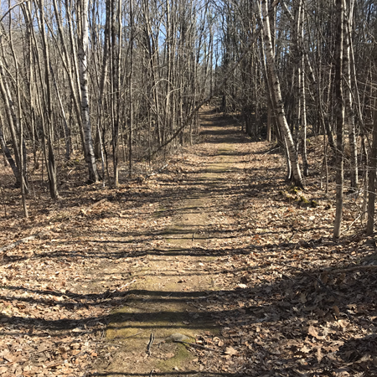
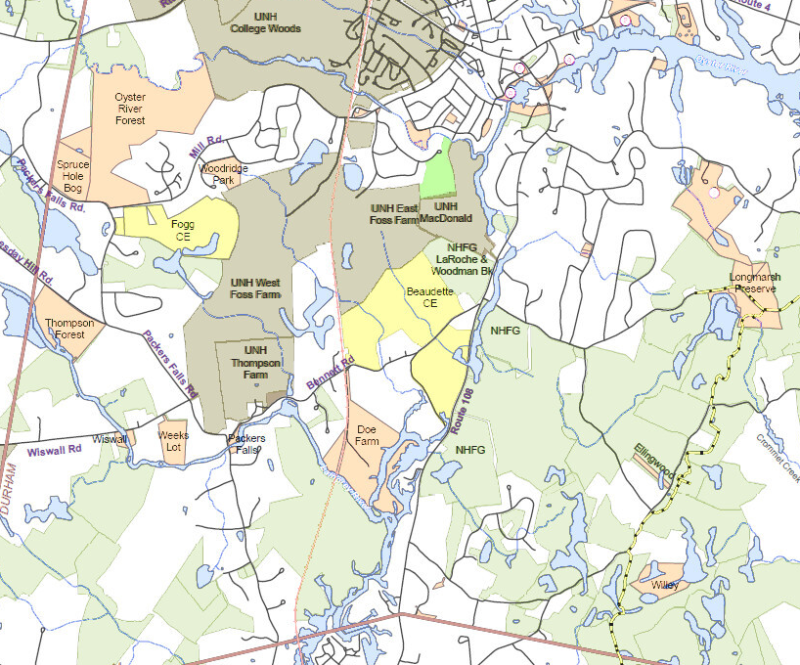
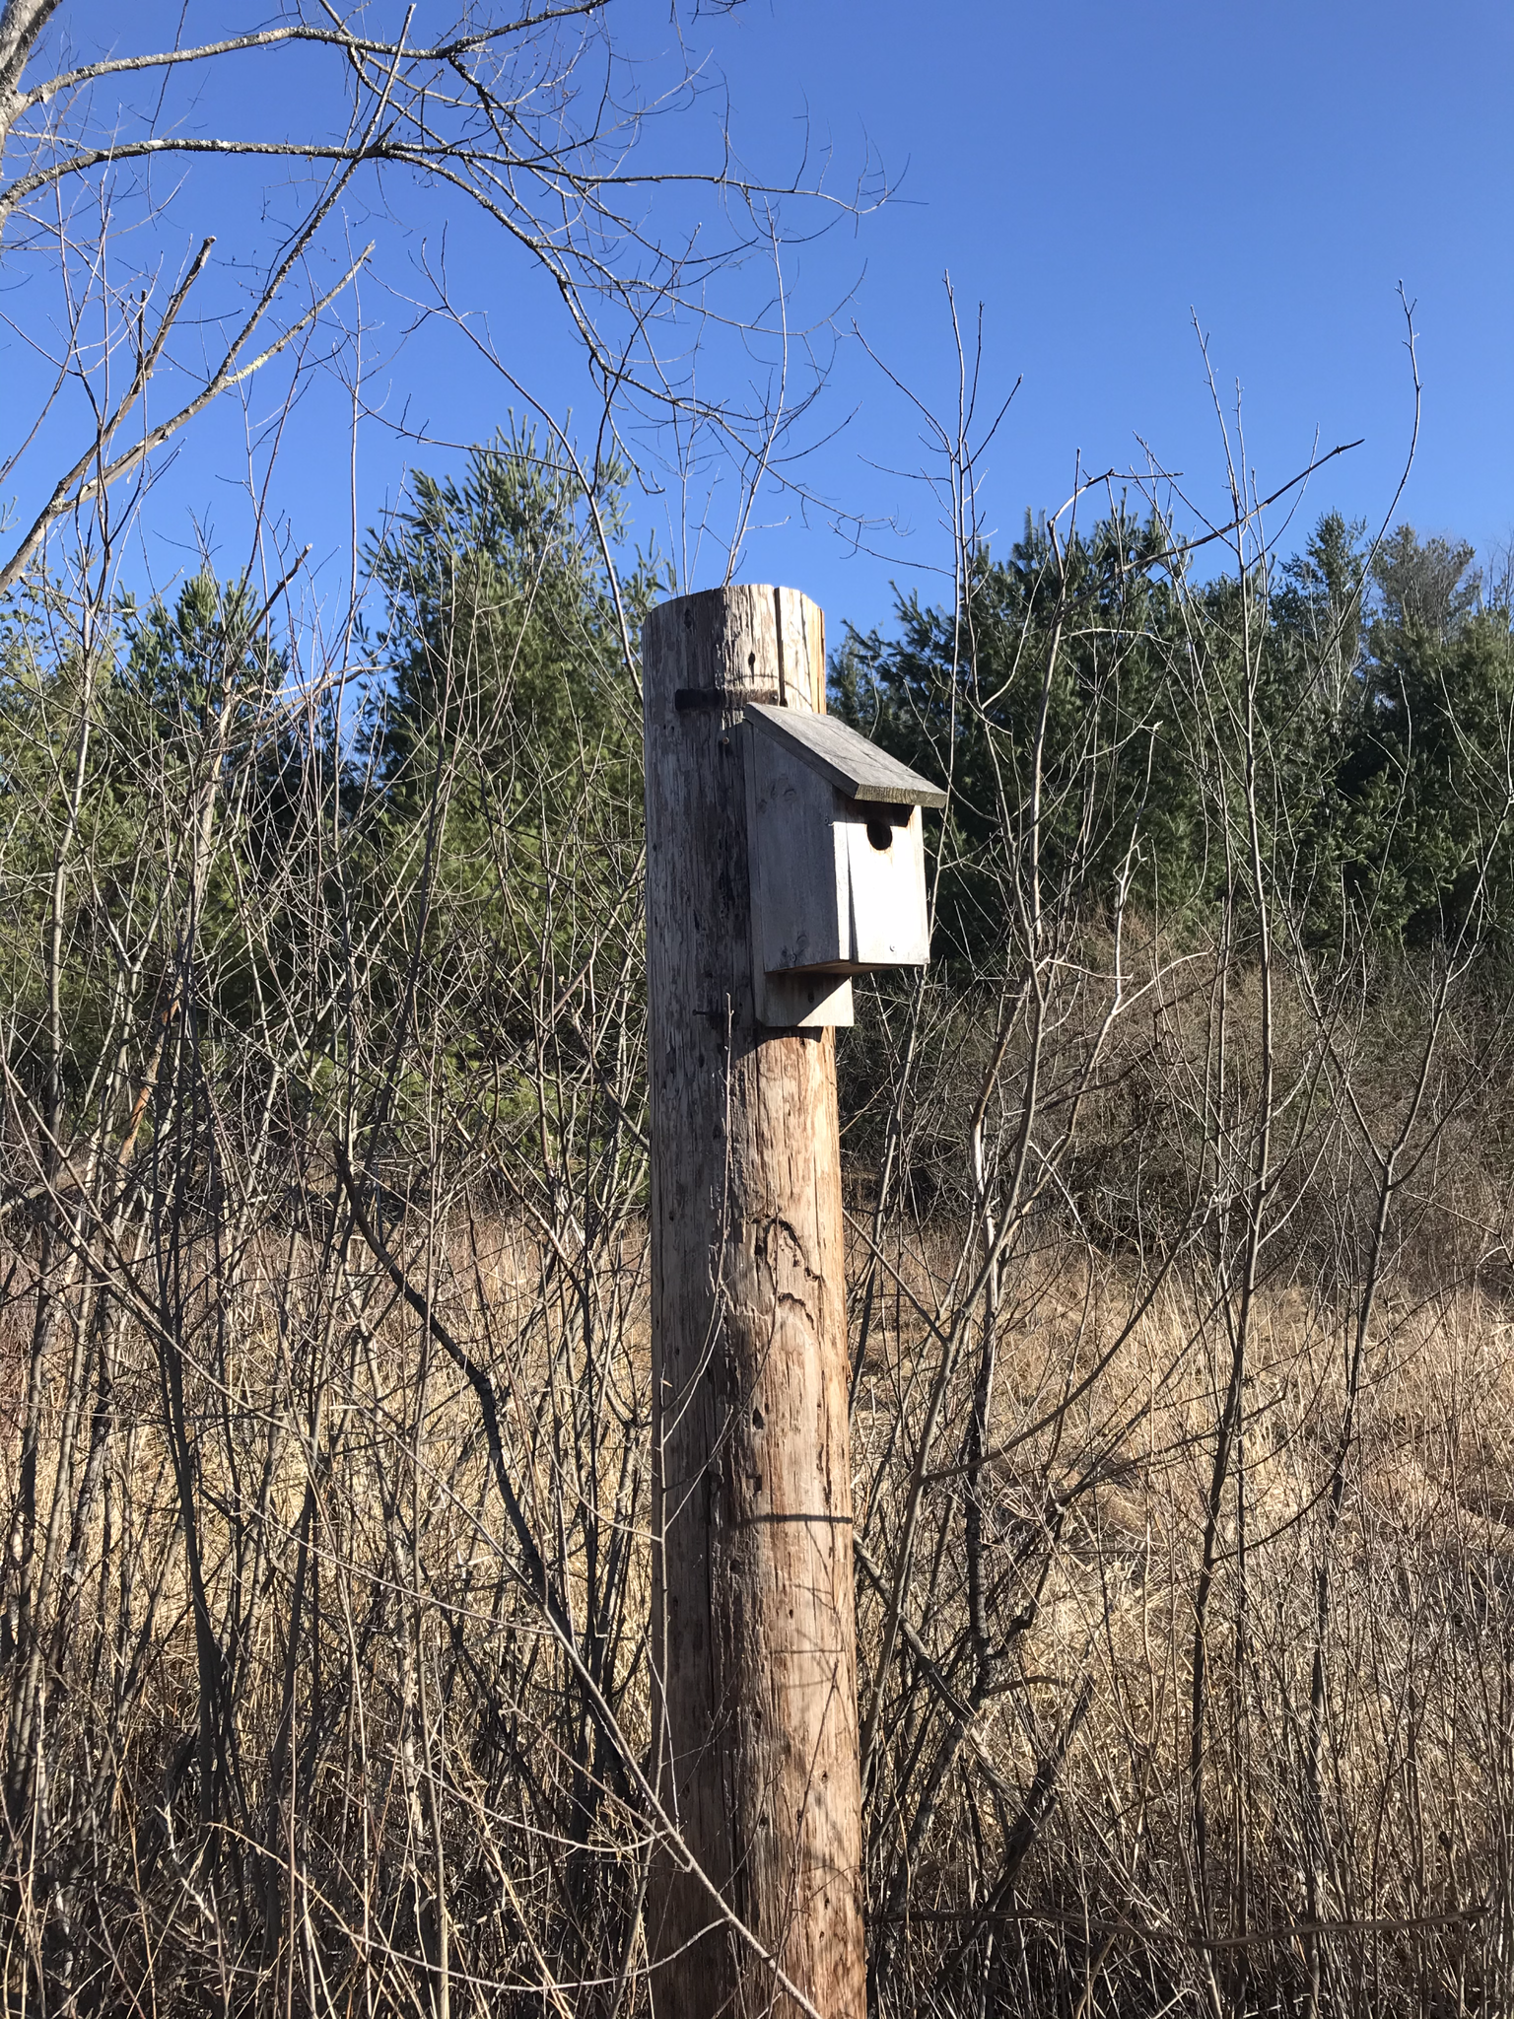
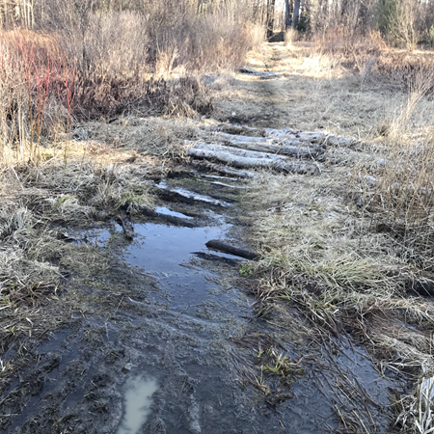
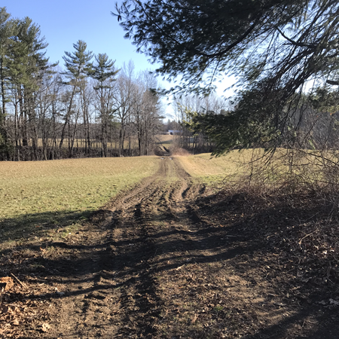
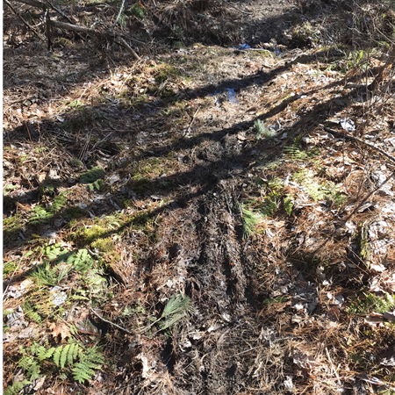
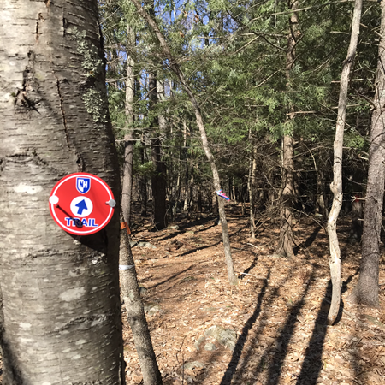
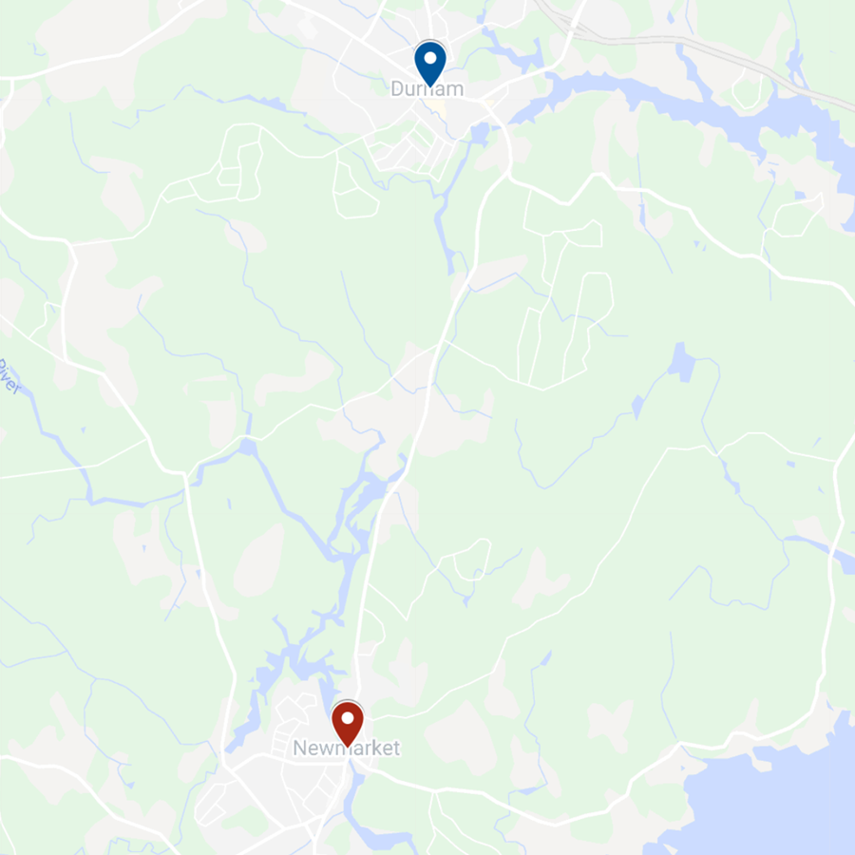
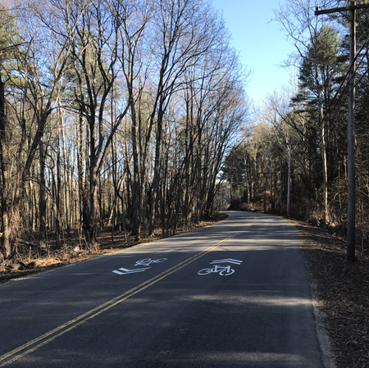
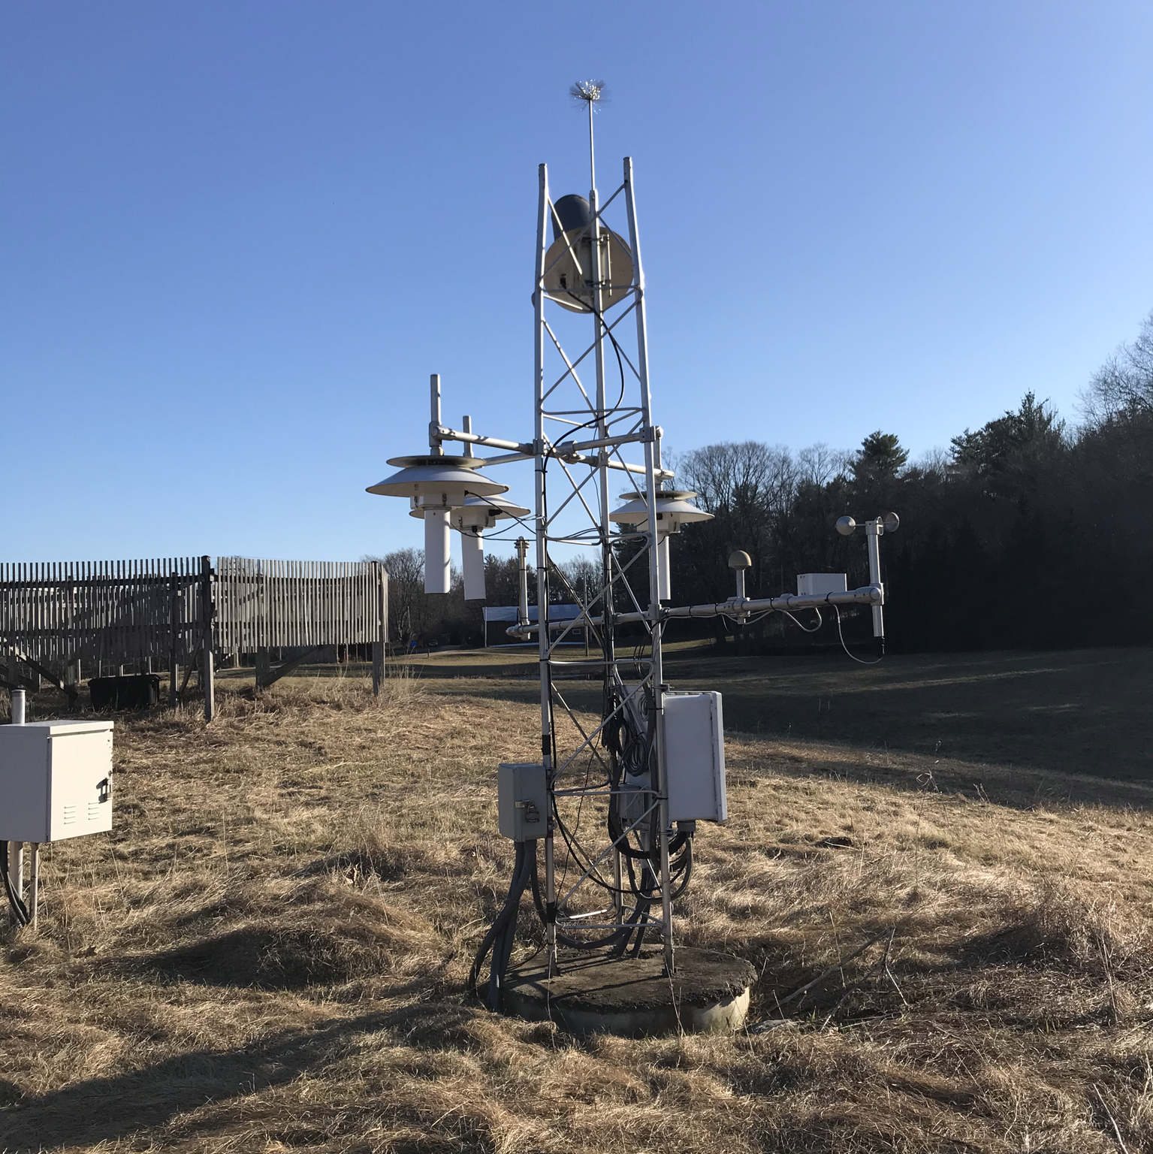
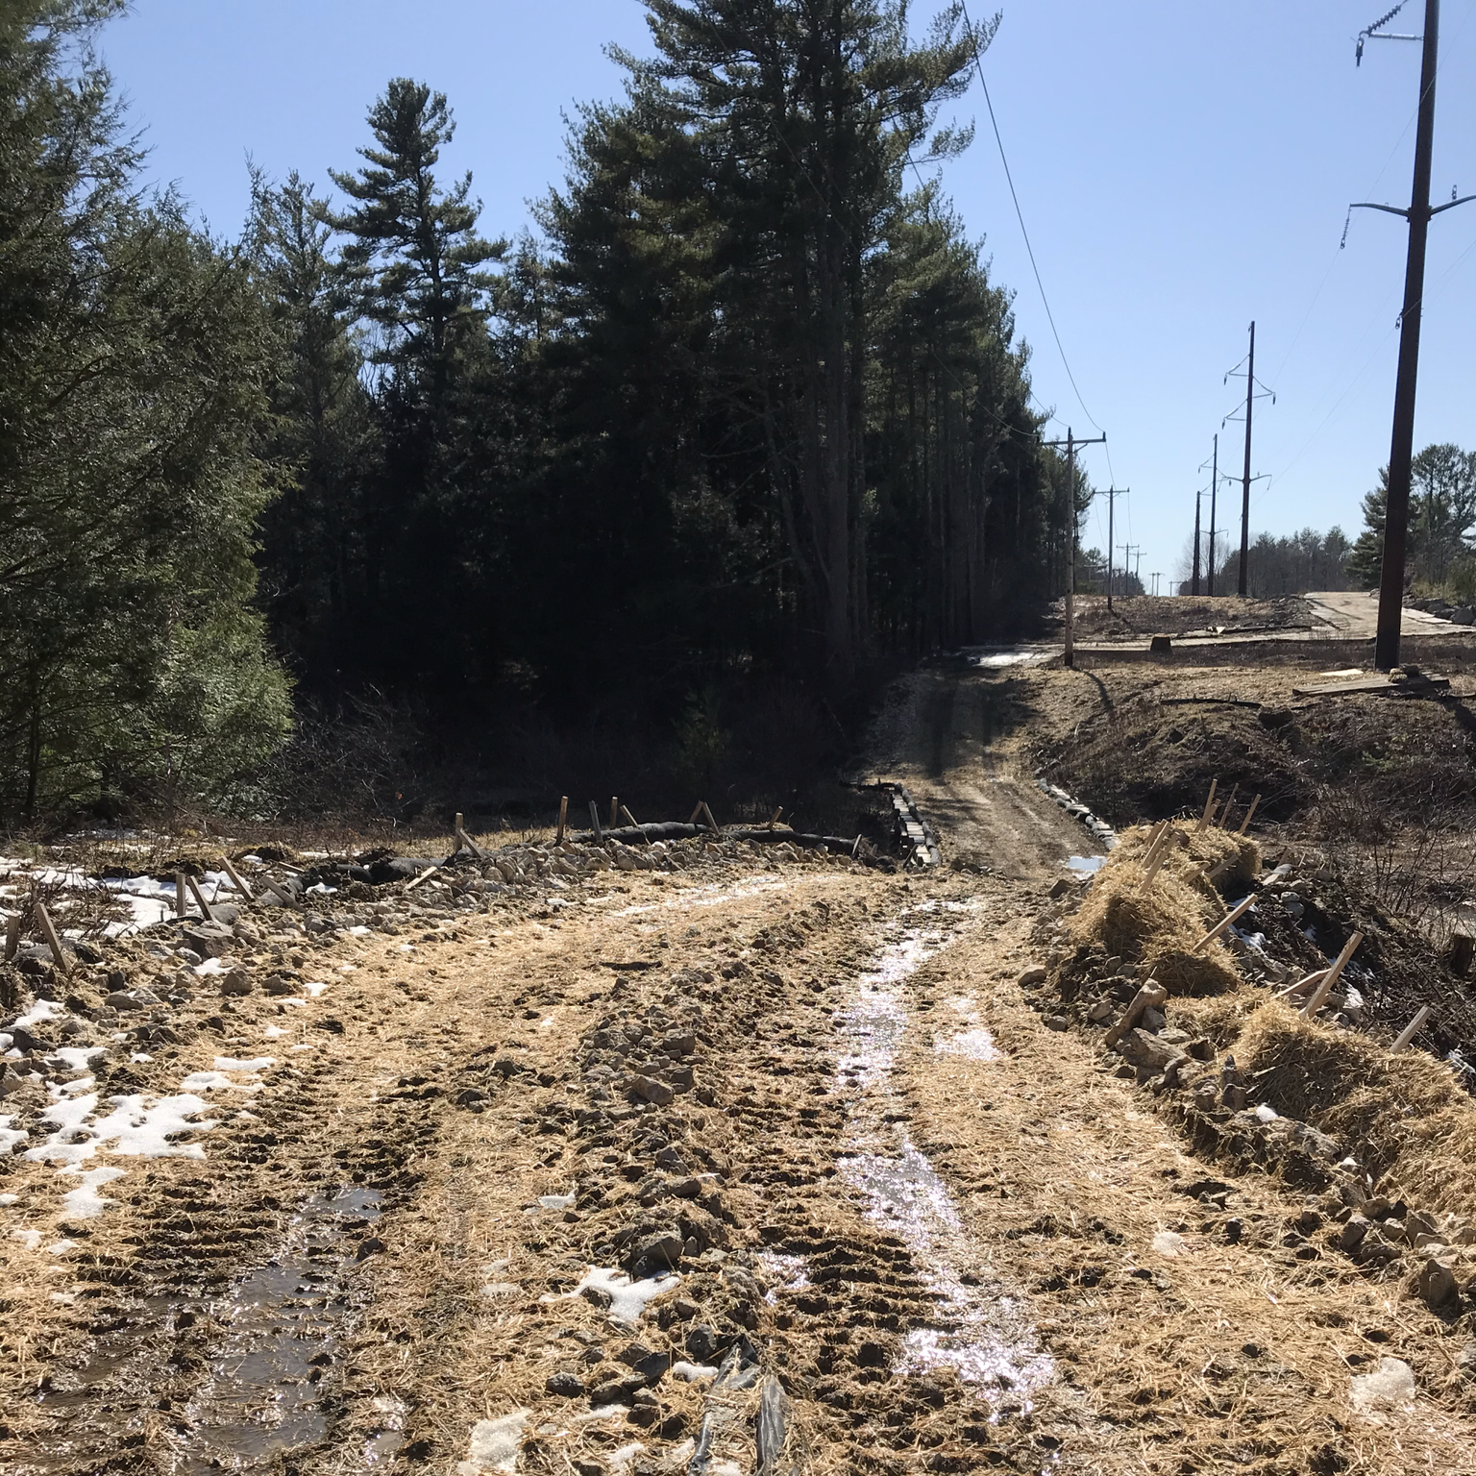
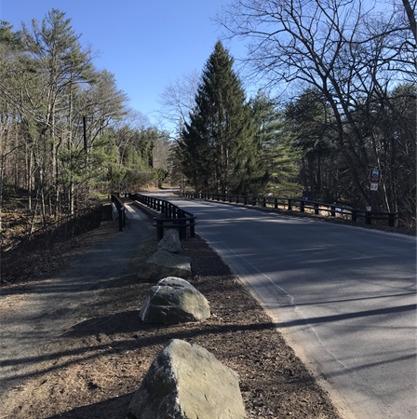
Durham-Newmarket Recreational and Commuting Trail:
A Feasibility Study
Matthew Bean • Alessandro Caruccio • Evan Shamim • Ethan Snitker
Tim Nichols, Project Sponsor • Dr. Kyle Kwiatkowski & Dr. Jo Sias, Faculty Advisors
Department of Civil and Environmental Engineering, University of New Hampshire, Durham, NH 03824
Introduction
Feasibility Analysis
Alternatives Analysis
The towns of Durham and Newmarket are two neighboring municipalities located in the Seacoast Region in the State of New Hampshire. Both communities have active downtown areas that offer abundant retail, restaurant, and tourism opportunities. Durham is the home to the University of New Hampshire (UNH), a campus of over 16,000 undergraduate students, graduate students, and faculty, many of whom reside in Newmarket. Because of this interplay between the two towns, there is a large percentage of residents who frequently commute between Durham and Newmarket.
Trail Option A – West Foss Farm/Thompson Farm
Trail Option A
Trail Option B
C
Trail Option B – East Foss Farm/Beaudette CE
P
Parking Area
Trail Option C – College Woods/Oyster River Forest
P
Bridge/Culvert
P
Trail Option D – Sweet Trail
Minor Drainage Issues
A
In consulting town officials and other stakeholders as well as conducting a preliminary site investigation, the project team selected four alternative route options for a feasibility analysis. The project team identified Trail Option A and Trail Option B as the most feasible alternative routes to NH Route 108/Newmarket Road based on this feasibility analysis. Thus, the project team conducted an advanced site investigation of the infrastructure utilized by Trail Option A and Trail Option B.
A
Moderate Drainage Issues
The towns are directly connected by a 3.80-mile state highway, NH Route 108/Newmarket Road. Despite recent reconstruction by the New Hampshire Department of Transportation (NHDOT) to improve non-vehicular access and safety, the roadway continues to be unsafe for pedestrians and bicyclists. The residents of both communities have expressed a desire to improve the transportation infrastructure to facilitate connectivity between the towns and offer an alternative route to NH Route 108/ Newmarket Road for commuting and recreational activity.
D
Severe Drainage Issues
Durham, NH
B
B
NH Route 108/
Newmarket Road
P
Newmarket, NH
Trail network distance: 2.08 miles
Roadway distance: 2.40 miles
Total distance: 4.48 miles
No trail markings
Trail path is wide, well-maintained, and easily navigable despite no trail markings
Moderate drainage issues throughout; some severe drainage issues
Trail network distance: 1.67 miles
Roadway distance: 2.80 miles
Total distance: 4.47 miles
Trail markings
Majority of trail path is relatively narrow and only partially maintained, but easily navigable with trail markings
0.3 miles of trail is very narrow, poorly maintained, and not easily navigable
Minor drainage issues throughout; some areas of moderate drainage issues
The objective of the project was to identify the most feasible alternative to NH Route 108/Newmarket Road that provides a safe, scenic, and reliable route for pedestrians, bicyclists, and other recreational activity.
Trail Option A
Advantages
Utilizes land owned by UNH
Moderately comparably direct
Disadvantages
Requires trail on roadways
Trail Option B
Advantages
Utilizes land owned by UNH/Durham
Moderately comparably direct
Disadvantages
Requires travel on roadways
Trail Option C
Advantages
Utilizes land owned by UNH/Durham
Disadvantages
Requires travel on roadways
Not comparably direct
Trail Option D
Advantages
Utilizes trail infrastructure of Sweet Trail
Disadvantages
Utilizes NHFG conservation land
Requires travel on NH Route 108
Not comparably direct
Methodology
The project team identified Trail Option A as the most feasible alternative route for the following reasons:
Existing Infrastructure
First, Trail Option A utilizes trail networks that are wider, better maintained, and easier to navigate than Trail Option B
Second, 0.3 miles of trail networks not accessible on Trail Option B – no guarantee of accessibility upon completion of Seacoast Reliability Project
Third, Trail Option A utilizes trail networks owned and managed by UNH, an institution which has reliable maintenance strategy
Durham-Owned Land
Trail Networks
Roadways
Durham-Held Conservation Easement
University of New Hampshire-Owned Land
West Foss/East Foss/Thompson Farms
Land owned by the University
Permits low-impact recreational activity (biking is not encouraged)
Used for teaching, research, and outreach; timber harvesting
Bennett Road
Rural highway
Speed limit: 35 mph
Shoulder: 0-2 feet
No sidewalks
Share-the-roadway
Packers Falls Road
Rural highway
Speed limit: 30-35 mph
Shoulder: 0-3 feet
0.7 miles of sidewalks
Share-the-roadway
NH Fish & Game-Held Conservation Land
The following are potential obstacles to the development of Trail Option A:
Oyster River Cooperative School District Parcel
Thompson Farm is active farmland; the Thompson Family, who owns a house on the property, has expressed opposition to increasing recreational and commuting activity
West Foss Farm and Thompson Farm are used extensively for teaching and research; increased traffic could disrupt ecological balance of area
NH Route 108/Newmarket Road
Given this objective, the project team focused on identifying alternative routes that were comparably direct utilizing land contiguous with or adjacent to NH Route 108/ Newmarket Road. To identify these alternative routes, the project team used the following methods:
Consulted town officials and other stakeholders to determine site constraints
Conducted preliminary/advanced site investigation to inventory existing conditions of trail network and roadway infrastructure and select route options
Analyzed feasibility of route options to determine most feasible alternative route
In consulting Ellen Snyder, Land Stewardship Coordinator for the Town of Durham, the project team was advised to identify route options that utilized land owned/held by UNH or Durham. Conversely, Ms. Snyder advised against utilizing New Hampshire Fish & Game Department (NHFG)-held properties, as the department is strict about increasing recreational and commuting activity on conservation land.
Recommendations
Beaudette Conservation Easement
Land held by the Town of Durham
Permits low-impact recreational activity (biking is not encouraged)
0.3 miles of trails not accessible due to Seacoast Reliability Project
Durham, NH
Bennett Road
Investigate measures to control surface runoff to mitigate drainage issues; implement Best Management Practices (BMPs) – NH Trail Construction and Maintenance Manual (2017)
Reevaluate maintenance strategy to accommodate increased recreational and commuting activity – Consult UNH Cooperative Extension
Analyze local and regional trail networks that are ADA-compliant and/or attentive to special accommodations – ADA Accessibility Guidelines (2010)
Expand the share-the-roadway program to improve pedestrian and bicycle safety – AASHTO Roadside Design Guide, 4th Edition (2011)
Renovate existing roadway shoulders with polymer-based additive to improve durability for increased traffic – Consult Town of Durham Public Works Department
Packers Falls Road
Newmarket, NH
Acknowledgements: (1) Benjamin Clark, Wunderlich-Malec Engineering/AECm (2) Steve Eisenhaure, UNH College of Life Sciences and Agriculture (3) Michael Lynch, Town of Durham (4) Tim Nichols, Wunderlich-Malec Engineering (5) Christopher Parker, City of Dover (6) Ellen Snyder, Town of Durham
References: (1) “Facts & Figures.” University of New Hampshire, 26 Nov. 2019, www.unh.edu/main/facts-figures (2) “Durham, NH.” Durham NH - Community Profile | Economic & Labor Market Information Bureau | NH Employment Security, www.nhes.nh.gov/elmi/products/cp/profiles-htm/durham.htm. (3) “Town Statistics.” Newmarket NH, www.newmarketnh.gov/about/pages/town-statistics. (4) “Newmarket Master Plan.” Newmarket NH, www.newmarketnh.gov/planning-board/pages/newmarket-master-plan. (5) “Future Land Use Community Forum.” Future Land Use Community Forum | The Town of Durham New Hampshire, www.ci.durham.nh.us/planningandzoning/future-land-use-community-forum-saturday-may-13-holloway-commons-unh-830-am-300-pm. (6) “Managed Properties.” College of Life Sciences and Agriculture, 24 Mar. 2020, colsa.unh.edu/woodlands/managed-properties
Contact Information: Matthew Bean, mjb1078@wildcats.unh.edu; Alessandro Caruccio, agc1023@wildcats.unh.edu; Evan Shamim; ers1024@wildcats.unh.edu; Ethan Snitker, eds2001@wildcats.unh.edu

