Slide 1


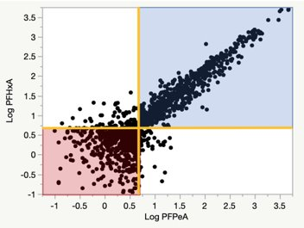
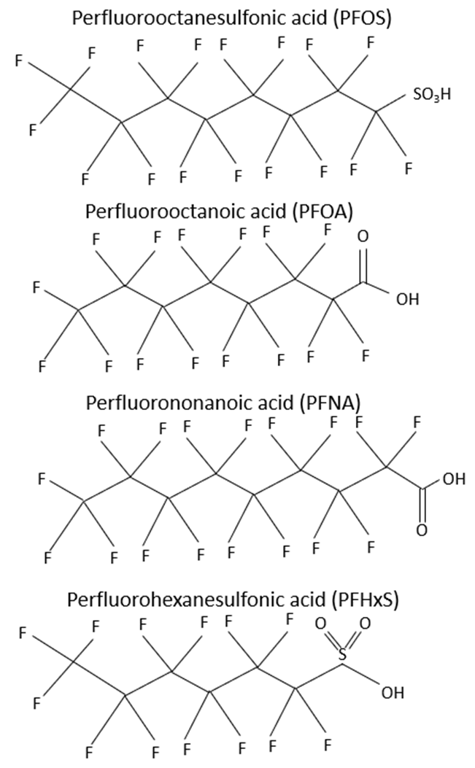
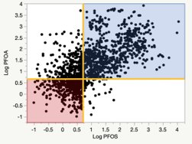
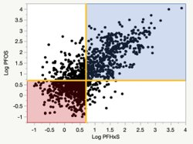
Meta-Analysis of PFAS in New Hampshire Groundwater
Cassidy Yates (PM), Emma Thibodeau, Eli Sorensen
Faculty Advisor: Dr. Jim Malley Project Sponsor: Harrison Roakes
Environmental Engineering Capstone
Introduction
Results
  Per- and polyfluoroalkyl substances (PFAS) are a group of man-made chemicals with thousands of types used worldwide. These compounds have been found in aqueous film firefighting foam, water resistant fabrics, food
  packaging, nonstick cookware, and many other products.
  Table 1: Percentiles in units of parts per trillion (ppt) and percent detections for nine PFAS analytes. Analytes with proposed regulations in NH are shown in blue.
 | PFOS | PFOA | PFNA | PFHxS | PFHxA | PFBS | PFHpA | PFPeA | PFBA
Maximum Concentration | 11,000 | 8,200 | 4,700 | 7,419 | 5,170 | 2,508 | 1,940 | 4,730 | 1,200
75th Percentile Concentration | 30.36 | 63.98 | <5 | 14.78 | 29.28 | 6.54 | 18.15 | 24.55 | 16
Median Concentration | 5.47 | 13.45 | <5 | <5 | 6.60 | <5 | <5 | 5.58 | 6.17
Minimum Concentration | <5 | <5 | <5 | <5 | <5 | <5 | <5 | <5 | <5
Percent detections > 5 ppt | 52% | 66% | 21% | 39% | 54% | 32% | 48% | 53% | 56%
NH Proposed MCL and AGQS | 15 | 12 | 11 | 18 | N/A | N/A | N/A | N/A | N/A
Potential health effects include hepatic, cardiovascular, endocrine, immune, reproductive,
and developmental [1]. The New Hampshire Department of Environmental Services (NHDES) proposed regulations for PFOS, PFOA, PFNA, and PFHxS, shown in Table 1. Strong fluorine bonds, create hydrophobic and lipophobic surfactant properties and allow these compounds to be thermally and chemically stable [2]. Figure 1 shows the structures of the fluorine chains and attached acids.
  Figure 1: Four PFAS Structures
  Figure 2: Scatterplot of log transformed PFHxA vs log transformed PFPeA
Maximum Contaminant Levels (MCL), Ambient Groundwater Quality Standards (AGQS)
Figure Key:
Data below 5 ppt
True detect data
Project Scope & Objectives
One detect analyte, one analyte below 5 ppt
Conduct a meta-analysis, or analysis across multiple sites and studies, using statistical approaches to find correlations within the data set
Assess the variables that could cause correlations such as physical and chemical properties
  Figure 3: Scatterplot of log transformed PFOA vs log transformed PFOS
  Figure 4: Scatterplot of log transformed PFOS vs log transformed PFHxS
Methods
Discussion
References & Acknowledgements
  Reviewed literature on PFAS fate and transport, chemistry, and regulations
  Worked with NHDES to obtain data
  Tidied data into a useable form
  Numbers randomly generated for values below 5 ppt
  Applied a logarithmic transformation on data
  Interpreted findings
  Calculated summary statistics
  Visualized data with scatterplots
  Median values in Table 1 are low compared to proposed AGQS regulations, some even under the detection threshold of 5 ppt
  Maximum values are orders of magnitude higher and likely sampled from source areas
  Figure 2 is the most visually correlated, both PFHxA and PFPeA are longer chain compounds with similar fate and transport
  Figure 4 shows PFOS to be better correlated with PFHxS than with PFOA as in Figure 3
  Assessing PFAS data through meta-analyses can yield big picture observations
  [1] The Agency for Toxic Substances and Disease Registry (ATSDR). (2018). Toxicological Profile for Perfluoroalkyls. Department of Health and Human Services, Public Health Service.
  [2] Interstate Technology Regulatory Council (ITRC). (November 2017). Naming Conventions and Physical and Chemical Properties of Per- and Polyfluoroalkyl Substances (PFAS).
  Thank you to the New Hampshire Department of Environmental Services for providing data, Dr. Ernst Linder for statistical consulting, and Dr. Jim Malley and Harrison Roakes for support and guidance.

