Slide 1


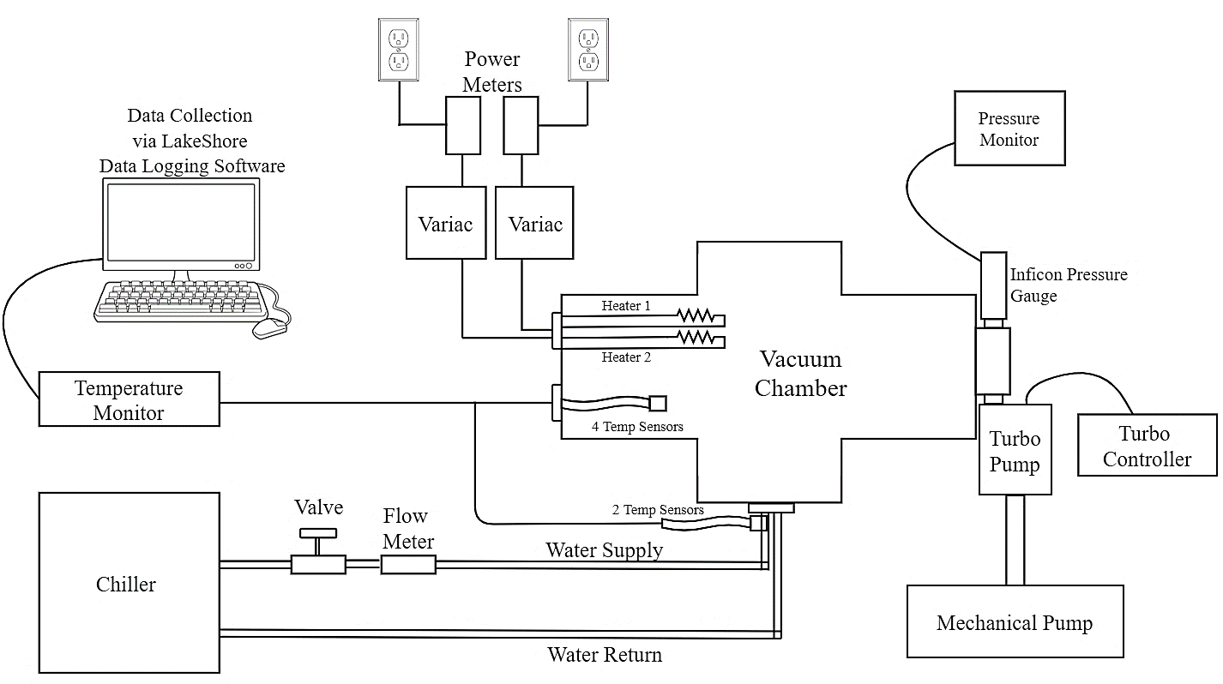
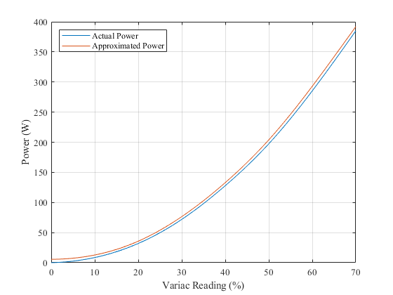
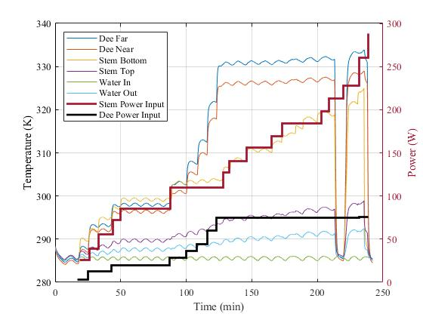
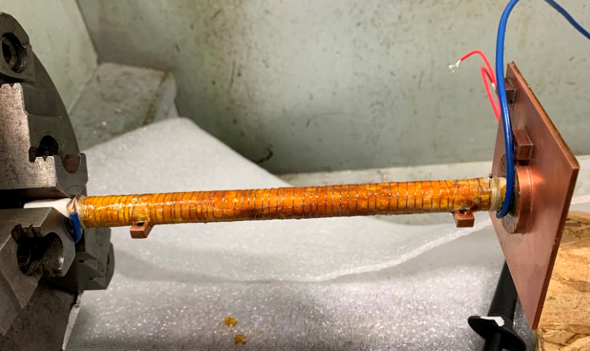
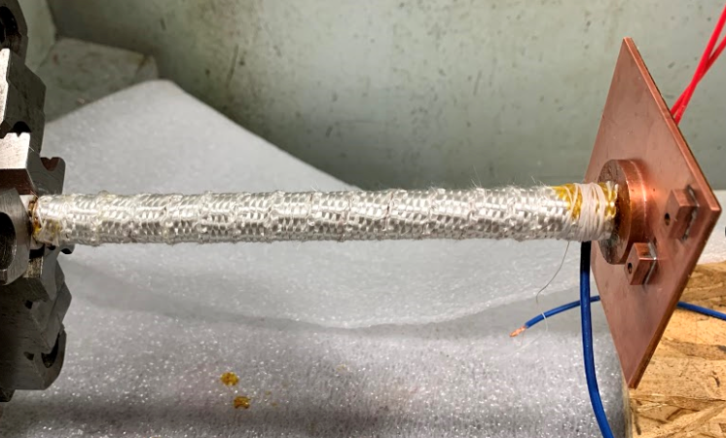
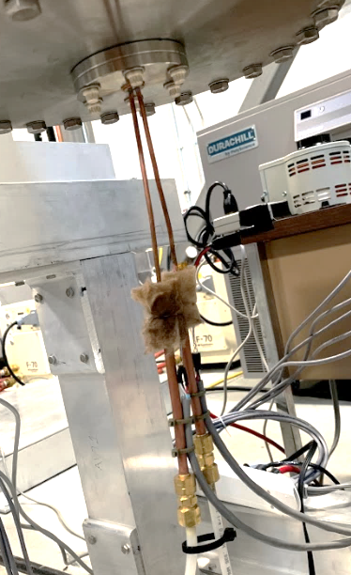
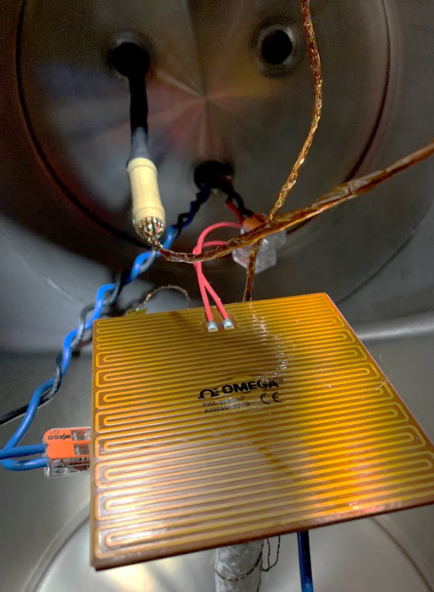
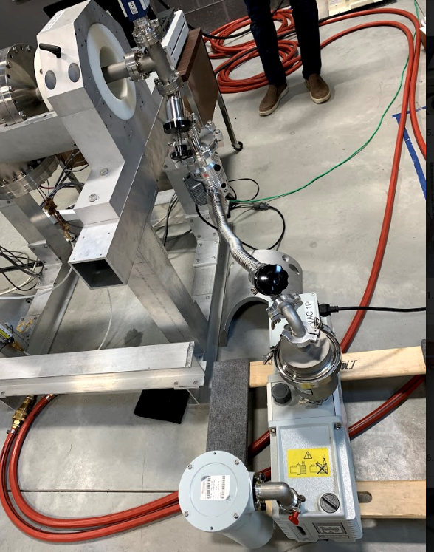
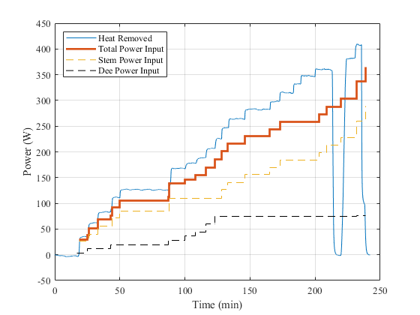
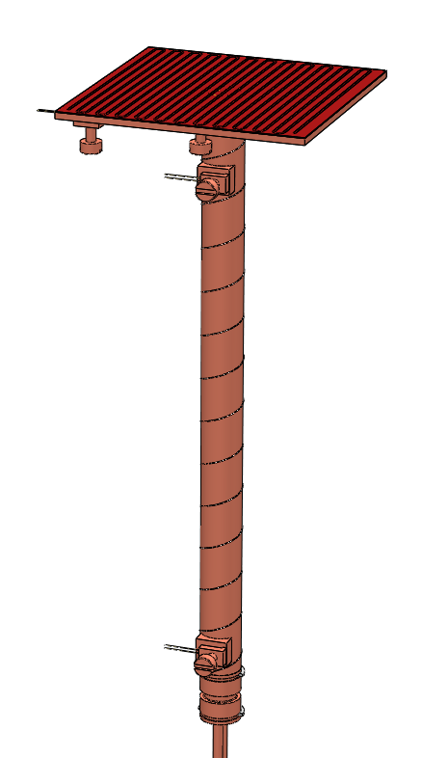
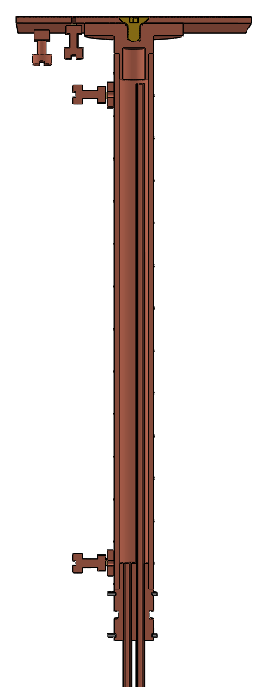
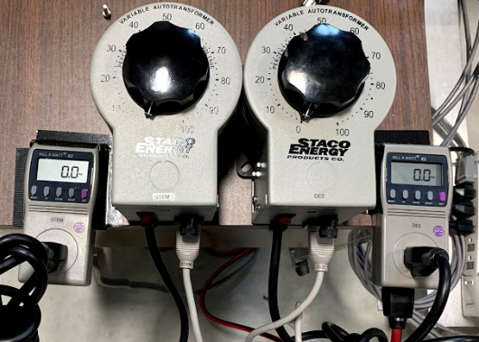
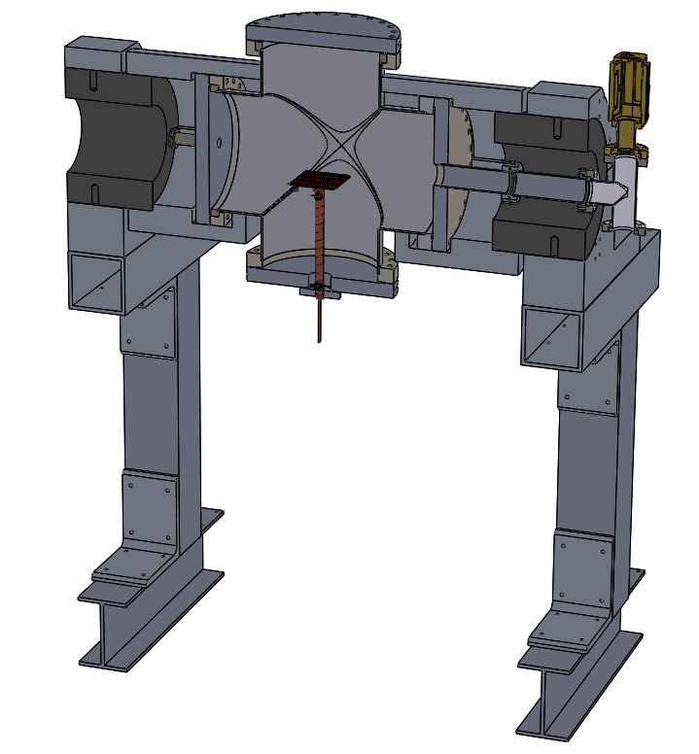
CYCLOTRON ELECTRODE COOLING TEST
Christen Gallant
Advised by Ivaylo Nedyalkov & Andre Chouinard
Mechanical Engineering
University of New Hampshire, Durham NH & Antaya Science and Technology, Hampton, NH
Background
Cyclotron – particle accelerator that produces a charged particle beam. Operates under vacuum at cryogenic temperatures (125 K→ 0 K)
Cyclotron use ranges from industrial to nuclear medicinal. Antaya specializes in the design of compact cyclotrons for on-demand radiopharmaceutical production (PET Scans).
In Antaya’s newest build, the electrode & stem assembly see combined power input of 350 W.
Proper cooling of multiple electrodes is necessary for functionality and efficiency.
Test Setup
Results
Power Correction Curve
Objective
Design a test to confirm the proposed cooling method will effectively cool the electrode & stem.
Analyze the steady state temperature distribution under maximum power conditions.
Temperature & Power vs Time
Test Assembly
Design Requirements
Material & mass properties held relatively constant with cyclotron build design.
Test fixture component geometry replicated for thermal distribution accuracy.
Power distribution consistent with projected model
Testing under vacuum pressure ≤ 5 * 10⁻⁴ bar.
Nichrome wire heater mounted to test fixture using varnish & cigarette paper (above left) and then wrapped with braided fiberglass insulation (above right).
Power Input & Heat Removal Comparison
In and out-flow cooling lines exiting the test fixture through the plug, mounted in CF flange.
2
(Left) Turbo pump backed by mechanical pump to maintain vacuum pressure.
1
3
Legend
9
View of dee plate from inside vacuum chamber with power feedthroughs.
1. Dee Plate
2. Kapton Heater
3. Foot
4. Stem
5. Nichrome Wire Heater
6. Plug
7. Cooling Lines
8. Retaining Clips
9. Temperature Sensors
5
4
Conclusions
Temperature at each sensor location was recorded and plotted with corresponding power input.
Combined power input plotted with calculated heat removal to confirm cooling.
With uncertainty from measurement devices accounted for, it was confirmed that the cooling method successfully removes all heat added into the system.
7
9
Variac on left used to control power to Kapton heater on dee plate, Variac on right used to control power to nichrome wire heater on stem.
Model of test fixture mounted in vacuum chamber.
6
8

