Slide 1
Albacore Museum
Maddie Hastie
Jacob Veronneau

Slide 2
Introductions
Team Members
Maddie Hastie
Jake Veronneau
Project Sponsor
Dr. Jean Benoît
Albacore Building Committee
Project Advisor
Dr. Jean Benoît
Winter-Holben Architects

Slide 3
Background
Location: 600 Market Street, Portsmouth, NH 03801
Placed into commission in December of 1953
Museum since 1985
Managed by the Portsmouth Submarine Memorial Association
No weapons
USN Submarine
Existing Building
Small- No room for additional exhibits
Need returning visitors

Slide 4
Past Student Projects
Upgrade of basin-UNH
Resulted in $1.2M project
Marketing plan – UNH Paul College students (2 projects)
Being implemented
Museum Interactive display-UNH Paul College students
Started last year
Fundraising plan for capital investments –UNH Paul College students
Current Paul College project

Slide 5
Objectives
Building
Meet the needs of the Albacore building committee
A larger space to exhibit history
Educational space
Attract new visitors
3D Model
Create a physical representation of future museum
Fundraise through visitors

Slide 6
Requirements of Design
Public Function rooms
Offices
Catering
Storage of artifacts
Basement
Balcony
Heavy loads
Parking lot design
Greenery around site
Display areas outside
Educational space

Slide 7
Educational Space
STEM Students
(Science Technology Engineering and Mathematics)
Workshops
Field trips
Virtual reality
Maine Maritime

Slide 8
Obstacles
Real world speed
Covid-19
Communication
Albacore Building Committee
Learning how to 3D print
Figuring the project out as it progresses
New ideas
Space constraints

Slide 9
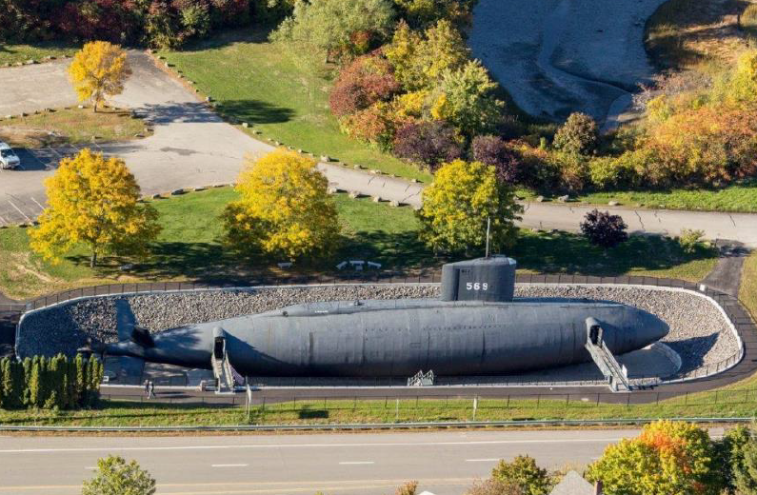
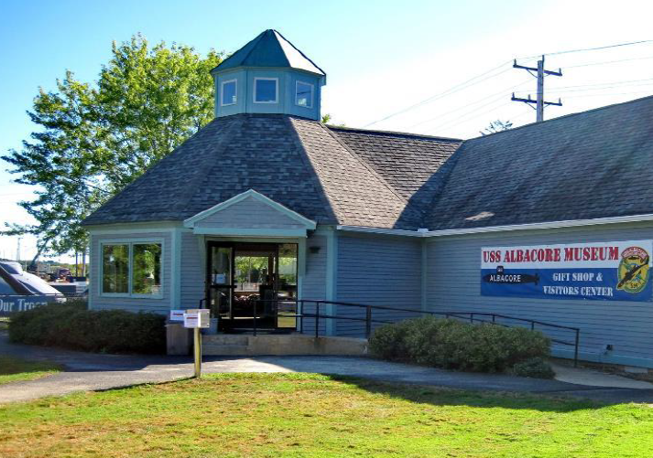
Current Status
Submarine
Museum with limited space

Slide 10
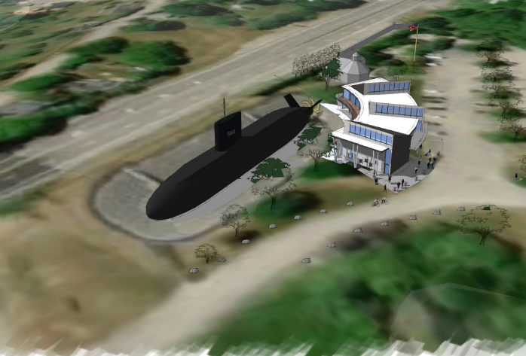
Winter-Holben Animated Models

Slide 11
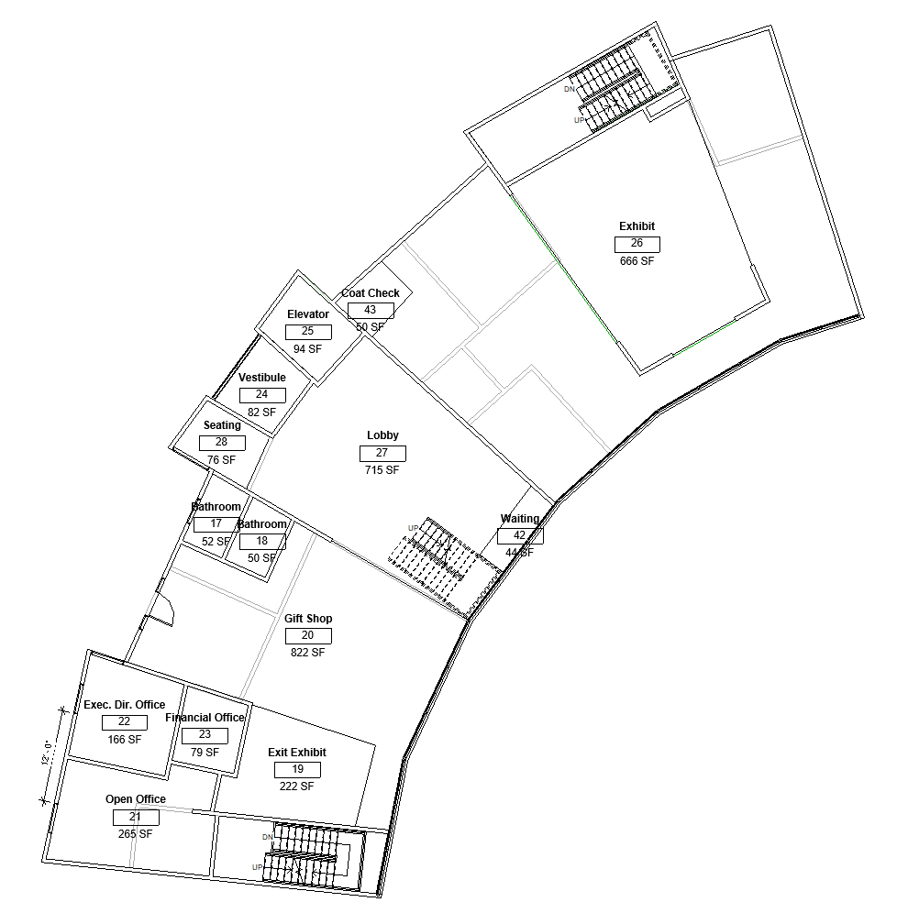
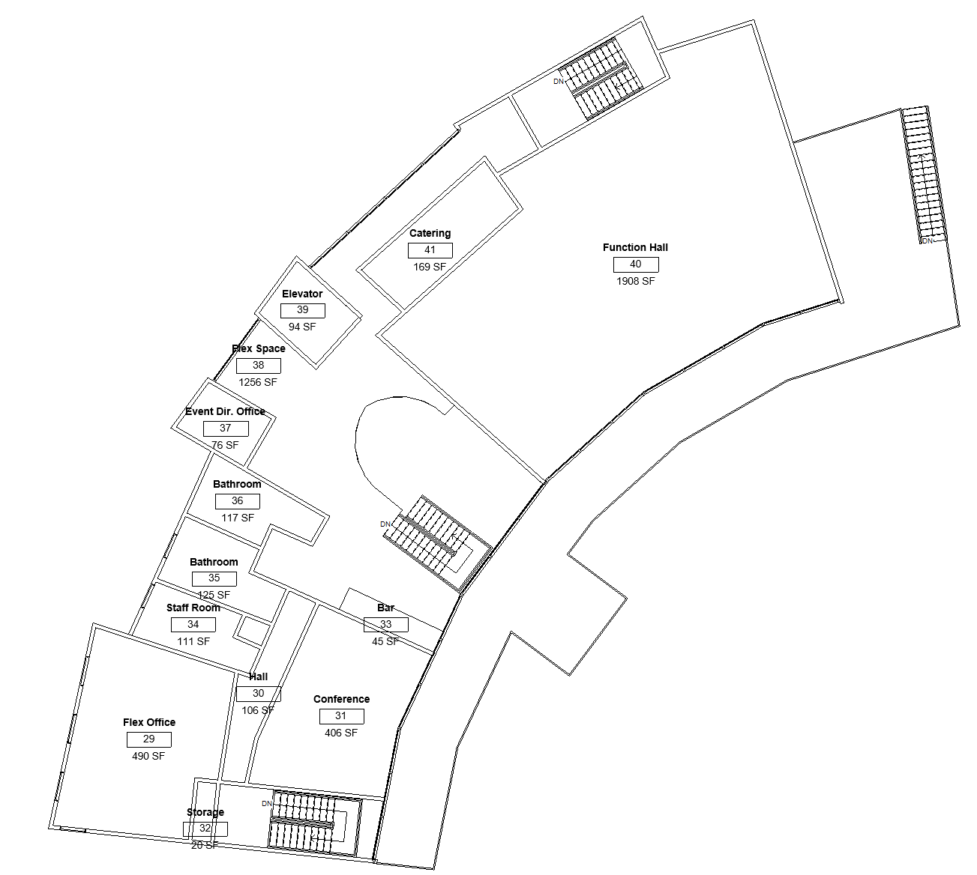
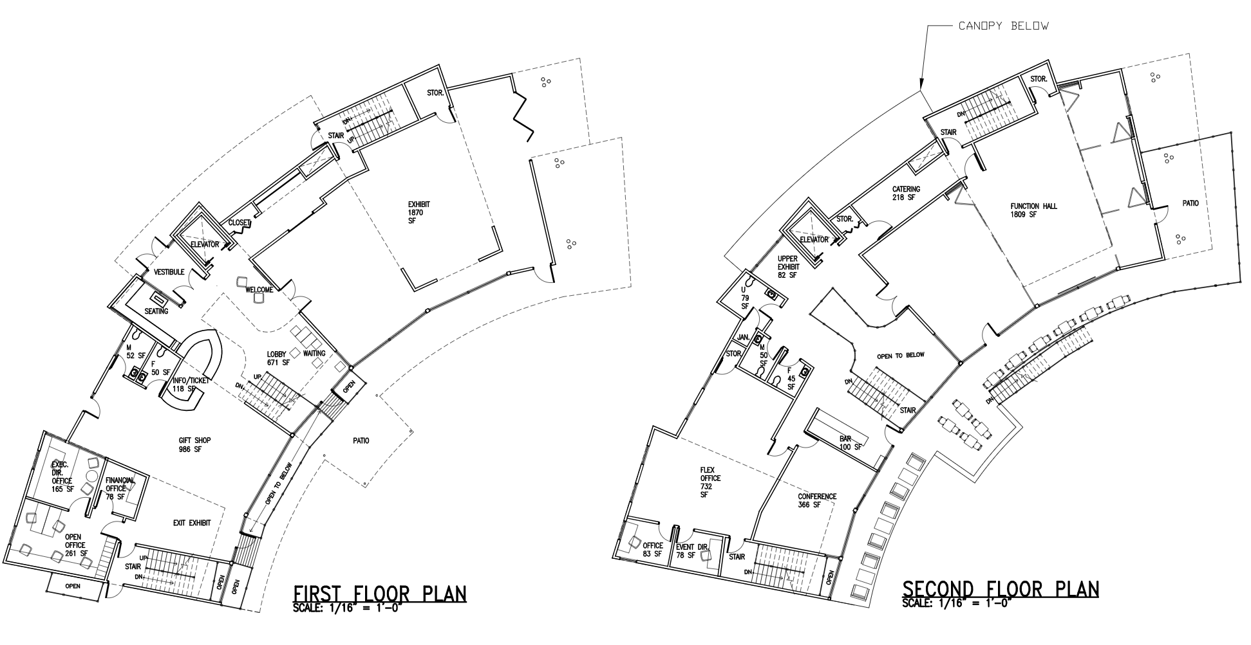
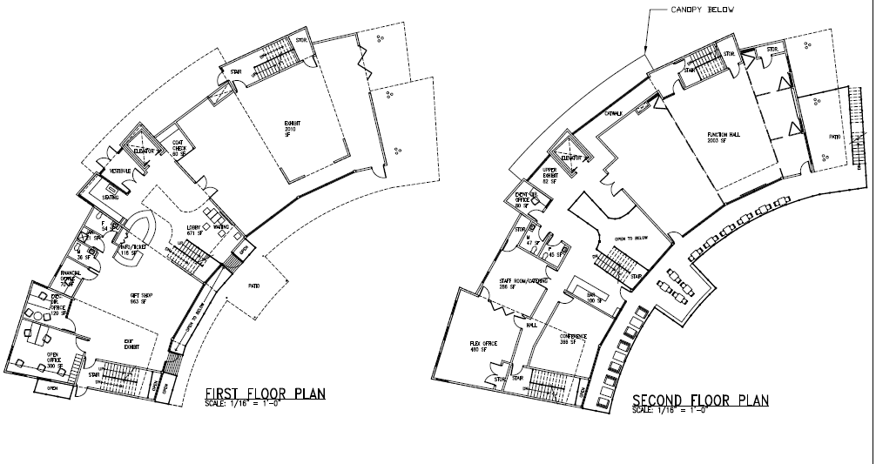
Potential First and Second Floor Plans

Slide 12
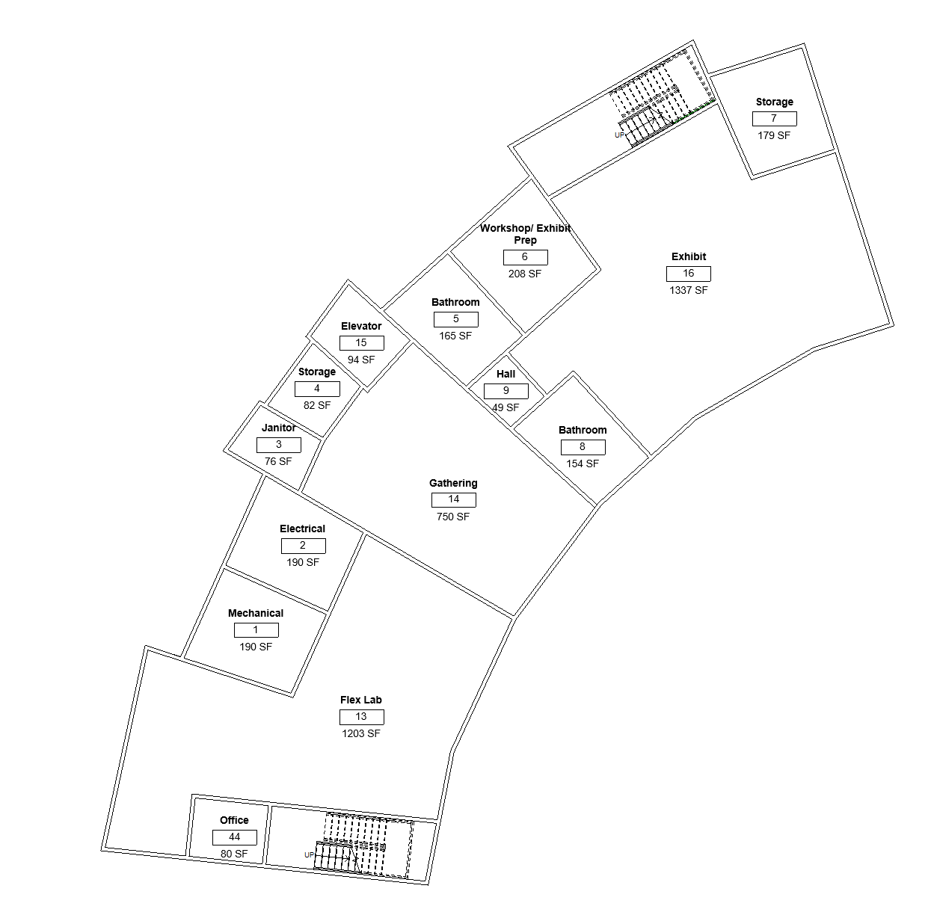
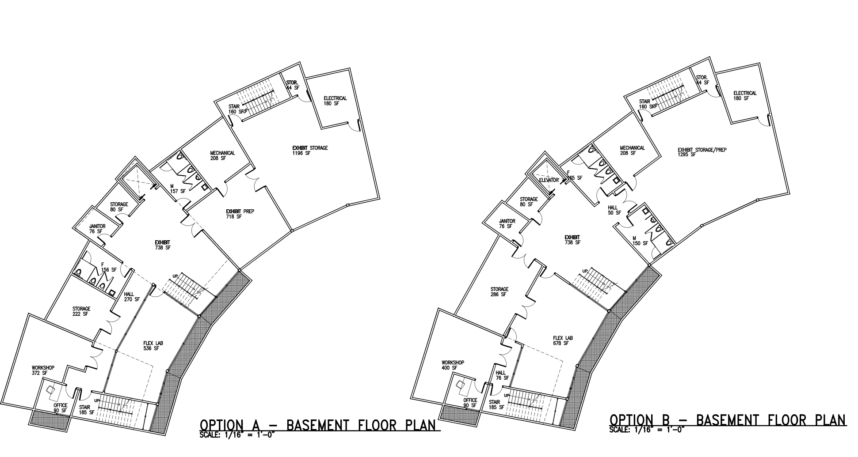
Potential Basement Floor plans

Slide 13
3d model- Revit file
Based on provided floor plans
First and second floors-option A
Basement-option B

Slide 14
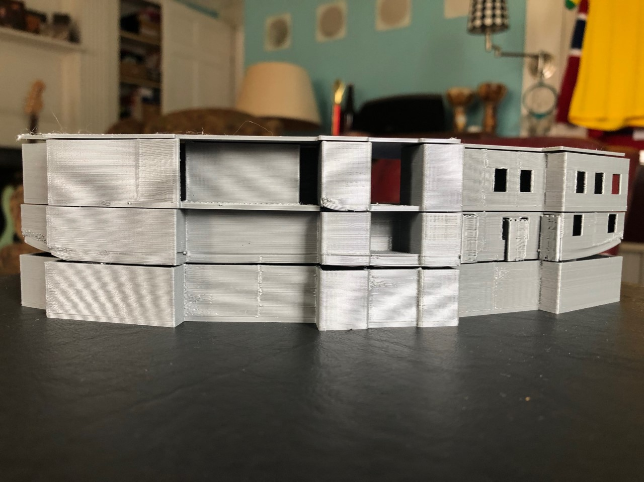
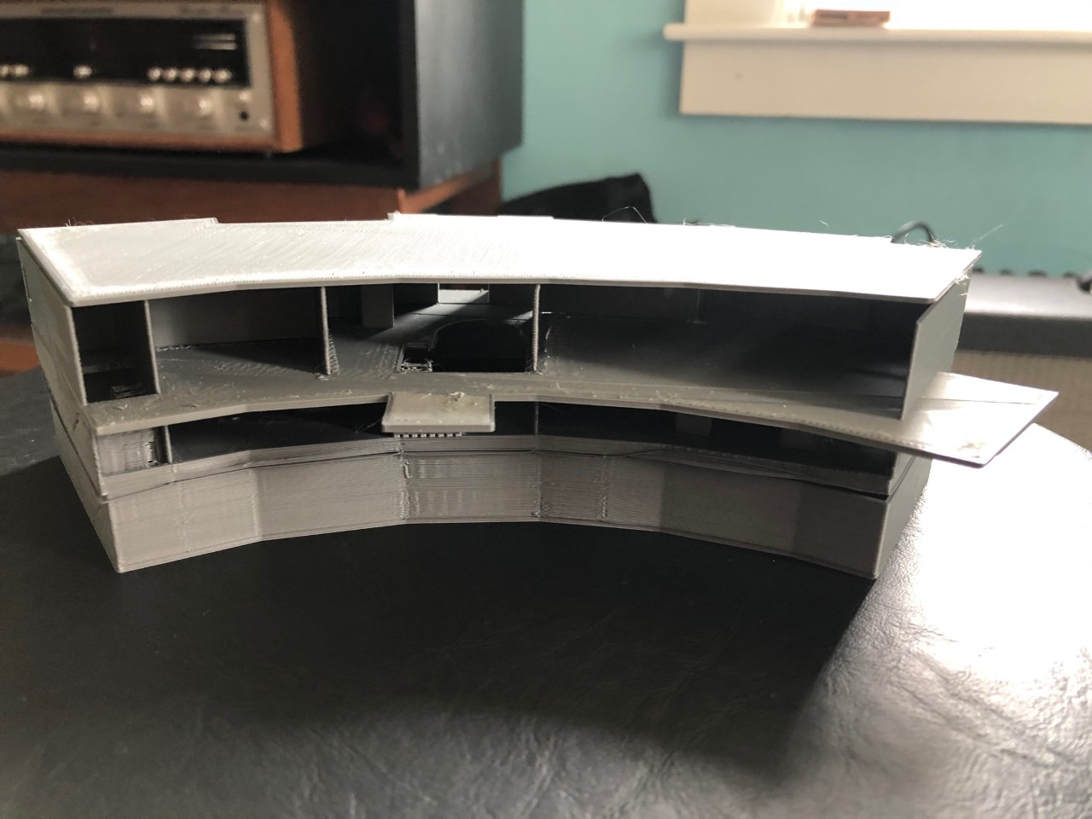
3D Printed Model
Ground Floor Print

Slide 15
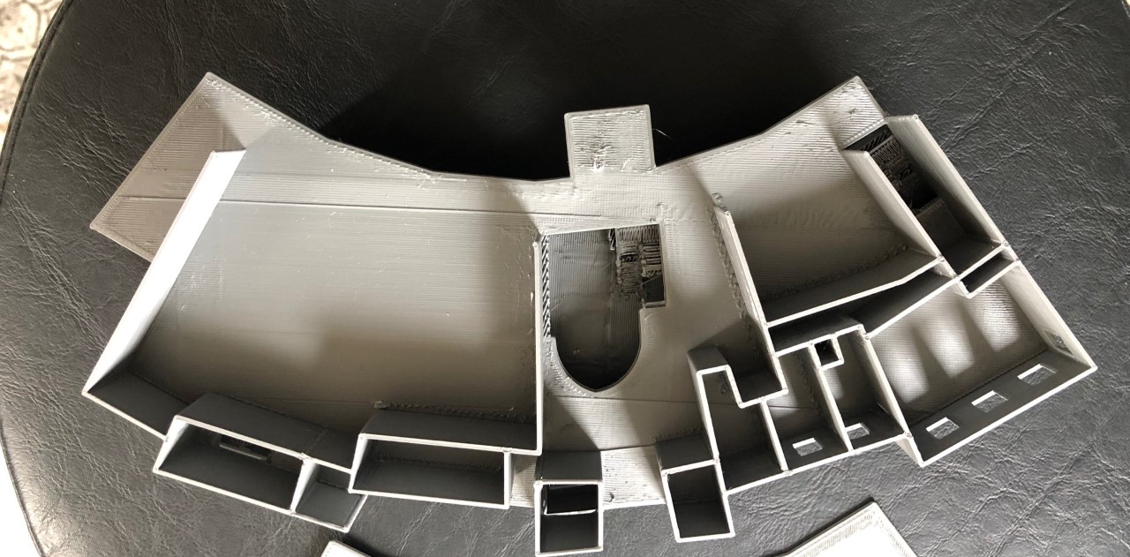
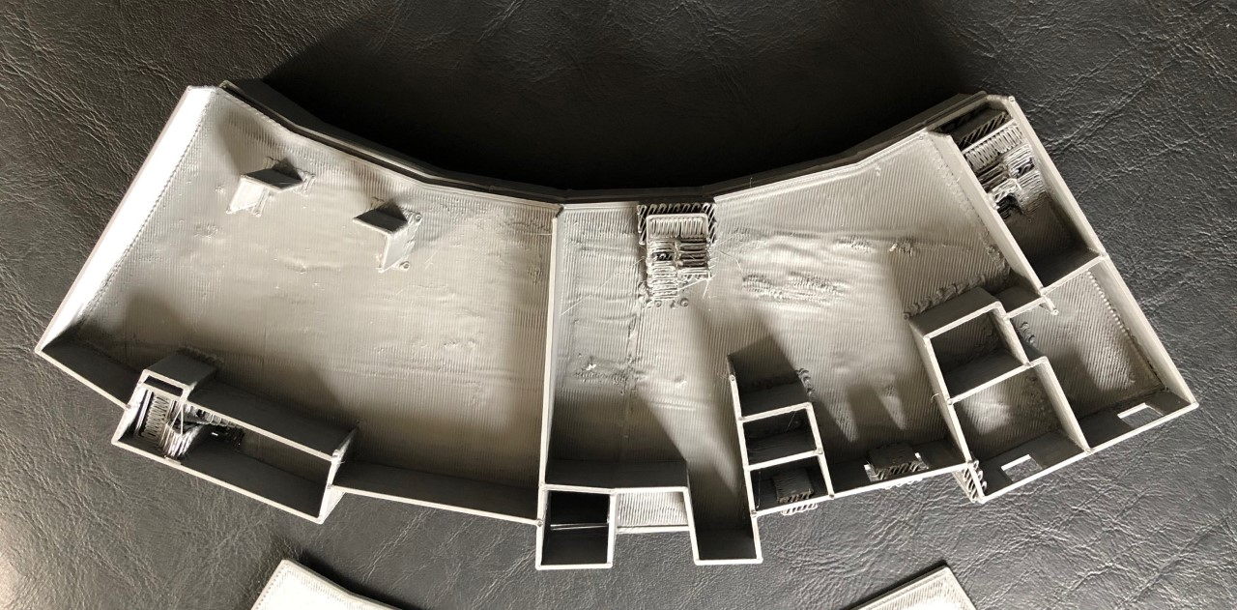
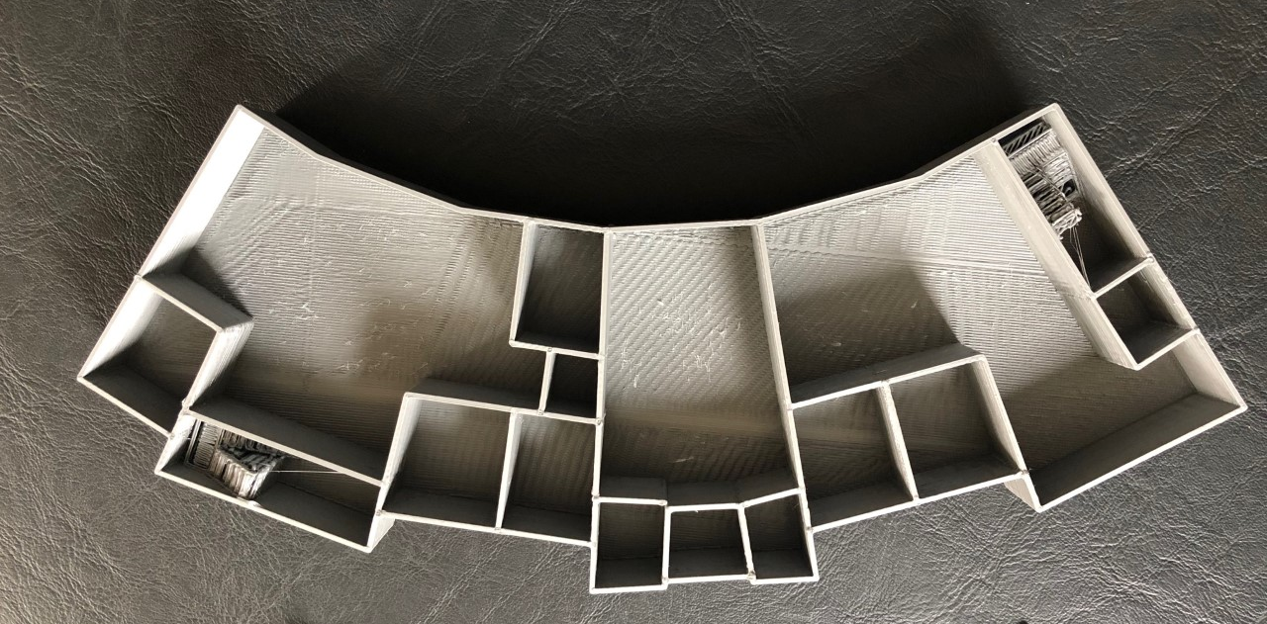
Questions?

Slide 16
Resources
http://ussalbacore.org/index.html
Architects of Winter-Holben

