Slide 1
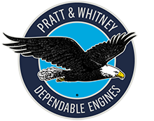

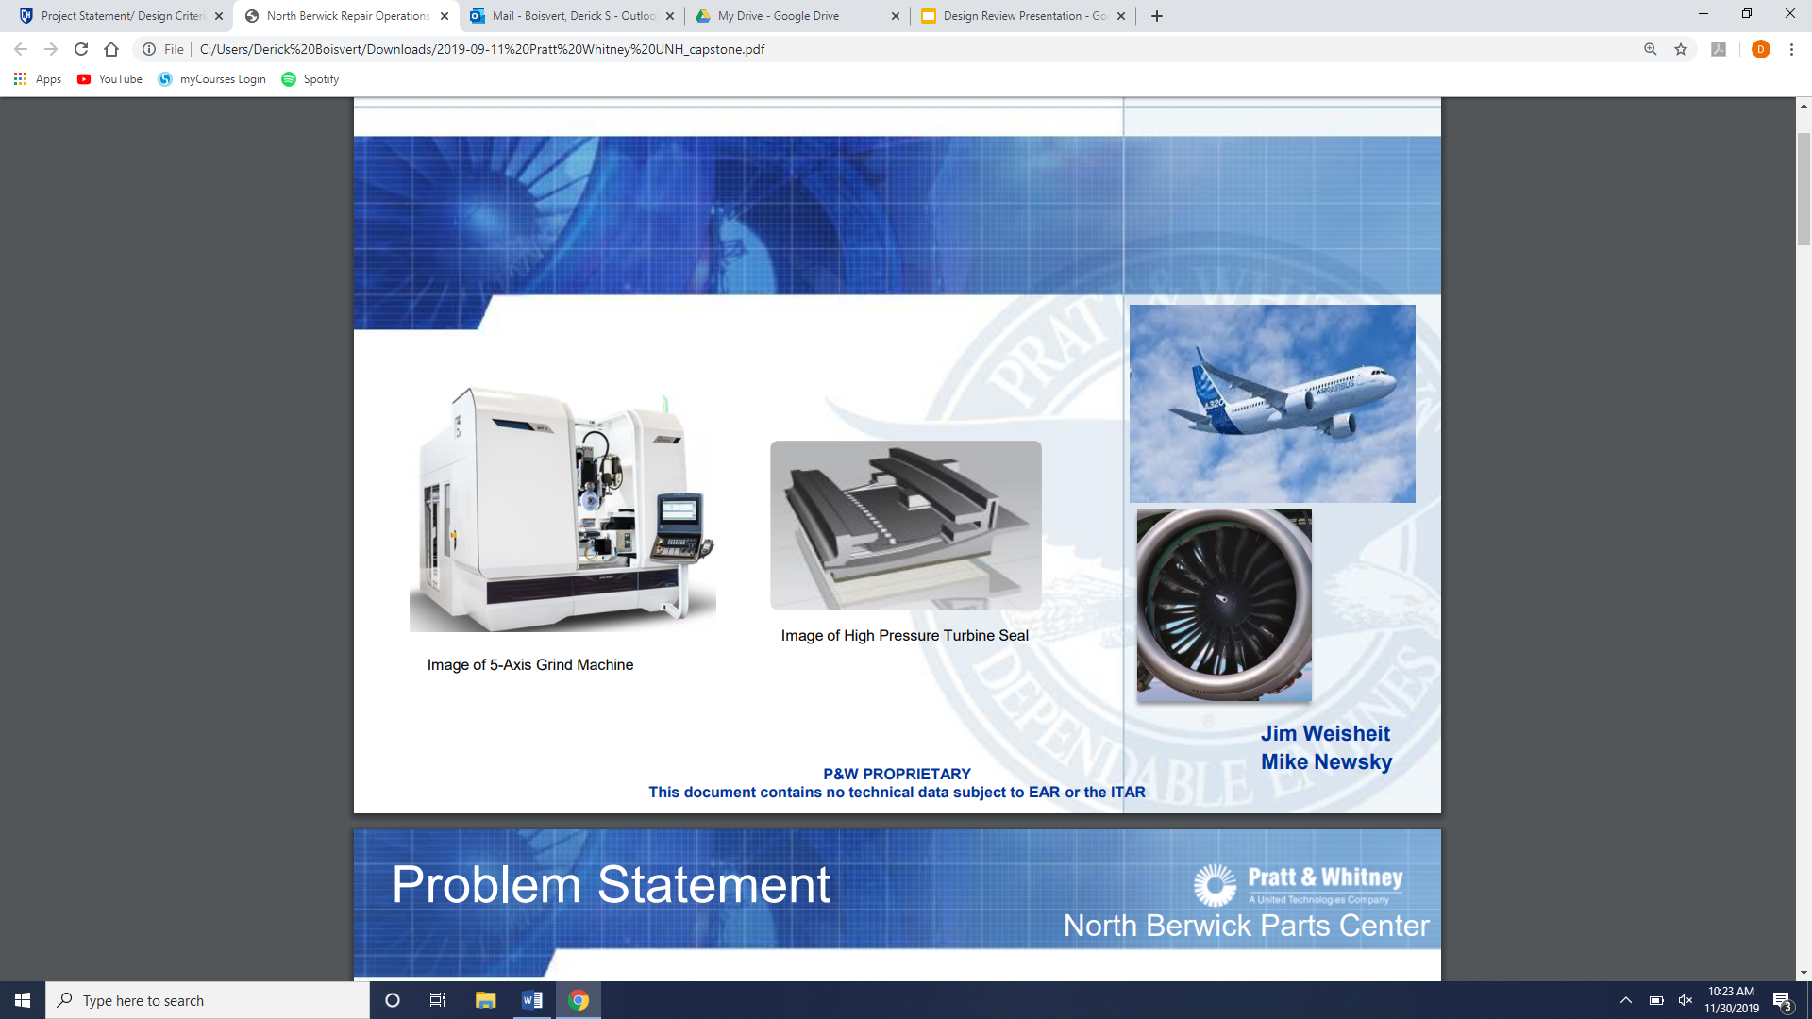
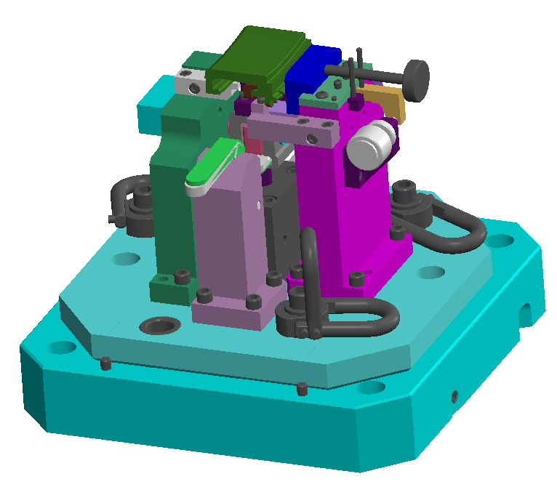
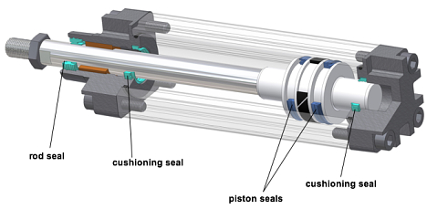
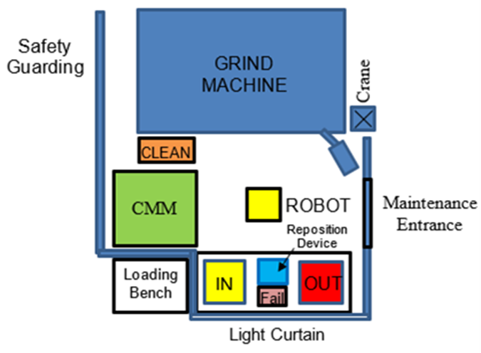
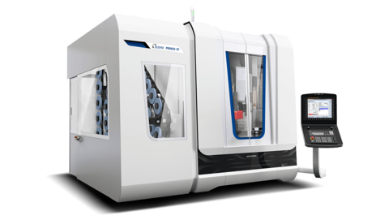
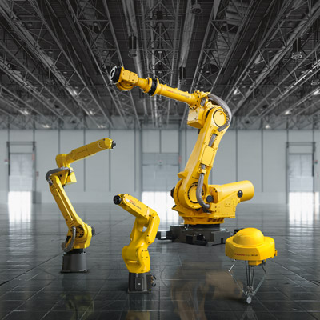
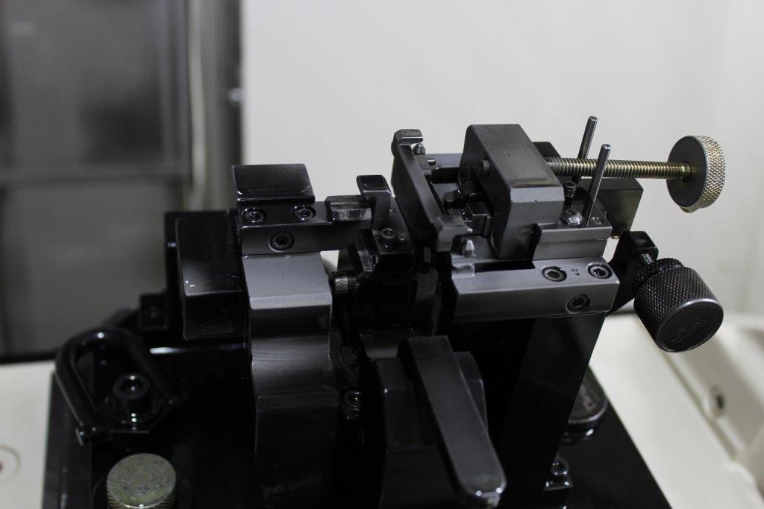
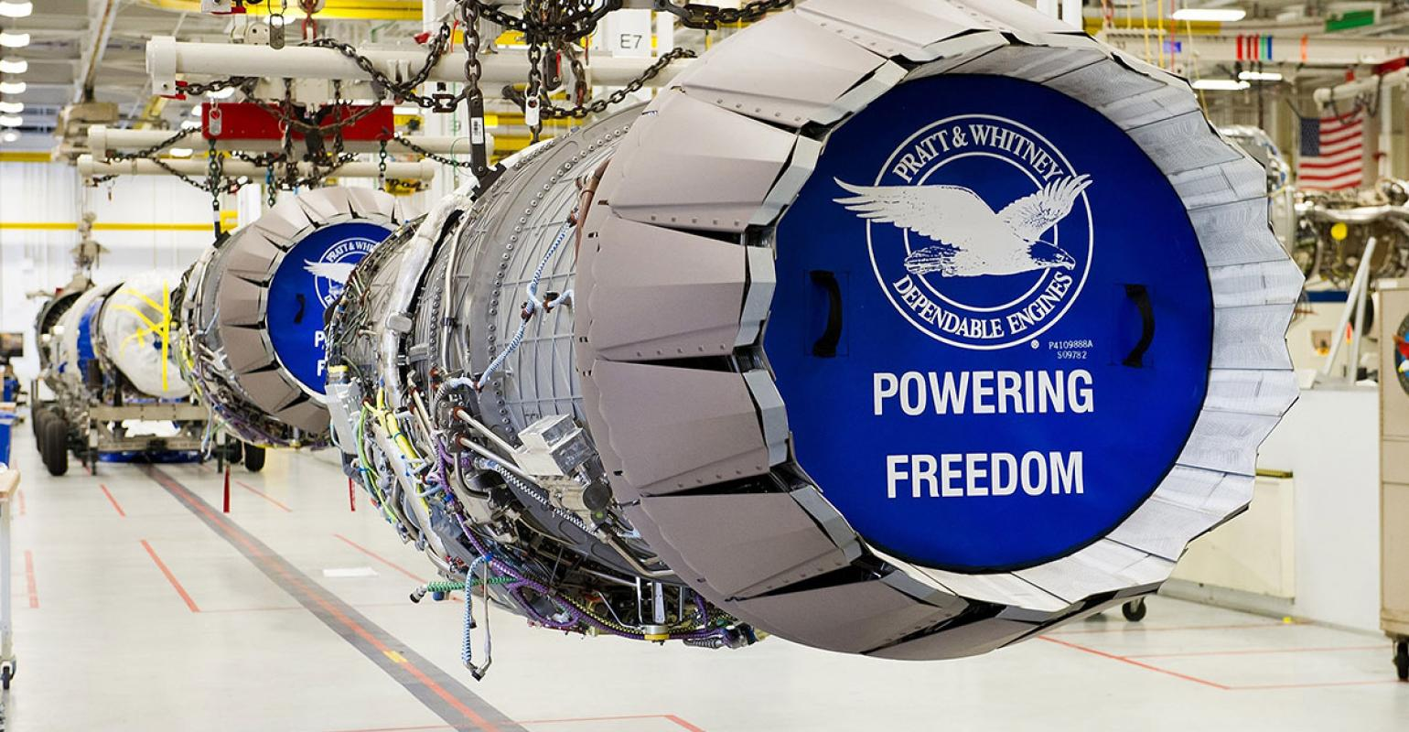
Pratt & Whitney
Grinding Cell Automation
Derick Boisvert and Dan Coburn
University of New Hampshire
Mechanical Engineering
Introduction
Fixturing Concepts
X-Axis
Workholding
Z-Axis
Workholding
Pratt and Whitney is a local commercial and military aerospace engineering firm. They focus on producing engine components at a high quality and quantity. The high quantity demand from customers has led their production line to look into robotic automation. This project aims to develop at least three concepts laying out the automated process of a specific engine seal.
Y-Axis
Workholding
Pneumatic Piston
Solenoid controlled
In-line mounting
Bulky
Motor
Rotations controlled by encoder
Waterproof concerns
Piston Activated Lever
Solenoid activated
Easy implementation
Remote mounting
Direct Piston Lock
Take the place of current fixture features
Mounts directly inside of the fixture
  Low profile
Pneumatic Swing Clamp
Solenoid controlled
Swivels into and out of position
Low profile
Motor
Rotations controlled by encoder
Waterproofing concerns
Design Criteria
Conceptualize at least 3 automated fixturing solutions
Automated fixturing, in tandem with robotic operation, must maintain or decrease current part takt time
Fixtures must be able to locate the part in the same position each cycle with a tolerance of ±0.003 inches
Current Process
Recommendations
Load/Shim Grinder
Run Grinder
Unload and Clean
Load/Shim CMM
Run CMM
Unload CMM
Verify Tolerances
After working independently and with Pratt & Whitney staff over the past year, a final plan was mapped out. A FANUC M10 or M20 series robot will be utilized in tandem with our automated fixture. The automated fixture will employ a piston activated lever (Z-axis), pneumatic swing clamp (Y-axis), and a pneumatic piston (X-axis). An air knife for part cleaning as well automatic offset compensation from the CMM will ensure the process consistently runs independent of an operator.
Update Offsets
Stage Part
Repeat
The process detailed to the top left represents the current amount of manual work needed to impart a single feature on the part. The process detailed in the bottom right is the ideal automated operation. This will be accomplished with the help of a FANUC Industrial robot, automated self-locating fixtures, and robot to CNC communication in the form of Auto-Comp. The robot will load the part where the fixture can accurately and correctly position it in the CNC and CMM.
Robot Loads Grinder
Automatic Grinder Start
Robot Unloads Grinder
Robot Loads CMM
Automatic CMM Start
Robot Unloads CMM
Tolerance Data Sent to Grinder
Auto-Comp Updates Offsets
Robot Stages Part
Repeat Until Stopped
Ideal Process

