Slide 1
Rennie Road
1,4 - Dioxane Groundwater Remediation
1
Project Manager: James Murphy
Project Members: Patrick Hamill, Zac Harvell, Lucas Theoharidis, Josh Thibeault

Slide 2
Outline
2
Introduction
Summary of Completed Work
Site Plan/ Soil Hydraulics
Permitting
Well Design
Treatment
Conclusion

Slide 3
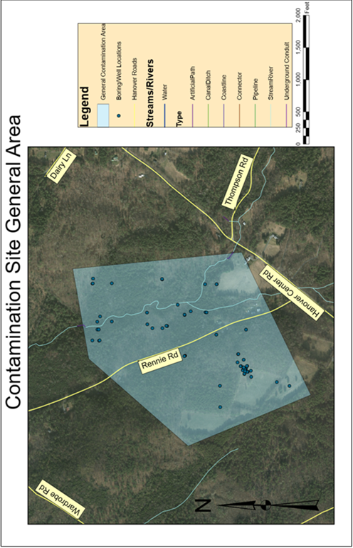
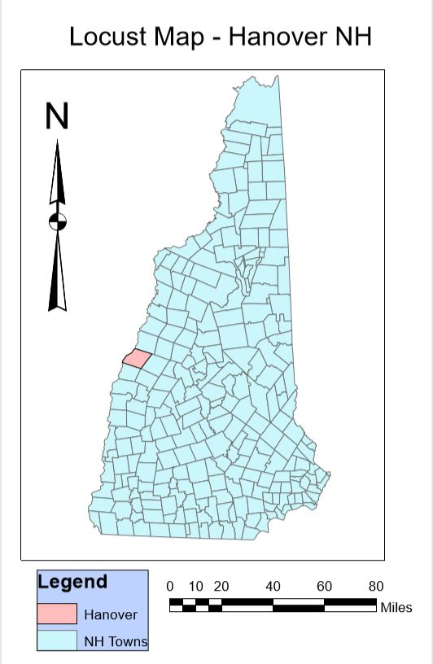
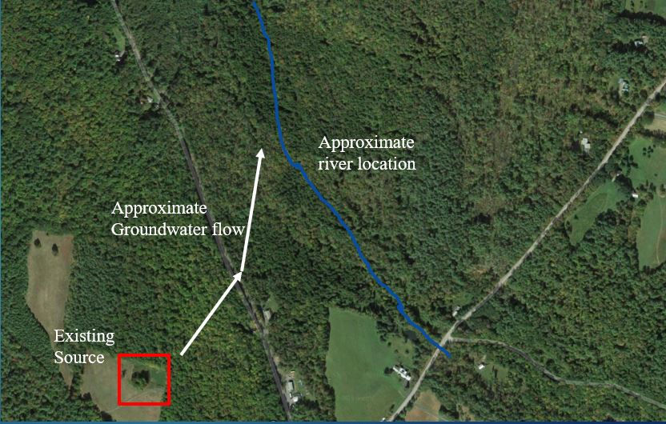
Introduction
3
Site Location: Rennie Road Hanover, NH
Contaminant: 1,4 Dioxane
Challenges:
  Location
  Gradient
  Proximity to water bodies
Figure 1: General Contamination Area
Figure 2: Source Location and Groundwater Flow Direction

Slide 4
Summary of Work
4
Phase 1
  Request for information (RFI)
  Feasibility study
    Pump and Treat
  General site plan
Phase 2
  Conceptual site plan
  Soil hydraulics
  Extraction Well Design
  Permitting
  Treatment

Slide 5
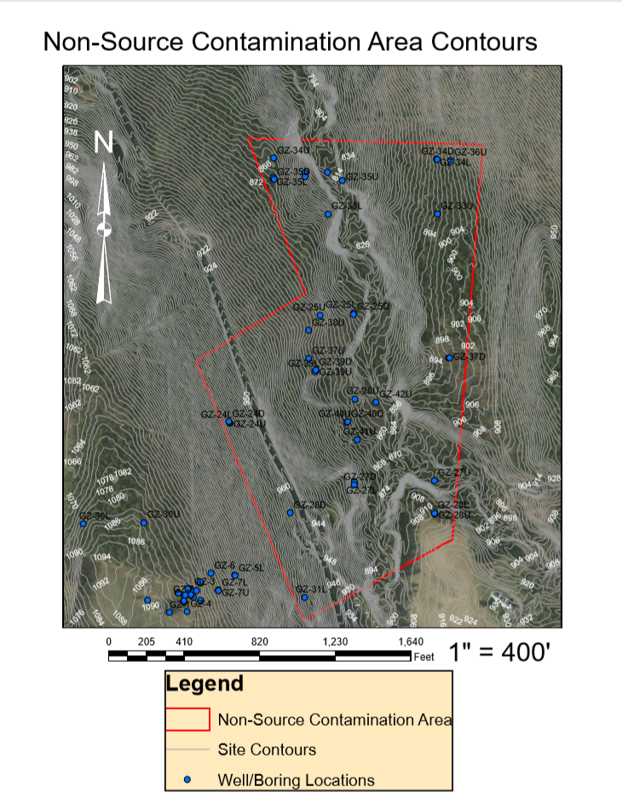
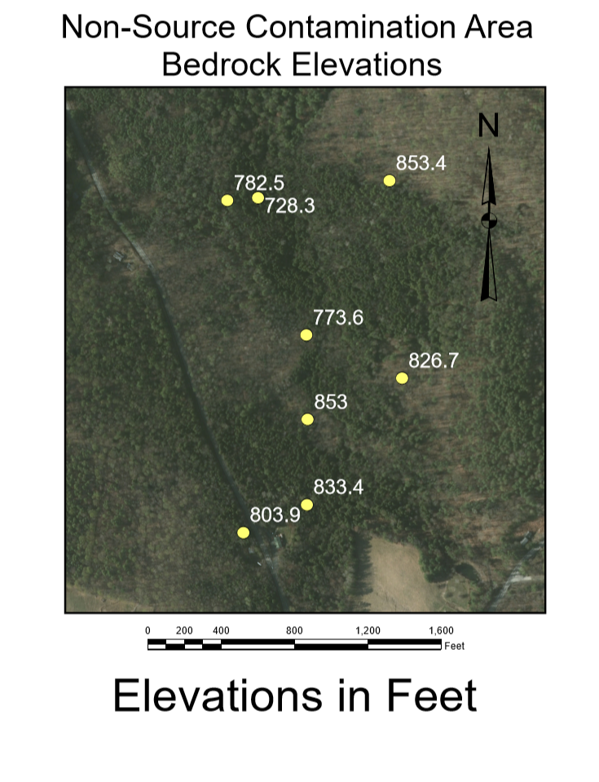
Site Plan
5
-Elevation Map -Bedrock Map
Elevation map used to understand steep slopes
Bedrock elevation map used to understand extent of plume
Flow
Direction
Flow Direction
9 Rennie
Road
9 Rennie
Road
Figure 3: Contour Map
Figure 4: Bedrock Map

Slide 6
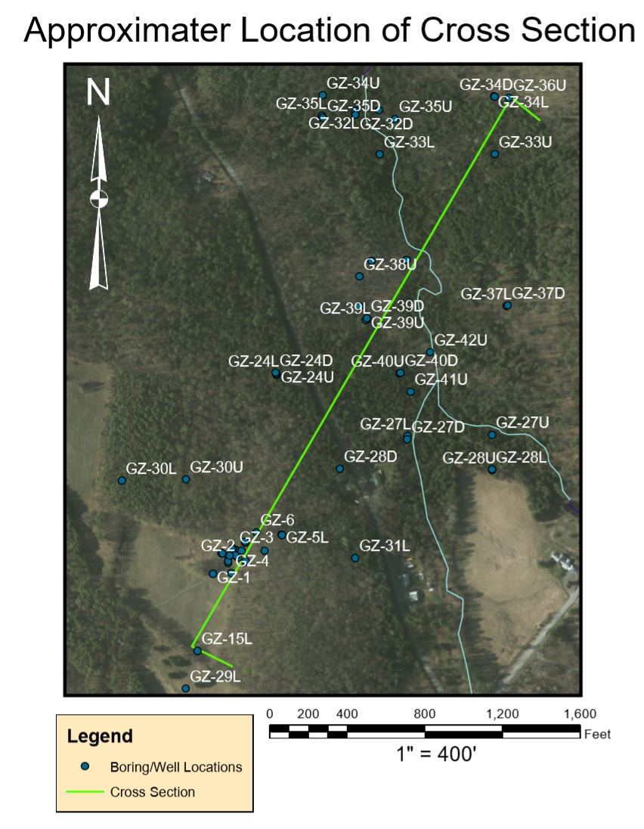
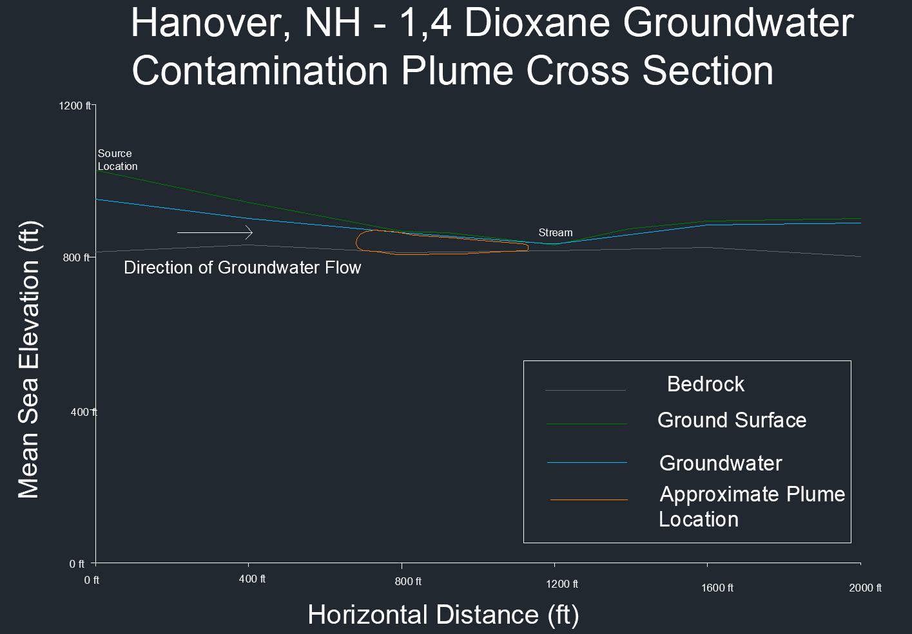
Site Cross Section
6
Help to understand:
Well lengths
Visualize Flow
9 Rennie Road
Figure 5: Cross Section Location
Figure 6: Cross Section

Slide 7
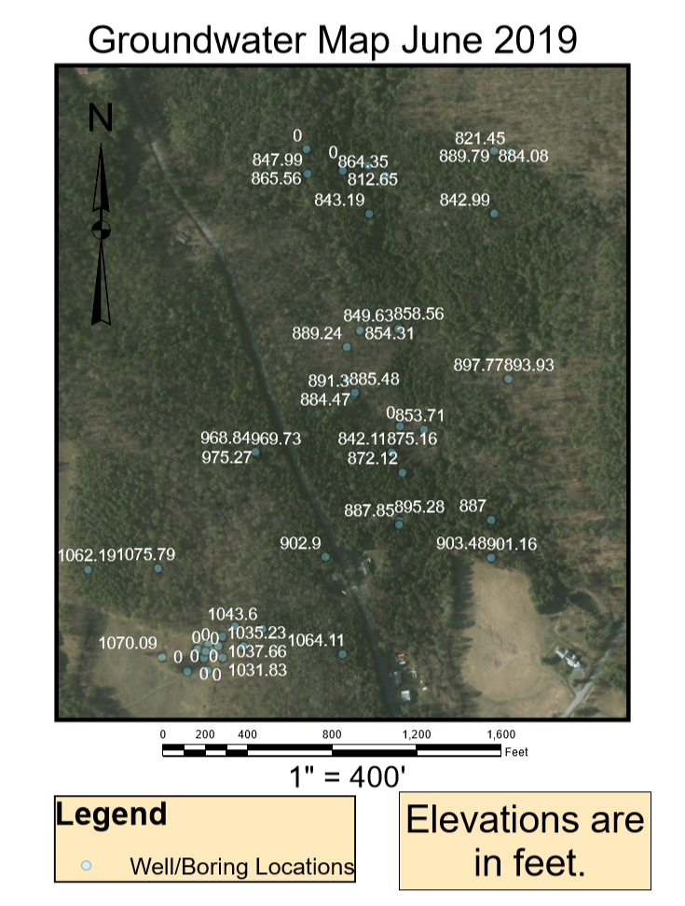
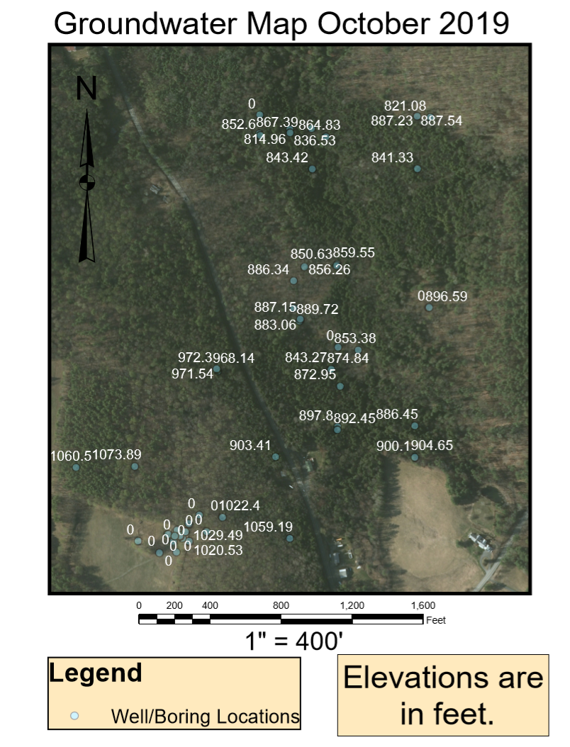
Groundwater Elevations
7
Groundwater elevations plotted on GIS
Used to make water contour map to find hydraulic gradient
​9 Rennie Road
​9 Rennie Road
Figure 7: June Groundwater Elevations
Figure 8: October Groundwater Elevations

Slide 8
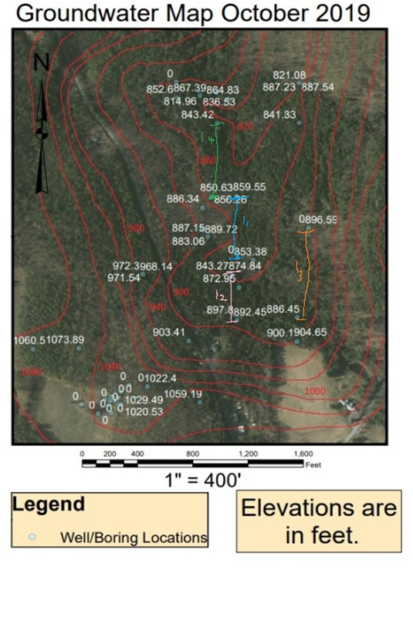
Soil Hydraulics - Hydraulic Gradient
8
Slope between monitoring wells
Monitoring well data provided by GZA
Contours drawn based on water table elevation data
Slope calculated between contours and monitoring wells
Geometric mean: 0.0468
Figure 9: Groundwater Elevations Contour Map

Slide 9
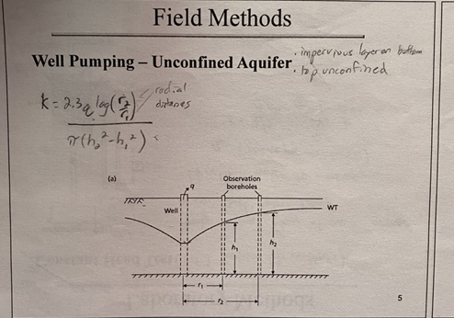

Soil Hydraulics - Hydraulic Conductivity
9
Velocity of groundwater
Assumed site conditions were unconfined
  Unreasonable values
  Optimized K value based on 50 ft ROI
Figure 10: Well Model

Slide 10
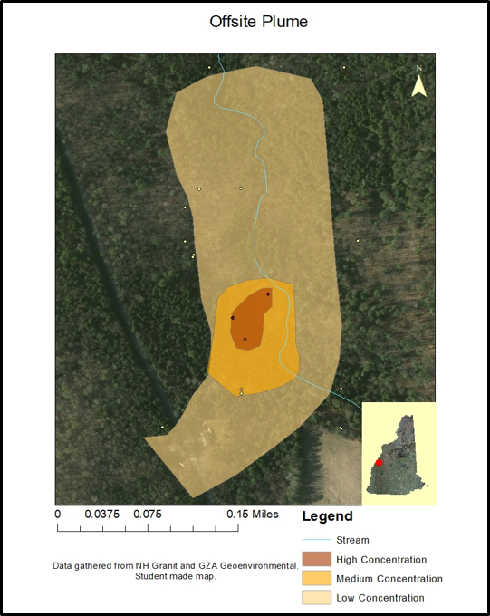
Plume Dimensions
10
Width of plume: 450 ft
  Estimated based on GIS map
Depth of contamination: 69.2 ft
  Calculated from soil boring logs
  Average depth to bedrock
Cross sectional area: 31140 ft²
Figure 11: Contamination Plume Map

Slide 11
Required Permits
Table 1: Required Permits
11
PERMIT | REASONING
Alteration of terrain | Road construction
Pump installation | Installation of pumps for treatment system
NPDES surface water discharge | Needed to protect the stream and marsh within the GMZ
Groundwater discharge | Needed for discharging treated effluent back into groundwater
Treatment | Required for treatment system operation
Stormwater site design | Site erosion will change as a result of road construction
Wetlands | The GMZ is in a wetland area
Env-wt 100-900
env-wq402
Env-OR600

Slide 12
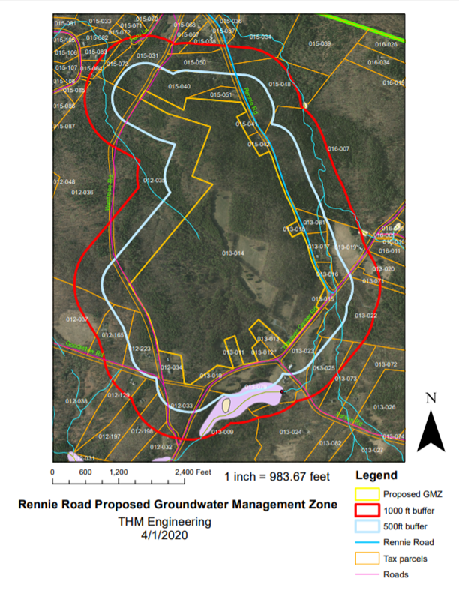
Permitting-ENV OR600
12
Must define a groundwater management zone (GMZ)
Requirements
Tax parcel 013-014
Water bodies and properties within 500ft
Roads within 1000ft
Figure 12: GMZ Map

Slide 13
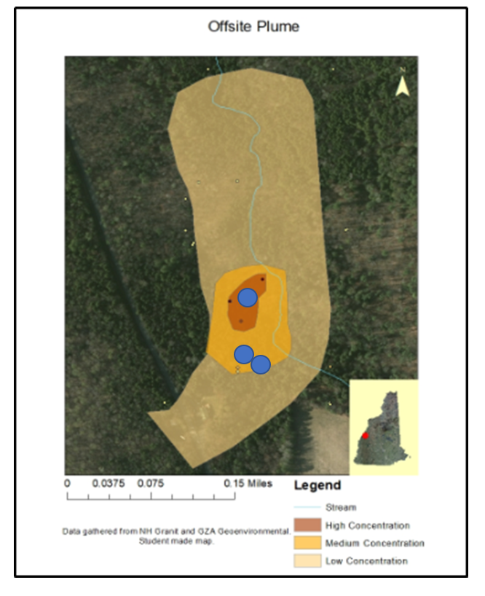
Well Placement
13
Due to motivation only three wells will be installed
Prevents further spread of 1,4 - dioxane
Intercept main plume
Avoid spread to stream
Figure 13: Well Location Map

Slide 14
Well Design
14
Table 2: Well Design
Based on soil gradation of sand, loam, and a combination of the two to simulate glacial till
Total Diameter including well pack: 6”
Will use 6" auger
Pump Rate (gpm) | 0.1
Upper Casing/Pump Housing
Nominal Diameter of Pump Bowl (inches) | 4
Casing Diameter (inches) | 5
Screening
75% of plume thickness screened
Slot Width (inches) | 0.008
Well Filter Outer Diameter (inches) | 2
Well Filter Inner Diameter (inches) | 1.75

Slide 15
Treatment Options
15
Table 3: Compared Treatment Processes Pros and Cons
Treatment Method | Pros | Cons
Hydrogen peroxide with UV Radiation | Proven to treat 1-4 Dioxane as well as other contaminants Moderate Capital Cost | Expensive O&M cost Must be pretreated to deal with turbidity Hydrogen peroxide residuals can pose safety risk
Hydrogen peroxide with Ozone | Proven to treat 1-4 Dioxane as well as other contaminants Moderate Capital Cost | Expensive O&M cost Hydrogen peroxide residuals can pose safety risk Bromide will oxidize to bromate requiring further treatment
Resin Treatment | Very Low O&M cost Modular/easily sized based off influent flow Small changes to influent flow will not affect levels of treatment Simple operation/will not require expensive employees | Expensive capital cost

Slide 16
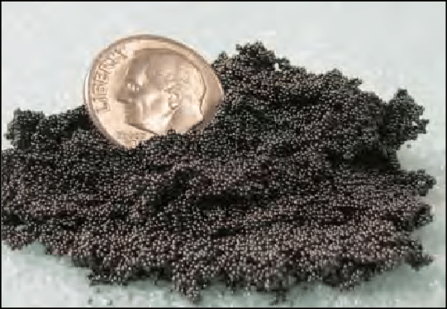
Treatment Decision
16
Resin treatment - Ambersorb 560
High capital cost, but very small O&M cost will result in saving money over the years
No electricity needed for treatment
No pre/post treatment necessary
Figure 14: Ambersorb 560 Resin

Slide 17
Treatment Flow Chart
17
To Treatment Facility
Screening
Flow through Ambersorb 560 (resin)
Pump back on-site using injection wells
Pump
Figure 15: Treatment System Flow Diagram

Slide 18


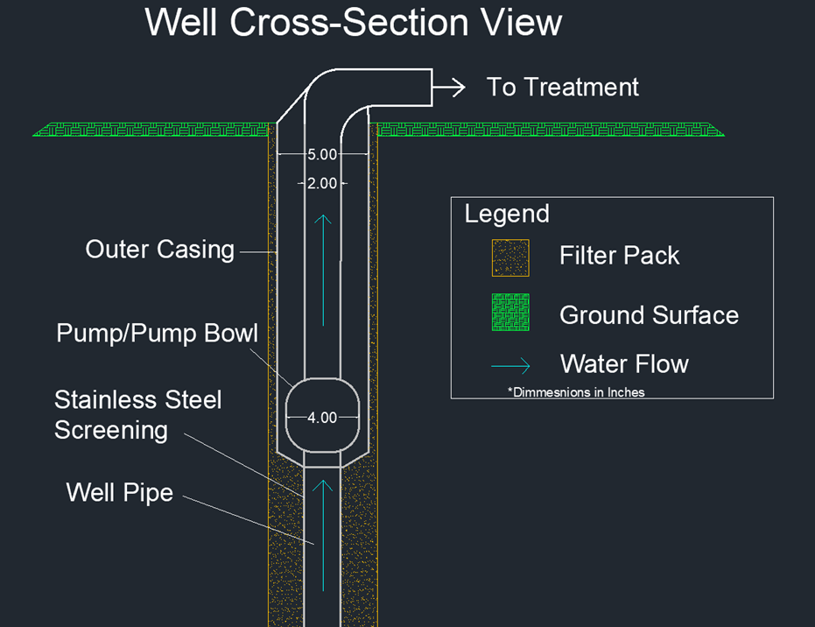



Final Design
18
Pump and Treat
  3 Wells
Resin treatment
Figure 16: Well CAD Drawing

Slide 19
Acknowledgements
19
Faculty advisor - Dr. Paula Mouser, P.E.
GZA GeoEnvironmental Inc.
Steven Lamb, P.G.
James Wieck, P.G.

Slide 20
Questions?
20
jrm1047@wildcats.unh.edu

