Slide 1


Riverwalk Pavilion
Team 22 – Jamie Fitzpatrick (PM), Griffin Curley, Jared Grondin, Oliver Roy, Jack Sargent, and Michelle Thibault
Project Sponsor – The Engineering Corp
Sponsor Contact – Chris Raymond
Project Advisor – Anthony Puntin
Notes:
Jamie

Slide 2
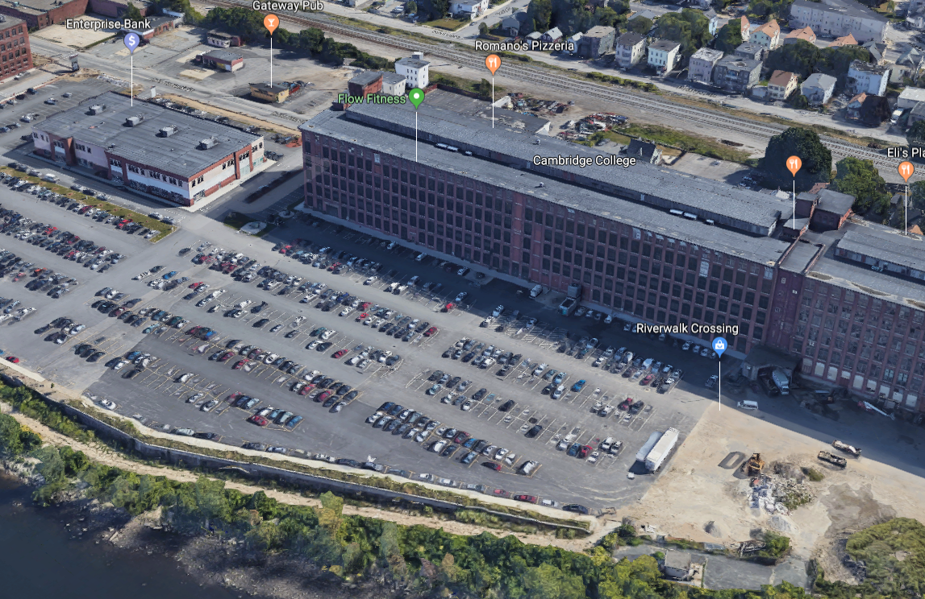
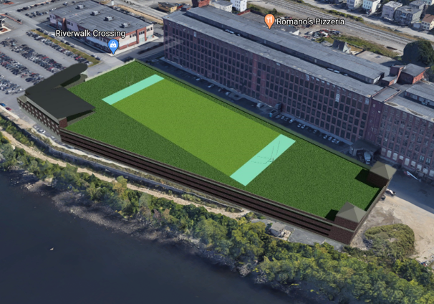
Introduction and Background
Existing Lot
4.67 acres
Lawrence, MA
Riverwalk Engineers proposed design
Notes:
Jamie

Slide 3
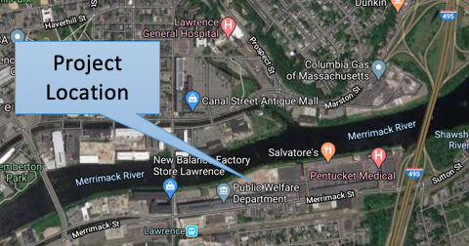
Locus Map of Project Site
N
EXIT 44
Notes:
Michelle

Slide 4

Scope
Develop a site concept
Perform structural and geotechnical calculations
Provide architectural renderings
Develop a transportation plan
Address floodplain issue
Notes:
Michelle

Slide 5
Program
4-Story Multi-Use Building with 60,000 SF Total Floor Area comprised of:
  7,500 SF Retail Space
  7,500 SF Restaurant Space
  30,000 SF Office Space
  15,000 SF Function Space
Parking Garage
Multipurpose Athletic Field
Notes:
Oliver

Slide 6
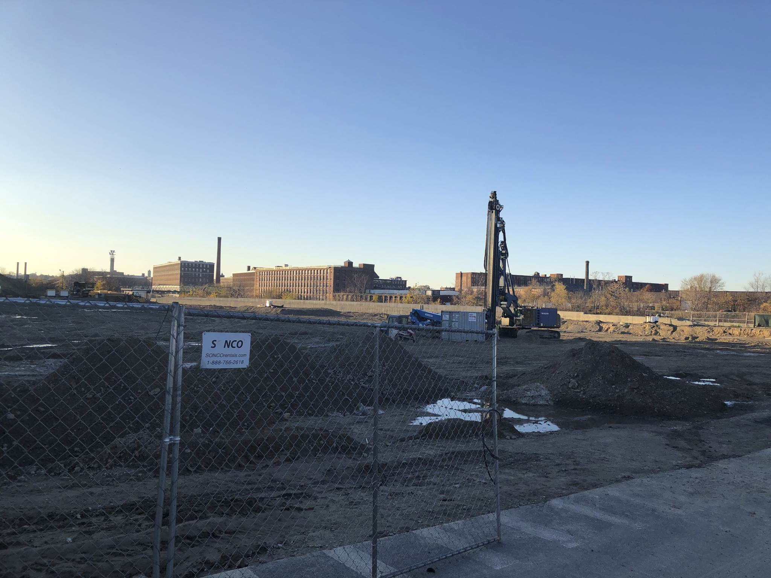
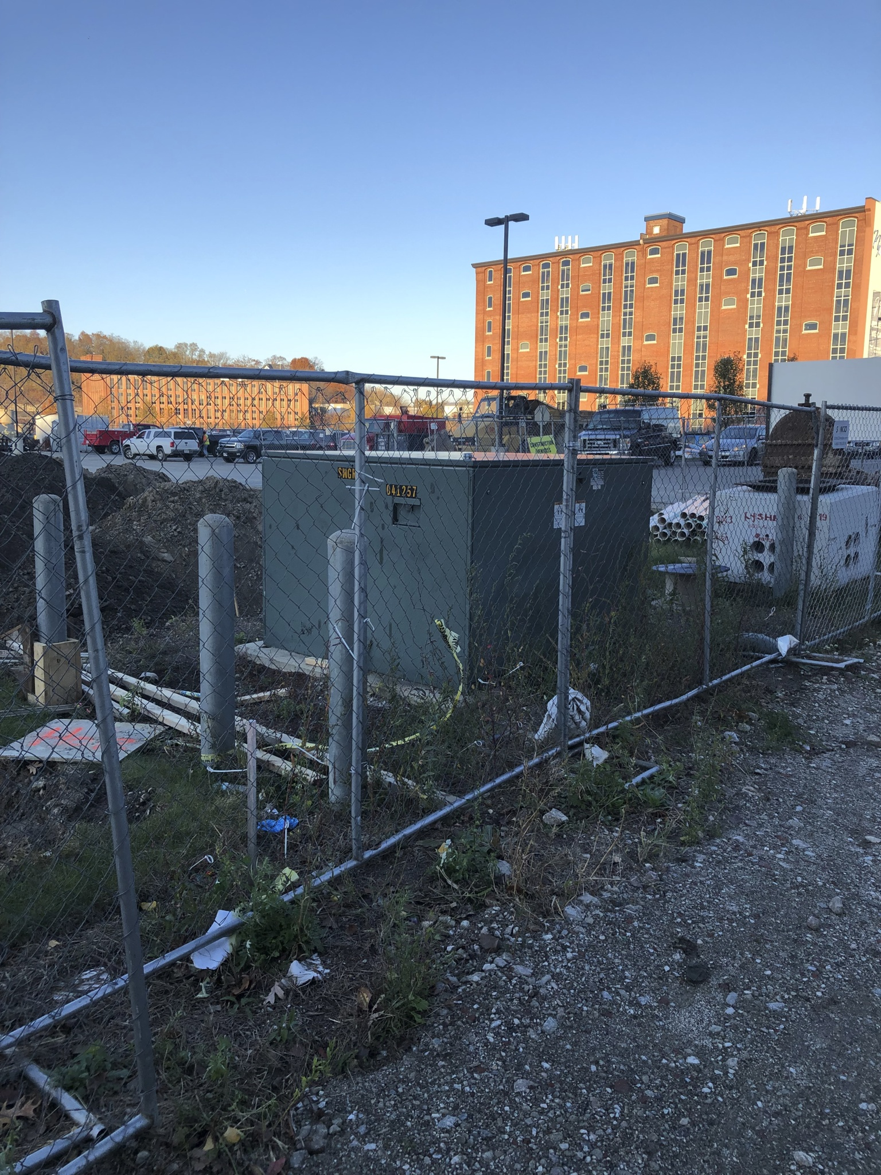
Site Visit
Transformer – cannot be moved
Notes:
Oliver

Slide 7

Parking Requirements
Required Parking from Lawrence, MA zoning regulations:
Function Hall: 75 spaces
Retail: 30 spaces
Restaurant: 25 spaces
Office: 90 spaces
Existing Lot: 500 spaces
Field: 120 spaces
Total: 840 spaces
Notes:
Jack

Slide 8
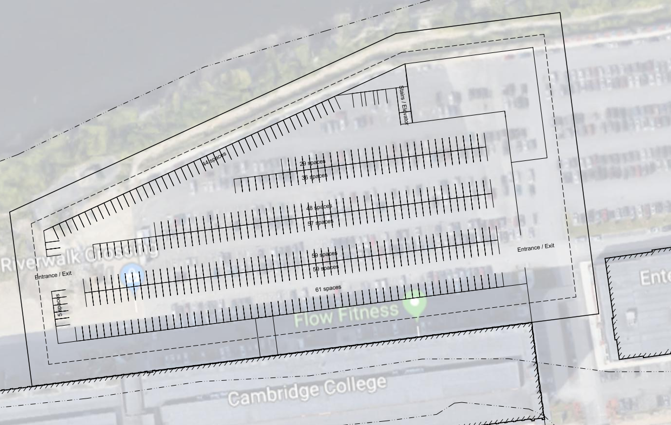
Parking Layout
Entrance/Exit
Exit
Location of Transformer
Notes:
Jack

Slide 9
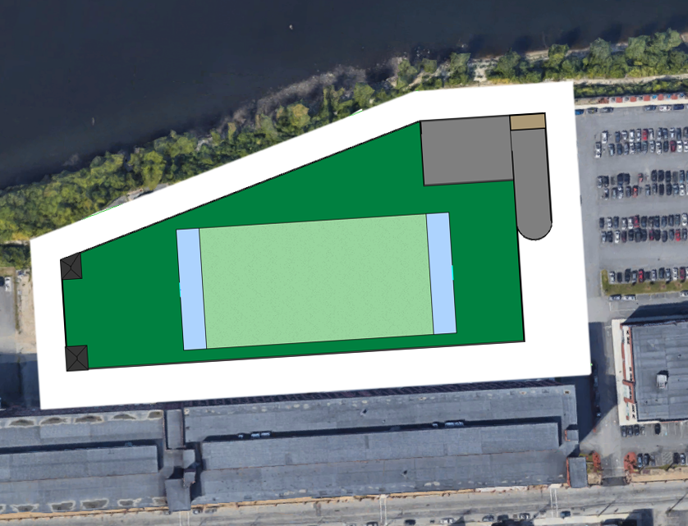
Plan View of Proposed Structure
N
Multi-purpose building
Riverfront pathway
Athletic Field
Road
Lot Entrance and Exit
Notes:
Jack

Slide 10
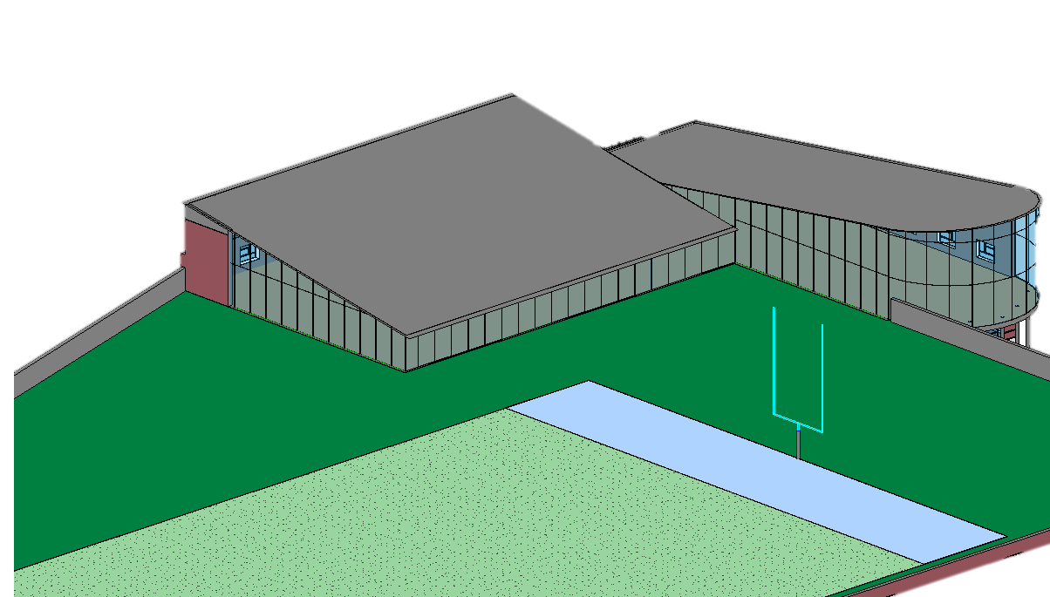
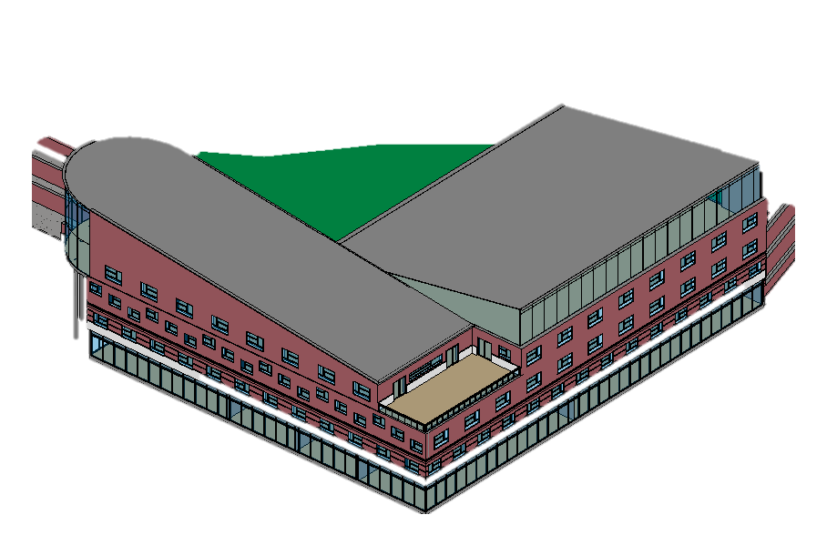
3D Modeling
Features:
Fourth floor curtain walls
Optimum roof for solar panels
Rooftop Deck
Walking path along river
Notes:
Jack

Slide 11
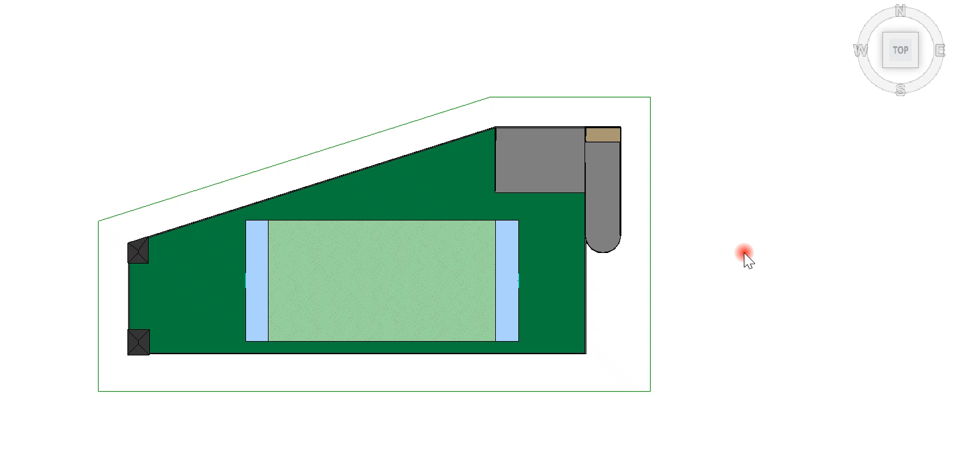
360° View of model (Video)
Notes:
Jack

Slide 12
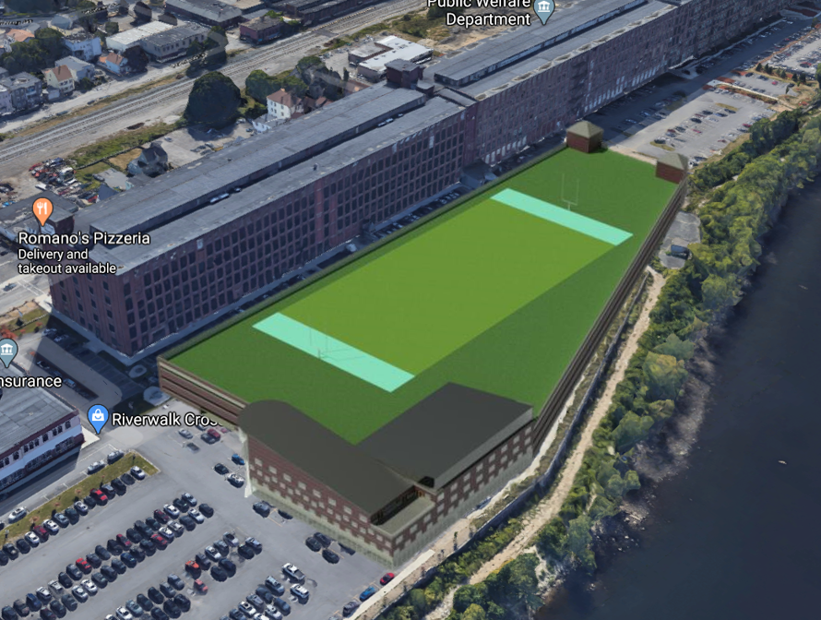
Rendering + Satellite
Notes:
Jack

Slide 13
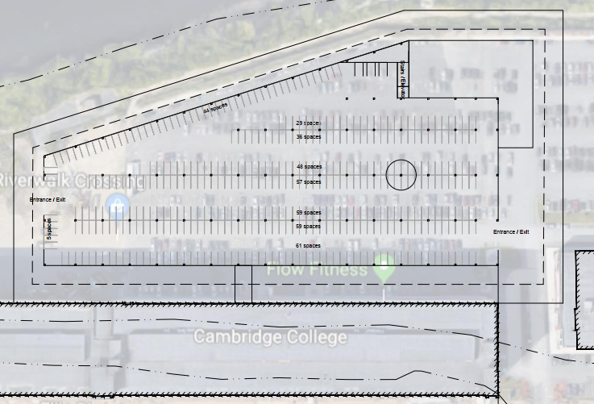
Column Layout
Exit
Entrance/Exit
Notes:
Michelle

Slide 14
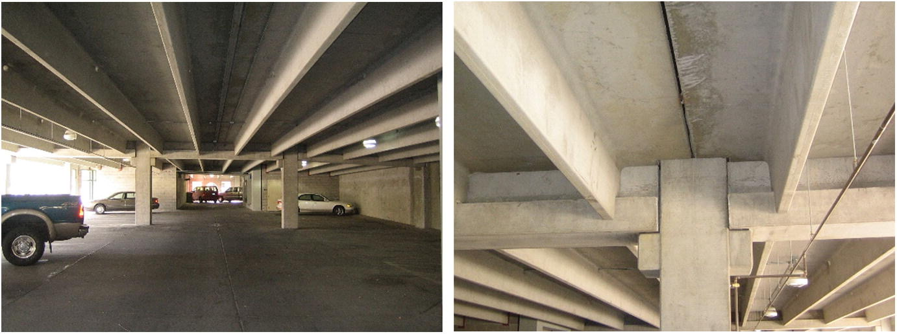
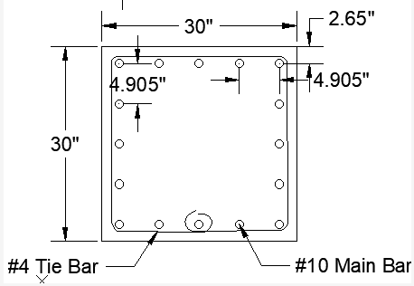
Structural Design Process
Assumed a typical floor system
  Inverted T-beam spanning 36 feet E/W
  Joist spanning 60 feet N/S
Calculated column loads based on ASCE 7-10
Final design:
30in by 30in RC column (10 ksi)
#10 Main Bars and #4 Tie Bars (75 ksi)
Notes:
Jamie

Slide 15
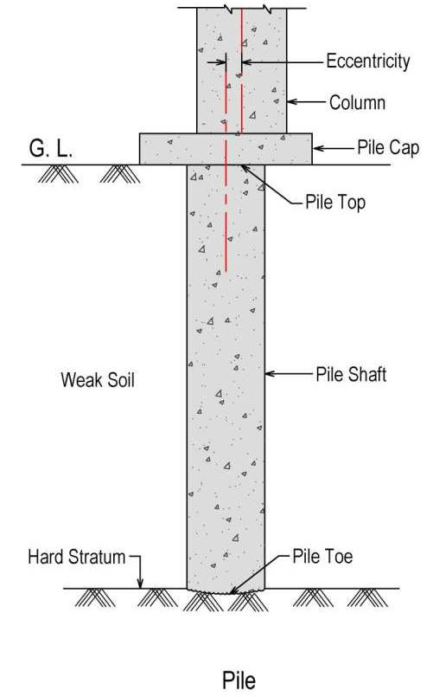
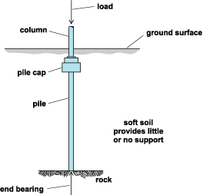
Geotechnical Design Process
Used column loads based on ASCE 7-10 and self weight of the column designed
Reviewed geotechnical report to evaluate soil conditions
Used toe bearing and side friction equations to design a driven pile in the drained condition
Calculated a required cross sectional area for a concrete driven pile
Final Design:
30 inch diameter concrete pile
1 pile per interior column
Notes:
Michelle

Slide 16
Locus Map of Project Site
N
EXIT 44
Notes:
Michelle

Slide 17
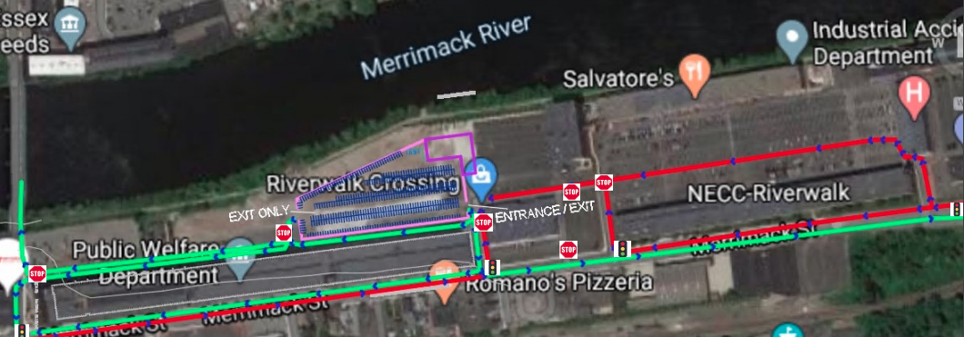
Transportation Design Plan
N
2
1
2
1
3
KEY:
Traffic Flow into Site
Traffic Flow out of Site
Notes:
Jared

Slide 18
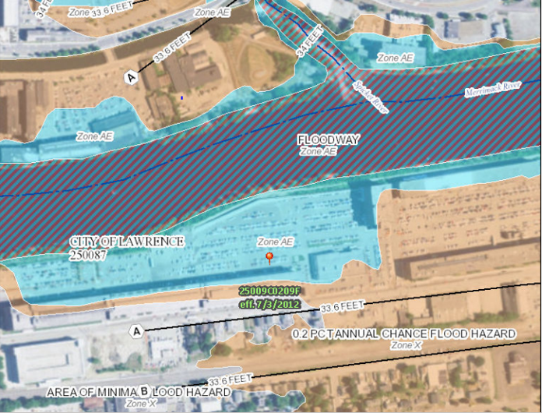
FEMA Flood Map

Slide 19


Floodplain Considerations
Found the 100-year flood elevation and the elevation of the site​
Calculated volume displaced
Options for compensatory storage:
      Depressing the parking garage
      Excavating a large hole to compensate
      A continuous catch basin around the perimeter of the building
Notes:
Jack

Slide 20
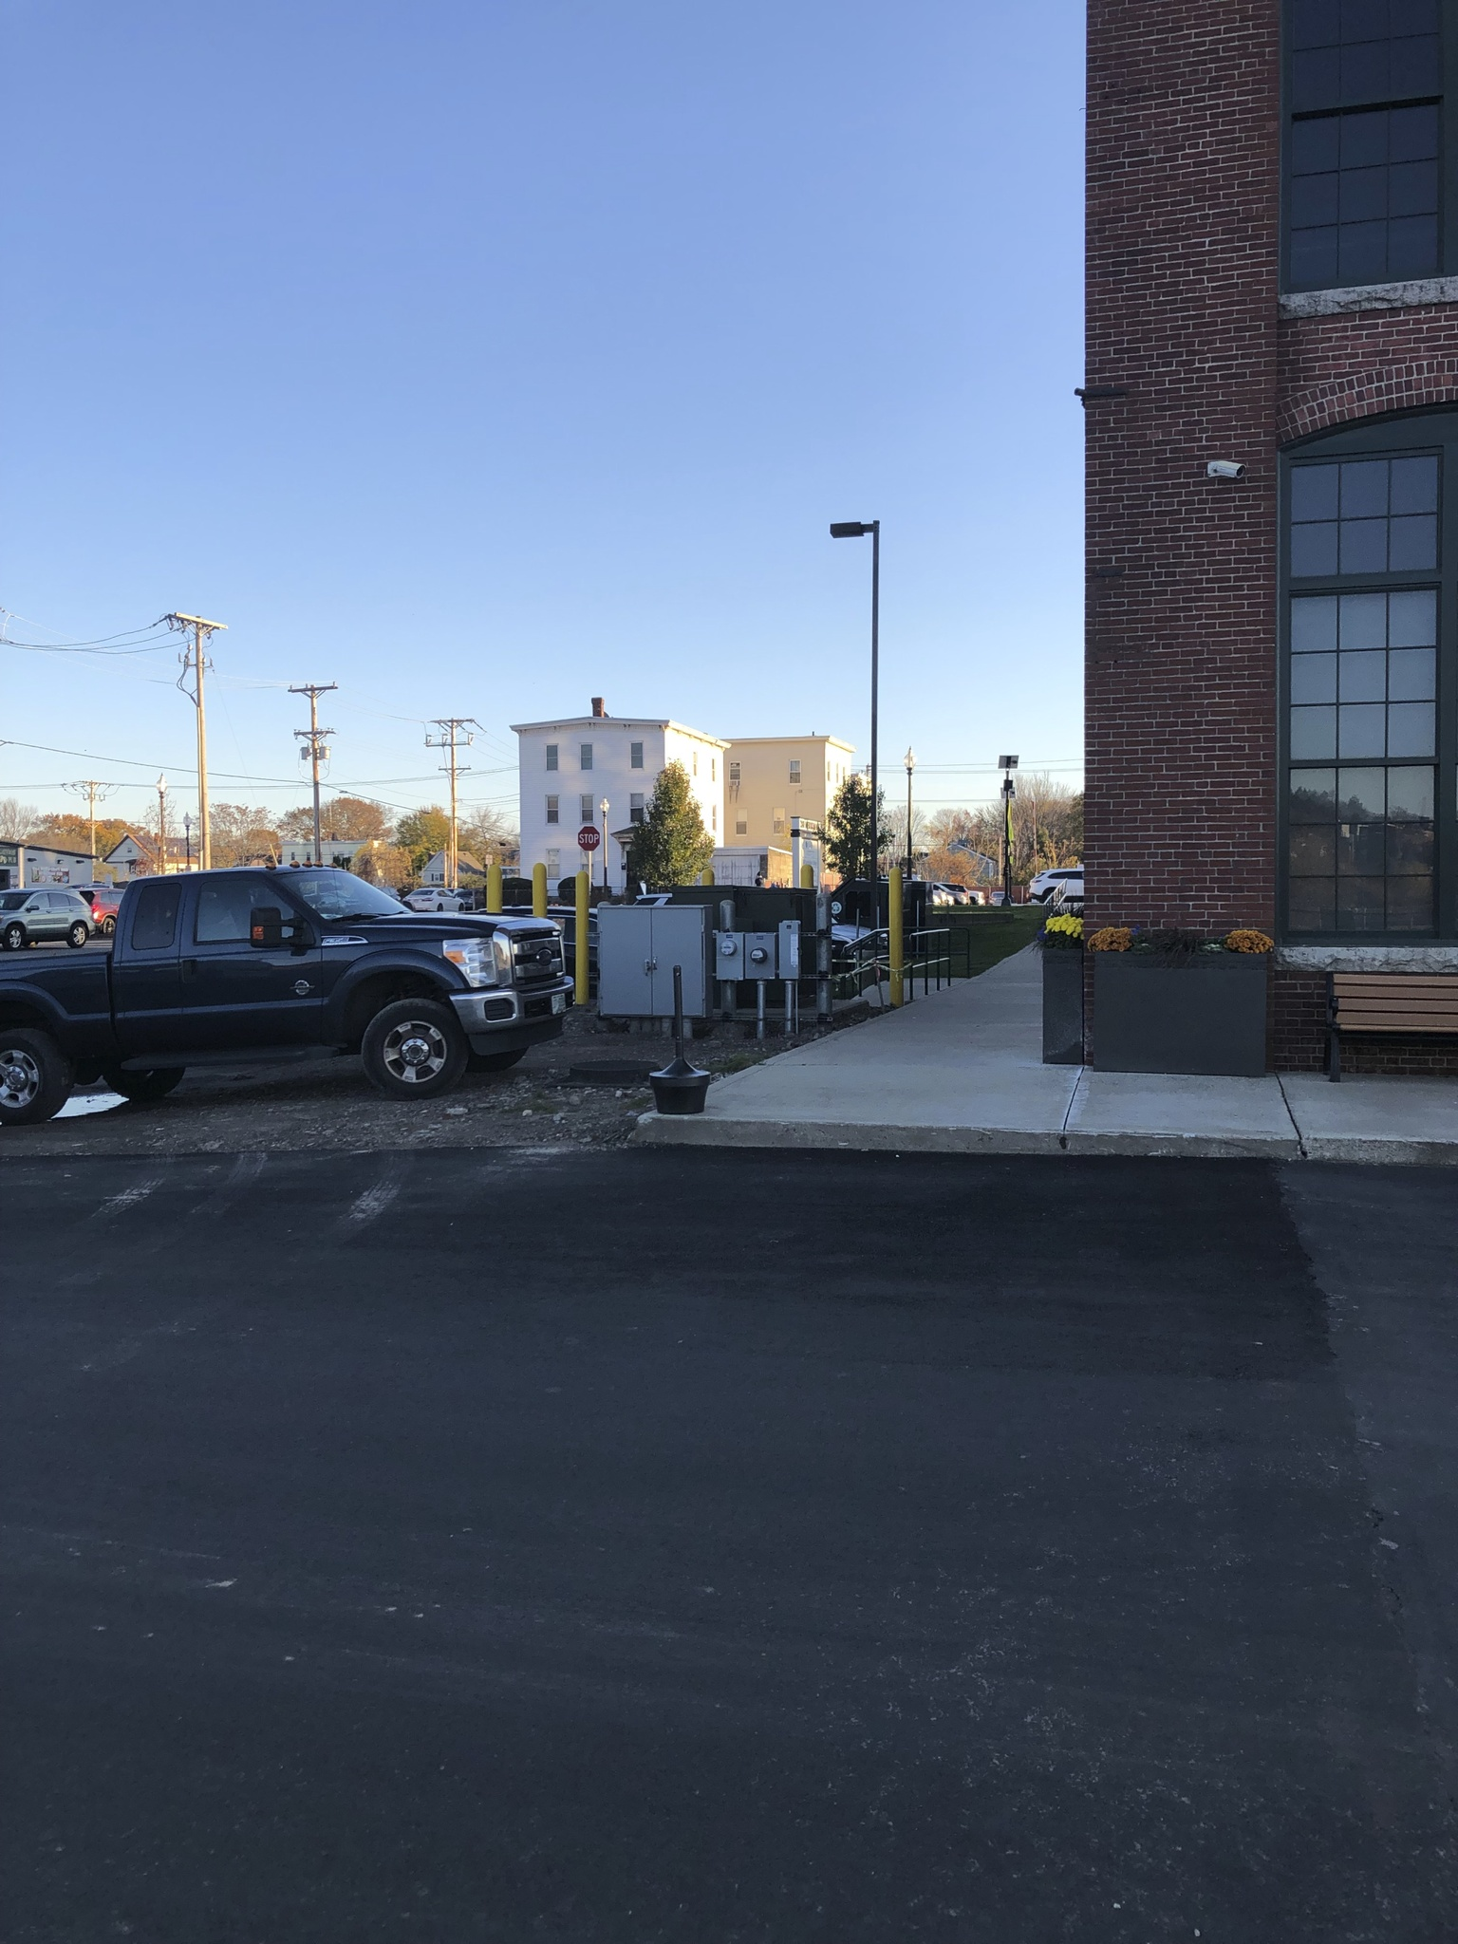

Challenges Encountered
Site Design
  Existing utilities relocation
  Setbacks and space constraints
  Pedestrian/vehicle transportation around the structure
Floodplain location
  1,222 cubic yard of water is displaced for a 100-year flood
Structural
  Calculating the moment at the top and bottom of the column
Geotechnical
  Determining soil properties
Notes:
Oliver

Slide 21
Thank you!
Please contact us with any questions involving the Riverwalk Pavilion at:
jmf1037@wildcats.unh.edu , Jamie Fitzpatrick (Project Manager)
met1019@wildcats.unh.edu , Michelle Thibault
jrg1038@wildcats.unh.edu , Jared Grondin
gc1036@wildcats.unh.edu , Griffin Curley
jjs1036@wildcats.unh.edu , Jack Sargent
or1008@wildcats.unh.edu , Oliver Roy
Notes:
Jamie

