Slide 1
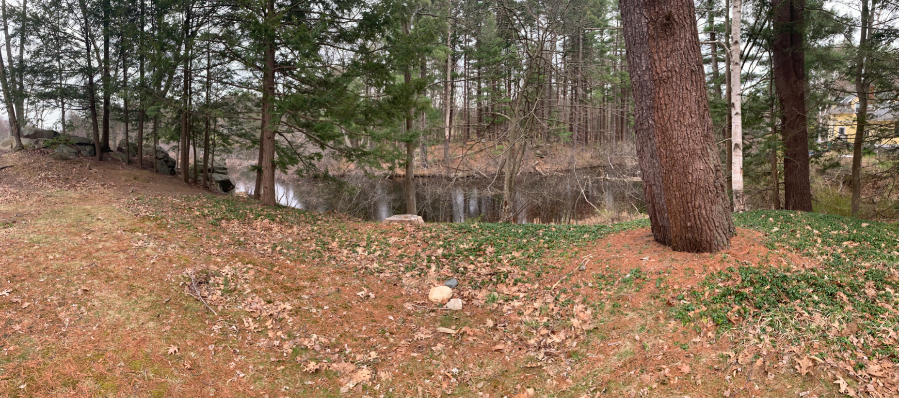
Proposed Pedestrian Bridge Over Oyster River
Durham, NH
Team #21: Matthew Spurr – PM, Alan Bauman, Matthew Golden, Wei He, Connor Thompson

Slide 2
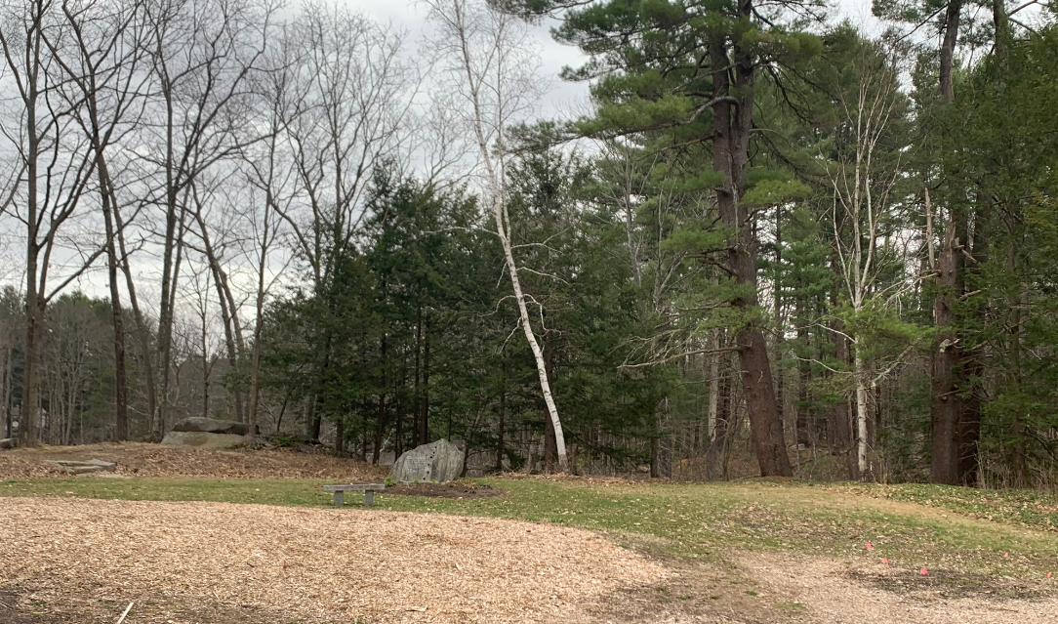
Project Involvement
Dennis Meadows, Project Sponsor
Dr. Bell, Project Faculty Advisor
April Talon, Town Engineer of Durham, NH
Milne Sanctuary Committee, Stakeholder
Durham and Newmarket Residents
UNH Students

Slide 3
Project Background
Pedestrian Bridge Over Oyster River
Purpose: Provide a convenient pedestrian travel way to residents of Durham, Newmarket, and neighboring communities
Span: 120 ft.
Limited access on east side
Milne Sanctuary on west side
  Consultation for abutment location

Slide 4
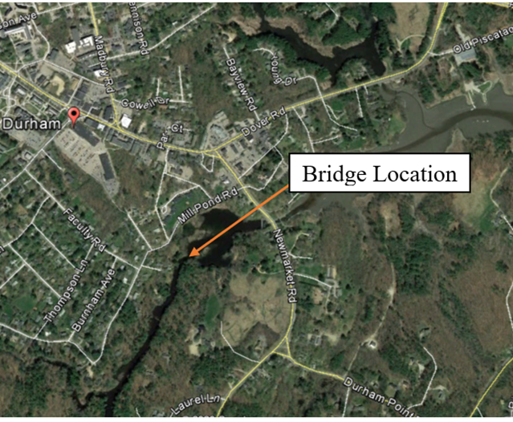
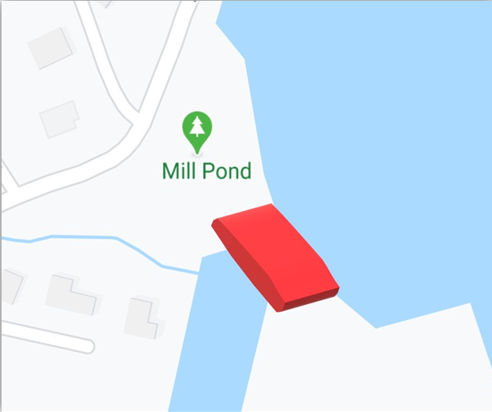
Site Location
Notes:
Speaker: Connor

Slide 5
Scope of Work
Communicate regularly with Dennis Meadows and Dr. Bell
Conduct at least 4 site visits
Coordinate with multiple stakeholders
Obtain soil sample and perform gradation analysis
Design abutments including footings
Notes:
Hello everyone my name is Connor and I am going to discuss the scope of work and permitting requirements for the proposed bridge

Slide 6
Scope of Work
Consult professionals and stakeholders about loading parameters
Select bridge type and appropriate material
Determine permitting requirements
Design a conceptual site layout and bridge rendering

Slide 7
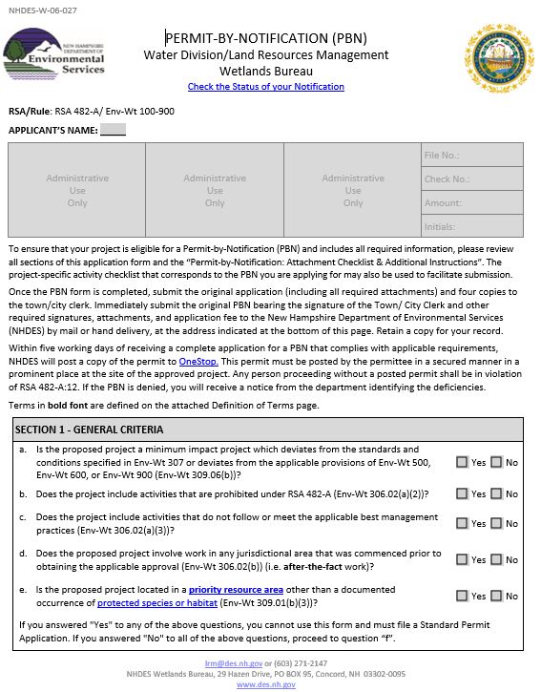
Environmental Permitting Requirements
NHDES Wetlands Permit by Notification
  Temporary impacts for access to eastern embankment
  Minimal impact with no middle pier
  Bridge abutments are about 15 feet above the water level
Notes:
Hello everyone, my name is Connor and I'm going to discuss the permitting requirements for the proposed bridge.

Slide 8
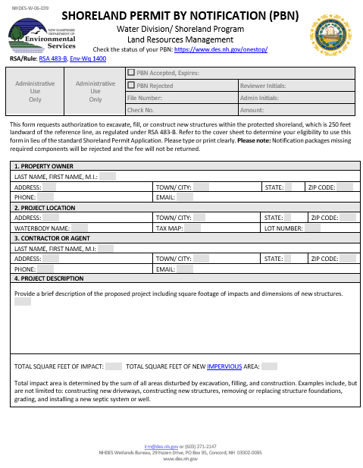
Environmental Permitting
Requirements
NHDES Shoreland Permit by Notification
  Oyster River classifies as a protected shoreland
  Excavation within 250 feet of Oyster River
  Qualifies as minor impact

Slide 9


Environmental Permitting
Requirements
Rare and endangered species are in the area
  Could not obtain types of endangered species from the Natural Heritage Bureau (NHB) due to COVID-19 situation
Follow NHDES Best Management Practices

Slide 10
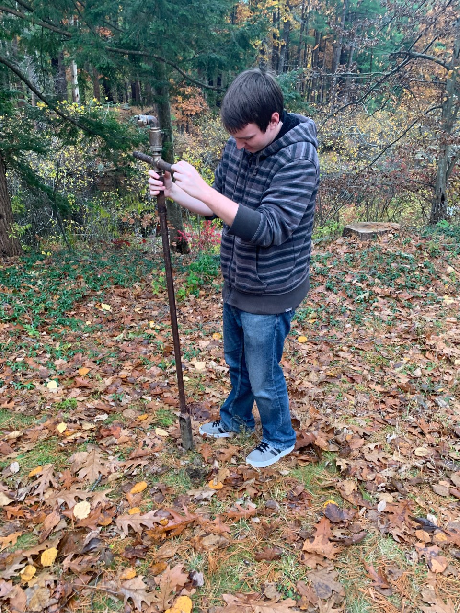
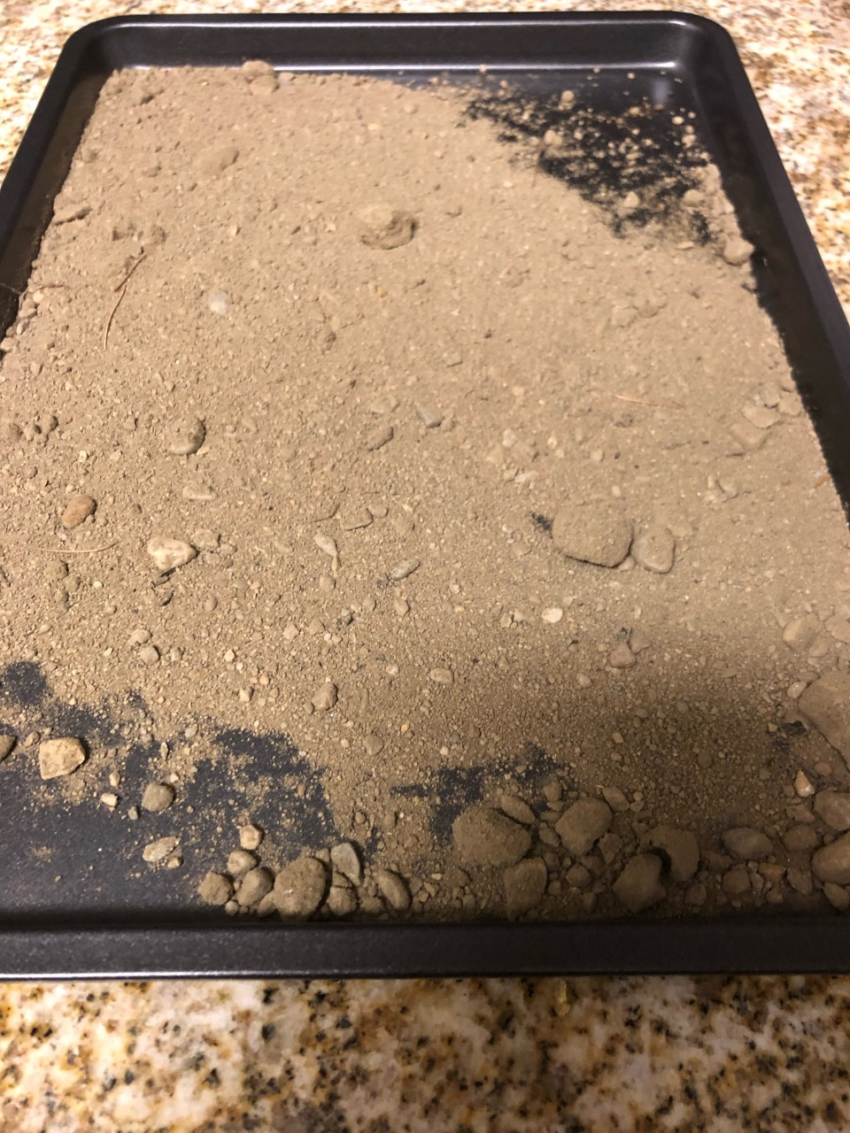
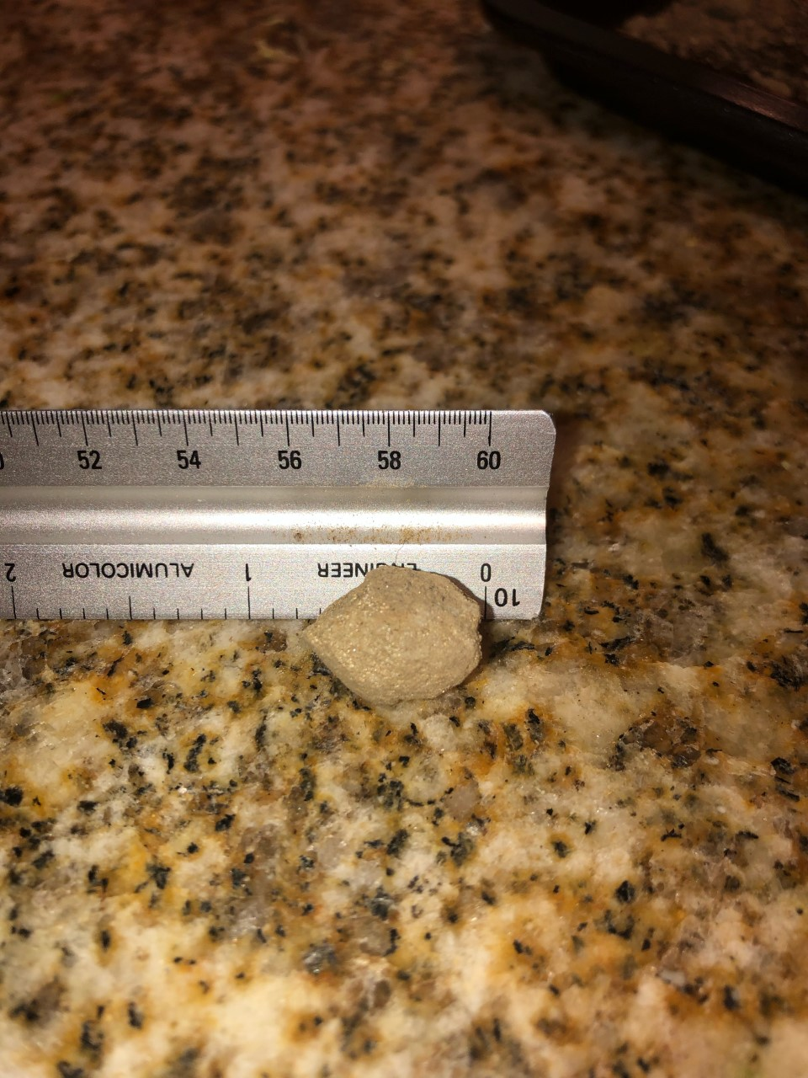
Geotechnical Findings
Soil samples taken during November site visits
Used a 4' hand auger
Low soil strength expectation

Slide 11
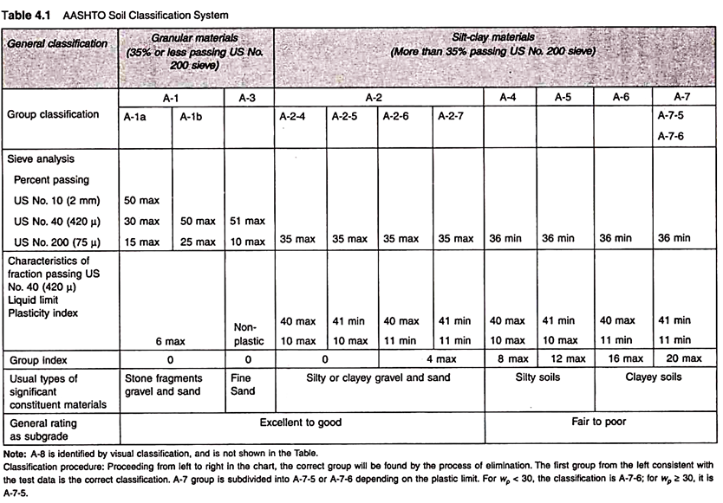
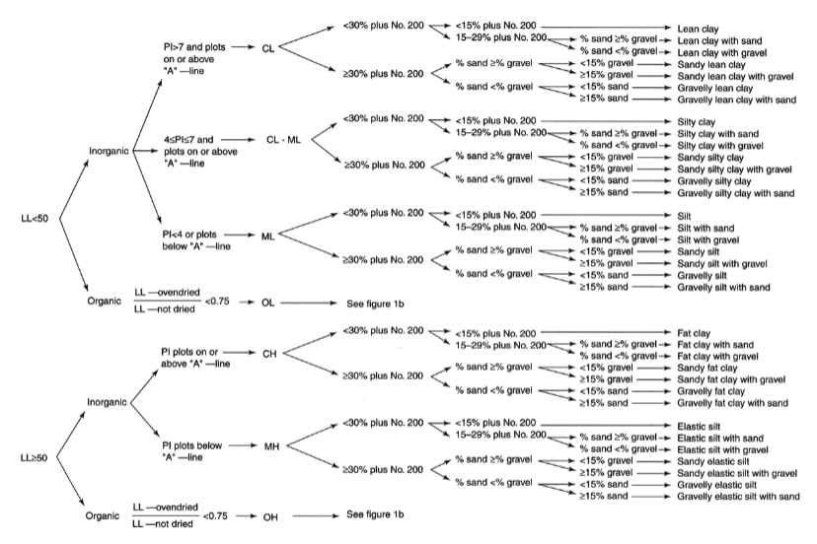
Geotechnical Findings
Gradation showed soil is a well graded sand
Load bearing capacity of 3,000 psf
Flow Chart for Classifying Fine-graded Sand
Findings provided various bridge design options for the Structural team

Slide 12
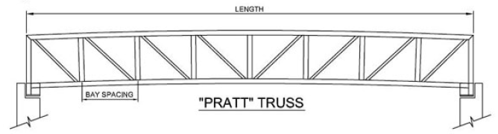
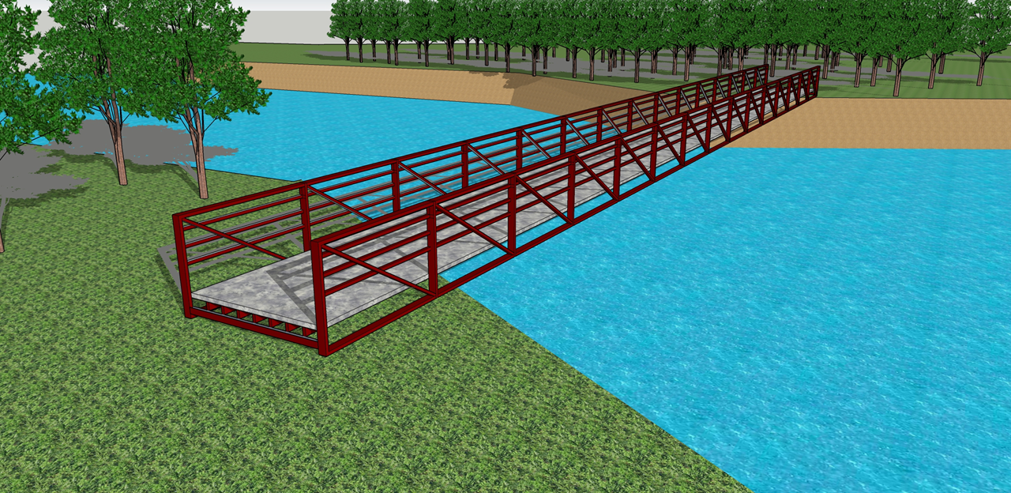
Bridge Type：Pratt Truss
Common bridge type
Low environmental & visual impact
Efficient members
  Cost-effective
  Low self-weight
No Piers required
Prefabrication available
Easy assembly

Slide 13
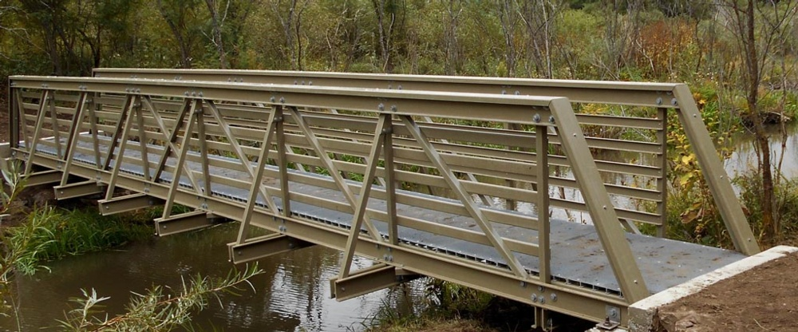
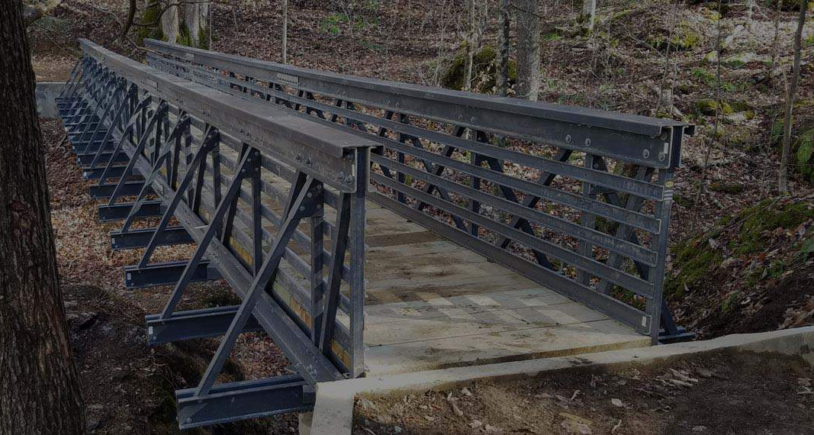
Bridge Material :
Fiberglass Reinforced Plastic (FRP)
Light weight (75% < steel)
Strong and durable (10,000lbs)
Resistance to
  heat/wind/rain/snow/corrosion/insects
Maintenance-free
Prefabrication Available
  Ex: Bedford Reinforced Plastics
Variety of colors (already molded)
Easy on-site Installation

Slide 14
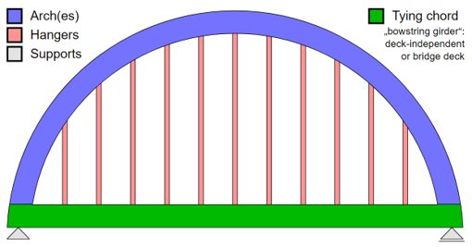
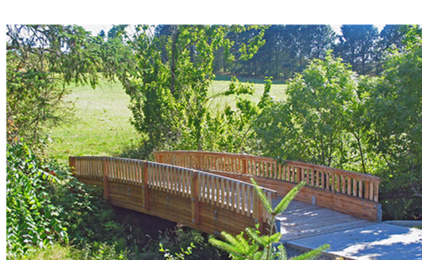
Considered Alternatives :
Bridge Type: Tied-Arch
  More complex design
  Maintenance required
  Costs more than simple design types
Bridge Material: Timber
  Susceptible to erosion and fire
  Maintenance required

Slide 15
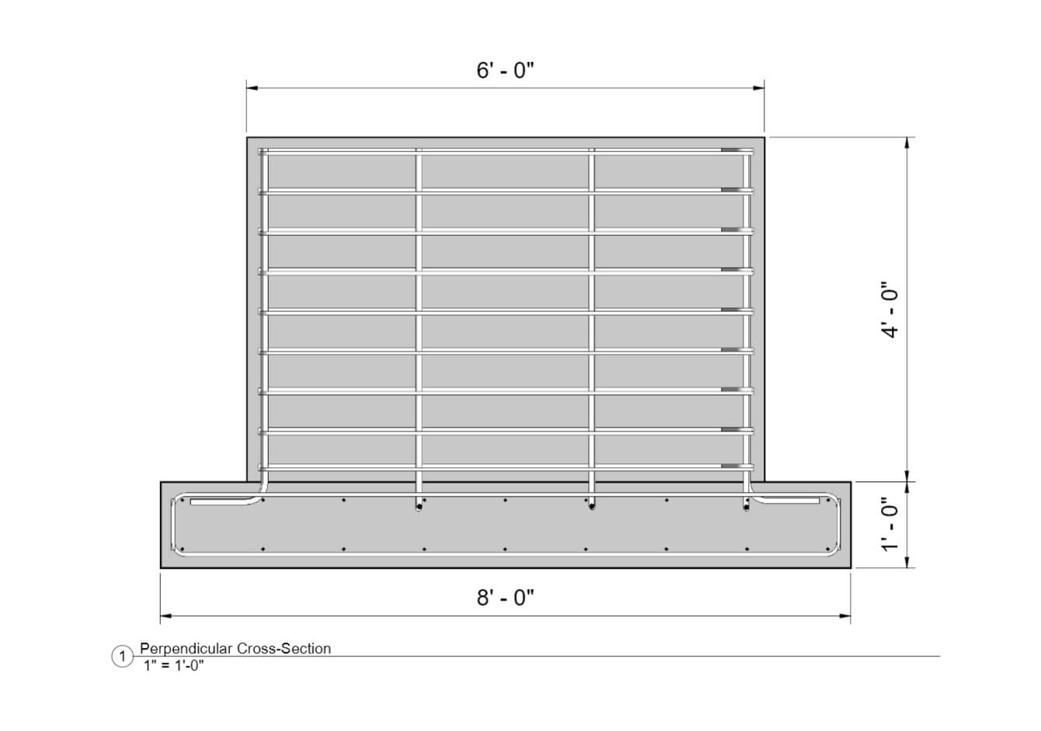
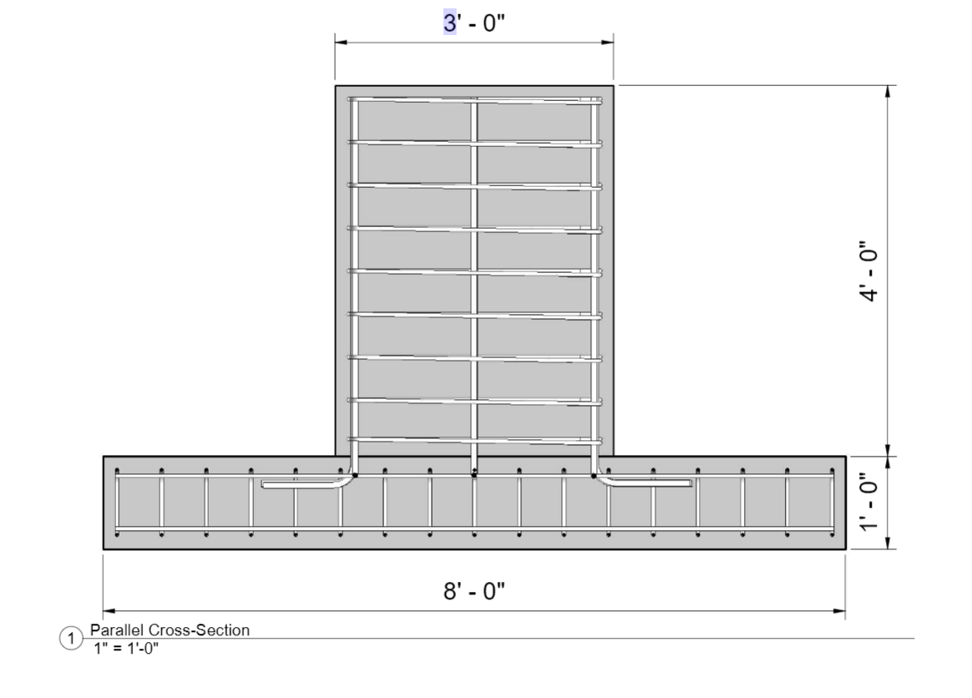
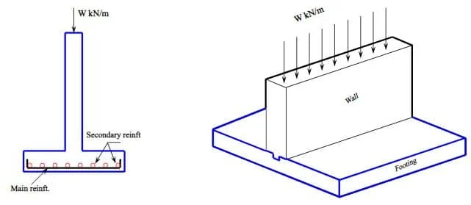
Abutment Design
Abutment geometry
  Spread footing with a foundation wall
Designed for 130,000 pound load
Soil bearing capacity = 3000 psf
  Footing determined to be 8ft x 8ft x 1ft
  Foundation wall determined to be 6ft x 3ft x 4ft

Slide 16


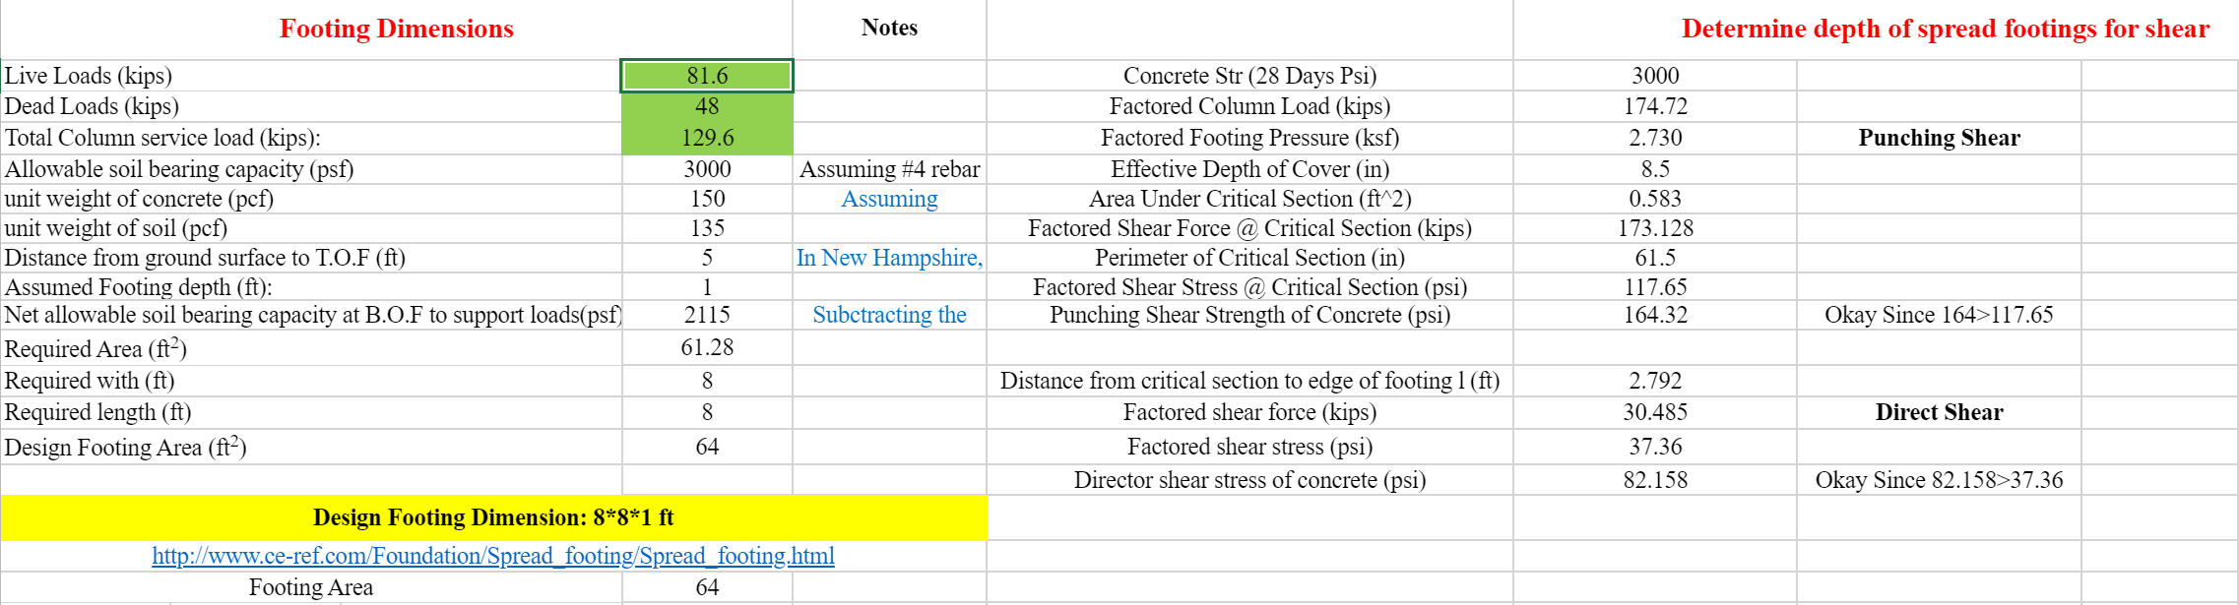
Abutment Design Cont.
Tested for direct and punching shear
Punching Shear – Crushing in the slab where the wall meets the footing
Direct Shear – Measures the shear capacity of the soil
Punching Shear > Factored Shear Stress @ Critical Section

Slide 17
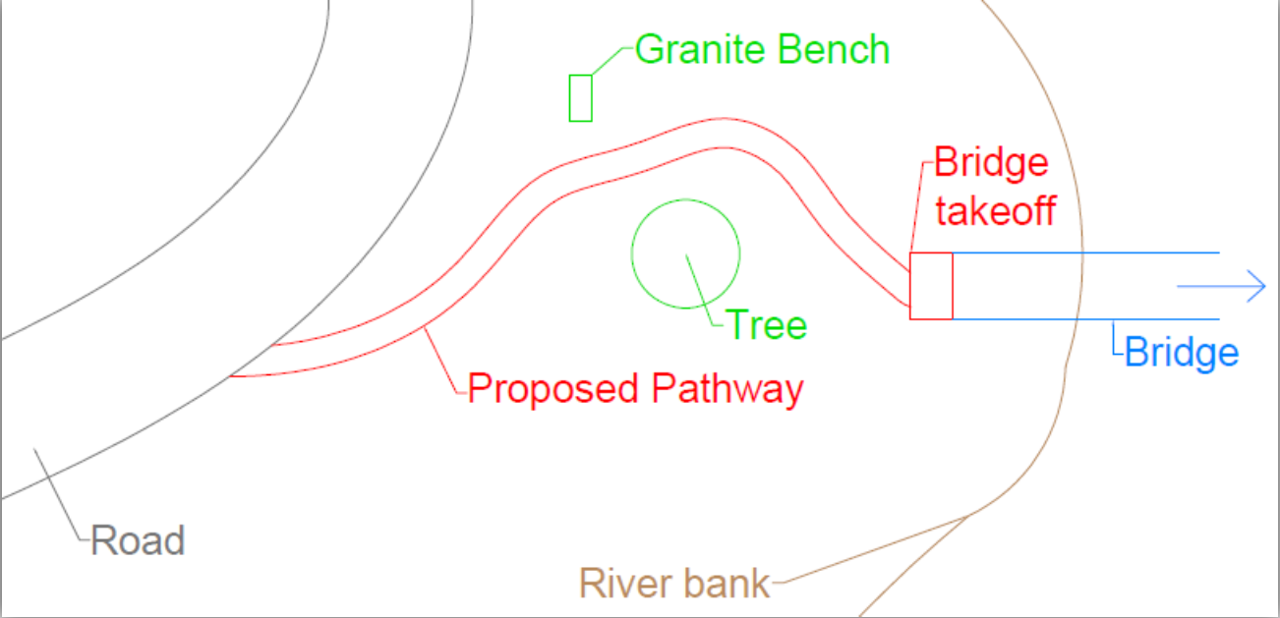
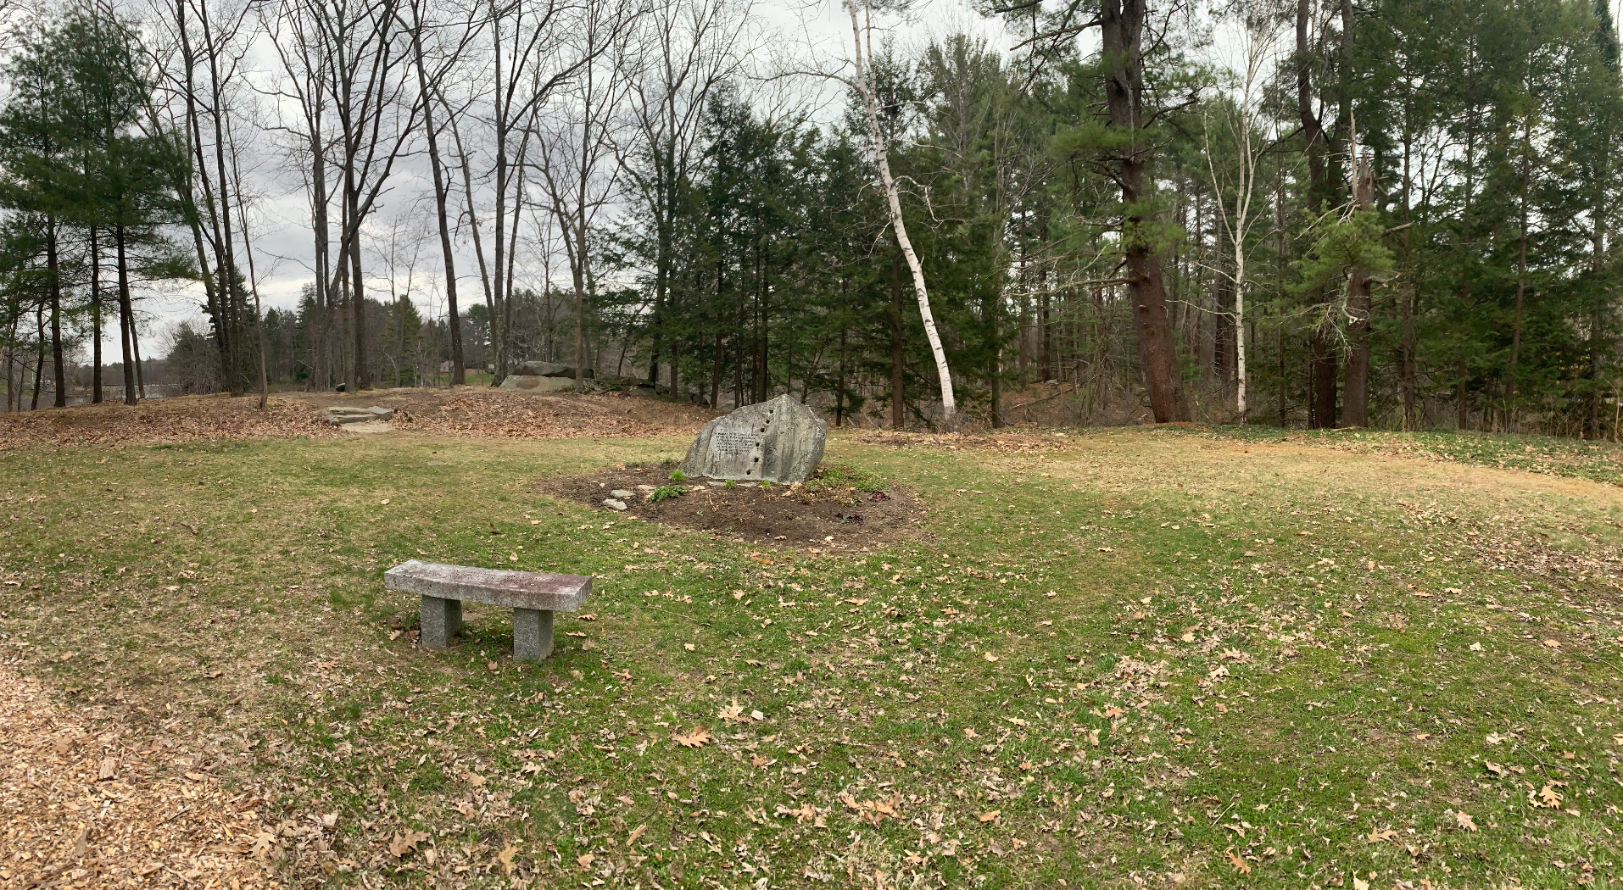
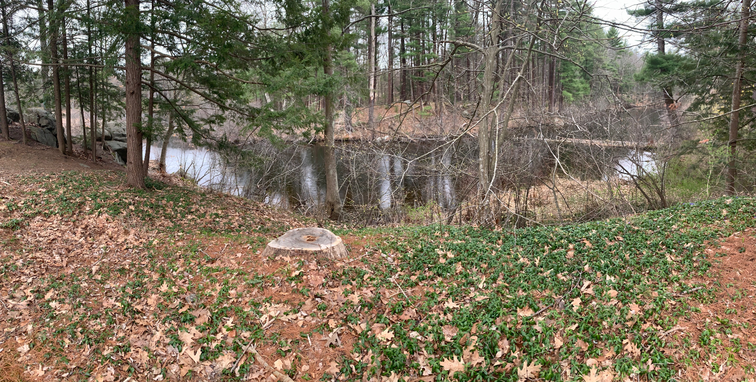
Obstacles
Construction through Milne sanctuary
Limited information about the site
Coordination with various parties

Slide 18
Questions?
Email: mls1040@wildcats.unh.edu

