Slide 1


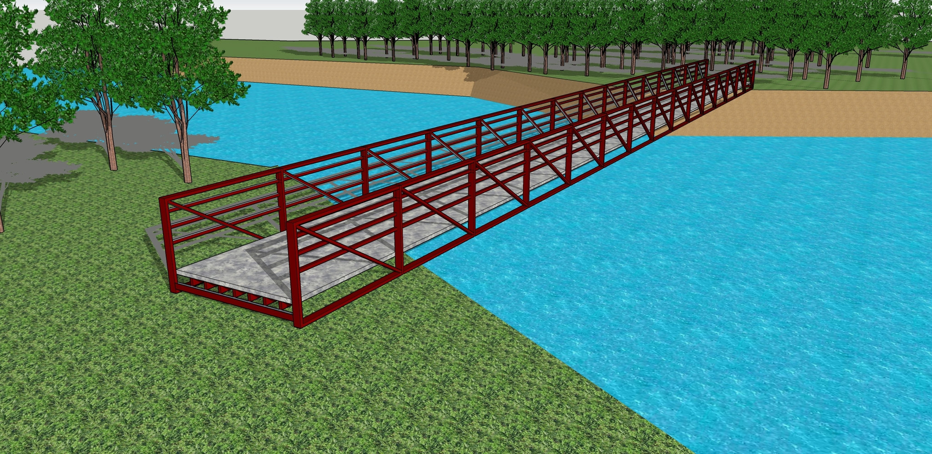

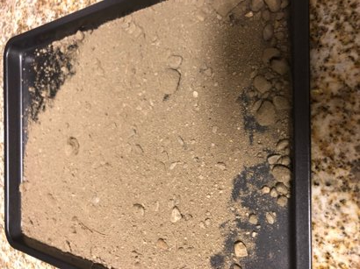
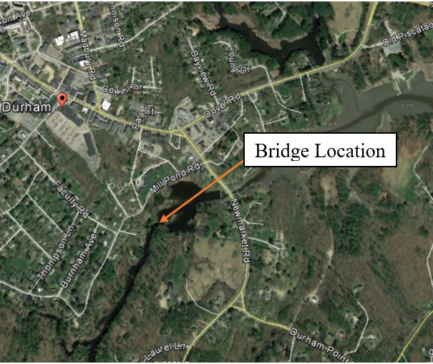
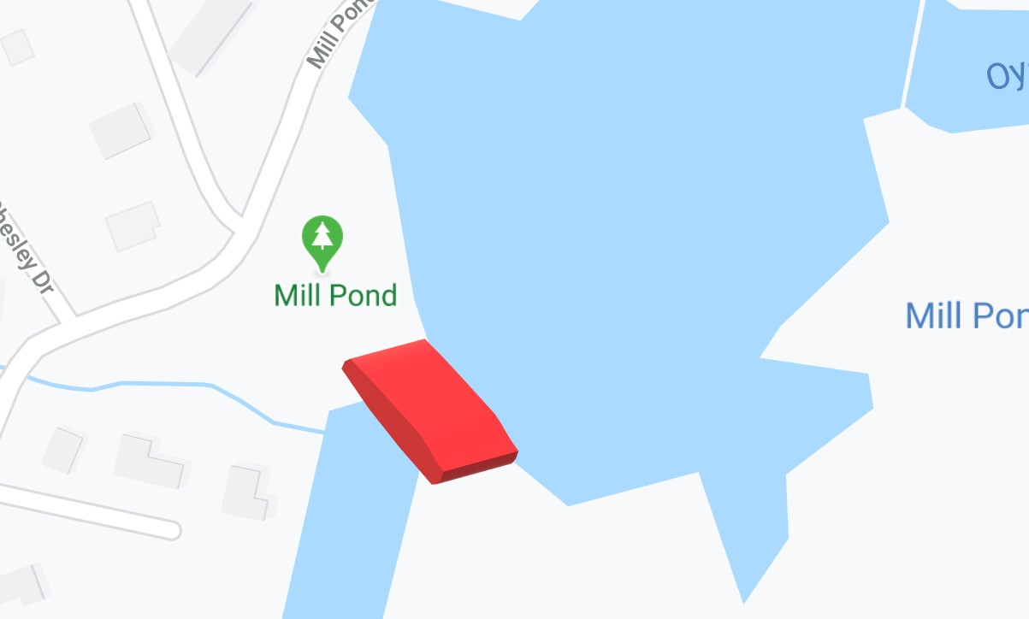
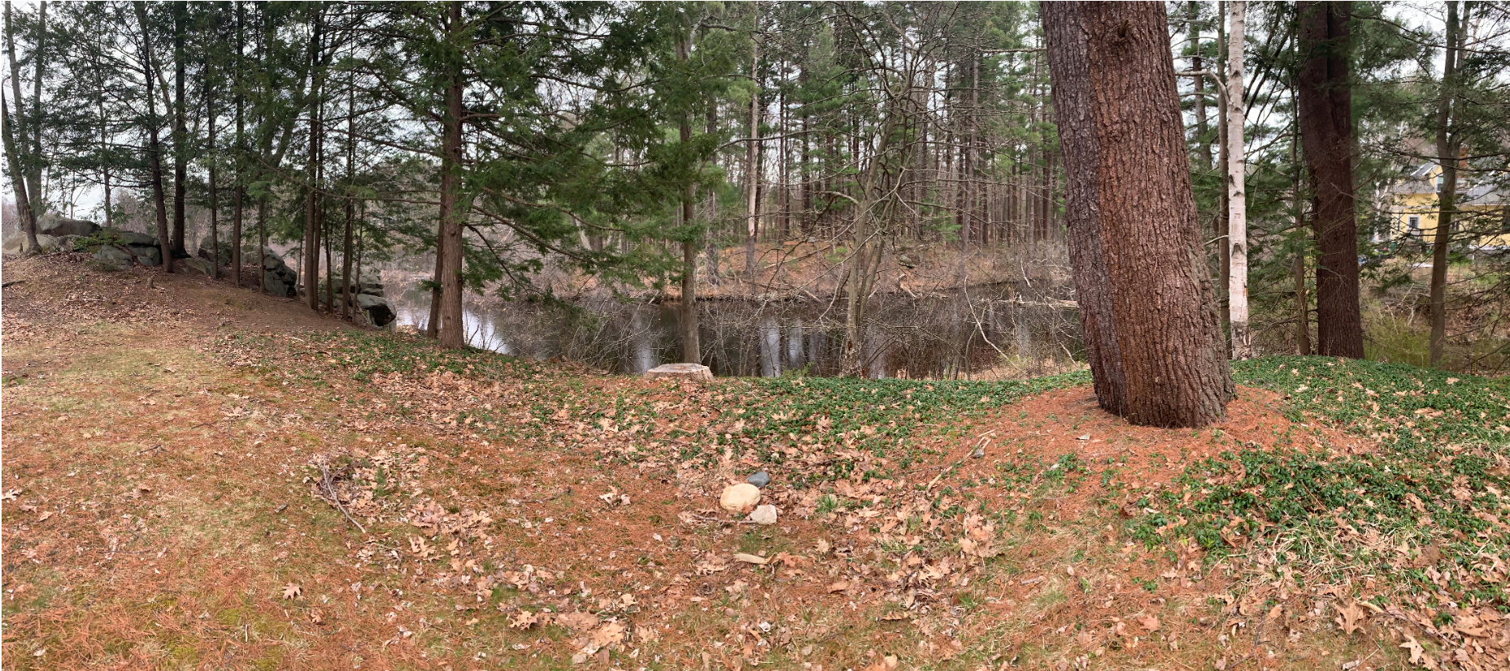
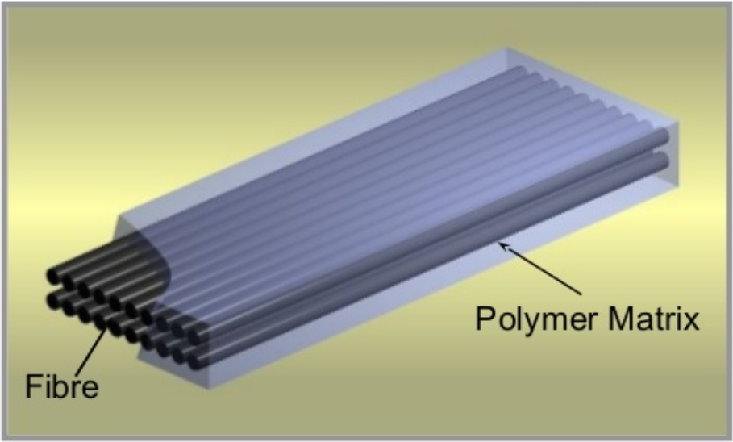
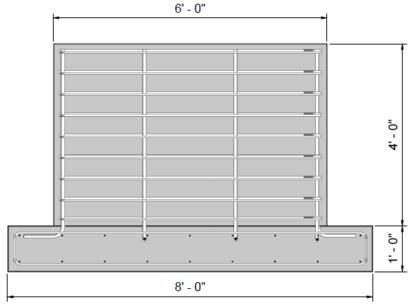
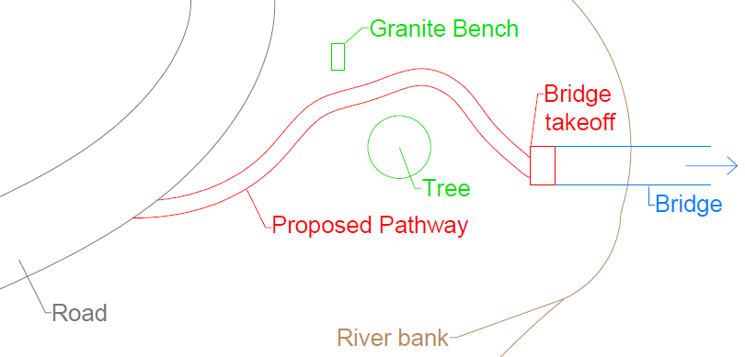

Pedestrian Bridge over the Oyster River in Durham, NH
Matthew Spurr (PM), Alan Bauman, Matthew Golden, Wei He, Connor Thompson
Faculty Advisor: Erin Bell │ Project Sponsor: Dennis Meadows
Project background
Proposed Bridge
results
Goal: Design a pedestrian bridge
Location: Oyster River off Mill Pond Road, at the inlet of Mill Pond
Founder: Dennis Meadows
Stakeholders: Milne Sanctuary, The Town of Durham, The Town of New Market, NH
Bridge Purpose: Connect the Milne Sanctuary to walking trail allowing for convenient pedestrian travel between Durham and Newmarket
AASHTO Soil Classification
- Soil sample taken at depths of 4'
- Soil Classification is a well graded sand
- Load bearing capacity of 3 ksi in the soil
Bridge Design
- Bridge Type: Pratt Truss
- Dimension: 8' x 120'
- Fiber-Reinforced Polymer
Foundation Design
- Axial Column Load: 130 kips
- Footing Area = Axial load/Allowable Soil Capacity
- Abutment Type: Spread Footing
- Dimension: 8' x 8' x 1'
- Foundation Wall: 6' x 3'
- #4 Rebar used in Footing
- #6 Rebar used for Stirrups
Environmental Permitting
- NHDES Wetlands
->Permit-by-Notification
- NHDES Shorelands
->Permit-by-Notification
- Minimal impact to endangered species in area
Virtual 3D Model of the Bridge
Arial view: Bridge Location and Direction in Relation to Durham
Proposed Bridge Location in Milne Sanctuary
Scope of work
PROJECT challenges
Create schedule of project deliverables
Obtain information for required permits
Select Bridge type and material
Design bridge, abutments and approach paths
Provide conceptual drawings of the bridge
Preservation of Milne Sanctuary
Limited information about the site
Soil extraction for strength testing
Lab space for gradation testing
Equipment deficiencies for site survey
Coordination with various parties
Foundation Cross Section
Milestones
Engaged with stakeholders about project details
Provided a conceptual site plan
Determined the bridge type, length, material and location
Designed a spread footing abutment
Proposed Pathway Leading to Bridge
Department of Civil and Environmental Engineering, University of New Hampshire

