Slide 1


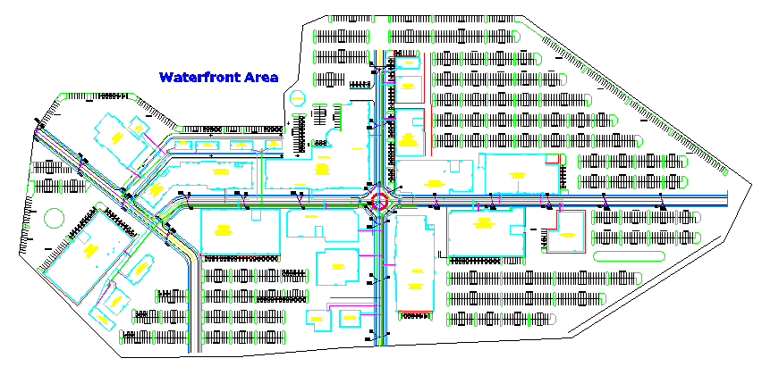
Tuscan Village Development
Spencer McKinnon (PM), Margaret Fillion, Matt Hall, Robert Joscelyn, Thomas Simoncelli
Faculty Advisor: Ken Flesher | Project Sponsor: Tighe & Bond
Department of Civil Engineering, University of New Hampshire
Introduction
The Tuscan Village is creating commercial, retail, and residential living in the heart of Salem, NH to redevelop the former Rockingham Park horse race track. In collaboration with Tighe & Bond and The UNH College of Engineering and Physical Sciences, a site design was proposed for the south and central village. The goal of this project was to create a downtown atmosphere while also providing safe passages for travel and an uplifting atmosphere. This site plan includes building locations, a transportation plan, parking to accommodate all businesses, and an analysis on the drainage necessary for the layout in accordance with local and state regulations.
BIG SITE
Scope of Work
Generate a master site plan for the south and central villages
      Develop a site plan
      Generate a parking plan with adequate vehicle circulation
      Creation of a stormwater plan
      Develop a plan for sewer, water, and electric utilities
      Create a detailed profile of a drainage run
All tasks done in compliance of all regulations and ordinances
Site Layout
Parking
Store frontage along sidewalks and roads
Parking found behind buildings
Restaurants located near waterfront
Apartments located near waterfront
Built within bounds set from existing plan
Retail focused around 2 main streets and central rotary running vertically and horizontally at the core of the site
Central rotary will serve as heart of the village and feature large horse statue to commemorate the history of the former horse track
Parking abides by Chapter 309, Article 7 Zoning Regulations
Total of 2,056 regular and 150 handicap spaces
Green space equivalent to one parking space every 15 spaces
Larger green space endcaps/islands make up for stretches with less green space available to maximize parking
Design Considerations
      24’ internal access for large trucks
      Landscaped islands & fountains for aesthetic appeal
      Easy exit access to main roads for congestion relief
      Majority of parking away from waterfront for added noise control
Utilities
      Sewer - Gravity fed to Rt. 28
                12” PVC SDR 35 Sewer main
                6” PVC SDR 35 Sewer services
.
      Drainage - Gravity fed to Rt. 28
                18” RCP Pipe
Roads and Transportation
      Water - tap to Rt. 28 force main
                12” PVC SDR 35 Sewer main
                6” PVC SDR 35 Sewer services
12' Roadway Lanes
Traffic circle designed to AASHTO truck turning standards
5' sidewalks and 5' greenbelt to encourage pedestrian travel
ADA accessible design
Retroreflective pavement markings
      Electric
                4” PVC Conduit Schedule 40
                4” PVC Conduit Schedule 80

