Slide 1
Zero Waste
Whitefield, NH
Sponsor: Robert Larson, Director of Public Works
Faculty Advisor: Anthony Puntin, PE
Notes:
Hello, We are team 18 and over the 2019-2020 school year we have been working on a zero- waste initiative for Wiitefield NH.

Slide 2
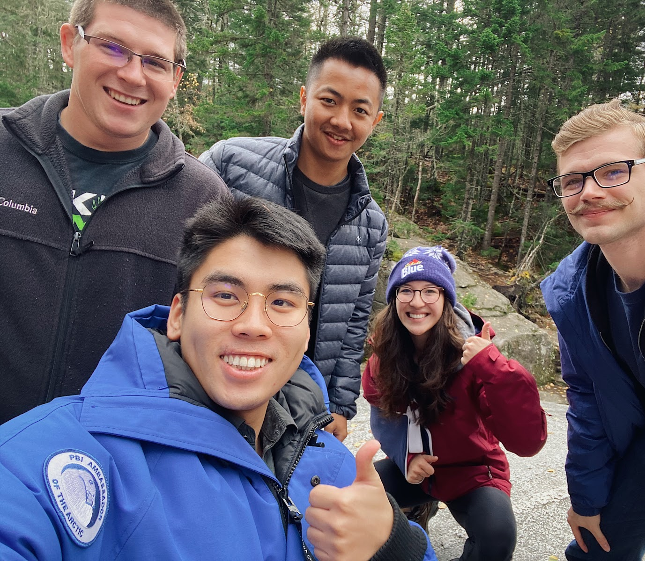
Team 18
Keaton Peterson
Arkar Soe Moe
Tyler Taggett
Mikayla Nguyen
Shudong Hua
1
Notes:
My name is Keaton and my fellow group mates:

Slide 3
Presentation Overview
Project Overview
Scope of Work
Existing Conditions
Design Alternatives
  Alternative I
  Alternative II
Solar Array Figures
Recycling Efforts
Recommended Policy
Challenges encountered
Overall Reason to Go Green
Final Results
2

Slide 4
Project Overview
The goal is to utilize zero waste strategies and incorporate a market for discarded trash, including further separation of trash and recycling policies.
Retrofit Brown Street Furniture building into Whitefield’s new transfer station.
Determined best design alternative (drive through facility) along with renovations to require minimum budget/impact on the environment.
3

Slide 5
Scope of Work
Define Zero-Waste
  Define zero-waste and develop policies for Whitefield to achieve a successful program
New Transfer Facility
  Observe the current transfer station, determine efficiency of current operations and evaluate if a new facility is recommended upon developing alternative designs
Public Policies
  Public education
Removed: Landfill Reclamation
  Average landfill reclamation cost $5.5 Mil.
  Monitoring wells cost $7800 a year
4

Slide 6
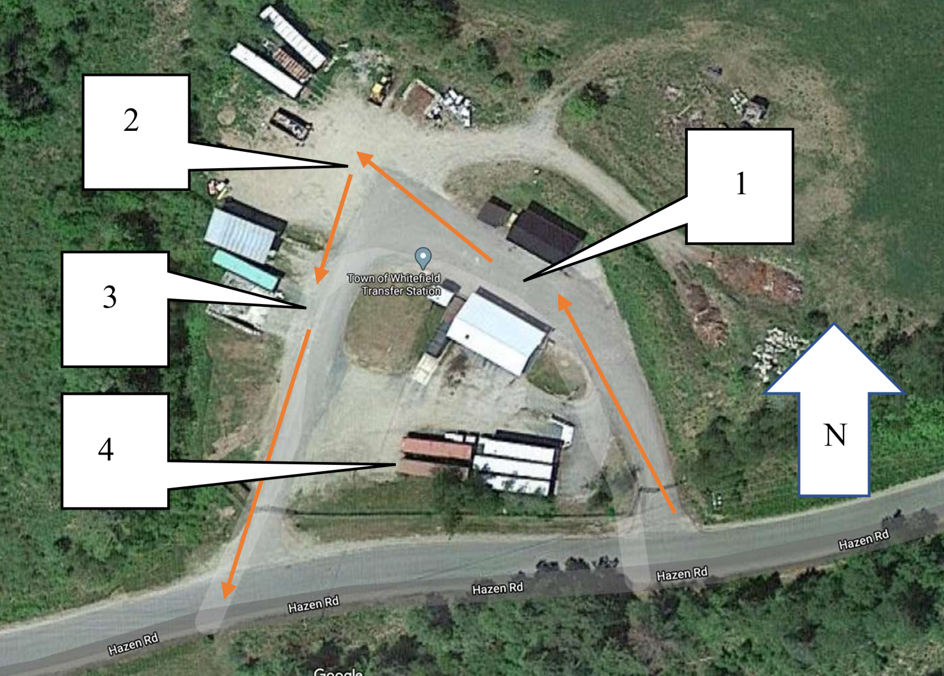
Whitefield Transfer Station
5
Source: Google Maps

Slide 7
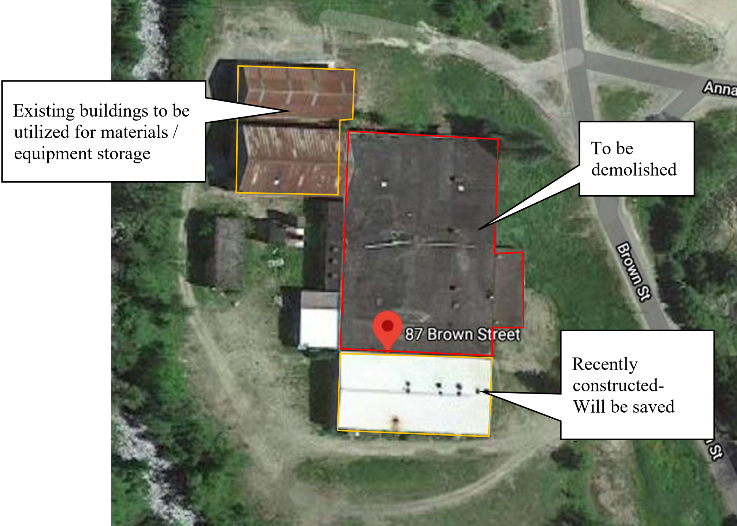
Existing Condition (Brown Street Furniture)
Source: Google Maps
6

Slide 8
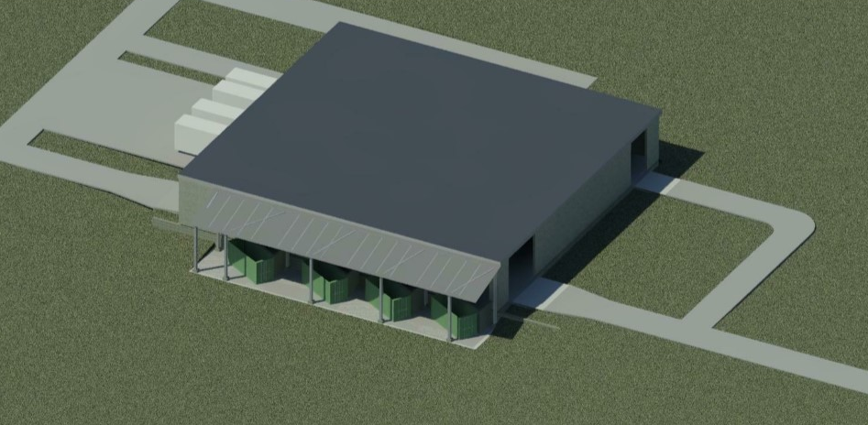
Design Alternative #1 3D View
7
Notes:
Major Highlights of this design include the the slab on the left, lower elevation supporting waste containers for easy discarding of waste. Also, the drive in drive out design decreases exposure to the elements. This in turn will ease recycling and sorting. Rear loading docks will make loading operations easier and more efficient.

Slide 9
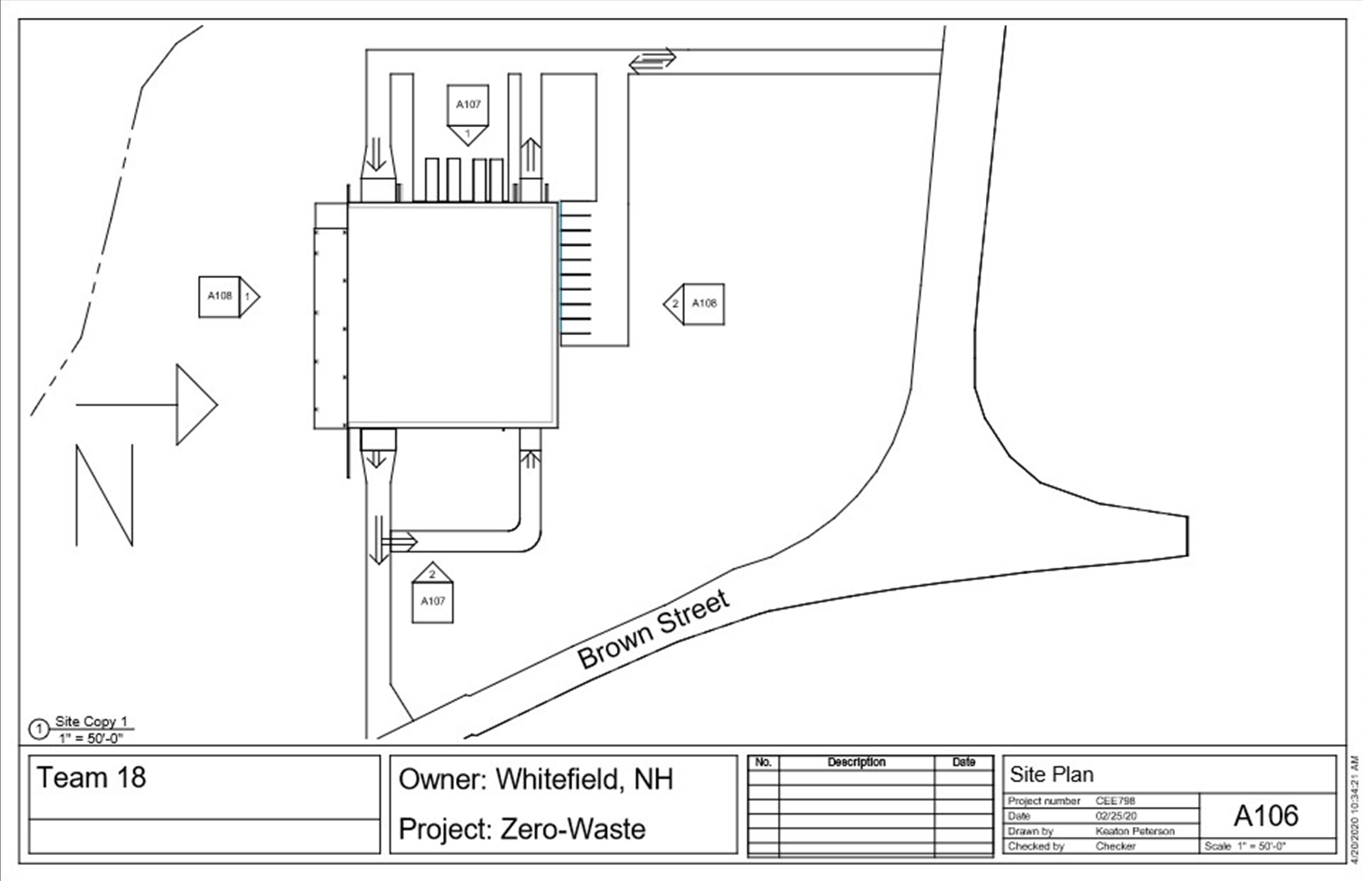
Design 1 cont.
8

Slide 10
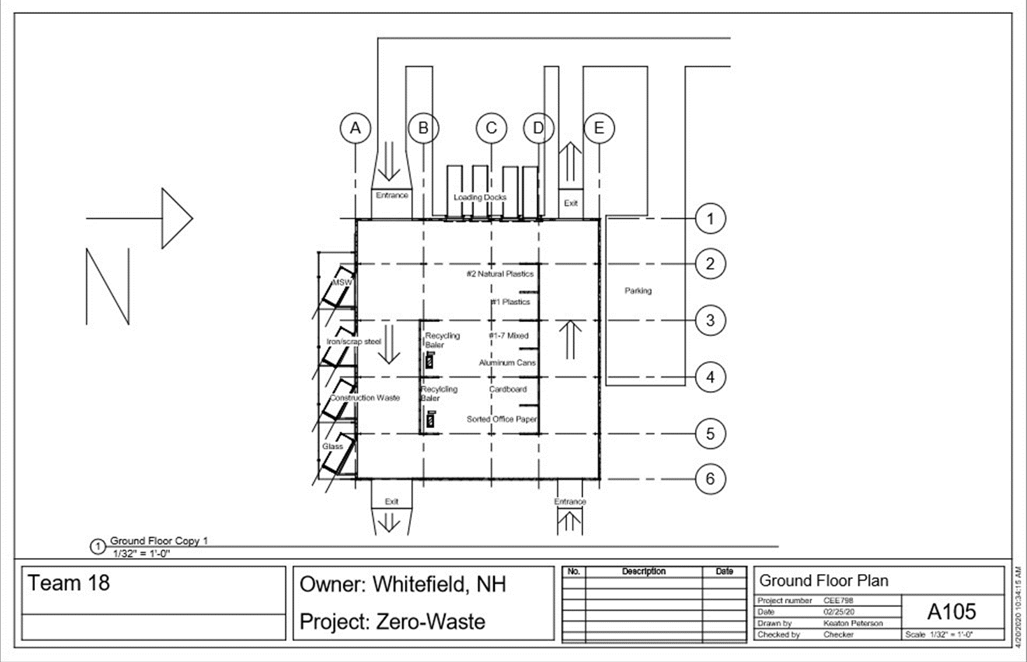
Design 1 cont.
9

Slide 11
Design 1 cont.
10

Slide 12
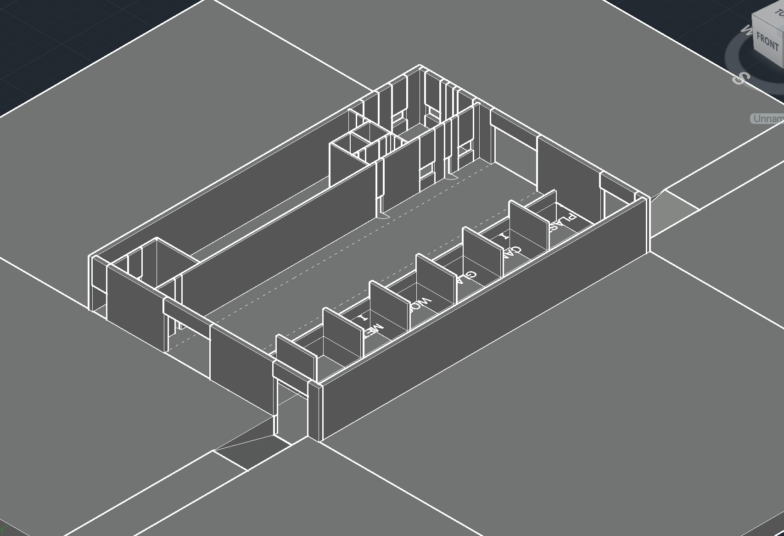
Design Alternative #2 3D View
11

Slide 13
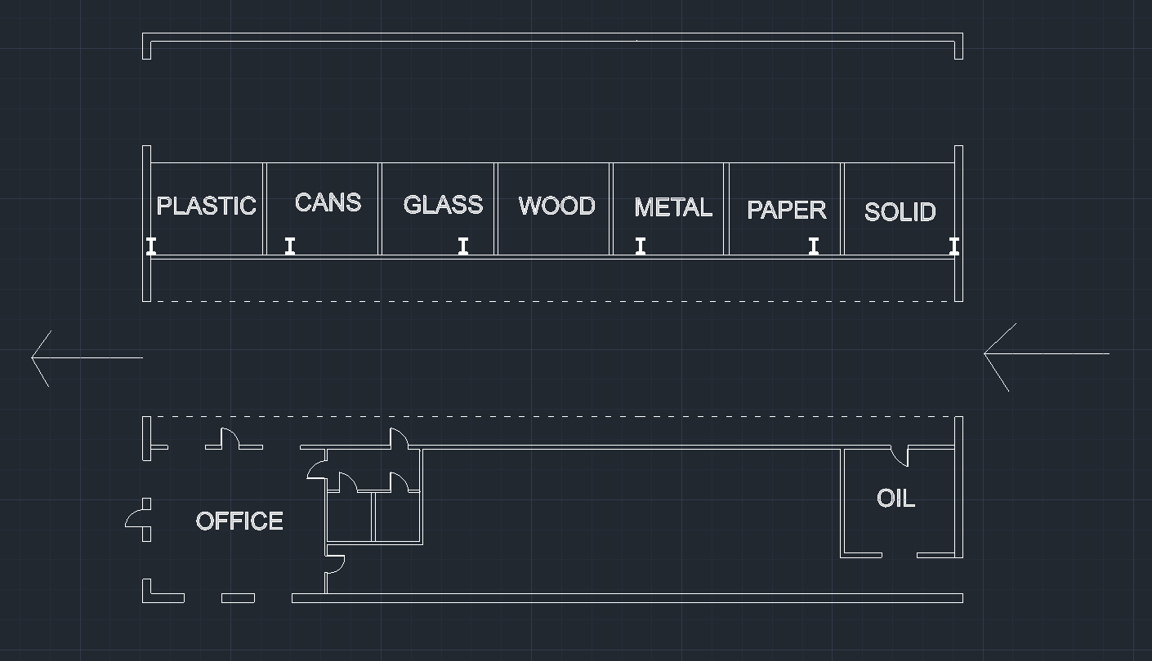
Design Alternative #2 Floor Plan
12

Slide 14
Reasons for Alternative I Selection
No interior subgrade work required
Materials remain inside facility
  Compaction occurs inside right next to intermediate storage
  Shipping containers connected at loading dock for additional long term storage and removal
Two separate lanes for travel
  Less congestion and limit wait times for less common materials - construction waste
13

Slide 15
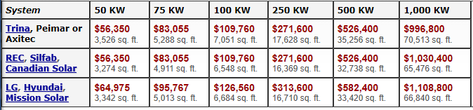
Solar Array Figures
Roof allows for 18,260 Sq ft of fixed roof mounted solar panel
Largest system would be 254.3 KW
Cost: A 250 KW system that covers 17,628 sq. ft costs $271,600
14

Slide 16
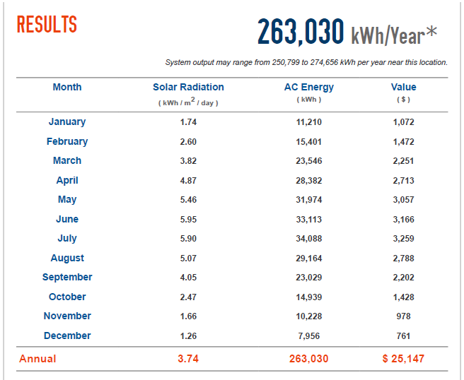
Possible Solar Panel Array
Figure from PVWATTS Calculator
Could pay for System in 11 years
Expected life 25 years
14 years of payout totaling $352,058
15

Slide 17
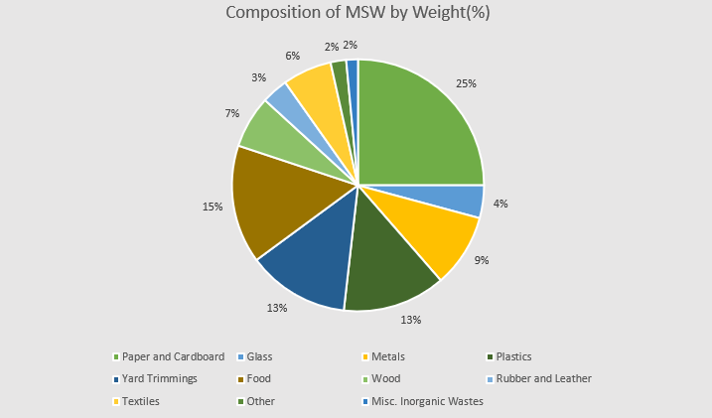
Recycling Efforts
16

Slide 18
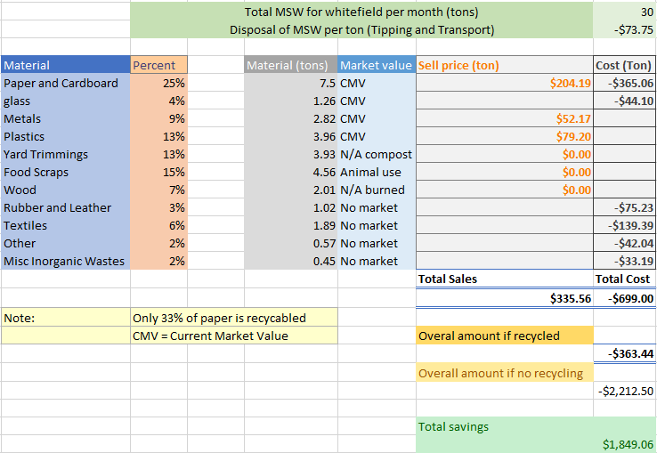
Potential Savings from Recycling
17

Slide 19
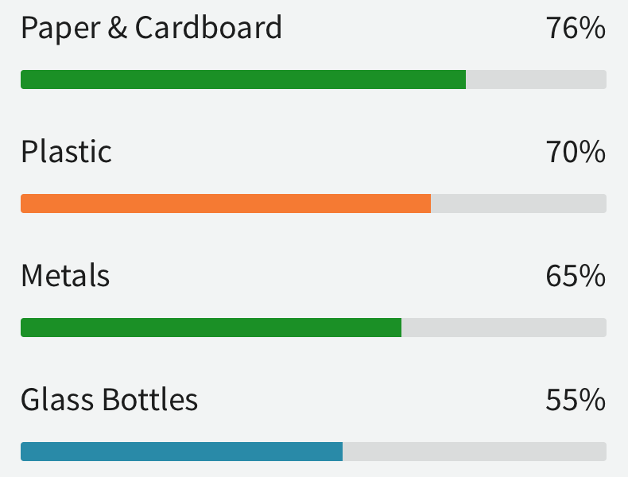
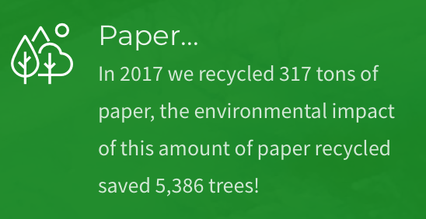
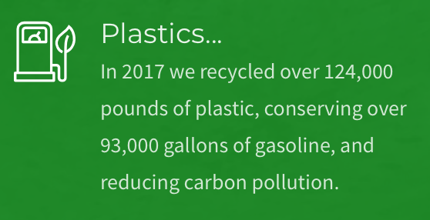
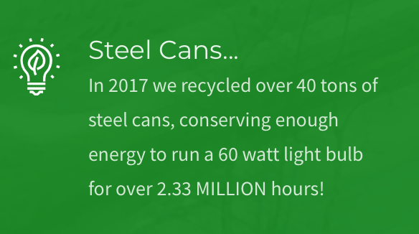
Neighboring Recycling Policies
Neighboring Locations:
  BCEP - Pittsfield NH
    Separation of materials for recycling made mandatory
    Saves tax dollars by avoiding disposal fees
    Recycled material generates revenue
18
https://bcepsolidwaste.com/recycling-policy/

Slide 20

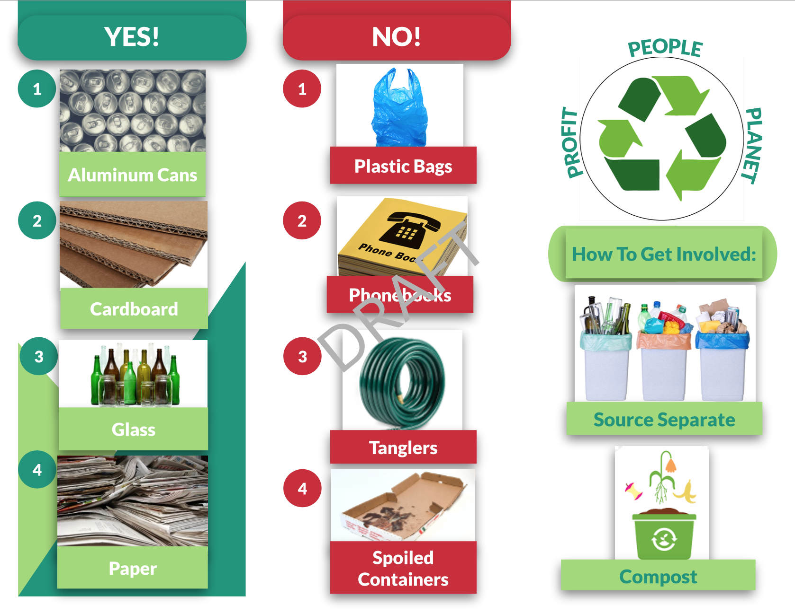
Educational Material
19

Slide 21
Challenges
Limited site visits (120 miles away from UNH and proximity from large cities)
Data collection for cost benefit analysis
COVID-19
    Time zones/zoom difficulties
Whether the existing building can withstand/qualify modifications if it can be retrofitted
  Feasibility of retrofit
20

Slide 22
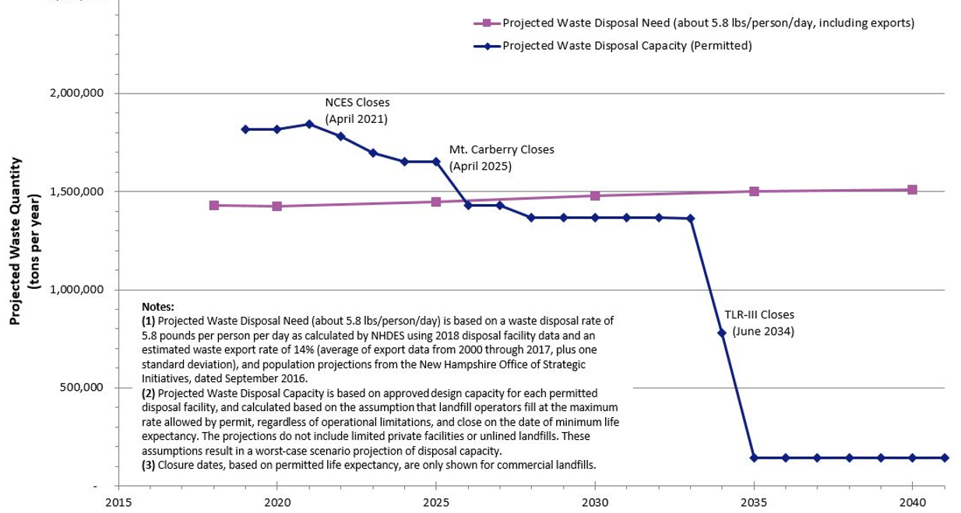
Major Reason to go Green
21

Slide 23
Final Results
Two-lane drive in drive out Facility
Suggested policy for Whitefield
Forming Policies for recycling requirements
22

Slide 24
References
http://paceglass.com/process.php
https://nrra.net/wp-content/uploads/NRRA-MIXED-GLASS-PGA-Spec-Sheet-Updated-June-2018.pdf
http://recyclingrai.wpengine.com/rai-difference/#payments
http://recyclingrai.wpengine.com/rai-difference/#payments
https://mrfoxcomposting.com/commercial-services/
https://recyclingworksma.com/recycler/reenergy-epping/
https://presbyrecycling.com/recycling/
https://www.yellowpages.com/milan-nh/mip/chapman-scrap-metal-recycling-demolition-481430057
23

Slide 25
Thank you for your time, any questions?
24
Notes:
thank you for your time and attention, we would now like to give you the opportunity for questions

