Slide 1
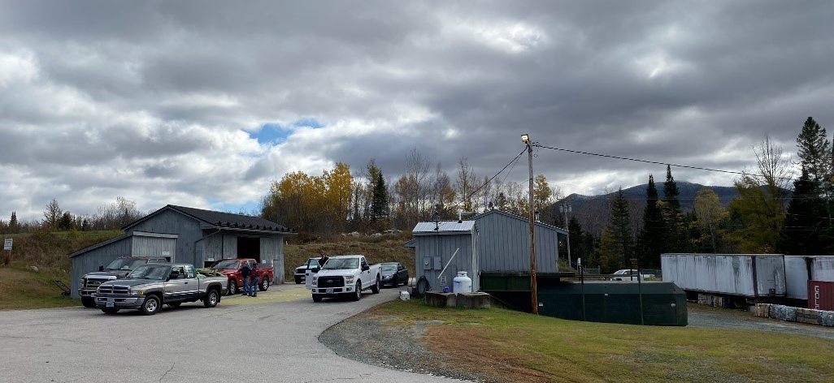
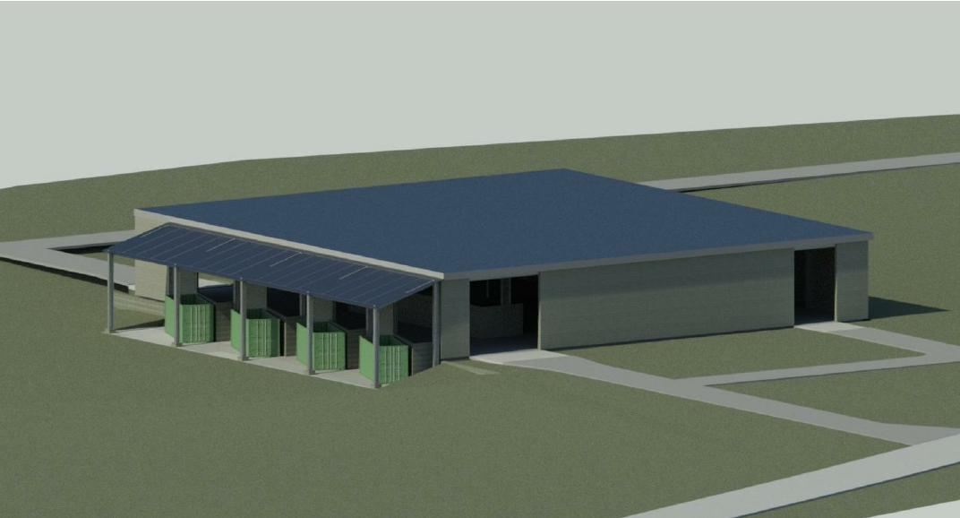
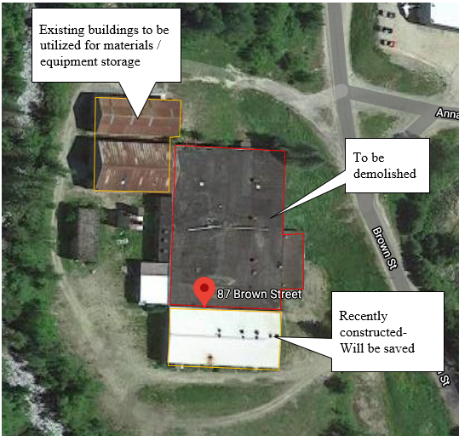
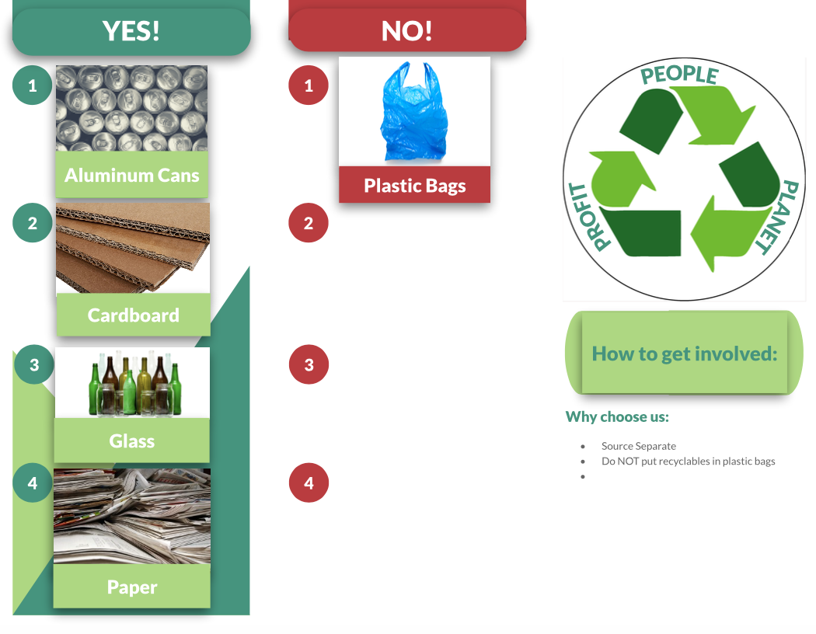
Zero Waste Transfer Station Whitefield, New Hampshire Department of Civil and Environmental Engineering, University of New Hampshire, Durham, NH 03824
Site Background
Transfer Station Design Alternative I
Existing Policy
Pay-As-You-Throw Incentive Program
Reduces amount of recyclable material entering the waste stream
Achieves higher material purity
Proposed Policy
Drive in- drive out facility
Bi- lane traffic
Left lane to dispose of larger wastes
Right lane to dispose of recyclables
Stricter separation at the household level
Use of educational material
Higher Value Incentives
Clear and concise ordinance documents
Draft
Aerial
Population: 2,213
Median Age: 51 years
Median Income: $32,893
Conserve energy by utilizing an existing building
17,000 square feet of solar panel potential.
Central location in Whitefield, within proximity of downtown.
Restore a deteriorating building, add value to the neighborhood
Draft
Current Facility Concerns:
Operation Inefficiencies
Environmental Impacts
Community Access
Increased MSW disposal costs
Market Research
Disposal cost of $67 per ton of MSW (Transportation fee $6.75 per ton)
Average composition of municipal solid waste
Paper and cardboard: 25%
Glass: 4.2%
Metals: 9.4%
Plastics: 13.2%
Yard Trimmings: 13.1%
Wood: 6.7%
Rubber and Leather: 3.4%
Textiles: 6.3%
Other: 1.9%
Misc. Inorganic Wastes: 1.5%
Whitefield MSW was 30 tons in a month
If recycled and sold at average market value
Costs $363.45 a month to dispose of MSW to landfill
If all MSW goes to a landfill
Costs $2212.50 a month to dispose of MSW to landfill
Recycling saves $1849.05 per month.
Note: Figures are a best-case scenario
Defining Zero Waste
Recommendations
Implementation of a new facility achieves:
Diversion of 75% of waste by weight as recyclable material
Remaining 25% of waste disposed of in a landfill
Design I alleviates Whitefield’s concerns
A bi-lane traffic pattern smoothens operations and allows for a higher volume of flow
The tipping floor is spacious for adequate work areas
Conclusion
Whitefield must educate residents to initiate Zero-Waste, public support is necessary
Bi-Lane drive in drive out is most economical and efficient retrofit determined

