Slide 1


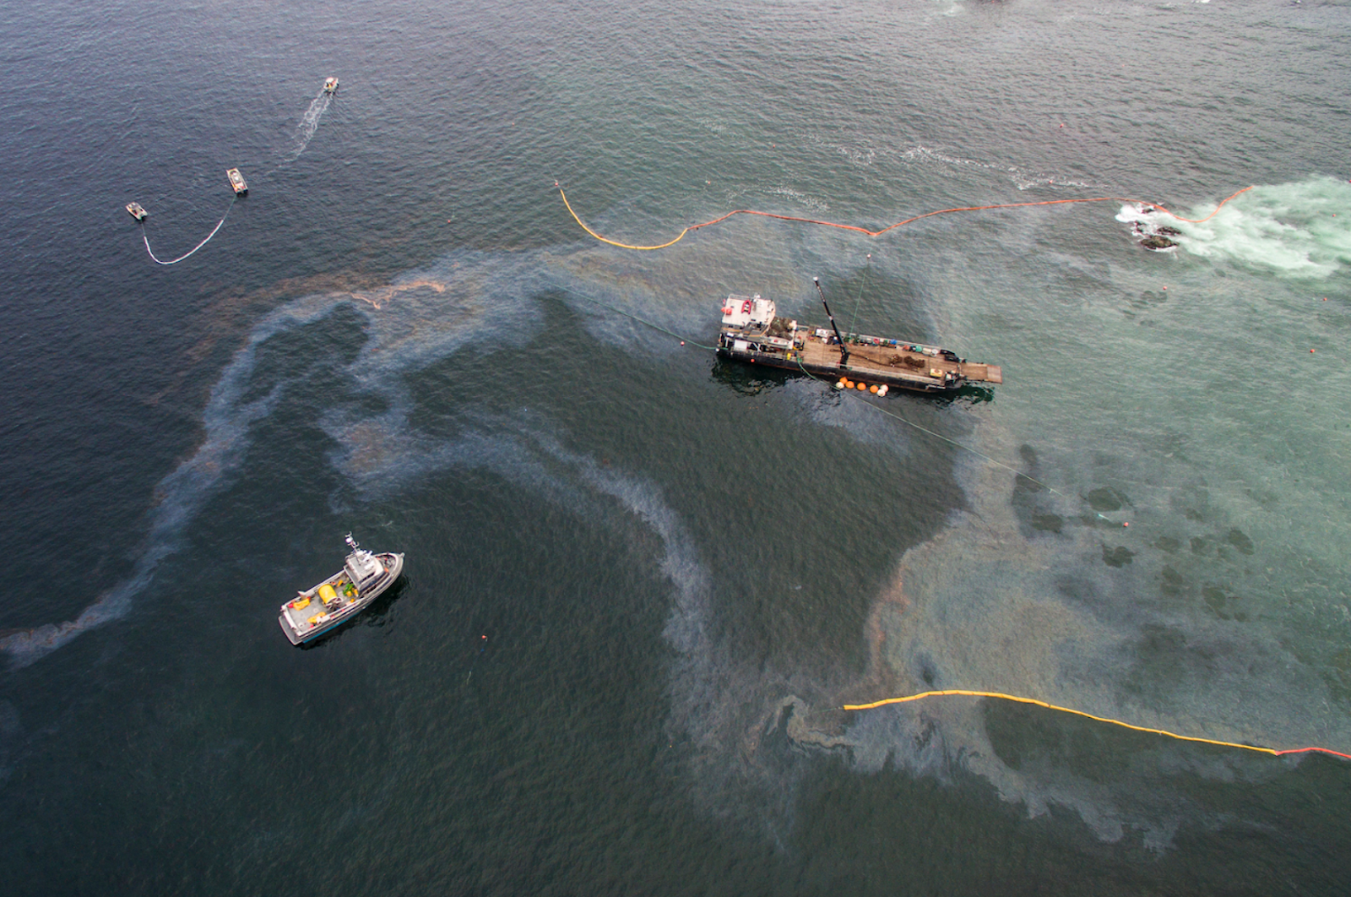
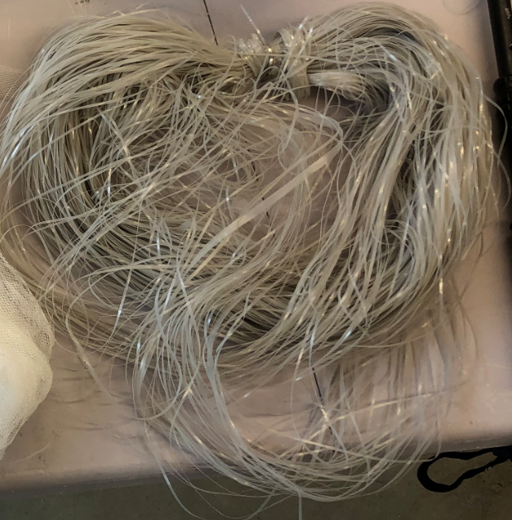
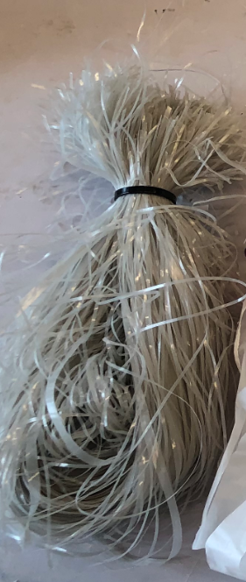
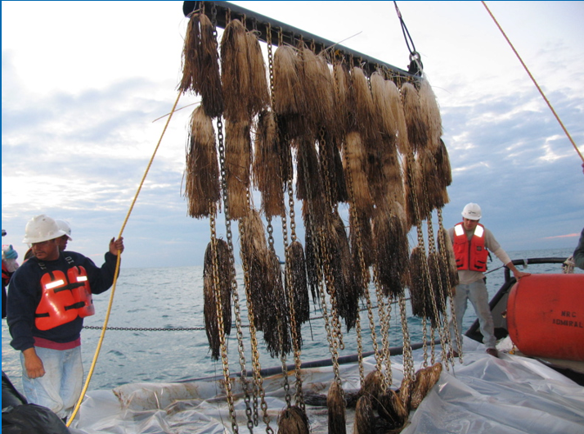
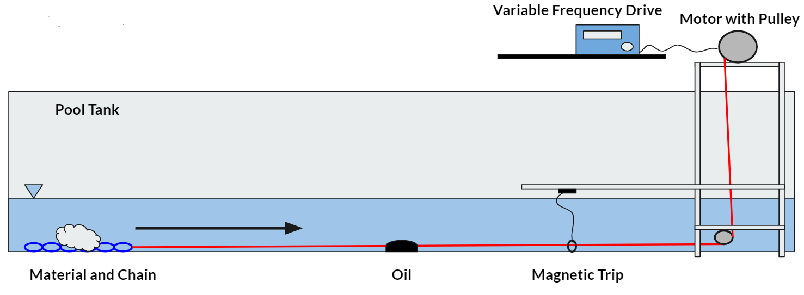
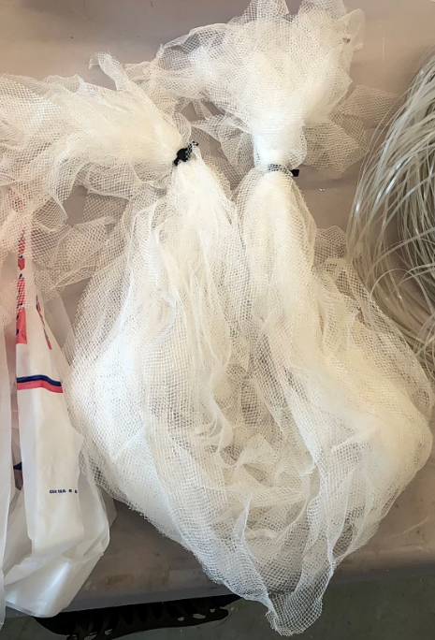
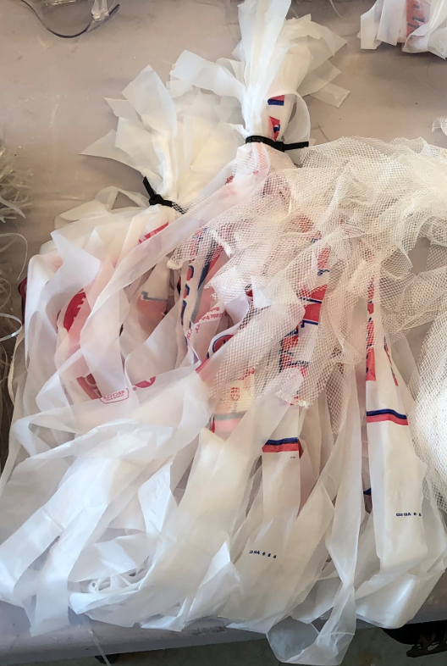
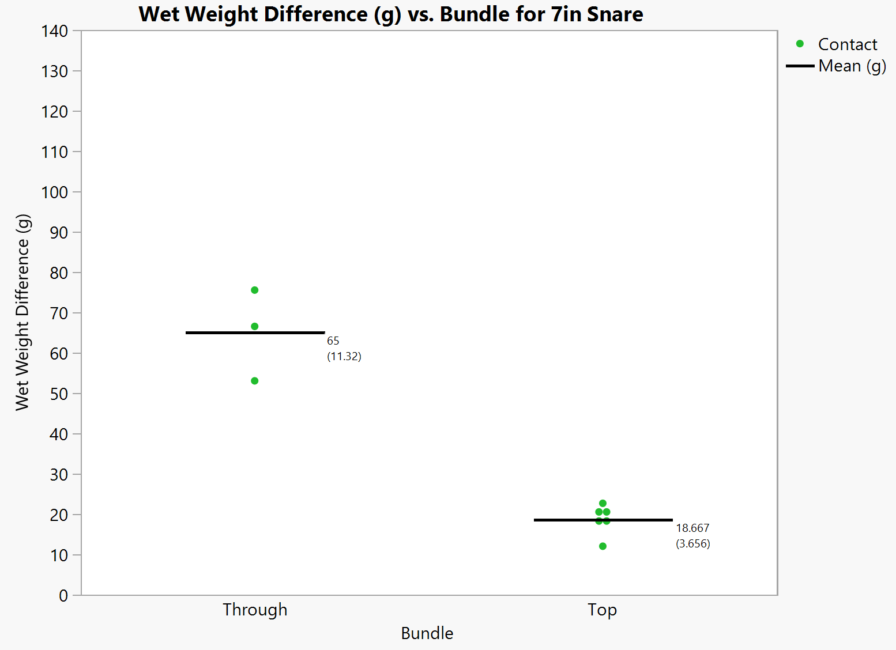
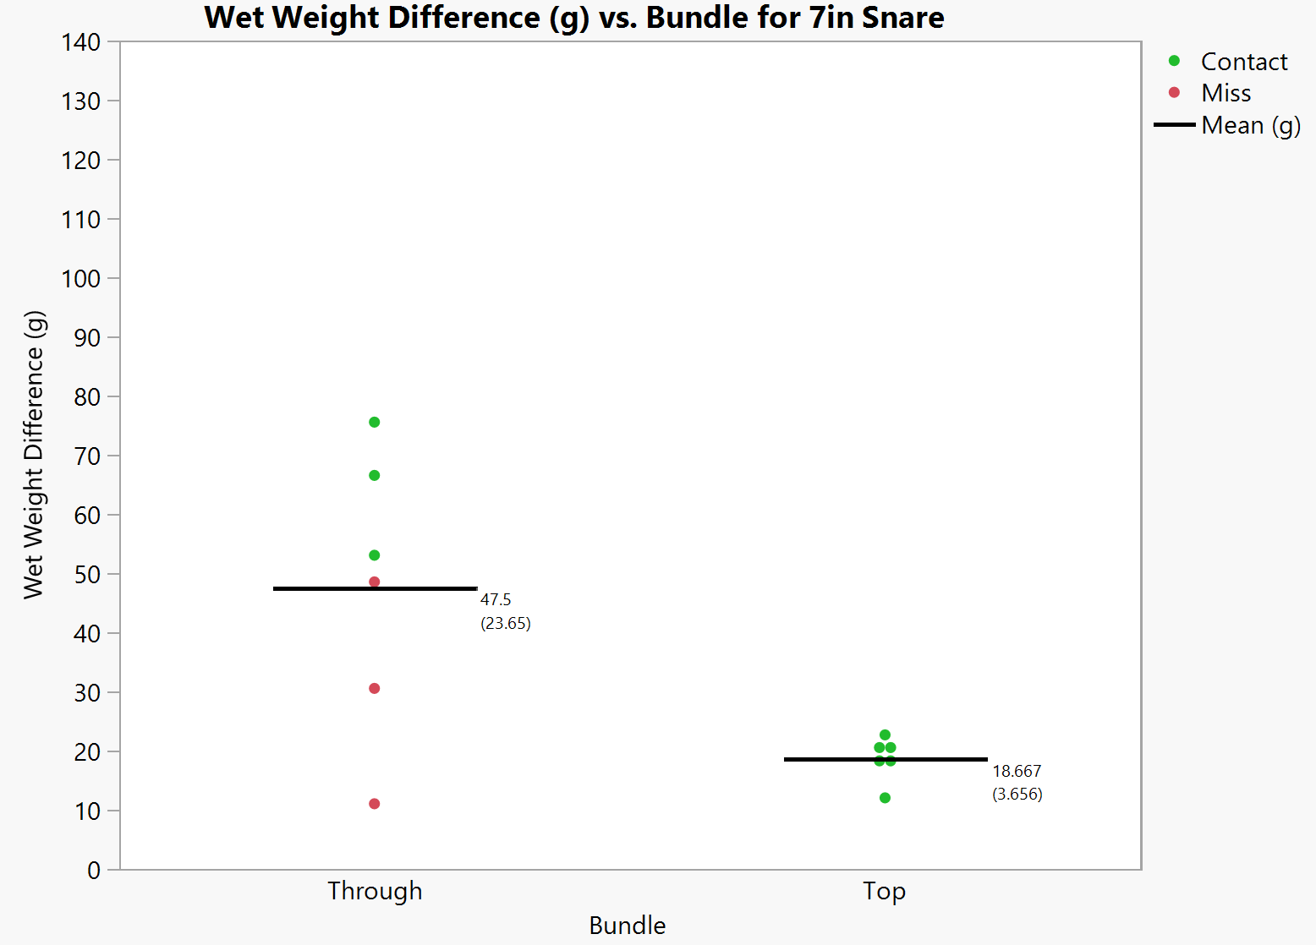
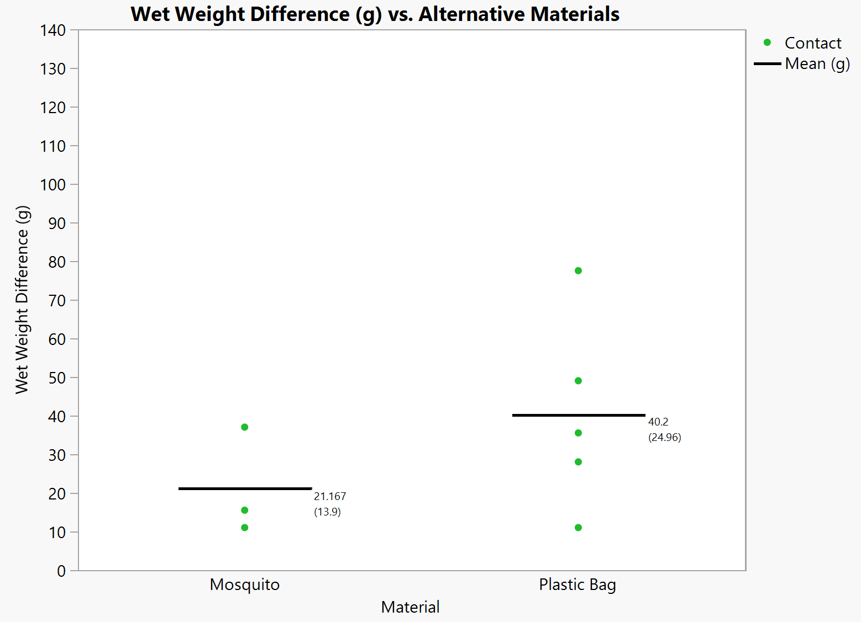
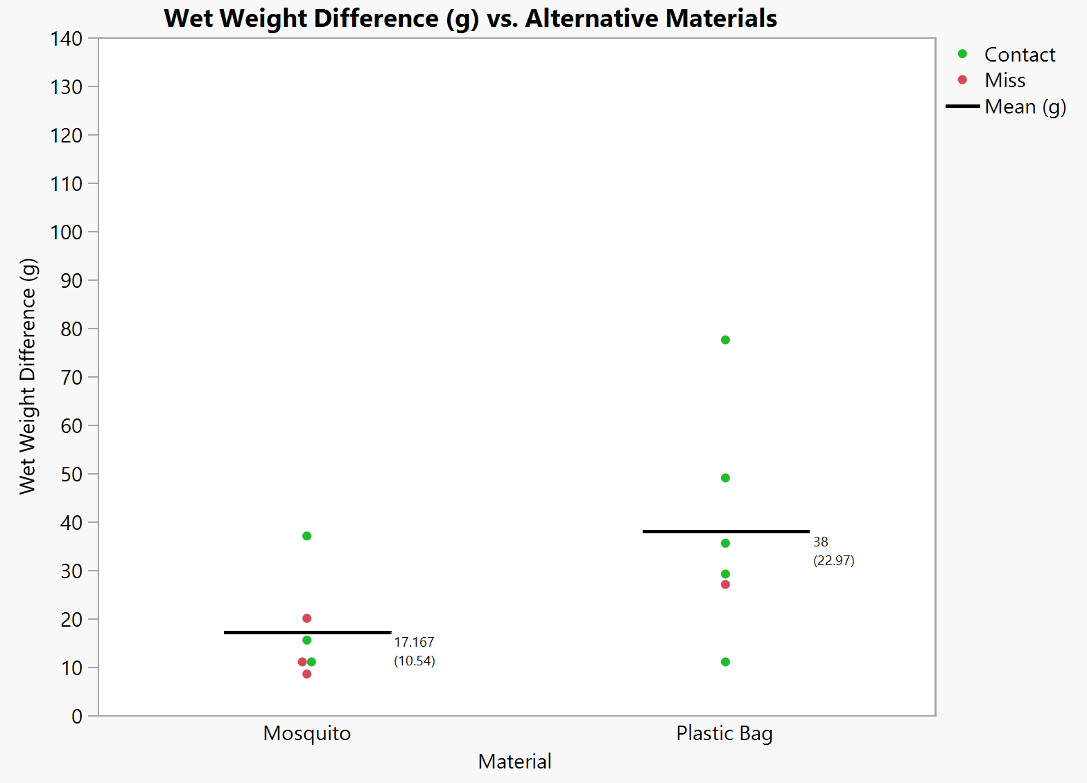
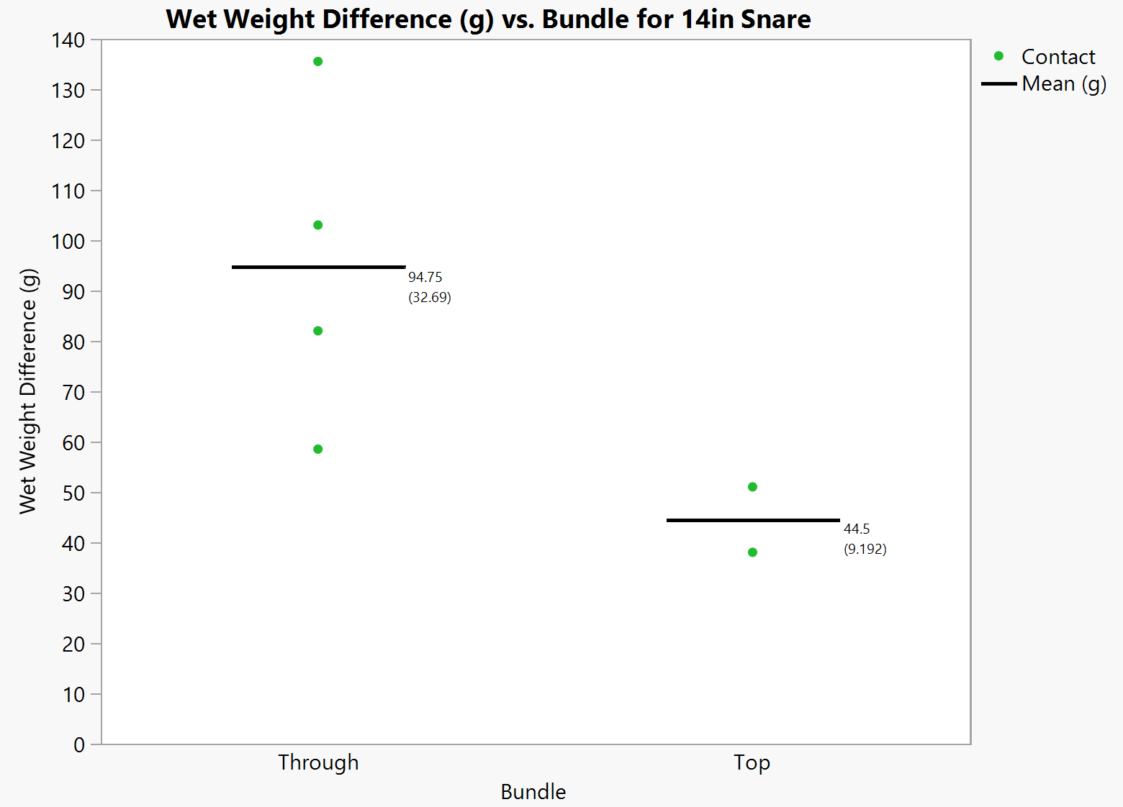
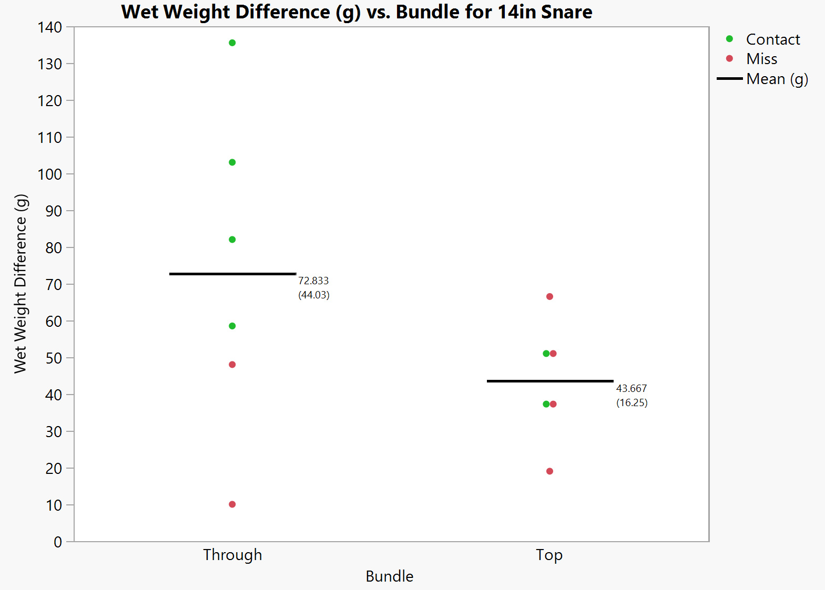
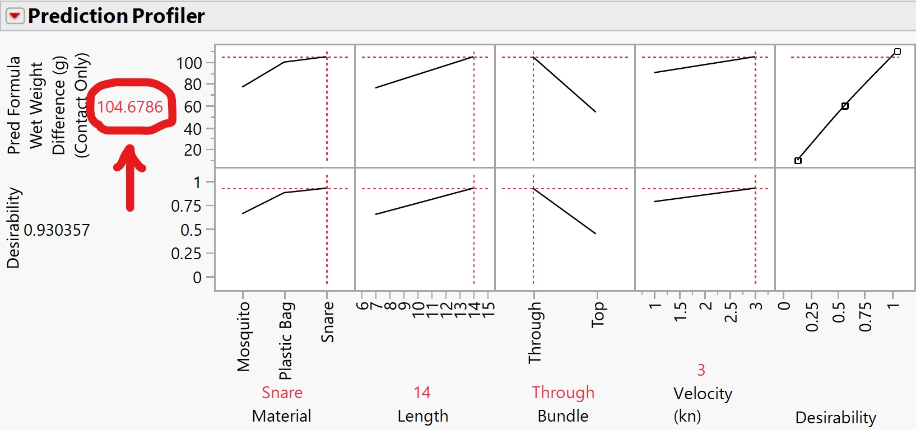
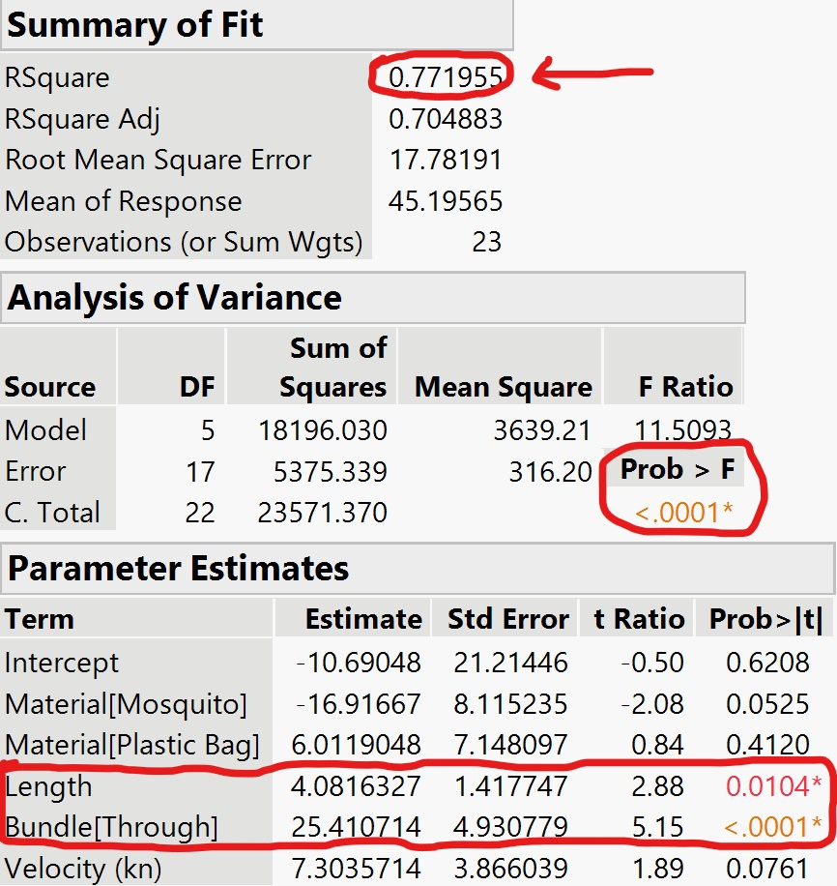
Oil Snare
Julissa Freund¹, Aaron Kearnan¹, Catherine Murphy¹, and Rebekah Alpert¹ Advisor: Dr. Nancy E. Kinner¹ Sponsor: Steven Lehmann²
College of Engineering and Physical Science, University of New Hampshire¹
NOAA Federal Office of Response and Restoration²
Introduction
Methods
Configurations
Oil spills in the marine environment.
  Caused by shipping accidents, oil
  rig leaks, runoff, natural oil seeps
  and natural disasters.
Difficult to remove oil from water if
the oil is submerged below the water
surface or sunken on the bottom.
Oil snare
  Used to locate submerged or
  sunken oil.
  Oleophilic plastic pieces and
  buoyant plastic.
Constants
Water Temperature : 22℃
Water Velocity: 0 knots
Oil Type: No. 6 Fuel oil with 7% kaolinite clay
Oil Mass: 200 g
Salinity: 0 ppm
Trial replicates : 3
Variables
Towing Velocity : 1 and 3 knots
Bundle material: Snare (half-length and full-length), Plastic bag, Mosquito netting
Bundle Configuration: Top, Through (for snare materials only)
Material | Attachment | Picture
14-inch Snare | Through (6) Top (6)
7-inch Snare | Through (6) Top (6)
Mosquito Netting | Top (6)
Plastic Bag | Top (6)
https://www.ccira.ca/2018/03/local-filmmaker-highlights-need-for-better-oil-spill-response/
Experimental Design Setup
Photo from : US Coast Guard
Objectives
To determine whether alternative materials or configurations would work more efficiently when compared to snare for sunken oil detection.
Results
Fish Planer
To determine if the snare material used in the first part of the project would be controlled in the water with the use of a fish planer.
The snare would be placed at a certain depth in the water, and towed with and without a planer, to see if there was a change in depth consistency.
UNH has closed for the remainder of the Spring 2020 semester. Due to this change, this part of the project was not completed.
Figure 1: Weight Differences for 7 in. Snare with Contact Only with Mean ( Standard Deviation in parentheses)
Figure 2 : Weight Differences for 7 in. Snare with Mean (Standard Deviation in parentheses)
Figure 5: Weight Differences for Plastic Bag and Mosquito Netting with Contact Only with Mean (Standard Deviation in parentheses)
Figure 6: Weight Differences for Plastic Bag and Mosquito Netting with Mean ( Standard Deviation in parentheses)
Next Steps
Future groups to look into “through” configuration for plastic bags and for mosquito netting, to determine whether it also impacts their overall oil sorption.
It is recommended to use a “cookie cutter” or other form of mold to place the oil under the water to standardize the area where the oil is placed.
It would be beneficial if faster speeds would be done in the future, to correlate more to real world towing.
Finally, as the last part of the project was not completed, having trials looking at snare depth control would potentially create a new innovation to a current issue.
Figure 3: Weight Differences for 14 in. Snare with Contact Only with Mean ( Standard Deviation in parentheses)
Figure 4: Weight Differences for 14 in. Snare with Mean ( Standard Deviation in parentheses)
Figure 7: Most ideal material, configuration, length, and velocity
Figure 8: Summary of fit for a regression model for oil detection prediction
Using all data points considered as “contact”, a prediction model was created. Figure 7, a Prediction Profiler, shows that the optimized design consists of the snare material, 14 in. in length, in the “through” configuration and a velocity of 3 knots. With a 93% desirability for maximized wet weight difference, this design is predicted to pick up 104.7 grams of oil.
Figure 8 shows the summary of fit and has a significant R squared value of 0.77. The model is accurate due to a significant p-value that is <0.0001. This shows that the variables Length and Bundle Configuration “Through” are significant to the model due to the <0.05 p-values
Acknowledgments
Dr. Nancy Kinner
Steve Lehmann
John Ahern
Melissa Gloekler
Megan Verfaille
Kathy Mandsager

