Slide 1
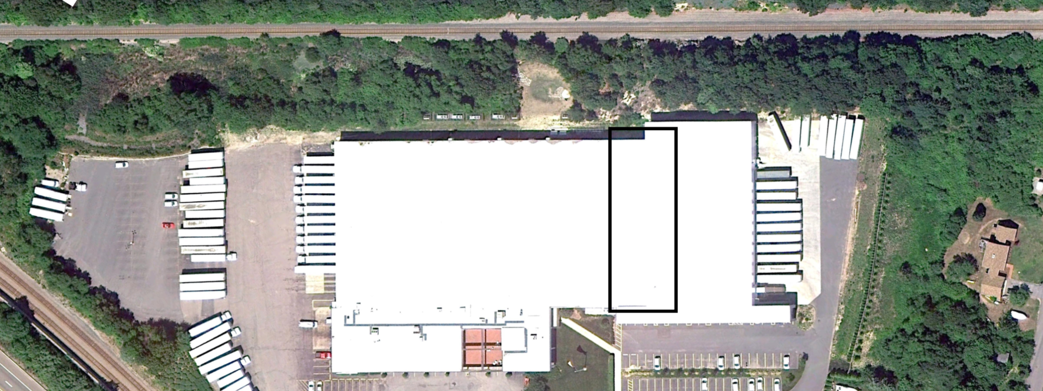
Metal Warehouse Collapse Investigation
Sarah Moriarty
Brandon Loiselle
Marco Gioioso
Alex Croteau
Sponsor: Simpson Gumpertz & Heger

Slide 2
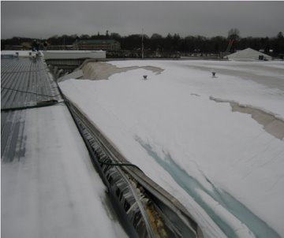
Failure Scenario
Date of Collapse: January 7th, 2009
Weather: 1.61" of rain on day before the collapse
Additional Conditions:
  2"-4" of snow on roof
  Addition to building being constructed

Slide 3
Scope of Work
Research metal warehouse roof collapses
Investigate using post-collapse photos
Identify potential failure mechanisms
Draft preliminary report
Develop structural analysis models
Run hand calculations to confirm models
Identify probable cause of collapse
Final Report and Presentation
Fall 2019
Spring 2020

Slide 4
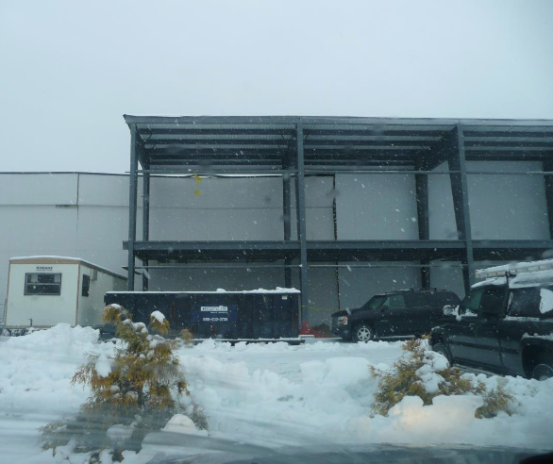
Description of Structure
Built in 1981
Stepped Roof
1'/48' Roof Pitch
Large Warehouse: 200' x 375'

Slide 5
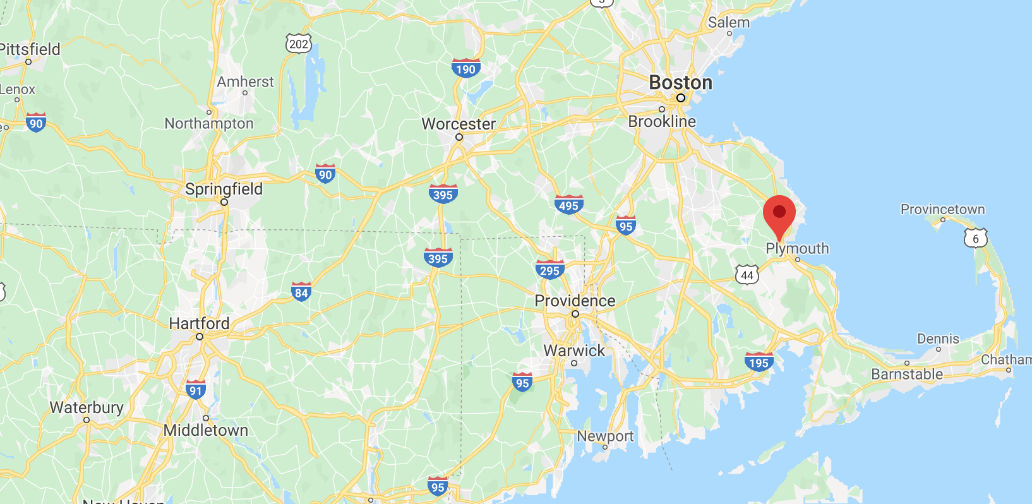
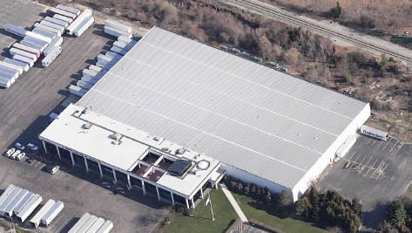
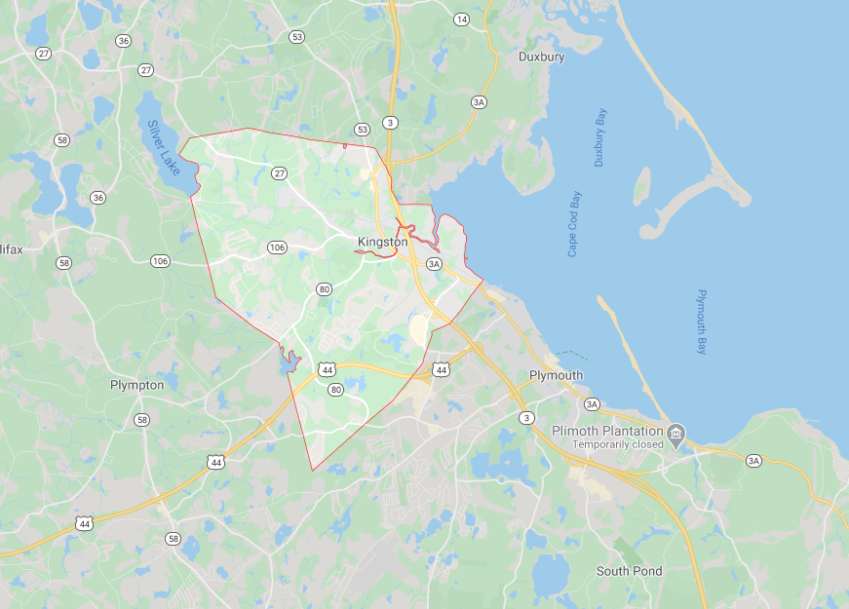
Structure Functionality and Location
Kingston, MA
Warehouse
Notes:
Damn that’s a nice pic top left

Slide 6
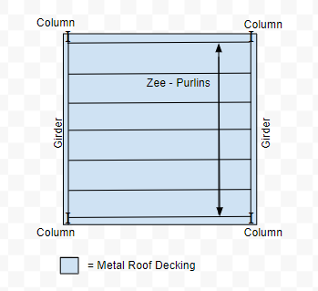
Load Path
Load Path for Loads Applied to Roof
Load => Decking
Decking => Purlin
Purlin => Girder
Girder => Column
Column => Foundation
Foundation => Soil
10 psf -> 10 psf
10 psf -> 50 plf
50 plf -> 250 plf
250 plf -> 6250 lb
6250 lb -> 6250 lb
6250 lb -> 6250 lb

Slide 7
Justified Assumptions
A36 Steel was used for Hot-Rolled Members
Massachusetts Building Code 4th Edition was used to construct warehouse
Modeling:
  Columns are modeled as pins and rollers
  Loads are modeled linearly along purlins
The warehouse was globally stable before the collapse
Notes:
Steel was assumed because it was relevant to time period. A992 Steel Gr. 50 wasn’t used until later so this was most common
This edition was effective from 1980-1991

Slide 8
Unverified Assumptions
0'-3" of Snow distributed on top of roof at time of collapse
Workers shoveled snow off the new roof onto old roof
5'-0" wide section that snow was shoveled onto (Old Roof)
A446 Steel used for Cold-Formed Members
W30x357 used for girders
Notes:
Alex End

Slide 9
Description of Modeled Loads
Load Combinations in Analysis Should Reflect Actual Loads at time of Collapse
Dead Loads:
  Self-Weight
  Decking/Roofing Material
  MEP
Snow Loads:
  Uniform
  Shoveled (Along 200' and 40' Edges)
Notes:
Converted from psf to plf over purlins ​
Shoveled Snow (200' Edge) applied to first 5' (All Purlins)​
Shoveled Snow (40' Edge) applied to full purlin (Two Southernmost Purlins

Slide 10
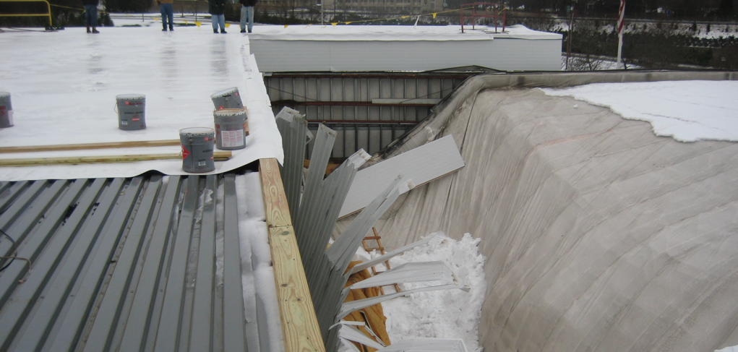
Notes:
We had many theories that were generated through our brainstorming sessions.
The theory we decided to go with was the Excessive snow load theory.
This was mainly done because it was the only photo evidence-based theory we had.
Many theories made sense but there wasn’t enough physical evidence, so we decided to dig a little deeper into the snow loadings
It was practical. Seemed most realistic. The picture backed the idea.

Slide 11
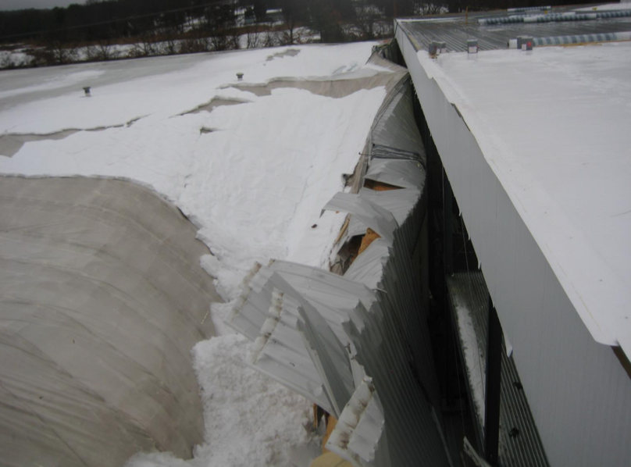
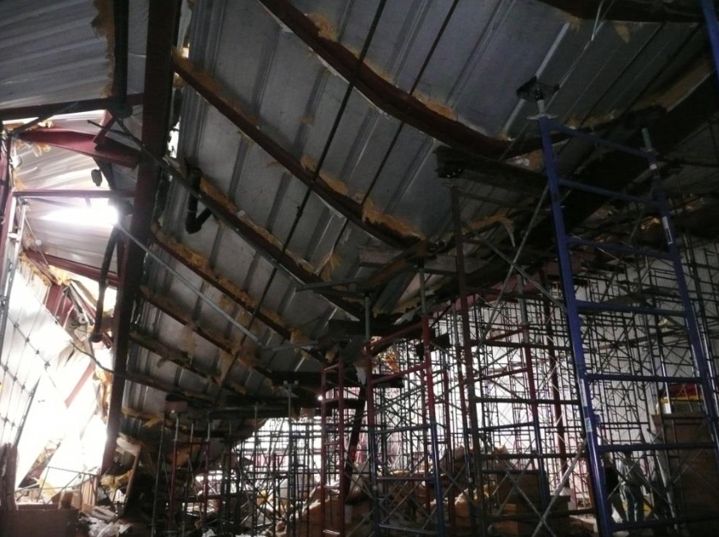
Snow Loading
Estimated Snow Thickness on Area of Interest
Original Thickness |  | New Thickness
2.00 | inches | 17.98 | inches
3.00 | inches | 25.43 | inches
4.00 | inches | 32.87 | inches
6.00 | inches | 47.85 | inches
9.00 | inches | 70.28 | inches
12.00 | inches | 92.70 | inches
Notes:
Sarah

Slide 12
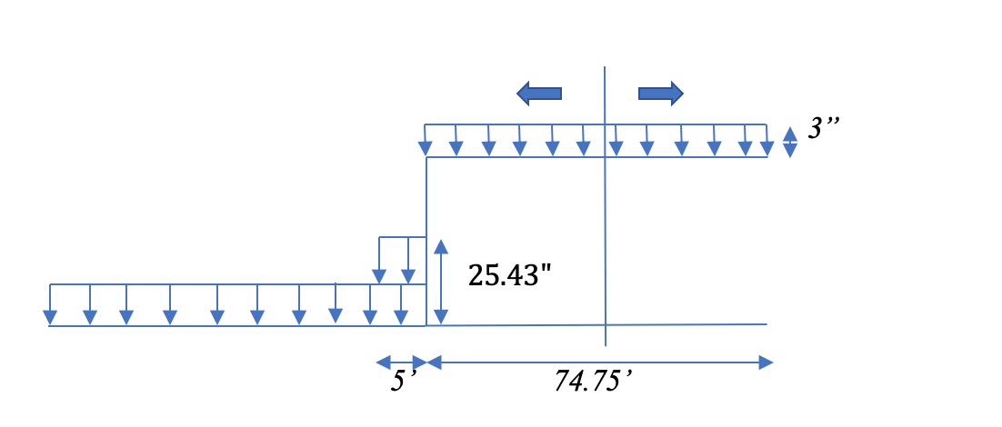
Distribution of Snow Load

Slide 13
Snow Loads Using Massachusetts Building Code 4th Edition
Variables | Value | Units
pf | 30 | psf
ps | 30 | psf
𝛾(min.) | 20 | pcf
Load on Old Roof (psf)
Cross Section | Normal (2 in.) | With Added Snow (17.95 in.)
Old Roof | 3.34 | x
New Roof | 3.34 | x
Section of Interest | 3.34 | 29.97
Cross Section | Normal (3 in.) | With Added Snow (25.43 in.)
Old Roof | 5.00 | x
New Roof | 5.00 | x
Section of Interest | 5.00 | 42.38
Cross Section | Normal (4 in.) | With Added Snow (32.87 in.)
Old Roof | 6.60 | x
New Roof | 6.60 | x
Section of Interest | 6.60 | 54.78
Notes:
Shows distribution on 5’ x 200’ section of interest
We assumed they used this code – more conservative assumption because the ASCE actually designed for a lower capacity of snow

Slide 14
ASCE Standard 7-16
Minimum Design Loads and Associated Criteria for Buildings and Other Structures
Variables | Value | Units
𝛾1 | 17.9 | pcf
pg | 30 | psf
pf | 23.1 | psf
ps | 23.1 | psf
Load on Old Roof (psf)
Cross Section | Normal (2in) | With Added Snow (17.98in.)
Old Roof | 2.99 | x
New Roof | 2.99 | x
Section of Interest | 2.99 | 26.82
Cross Section | Normal (3in) | With Added Snow (25.43 in.)
Old Roof | 4.48 | x
New Roof | 4.48 | x
Section of Interest | 4.48 | 37.93
Cross Section | Normal (4in) | With Added Snow (32.87in.)
Old Roof | 5.96 | x
New Roof | 5.96 | x
Section of Interest | 5.96 | 49.03
Notes:
Shows distribution on 5’ x 200’ section of interest

Slide 15
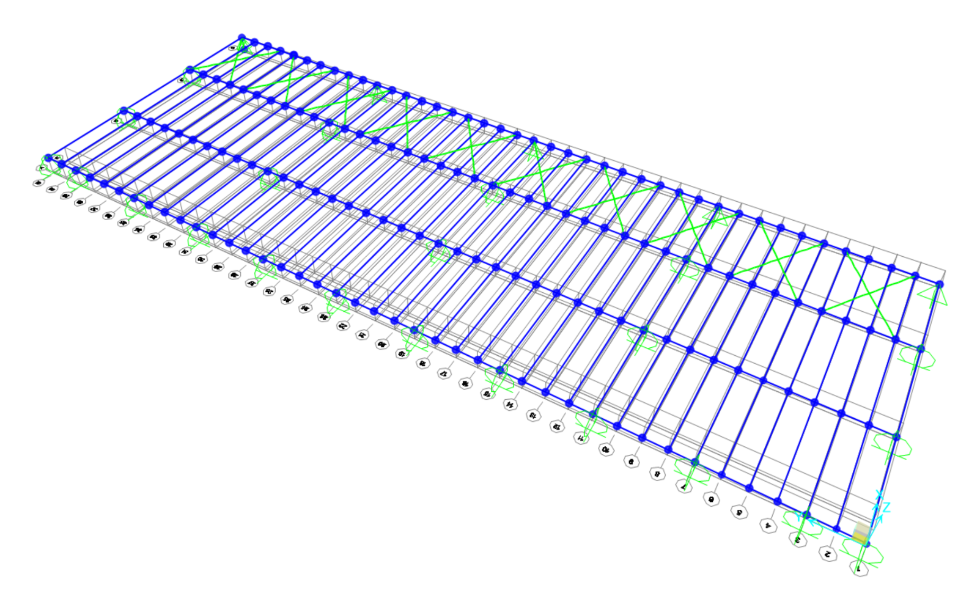
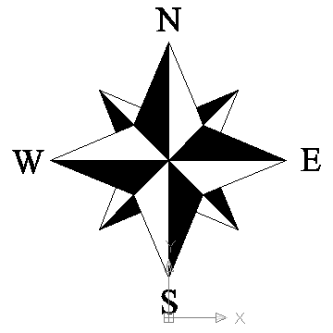
Modeling
Used SAP 2000 to prepare the model
Created the model using original design drawings and site photos
Modeled using a Linear-Static Analysis
Notes:
Marco
Mention the collapsed area and what are the purlins and what are the girders

Slide 16
Material Properties
Steel types are un-specified therefore, material choices reflect common gradations of the time period (1981).
Hot-Rolled Steel Members: Girders
  A36 Steel => F_{y}= 36 ksi
Cold-Formed Steel Members: Zee-Purlins and Roof Deck
  Cold-Formed Steel gradations did not show any time period relevant trends
  A446 Steel => F_{y} = 33.4 ksi (available at the time)
Notes:
If we remember, download ppt and add subscripts where appropriate

Slide 17
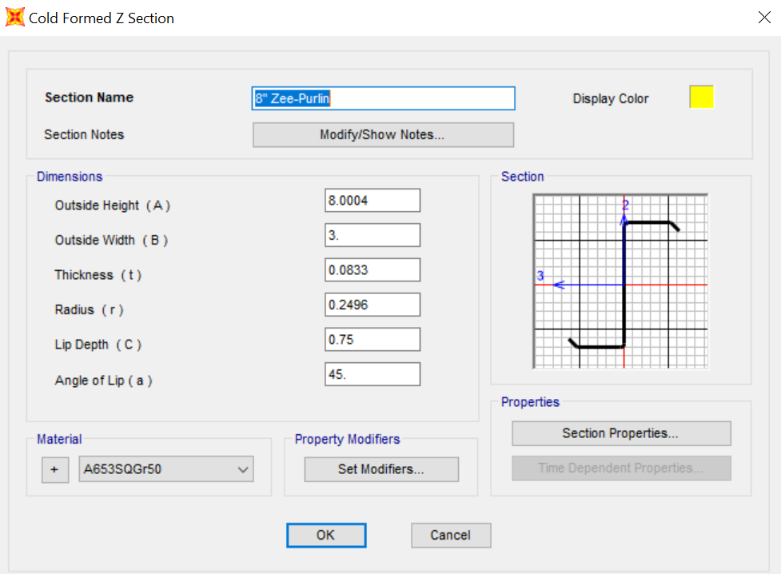
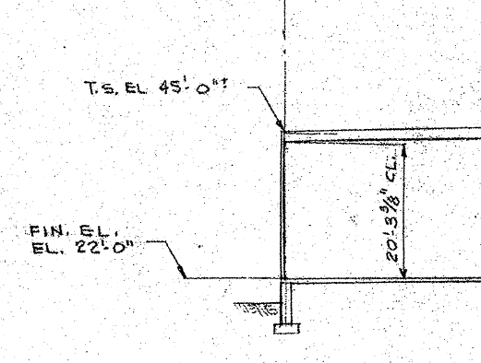
Member Geometry
Zee-Purlin Dimensions:
  8" Deep x 3"Wide x 3/32" thick
  ¾" 45° flanges
  Specified by SGH
Girder is a W30x357
  Determined by differences in elevation on original drawings (d=32-5/8")
  The section properties were pulled from the American Institute of Steel Construction (AISC) manual

Slide 18
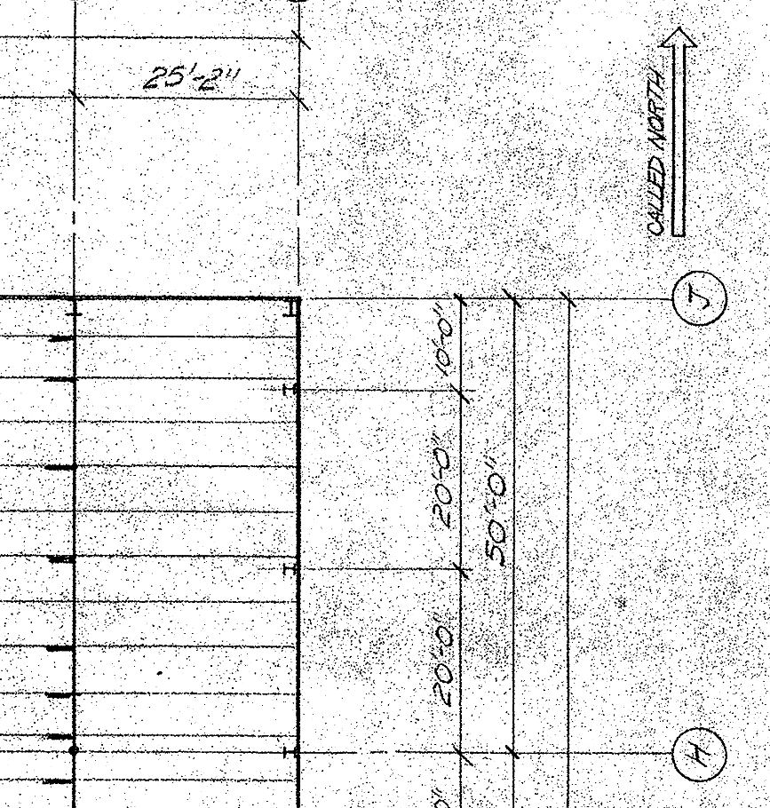
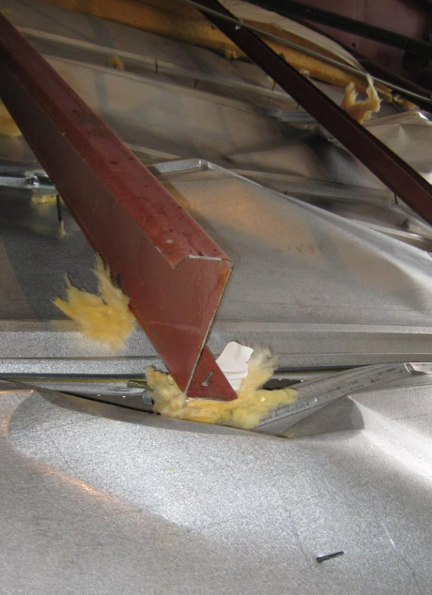
Structural Geometry
Columns are Spaced 50' (N/S) and 25' (E/W)
Girders Span 50' on Columns; 25' on Center
Purlins Span Girders; 5' on Center
Kickers Brace Purlins on the West Side of Girders
Columns on East Girder are spaced at 10' to 20' Intervals
One Purlin Appears to have been incorrectly spliced

Slide 19
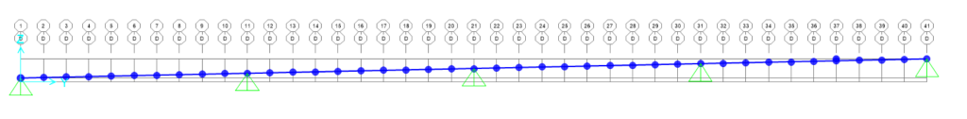
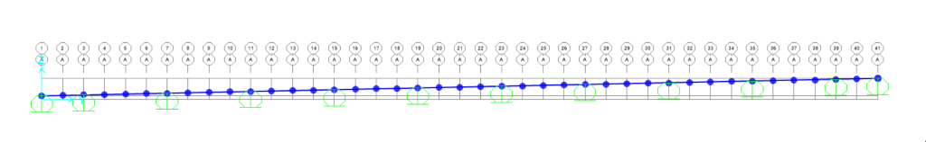
Modeling
Desire to focus on the failure of the purlins and lack of information lead to not modeling the columns.
The columns would not provide much moment resistance
Columns were modeled as pins and rollers.
Pins as Columns
Rollers as Columns

Slide 20
Analysis and Evaluation Computations
Splice Capacity
  A faulty splice provides significantly less moment capacity
  Two modeling approaches:
    Two cantilevered purlins (No rotational restraint)
    Two purlins joined by a weak member
  Two cantilevered purlins were chosen.
    Spliced purlin cannot resist full design loads
    Loads are distributed to other purlins

Slide 21

Analysis and Evaluation Computations
Kicker Evaluation
  Kickers would not provide 100% fixity
  Estimated to be 50% fixity
  Joint Stiffness Defined by $k=\frac{4EI}{L}$
  For 50% fixity $k=\frac{2EI}{L}$
  Comparison to two control groups; Full Kicker Fixity and a Pined Connection
Notes:
I muffed up the 1st equation, should be 4EI/L

Slide 22
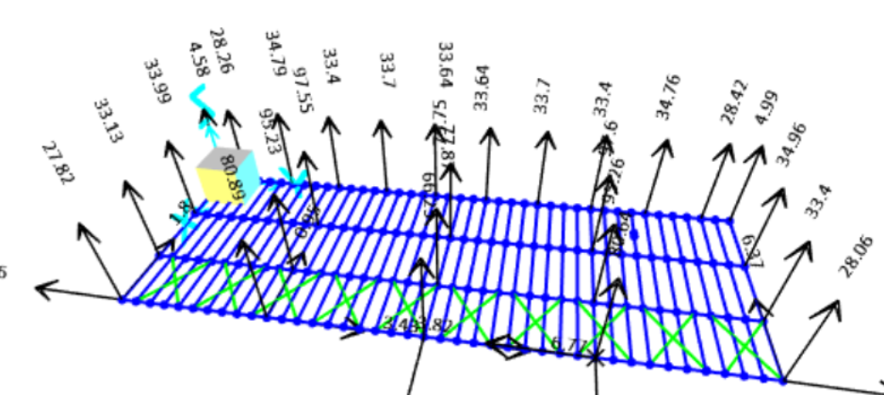
Original Design Confirmation
Model design can be confirmed via:
  Summation of base reactions:
    1236 kips (Calculations)
    1212 kips (Model)
    Differences can be attributed to rounding
  Structural Geometry, Member Geometry and Material checks
  Force/Moment Concentrations in expected area

Slide 23
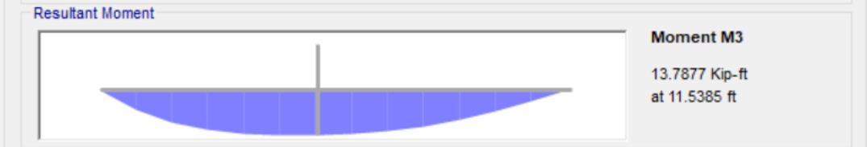
Evaluation of Structural Components
Zee – Purlin
  Yielding Moment = 9.6 kip-ft.
  Moment Applied= 13.8 kip-ft. (Purlin Adjacent to Splice)
Deck does not near yield stress
Actual yield stress is often times much higher than design yield stress thus a higher capacity would be generated

Slide 24
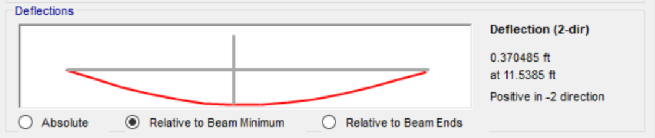
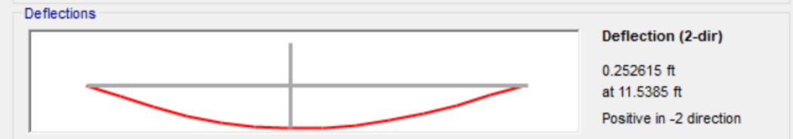
Evaluation of Deformation
Roof Slope: 1'/48' (Water Drains North)
Drainage Concerns
  Purlin Deflection:
    Maximum allowable is 1-½"
    Actual is 1.3"
    Purlins Depicted below:
    Immediately North of Splice (4.4") Immediately North of the Left Purlin (3.1")

Slide 25
Evaluation of Deformation
Drainage Concerns
  Purlin and Deck deflection could cause ponding
  Deck Deflection:
    Actual deck deflection is 3/8"
    Maximum allowable is ¾"
  Deck and Purlin Compounded
    Actual is 1.675"
    Maximum allowable is 1-½"

Slide 26
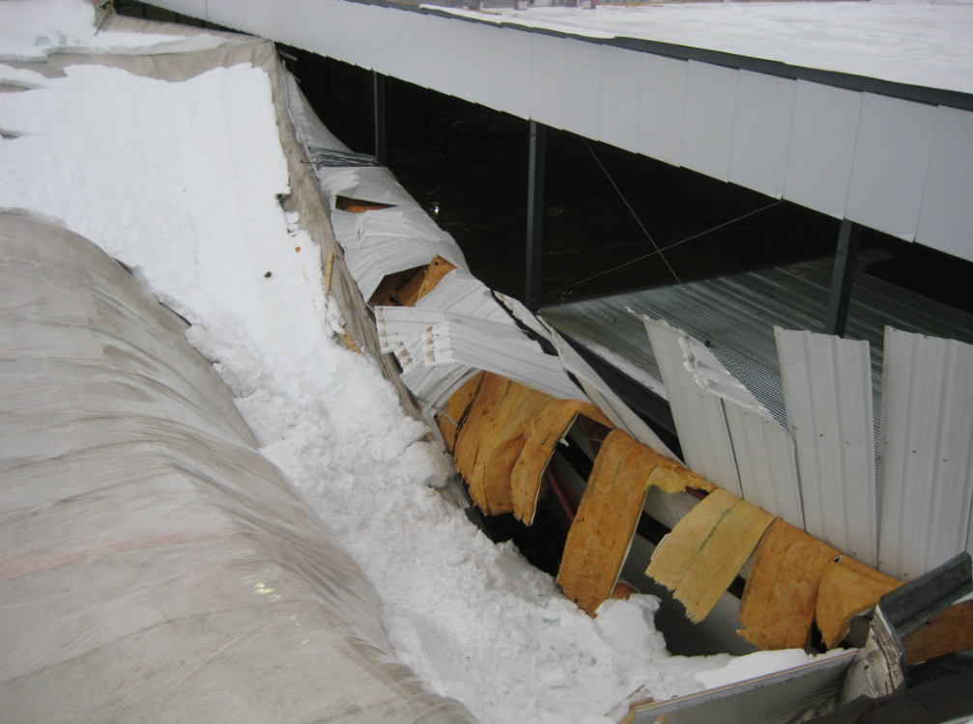
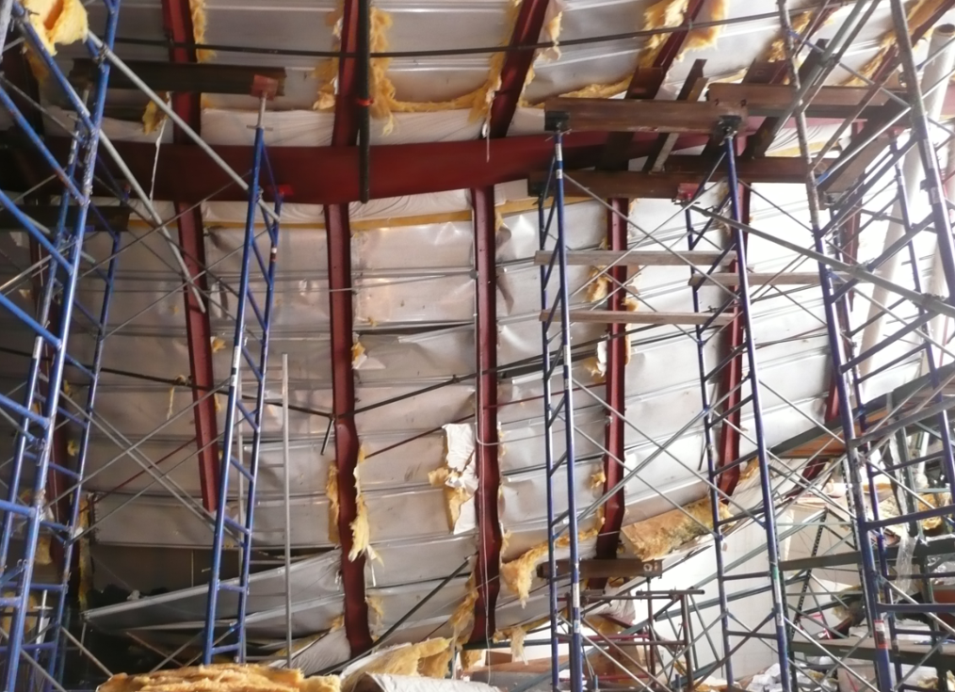
Correlation of Model to Field Observations
The images indicate the multiple purlins failed inducing torsional failure on girder
Failure occurs in overload bay (Shoveled Snow)
Images indicate that the upper roof was clear of snow
Notes:
Girder Torsional Capacity not tested due to time constraints

Slide 27
Summary
The probable mode of failure is:
  Excess snow was shoveled off of the upper roof onto the lower roof
  Compounded deflections in the deck and purlins adjacent to the faulty purlin splice
  No drainage of water during a 1.61" storm immediately preceding collapse
  Ponding instability occurs

Slide 28
Challenges
Site access and pictures were limited
Passage of time after failure
Original design drawings are incomplete
Zee purlins are cold formed Steel
  Cold formed steel is not covered in courses
COVID-19
  Temporarily hindered access to SAP 2000
  Remote meetings
Notes:
Brandon

Slide 29
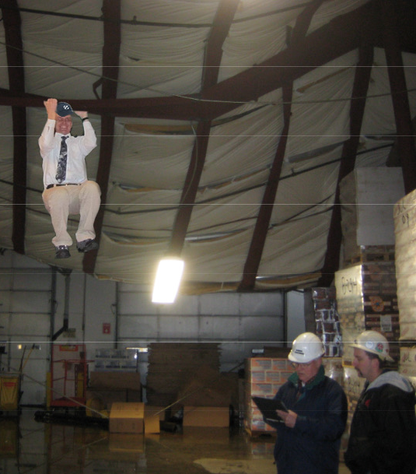
Questions?

