Slide 1
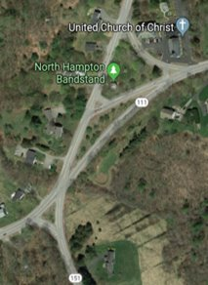
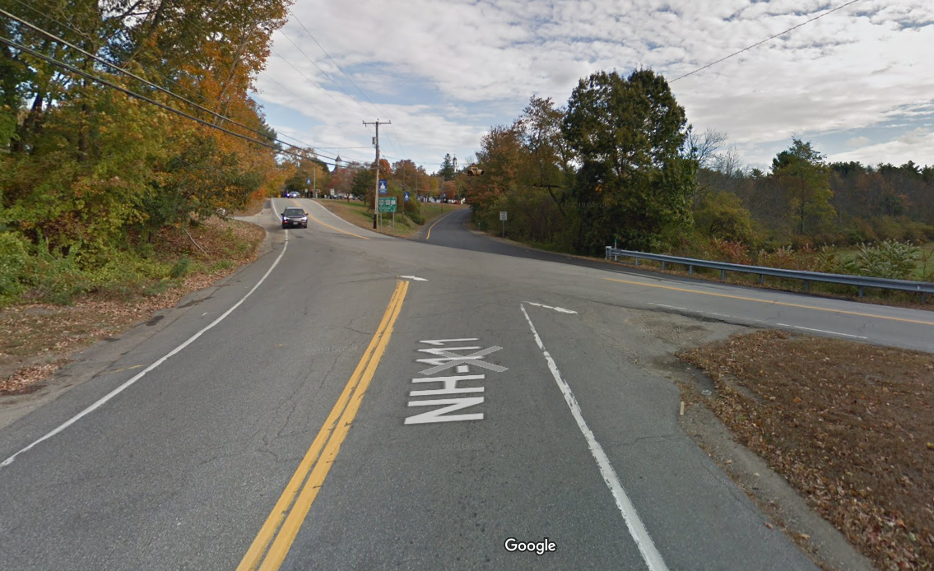
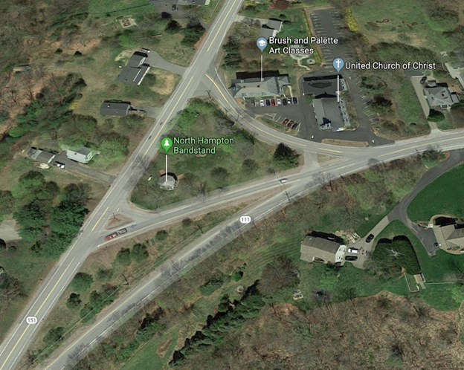
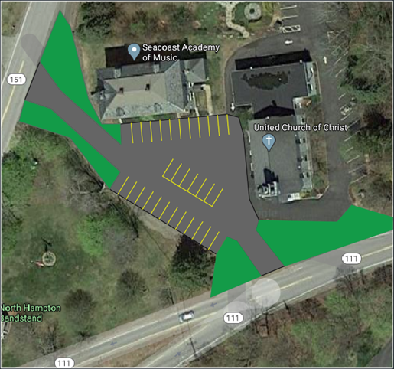
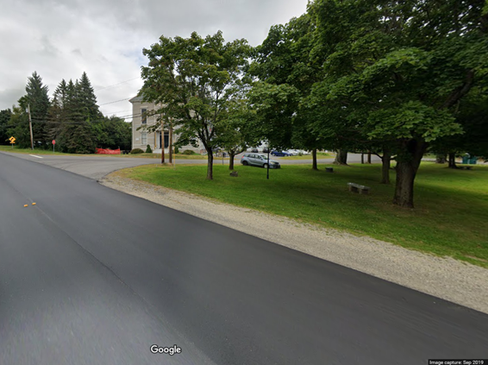
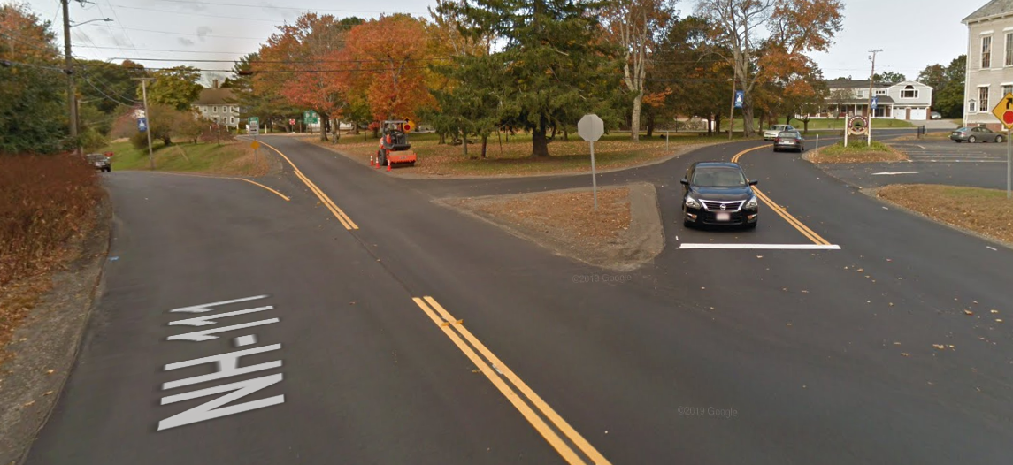
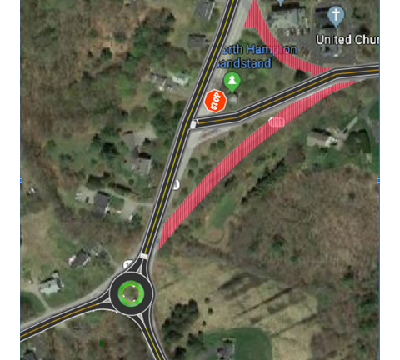
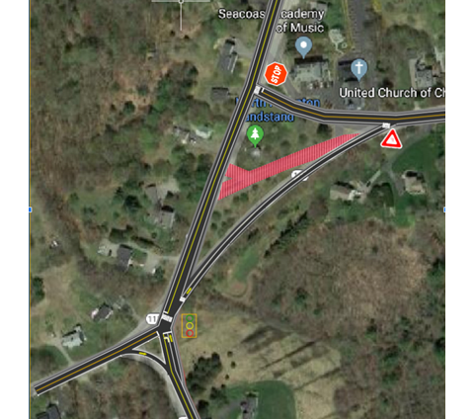
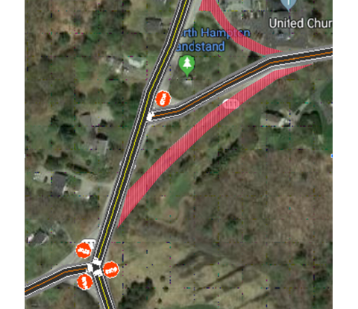
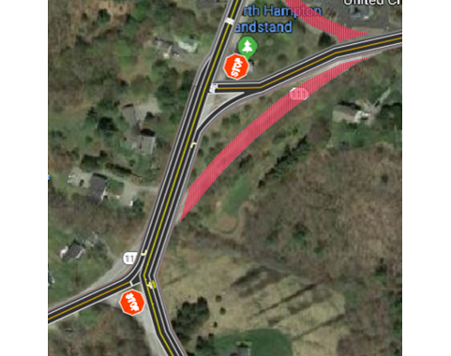
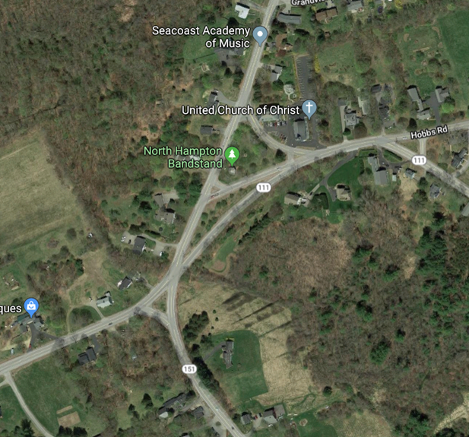
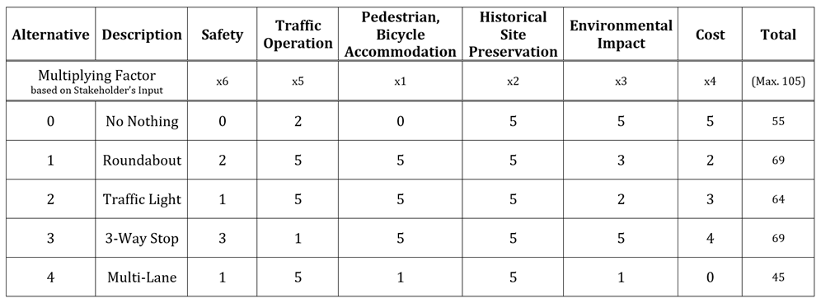
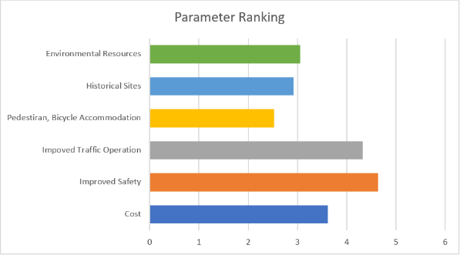
North Hampton Intersection Redesign Liam Cullinane (PM), Melissa Lyford, Michael Menary, Bill Nguyen College of Engineering and Physical Sciences, University of New Hampshire, Durham, NH 03824
Goal
Problems Identified
Optional Add-on Parking Lot
Improve both traffic and pedestrian safety and access in the NH111-NH151 intersection.
Main NH111-NH151 Intersection
Pedestrian Access
1
Skewed stop angle (NH 111)
Low sight distance (111/151)
Uncontrolled Traffic (NH 151)
“I walk in people’s yards to avoid the cars while going to the bandstand.”
- Town's Person, Selectman's Meeting 11/20/19
High Support from town residents & select board
Located over current Centennial Hall Road
Minimum of 30 additional parking spots for Church or Bandstand Events
Estimated $408, 400
The Process
2
Parking
IDENTIFY PROBLEMS
CHOOSE A DESIGN
MATRIX ANALYSIS
SELECT FOCUS ALTERNATIVES
Problems Presented to Us
Input from Stakeholders
Group Site Visit
From Group
From Residents
Designed By Group
Weighed by Stakeholder Survey
BRAINSTORM IDEAS
1
2
Intersection by Church
“People park on the grass or on the side of the road during bandstand events.”
- Town's Person, Selectman's Meeting 11/20/19
Poor Visibility
4 Roads and vehicles coming from 3 directions
Additional Problems: 8 Separate Intersections, Skewed Crossing Angles, High Traffic Volumes, Significant Grade Changes, Historical Buildings
Satellite Image of the NH111 (East to West) & NH151 (North to South) Intersection
Final Decision: Roundabout
Alternatives
Stakeholder Input
No Change
Roundabout
Traffic Light
3-Way Stop
Multi-lane
Category | Analysis
Cost | Roughly $$3,281,900 2nd Most Expensive
Impact on the Environment | 1-way Adjacent to Wetlands Removed
Pedestrian/Bicycle Accommodation | Yes, Both
Preservation of Historical Sites | No interference, allows for additional parking space
Safety | Ranked #2 of 5 Options, Slows NH 151 Drivers Down, Safer Cross for NH111 Eastbound Drivers
Traffic Operation | 2nd Best Option, All Traffic Directions Have Equal Opportunity to Cross Intersection
Group Presented at 2 North Hampton Select Board Meetings
Meeting 1 (11/20/19) | Meeting 2 (3/9/20)
Identify all existing problems, ask what is missing Introduce redesign ideas, ask for residents own ideas | Present 4 Narrowed down alternatives, ask for input Survey residents on what they prioritize most for alternatives matrix
Roundabout
Yielding makes it efficient in reducing potential crashes
Equal car entry opportunity results in better traffic flow
Provides pedestrian access & allows for additional parking
Blinking Yellow Light on NH151 & Blinking Red Facing NH111
Pros: No Direct Cost
Cons: High Indirect Cost, Traffic Congestion, Unsafe
Add a Roundabout at Main Int.
Pros: Improved Traffic Flow, 2nd Safest Alternative
Cons: 2nd Most Expensive Alt., Slows NH151 Drivers
Traffic Light at Main Int.
Pros: Gives NH111 Equal Opportunity to Cross
Cons: Slows NH151 Drivers, Least Safe Besides No Change
3-Way Stop at Main Int.
Pros: Safest Alternative, Cheapest Besides No Change
Cons: Worst Traffic Flow
4 Total Lanes Between Main Int. & Int. Below Bandstand
Pros: 2nd Safest Alt., Good Traffic Flow
Cons: Most Expensive
About Current Intersection
Alternative Analysis Matrix
Table #1: Alternative Matrix
Graph #1 Parameter Ranking
Acknowledgements
4,000 vpd
9 Crashes in 15 Years
William Lambert and the NHDOT
Dr. Kyle Kwiatkowski, Dr. Jo Sias, & the University of New Hampshire
Rockingham Planning Commission
North Hampton Select Board
North Hampton Residents
30 Crashes in 15 Years
10,000 vpd
References
Table shows grading of each alternative for each parameter; for which the parameters were ranked on a scale from 0 to 5 with zero being the "worst" and a five for the "best".
Graph shows the priority ranking of parameters based on North Hampton public's input.
[1] Google Images
[2] NH DOT Automatic Traffic Data Recorder
[3] Crash Data from Rockingham Planning Commission
*Sources [2] & [3] Used

Slide 2
This poster template provided courtesy of
UNH ESRC Poster Printing Services
Trust us to make your poster look GREAT!
Website: http://posters.unh.edu
Poster Guide: http://goo.gl/1E7TJY
DELETE THIS SLIDE BEFORE PRINTING

