Slide 1
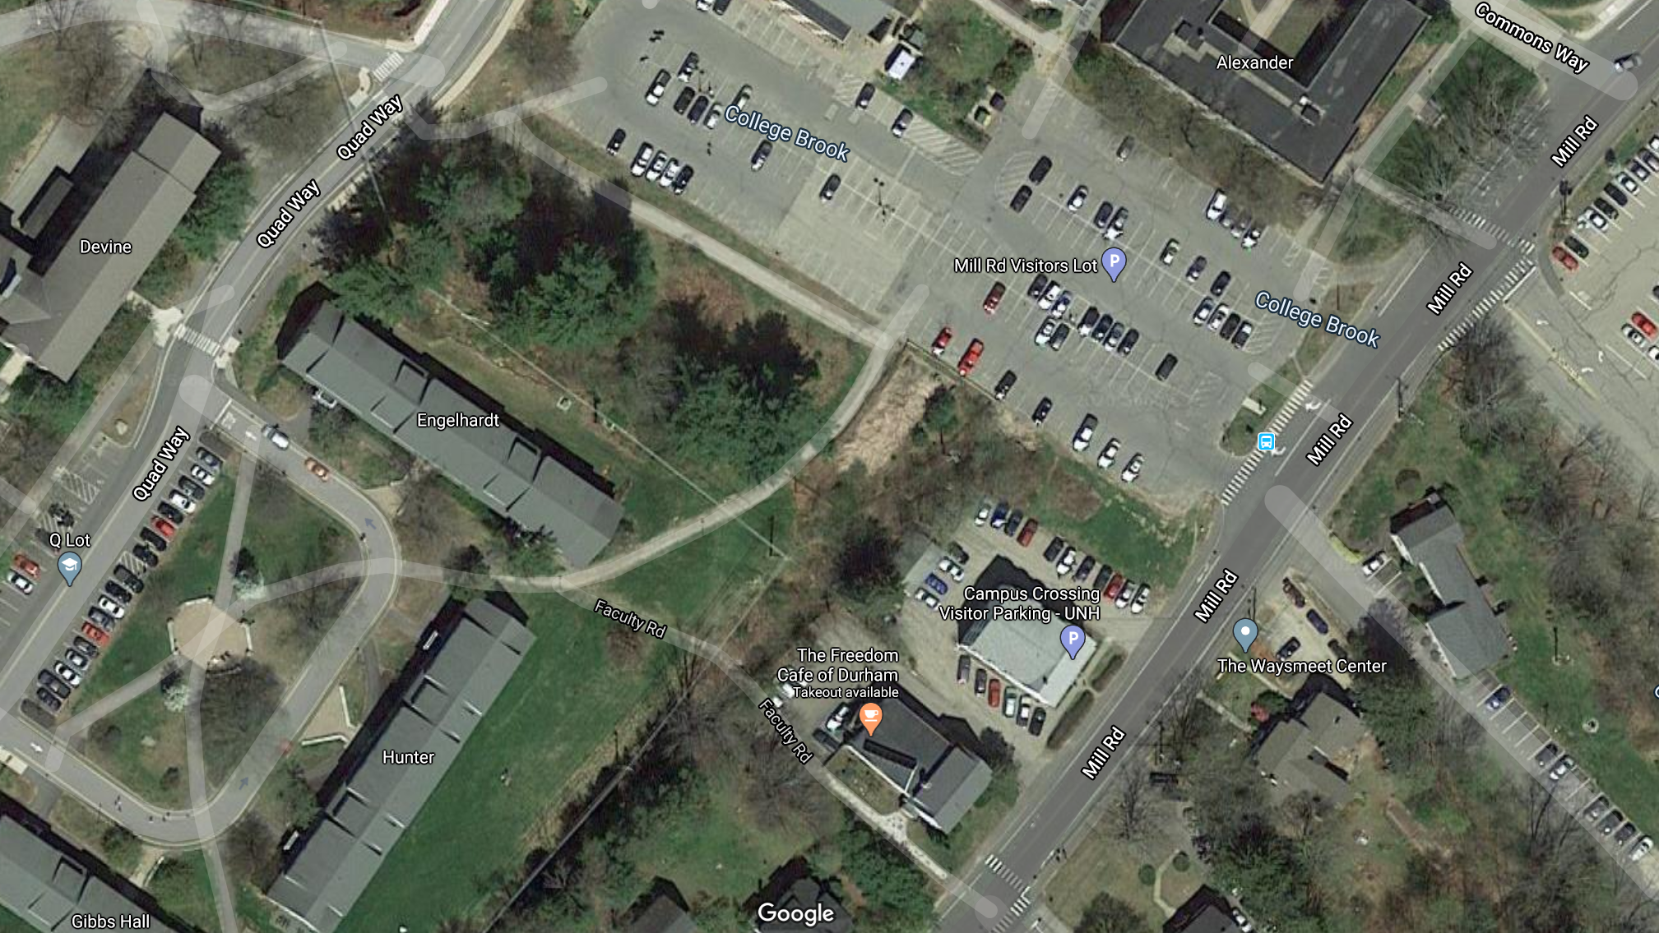
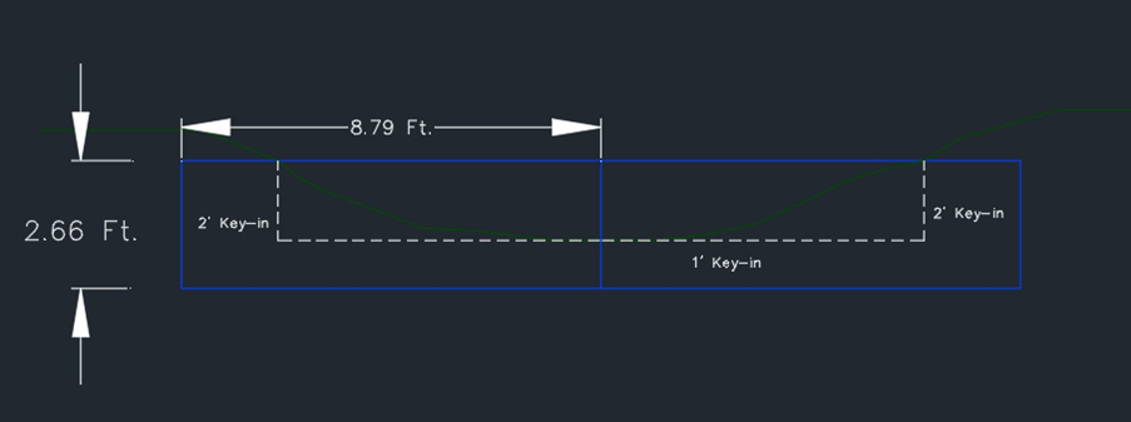
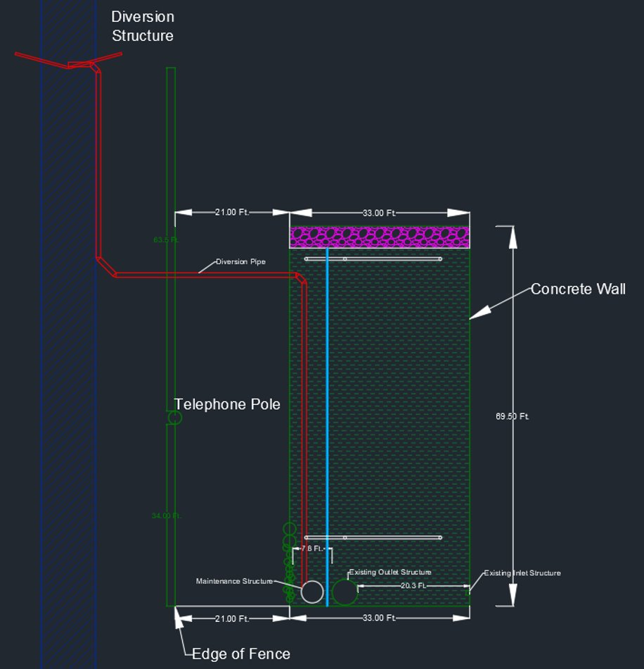
C-Lot Drainage and BMP Design Project Nicole Haggerty, Chloe Carter, John Nader, Sawyer Hall Faculty Advisors/ Sponsors: James Houle, Tom Ballestero UNH Stormwater Center
Introduction
Results
This project focuses on managing the runoff from the area along the southeastern portion of UNH Durham campus (next to C-lot). The best management practice (BMP) proposed is a subsurface gravel wetland system. Through the implementation of this system, the project will divert and treat runoff prior to discharging to receiving waters. The goal is to reduce the nitrogen load to the Great Bay.
Drainage Area | Area (acres) | Impervious Cover (acres) | % IC | 25-year Flow (cfs)
DA 1: Ditch | 15.82 | 8.35 | 52.75% | 46.78
DA 2: C-lot | 1.26 | 0.42 | 33.29% | 2.86
Total |  |  |  | 49.64
Methods
(Google Maps, 2020)
Watershed Delineation:
QGIS: Flow Accumulation Function
Lidar data
Topographic lines
Catch basin locations
Delineations of two drainage areas were formed:
(1) runoff from campus going to the ditch
(2) runoff from C-lot going to the system
Flow Calculations:
Rational Method
Design event: 25-year storm
Diversion Structure/ Inlet Design:
Size of diversion structure based on the cross-section of the ditch and the 25-year design flow
Size of ditch influent pipe was determined by the maximum allowable flow entering the system based on capacity of existing outlet structure
Considered the pipe slope and existing utilities to determine the best location for the structure
System Design:
System size was predetermined by the existing wetland area
Design was based on the UNHSC Subsurface Gravel Wetland Design Specifications
Discussion
Cross Section of Ditch Diversion Structure
Alternatives Investigated:
Not viable due to lack of space available:
Forebay
Second treatment cell
Diversion wall next to C-lot inlet
Obstacles:
Surveying the site through thick vegetation
Limiting existing conditions
Finding a location for the diversion structure and system inlet
Incorporating an existing half-submerged inlet structure into the system design
Erosion:
Geogrids and riprap to prevent further erosion of ditch
Cross Section of Subsurface Gravel Wetland
References
Ballestero, T. P., Houle, J. J., & Puls, T. A. UNHSC Subsurface Gravel Wetland Design Specifications, 2016, pp. 1–11. Durham, NH: University of New Hampshire.
Google Maps, 2020, maps.google.com
Thompson, David B. “The Rational Method.” Engineering Hydrology, 2006. Texas Tech University.
Plan View of Subsurface Gravel Wetland

