Slide 1


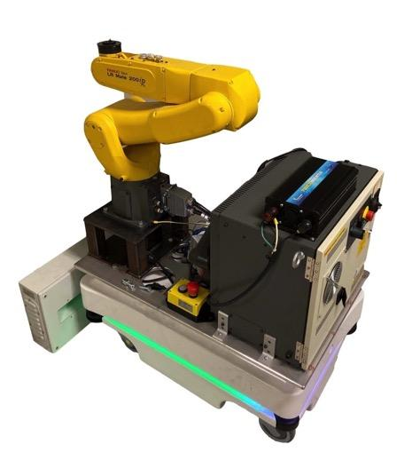

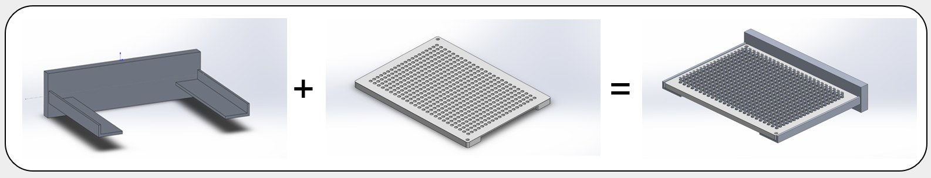
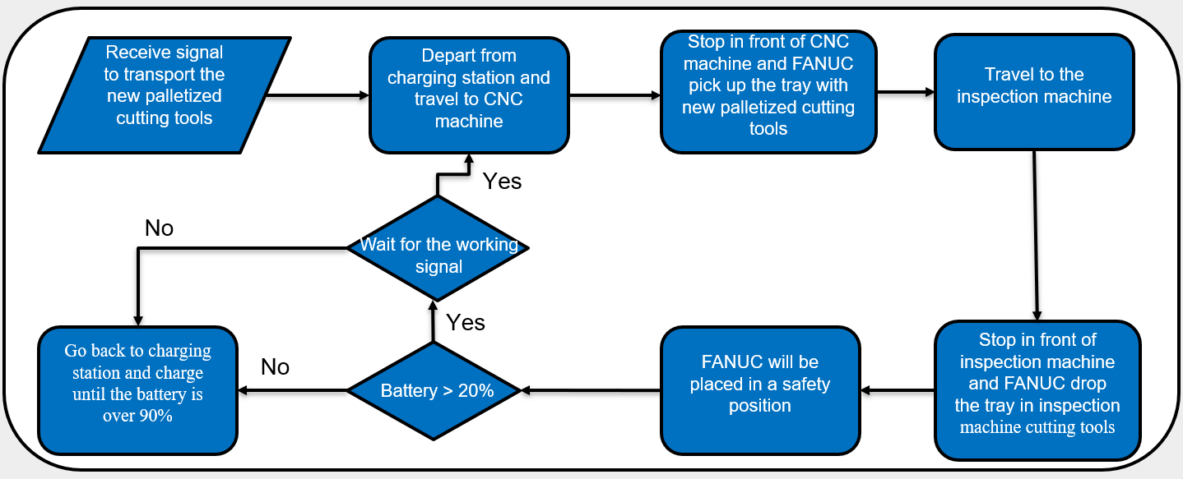
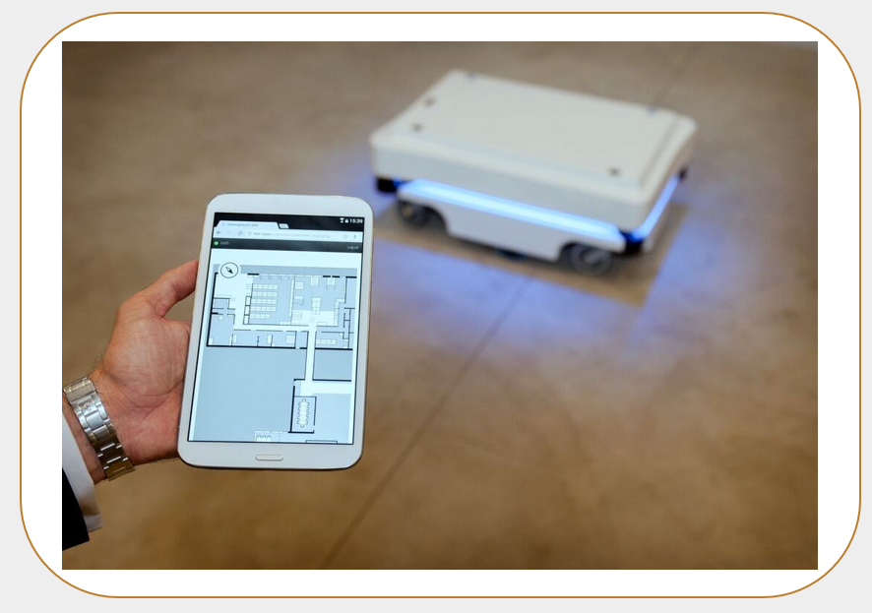
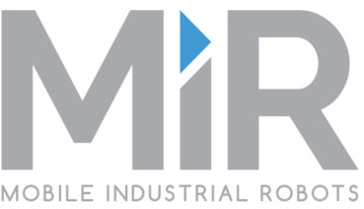
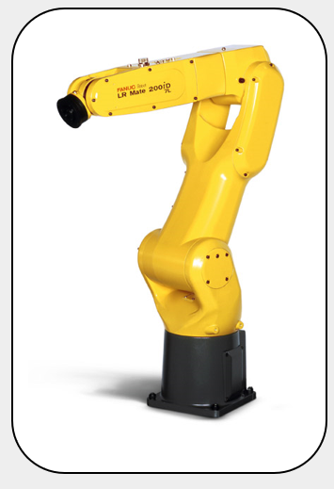
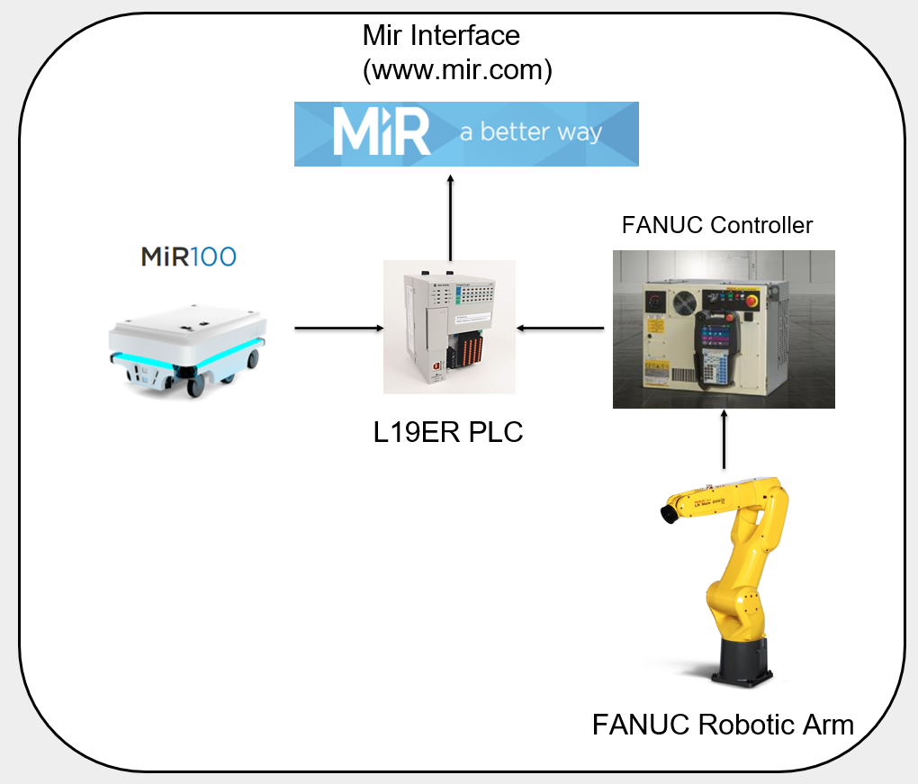
Automated Transportation Robots Designed For Industrial Machine
Team Members: Qiwei Wang & Haocheng Han
Faculty Advisor: Brad Kinsey Industrial Advisor: Kris Fargo
Department of Mechanical Engineering, University of New Hampshire
Background
End of Arm Tooling
Time is extremely critical in manufacturing processes and systems.
Manufacturing automation is becoming more and more prevalent.
Autonomous robots can increase overall process efficiency.
Aluminum 6061 alloy
Designed to pick up 7kg tray
Low-cost, high-reliability solution
End of Arm Tooling
Tray for cutting tools
Project Overview
Two industrial robots working in tandem
Use an autonomous, mobile industrial robot, i.e., MiR, to move palletized cutting tools from a CNC machine to an inspection machine and then return to the charging base station.
Mobile Industrial Robot (MiR)
For smaller transport tasks within industry, logistics and healthcare
Robot payload: 100 kg (maximum 5% incline)
Towing capacity: 300 kg
Running Time: 10 Hours or 20 Km
Charging Time: Up to 3 Hours
Progress
FANUC Industrial Robotic Arm
Communications and Programming
MiR autonomously finish the task by moving from the charging base to the CNC machine and final to the inspection area.
FANUC robotic arm can autonomously pick up the tray from the CNC machine and drop it off at the inspection area.
MiR battery life study completed.
Selecte the best design for the end of arm tooling and analyzed to be sure that material could withstand the stresses induced.
Manufacture and assemble the end of arm tooling for the robotic arm.
Work on establishing Ethernet connection between the MiR and FANUC Industrial robotic Arm.
FANUC Controller:
Use control panel to program each move
MiR interface:
Dedicated language to program the MiR
Can combine the MiR and FANUC robotic arm into one function
PLC:
Used as a controller to bridge communications between Mir and FANUC Industrial Robotic arm
LR Mate 200iD/7L
Six-axis robot arm
Used for moving material around a workspace
Pneumatic Operation (7kg max load capacity)
Maximum reach of 911mm
Mounted to the base of the MiR
Acknowledgments: Olson Center (in particular Mike Locke), Turbocam Inc., and Jaiden Evart and Vinayak Chaturvedi for assistance with robot programming and control.

