Slide 1
Egmont Channel Range Rebuild

Slide 2
Project Involvement
Team:
Nicole Sanborn- Project Manager
Ryan Boyle
Gabe Paster
Brian Duignan
Project Sponsor: Appledore Marine Engineering, LLC
Thomas Ducharme
Project Advisor:
Professor Benoit
University of New Hampshire

Slide 3
Introduction
Background
Range Front Light
Range Rear Light
Design Criteria
Scope of Work
Alternatives Investigated
Final Design
Challenges
Conclusion
Questions
3

Slide 4
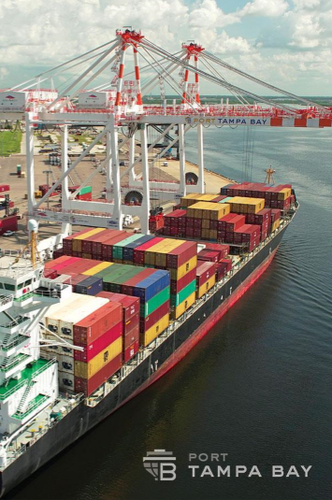
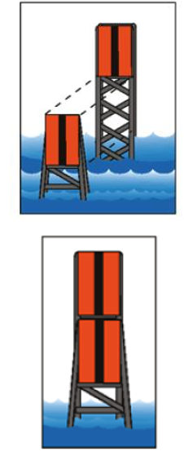
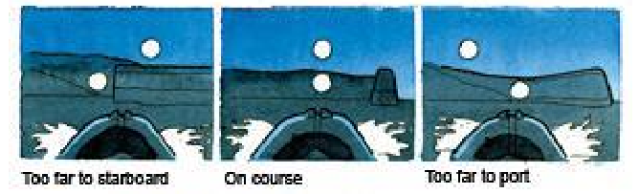
Project Background
Located in St. Petersburg, Florida
Tampa Bay Port
Florida's largest Port
Over 5,000 acres
Handles over 37 million tons of cargo a year
Egmont Channel
Only entrance into Tampa Bay Port from Gulf of Mexico
Range
Critical to aid ships into Tampa Bay Port safely
Two well lit, fixed offshore structures

Slide 5
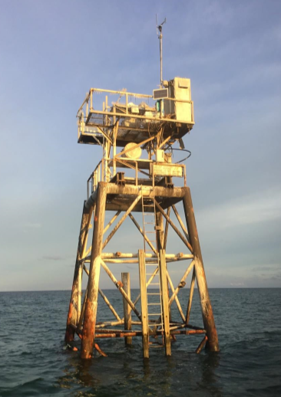
Existing Range Front Light
Located 2 miles offshore
Constructed 1990
Prefabricated steel jacket structure
10 foot water depth
Focal height 30 feet above MHW (Mean High Water)
Severely corroded

Slide 6
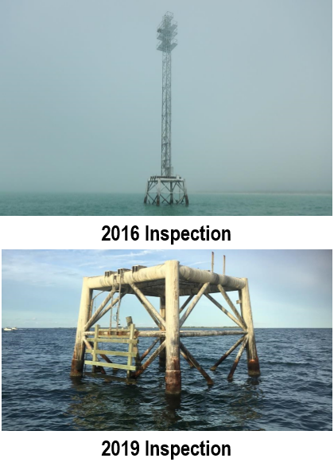
Existing Range Rear Light
Located 300 yards offshore
Constructed 1990
Prefabricated steel jacket structure
15 foot water depth
Focal height 115 feet above MHW (Mean High Water)
Severely corroded
Lattice Tower/Light destroyed in 2017 hurricane season

Slide 7
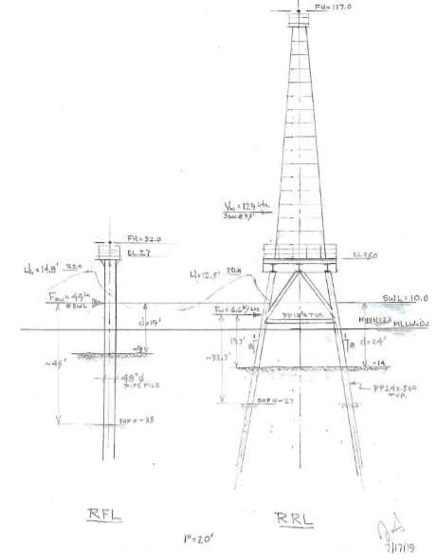
Design Criteria
Criteria
50 year design life with little to no maintenance
100 year return period for wind and wave load
Design Concepts
Range front light
Monopile design
Range Rear Light
Multi-pile

Slide 8
Scope of Work
Maintain regular project meetings
Continuous communication
Obtain background information
Geotechnical feasibility study for the foundation
Assess the wave loads on structure
Develop 100-year design wind and wave loads
Design range front light
Design range rear light
Perform structure life cycle analysis for 50-year
Develop construction cost estimates

Slide 9
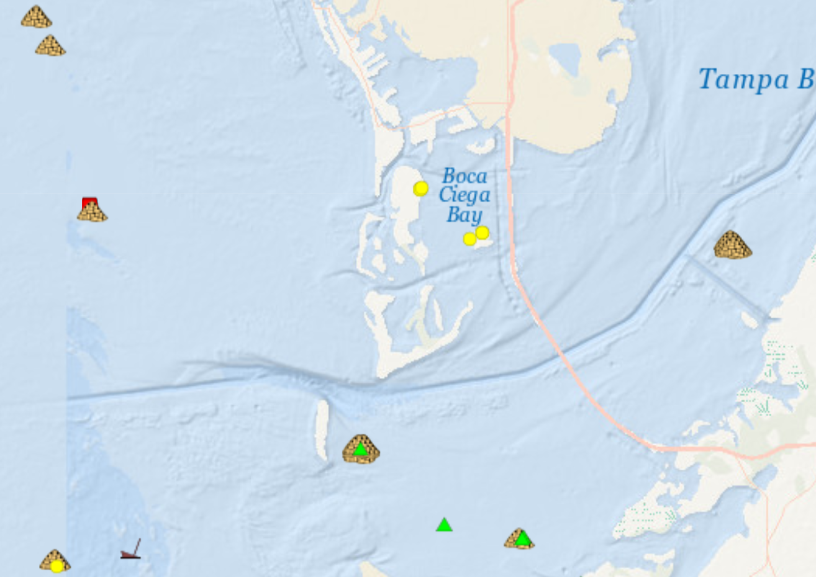
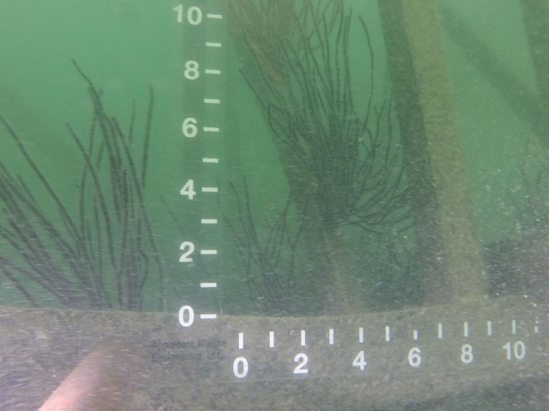
Potential Reef Structure
Save Money on demolition and disposal costs
Creates artificial reef for Marine organisms
Environmental Resource Permits
General Permit
Individual Permit
http://myfwc.maps.arcgis.com/apps/View/index.html?appid=4675e1db32ac43a9a4308e757965d17d

Slide 10
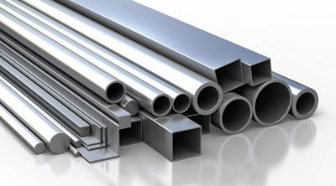
Structural Alternatives
Materials:
Corrosive resistant
Handle wind and wave loads
Timber- no corrosion. Insufficient load capability
Steel- susceptible to high corrosion
High Grade Stainless- strong, corrosion resistant, $$
Steel with corrosion protection
Epoxy coating- 5-10 years before breaking down
Sacrificial Anodes- 5-10 years before breaking down
More negative electrochemical potential than structure
Sacrificial Steel on Wall thickness- to get structure to desired design life
https://www.stainlesstubular.com/bar-structural-shapes.html

Slide 11
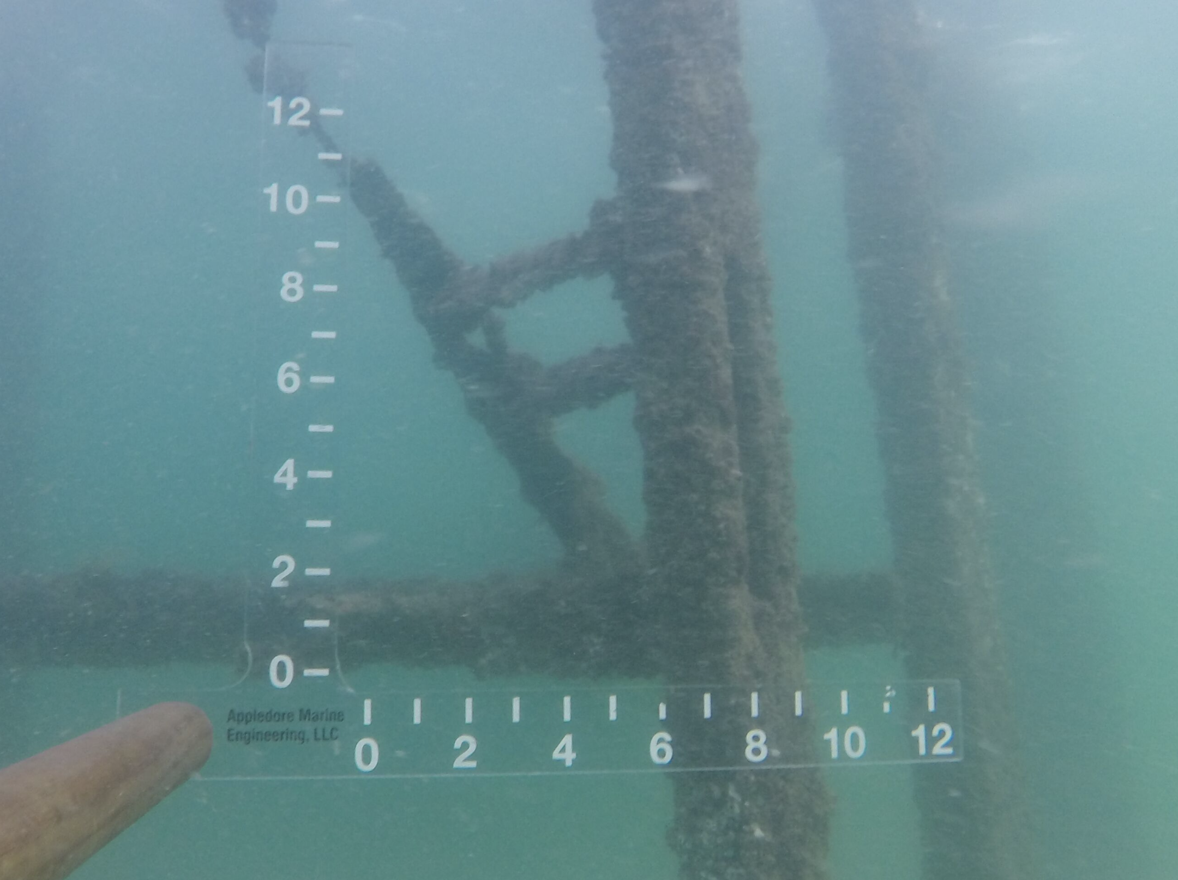
Corrosion Resistance
50 year design​
Probable failure of previous structure​
Wetting and drying of structure

Slide 12
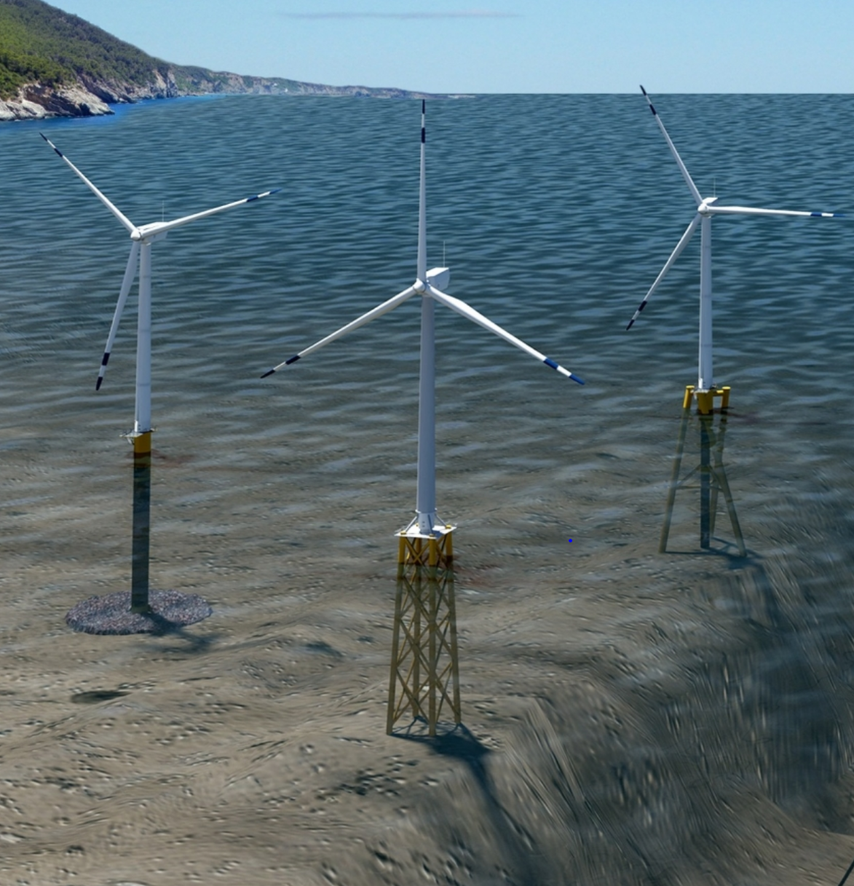
Geotechnical Alternatives
Monopile
Jacket Structure
Twisted Jacket
https://www.energy.gov/eere/articles/us-conditions-drive-innovation-offshore-wind-foundations

Slide 13
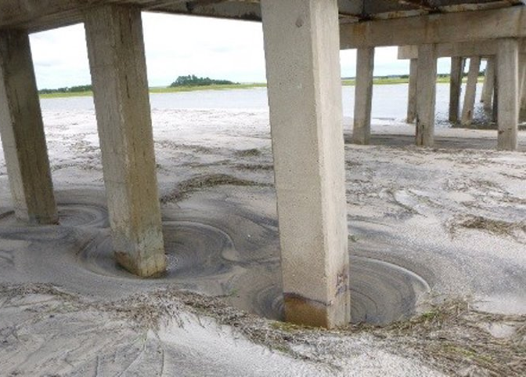
Scour
Common problem for marine structure
Occurs when water moving past structure loosens soil around foundation below
https://www.ayresassociates.com/battling-bridge-scour-with-research-inspections-and-training/
*Example of Scour*

Slide 14
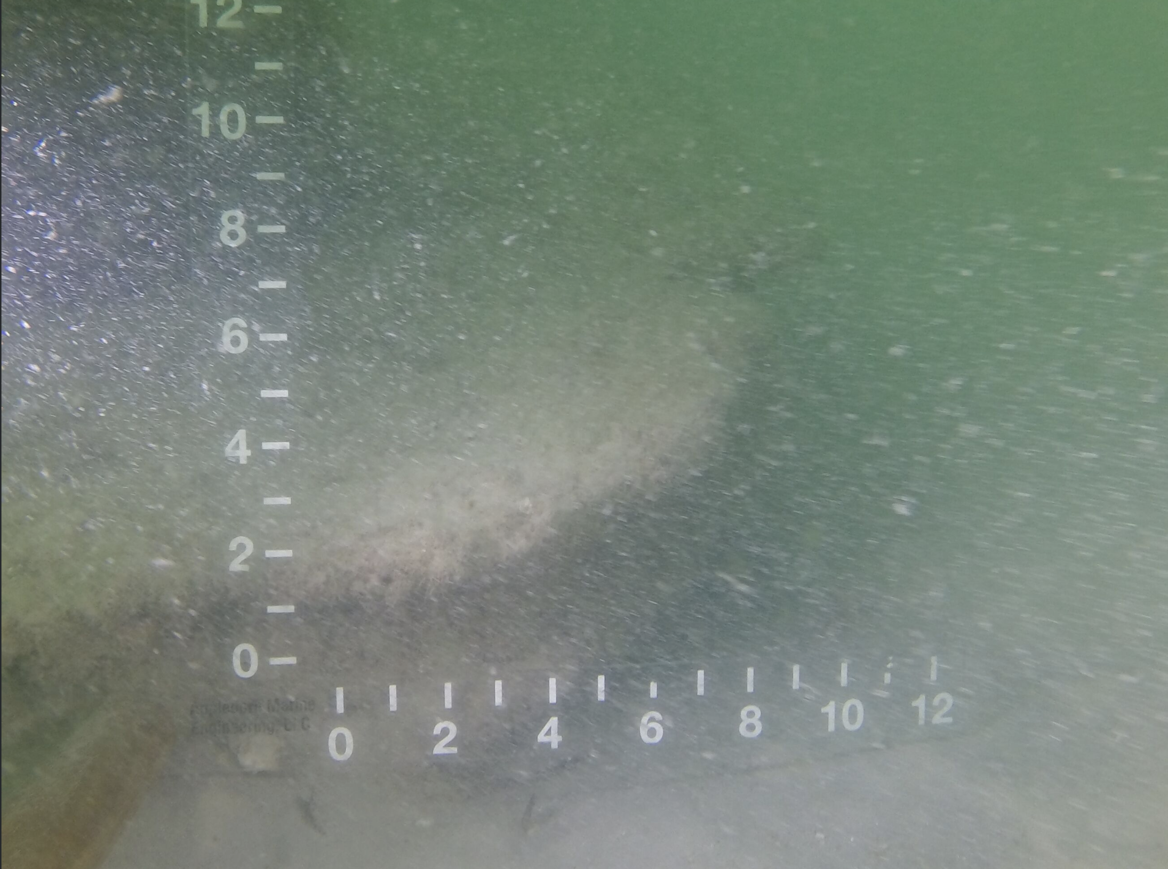
Scour
Previous design had problematic scouring ​
Attempt was made to remediate by pouring concrete around existing piles​
Scour continued to occur

Slide 15
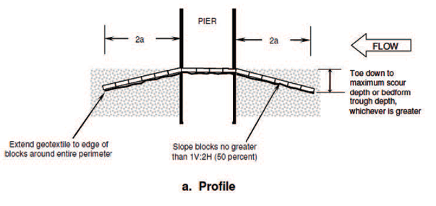
Articulating Concrete Block Mattress
Effective and relatively easy way to fight scour
Concrete block mattress installed in all directions from structure
Mattress slopes down and reaches underneath the maximum scour expected
https://www.maccaferri.com/ae/products/articulated-concrete-block-mattresses-acbm/
https://www.conteches.com/knowledge-center/pdh-article-series/articulated-concrete-block-design

Slide 16
Wind Calculation Development
Wind loads calculated using ASCE 7-10
Wind loads negligible for monopile
Cannot have wind and wave acting at same spot
Wind loads calculated by taking tower as sections
Assumed 50% cross sectional area for the tower
Taken about two directions
16

Slide 17
Development of Wave Loading
Cyclic Loading​ (wave period)
Wave height​
Storm Surge
High water level
Sea level rise
17
http://www.hann-ocean.com/index.php/products/ocean.html

Slide 18
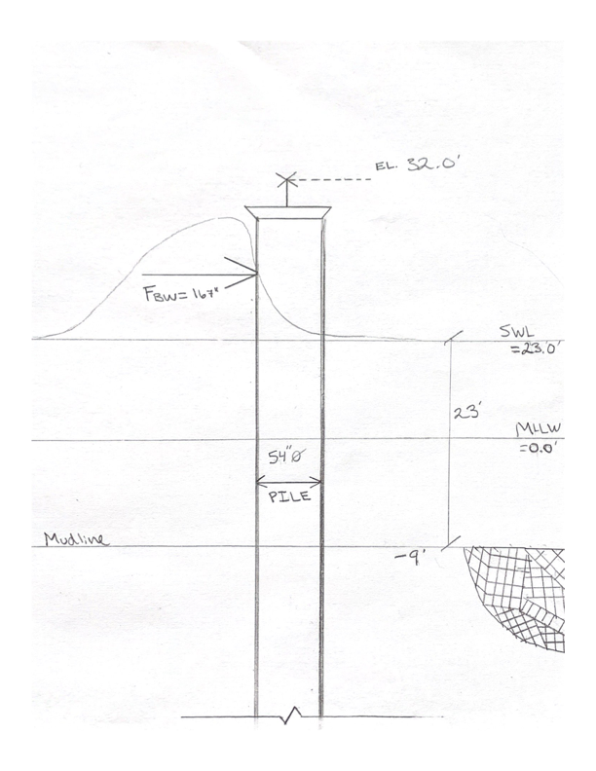
Wave Calculation Development
Three types of forces from waves
Drag
Inertia
Breaking wave
Breaking wave controls
Water depth affects wave loads greatly
Sea growth taken as a factor
18

Slide 19
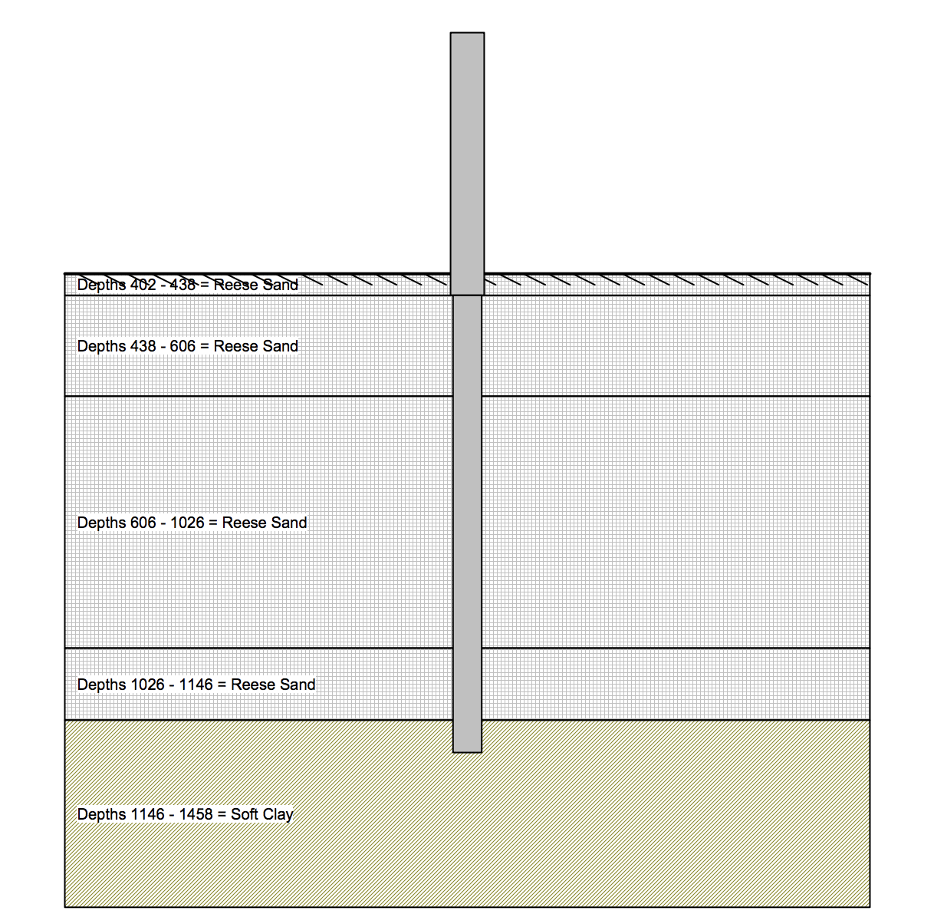
Soil Conditions
Four layers of sand from –15 ft MLLW (Mean Lower Low Water Level)​
Clay layer at –100 ft MLLW​

Slide 20
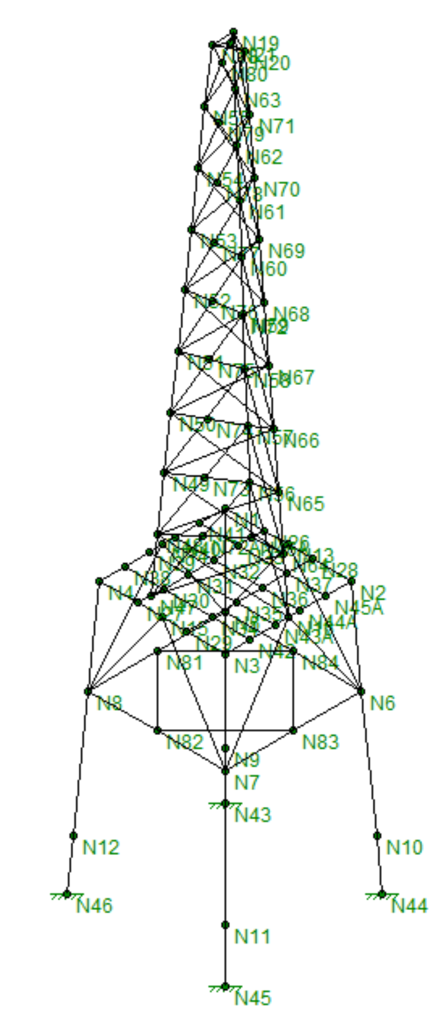
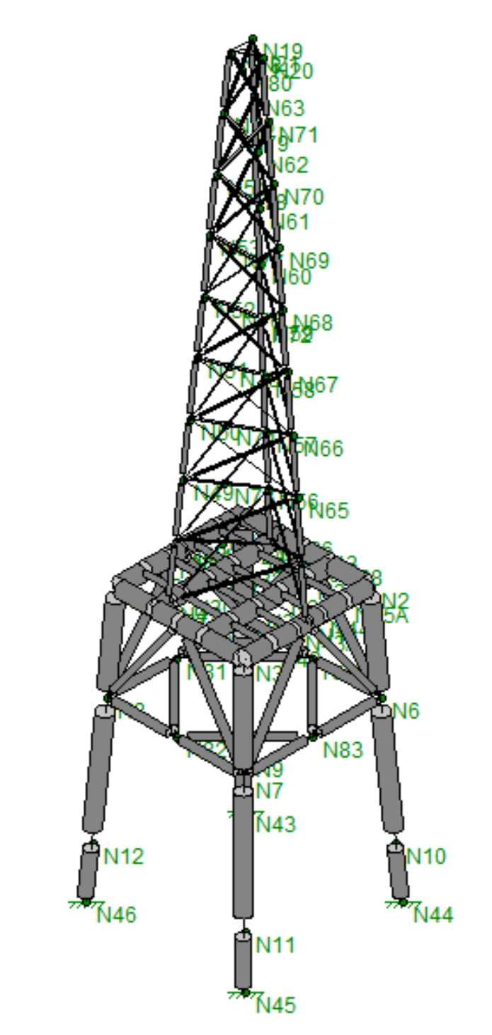
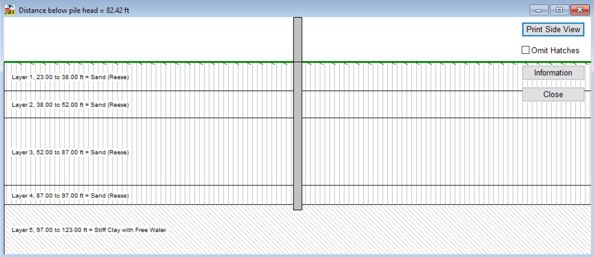
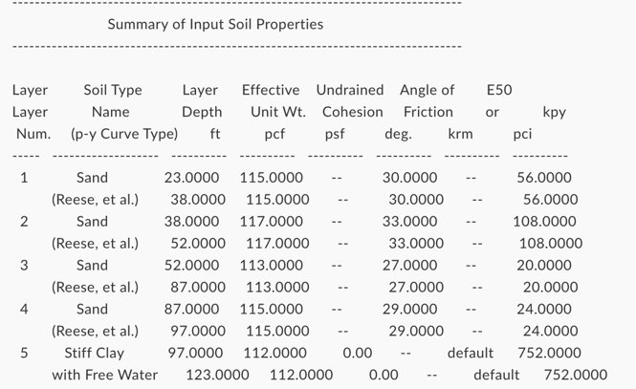
Modeling Process
LPILE
Performs hundreds of iterations of the pile with soil profiles and properties input
RISA
Optimizes structure
Coupled system

Slide 21
RISA Issues
UNH provides demo version
Saving model files
Limits extent of design
Led to adjustment of scope

Slide 22
Coronavirus Complication
Modeling challenges
Ten minute in person introduction prior to vacation
Adjustment to a new work environment
Lack of reliable software
No in person meeting

Slide 23
Life Cycle Assessment
Goal in our LCA: analyze the potential environmental impacts and determine if the life cycle of the structures will meet design requirements designated by the scope
Making sure the structures are sacrificial anodes and steel with an epoxy coating
Climate change
Old Structure into a reef structure
If not removal of old structure to reduce physical risk
Recommend same locations, same impact
Not in scope: recommend putting solar panels on the top of the structures to power the lights
http://fibrenet.eu/index.php?id=blog-post-eleven
23

Slide 24
Conclusion
Followed scope with minor amendments
Load Development Process
Choosing the best course of action to meet our design goals
Working through challenges presented with resources available
Taking advantage of virtual connections and resources
Communication amongst group, sponsor and advisors

Slide 25
Sources
AppledoAppledore Marine Engineering, LLC “Articulated Concrete Block Mattresses (ACBM) - Maccaferri Middle East.” Maccaferri Middle East,
www.maccaferri.com/ae/products/articulated-concrete-block-mattresses-acbm/. Coastal Engineering Manual. Coastal and Hydraulics Laboratory, U.S. Army Engineering Research and
Development Center, Waterways Experiment Station, 2004. Coulbourne, William L, and T. Eric Stafford. Wind Loads: Guide to the Wind Load Provisions of ASCE
7-16. American Society of Civil Engineers, 2020. Minimum Design Loads and Associated Criteria for Buildings and Other Structures. American Society of
Civil Engineers, 2017. “U.S. Conditions Drive Innovation in Offshore Wind Foundations.” Energy.gov,
www.energy.gov/eere/articles/us-conditions-drive-innovation-offshore-wind-foundations

Slide 26
Acknowledgements
The project team would like to express thanks to the project sponsor and advisor, Thomas Ducharme and Jean Benoit for the continuous support and guidance they have provided thus far for this project. The team would also like to thank Raymond Cook for his help with the understanding of foundation and structure alternatives, Majid Ghayoomi for his help with structural elements, and Thomas Ballestero for his help with load development. This project and its development would not have been made possible without the resources or help provided by the University of New Hampshire.

Slide 27
Questions?
Please feel free to send any questions to:
nss1007@wildcats.unh.edu
CEE 797 - 4 Presentation Skills.pdf
CEE 797 - 4 Presentation Skills.pdf

