Slide 1
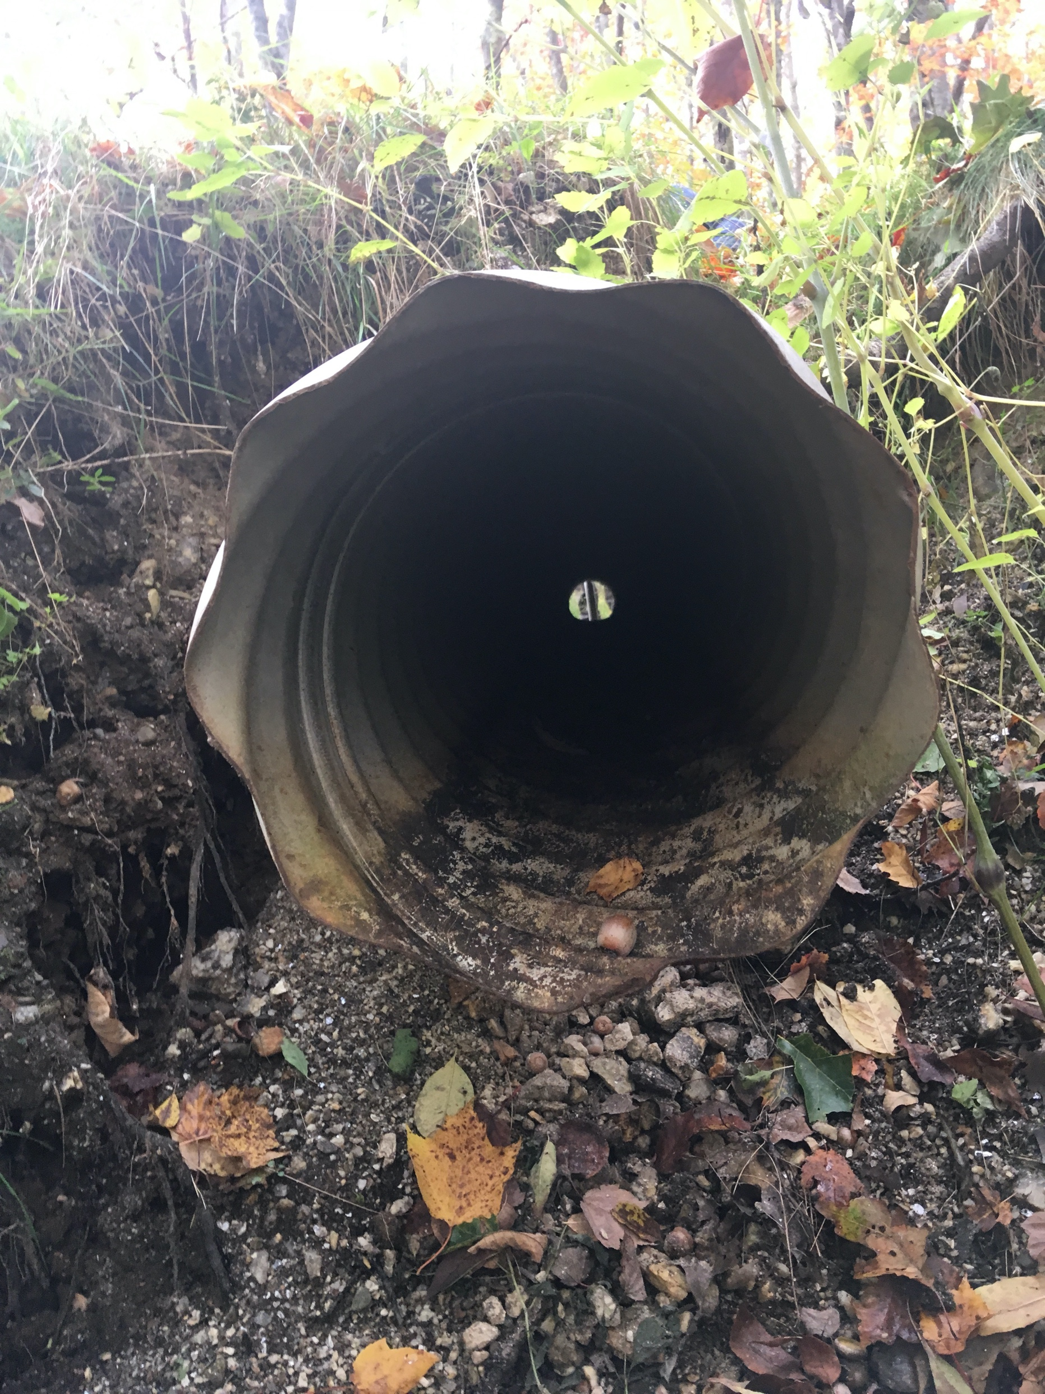
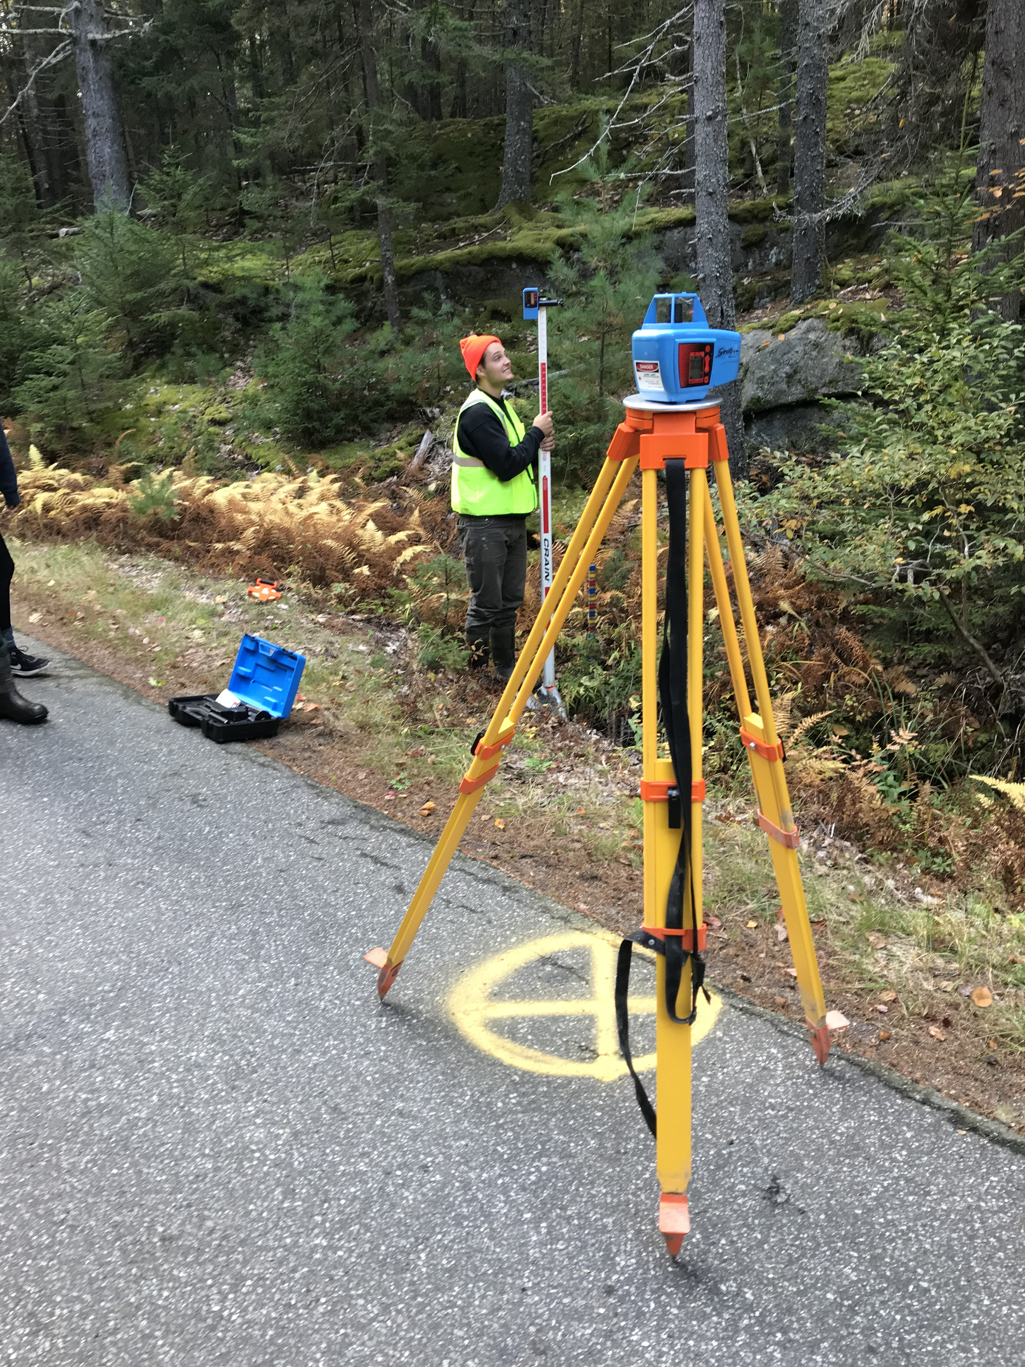
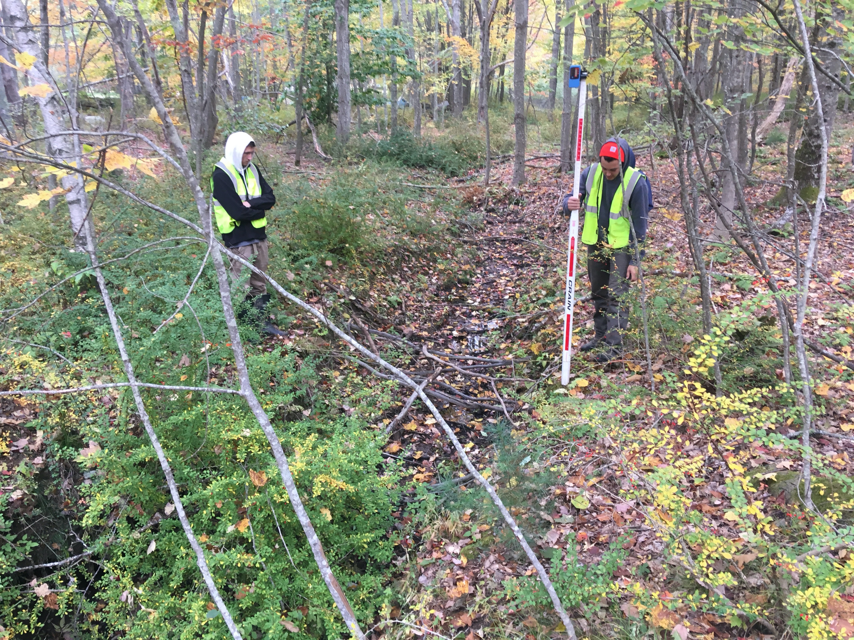
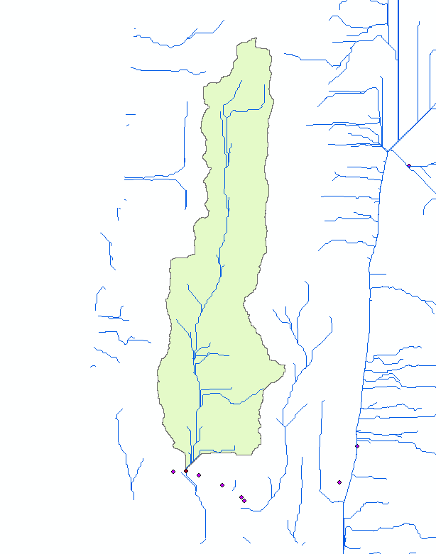
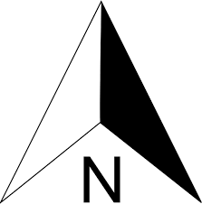
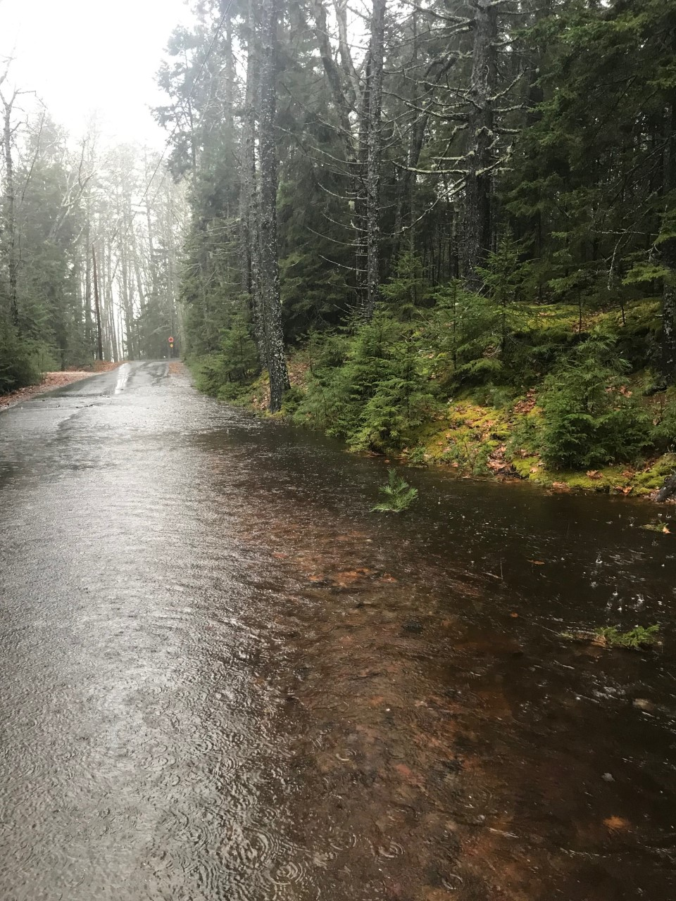
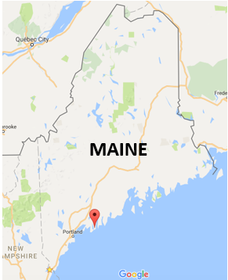
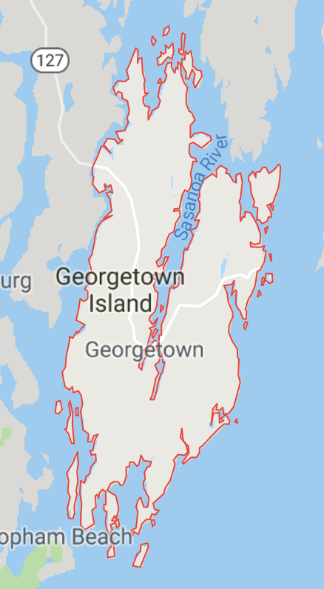
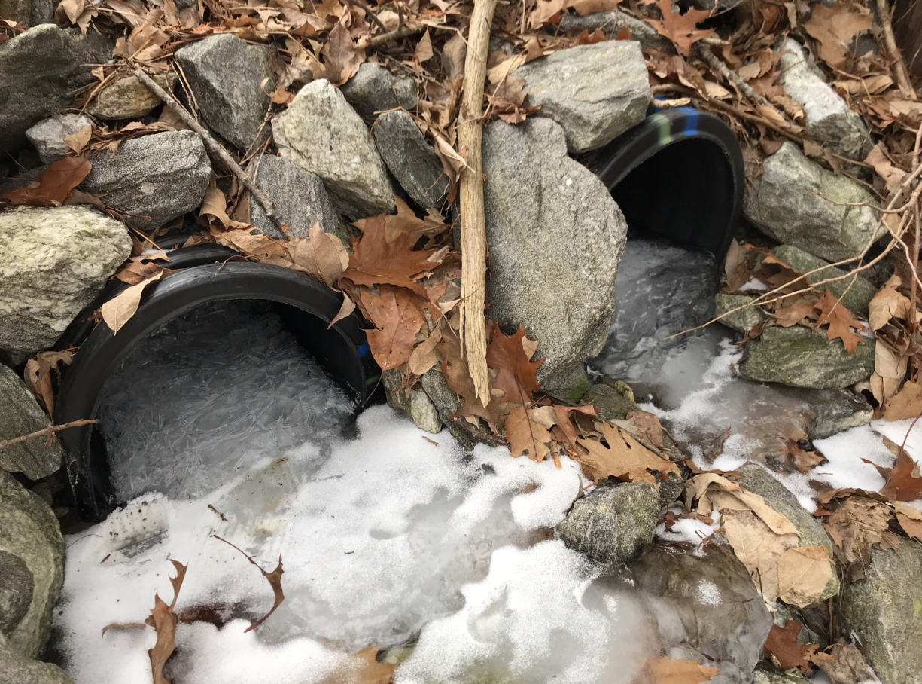
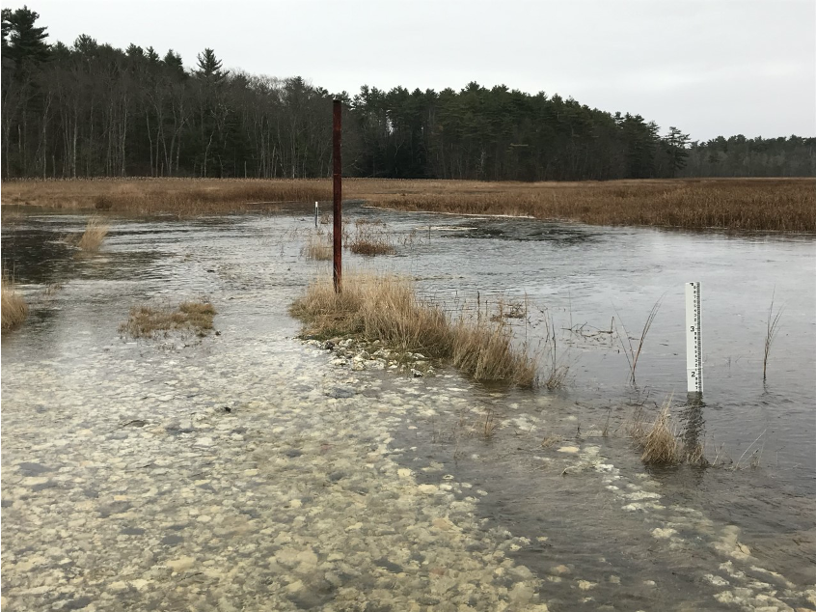
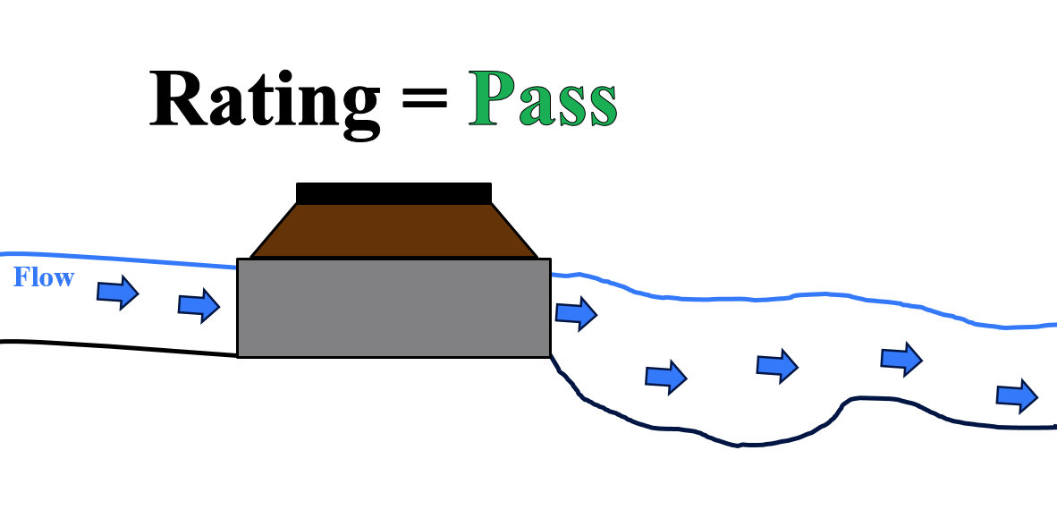
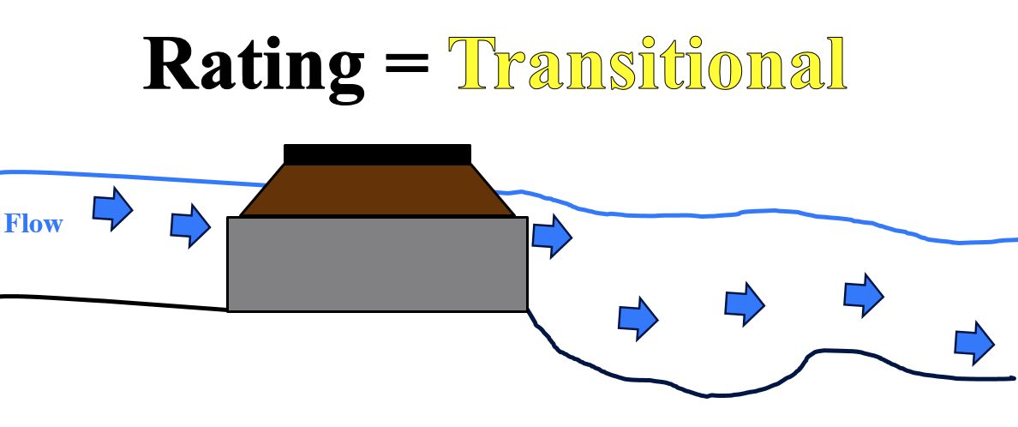
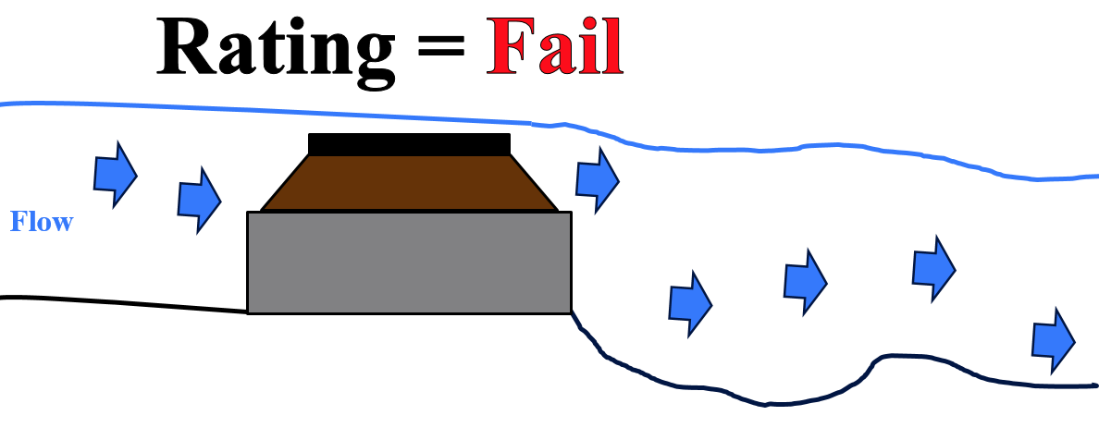
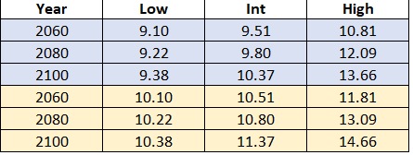
Georgetown, ME Culvert Analysis Project
Anna Lampman, Jordan Meaney, Ross O’Neil, Kyle Szewczyk
Client: Charlie Collins, Georgetown Road Commissioner
Advisor: Dr. Nancy Kinner
Assisting Consultant: Joel Ballestero
Introduction
Field Work
Analysis and Results
The Georgetown, ME Culvert Analysis Project was started in 2014 by a UNH senior project group.
When properly functioning, culverts allow precipitation runoff to pass under roads, minimizing flooding or washout potential.
The team surveyed 33 culverts; locating and obtaining GPS coordinates, and measuring/recording culvert characteristics.
Material, shape, end/edge type, geometry, inlet/outlet elevations, downstream slope and tailwater cross-section profile.
Streamworks, an Excel modeling tool, predicted culvert pass/fail ratings during certain nth (e.g., 2, 10, 25, 50, 100) year storm events.
The team started a volunteer program with town residents to monitor high risk culverts in order to validate the Streamworks predictions of flooding.
Data collected from each culvert:
Culvert material
Diameter
Lat/Long coordinates
Culvert length
Streamworks Inputs:
Invert elevations, Slope, Diameter, Length, Material
Streamworks Output:
Rise of culvert inlet vs outlet
Elevation measurements
Photos
Hydrology Methods: Arc Hydro Tool, Google Earth, USGS Streamstats, Drainage-Area Ratio Method
Crossing ID | 2 | 10 | 25 | 50 | 100
MT-0.974 | V | O | O | O | O
MT-1.02 | P | P | V | V | O
MT-1.14 | P | P | P | P | O
MT-1.15 | P | P | P | P | P
MT-1.18 | V | O | O | O | O
MT-1.23 | P | V | V | O | O
MT-1.21 | V | O | O | O | O
MT-0.640 | P | V | V | O | O
KP-0.014 | P | P | P | P | P
KP-0.178 | P | V | V | V | O
KP-0.451 | P | P | P | P | P
KP-0.600 | P | P | P | P | P
KP-0.766 | P | P | P | P | P
KP-0.829 | P | P | P | P | P
HH-0.066 | P | P | P | P | P
NE-0.360 | P | P | P | P | P
NE-0.475 | P | P | P | P | P
NE-0.565 | O | O | O | O | O
NE-0.730 | P | P | V | V | V
NE-1.19 | P | P | P | V | V
NE-1.23 | P | V | V | V | O
NE-1.57 | P | P | P | P | P
NE-1.67 | P | P | V | V | V
LP-0.031 | P | P | P | P | P
LP-0.081 | P | P | P | P | P
LP-0.280 | P | P | P | P | P
LP-0.354 | P | P | P | P | P
LP-0.423 | P | P | P | P | P
LP-0.578 | P | P | P | P | P
LP-0.628 | P | P | P | P | P
LP-0.656 | P | P | P | P | P
LP-0.674 | P | P | P | P | V
LP-0.721 | P | P | P | P | P
Instruments Used For Data Collections:
Laser Level
Stadia Rod
Smartphone
Measuring Tape
Camera
Field Book
Georgetown Background
Rural island town on the coast of Maine.
The year-round population is ~1000, tripling in the summer due to seasonal residences.
There are over 200 culverts on the island.
This project primarily focused on completing the town-owned culvert database.
Citizen-Scientist Program
This program was used to validate the Streamworks model failure predictions.
Select culverts predicted to fail at the 2-year storm were monitored.
Constant communication with volunteers about when to go out and take photos based on monitoring weather
Culverts MT-0.947, MT-1.21, RH-1.059 accurately modeled by Streamworks
Culverts MT-0.640, and Sagadahoc Bay road and Bay Point Road not accurately modeled by Streamworks
Error could be from poor maintenance of culvert, inaccurate hydrology method, field error
Crossing Rating | Total Crossings by Return Period
 | 2 | 10 | 25 | 50 | 100
Overtopping Crossings | 1 | 4 | 4 | 6 | 10
Vulnerable Crossings | 3 | 4 | 7 | 6 | 4
Passing Crossings | 29 | 25 | 22 | 21 | 19
Challenges
Watershed Delineation
COVID-19 Pandemic
Coordination of previous groups information
Analysis of buried, damaged, or irregular culverts (adjacent photo)
Insufficient amount of rain for volunteer data collection
Tidal Culvert Analysis
Three tidal culverts analyzed by this team:
Williams Road
Flying Point Road
Indian Point Road
After meeting with tidal culvert engineers, the following analysis steps were provided:
Use FEMA flood maps to determine 100-year flood elevation for each culvert
Use NOAA Sea Level Rise Curves to determine sea level rise and add this to the 100-year Flood Elevation
This is the elevation that the road should be raised to in order to pass all tidal floods for a long-term design
Culvert Ratings at n^{th} Year Storms
Pass: Water level is below the top of the culvert. All water flows through the culvert.
Vulnerable: Water level is above the top of inlet, but below the surface of roadway. All water flows through the culvert.
Overtop: Water level is above the road surface. Water flows through the culvert and over the roadway.
Pass
References
Vulnerable
Georgetown Conservation Commission. (2015). Climate Change Adaptation Report: Georgetown, Maine. Georgetown, ME: A special publication by the Georgetown Conservation Commission.
Lombard, P.J., and Hodgkins, G.A.,2015, Peak flow regression equations for small, ungaged streams in Maine— Comparing map-based to field-based variables: U.S. Geological Survey Scientific Investigations Report 2015–5049, 12 p.
Acknowledgments
Overtop
This table shows the elevations (Feet above NAVD88) that Williams Road (Blue) and Flying Point Road (Yellow) should be raised to. The low values are with little sea level rise and the high values are with high sea level rise. Intermediate is used for most designs
We would like to thank Dr. Nancy Kinner for being our advisor throughout this project, Joel Ballestero for helping with the culvert analysis, and Lexy Hidrovo, 2018 Project Manager, for helping with GIS inputs. We would also like to thank the Georgetown Conservation Commission and volunteers for their help and for giving us the opportunity to work with them and the Town of Georgetown. Lastly, we would like to thank Joseph McLean, Matt Schultz and Robert Prue for assisting us with the tidal culvert portion of this project.

