Slide 1


Heavy Metal Bioremediation
Joseph Tumidajski
University of New Hampshire
Chemical Engineering Department
Faculty Mentor: Dr. Kang Wu
Notes:
Hello,
My name is Joe and I will be presenting my undergraduate research project on heavy metal bioremediation using b. subtilis spores. This research was conducted in the laboratory of my faculty mentor Dr. Wu of the

Slide 2
Introduction
Heavy metal contamination is a problem that affects populations and individuals worldwide. Current methods of heavy metal removal can be costly, inefficient, and sometimes produce toxic waste. Bioremediation provides an alternate method by using the natural abilities of biological systems or materials to capture pollutants. The goal of my project is to express proteins on the the spore surface of Bacillus subtilis for heavy metal remediation. Our group has displayed various proteins on the dormant spore surface, which show enhanced robustness and remain functional for months at room temperature, making it an ideal system for bioremediation. In the research I will be sharing with you, I studied how we can use this method to remove the heavy metal arsenic.
Notes:
Heavy metal contamination is a problem that affects populations and individuals worldwide. Current methods of heavy metal removal can be costly, inefficient, and sometimes produce toxic waste. Bioremediation provides an alternate method by using the natural abilities of biological systems or materials to capture pollutants. The goal of my project is to express proteins on the the spore surface of Bacillus subtilis for heavy metal remediation. Our group has displayed various proteins on the dormant spore surface, which show enhanced robustness and remain functional for months at room temperature, making it an ideal system for bioremediation. In the research I will be sharing with you, I studied how we can use this method to remove the heavy metal arsenic.

Slide 3
BACKGROUND
Examples of Heavy Metals
  Mercury, Lead, Arsenic, Cadmium, Copper, Zinc
Common Sources:
  Soil erosion, mining, industrial waste/ sewage, pesticides
  Effect both rich and poor countries
Heavy Metal Poisoning:
  Cancer
  Birth Defects
  Headaches and fatigue
Notes:
Heavy metals are ions that are both necessary for our survival and can pose serious health risks if not regulated or if we are exposed to certain types. Arsenic contamination is a serious public health risk that affects many different countries worldwide, mainly in parts of South America and Southern Asia. One of the hardest hit countries is Bangladesh, which the WHO reports has an estimated 19 million to 39 million affected people. This alarmingly high number is due to the fact that most of their drinking water comes from groundwater that contains arsenic, and is now responsible for 21% of all deaths in Bangladesh (World Health Organization 2018). This contamination can occur for many different heavy metals and its sources are usually erosion, mining, industrial waste and pesticides. Even Prolonged exposure to even small amounts can lead to severe skin and lung cancer, heart attacks, headaches, and can even cause premature fetal loss and birth defect. And this problem is not exclusive to poor countries. As many of us remember here in the US, Flint Michigan had lead contaminated water for a very long time leaving many without clean drinking water. It was only until recently that a solution was made available and put into place to treat this problem. The need for an efficient and effective was to remove heavy metals is critical reguardless of where you are in the world.

Slide 4
Current Physio-Chemical Removal Methods
Physical
Nanofiltration: high efficiency but very high cost and requires pretreatment/ replacement
Reverse Osmosis: expensive but no toxic waste produced
Ion-exchange: very expensive but high selectivity
Chemical
Coagulation: low cost and easily available materials but produces toxic sludge or needs filtration step
Oxidation: simple and cheap but does not effectively remove the metal
Notes:
So now that we know why its bad, how do we get rid of it? The two popular methods of removal are physical and chemical. Physical methods usually involve using some kind of filtration or chromatography. This option is usually very effective at removal, but has the downside of being very costly. The chemical method is a much cheaper option but has significant trade offs, like sometimes producing toxic sludge and being less effective at removal than the physical methods described.

Slide 5
Methods
Notes:
Now I will explain what I did for my research and how we tried to develop a third way of removing heavy metals, the biological method.

Slide 6
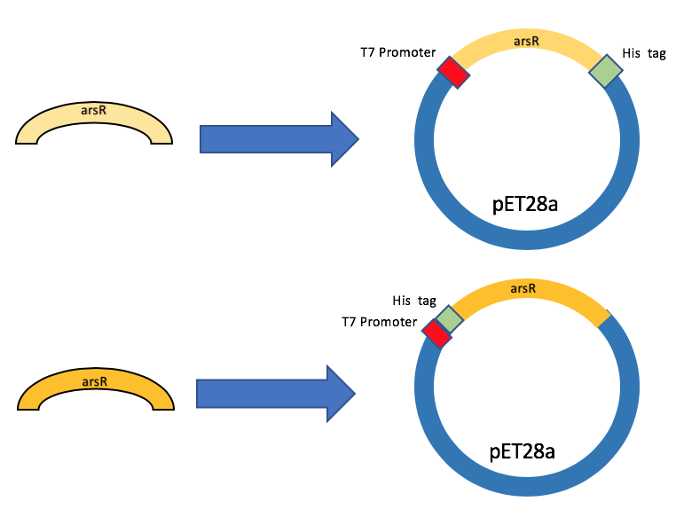
Step 1:
DNA Cloning
Figure 1: Example of an operon and how ArsR works
Plasmid constructed using restriction enzymes and double digestion (Fig.2)
ArsR gene transformed into DH5a E. coli and then into BL-21 E. coli for protein expression.
Histidine (His) tag was expressed on the C and N terminus
Figure 2: Plasmid map of my constructed plasmids. One with a histidine tag on the N terminus and the other on the C terminus.
Notes:
The first step was to find a protein that would actually bind to arsenic and get the genetic information into a cell that could produce many copies of the protein. We decided to use a repressor protein called ArsR. Bacteria the are resistant to certain heavy metals can create protein pumps that will remove the heavy metal from the cell. These are only made however in the presence of arsenic. When arsenic enters the cell it will bind to ArsR which will cause the protein to undergo a conformational change, releasing it form DNA, and allowing the pumps to me made. An example of this process can be seen in figure 1. In order to get my E. coli cells to make this protein I cloned the DNA template of it from another strain of bacteria using Polymerase Chain reaction, or PCR, and inserted them into a vector to help transform it into my cells. I did this using restriction enzymes to basically cut and paste it into a plasmid. As you can see in figure 2, I have 2 plasmids. One has a special histidine tag on either end to help with protein purification, which I will explain in the next slide.

Slide 7
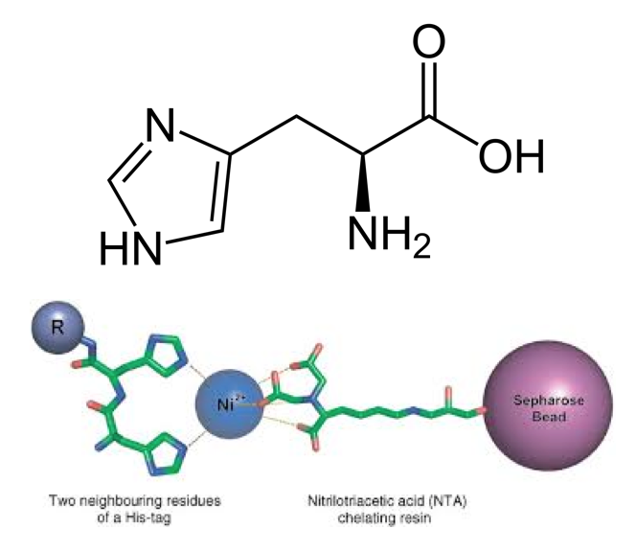
STEP 2: PROTEIN EXPRESSION AND PURIFICATION
Use a Ni-NTA column for purification of ArsR. The nickel in the column will interact with the functional group of 2 histidine molecules (Figure 1)
Must determine if His tag works better on the C or N terminus.
Will use SDS-Page to determine if protein was produced at all. This will also help to further purify the sample
Figure 1: Atomic structure of histidine followed by a 3D illustration of how it interacts with the Ni-NTA column
Notes:
Once I had my DNA transcript successfully inserted into the right cells it was time to start producing the protein. This step requires the use of scale up. Unfortunately, due to the recent shutdown, I was unable to fully complete this step, but I will still explain what next steps would have been had I had the opportunity to continue, For scale up, I start with a small amount of cells and then continue to put the cells into larger and larger containers of media until there are a lot of them. Protein expression is induced and then the protein is collected using a type of chromatography column called a Nickel-NTA column. This is specifically designed to bind to the histidine tag that I mentioned earlier on the ends of my protein. The reason that it was tested on both ends is because we do not know how exactly the protein will fold, and may block the tag if it folds in an unfavorable way. To see if protein was actually collected, I would run an SDS Page, which is a way of separating proteins based on their size.

Slide 8
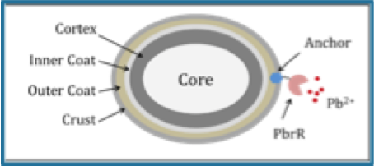
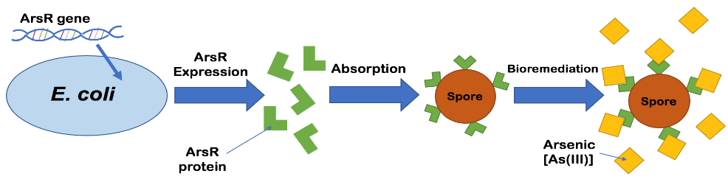
Step 3: Surface display
(2 methods)
Method 1: Fusion Protein
Would require constructing a new plasmid with ArsR and a CotC anchor protein gene being expressed together
Method 2: Adsorption
A newer method that would increase the chance of ArsR being functional but decrease its spore surface adherence
Figure 1: Example of fusion protein but with a lead binding protein (PbrR). Picture from lab mate’s project (Justin Hardcastle)
Figure 2: Example of adsorption method
Notes:
The last step of this project is to have the protein be expressed onto the surface of the spore of b. subtilis. There are two ways that this can be achieved. The first method is to try and create a fusion protein along with an anchor protein that is already expressed on the surface of B. subtilis when it undergoes sporulation. This is the most robust method because the two proteins are physically linked together by covalent bonds, but they are being expressed together as one protein, there are potential issues with folding that could make ArsR non–functional, meaning it cannot bind to arsenic. The second method, which is the one I would have attempted, is to attach the protein to the spore surface using different buffers that will allow for chemical interaction between the spore surface and the protein to occur, sticking them to the outside. The downside to this method however is that the protein may not be as strongly attached to the outside of the spore. illustrations of these two methods can be seen in figures 1 and 2.

Slide 9
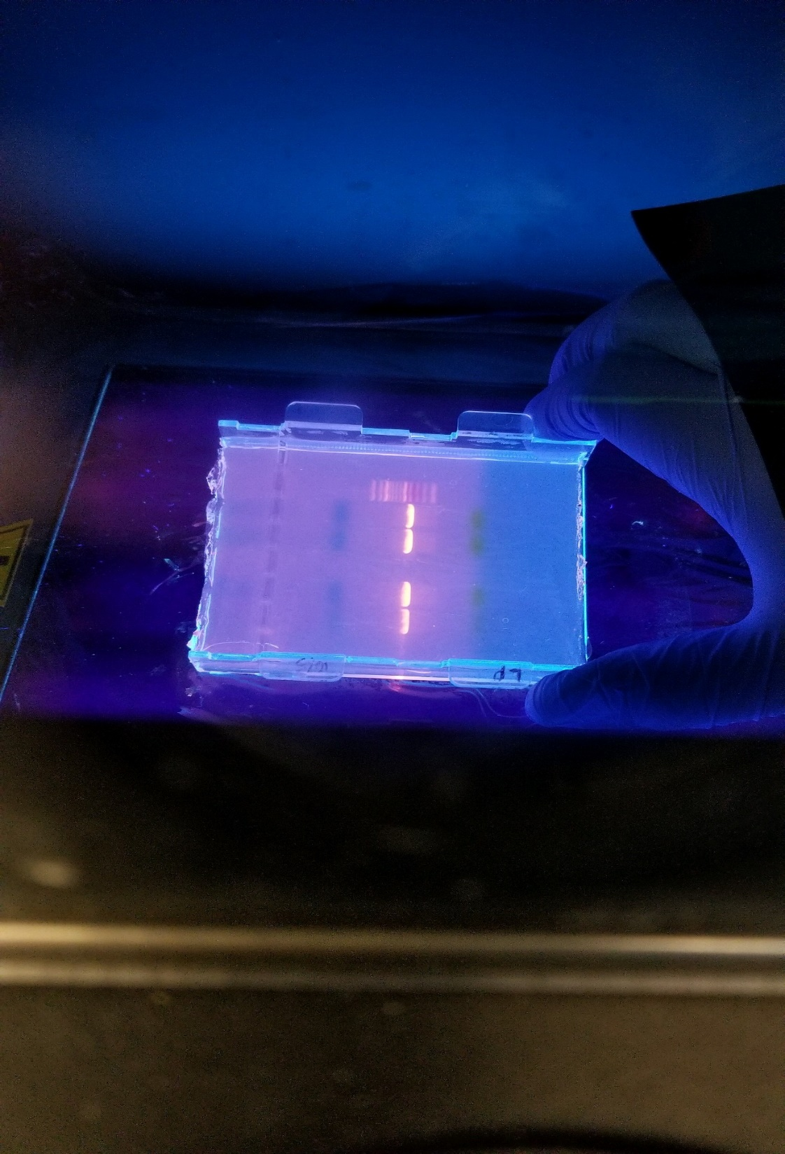
Results and Discussion
Successful in creating plasmid constructs that will express ArsR. Confirmed by running PCR using my plasmids as template (Figure 1)
Application for this project would be bioremediation by immobilizing the spores in a column and allowing them to bind to arsenic from a solution. Then, similar to affinity chromatography, elude the arsenic and reuse the column for further removal runs.
    This method can also hopefully be applied to other heavy metals
Spores do not require nutrients to survive and they do not secrete anything so they are safe to use in a column
Figure 1: Bright bands represent the ArsR genetic code that was copied from my constructed plasmid
Notes:
As for my results, I was successful in creating the plasmids that were mentioned in step one of my methods. I proved this by performing PCR on my newly constructed plasmids and using the same primers that I did to originally clone them. The many copies that were made are indicated by the bright yellow bands in figure one after running them on a gel. The applications of this research is that it can hopefully be used to remove arsenic from water or air similarly to how affinity chromatography would work. The arsenic could then be removed using an elution buffer, and the column could be reused multiple times. Another advantage to this method is that b subtlilis spores do not require and nutrients to survive and do not secrete anything, making them safe to use in a column since they are basically inactive. They are also fast and easy to produce and cheap to make once a suitable cell line is established. Although this research could not at this time be carried out to its completion, it is exciting to me to think about how this field of study can be used as a way of removing heavy metals like arsenic in a cost effective and efficient way. Thank you for your time and attention, and I hope you were able to learn something from this presentation.

