Slide 1
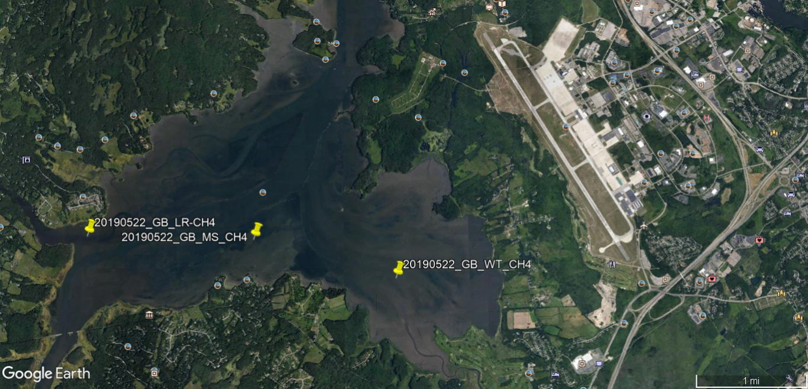
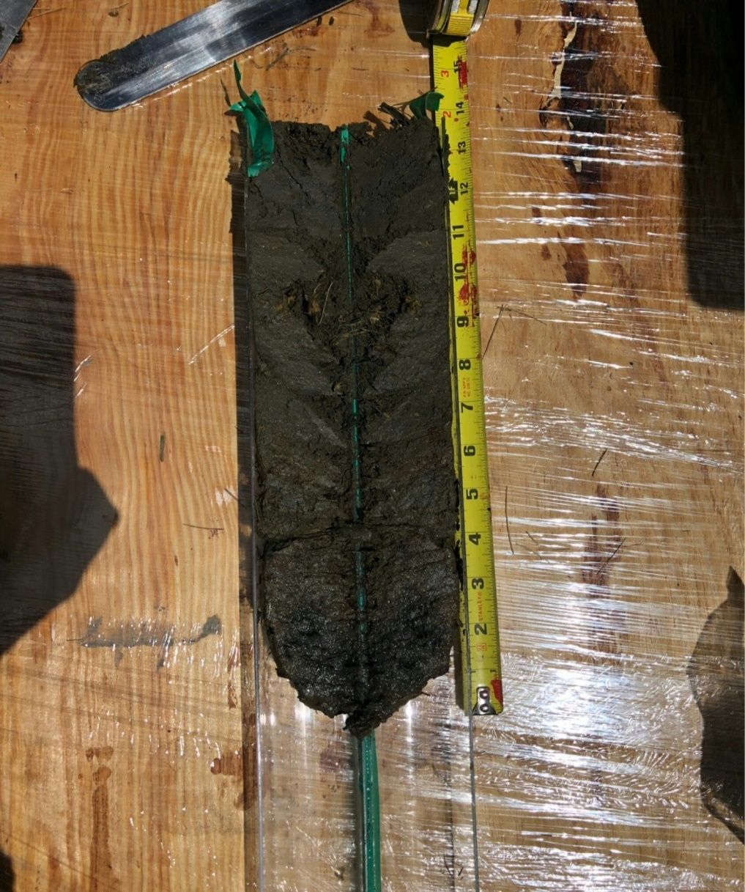
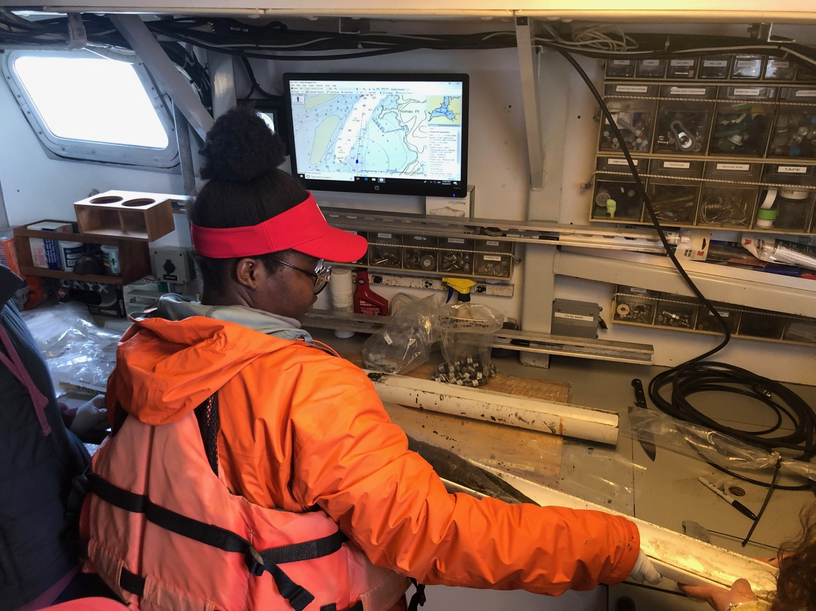
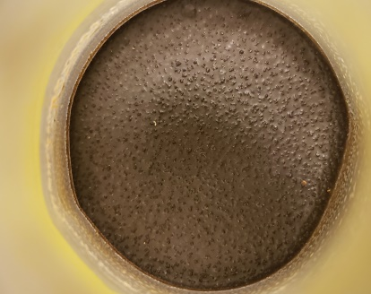
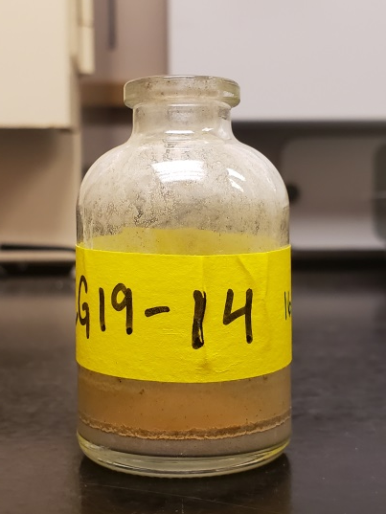
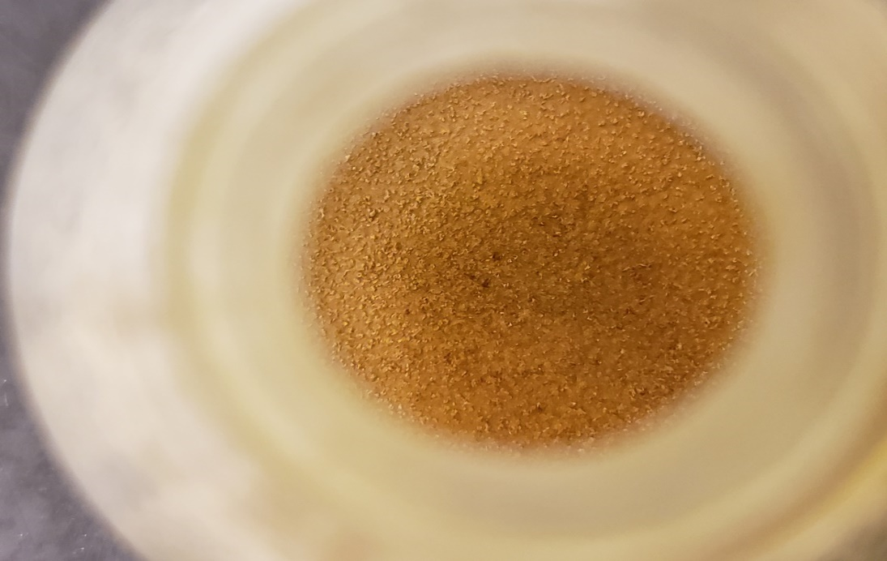
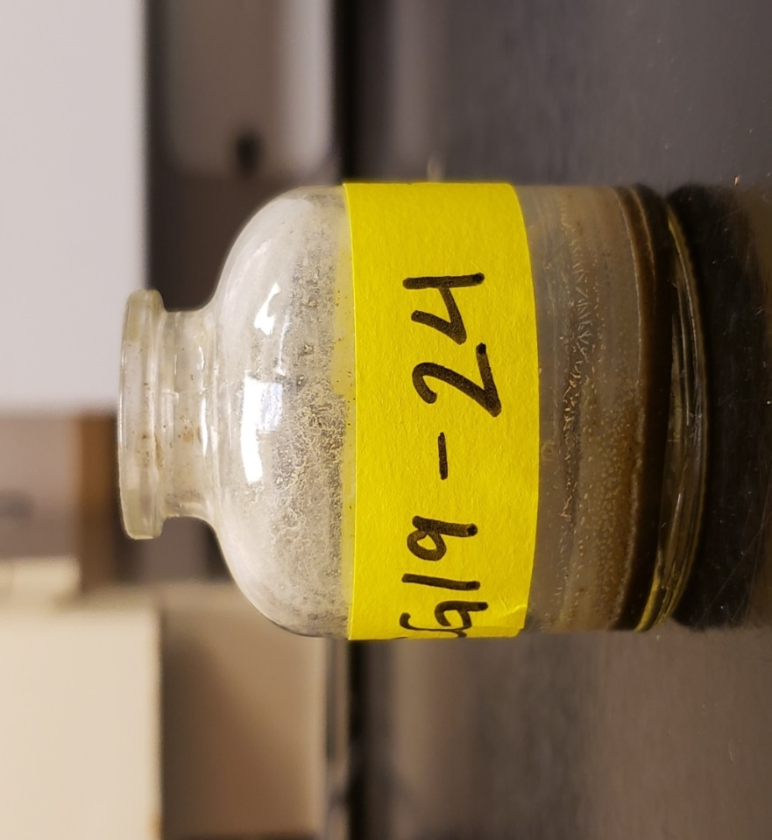
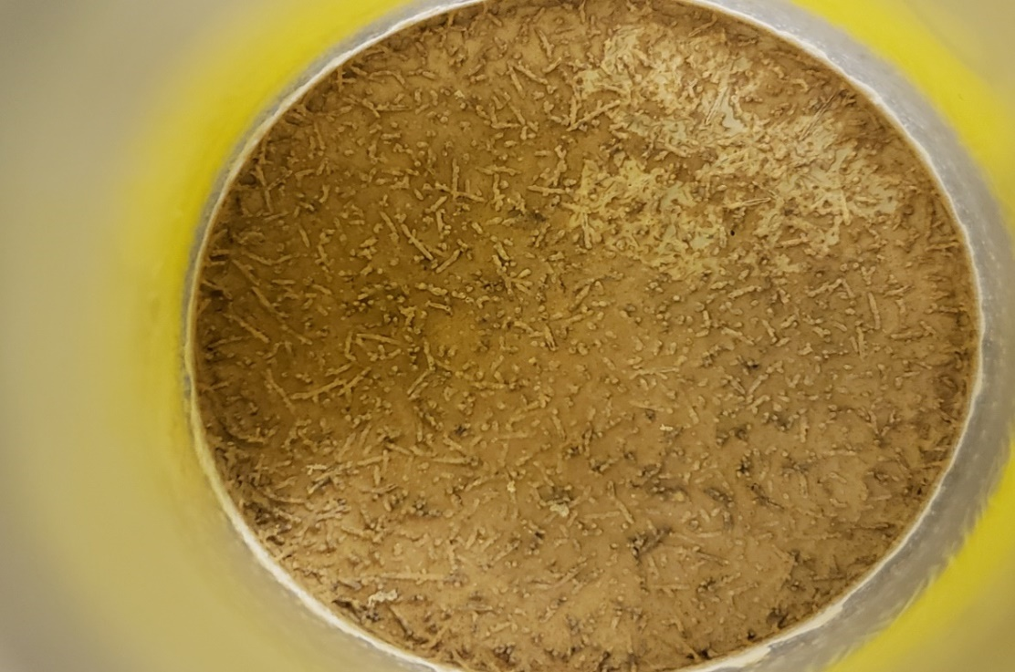
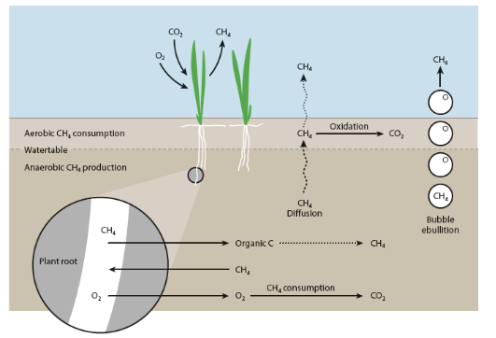
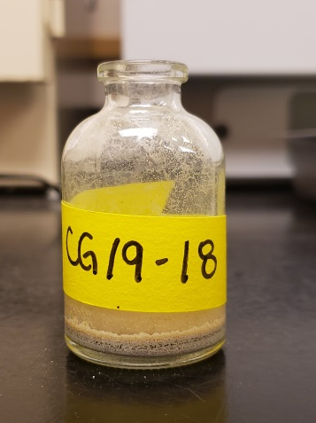
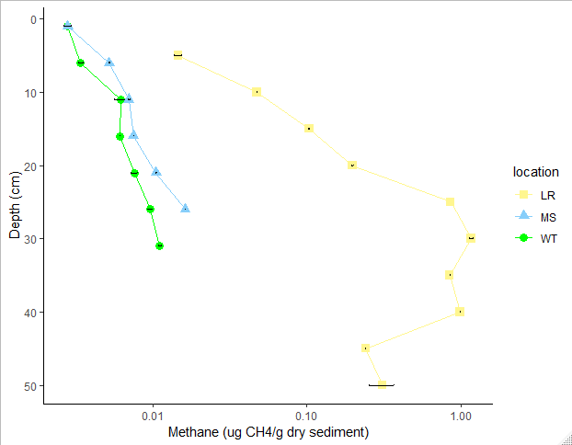
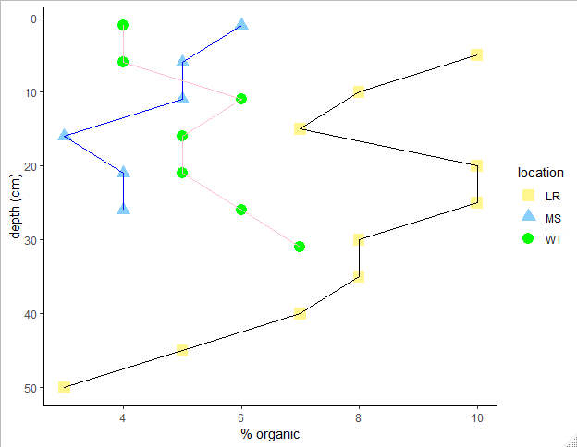
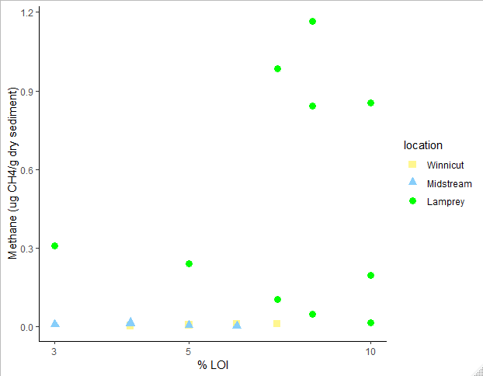
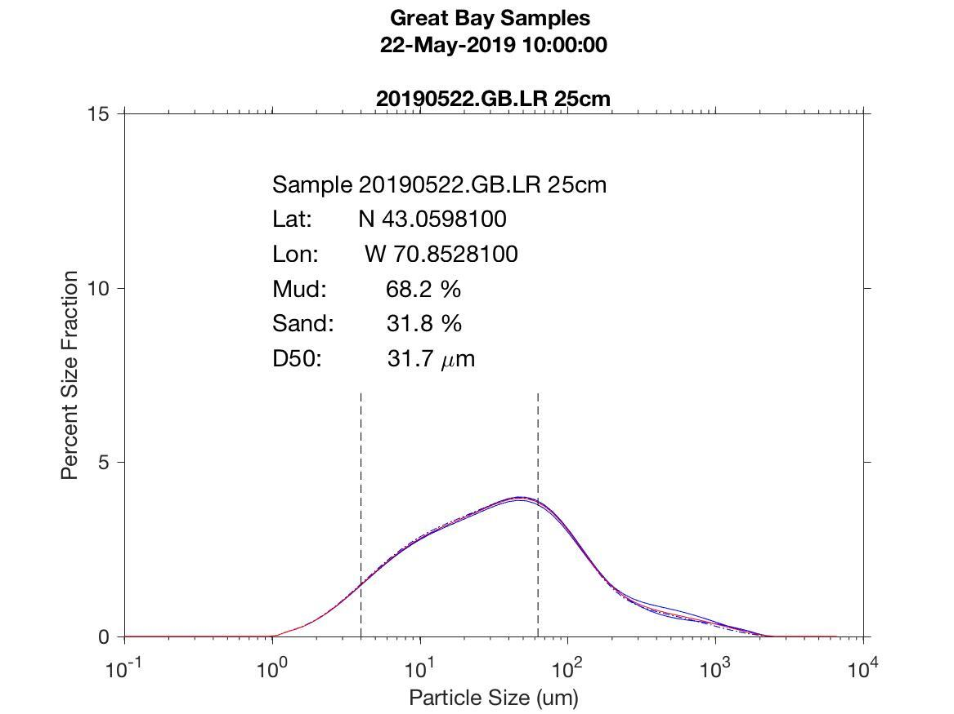
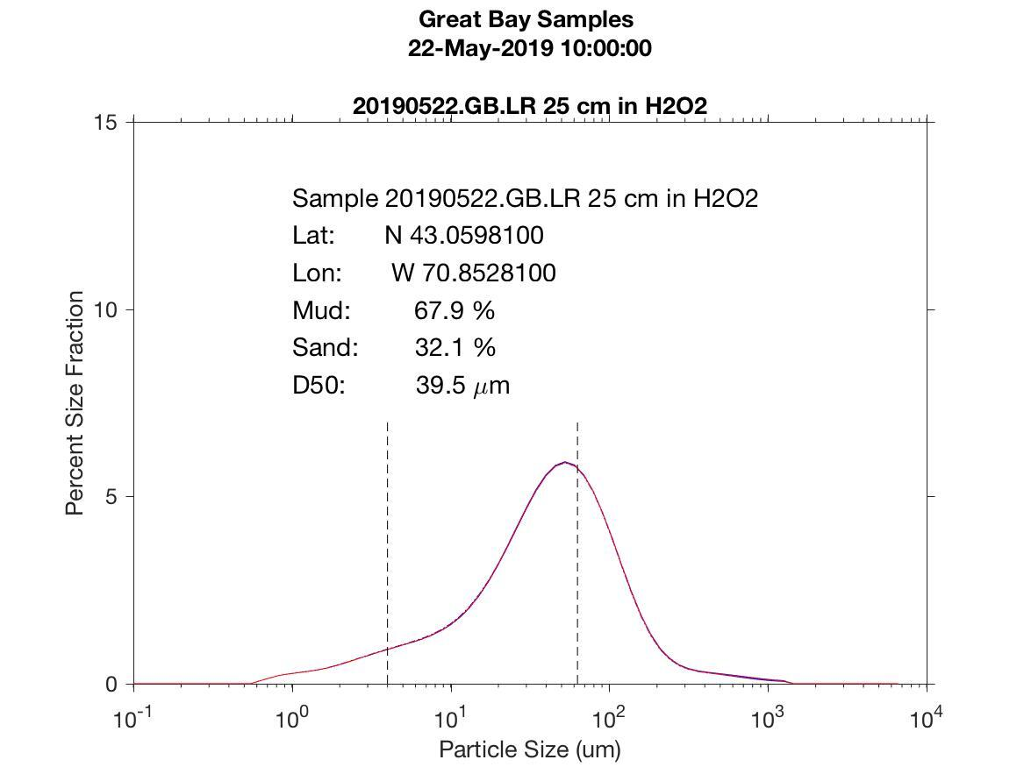
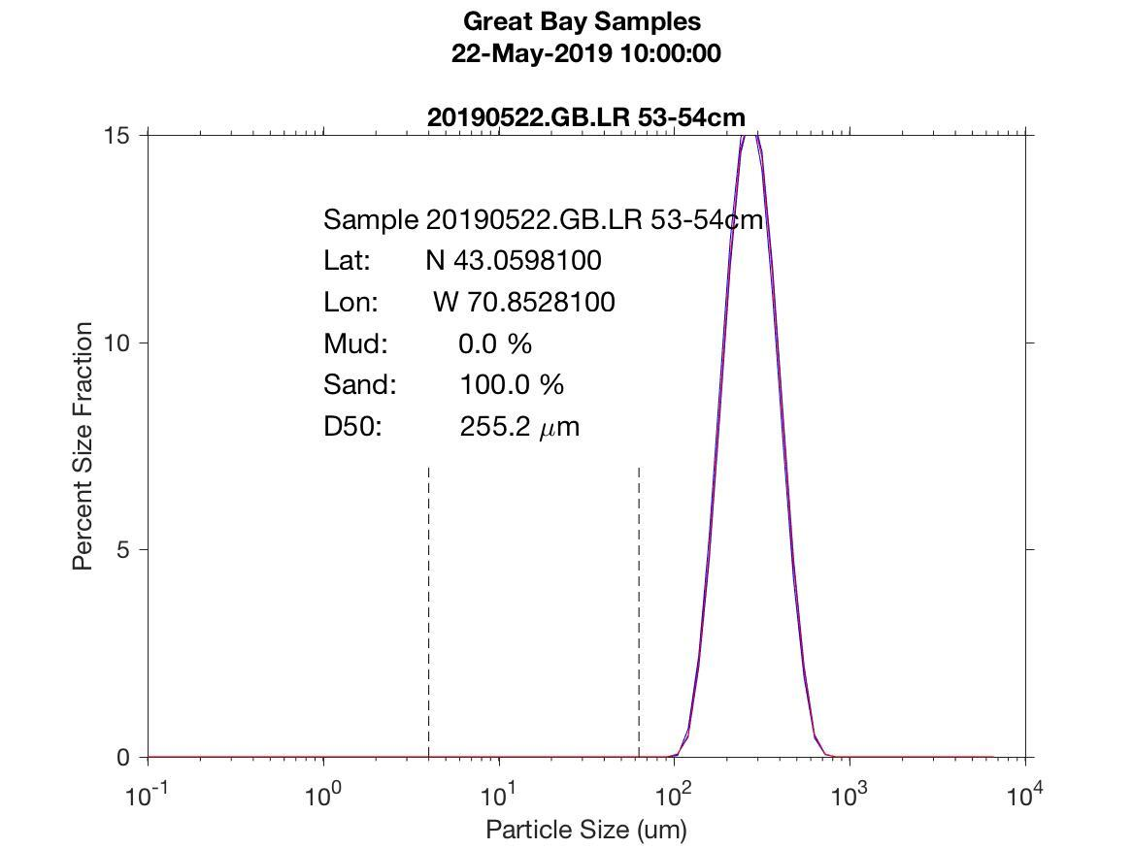
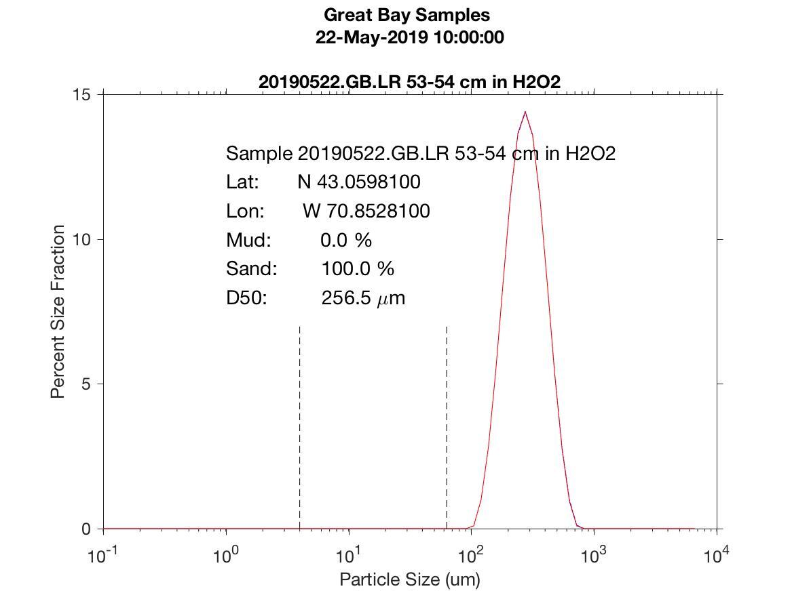
Methane Distribution in River Mouth Sediments in Great Bay
Suah Yekeh^{1,2} and Closes- Gap19 Team¹
1. University of New Hampshire Durham, USA
2. Rutgers University – Newark, 101 Warren Street, Newark NJ, 07029
Suah.yekeh@gmail.com
Introduction and Study Objective
Field Site and Approach
Methods
Methane (CH₄) a potent greenhouse gas occurs naturally in the environment and at elevated levels in coastal wetlands and in estuarine sediments. This study aimed to compare concentrations of CH₄ to the characteristics of the host sediment, specifically grain size (mud fraction and d50) and carbon content.
The locations for this research are three sites within the Great Bay Estuary where we obtained sediment cores near river mouths (mid stream, Winnicut, and Lamprey Rivers).
Cores were taken at the Winnicut, Lamprey and mid stream in the Great Bay Estuary (Figure 2).
Five ml of 2M NaOH was placed into the sample vial.
Cores were subsampled every 5 cm and placed in the sample vial and sealed with a septa and crimp top (Figure 3).
Samples were subsequently analyzed with a Gas Chromatograph, and then dried and weighed again.
Grain size distributions were determined with a Mastersizer Malvern 2000 Laser Particle Analyzer. Samples were run in pairs, with one aliquot run untreated and a second treated with H₂O₂ to remove organic material prior to analysis.
Carbon fraction was assessed by loss-on- ignition (LOI) methods, chiefly by baking the samples at 450 degrees for 24 hours.
Figure 2. The Lamprey (LR), mid stream (MS) and Winnicut (WT) locations. (image developed with Google Earth)
Figure 4. Image of the relationships between methane and organic matter
Figure 1a. A Great Bay sediment core with measuring tape for scale. Figure 1b. Opening of a core for sampling on the Gulf Challenger.
Figure 3. Oven dried samples (Lamprey, mid stream and Winnicut) after CH₄ analyses.
Results
The results from our analyses indicate that methane increased down the core in each location. Figures 5 and 6 illustrate that Lamprey river sediments contain the greatest amount of CH₄ (Figure 5,6). The methane concentrations associated with the amount of organic matter was estimated from LOI (Figure 5). Figures 8a, 8b, 9a, and 9b displayed Lamprey river(LR) grain size diagram for treated (H₂O₂) and non-treated at 25 cm and 53-54 cm. Lamprey was used in order to determine grainsize relationships to organic matter. According to Lundgren 2016, methane and grain size are associated. Lundgren had the ability to dig deeper and saw a relationship between methane and grain size.
Summary
Based on our results, we observe that LOI and CH₄ are dependent on the grain size, depth and organic matter.
Methane and LOI were highest in the Lamprey River cores illustrating the importance of organic matter presence in methane production.
References
Figure 5. Methane from the Lamprey (LR), mid stream (MS) and Winnicut (WT) as a function of depth in the sediment core.
Figure 6. Sediment loss-on-ignition (LOI), a proxy for organic carbon content, as a function of sediment depth.
Figure 7. Scatter plot of methane and LOI in Great Bay sediments . The higher The LOI the higher the Methane concentration.
Lundgren, Dylan, et al. “Assessing Bottom Sediment Methane Concentrations and Extent of Anaerobic Oxidation of Methane in The Great Bay Estuary.” University of New Hampshire , vol. 1, no. 1, Sept. 2016.
Acknowledgements
Research was supported by National Science Foundation- 18011420. This project was carried out at University of New Hampshire, in the Earth Science Department. Special thanks to Jackson Estuary Laboratory , Gulf Challenger crew, Dr. Lee Slater , Dr. Rose Ozbay , Dr. Maurice Crawford, CLOSES-GAP19 advisors (Dr. Tom Lippmann, Dr. Ruth Varner, Florencia Fahnestock, Dr. Julie Bryce) , CLOSES- GAP19 Team, Katie Bennett , Clarice Perryman, Quinton Hill, Emma Burkett, Maddie Wood, Sophie Burke , Steve Hale, Erik Froburg, Sandy Coit and Dr. Joel Johnson.
Figure 8a. LR Grain size distribution showing that at 25 cm the mud mix is much higher than sand. The D50 is also shown.
Figure 8b. LR Grain size distribution at 25 cm with H₂O₂ treatment. Data show that the mud mix is higher than the sand. The sand and mud is around the same as Figure 8a.
Figure 9a. LR Grain size distribution at 53-54 cm without H₂O₂ treatment. D50 is slightly smaller than in Figure 9b.
Figure 9b. LR Grain size distribution at 53-54 cm with H₂O₂ treatment. Sand is higher than mud and D50 is larger

