Slide 1





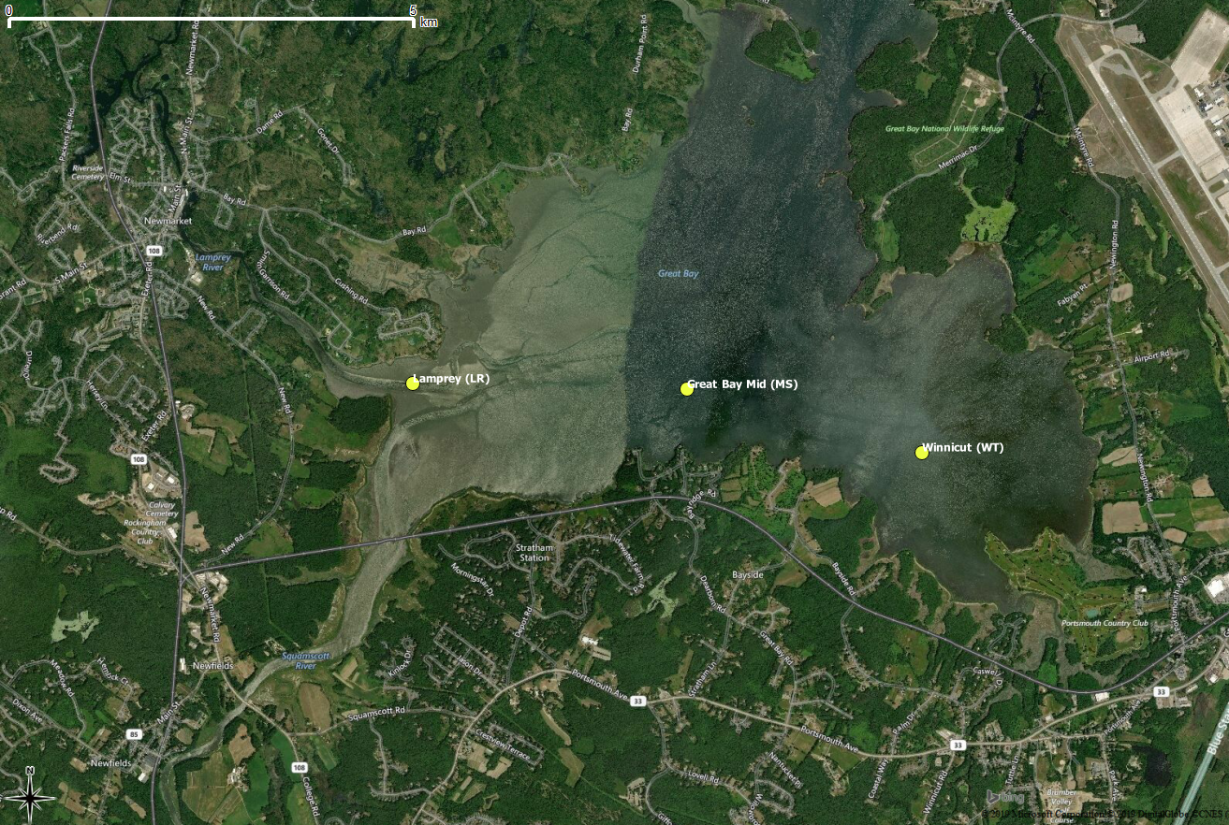
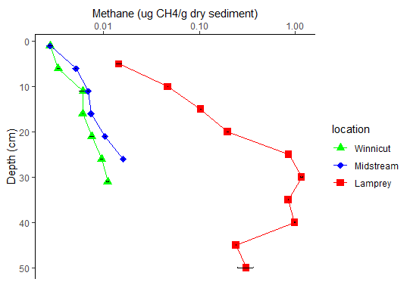
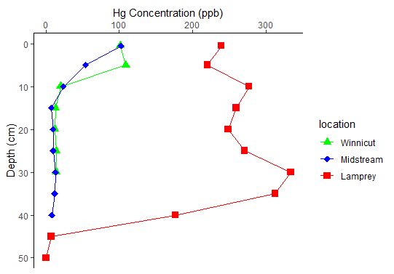
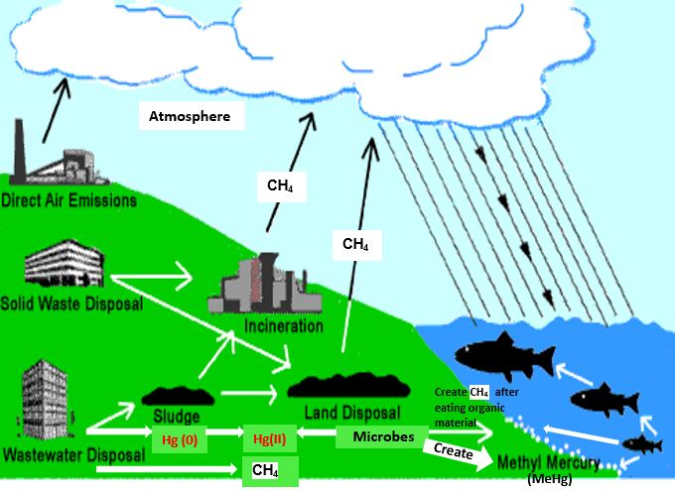
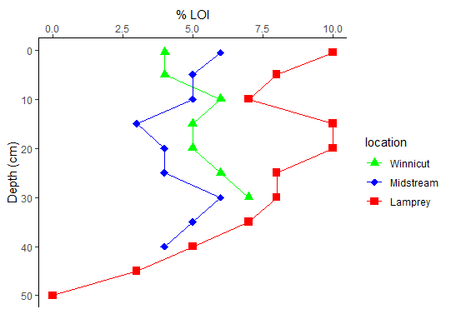
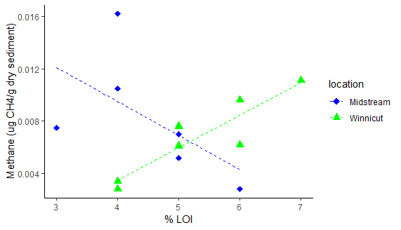
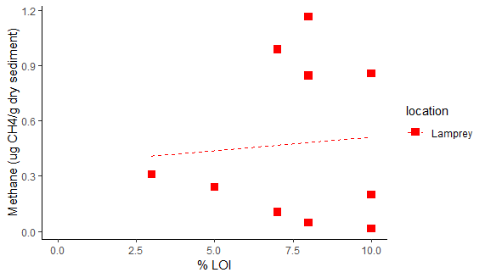
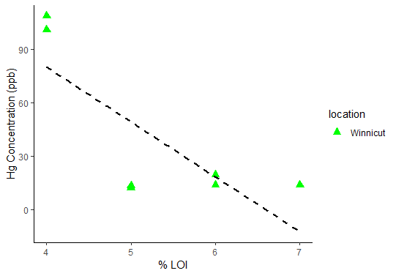
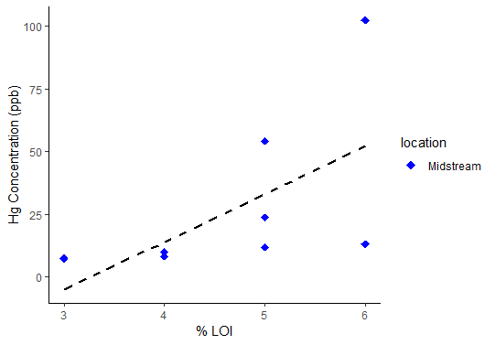
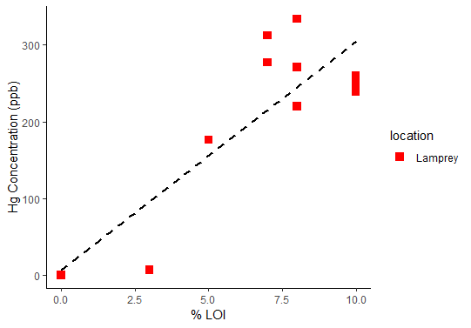
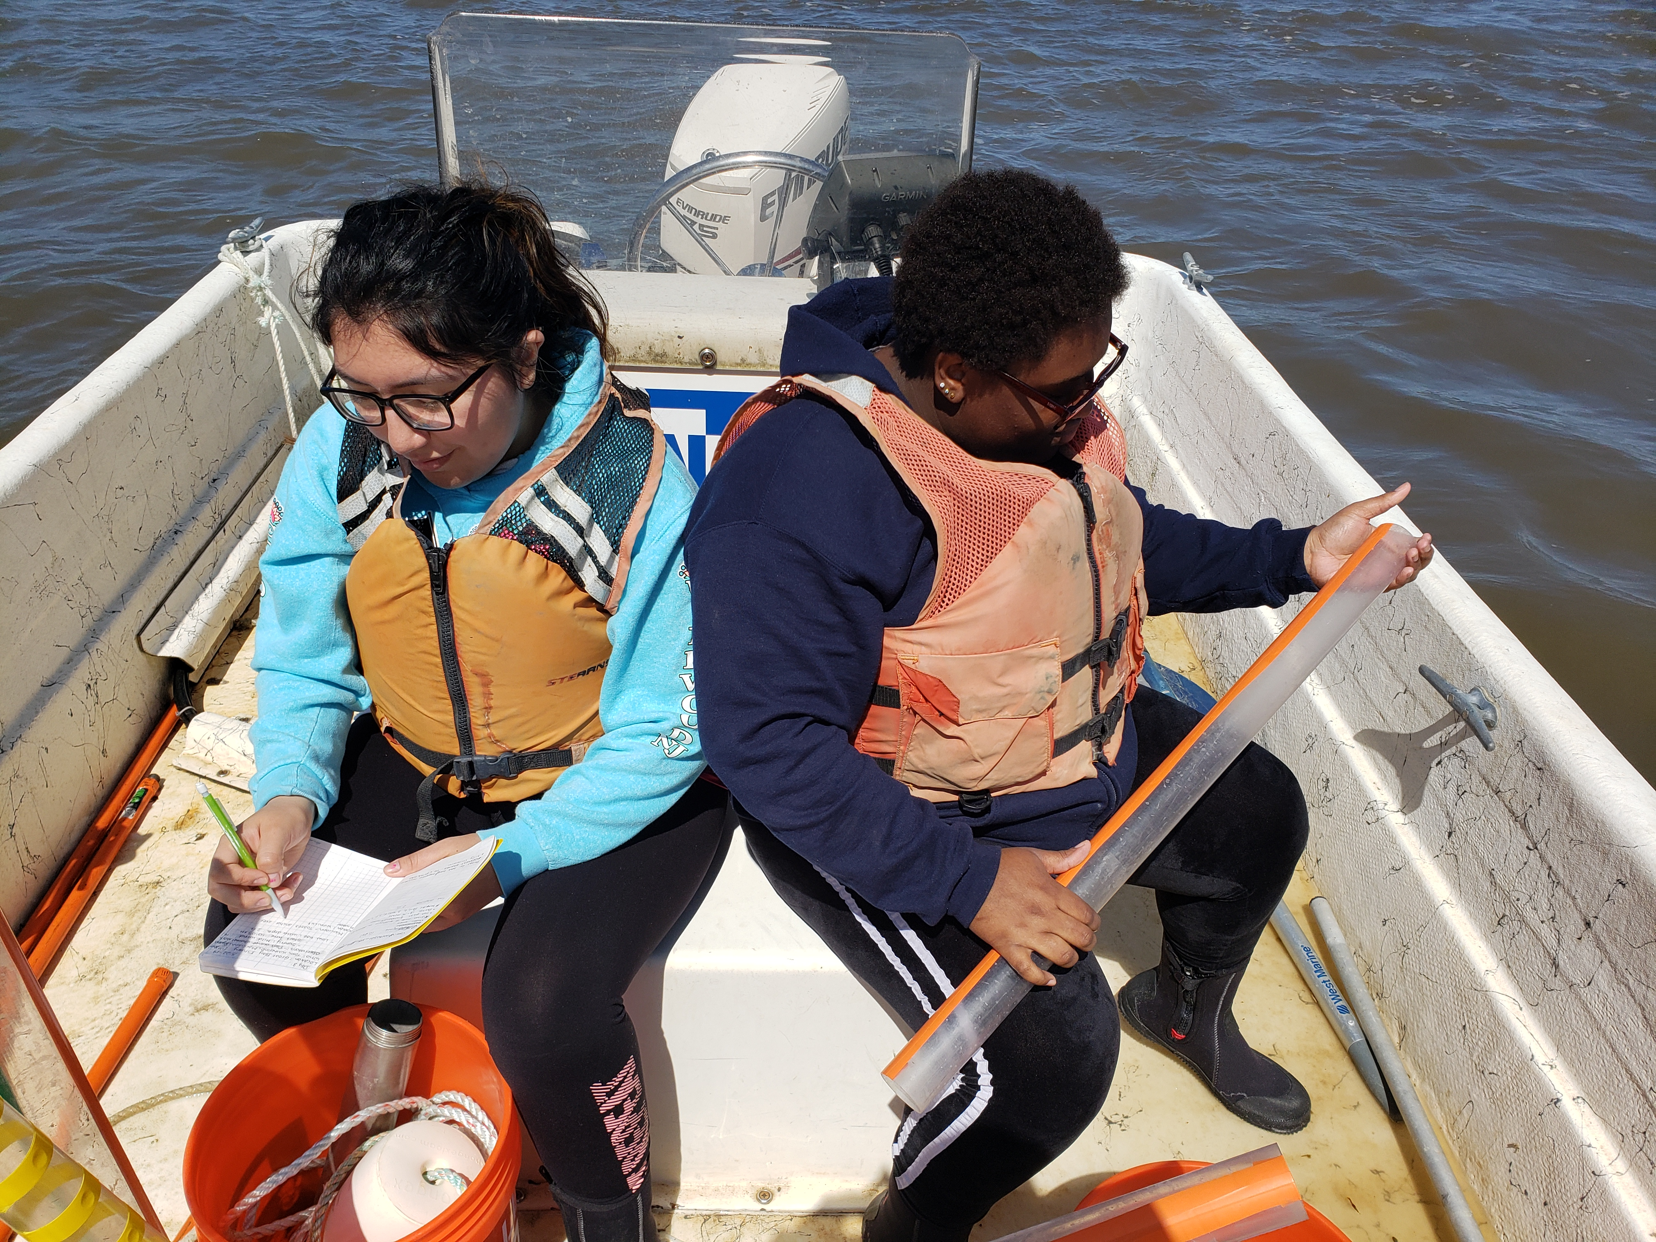
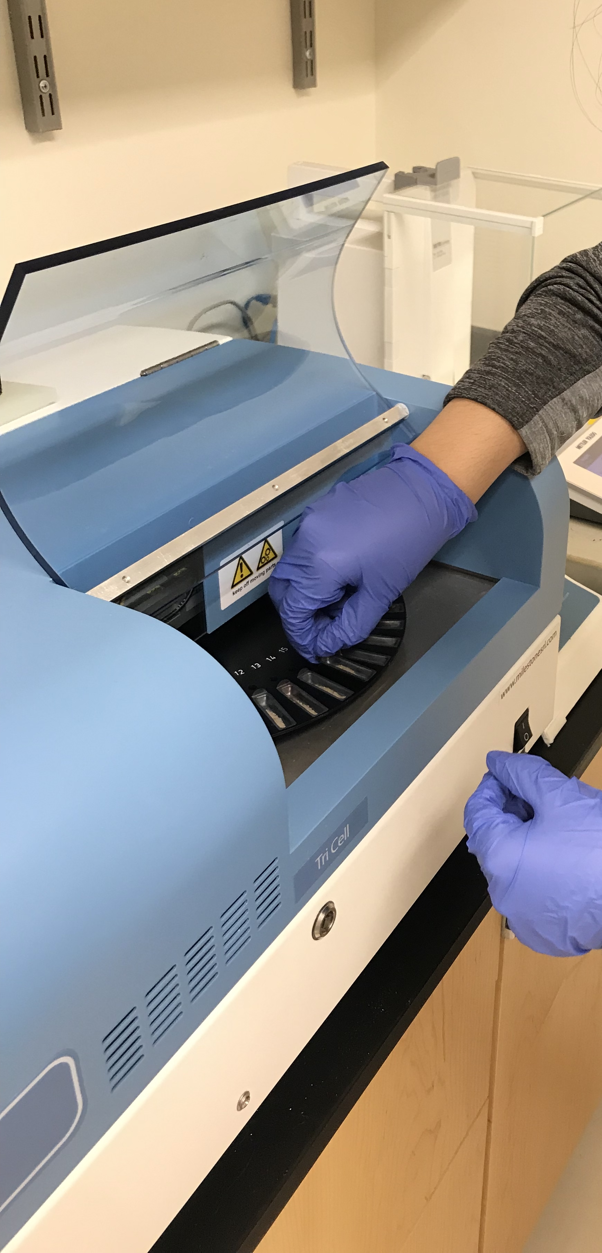
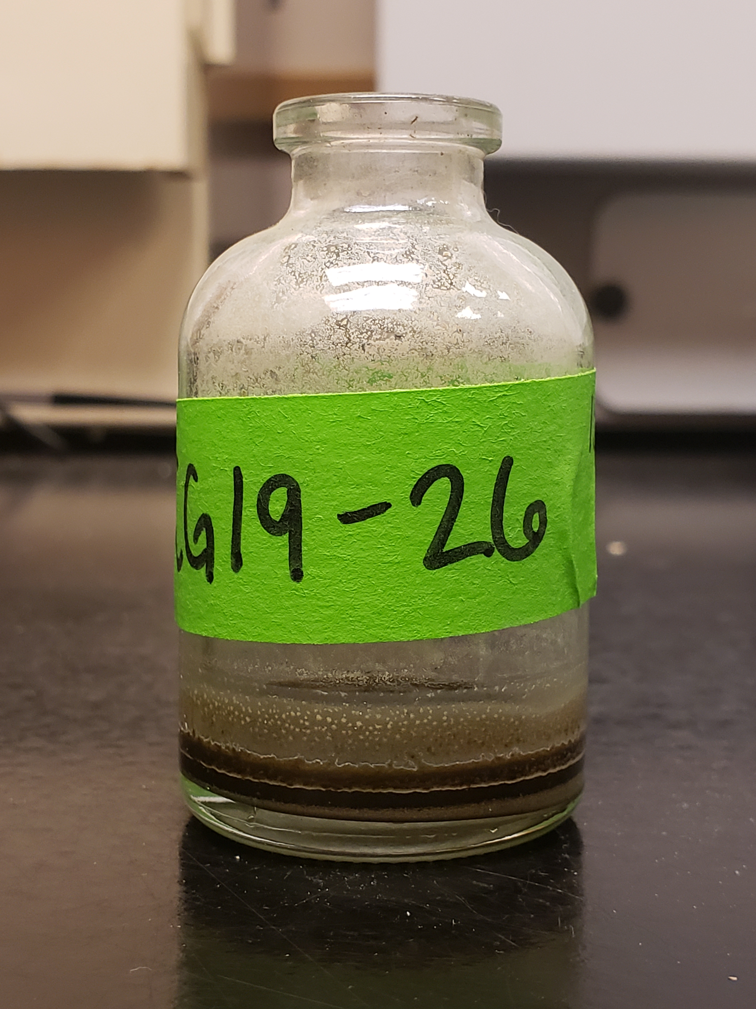
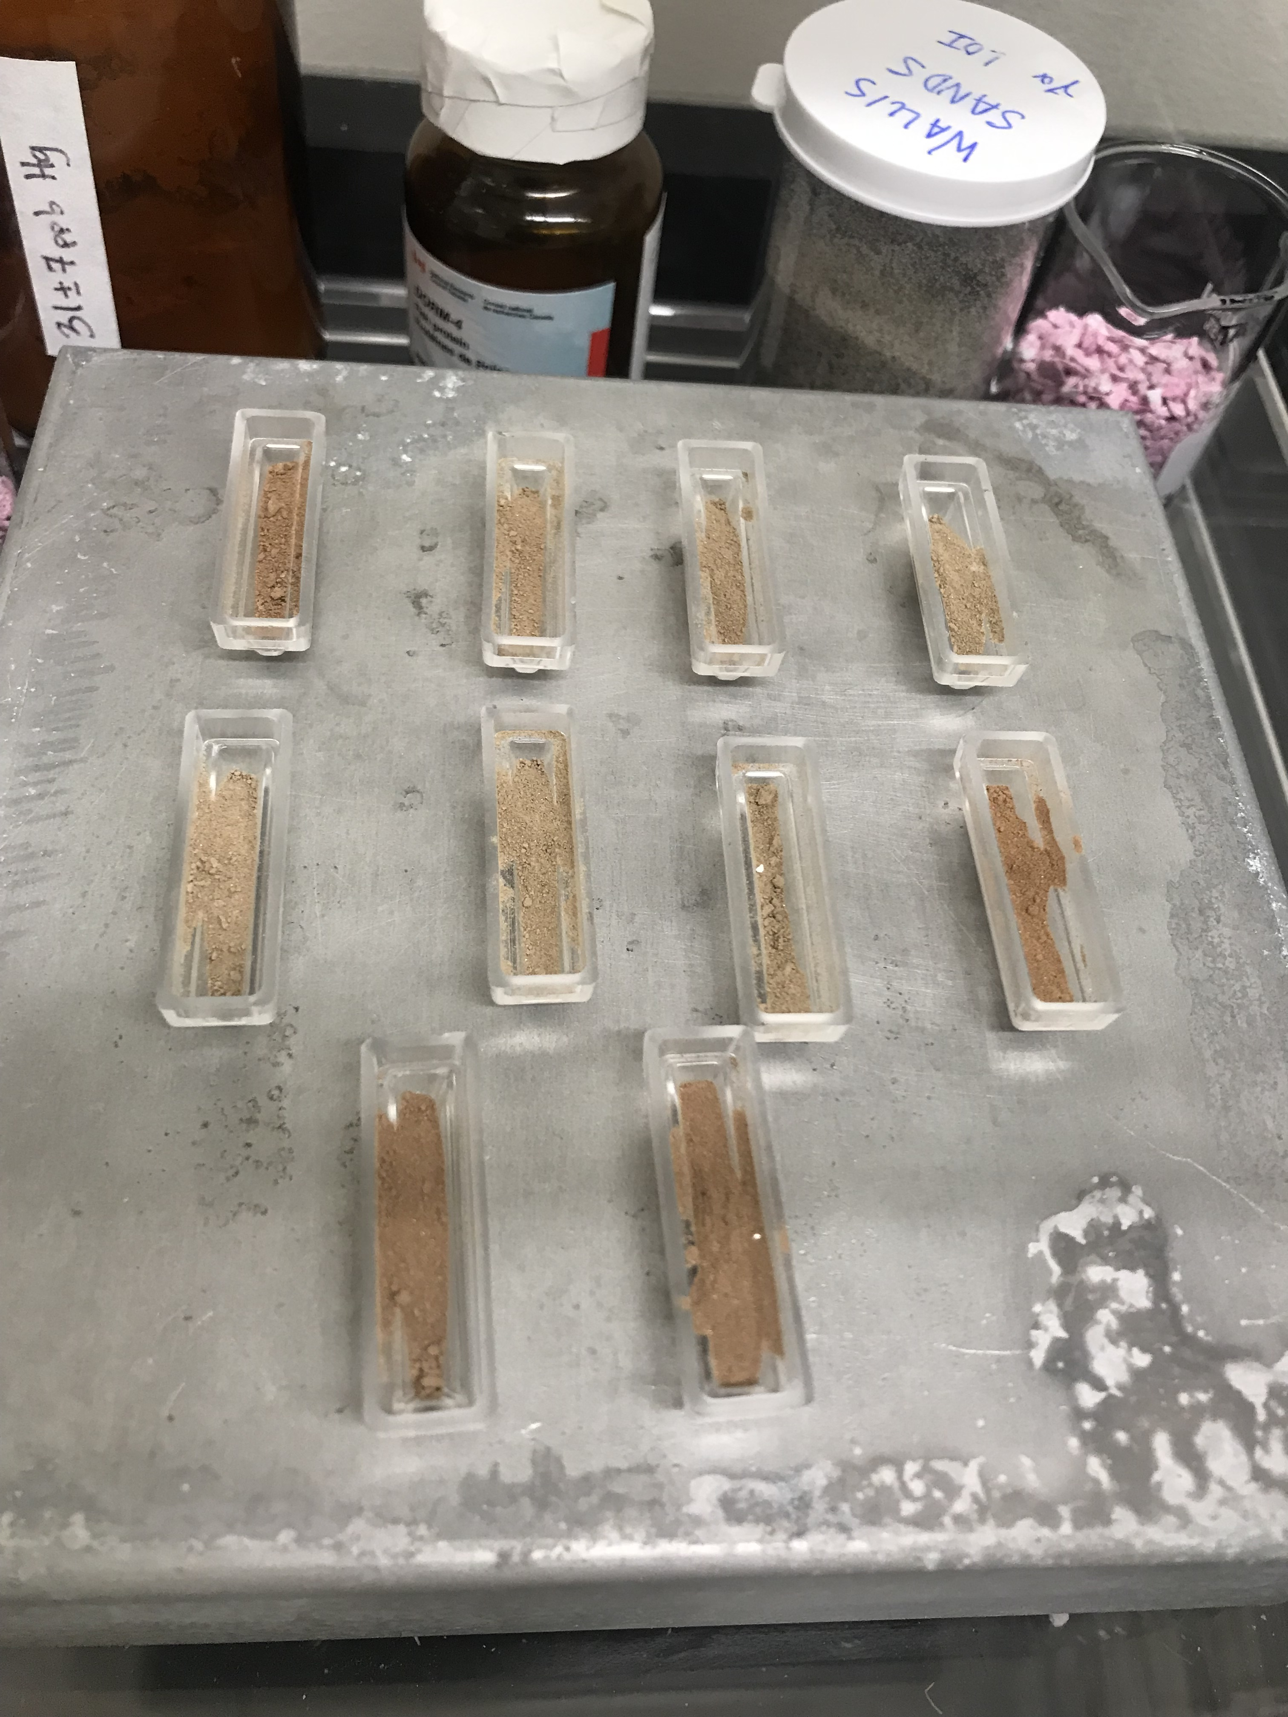
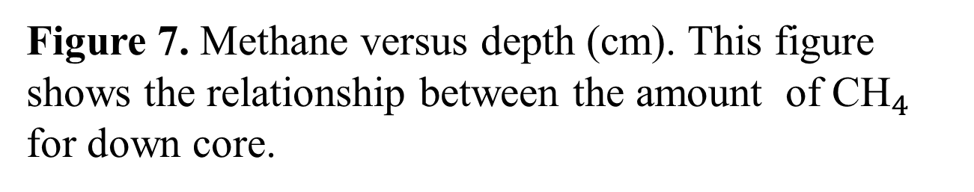
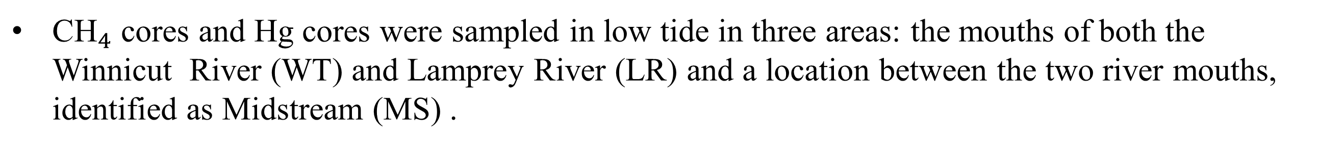




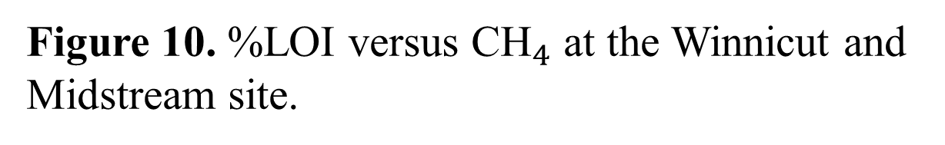





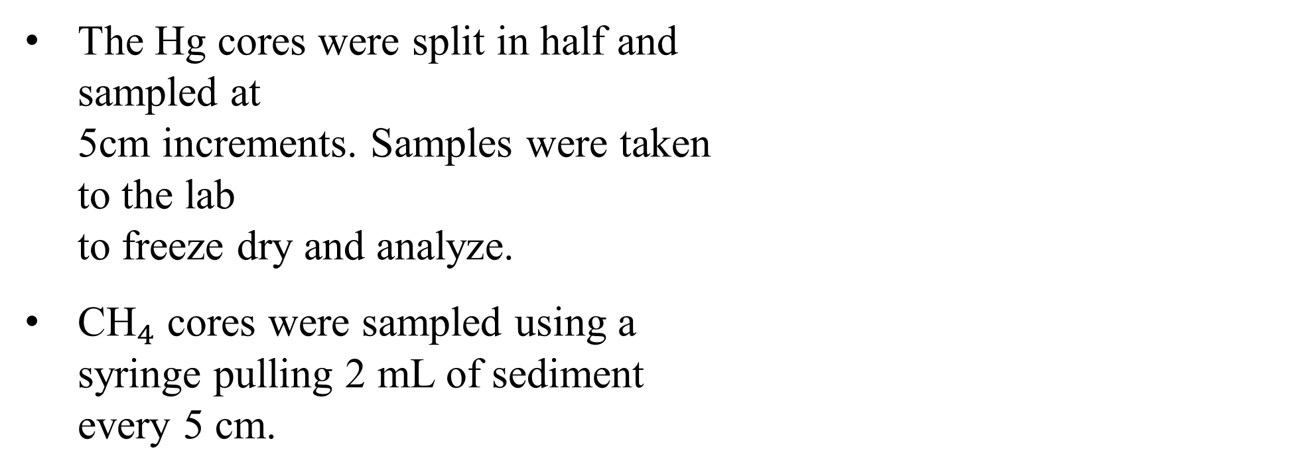
Understanding the Role of Organic Matter in Methane and
Mercury Cycling within Great Bay Estuary Sediments
Katherine Rodriguez$^{1,2}$, ${\text{CLOSES}\text{−}\text{GAP}\text{19 }\text{Team}}^{2}$
1. Rutgers University – Newark, 2. University of New Hampshire, Delaware State, UMES, Rutgers University
.
Our aquatic ecosystems are filled with organic matter at the ocean floor. Methane (${\text{CH}}_{4}$) and Mercury (Hg) concentrations have been linked to organic matter content within sediments. For that reason, it is important to understand methane and mercury cycling because at high concentrations, ${\text{CH}}_{4}$ and Hg become very toxic and if consumed can cause health defects. Loss on ignition (LOI) is a useful method to determine approximate amounts of organic matter within sediments. The % LOI will provide results that can indicate if the organic matter content is associated with ${\text{CH}}_{4}$ and Hg concentrations.
Research Objective: (1) Is there a relationship between % LOI from estuary sediments vs Hg? (2) Is there a relationship between % LOI from estuary sediments vs ${\text{CH}}_{4}$? (3) What happens to the amount of ${\text{CH}}_{4}$ and Hg stored in Great Bay sediments with depth?
Results
Introduction
Figure 6. Sampling sites from the Rivermouth, Great Bay Estuary.
Figure 7. Methane versus depth (cm). This figure shows the relationship between the amount ${ \text{of} \text{CH}}_{4}$ for down core.
Figure 8. Hg concentration versus depth (cm). This figure shows the relationship between the Hg concentration (ppb) and depth.
Figure 1. A conceptual map showing sources of Hg and ${\text{CH}}_{4}$. Microbes are a good source for creating these elements. Microbes consume Hg(ll) and create MeHg after. Microbes also eat organic matter and create ${\text{CH}}_{4}$ as a result. Both ${\text{CH}}_{4}$ and MeHg are later expelled to the ocean where aquatic animals consume it. Modified after Department of Environmental Conservation, New York State et.al., 2020.
$$R^{2}=0.34$$
$$R^{2}=0.83$$
Field Methods
Figure 9. %LOI versus depth (cm). This figure shows the relationship between the percent of organic matter with depth.
Figure 10. %LOI versus ${\text{CH}}_{4}$ at the Winnicut and Midstream site.
Figure 11. %LOI versus ${\text{CH}}_{4}$ at the Lamprey site.
${\text{CH}}_{4}$ cores and Hg cores were sampled in low tide in three areas: the mouths of both the Winnicut River (WT) and Lamprey River (LR) and a location between the two river mouths, identified as Midstream (MS) .
The Hg cores were split in half and sampled at 5cm increments. Samples were taken to the lab to freeze dry and analyze.
${\text{CH}}_{4}$ cores were sampled using a syringe pulling 2 mL of sediment every 5 cm.
Figure 2. Soil coring at the Great Bay Estuary. This image shows me taking notes of our location while Rhyan (to my right) is preparing the next core. Photo credit: Marci-Ann
$$R^{2}=0.3567$$
$$R^{2}=0.7579$$
$$R^{2}=0.6032$$
Figure 12. %LOI versus Hg concentration (ppb) at the Winnicut site. Regression line shows negative relationship between the percent of organic matter with Hg concentration.
Figure 13. %LOI versus Hg concentration (ppb) at the Midstream site.
Figure 14. %LOI versus Hg concentration (ppb) at Lamprey site. Regression line shows positive correlation.
Discussion
Analytical Methods
Methane increases with depth at all sampled locations. The LR site however decreases with depth after 40 cm and showed the highest overall concentrations (Fig.7).
Again, higher concentrations of Hg are observed in the LR core (Fig.8).
LOI is highest in the LR core and decreases with depth. However, it remains at a consistent range for WR and MS core (Fig.9).
LOI is not significantly correlated to methane in either LR or MS (Fig.10/Fig.11). However, there appears to be a strong correlation at the WT site (Fig.10).
LOI does not show a positive relationship to Hg concentrations at the Winnicut site, indicating that the amount of organic content at this site is not associated with the Hg present (Fig. 12).
In contrast, there is a weak, positive relationship between LOI and Hg concentration at the MS site (Fig. 13).
According to Hines 1981, between June to December, bioturbation is not active at the Lamprey River. This indicates that sediments and microbial processes remain undisturbed. This supports (Fig.9), showing that organic content is greater at shallow depths.
The percent LOI, a proxy for carbon content, has a strong positive relationship with Hg concentration (ppm) at the LR site (Fig.14).
Figure 3. Mercury analysis - involved using the Direct Mercury Analyzer (DMA 80) where Hg samples were carefully weighed between 30 mg to 50 mg. Samples ran for 3 hours to obtain total Hg in sediments.
Figure 4. Methane analysis - vial samples were analyzed by using a needle syringe to extract 2 mL of methane gas from the headspace of the vial. The syringe was then introduced into the Gas Chromatograph (GC) at 1 ml intervals where concentration peaks of ${\text{CH}}_{4}$ were generated from the GC.
Figure 5. LOI analysis – Freeze dried samples were weighed (~0.4 g) of sediment. Ten samples at a time were placed in a 450 degrees Celsius furnace to combust for 4 hours, allowed to cool and weighed again to calculate %LOI.
Acknowledgements
References
The CLOSES GAP 2019 fellowship is funded by the National Science Foundation (NSF-18011420) . Special thanks to Clarice Perryman for assisting with R Software and Sophie Burke. Thank you to Katie Bennett, Maddie Wood for assisting with field work. Also, a special thanks to the CLOSES-GAP members: Rhyan Knight, Nikita Bendre, Suah Yekeh, Carolina Caro Cano, Julianna Gutierrez, Sydney Wicklund, Marci-Ann Smith, and Romuald Kenmegne. Thank you to the UNH Coordinators: Steve Hale, Erik Froburg and Sandy Coit. Thank you to Quinton Hill and Joel Johnson for sediment lab work. Thank you to Emma Burkett for QGIS images. Thank you to the University of New Hampshire and home institution Rutgers University – Newark.
CLOSES –GAP19 Team*
-UNH: Ruth Varner, Julie Bryce,
Florencia Fahnestock, Thomas Lippmann
-Rutgers University-Newark: Lee Slater
-Delaware State University: Rose Ozbay
-UMES : Maurice Crawford
Santisteban et al., Journal of Paleolimnology 32: 287–299, 2004.
Hines, Mark E., Seasonal Biochemistry in the Sediments of Great Bay Estuarine Complex, New Hampshire, 1981.

