Slide 1
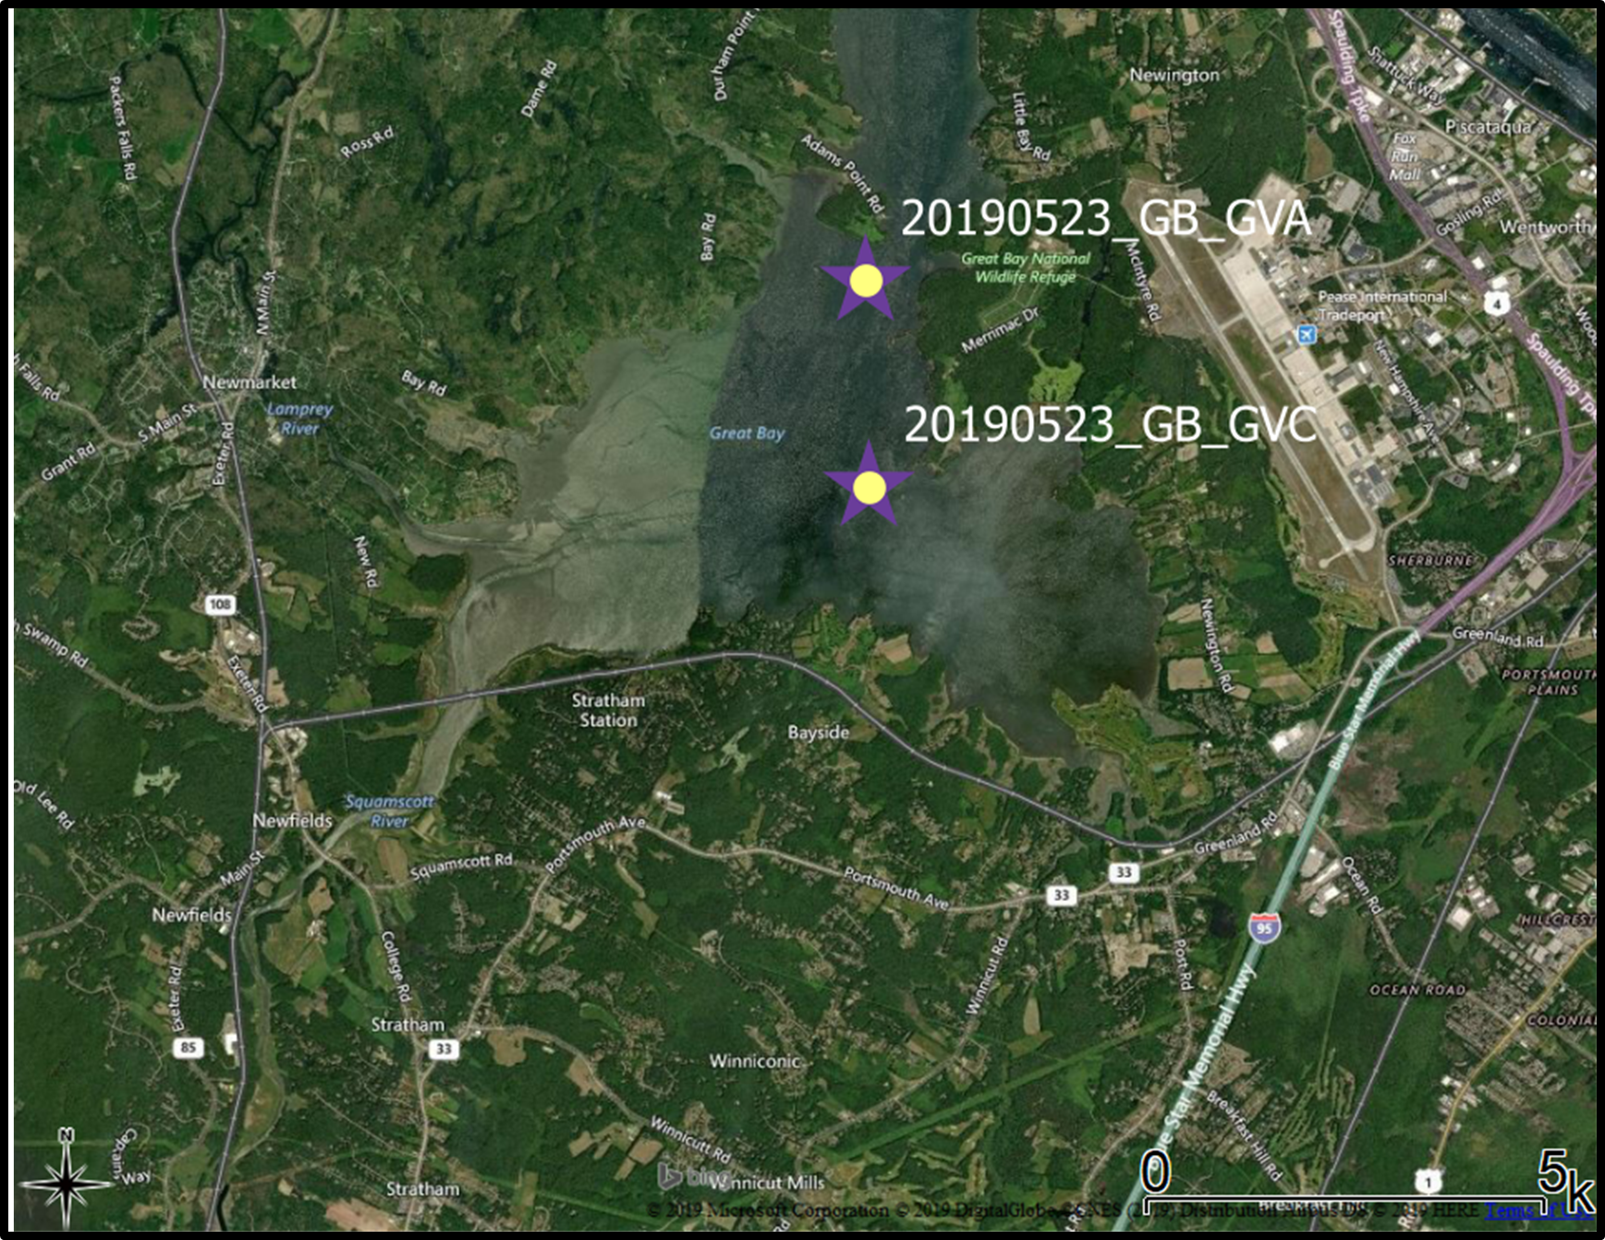
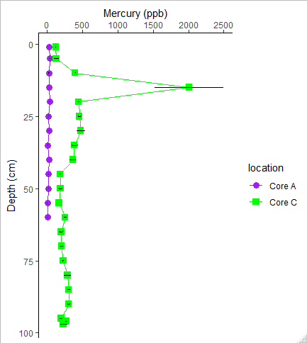
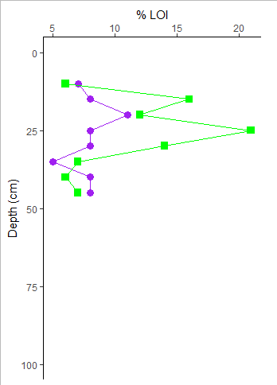
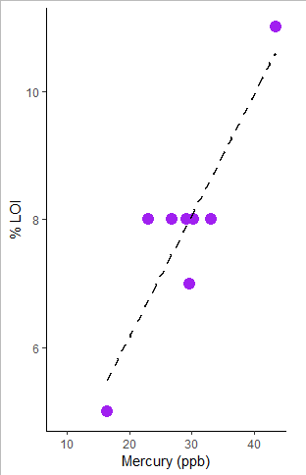
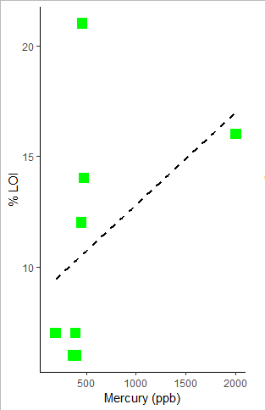
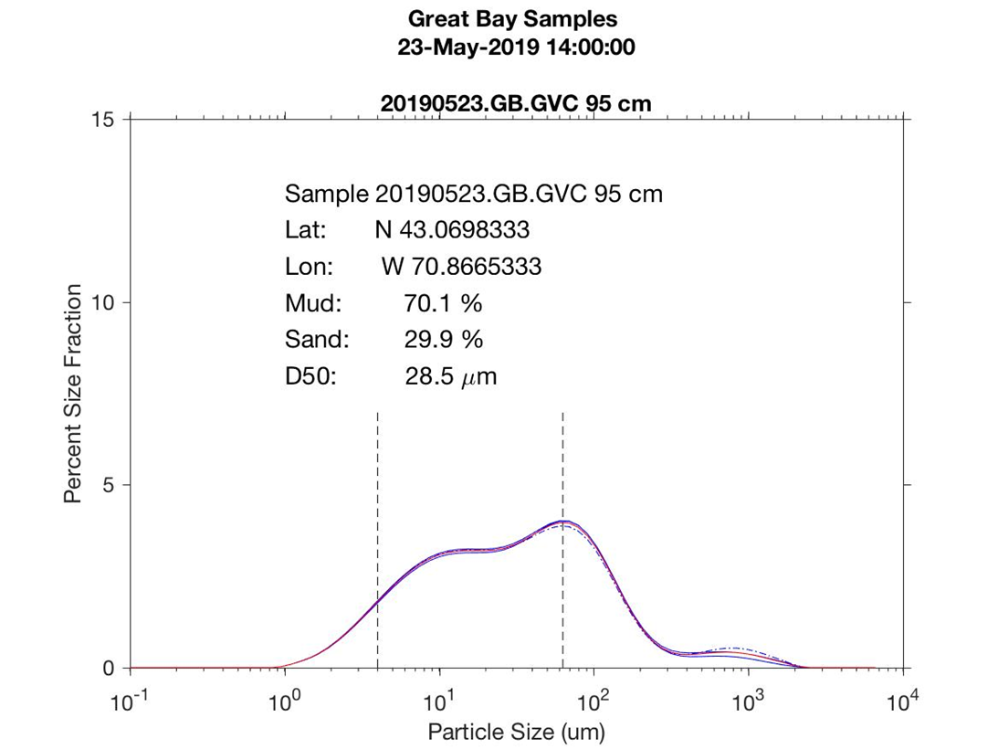
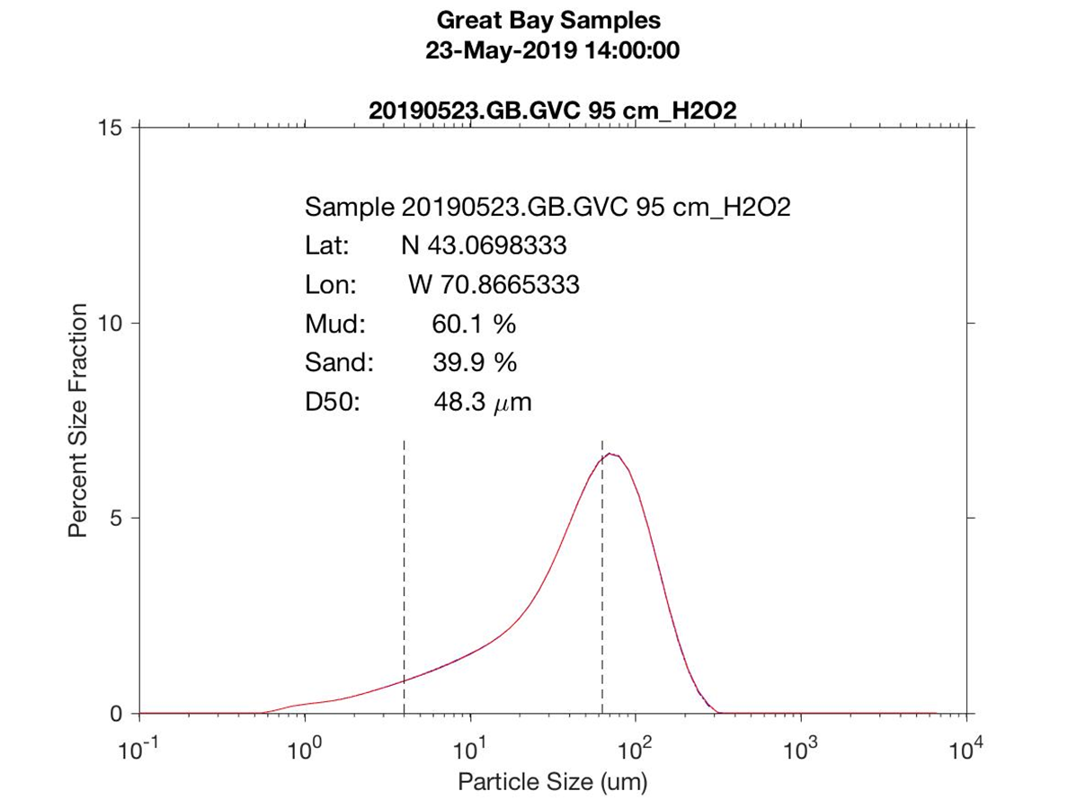
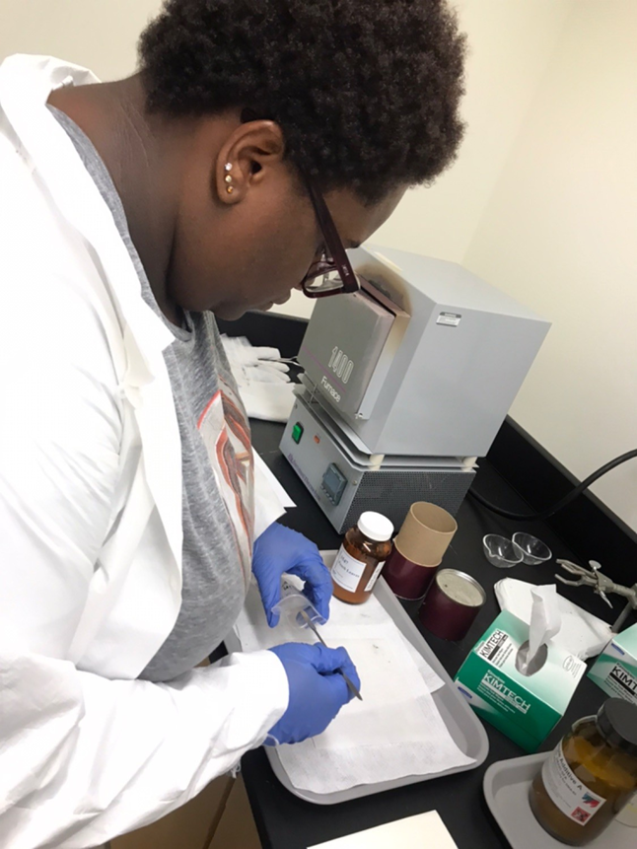
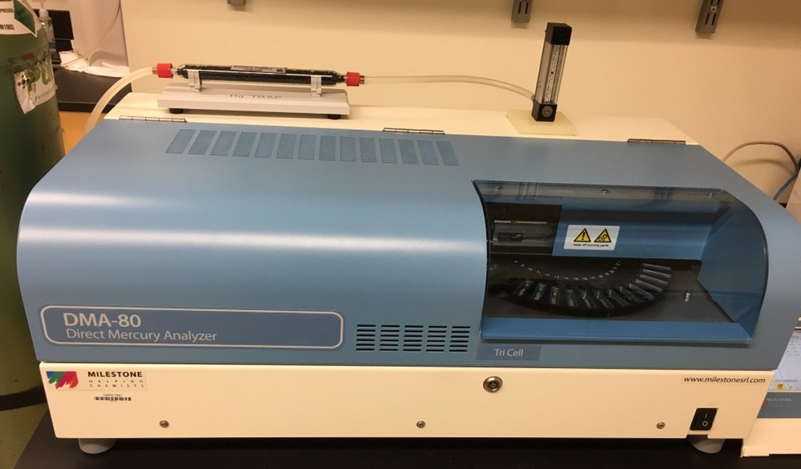
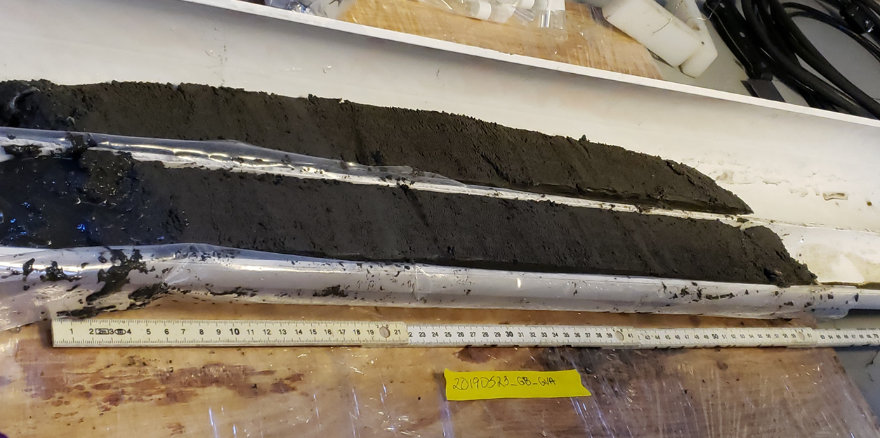
Mercury Accumulation in the Great Bay Ecosystem- Links with Carbon and Sediment Size
By: Rhyan Knight$^{1,2}$, CLOSES-GAP19 Team$^{2}$
1.University of Maryland Eastern Shore, 11868 College Backbone Rd, Princess Anne, MD 21853
rkknight@umes.edu
Introduction
Results/Discussion
Mercury (Hg), is well-documented in ecosystems and is a human health concern. It is commonly found in wetland and aquatic systems. The main sources of Hg contamination to these ecosystems include near and long-range transport of Hg from wet and dry deposition from the atmosphere. Hg is emitted into the atmosphere mainly from fossil fuel emissions such as coal-fired power plants .
Objective
Investigate relationships between sediment characteristics and Hg concentrations in the Great Bay estuary.
The purpose of this study is to evaluate Hg concentrations in two sediment cores from the Great Bay to assess how Hg is stored in this estuarine environment – we focused on Hg concentrations with grain size and inferred carbon content (assessed by loss-on-ignition (LOI)).
Hg concentrations in sediments can tell us if the ecosystem is at risk for Hg contamination that might harm the health of organisms within the ecosystem.
Studies have linked elevated Hg in the blood or tissue of fish, birds, and mammals with negative effects such as reduced reproductive success, hormonal changes, and motor skill impairment (Wiener and Spry 1996, Nocera and Taylor 1998, Evers et al. 2004 as cited in Driscolletal_2007).
Grain size and LOI are important characteristics to look at because they have the potential to influence Hg concentrations in sediments.
Conceptual Model – Hg dynamics in the Environment
Figure 1. Conceptual diagram of mercury cycling showing the dominant reservoirs and pathways of mercury transport. Adapted from H. Zhang and S. E. Lindberg 1999.
Figure 4. Mercury shows different trends with depth in the two cores. Core A has relatively low and consistent concentration of Hg in the sediment as a function of depth. Core C has elevated Hg below the surface, including a thin lens where the Hg is exceptionally high (> 2000 ppb)
Figure 5. Carbon content (inferred from LOI) also varies with depth and between the two cores.
Atmosphere
Figure 3. The location in the Great Bay estuaries where the cores were taken. The scale of 5 km is shown in the lower right-hand corner.
Hg(0)
Hg(0)
Hg(0)
Hg(II) absorb onto Organic Carbon, Sulfur particles
R$^{2}=0.8046$
R$^{2}=0.1874$
Figure 8a.
Figure 8b.
Overland Flow + River Discharge
Hg(II)
Hg(II)
Water Column
Sediment
(CH$_{3}Hg ^{+}$)
Analytical Methods
Figure 8a and 8b. Grain size distribution of sediments sampled from Core C, 95 cm. 8a shows the distribution of size in bulk sediment, and Figure 8b shows the distribution of sediment after treated with H₂O₂ to remove organics. Carbon (and we infer Hg) is associated with both fine and coarse carbon grains.
Approach
Obtain cores of Great Bay sediments and analyze the sediments for Hg and sediment characteristics.
Analysis using the Milestone Direct Mercury Analyzer: Sediment samples were weighed between 30 mg to 50 mg. The samples were analyzed over 3 hours.
LOI analysis: Using a muffle furnace, sediment samples were weighed between 2.9 and 3.0 grams. They were placed inside the furnace at 450° C for a minimum of 4 hours.
Discussion:
In Brown et al., 2015 there were cores taken from two mudflats in the Great Bay Estuary in New Hampshire. The trends that were seen was that Hg spiked closer to the surface.
The average solid-phase Hg_{i} concentration at the Portsmouth mudflat (559 ± 166 ppb) was higher than that at Squamscott mudflat (319 ± 82 ppb) (Brown et al., 2015).
In Rasmussen et al., 1998 there was a strong areal correlation (R²= 0.77) between LOI and Hg in the deep sediments.
Figure 6. Mercury concentrations show some correlation with carbon content.
Figure 7. Elevated organic content (inferred from LOI) does not explain the highest Hg found in the core, indicating that there are other factors controlling Hg concentration.
Summary and Future Work
References
Figure 2b.
A general assumption is that Hg, LOI, and grain size correlate with each other. Our data reveals a more complex relationship between Hg, LOI and grain size. In the future, I plan to research more about the spike in Hg and to find out what other factors contribute to that spike.
Zhang, H., & Lindberg, S. E. (1999). Processes influencing the emission of mercury from soils: A conceptual model. Journal of Geophysical Research: Atmospheres, 104(D17), 21889-21896. doi:10.1029/1999jd900194
Driscoll, C. T., Han, Y., Chen, C. Y., Evers, D. C., Lambert, K. F., Holsen, T. M., Kamman, N. C., & Munson, R. K. (2007). Mercury contamination in forest and freshwater ecosystems in the northeastern United States. BioScience, 57(1), 17-28. https://doi.org/10.1641/b570106
Brown, L. E., Chen, C. Y., Voytek, M. A., & Amirbahman, A. (2015). The effect of sediment mixing on Mercury dynamics in two intertidal mudflats at Great Bay Estuary, New Hampshire, USA. Marine Chemistry, 177, 731-741. https://doi.org/10.1016/j.marchem.2015.10.011
Rasmussen, P. E., Villard, D. J., Gardner, H. D., Fortescue, J. A., Schiff, S. L., & Shilts, W. W. (1998). Mercury in lake sediments of the Precambrian shield near Huntsville, Ontario, Canada. Environmental Geology, 33(2-3), 170-182. https://doi.org/10.1007/s002540050236
Figure 2a.
Acknowledgments
Obtaining and processing the sample in the lab.
This Internship was funded by National Science Foundation (NSF- 18011420). Special thanks to all CLOSES-GAP advisors, the CLOSES-GAP19 Team includes: Ruth Varner, Julie Bryce, Florencia Fahnestock, Thomas Lippmann, Maurice Crawford, Lee Slater, Rose Ozbay, Steve Hale, Erik Froburg, Sandy Coit, Nikita Bendre, Katherine Rodriguez, Suah Yekeh, Carolina Caro, Julianna Gutierrez, Marci-Ann Smith, Sydney Wicklund and Romuald Kenmegne . Also thanks to Clarice Perryman, Katie Bennett, Maddie Wood, Quinton Hill, Emma Burkett for their assistance throughout the program.
Figure 2c.

