Slide 1
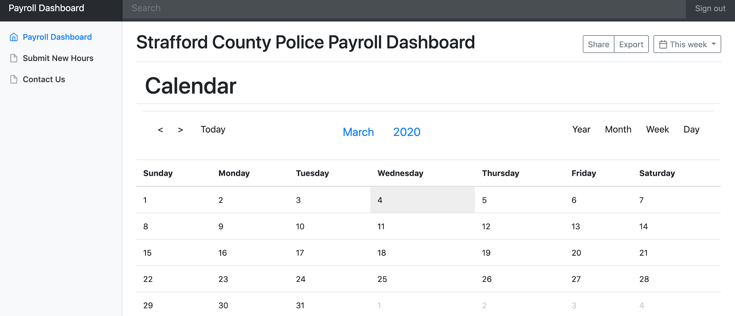
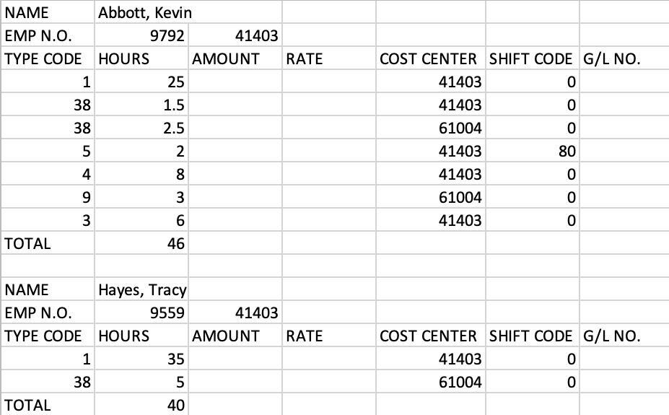
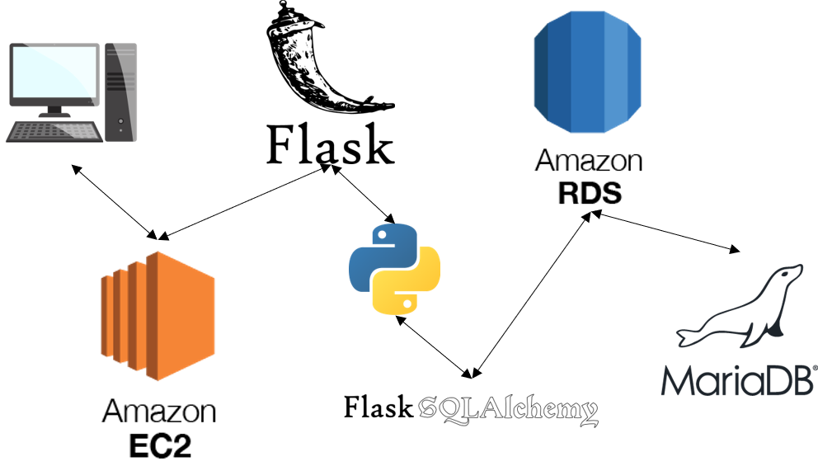
Strafford County Payroll System
Tony Barboza, Brandon Cammett, Tyler Currier, Dane Hoover, Ke Chen, Brandon Rose
University of New Hampshire
BACKGROUND
APPLICATION INTERFACE
APPLICATION OUTPUT
The objective of the Payroll System project is to provide a web application that allows police officers of Strafford County to submit time cards as a means for payroll.
Officers can securely login and track the amount of hours and the type of work they do.
The web application can generate an excel file of a selected pay period, and provide overtime metrics for budget management.
(see application output)
This project provides value by automating hours of work that the sheriff’s department currently does each week by hand.
Payroll System Dashboard
Automated CSV Output
Currently, the Strafford County officers do all payroll by hand, requiring them to return the police station to submit hours.
This web application will be accessible to all officers and will be usable by any reasonably modern smartphone, tablet, or computer device with an internet connection.
The end result of this project is to deliver a formatted excel sheet that pulls all shifts for the current week.
Currently, one employee spends an entire workday making this sheet by hand. Assuming a 8 hour work day, this would save ~400 hours of work per year
DESIGN DECISIONS/TOOLS
SHIFT CALCULATION
CONCLUSIONS
Officer submits time in, time out, and type of work (Sheriff, Federal, Bus Driver, etc.).
System finds right type code and cost center for the type of work for the particular officer.
System splits single shift into more shifts if shift falls into multiple time categories (weekday or weekend, 8am to 4pm or 4pm to 8am).
System corrects type codes to reflect correct day and time.
System stores date and time, cost center, and type code in database.
When shifts are requested to be read, overtime hours are calculated before sending shift info back to user.
This project will replace the current paper based payroll system for the Strafford County Sheriff’s department.
Officers can submit their hours from their phone or computer whenever it is convenient for them.
Project may have to be continued by another team due to the scope being too large for a two semester project.
Amazon EC2 cloud hosts a Flask microframework that handles all requests, sending them to the correct Python endpoints for processing.
Flask SQLAlchemy translates Flask Python code to SQL to make database queries to MariaDB database hosted on Amazon RDS.

Slide 2
BACKGROUND
The objective of the Payroll System project is to provide a web application that allows police officers of Strafford County to submit time cards as a means for payroll.
Officers can securely login and track the amount of hours and the type of work they do.
The web application can generate an excel file of a selected pay period, and provide overtime metrics for budget management.
(see application output)
This project provides value by automating hours of work that the sheriff’s department currently does each week by hand.

Slide 3
APPLICATION INTERFACE
Payroll System Dashboard
Currently, the Strafford County officers do all payroll by hand, requiring them to return the police station to submit hours.
This web application will be accessible to all officers and will be usable by any reasonably modern smartphone, tablet, or computer device with an internet connection.

Slide 4
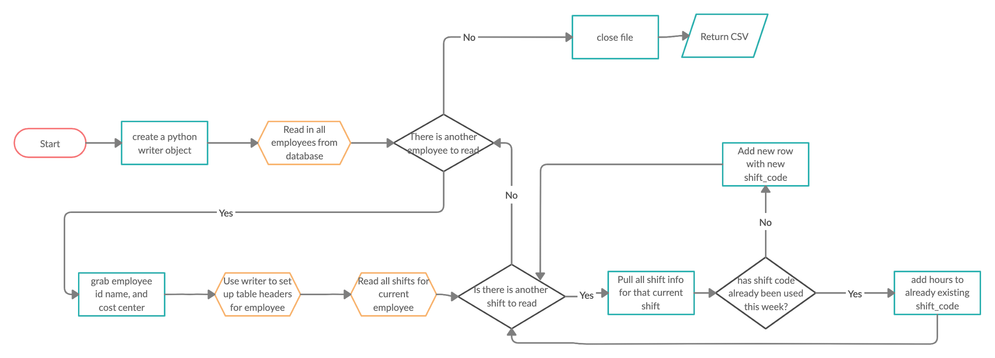
APPLICATION OUTPUT
The end result of this project is to deliver a formatted excel sheet that pulls all shifts for the current week.
Currently, one employee spends an entire workday making this sheet by hand. Assuming a 8 hour work day, this would save ~400 hours of work per year

Slide 5
DESIGN TOOLS/DECISIONS
Amazon EC2 cloud hosts a Flask microframework that handles all requests, sending them to the correct Python endpoints for processing.
Flask SQLAlchemy translates Flask Python code to SQL to make database queries to MariaDB database hosted on Amazon RDS.

Slide 6
SHIFT CALCULATION
Officer submits time in, time out, and type of work (Sheriff, Federal, Bus Driver, etc.).
System finds right type code and cost center for the type of work for the particular officer.
System splits single shift into more shifts if shift falls into multiple time categories (weekday or weekend, 8am to 4pm or 4pm to 8am).
System corrects type codes to reflect correct day and time.
System stores date and time, cost center, and type code in database.
When shifts are requested to be read, overtime hours are calculated before sending shift info back to user.

Slide 7
CONCLUSIONS
This project will replace the current paper based payroll system for the Strafford County Sheriff’s department.
Officers can submit their hours from their phone or computer whenever it is convenient for them.
Project may have to be continued by another team due to the scope being too large for a two semester project.

Slide 8
Strafford County Payroll System

