Slide 1




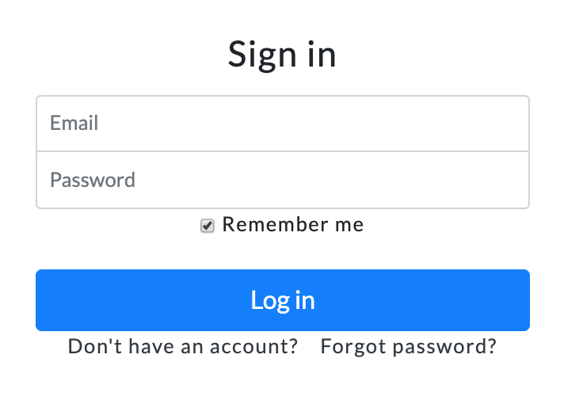
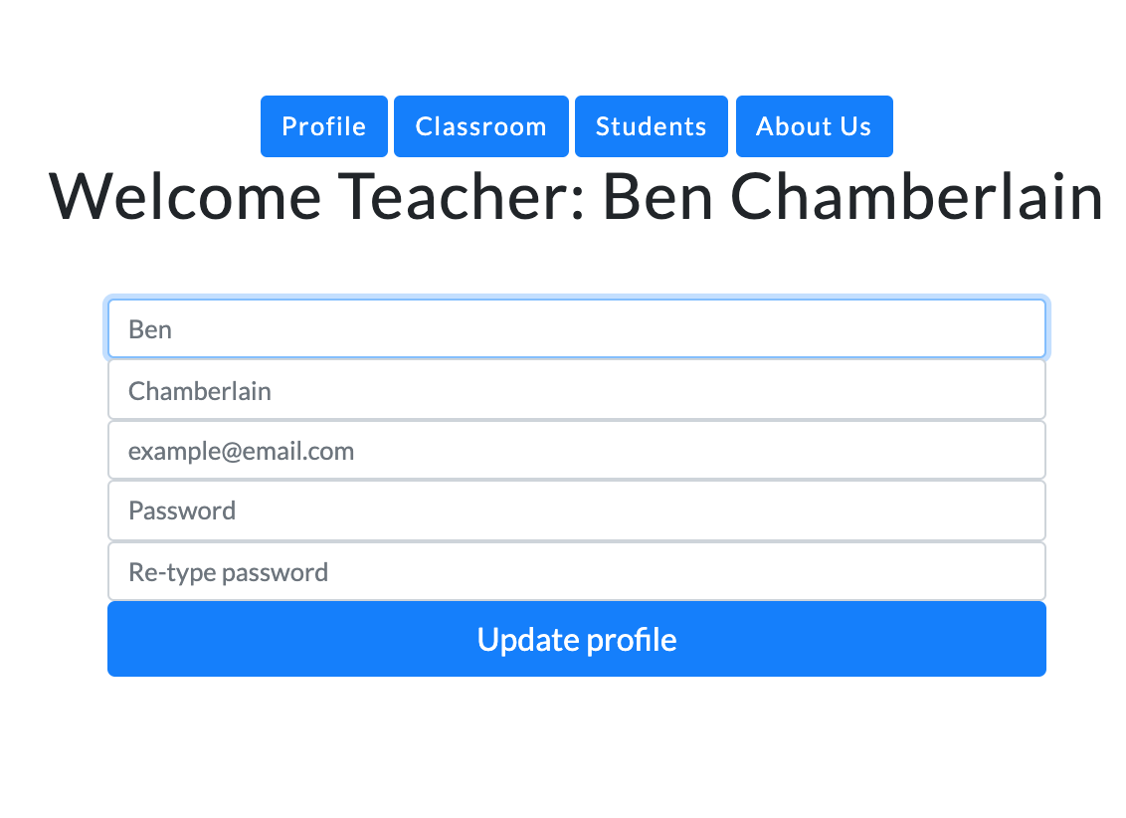




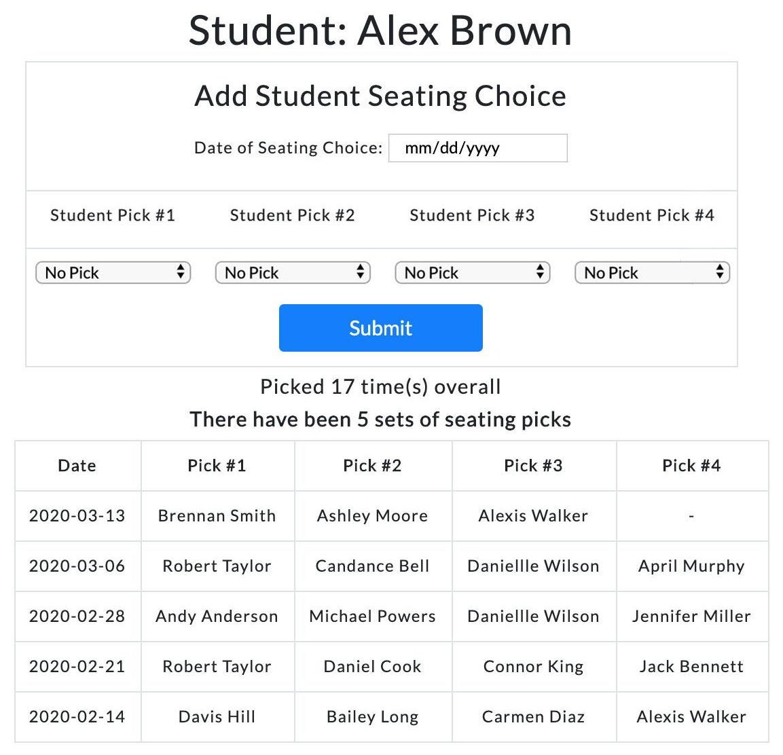
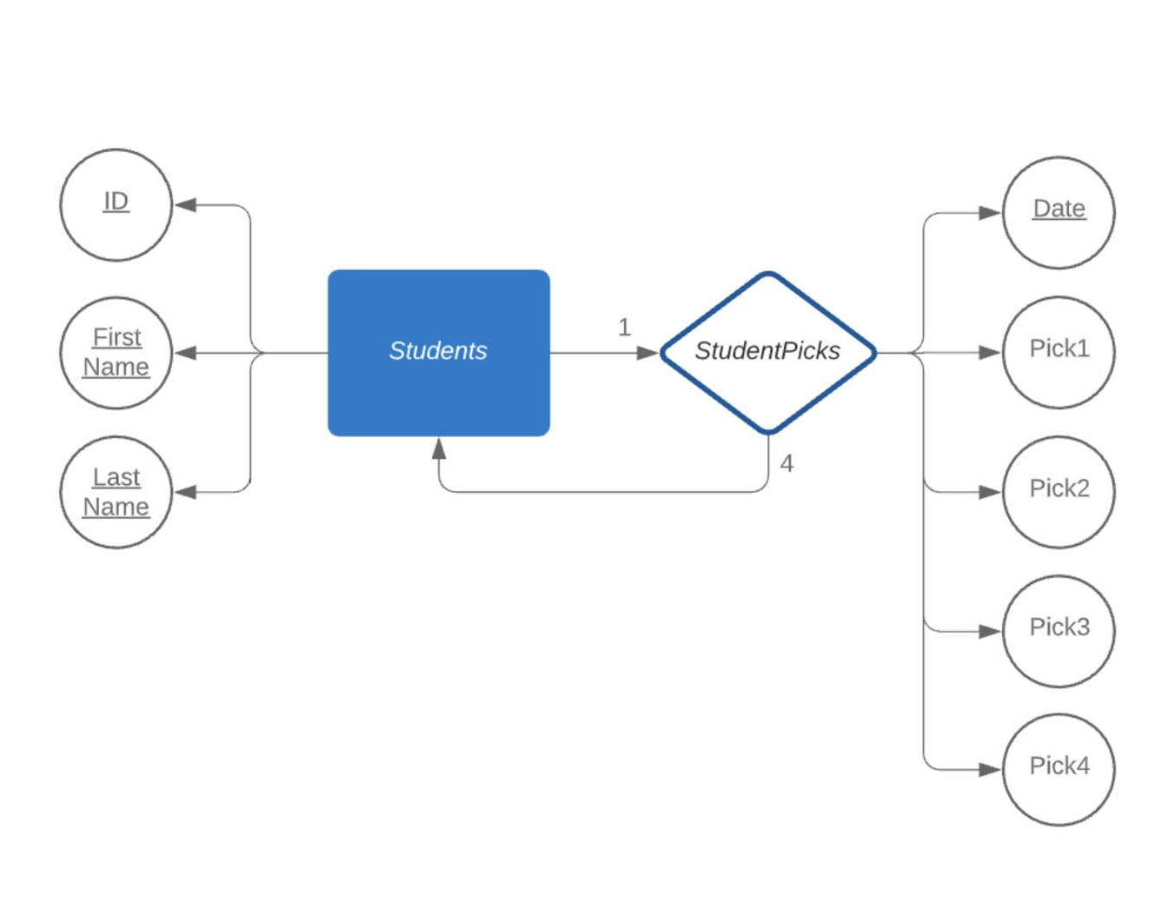
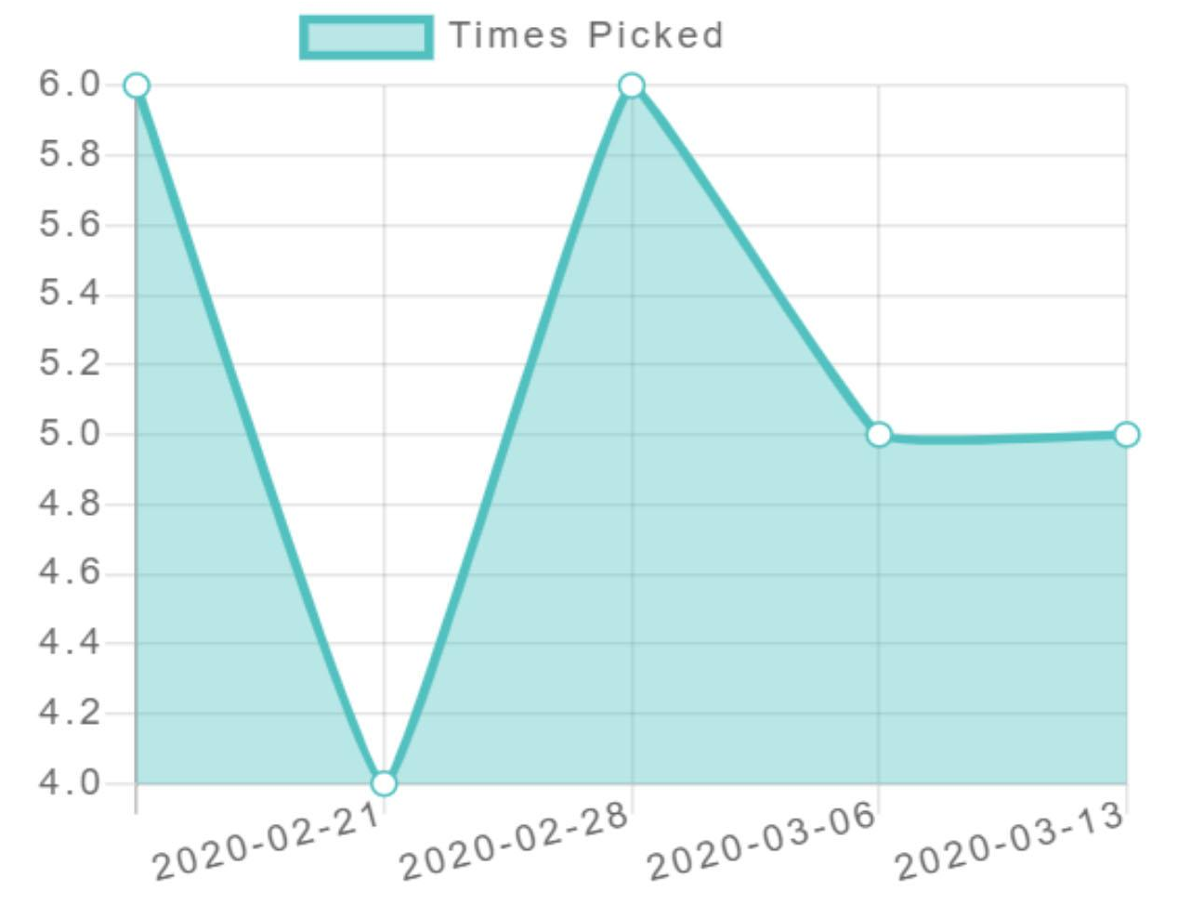
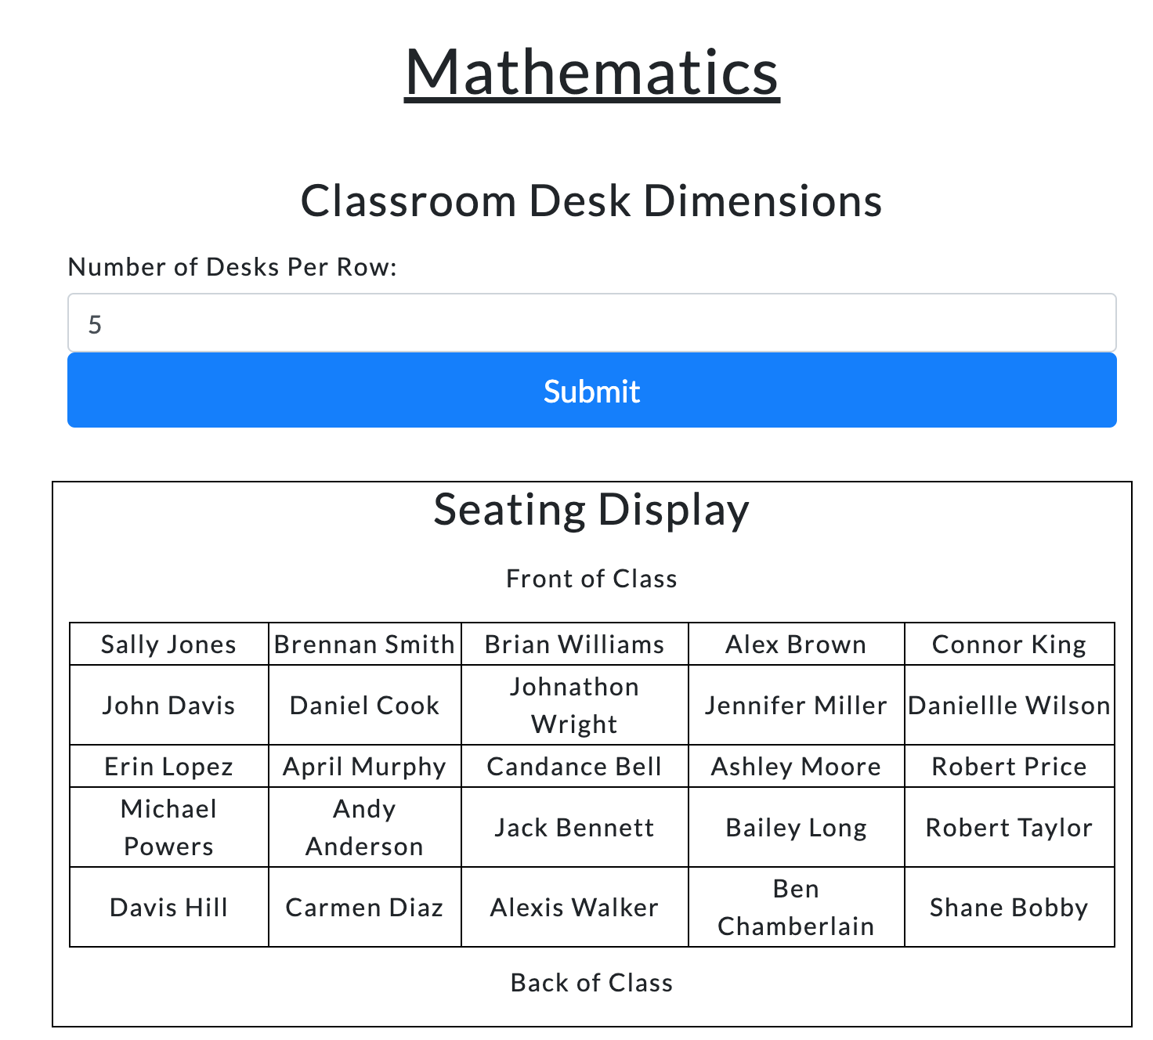
Preemptive Involvement and Tracking by Teachers (PITT)
Ben Chamberlain, Shane Chinburg, & Bobby Chisholm
Sponsor: Daniel Shepard
Department of Computer Science, University of New Hampshire
Introduction
Diagrams & User Interface
Technologies Used
This application was inspired by Kathy Pitt, an elementary school teacher in Florida.
Kathy’s idea was to hand out index cards to her students every week where they could write down who they want to sit next to during the following week.
She analyzed the index cards and was able to tell which students are the ones who are not fitting in.
Our goal with this project was to make this process easier for the teachers by providing a website to analyze the data and trends for them.
Profile Page
Python 3
Amazon EC2
Login Page
Adding Student Picks/History
HTML
Bootstrap
CSS
Problem
Database Diagram
Many young students have trouble fitting in, but teachers have trouble figuring out which students need extra attention or help finding friends.
Students who struggle socially are often the kids who are bullies or are being bullied.
Being socially outcast can also have adverse effects later in life, such as turning to violence or drugs.
Our server was written using Python on an Amazon EC2 instance.
This was used alongside a SQLAlchemy database to make up the infrastructure of our application.
We used HTML for the basic pages of the website.
CSS and Bootstrap were used in order to improve the website’s appearance.
Flask was used to make our HTML code more dynamic and modular.
Implementation
Conclusion
Output
Our website allows teachers to login and input seating choices made by students.
To save the data we used a simple database and different models to act as tables.
We created tables for students/student picks and an association table between the student and their picks.
The picks and their history are processed in the backend and sent to the front end as simple data structures.
We use a chart to show the history of a student being picked so the teacher can see any significant changes.
There are also some basic statistics like how many sets of picks and how many times they’ve been picked overall.
Student’s seating choices are tracked over time and are displayed in comprehensive tables and graphs and reflected in the seating chart.
Testing was done on a sample classroom (25 students with 5 sets of picks each) to ensure the website functioned correctly.
This is meant to be a multi-year project and in the future a seating algorithm can be optimized, real world testing by teachers, and a secure login can be implemented.
Overall, this application helps teachers get to know more about the social dynamics of their classroom by having easily readable history for their student’s seating choices. Teachers can look for patterns in the data and use that information to help out kids who need it.
Student History Graph
Classroom Display
.
Our website generates graphs for each student.
A seating chart is also created and displays where the students should sit in the Classroom Display.

