Slide 1

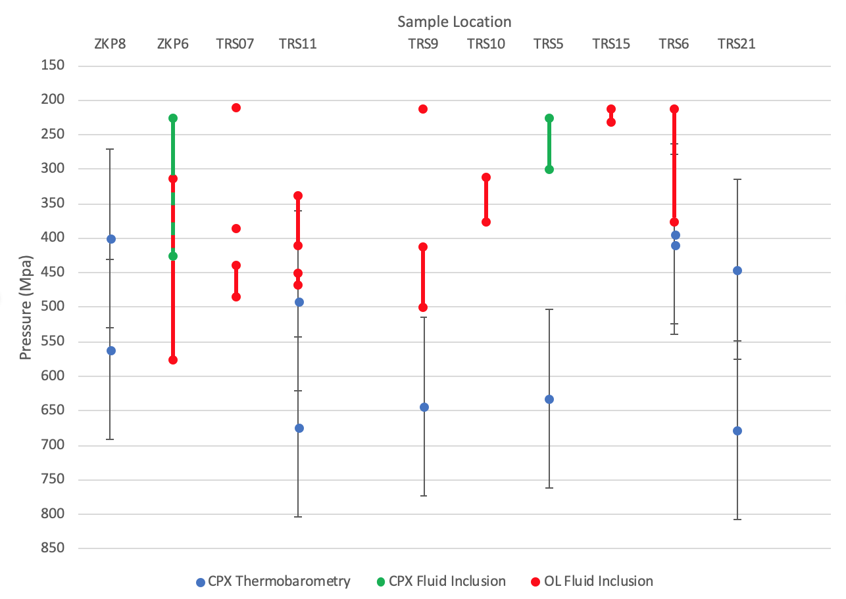
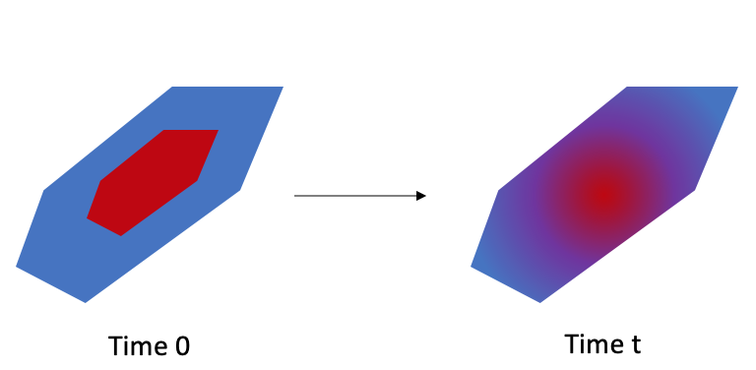
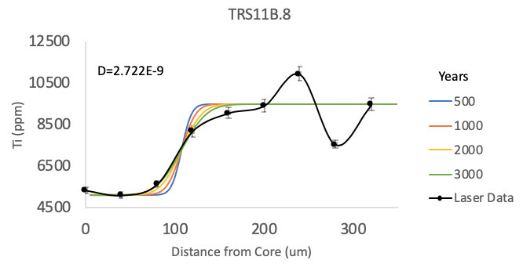
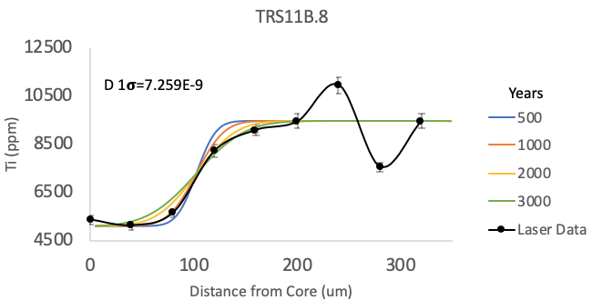
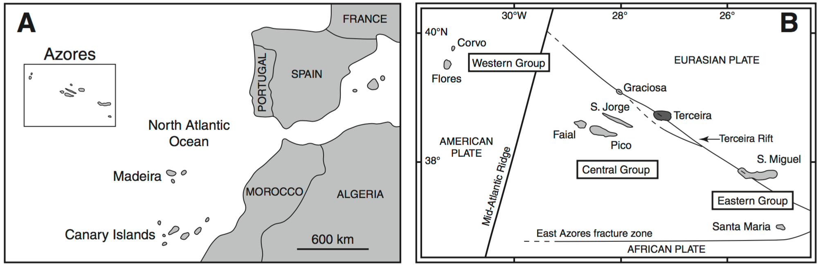
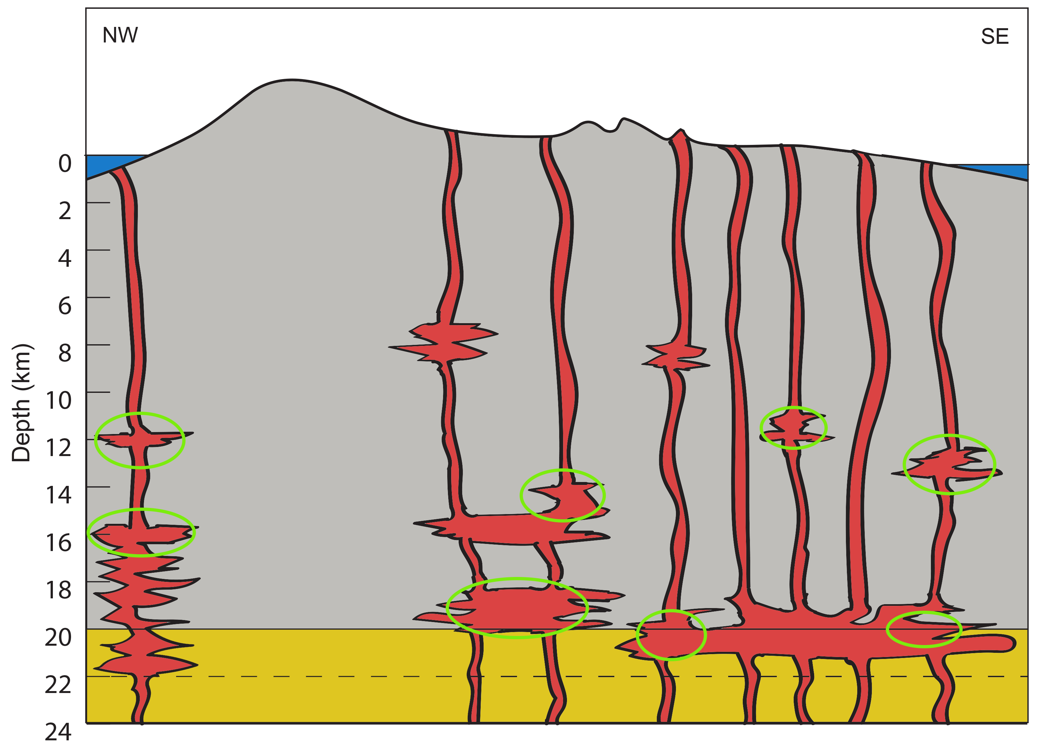
Reconstruction of the Terceira Magma Plumbing System
Brendan Garvey¹
Collaborators: Emma Burkett¹, Florencia Fahnestock¹, Vittorio Zanon², Michael Palace¹, Julie Bryce¹
¹Univeristy of New Hampshire, ²Institute for Research in Volcanology and Risk Assessment, Ponta Delgada, Portugal
Introduction
Results: Thermobarometry
Results: Crystal Residence Times
A magma plumbing system consists of a series of pools and pathways of crystal mushes and molten rock.
The mineral clinopyroxene can provide the barometric conditions of a magma body at the time of crystallization.
This study seeks to compare the recorded pressures of crystallization of clinopyroxene in the magma plumbing system feeding an oceanic island eruption.
A secondary project goal is to evaluate the ability to use LA-ICP-MS analyses to reconstruct both thermobarometric calculations and trace element diffusion on clinopyroxene.
Sample | Residence Time (years) | 1𝜎 (years)
TRS11B.8 | 3000 | 1000
TRS6RM.1 | 2000 | 1000
TRS6RM.8 | 3000 | 2000
ZKP8.4 | 3000 | 2000
Figure 4: Conceptual model of elemental diffusion in a clinopyroxene crystal.
Table 1: Crystal residence times of the 4 applicable crystals.
Geologic Background
The Azores archipelago is a chain of volcanic islands located off the coast of Portugal near the Mid-Atlantic Ridge. The Island of Terceira consists of 2 quiescent volcanoes, 2 extinct volcanoes, a young fissure zone, and the Terceira Rift. This provides simple volcanic system where a new approach can be tested.
Figure 2: Comparison of clinopyroxene thermobarometric calculated pressures and Zanon and Pimentel (2015) clinopyroxene and olivine fluid inclusion pressures.
Figure 5: Select Ti contents interpreted with diffusive models used to determine the crystal residence time within the magma plumbing system. Also shows the 1𝜎 residence time.
Conclusions
Clinopyroxenes record crystallization depths at 12-14 km below the Terceira system, broadly consistent with the Zanon and Pimentel (2015) fluid inclusion study. Clinopyroxene also records deeper crystallization, ca. 20 km, consistent with crystallization at the base of the crust.
Reconstructions of diffusive re-equilibration indicate ca. 3000-year storage times of magmas within the plumbing system.
Coupled thermobarometric and diffusive profiles, obtained via LA-ICP-MS, hold promise for wider-scale volcanic plumbing system reconstruction.
Figure 1: A: Sketch maps of (a) the North Atlantic Ocean showing the location of the Azores Archipelago and (b) the Azores Archipelago including the tectonic setting of the islands (with Terceira in darker grey). Taken from Gertisser et al. (2010).
Methods
Elemental Analyses
Laser Ablation Inductively Coupled Mass Spectrometry
Trace Element Diffusion
Ti concentrations, interpreted through Diffusion modelling employing a Monte Carlo Simulation and Least Squares analysis.
References and Acknowledgments
Cherniak, Daniele J., and Yan Liang. Geochimica et Cosmochimica Acta, vol. 98, Dec. 2012, pp. 31–47.
Costa, F., et al. Reviews in Mineralogy and Geochemistry, vol. 69, no. 1, Jan. 2008, pp. 545–94.
Gertisser, R., et al. Geological Society of America Special Paper 464, p. 133–154.
Putirka, K. D. Reviews in Mineralogy and Geochemistry, vol. 69, no. 1, Jan. 2008, pp. 61–120.
Zanon, V., and A. Pimentel. American Mineralogist, vol. 100, no. 4, Apr. 2015, pp. 795–805.
Many thanks to Mr. Dana Hamel for financial support through a SURF, UNH Earth Sciences grant for financial support, to Emma Burkett and Zach Gude for assistance with the diffusion studies, Flor Fahnestock for assisting with analyses, Michael Palace for assisting with statistical and spatial analyses, Vittorio Zanon for his support and supplying samples, and Julie Bryce for her continued support and mentorship.
Thermobarometry
Putirka (2008) Eqns. 32B and 32D
Figure 3: NW-SE cross-sectional sketch of Terceira adapted from Zanon and Pimentel (2015). The green ellipses represent the crystallization depths and locations of the thermobarometric calculations. The error on these locations is 3.9 km.

