Slide 1

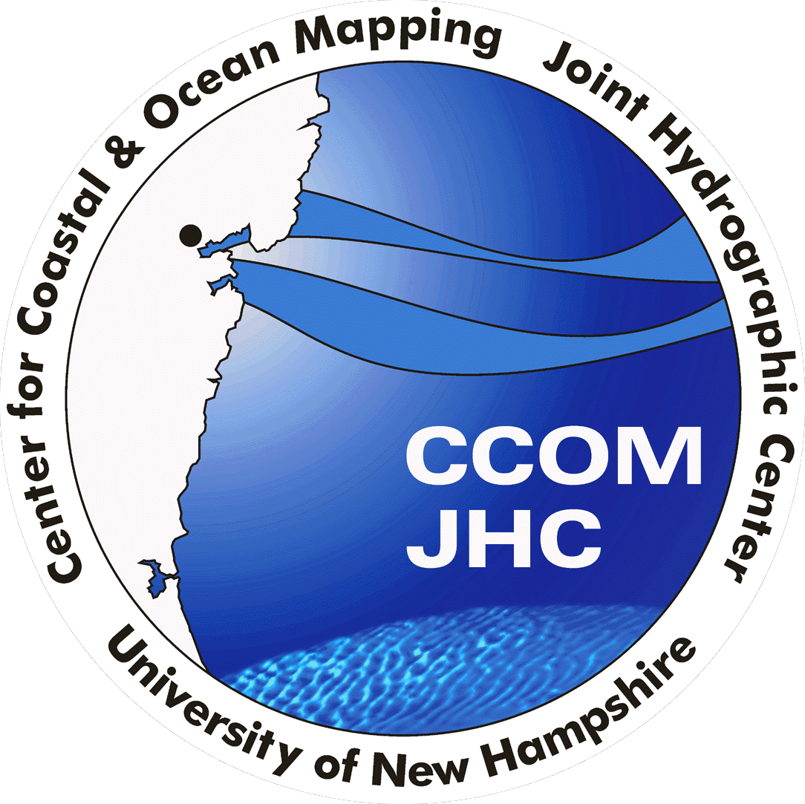
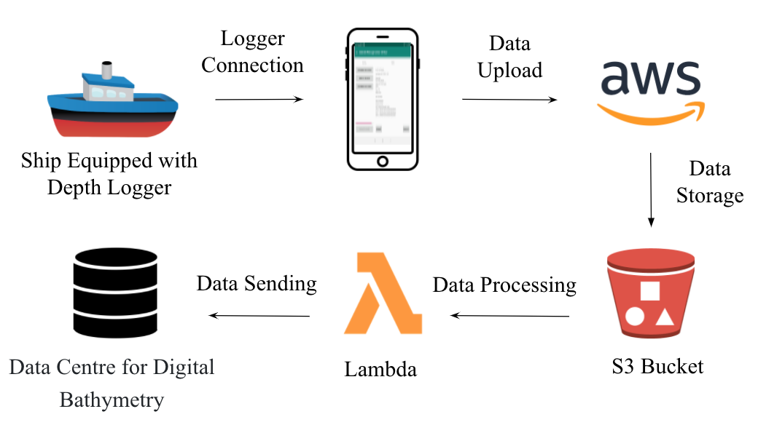
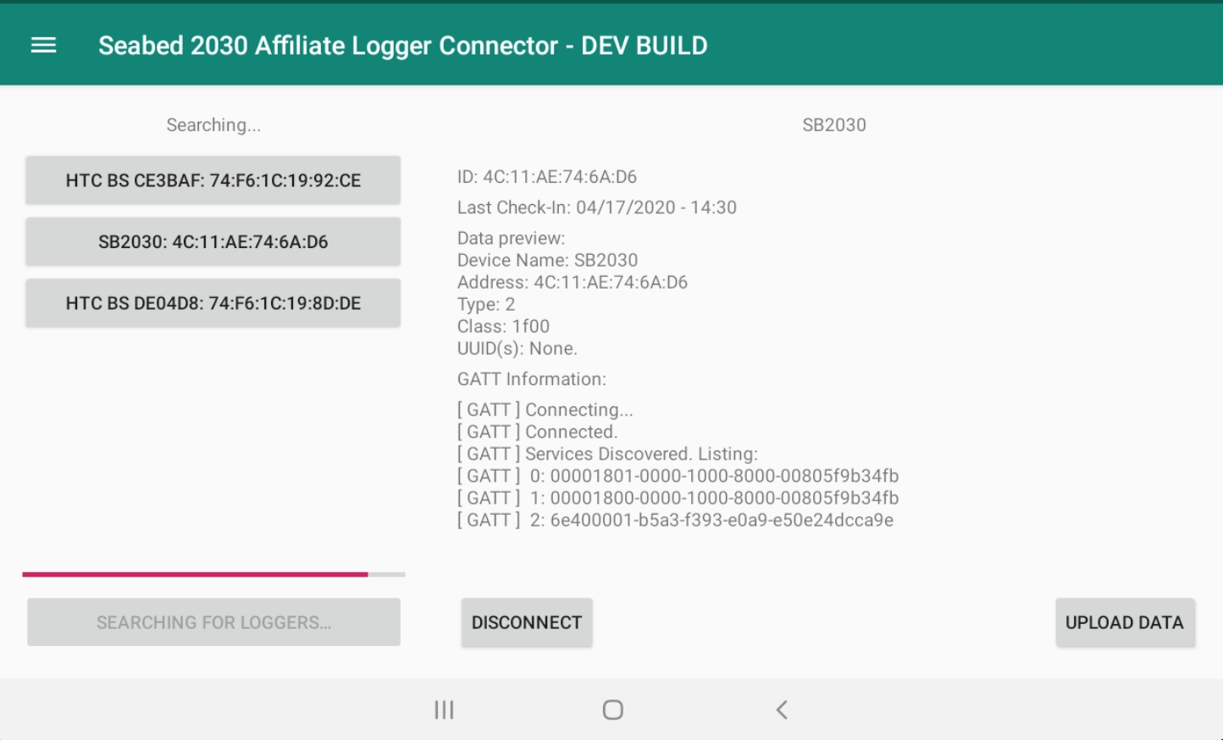
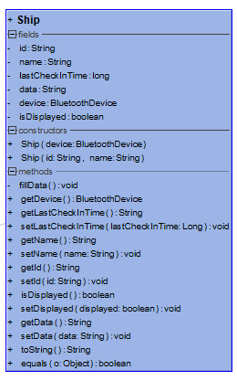
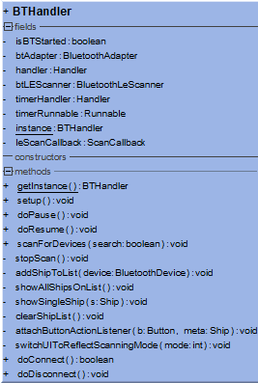
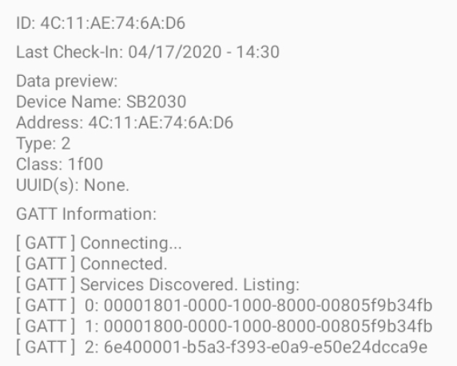
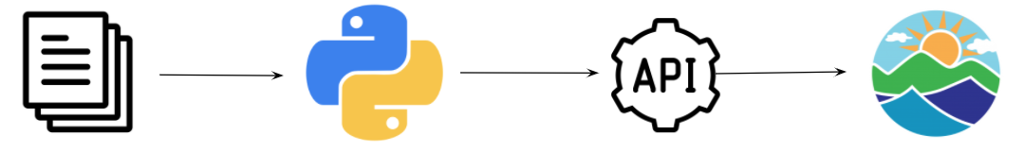
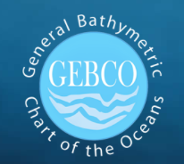
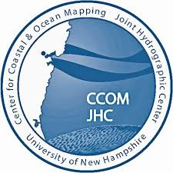


Seabed 2030 Affiliate Project
Chris Schwartz, Noah Perron, Hannah Dukeman, Taylor Roy
Department of Computer Science, University of New Hampshire, Durham, NH 03824
Sponsored by Dr. Brian Calder
Introduction & High-Level Overview
Application Design
Goal: Contribute to Seabed 2030’s mission of mapping the entire ocean floor by 2030 through the development of a back end system for a low cost, accessible ocean depth data logger
Developed a phone application for data collection and a cloud-based solution for processing and sending the data to the DCDB
Next Steps
Train volunteers to use phone application to perform data collection
CCOM will take over further development and widespread adoption of this project
Cloud Processing & Data Submission
References
Raw Data Files
NMEA2000
NMEA0183
Data Transformation via Python Scripts
Ingest-
External API Submission
Data Archived at the NCEI

