Slide 1

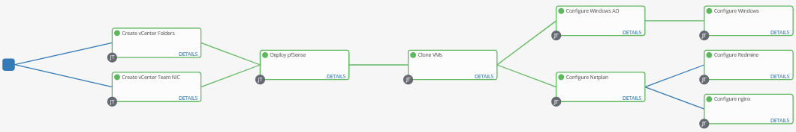








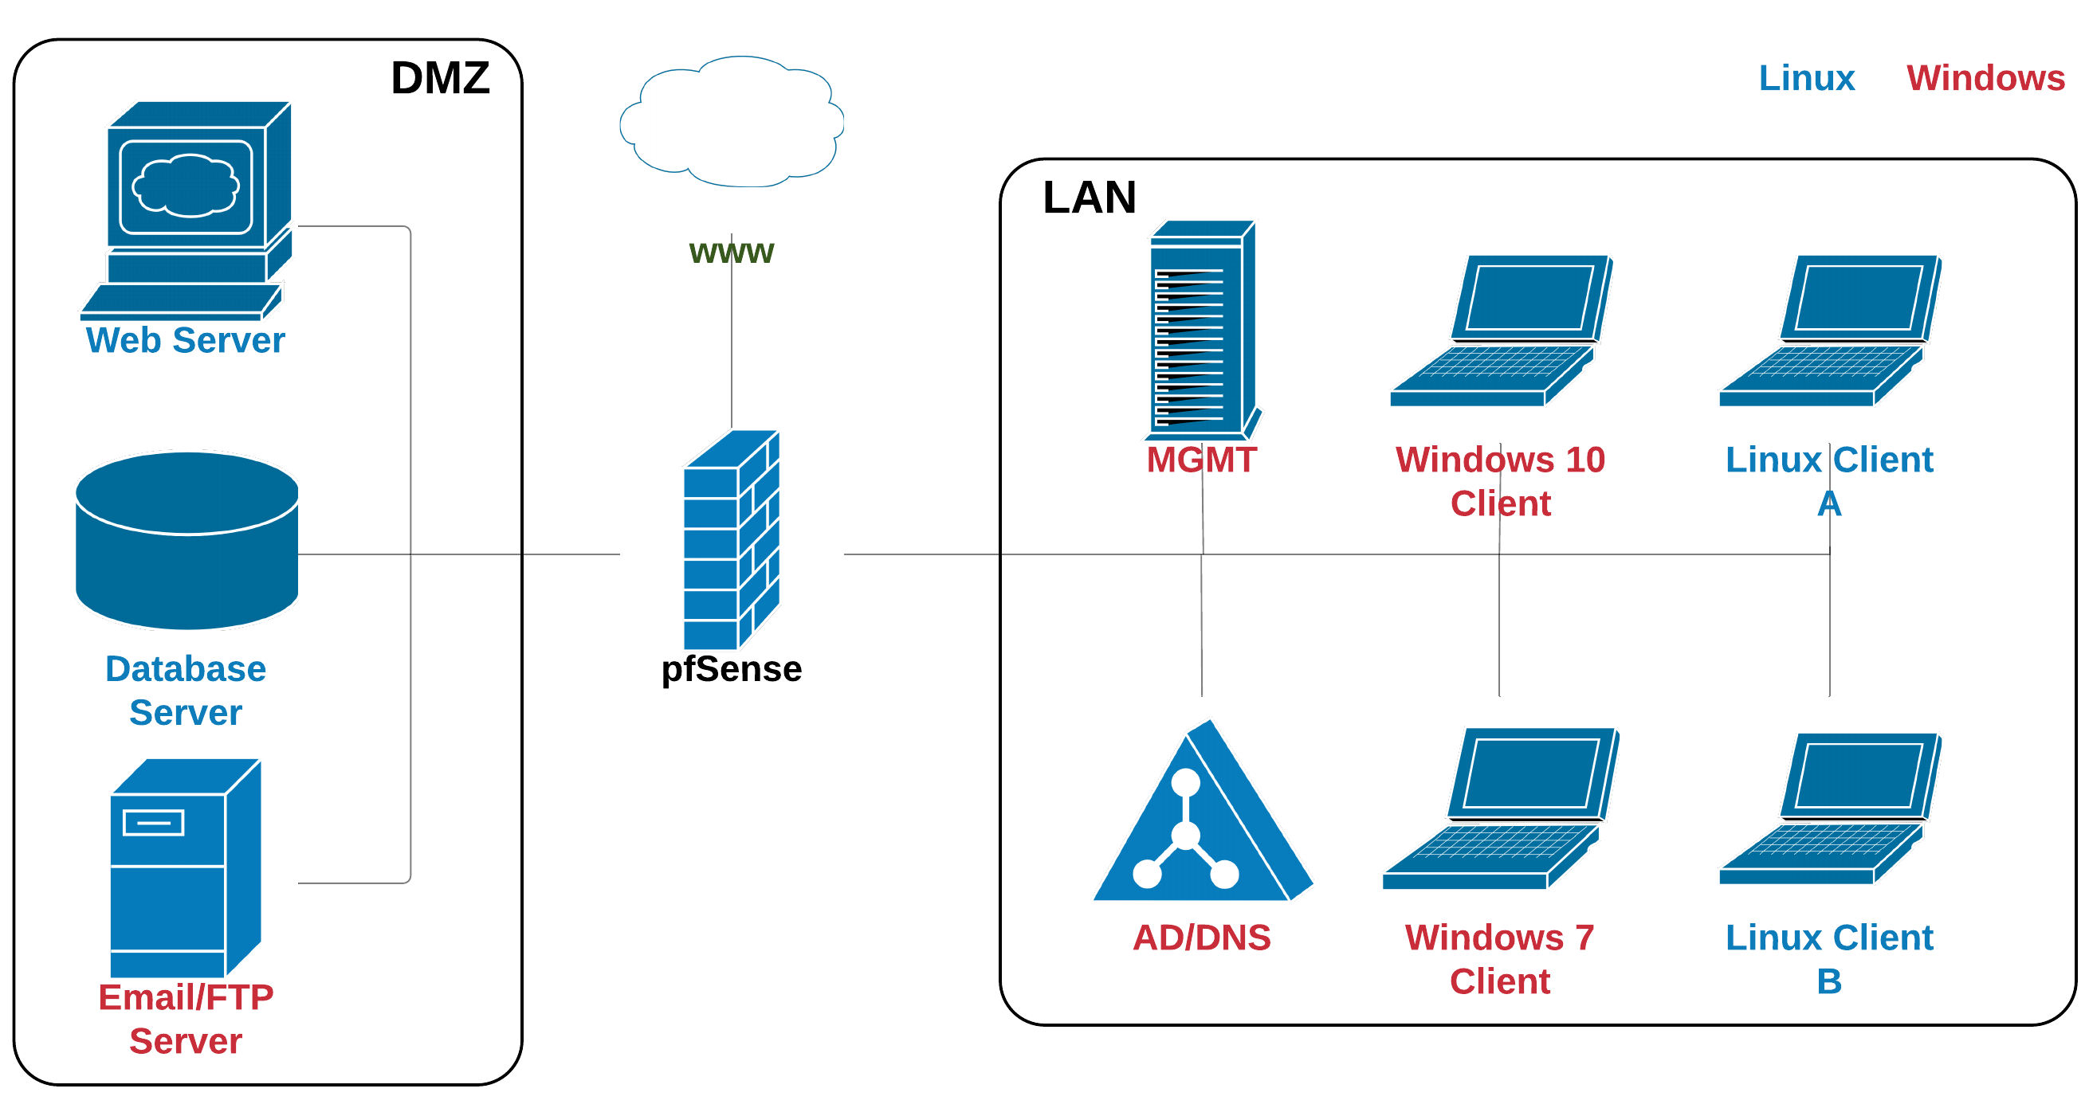
R.E.D.S.W.A.R.M.S.
Resilient Enterprise Deployment System Which Automates tRaining Modules Securely
Max Del Rio, Ben Patton, & Dylan Wheeler
Sponsor: Ken Graf + Cybersecurity Club, Department of Computer Science https://bitbucket.org/unhredswarms/maincode/
Introduction
Ansible Workflow
Context: UNH’s Cybersecurity Club trains students to tackle tomorrow's biggest cybersecurity challenges.
The Club provides a wealth of resources for students to practice and grow by sponsoring Cyber Defense/Offense competitions, labs, and security research.
Problem: Standing up networks to train on is time-consuming and error-prone. Students often spend entire meetings cloning and configuring virtual machines.
Solution: By automating this process, students can spend less time configuring and more time learning.
UNH will also be in prime position to host cybersecurity competitions and events.
Ansible AWX manages and orchestrates network deployments. A team network is deployed via a workflow composed of smaller deployment tasks as templates.
                Each template contains the necessary steps to configure each host. Each component could be deploying a VM template or configuring an application/computer.
                Host information, such as IP addresses, users, and target VM template file, is maintained as an inventory. Similar hosts can be grouped using a tagging system. This allows us to run certain tasks on specific hosts. For example, Linux configuration tasks can run independently of Windows tasks. This also simplifies the process of adding new hosts to a deployment.
Goals
A network/scenario can be deployed and destroyed automatically using an Ansible module for VMware
Ansible pipeline must be at least twice as fast as the manual equivalent (and scale with large teams)
System must be packaged and used to deploy team networks for a UNH-hosted competition
Each team’s network must be isolated from each other and the competition infrastructure
Produce necessary competition documents for a future UNH-hosted cybersecurity event
Allow networks to be easily customized with operating systems, devices, and software
Team Scenario Components
Example Team Topology
Various components of the team network are meant to simulate systems that students might see in a mock enterprise network or competition scenario.
Technologies:
Palo Alto virtual router isolating and controlling access from each teams to the internet
pfSense firewall/router appliance
Redmine issue tracker
Ubuntu Desktop for Linux workstations
Nginx Web server for a “customer facing” service
Windows Server with AD service for user/policy management
Features:
Customizable networks and devices, where a tagging system is used to identify device roles and locations in a deployment
Intentionally vulnerable systems, such as old or unconfigured versions of software, to allow students to practice finding and exploiting vulnerabilities
Results
Completed one-touch automated deployment of a competition scenario
Authored detailed technical documentation for future students to expand
Built a modular framework to support additional scenarios with more complex networks or vulnerabilities
Project version control managed by Bitbucket
With only minor changes, REDSWARMS can deploy a Cyber Defense competition in its current state
Future Work
Additional scenarios to be created for different competition styles (including new software or operating systems).
Introducing intentionally vulnerable components for remediation training
Hosting a competition with our new technology
Ensuring the lab's infrastructure can support a competition

