Slide 1
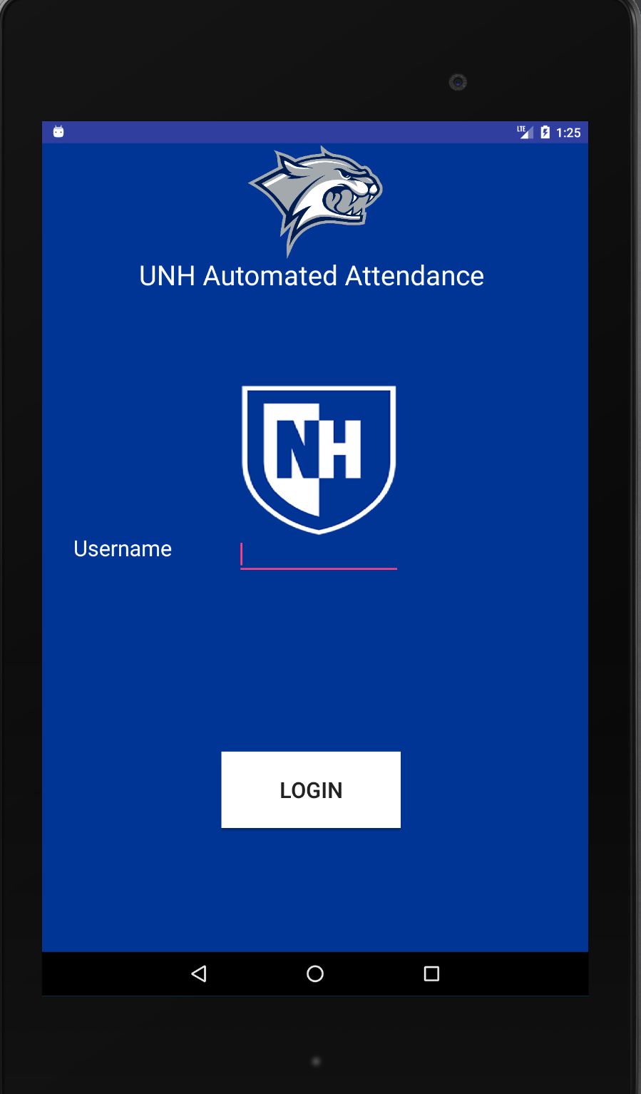
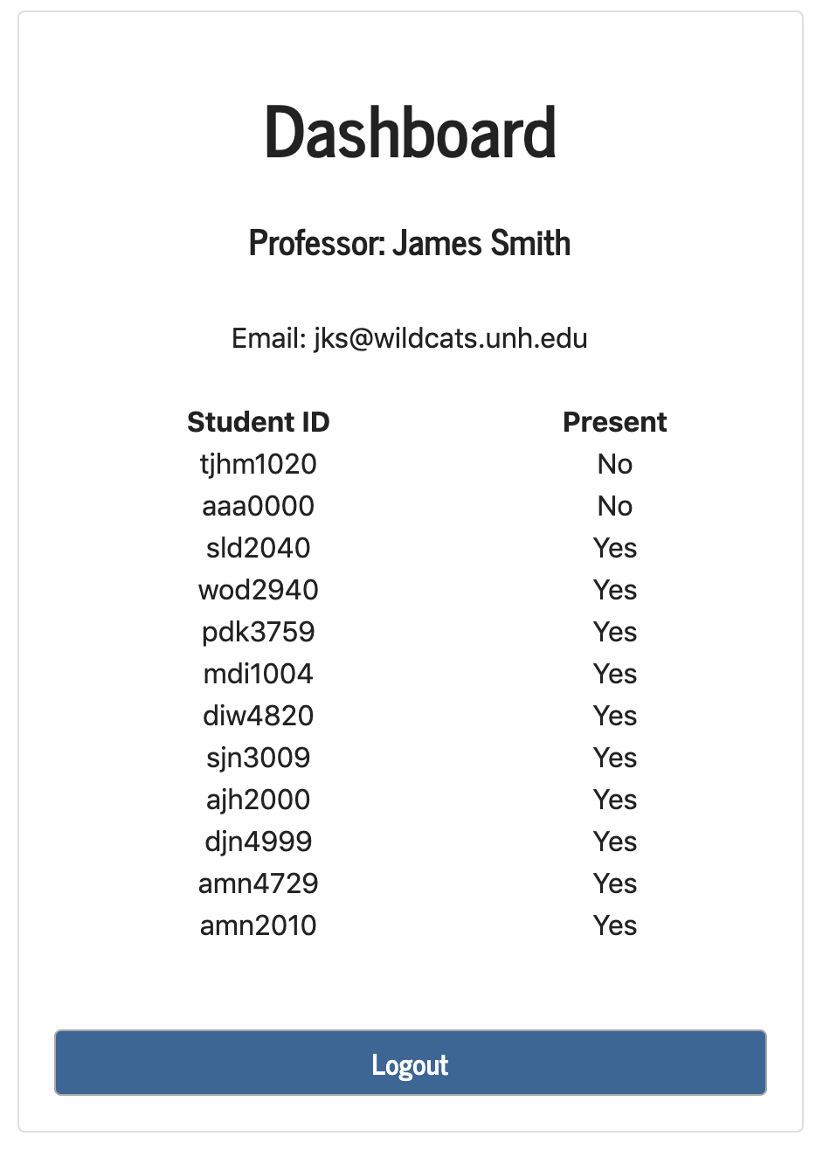
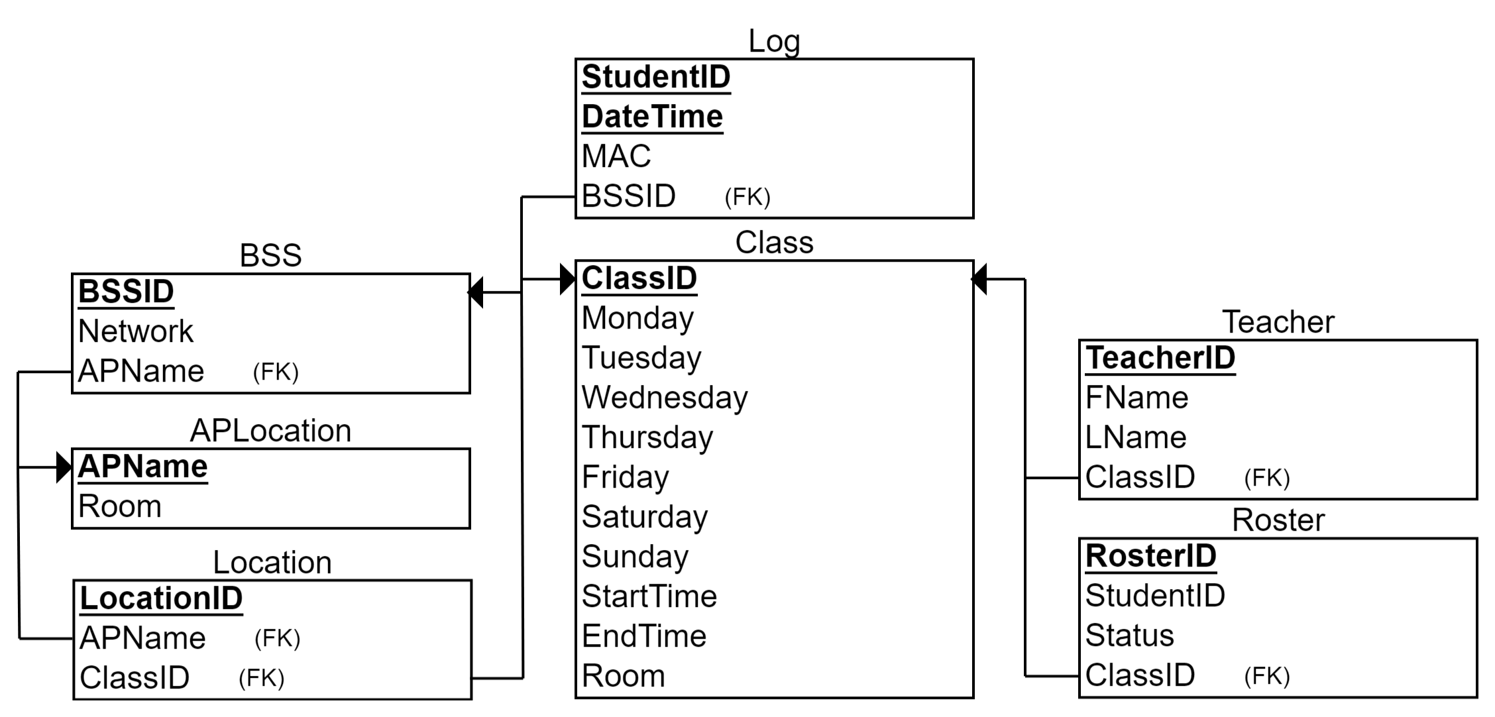
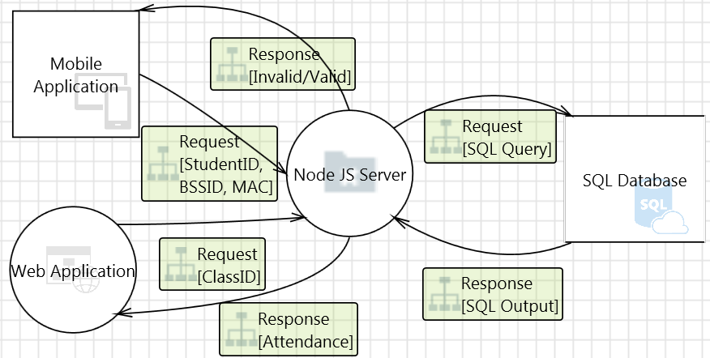
Automated Attendance
Project Sponsor: Scott Valcourt, PHD
Josh Guarnieri, Nicholas Harrigan, Marko Novcic, Joshua Mawuntu, Taylor Merrifield
Department of Computer Science, University of New Hampshire, Durham NH
Problem
Applications
Front-End
Across multiple universities, attendance taking is a disruptive, expensive, and time consuming process
Current solutions involve wasting class time manually taking attendance, or requiring students to purchase expensive devices like an iClicker
Students and professors are both extremely busy; minutes of attendance taking can build up to wasting hours of class time every semester
Smartphone App
Students sign in with their student ID through IOS/Android
Students receive a response with confirmation of attendance
Web App
Professors login and register their courses
Dashboard enables the professor to view course attendance
Solution
Back-End
We used UNH’s existing router infrastructure to determine where a device is connecting to a UNH WIFI Access point
Develop an attendance app for professors to register courses, and for students to login. Students enter their username at the beginning of class, and based on their room, time, and day, attendance is tracked and it becomes available to the professor through a web app
This will lead to UNH no longer having to pay licensing fees for use of auxiliary infrastructure and waste less class time for manual attendance taking
MySQL Database
Stores unique identifiers of wireless access points in Kingsbury
Stores list of classes and student check ins
Stores professor registration information
Server
Linux server provided by UNH IT hosting Node JS server
Cron triggers javascript to mark logged in students as active in the database
Checks for duplicate student entries based on unique identifiers of hardware being used by students
Smartphone App
Web App
Database
Data Flow
Future Work
Coordinate with the USNH Login System to further ensure accuracy
Implement IClicker Quiz replacement in the application
Allow for an option to directly submit attendance into Canvas
Create a web-based login for students without mobile devices
Expand the project to enable automated attendance through the entire campus
Professors populate the Teacher, Class, and Roster table with the appropriate class information
When students log in through the app, they are added to the Log table
BSS, APLocation, and Location tables keep track of UNH router infrastructure information

