Slide 1

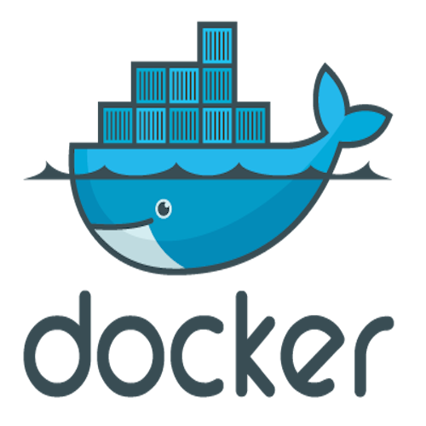




Drupal in Docker For Incoming UNH CS Students
Scott Kitterman : stk@cs.unh.edu
Noah Levin : ndl1004@wildcats.unh.edu & Efras Soputan : ees1023@wildcats.unh.edu
Department of Information Technology, University of New Hampshire
Introduction
Tools & Technologies
Implementation
Working with the UNH Computer Science Department
Replace the old infrastructure where the workspace for student requires a large amount of resource compared to the current technology
Result in cumbersome task to set up in every each semester
Docker is a container technology that utilize the OS’s kernel while putting the userland applications into a sandbox
This allows student to have their own workspace in the container while making it easier for the UNH staff to manage in the background
Created Drupal and MySQL images and linked the services to host and store student data for CS408
Integrated Docker with Kubernetes web UI to monitor Docker containers
Put Drupal, NGINX, and MySQL images into one container for each student to allow for reproducible deployments across different hardware.
Our project implementation will replace the old model in which CS student accounts are deployed and hosted. It gives access to a Docker image for each student for their specific courses.
NGINX, MySQL databases and Drupal images are deployed inside Docker containers which reside in UNH servers. Kubernetes nodes are deployed in alternate UNH servers which easily monitor the Docker container status within clusters via a graphical user interface.
Students are able to login using their UNH account credentials and on that webpage the appropriate permissions are set on student, teacher, and administrator accounts.
UNH Server
Our New System
The previous model of just one server for all services and storage was replaced by our system that uses containerized deployments using Docker to host one Drupal web server with one MySQL database per student. Our new design has the advantages of simplified user interfaces, quick scaling up or down for the number of containers needed, fault tolerance, a portable design that allows for diverse and flexible deployments on different hardware, and better security since the network sits behind a Palo Alto firewall.
Project Goals
To create a more efficient system to host student sites for CS408
To be able to monitor and report on Docker containers and Drupal status whether the current service is accessible or not
To be able to scale up or down deployments with ease
To have portable, reproducible, and flexible deployments since they will be unique each semester
.
Notes:
Add in more content on goals, our new system (details). Replace research on tools and technologies, talk about how were using it in our system. Work on the image, discuss relationships between web UI, database, drupal. Make it more clear on why we are deploying the new things, how it works, how it was built. Results / conclusion section, what we got done.

