Slide 1

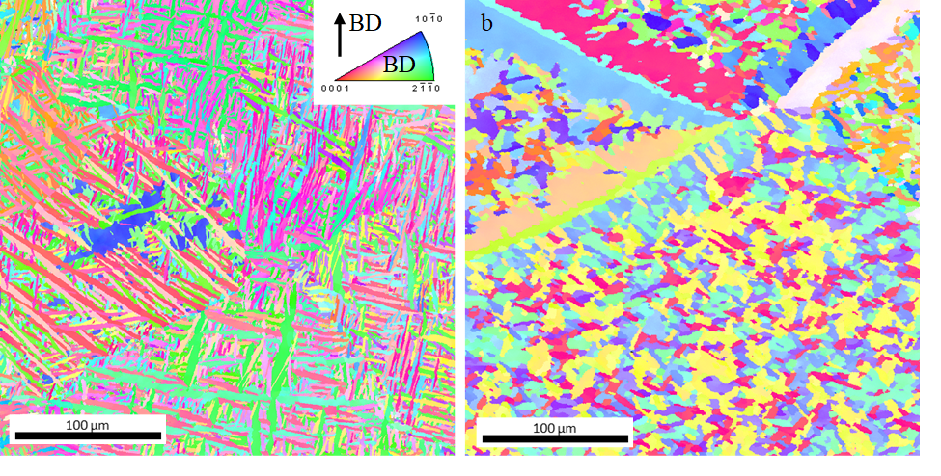
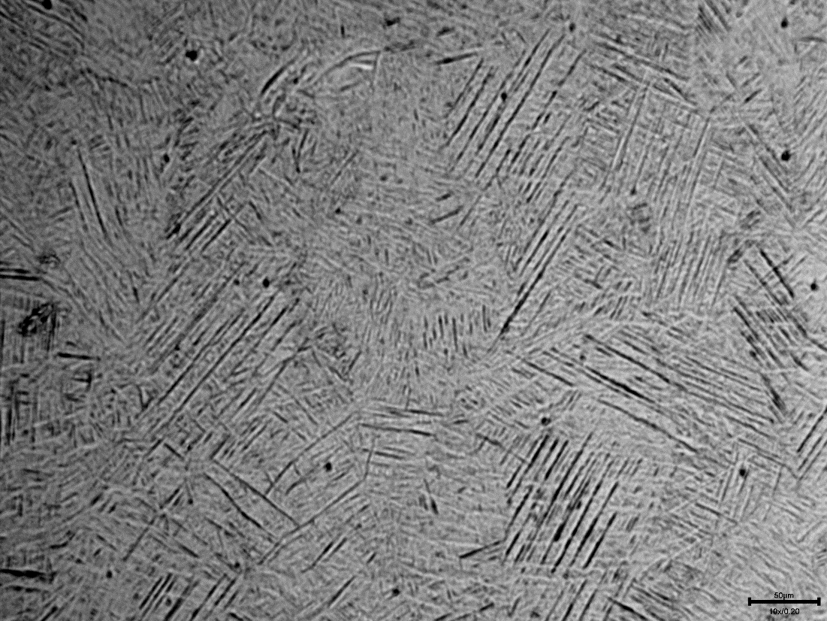
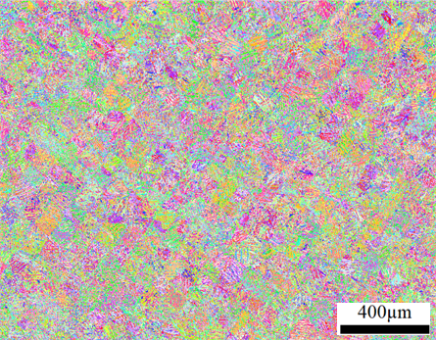
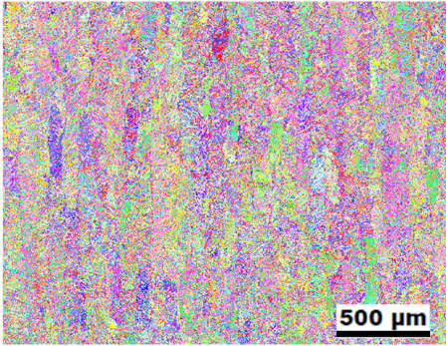
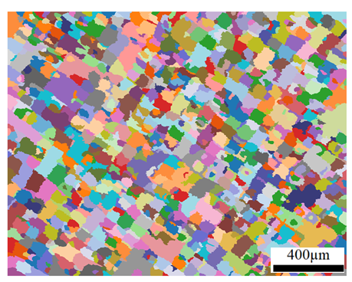
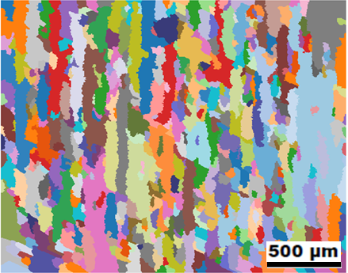
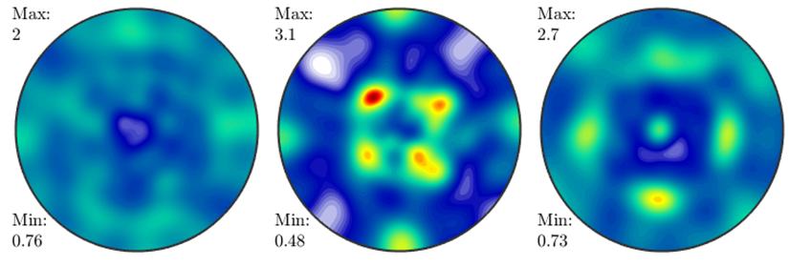
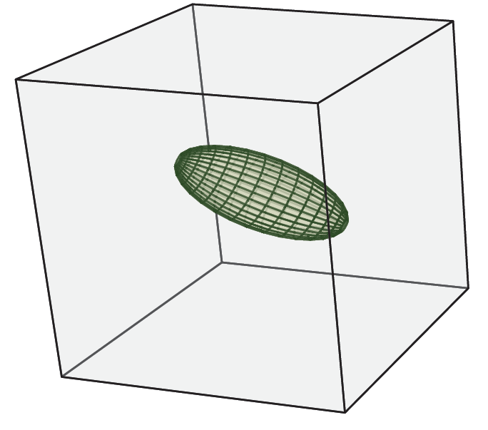
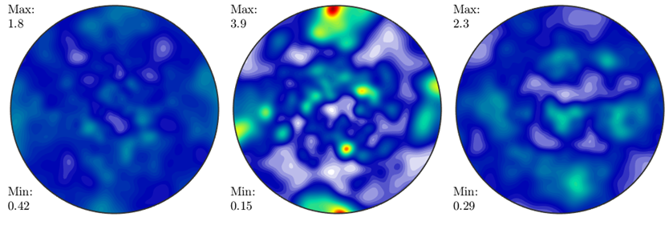
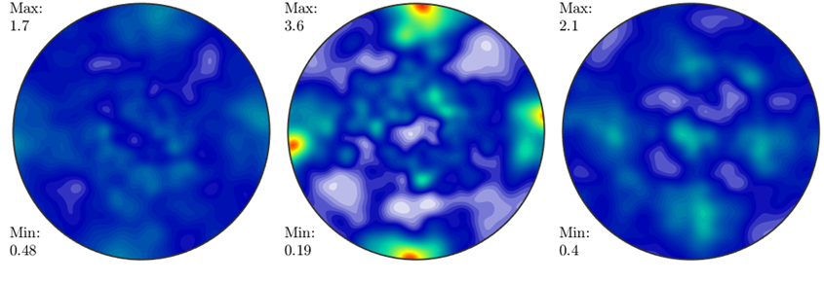
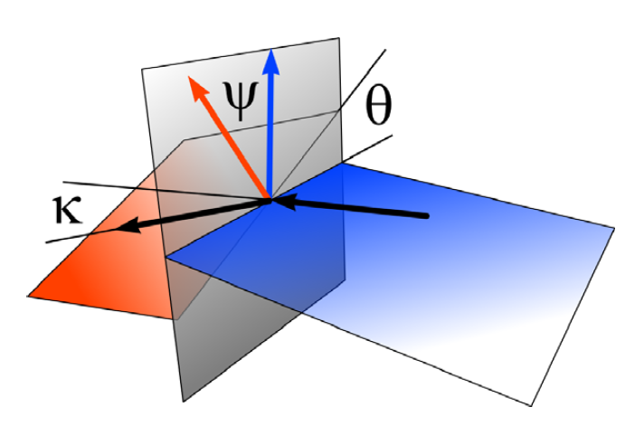
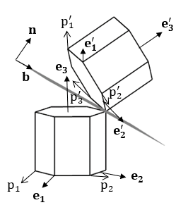
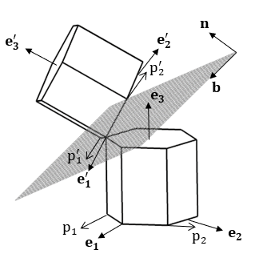
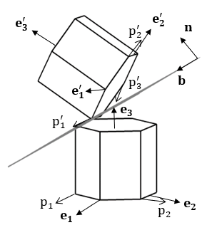
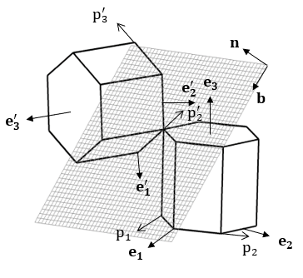
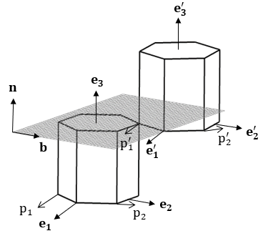
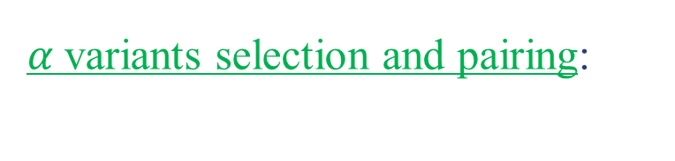
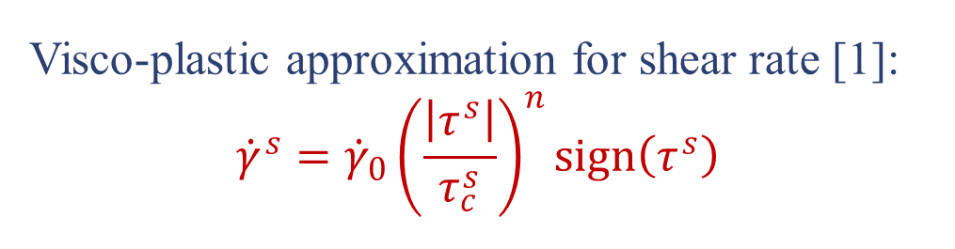
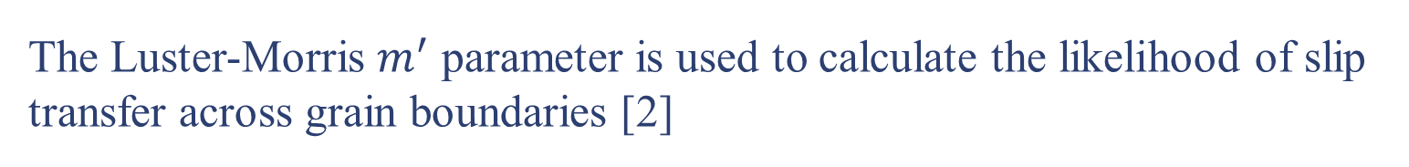


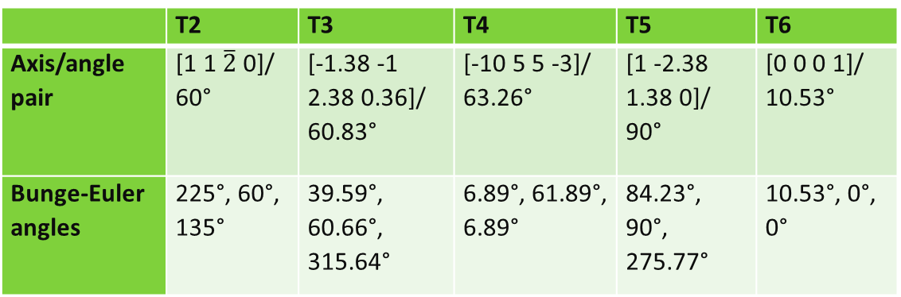
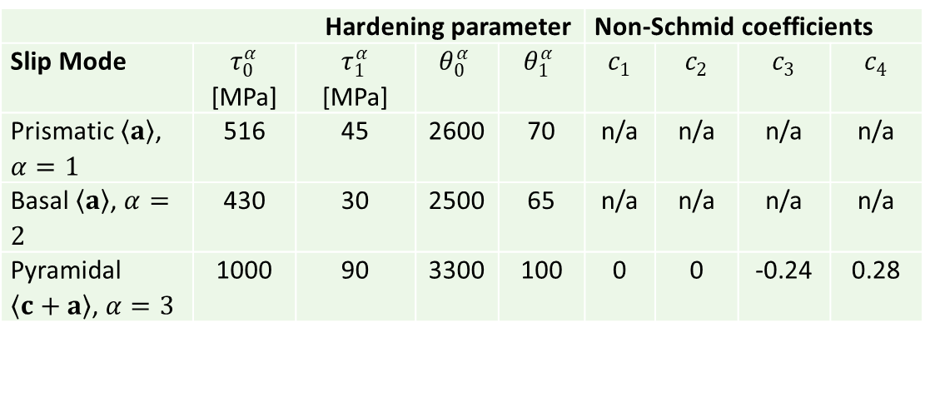

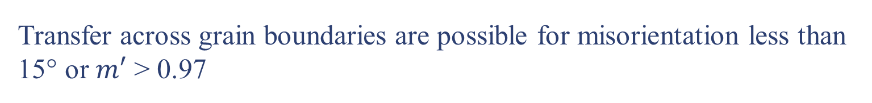





Modeling the role of local crystallographic correlations in lamellar microstructures of Ti-6Al-4V fabricated via laser powder bed fusion
Iftekhar A. Riyad¹, Evgenii Vasilev¹, Ricardo A. Lebensohn², Brandon A. McWilliams³, Adam L. Pilchak⁴, Michael G. Glavicic⁵, and Marko Knezevic¹
¹University of New Hampshire, ²Los Alamos National Laboratory, ³CCDC Army Research Laboratory, ⁴Air Force Research Laboratory, ⁵Rolls-Royce Corporation
Introduction
Model
Stress-strain response and texture evolution:
Titanium-alloys are widely used as high temperature structural material and in recent years, additive manufacturing (AM) using Ti-6Al-4V as feedstock material has been popular due to its capability to fabricate complex parts. For modeling and predicting the large strain behavior of Ti-6Al-4V with fully α-lamellar structure, a lamellar visco-plastic self-consistent (VPSC) polycrystal plasticity model is adapted. The model incorporates the local crystallographic correlations including the slip transfer between adjacent lamellae and considers the non-Schmid effects for activation of pyramidal slip to capture tension versus compression asymmetry. The lamellar VPSC formulation considers paired α-lamellae and a procedure is developed to construct paired variants from experimental EBSD data. The habit plane of the paired lamellae has effect on the anisotropy in hardening. The model is calibrated and validated on a data set for Ti-6Al-4V fabricated via laser powder bed fusion.
Single crystalline response:
Comparison of experimental (Exp.) and simulated (Sim.) true stress-true strain curves for compression and tension.
(c) along BD and simulations with slip transfer
(d) perpendicular (⊥) to BD and simulations with slip transfer
(e) along BD and simulations without slip transfer
(f) ⊥ BD and simulations without slip transfer.
Relationship between stress and strain rate at the single crystal level is approximated using the visco-plastic equation.
c
d
Visco-plastic approximation for shear rate [1]:
$${{\dot{γ}}^{s}={\dot{γ}}_{0}\left(\frac{\left|τ^{s}\right|}{τ_{c}^{s}}\right)}^{n}sign\left(τ^{s}\right)$$
Lamellar aggregate and polycrystalline response:
e
f
The mechanical response of the polycrystal is obtained by self-consistent homogenization (VPSC model).
𝛼 -phase lamellar Ti64
Microstructural Characterization
Hardening parameter |  |  |  |  | Non-Schmid coefficients
Slip Mode | $τ_{0}^{α}$ [MPa] | $τ_{1}^{α}$ [MPa] | $$θ_{0}^{α}$$ | $$θ_{1}^{α}$$ | $$c_{1}$$ | $$c_{2}$$ | $$c_{3}$$ | $$c_{4}$$
Prismatic $\left\langle \left.a\right\rangle \right.$, $α=1$ | 516 | 45 | 2600 | 70 | n/a | n/a | n/a | n/a
Basal $\left\langle \left.a\right\rangle \right.$, $α=2$ | 430 | 30 | 2500 | 65 | n/a | n/a | n/a | n/a
Pyramidal $\left\langle c+\left.a\right\rangle \right.$, $α=3$ | 1000 | 90 | 3300 | 100 | 0 | 0 | -0.24 | 0.28
a
b
e
e'
lamellar structure VPSC
(LS-VPSC)
Polycrystalline material under applied load.
Matrix
Single Lamella
(a) Optical micrograph and (b) IPF map showing the lamellar structure of α phase variants.
The α variants are hexagonal closed pack (HCP) crystal structure
f
f'
Grain
g
(g) PFs measured by neutron diffraction compressed to a true strain of 0.01 $s^{−1}$.
(h) Corresponding simulated PFs. The BD is pointing out of the plane.
Three different scales are defined for VPSC:
microscopic, at single crystal (single lamella) scale
mesoscopic, at the scale of two lamellar colony
macroscopic, at lamellar aggregate level (grain)
(e) and (e’) IPF maps and (f) and (f’) reconstructed prior 𝛽 grains of Ti-6Al-4V fabricated via laser powder bed fusion.
The build direction is perpendicular to (e) and (f), and vertical to (e’)and (f’).
α variants are extracted from reconstructed 𝛽 grains for simulations.
Grain
h
$$\left\{10\overline{1}0\right\}$$
$$\left\{0001\right\}$$
$$\left\{11\overline{2}0\right\}$$
Matrix
Luster-Morris parameter:
Conclusions
The Luster-Morris $m^{′}$ parameter is used to calculate the likelihood of slip transfer across grain boundaries [2]
The simulation results for stress-strain curves are compared with experimentally measured data set for tension- compression. Hardening parameters are chosen to best fit the experimental results.
A random distribution of habit planes is found to best fit the data and underlying anisotropy in hardening.
Non-Schmid effects for activation of pyramidal slip captures tension versus compression asymmetry well.
The local crystallographic correlations including the slip transfer between adjacent lamellae based on Luster-Morris parameter improves the simulation results.
$$m′=cos⁡κ∗cos⁡ψ$$
Pole figures (PFs) showing the initial measured by:
(c) neutron diffraction (NeD)
(d) electron backscattered diffraction (EBSD)
Transfer across grain boundaries are possible for misorientation less than 15° or $m′$ > 0.97
PFs of the initial texture used in simulations
$κ$ = angle between two slip directions
$ψ$= angle between two slip plane normal
$θ$ = angle between two slip direction projected
on grain boundary
[2]
Literature Cited
Construction of α lamellae from EBSD data
Results
[1] Lebensohn, R., 1999. Modelling the role of local correlations in polycrystal plasticity using viscoplastic self-consistent schemes. Modelling and Simulation in Materials Science and Engineering 7, 739-746.
[2] T. R. Bieler, et al., 2019, “An analysis of (the lack of) slip transfer between near-cube oriented grains in pure Al,” International Journal of Plasticity,118, 269-290.
[3] Wang, S.C., Aindow, M., Starink, M.J., 2003. Effect of self-accommodation on α/α boundary populations in pure titanium. Acta Materialia 51, 2485-2503.
[4] Humbert, M., Moustahfid, H., Wagner, F., Philippe, M.J., 1994. Evaluation of the high temperature texture of the β phase of a TA6V sample from the individual orientations of grains of the low temperature α phase. Scripta Metallurgica et Materialia 30, 377-382.
[5] Knezevic, M., Lebensohn, R.A., Cazacu, O., Revil-Baudard, B., Proust, G., Vogel, S.C., Nixon, M.E., 2013. Modeling bending of α-titanium with embedded polycrystal plasticity in implicit finite elements. Materials Science and Engineering: A 564, 116-126.
At high temperature, Ti-6Al-4V has BCC phase, $β$ and when cooled to room temperature, it transforms into HCP phase, $α$.
The transformation of $α→β$ and $β→α$ is governed by the Burgers relationship.
T2
T3
a
T2
b
Min: 0.50
T3
Min: 0.57
Effect of habit plane inclination on yield stress predicted by considering two lamellae under tension/ compression along e₃ direction of reference crystal
(a) without slip transfer across grain boundary (GB)
(b) with slip transfer across GB. The loading direction (LD) is at the center of the pole plots. The habit plane normal (n) is aligned with the LD at the center.
T4
T5
$α$variants selection and pairing:
Min: 0.50
T4
Min: 0.49
Five misorientations (T2-T6) can be formed when the microstructures are all $α$ variants.
Misorientations are shown with respect to reference crystal.
T6
Min: 0.30
T5
Min: 0.46
Acknowledgements
 | T2 | T3 | T4 | T5 | T6
Axis/angle pair | [1 1 $\overline{2}$ 0]/ 60° | [-1.38 -1 2.38 0.36]/ 60.83° | [-10 5 5 -3]/ 63.26° | [1 -2.38 1.38 0]/ 90° | [0 0 0 1]/ 10.53°
Bunge-Euler angles | 225°, 60°, 135° | 39.59°, 60.66°, 315.64° | 6.89°, 61.89°, 6.89° | 84.23°, 90°, 275.77° | 10.53°, 0°, 0°
Burgers relation:
${\left\{1 0 1\right\}}_{β}{‖\left\{0 0 0 1\right\}}_{α}$
${〈1 1 \overline{1}〉}_{β}‖{〈1 1 \overline{2 } 0〉}_{α}$
Min: 0.31
T6
Min: 0.40
This research was sponsored by the U.S. Army Research Laboratory and was accomplished under a Cooperative Agreement No. W911NF-15-2-0084.
Min: 0.31
Contacts
Min: 0.32
Iftekhar Riyad (iar1001@wildcats.unh.edu)
Marko Knezevic (marko.knezevic@unh.edu)

