Slide 1
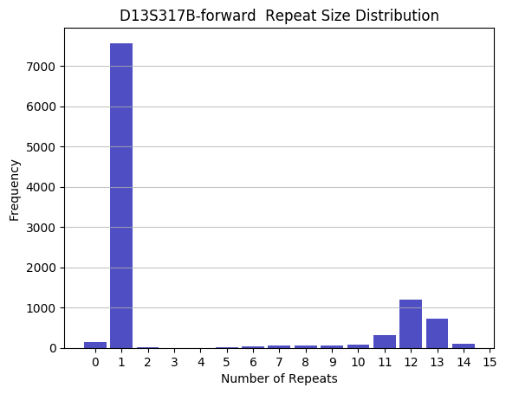
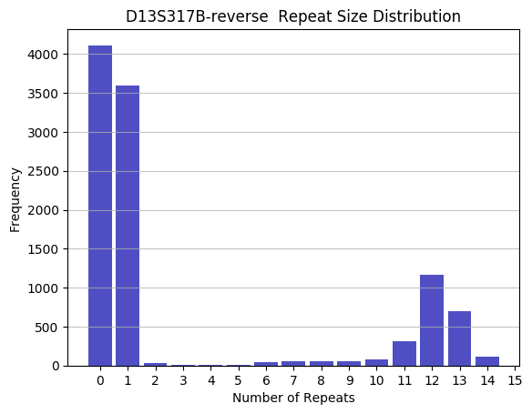

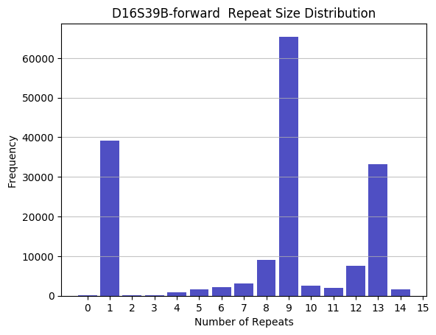
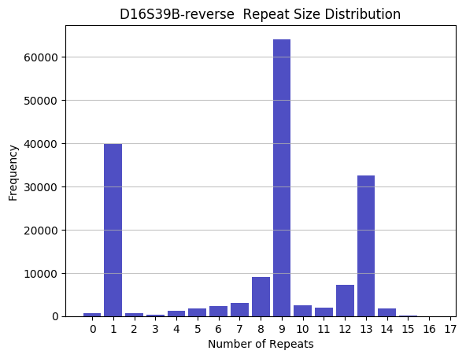


Multiplexing for simple sequence repeats for use with degraded DNA
Jessica Haskins
University of New Hampshire
Overview
Analysis & Preliminary Results
Humans can be distinguished from one another by their DNA. The Combined DNA Index System is a national database that contains DNA profiles. It allows for investigators to match DNA to anyone with a submitted profile.
The current method for developing a DNA profile is Sanger sequencing. It is length-based and only allows for a limited number of informative DNA regions to be evaluated at once.
Goal: Develop a method to identify 20 short tandem repeats (STRs) in human DNA in one reaction using Next-Generation sequencing.
Previously, primers were successfully tested as a multiplex
The sequences are run through a program to count the number of repeats
This is an example of a homozygous individual for the repeat at site D13S317 in the genome. Both of their chromosome 13 have 12 repeats of TATC.
Methods
Design Illumina primers for each repeat
Test each primer pair on different cell lines
Combine the primers into one reaction (multiplex)
Use the multiplex reaction with mixed cell line samples (co-mingled DNA)
Use the multiplex reaction with degraded DNA
Develop an analysis pipeline
This is an example of a heterozygous individual for the repeat at site D16S39 in the genome. One of their chromosome 16 has 9 repeats of GATA and the other has 13 repeats.
Questions? Comments?
Email me: jlh1020@wildcats.unh.edu

