Slide 1
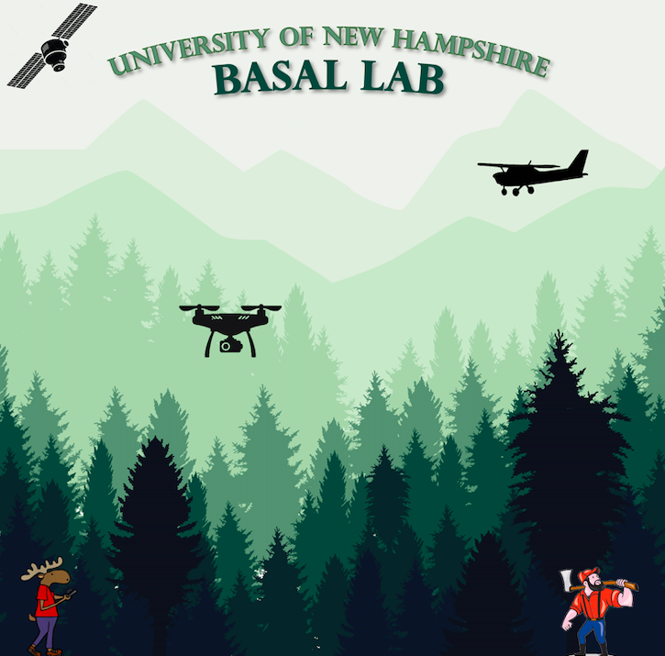
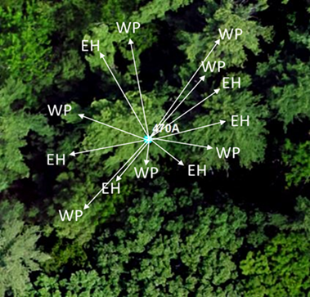
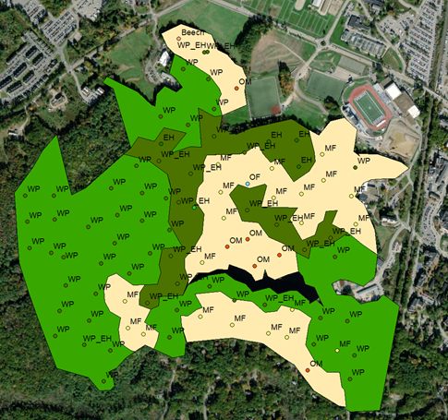
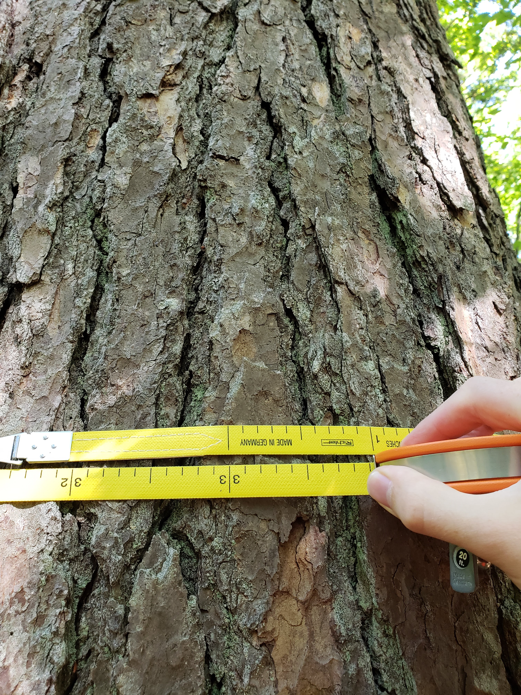
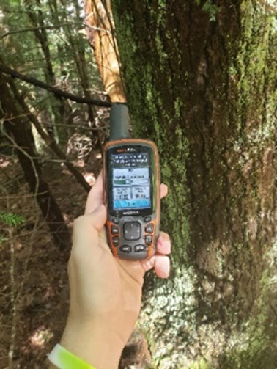
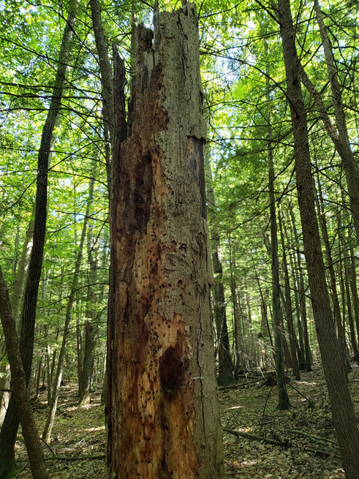
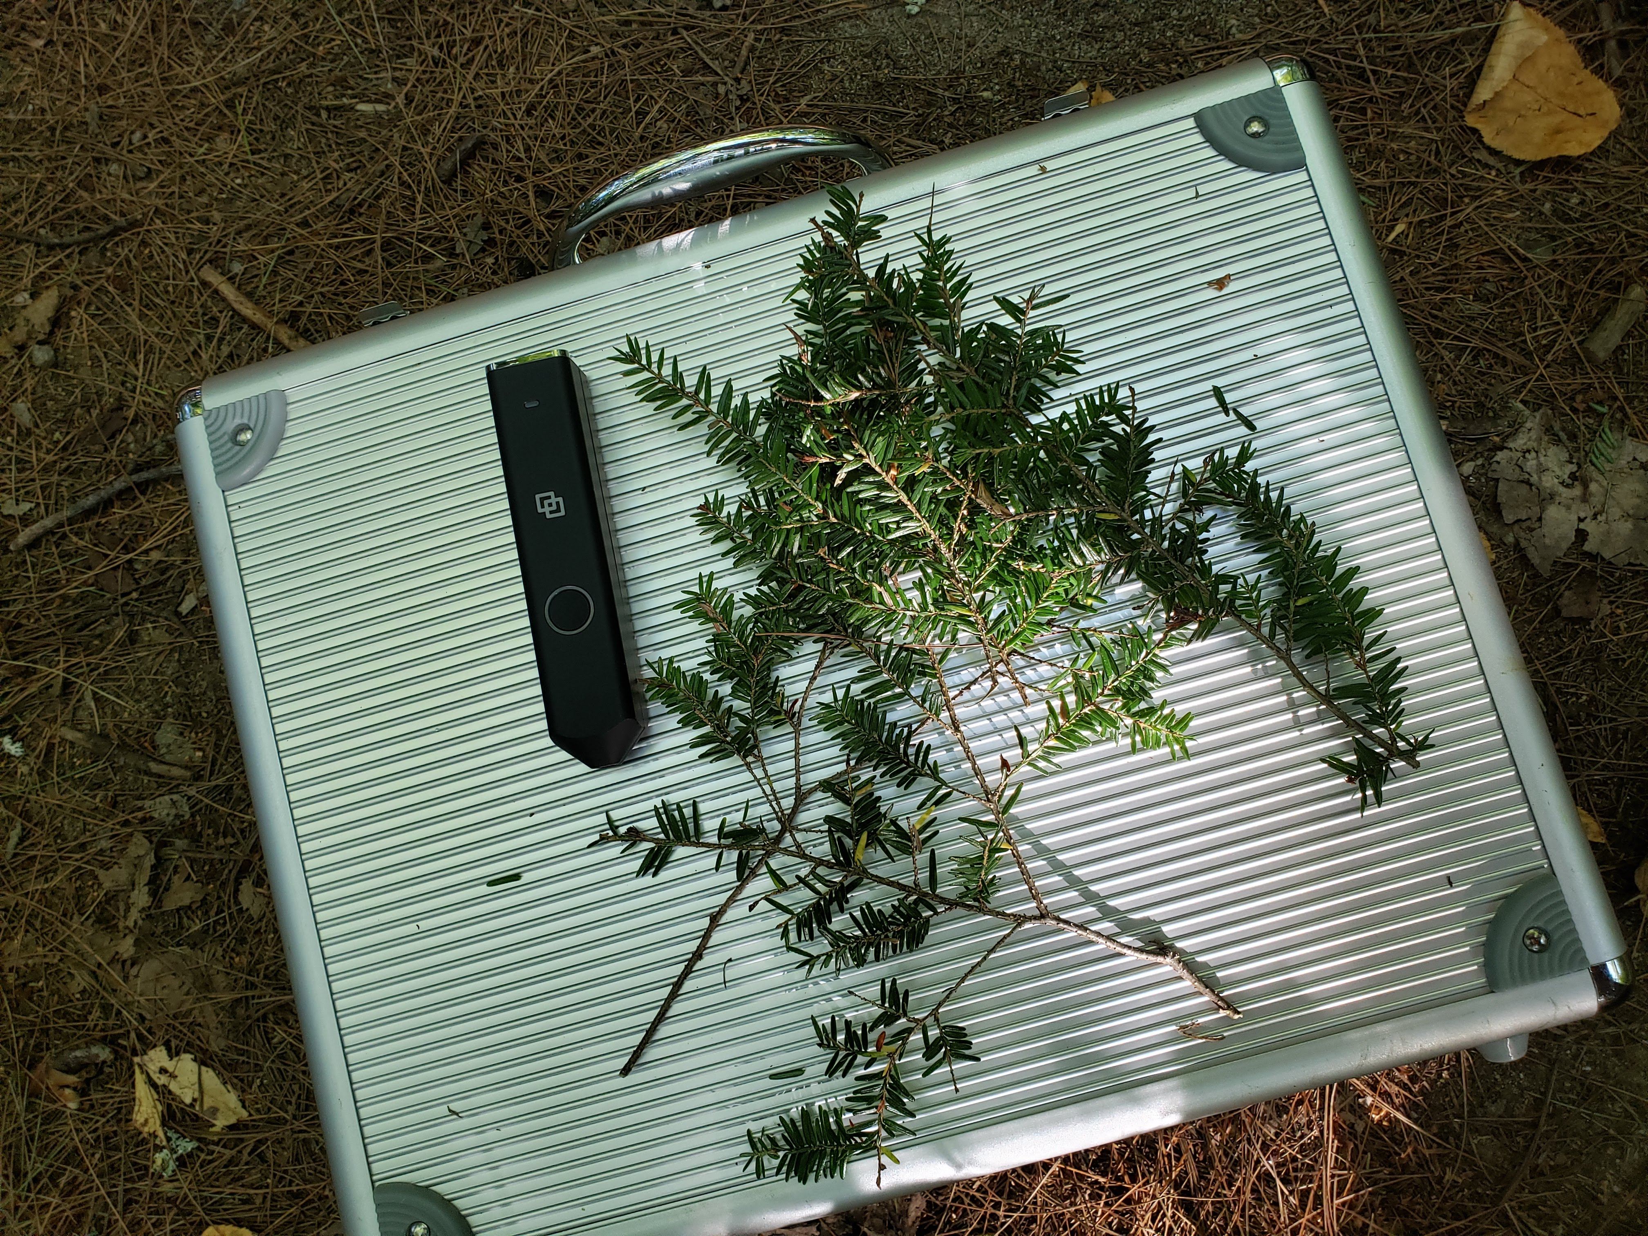
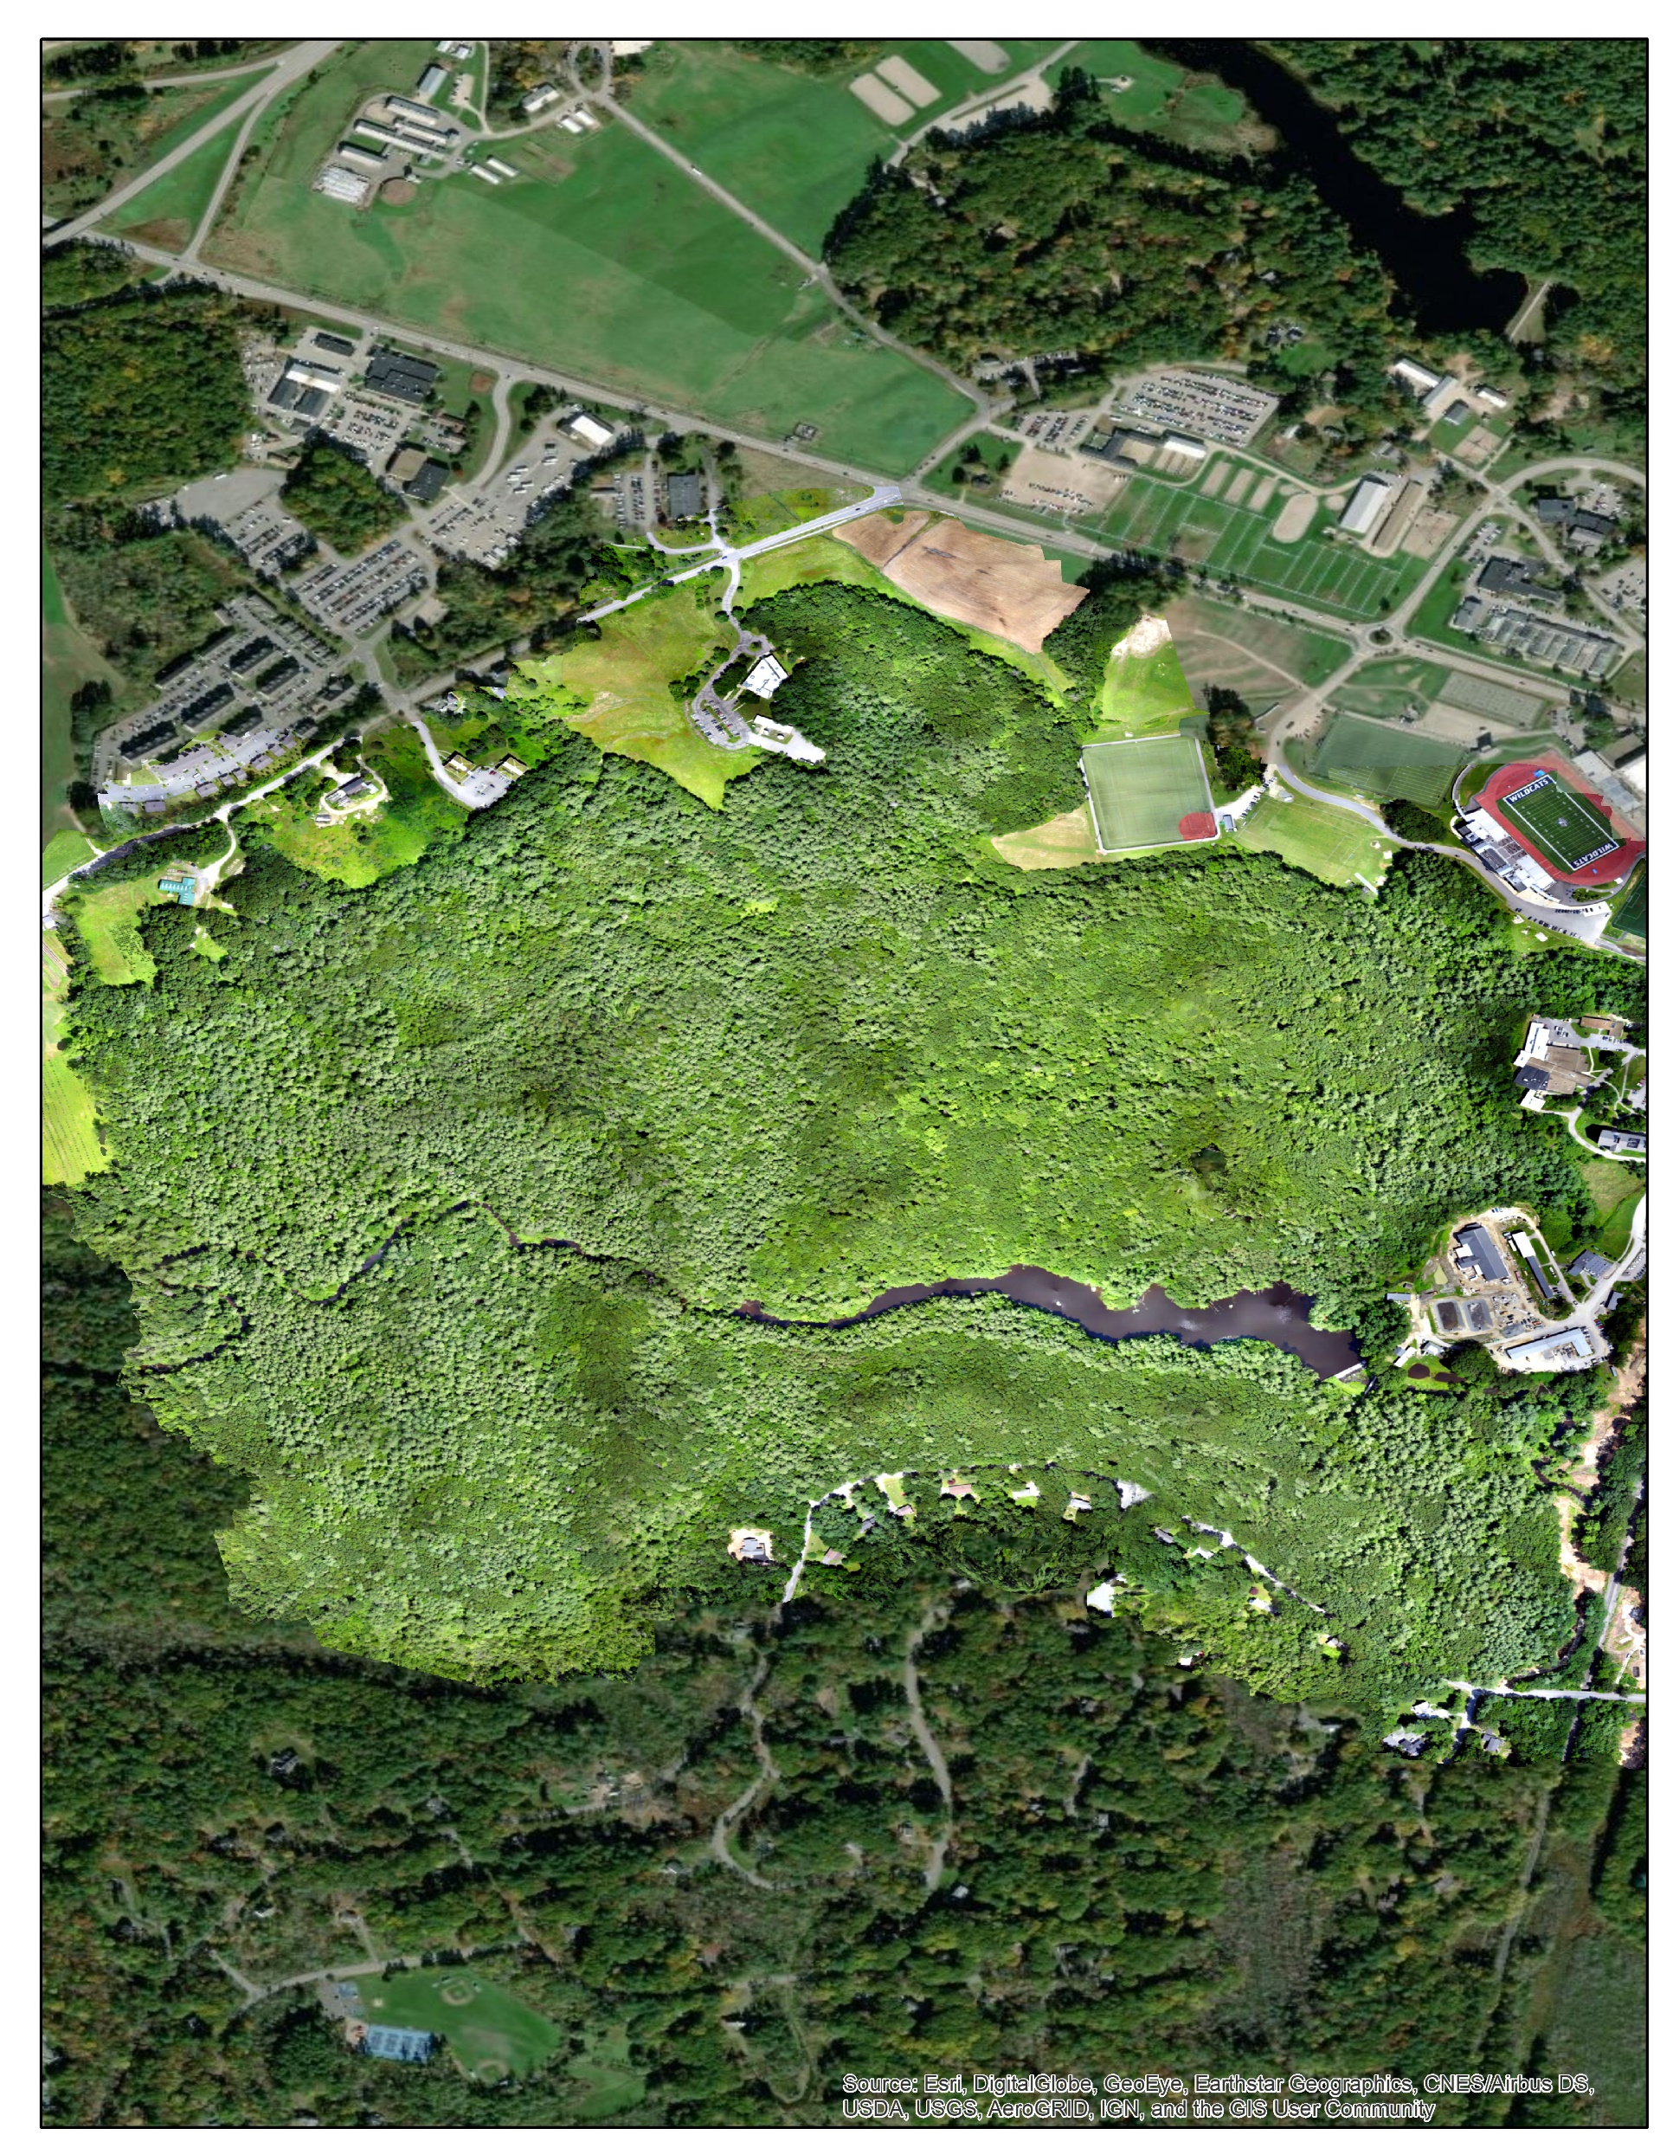
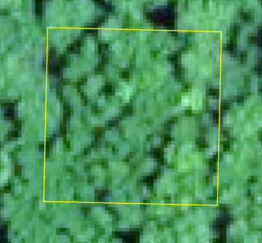
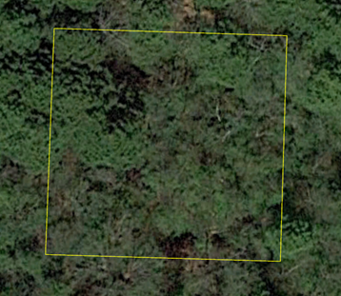
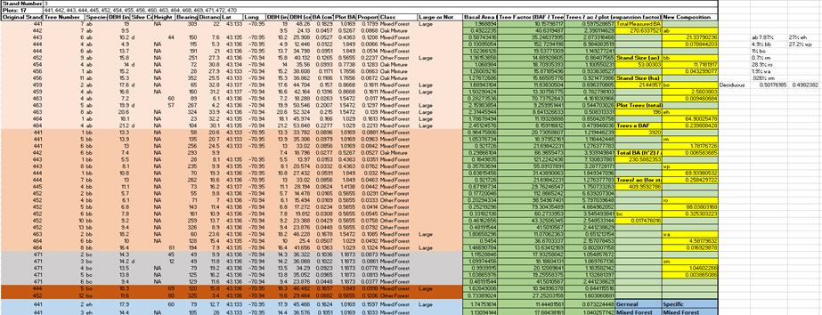
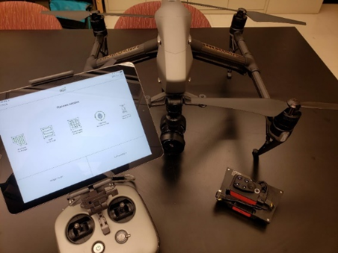
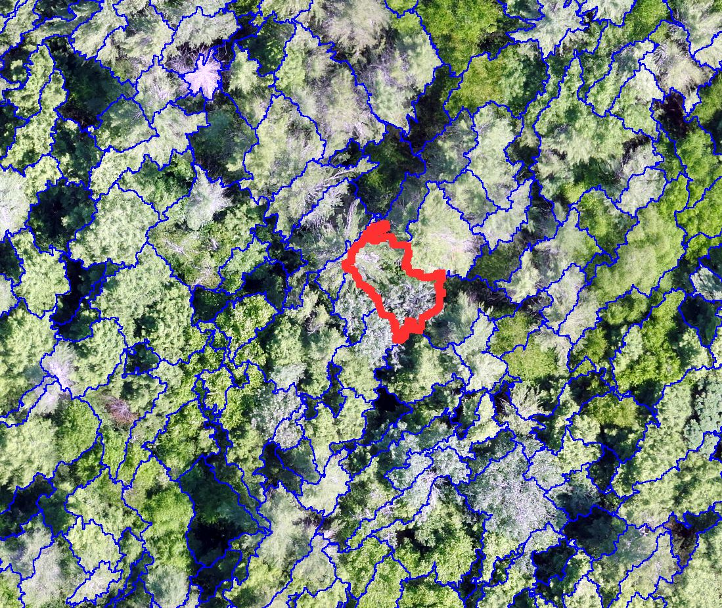
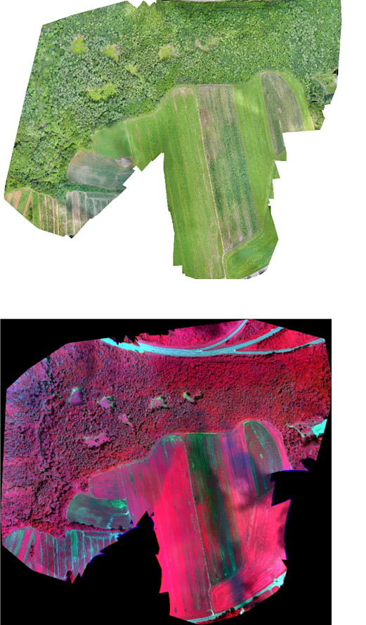
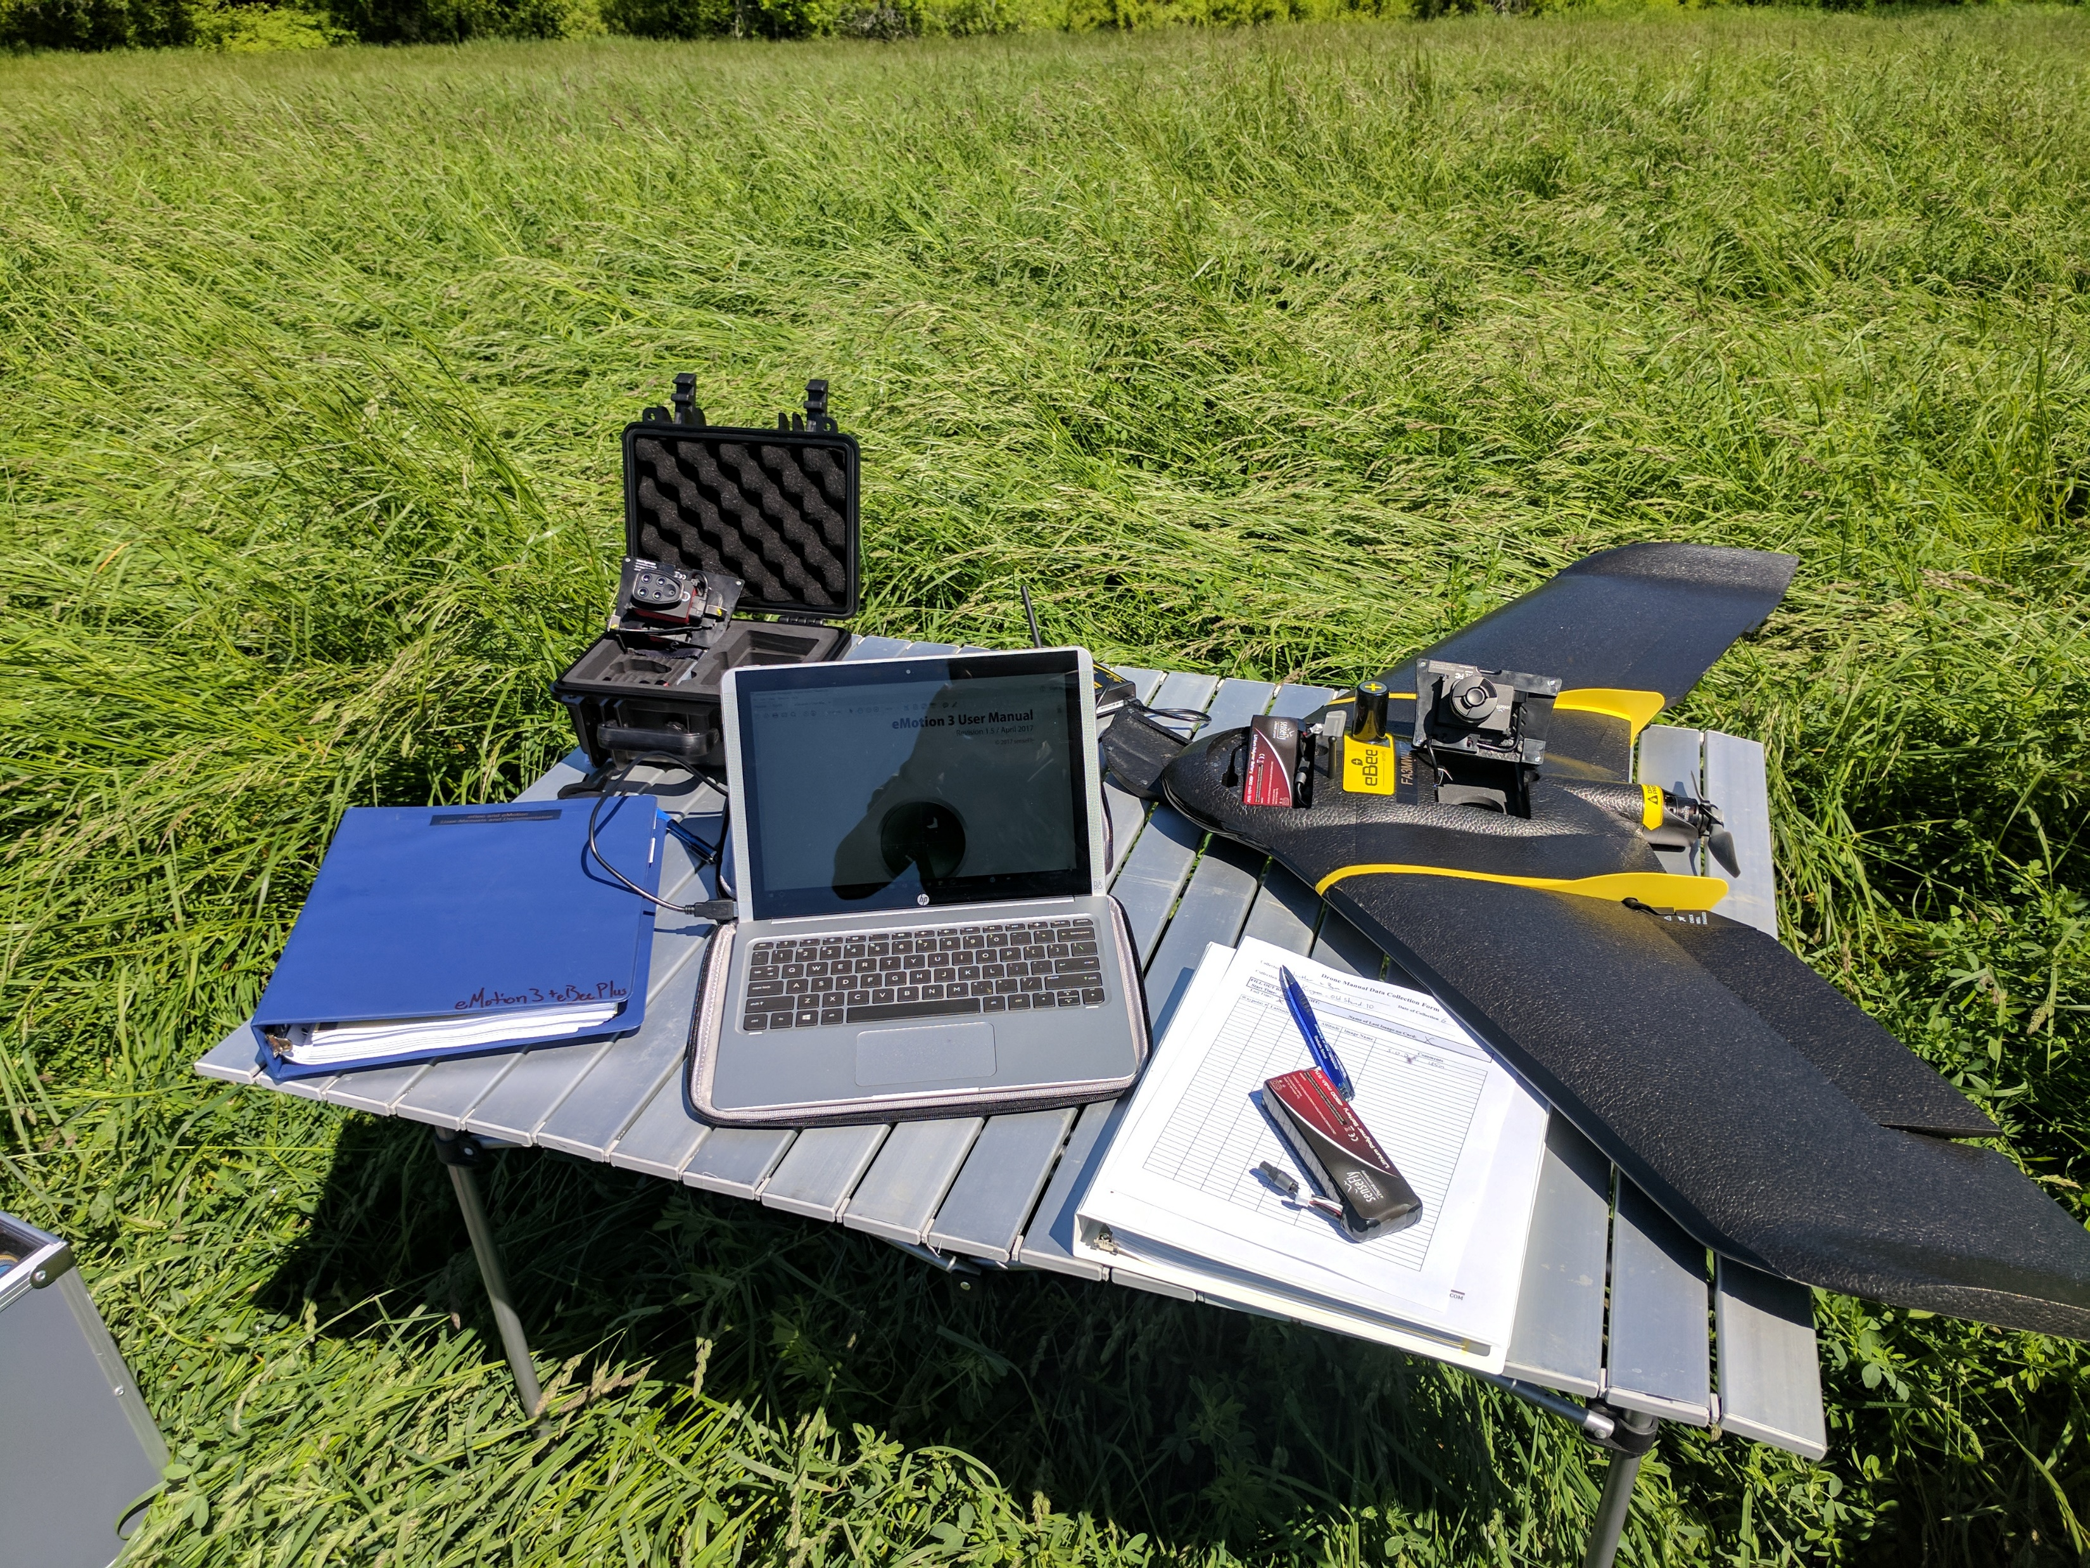
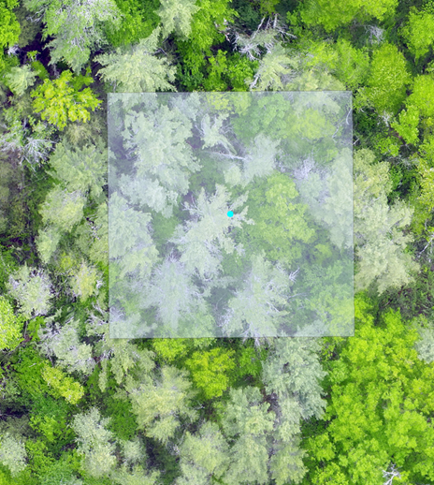
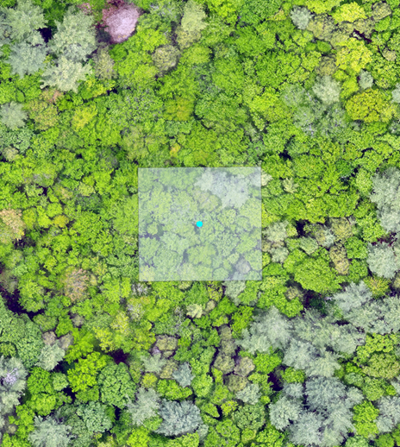
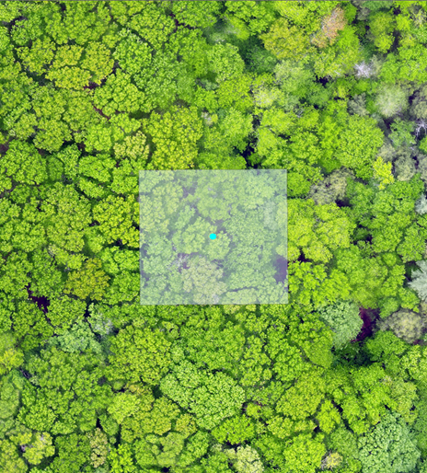
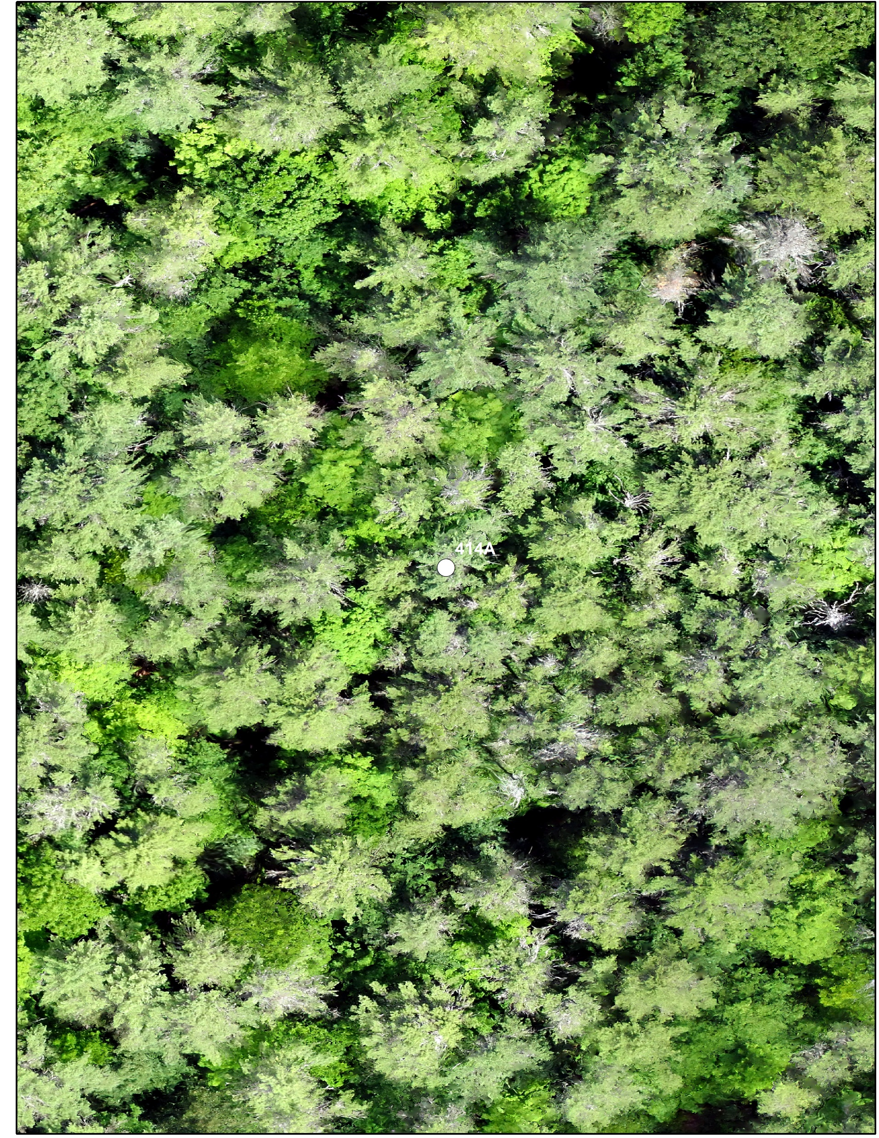
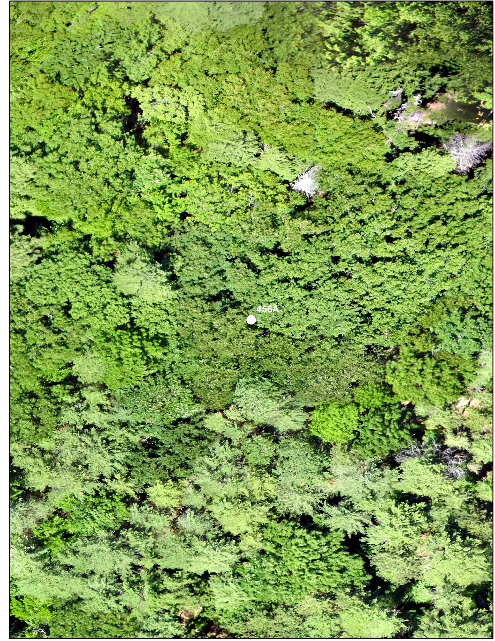
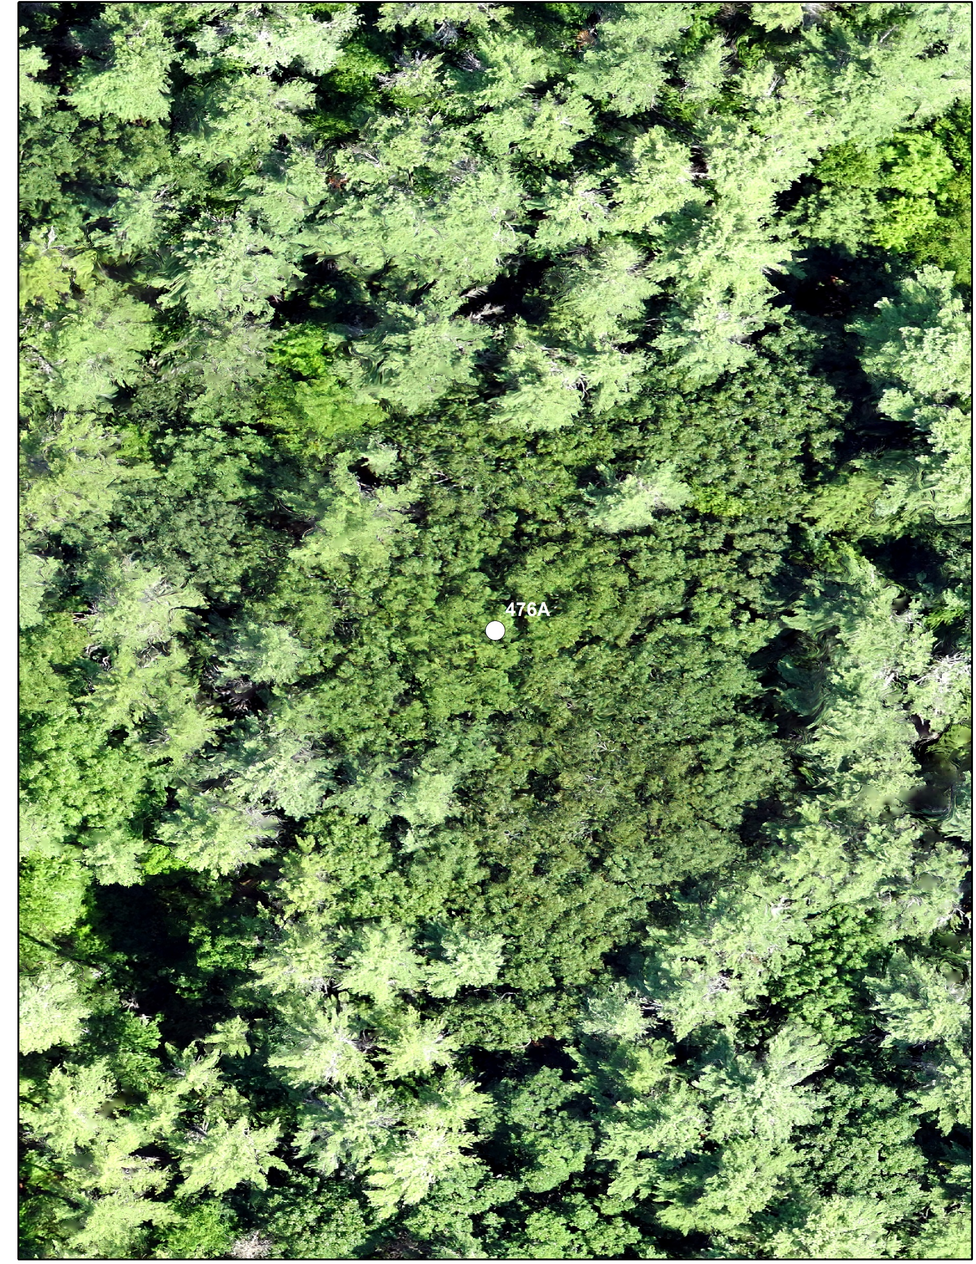
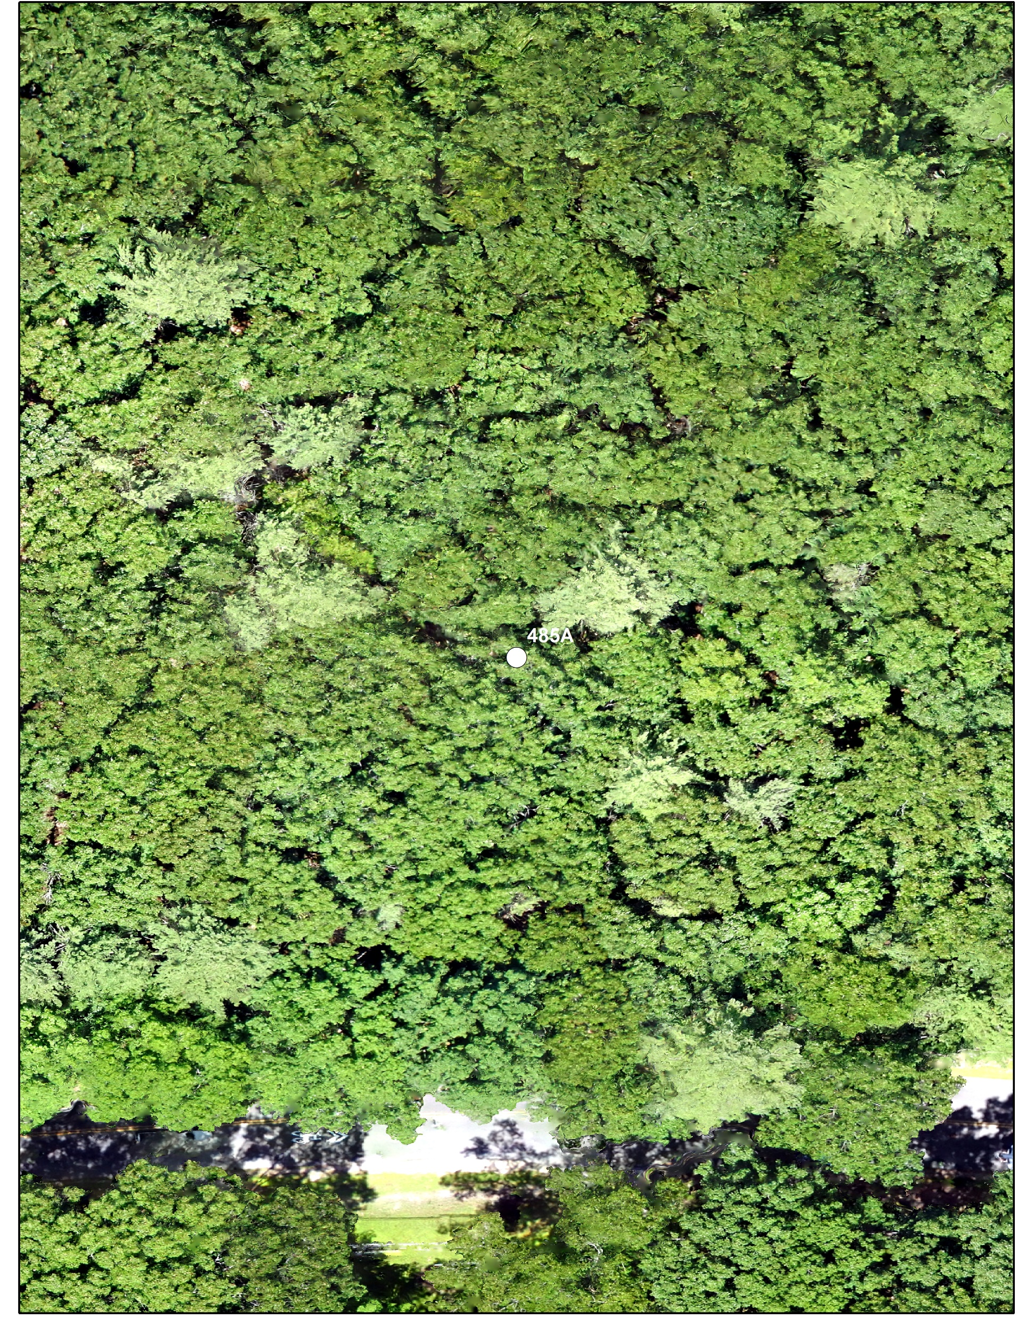
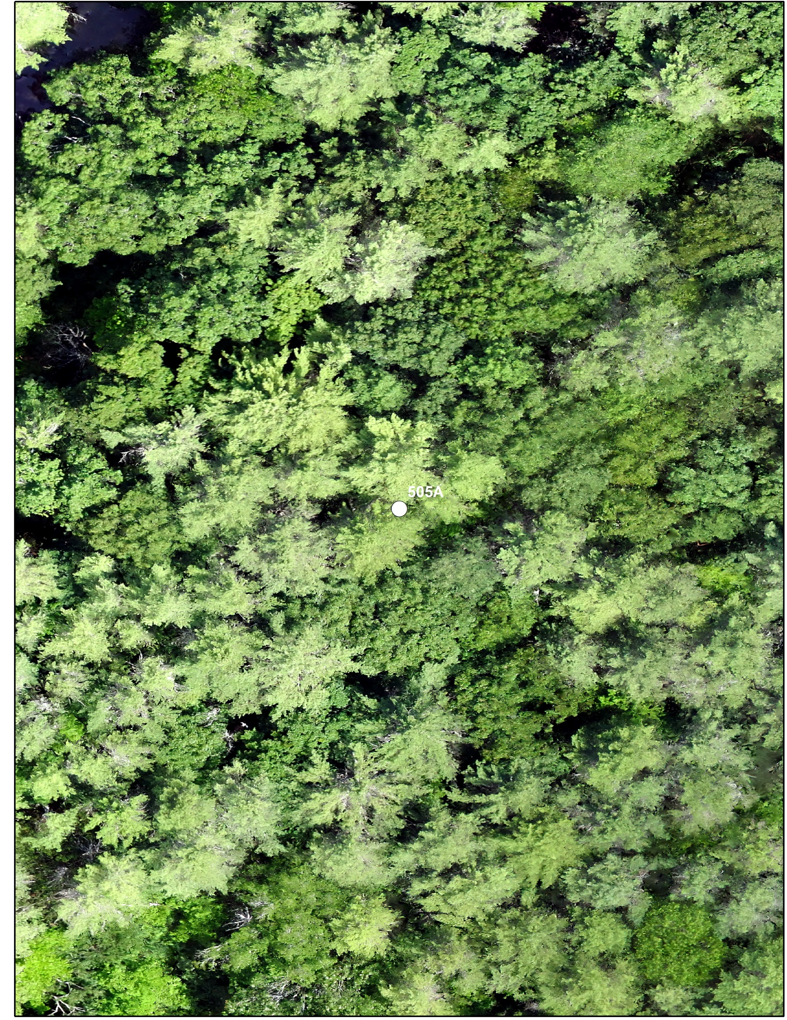
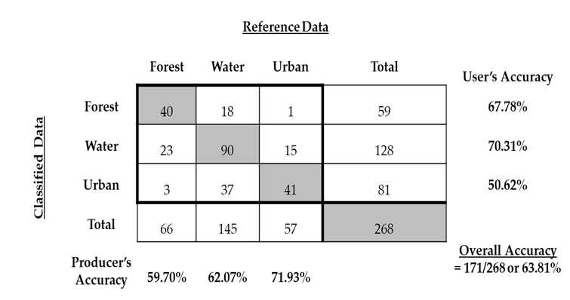
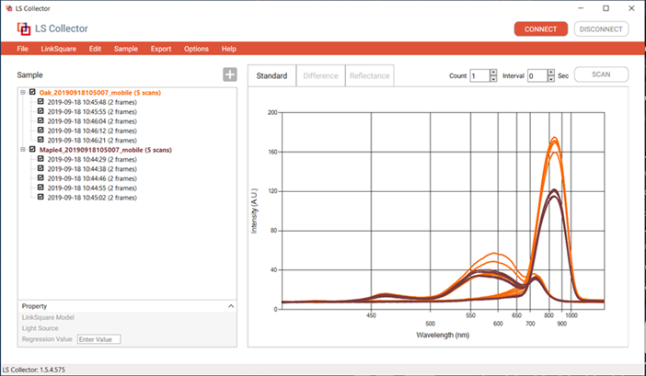
Characterizing Forest Stands Using Unmanned Aerial Systems (UAS): Evaluating Forest Attributes and Ecological Health
D
Department of Natural Resources & the Environment
Basic and Applied Spatial Analysis Lab
Research Objectives
Chapter I
Chapter II
Chapter III
Chapter I
1. Quantify the classification agreement between ground-based reference data and UAS reference data
2. Determine if UAS reference data provides statistically different results from conventional remote sensing platforms
3. Document sources of uncertainty in collecting reference data in using UAS.
Chapter II
Establish a confidence interval for forest stand biometric estimates derived from UAS models
a. Calculate stand density using basal area and trees per acre by species.
b. Compare estimates to Continuous Forest Inventory (CFI) plot measurements.
2. Assess the detection of ‘large’ living and dead trees as economic and ecological indicators of forest condition.
Chapter III
1. Determine the proficiency of UAS for classifying forest health at the forest stand, individual tree, and branch scale.
2. Calibrate the spectral response of UAS models for healthy and degraded individuals of select species
a. These include Oaks, Hemlock, White Pine, Ash, Red Maples, and American Beech
Unmanned Aerial Systems (UAS) can expand field-inventories and traditional remote sensing to help land managers understand the complex forest stand composition, structure, and health of our local landscapes.
Quantifying the potential of Unmanned Aerial Systems (UAS) for collecting thematic map accuracy assessment reference data of complex forest communities
Estimating Primary Forest Attributes and Rare Community Characteristics using UAS: An Enrichment of Conventional Forest Inventories
Monitoring and Managing Fine-Scale Forest Change, Stress, and Disturbance using UAS-SfM Multispectral Models. A Case Study for both Natural and Developed Areas.
Field Data
Field Data
Field Data
Continuous Forest Inventory (CFI) plots (left) record species, and diameter at breast height (dbh), which is then aggregated to delineate natural forest communities (forest types) (right)
CFI measured trees and large trees (>40cm dbh) are remeasured and precisely located (upper) to calculate stand level attributes (lower).
Ocular (visual) assessments (left) and handheld spectrometers (right) of both healthy and degraded trees represent common field based forest health methods.
Remote Sensing Data
UAS Data
DJI Inspire 2 quadcopter UAS (left) assists image capture in more constrained environments.
Natural color (left) and multispectral (lower) image models can be visually interpreted or digitally classified to determine forest (or tree) health
2018 NH National Agriculture Imagery Program (NAIP) (left) and Google Earth (right) imagery used as reference data via image interpretation
UAS Data
UAS Data
Individual trees within high-spatial resolution UAS models are delineated. Using crown diameter and crown area stand attributes are calculated and large trees are classified.
SenseFly eBee+ UAS and spatial models for Coniferous, mixed, and deciduous cover types
Evaluation
Evaluation
Evaluation
Average basal area, stem density, and tree density estimates (and confidence) for UAS models are compared to ground data.
UAS large tree detection is compared to CFI plot density estimates.
College Woods spatial model (orthomosaic) generated from over 2,500 natural color images (above). Images collected using eBee+ UAS. Individual CFI plot locations (below model) show greater detail. Final spatial resolution ~3.3cm. One of 13 properties captured.
Thematic map accuracy assessment error matrix and kappa analysis
Spectral responses for healthy and degraded individual trees will be analyzed to determine their separability.
Benjamin T. Fraser and Dr. Russell G. Congalton Natural Resources and Earth Systems Science (NRESS) Ph.D. Btc28@wildcats.unh.edu

