Slide 1

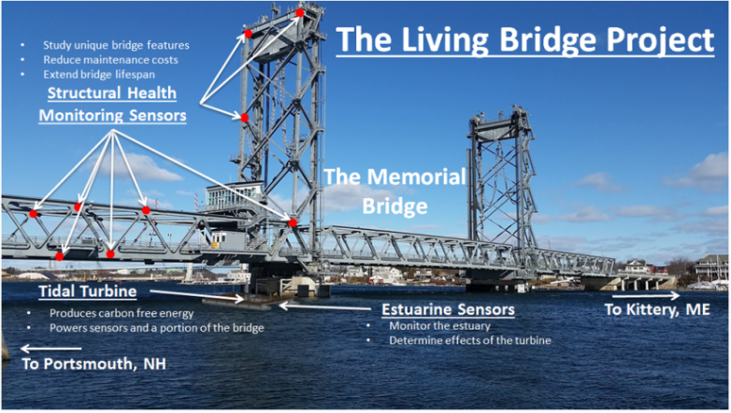
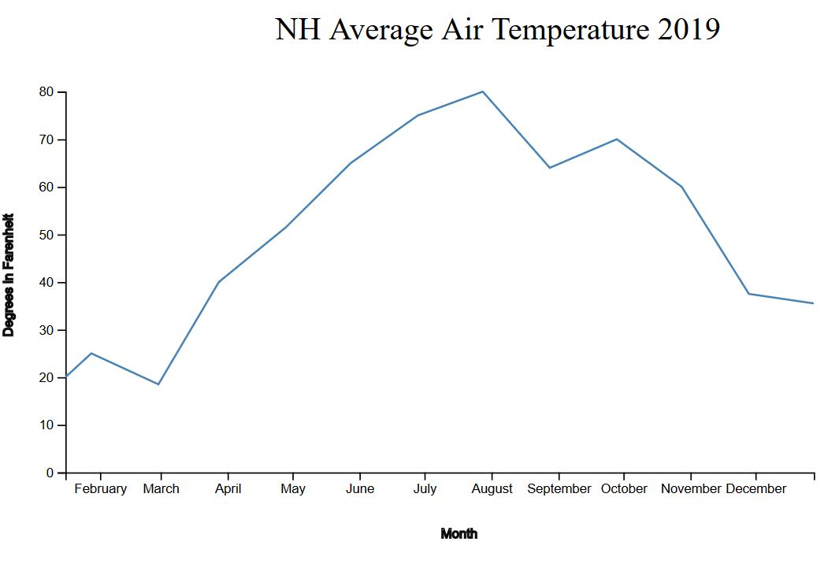
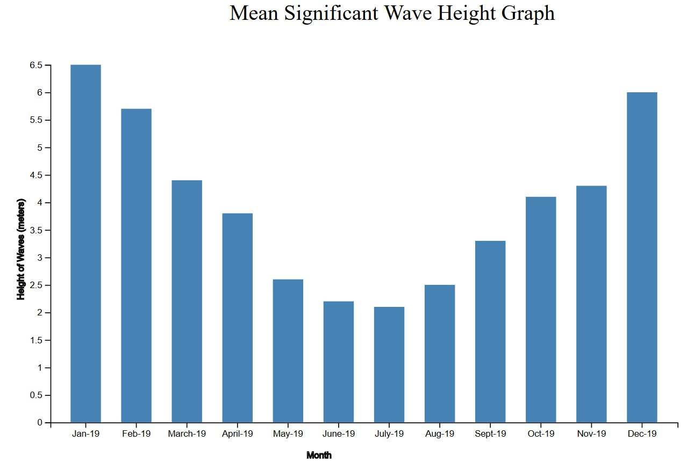
The Living Bridge Project:
Database and Data Visualization Study
Anthony Rocchio, Chaitanya S. Bista & Brian Landolt
Department of Information Technology, University of New Hampshire
Introduction
Background
The project is focused on building a MySQL Database as well as creating visualizations for the Living Bridge Project that will contain data regarding time, temperature, weather patterns, ocean data and more. We are using D3.js which is a dynamic JavaScript Library. This will allow us to visually display data in the form of charts/graphs and overall make the data more understandable and user friendly.
The Memorial Bridge that connects Portsmouth, NH and Kittery, ME, is also known as The Living Bridge. This bridge is outfitted with multiple sensors that can measure almost every aspect of the bridge from water levels to strain. The data this bridge holds can be extrapolated to many other impacts of society and life including infrastructure and environmental impact.
Objectives
Results
Creating a new relational database and insert data
Use visualization tools to display data in multiple forms of charts and graphs
Have data communicate with charts and graphs and be easily editable
Ensure that the data visualization is user-friendly and highly accessible
For the two examples being shown, we created these graphs by using D3.js. The bar graph is showing the average height of waves in the Atlantic Ocean according to month, from the beginning to end of 2019. Whilst the line graph visualization is showing the average temperature by month in New Hampshire during the year of 2019. The data in these can be changed by editing their individual CSV (Comma Separated Value) files. The CSV data acts as input for the models. Data from the database can be taken and utilized for the visualizations we created. The charts and graphs can also be employed as a groundwork for multiple purposes by tweaking minimal code and editing the CSV file.
References
Contacts
.
      For more information contact:
      Dr. Erin Bell: erin.bell@unh.edu
      Prof. Martin Wosnik: martin.wosnik@unh.edu
https://livingbridge.unh.edu/
https://www.kaggle.com/
**All data used is from simulated data

