Slide 1

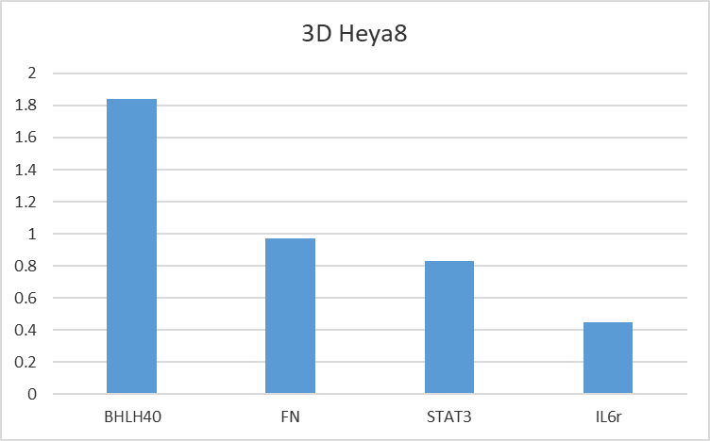
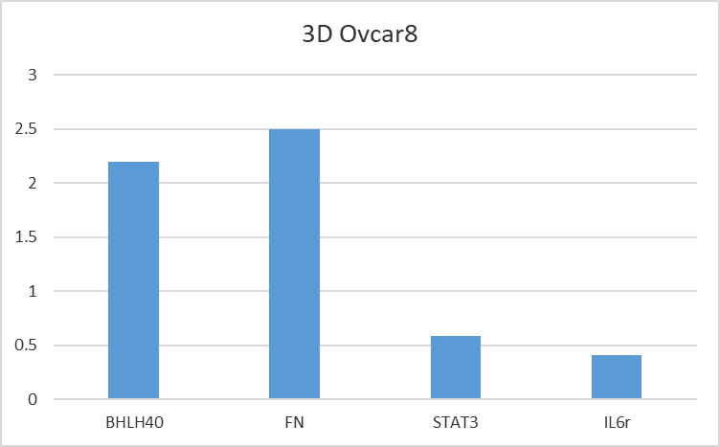
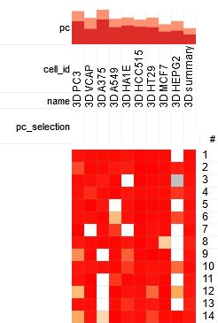
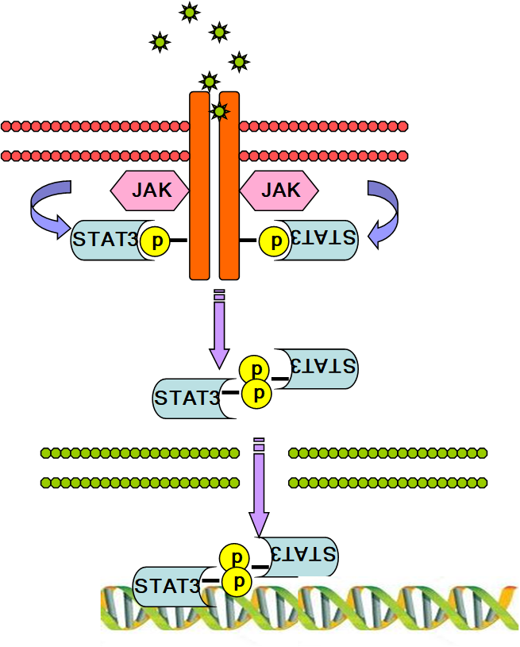
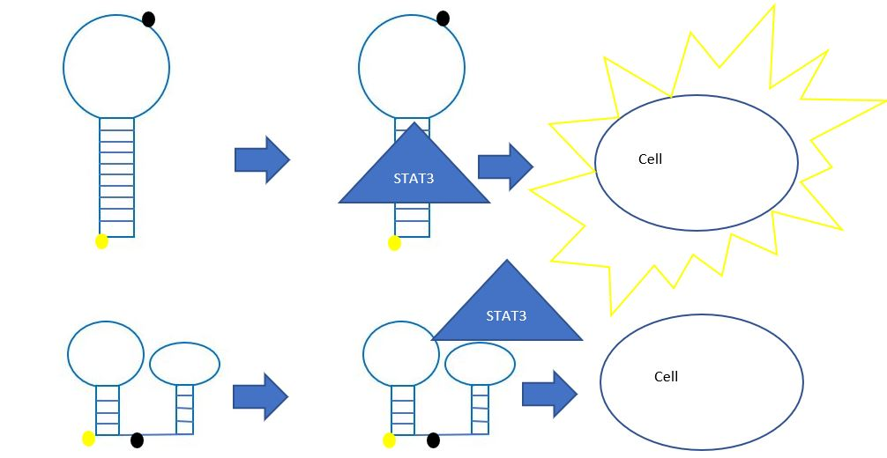
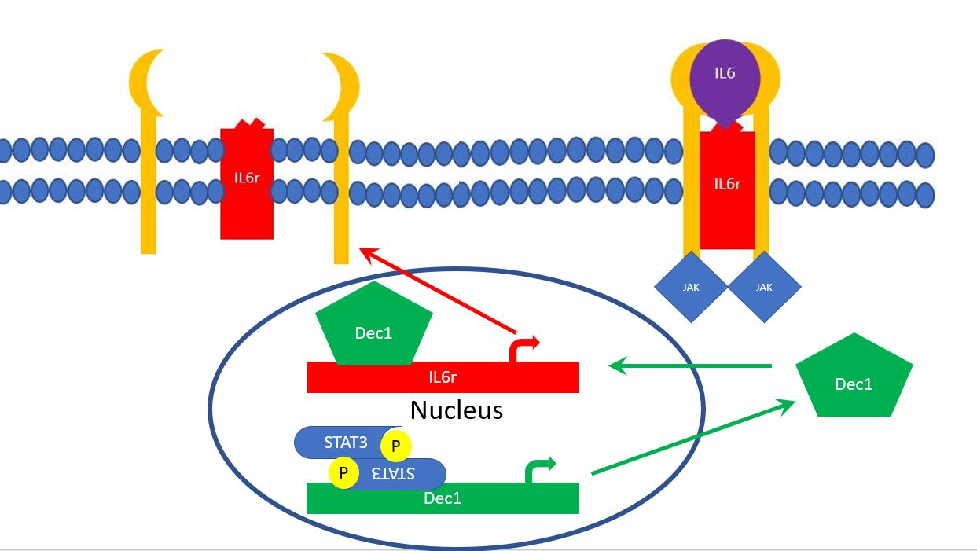
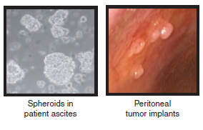
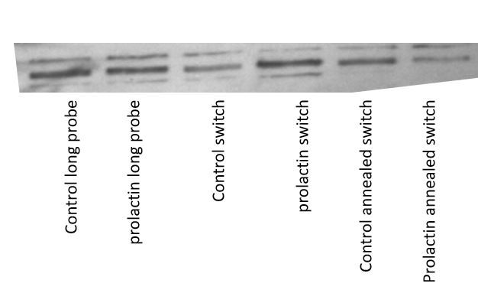
Dec1 and STAT3 in Ovarian cancer
Brendan Reilly and Sarah Walker
The University of New Hampshire, Department of Molecular and Cellular Biology
Ovarian cancer
Dec1 overexpressed in 3D
Discovering Treatments
Ovarian cancer is difficult to detect and as a result ovarian cancer is often diagnosed after it becomes metastatic. Because of late stage diagnoses ovarian cancer has a low 5-year survival rate and causes around 14,000 deaths of women in the United states each year. Understanding the roles that transcription factors play in proliferation and survival of ovarian cancer may lead to more targeted therapies in the future. One transcription factor of interest is Signal Transducer and Activator of Transcription 3 (STAT3). STAT3 hyperactivation is seen in roughly 70% of cancers including ovarian, and is known to target a variety of genes associated with survival and proliferation of cancer cells. STAT3 regulates many genes, including transcription factors like Dec1 (bHLHe40), both of which may play a role in cancer progression.
Figure 7: Clue results for 3D gene signature. Red indicates how close the expression matches the gene signature. Numbers correlate to different treatments effecting gene expression. Clue is a tool available from the Broad Institute and takes inputs of gene lists that are either upregulated or down regulated in the condition of interest.
Jak-STAT3 signaling pathway
Figure 3: gene expression in Heya8 and Ovcar8 cells grown in 3D. Cells were grown in culture plates (for 2d growth) and in low adhesion plates (for 3d growth). Both sets of cells were then harvested and RNA was isolated. Using qPCR gene expression was measured, standardized to an actin control, and relative expression of the 3D grown cells was compared to those grown in 2D. Here we see BHLHe40 (Dec1) is expressed more when Heya8 and Ovcar8 cells are grown in 3D compared to 2D.
Monitoring STAT3 activation
Figure1: Depiction of STAT3 activation pathway. A receptor is activated by its cytokine allowing it to recruit JAK to phosphorylate STAT3. STAT3 can then enter the nucleus and affect transcription.
Figure 4: Ovcar8 cells grown in 3D with knockdown of STAT3 and identified STAT3 genes: Dec1, CD44, TNFRS1A, UGCG, PXN and KLF6. Data was acquired through qPCR and values are expressed in relative value compared to a knockdown control (siCTLA). Data courtesy Sarah Lecroix.
Figure 5: Knock downs of Dec1 and IL6R decrease levels of P-STAT3. Data provided by Dr. Sarah Walker.
Figure 8: Depiction of a Molecular switch for STAT3. The switch uses a fluorophore and a quencher molecule when the quencher is near the fluorophore no light is emitted. The DNA probe is designed to fold in two possible confirmations, “on” and “off”. STAT3 should bind the probe in the “on” conformation stabilizing it and driving the equilibrium in that direction. By having more switch in the “on” conformation the fluorescence should increase indicating an increase in STAT3 activation. We will also will be designing a switch for Dec1 to test its activity.
In late stage ovarian cancer cells split off from the primary tumor forming spheres of cells that can then implant on other tissues. We model this by growing our cells in low adhesive plates to grow spheres in 3D.
Monitoring STAT3 activation
Future Plans
-Transfect Switch into cells
-Test drugs from Clue effect on 3D cells using Viability assays
-Use switch to test if drugs effect on STAT3 and Dec1 activity
Figure2: images of both spheroids in ascites fluid and implanting on the Peritoneal wall. Tong et al. 2015
Figure 6: Proposed Dec1 STAT3 feed back loop. Here IL6 binds to the IL6r leading to the recruitment of JAK. JAK then phosphorylates Stat3, activating STAT3 and causing it to affect transcription. STAT3 causes the transcription of Dec1 which in turn causes the transcription of IL6r allowing for more STAT3 activation to occur.
Figure 9: Western blot of a pulldown assay using probes bound to biotin. The STAT3 switch is called switch in this blot The switch binds Stat3 more after prolactin stimulation.
Supported by an Institutional Development Award (IDeA) from the National Institute of General Medical Sciences of the NIH under grant number P20GM113131.

