Slide 1

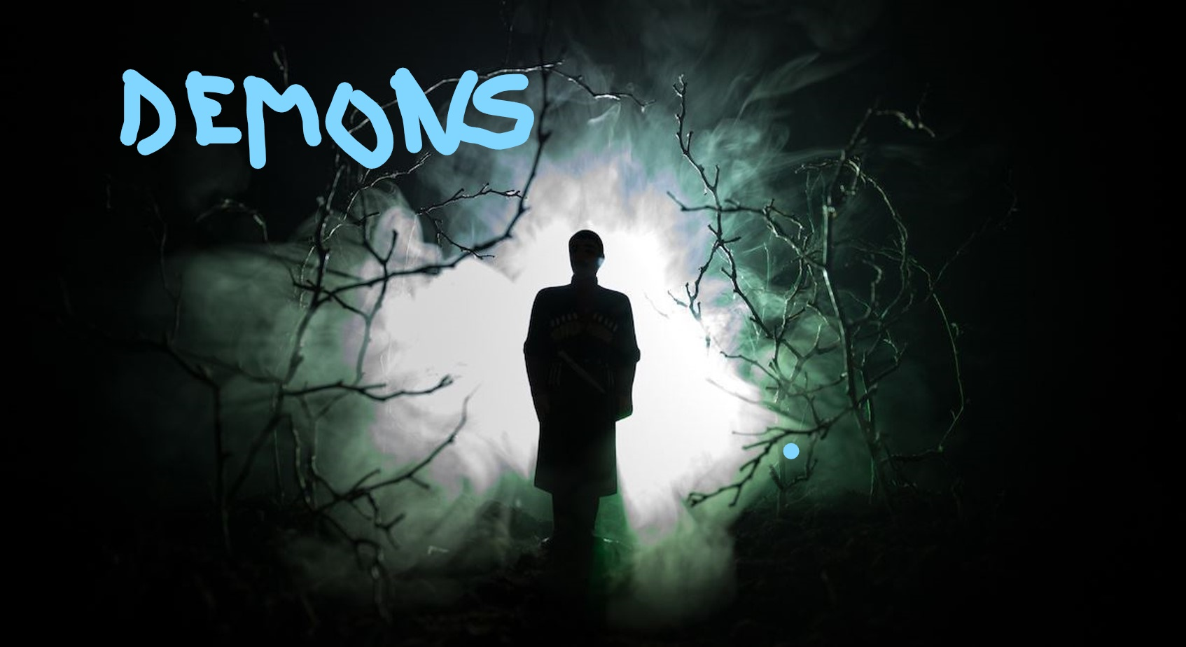
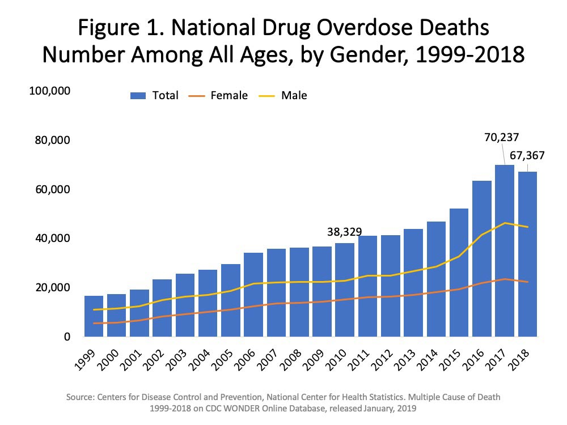
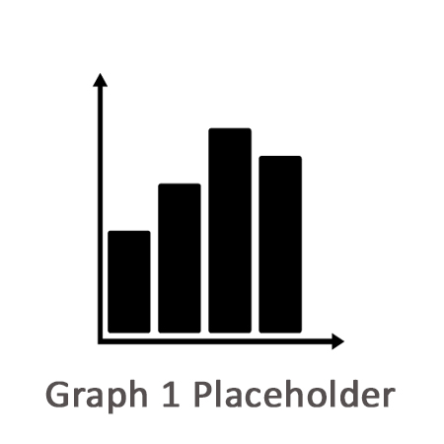

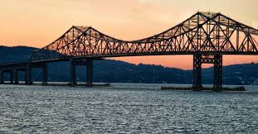
Demons
By Douglas J. Rodoski
Results discussion goes here
When the locale power structure throws up obstacles to hinder Nick’s inquiries, Nick takes matters in to his own hands, and there is a violent confrontation with local thugs. When the dust settles, and it looks like the perpetrators of Nick and Tom’s past hauntings are held accountable, an old adversary steps out of the shadows to confront Nick, and demands a reckoning.
In Demons, I use the template of old style detective fiction to address cotemporary issues.
………...
Image 1 – Caption
Background text goes here.
More discussion
Image 2 – Caption
Who in the audience at least knows of someone struggling with opioid addiction? It makes you angry, doesn’t it, that there is someone out there profiting from the suffering of others.
When
Arriving in town to visit his friend Tom, Nick is assisted by Tom’s sister, Kayla. Nick is haunted by obscure nightmares that hint at a childhood trauma that might also be the source of Tom’s depression and drug abuse. Nick,with the help of Kayla, remembers an old childhood hockey coach who is now a successful pharmacist and politician. The old coach has a past he is keen to keep hidden.
Do you know who else is angered by it? Returning Iraq veteran Nicholas Stryker. Nick travels to the scenic mid-Hudson Valley locale of Silver Spring to assist a childhood friend who has been in rehab.
Image 3 –ee Cption

Slide 2

This poster template provided courtesy of
UNH ESRC Poster Printing Services
Trust us to make your poster look GREAT!
Website: http://posters.unh.edu
Poster Guide: http://goo.gl/1E7TJY
DELETE THIS SLIDE BEFORE PRINTING

