Slide 1


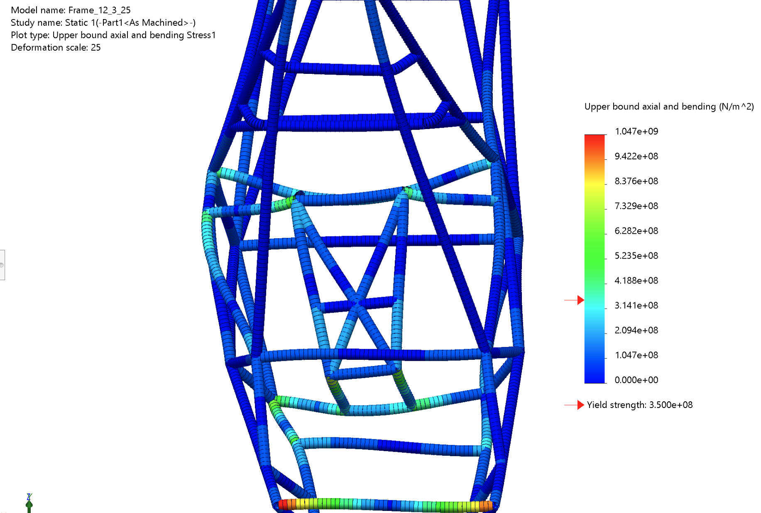
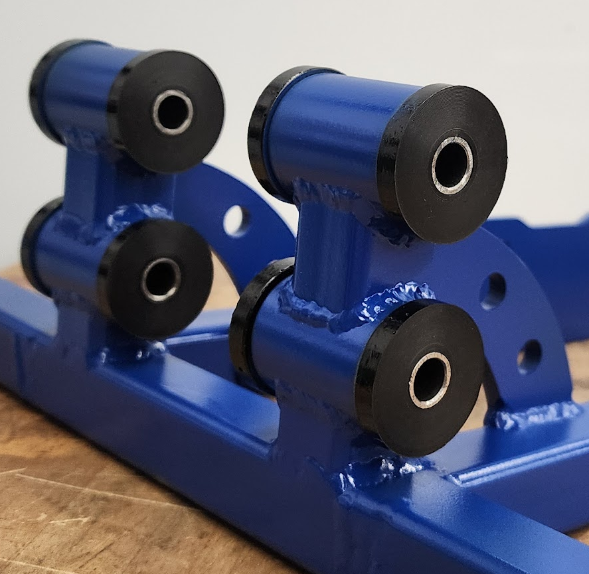
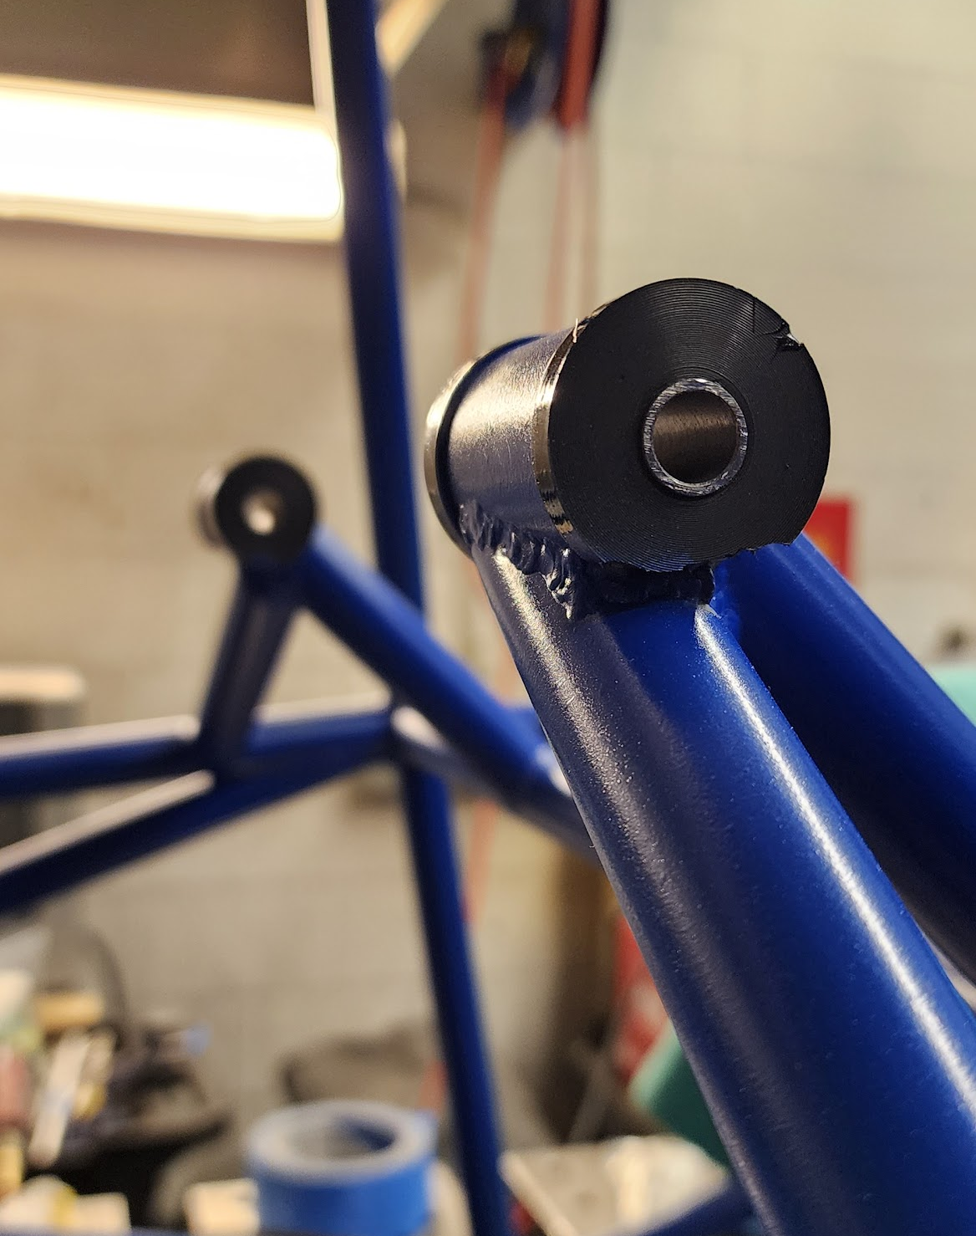
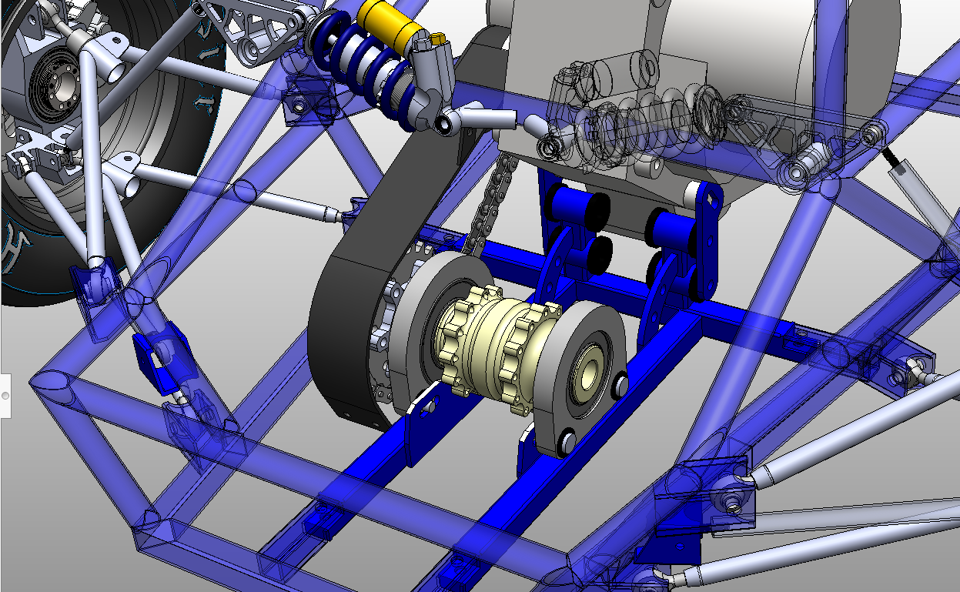
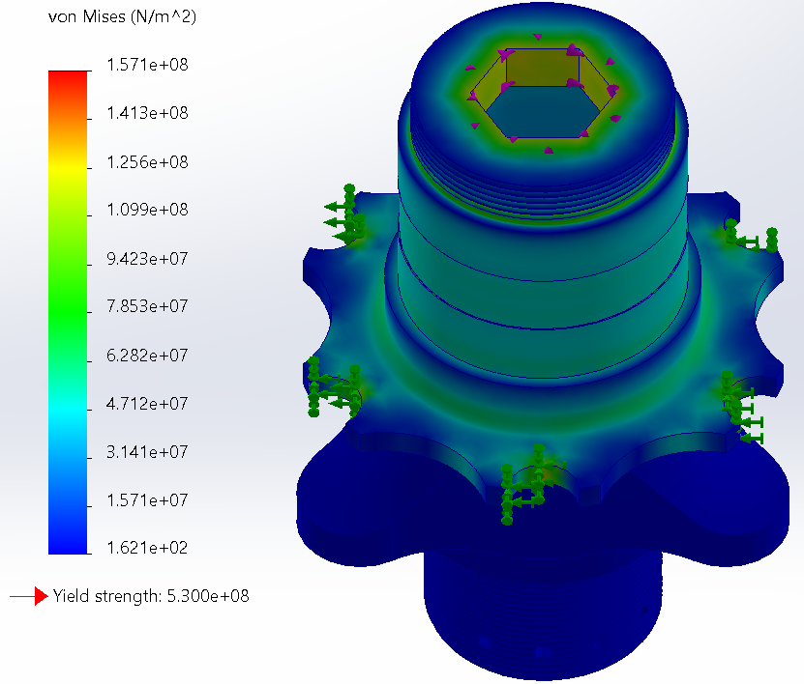
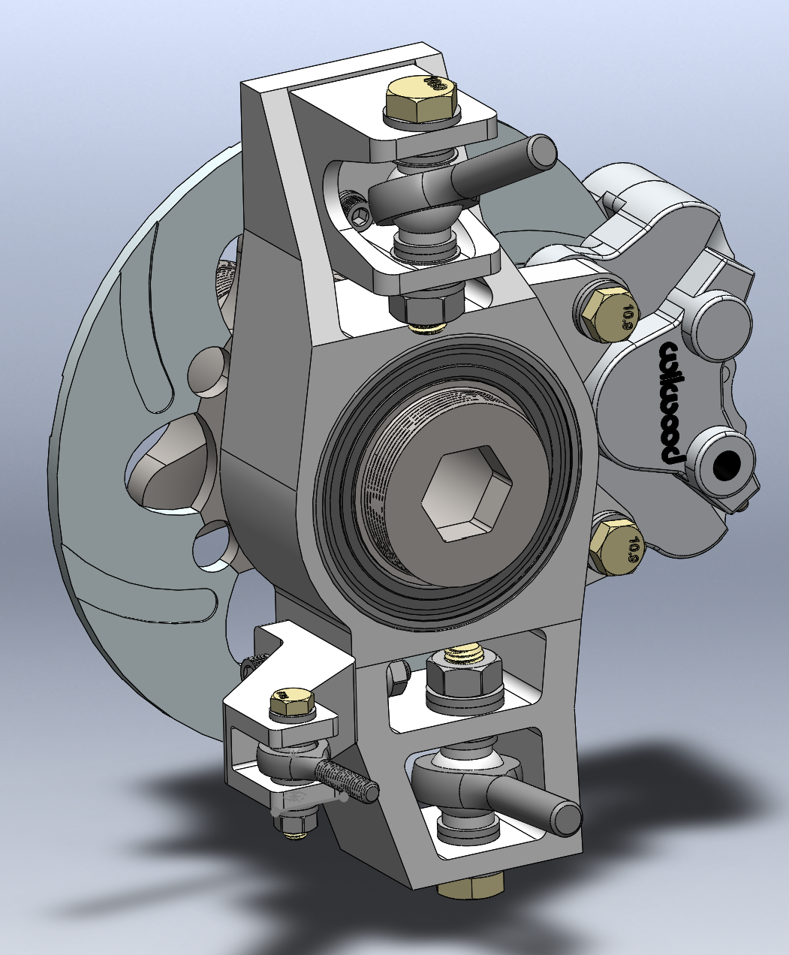
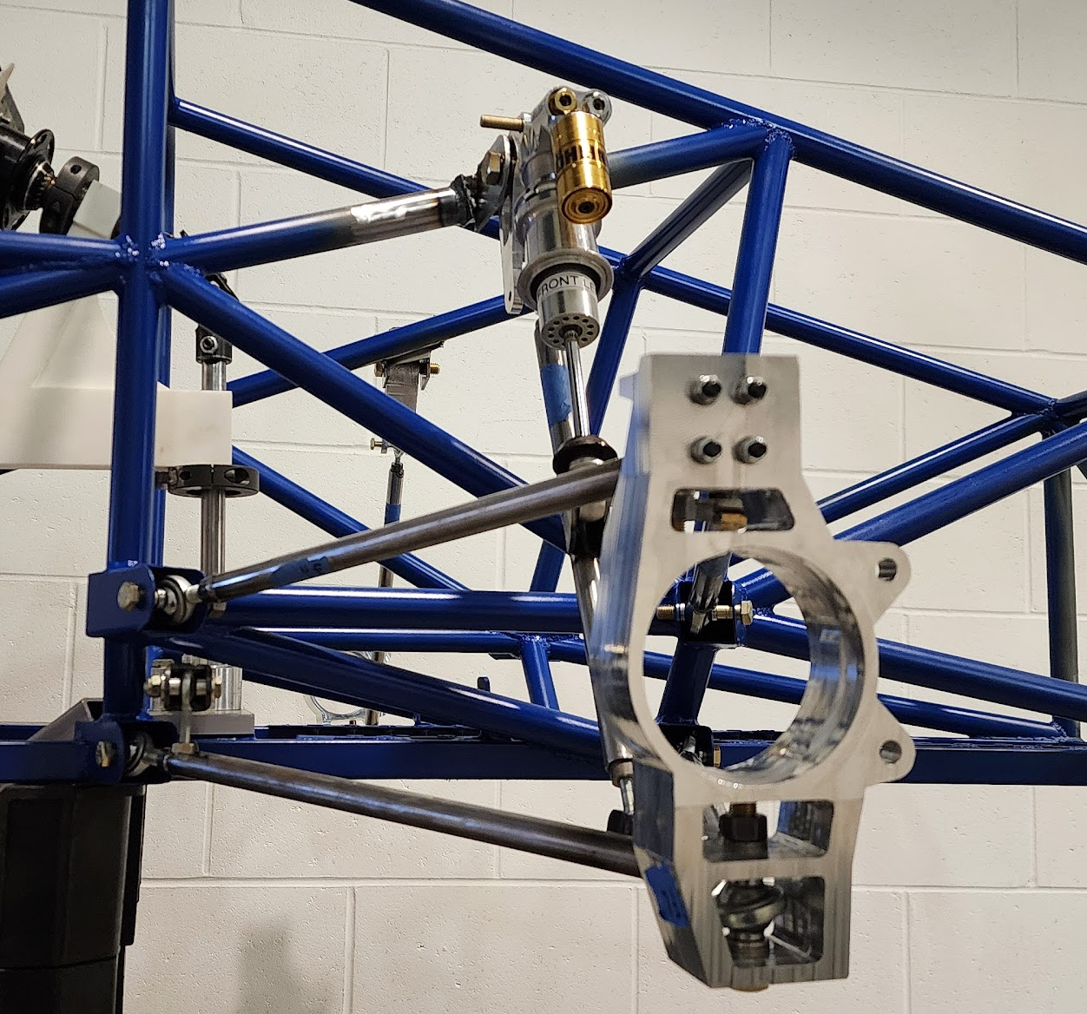

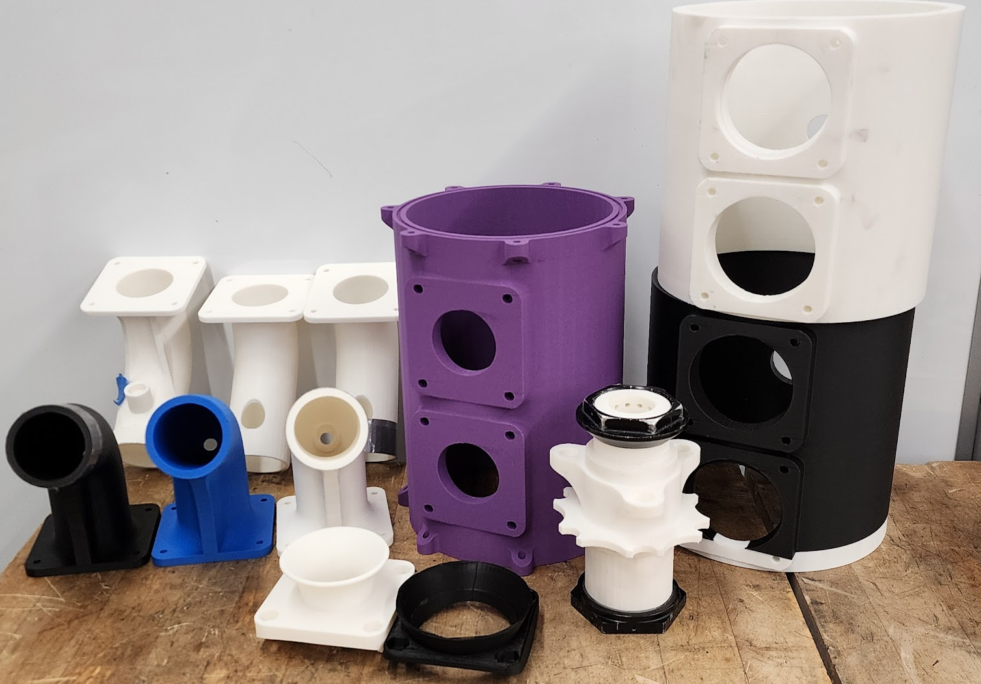
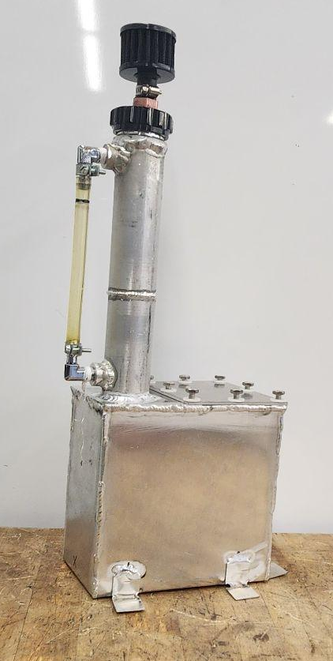
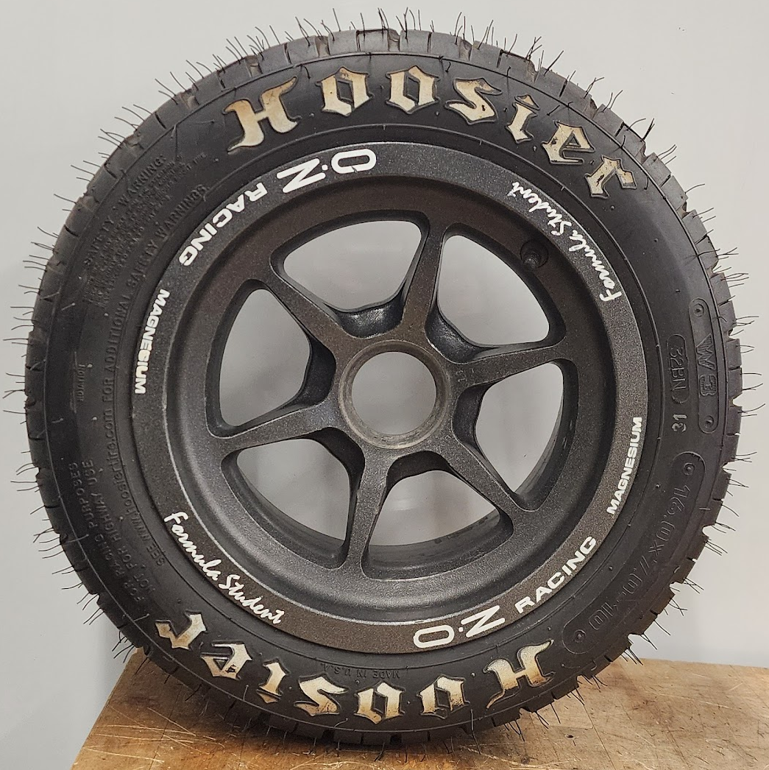
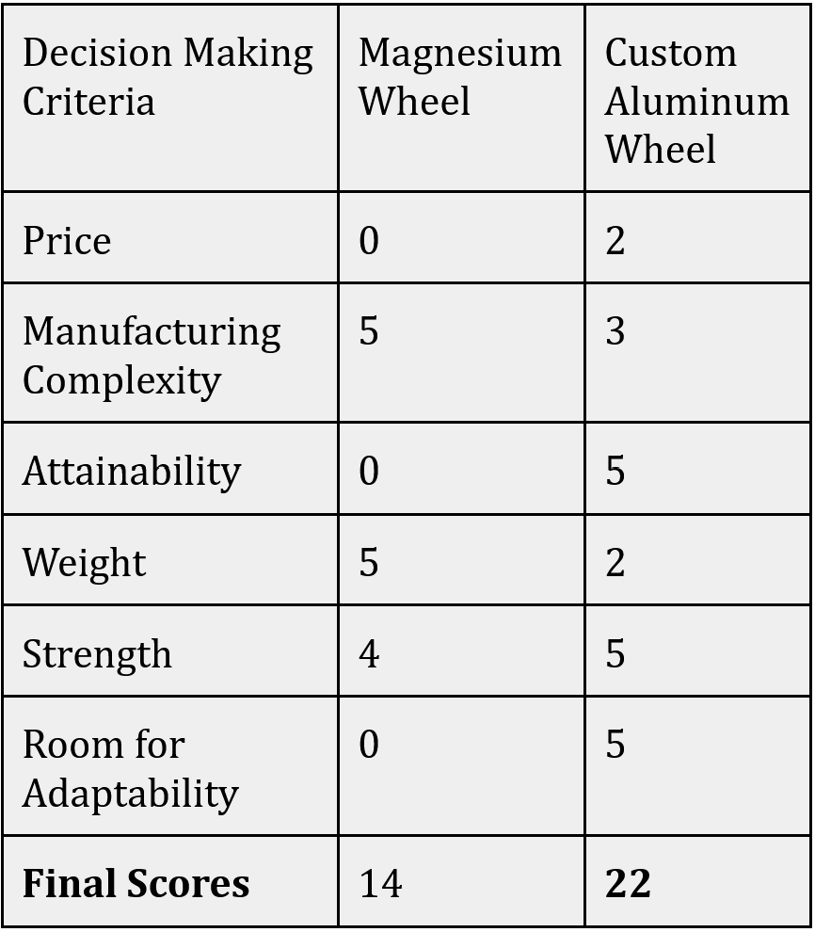
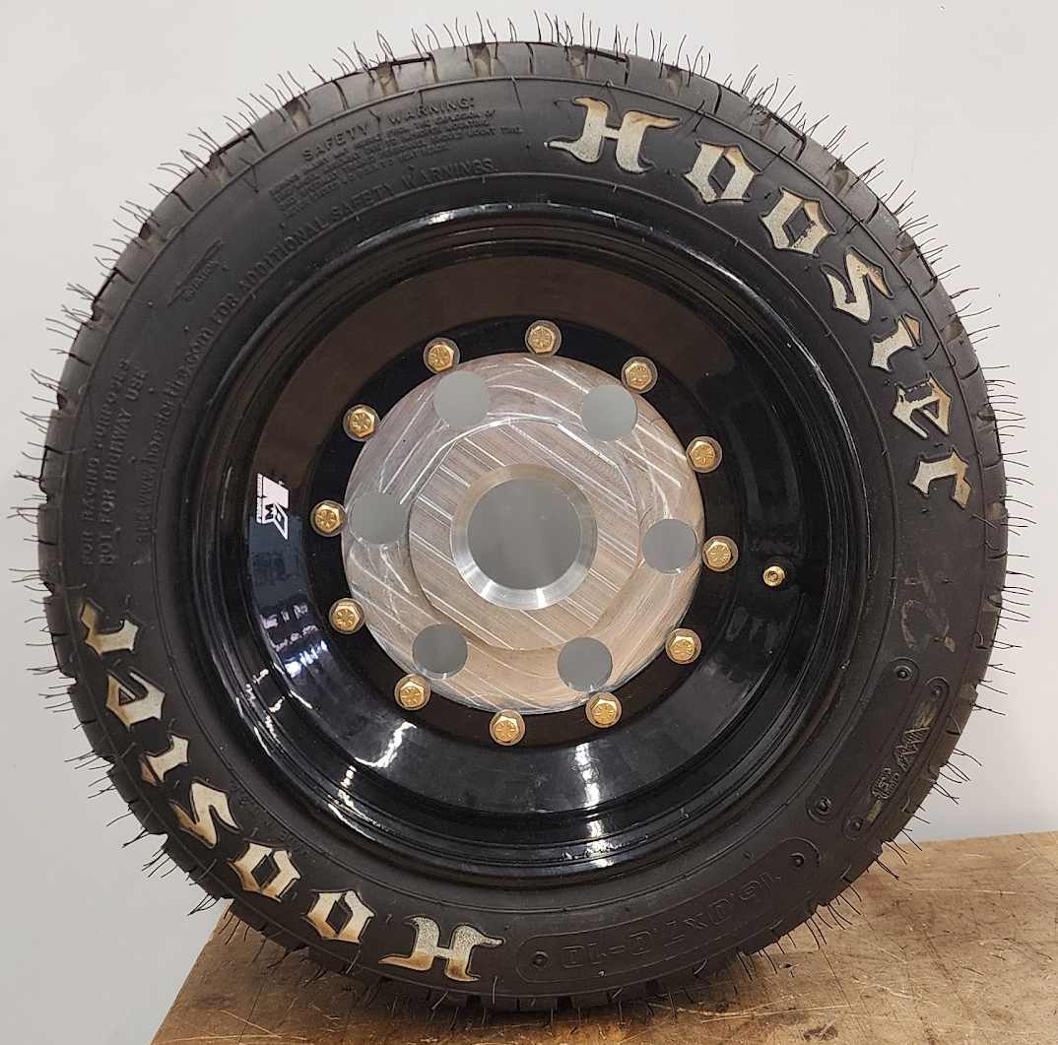
UNH Precision Racing ~ Powertrain Team
Jonathan Dean, Sam Harms, Matt McCoy, Josh Lesniak, Joe Aubut
College of Engineering and Physical Sciences, University of New Hampshire, Durham, NH 03824
Faculty Advisors - Elvis Marin, Juan Carlos Cuevas Bautista
Introduction
Engine Mounting
Acknowledgements
As UNH Precision Racing’s Powertrain Team, our goal is to develop an engine and drivetrain system for ⅔ scale Formula-style race car to compete in a competition held by the Society of Automotive Engineers (SAE) in Michigan this May.
Our project, guided by the specifications listed in the SAE competition rulebook, is presented under the premise that the vehicle will be sold and marketed as a “weekend warrior” race car for a novice to intermediate driver, so our design focuses on reliability, ease of maintenance, and safety.
Initial Concepts and FEA Analysis
Implementation
We would like to thank:
Scott Campbell
Noah McAdam
Matthew Yates
Elvis Marin
Ben Mitchell
Nathan Daigle
Nick Fischer
Will Donovan
James Puopolo
Future Work
Leading up to our competition in May, we’ll continue to refine our intake system design, fabricate the exhaust, and assemble cooling system components; most of which are off the shelf parts. During the design phase, areas within the engine bay were reserved for these systems, which now can be installed
One of our primary goals was to establish a solid platform for future teams to build upon. This is the most advanced powertrain system ever fitted to a UNH FSAE car, and we’ve worked very closely with underclassmen to ensure the principles laid out in our design are carried forward. There will be continuous optimizations for weight and strength as the system matures.
Initial SolidWorks simulations for concept engine mounts
Used to gain insight on load distribution, ideal locations
Final lower engine mounting
Final upper engine mounting
Powertrain System - Isometric View
Suspension & Power Delivery
Results
Redesigned Spindles
Structural analysis allowed us to determine optimal locations for engine mounts, evaluating load transfer to frame to ensure adequate strength. For vibration damping, a minimum of 0.25” of polyurethane isolates the system at all engine and chassis connections. Our differential mounts with custom in-house bushings solve space constraints while reducing chain-transmitted vibrations. 3D printing was used for precise custom fixtures, as well as rapid prototyping of the intake assembly. Basic geometry was evaluated in early iterations, with later iterations adding fuel system mounting, sensors, structural reinforcements, and connection points.
Our new spindles allow for easy rotor removal, reduce the total component count by combining features, and eliminate a critical fracture failure zone at the center-lock threads. The current designs have been optimized with a generous safety factor allowing for additional weight reduction after testing and evaluation in Michigan.
The combined suspension and differential mounting redesign delivered a functional system with no interferences throughout suspension travel. We met our serviceability constraints, using readily available hardware throughout, and incorporated component symmetry to reduce the total design cost and number of unique parts while improving repairability.
SolidWorks assembly tools were used to verify locations of main static systems to confirm clearances and fitment, as well as to evaluate potential interference between adjustable components
SolidWorks FEA simulations allowed us to analyze complex shaped parts such as the spindle under worst case scenario load cases
Front upright assembly
Front suspension on Frame
Specifications
Design Process Methodologies & Other Components
Drivetrain completely isolated from chassis by plastics to reduce vibration-based wear
Driveline interacts properly with adjacent subsystems, including suspension
Removable powertrain crossmember for easy system removal, disassembly, and maintenance with height-adjustable engine mounting and fore-aft adjustable differential mounting
At least four gears usable under 75 mph
All components designed and mounted such that they survive drivetrain forces & impact loading
All driveline components are easy to maintain or replace, and can be serviced with common hand tools and minimal technical knowledge
All powertrain components and designs meet or exceed SAE requirements for competition
Intake System & Rapid Prototyping
Fuel Tank Design
Our team inherited a proprietary, wheel package that we found challenging to obtain replacements for. Similarly to other design challenges, we used a decision matrix to determine if we should either attempt to purchase a wheel, or manufacture our own.
Custom Wheel
Our fuel tank was designed with manufacturing efficiency in mind and incorporated a folded box structure; allowing for easy assembly and minimal final welding. Time was saved by reusing old components such as the filler neck
Purchased Wheel
(Top Right)
Vs. Custom Wheel
(Bottom Right)
Examples of Rapid Iterative Prototyping using team’s Bambu P2S Printer. With it we were able to test fitment of systems connected to non-ridgid parts before committing to a final design

