Slide 1
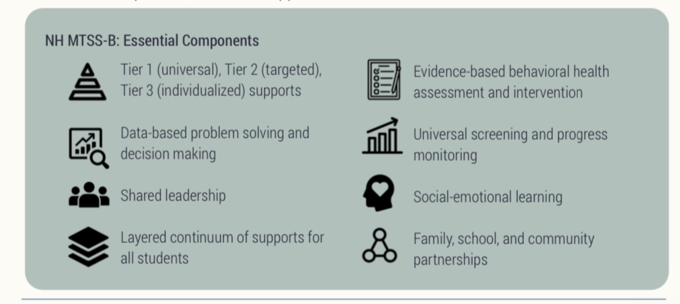
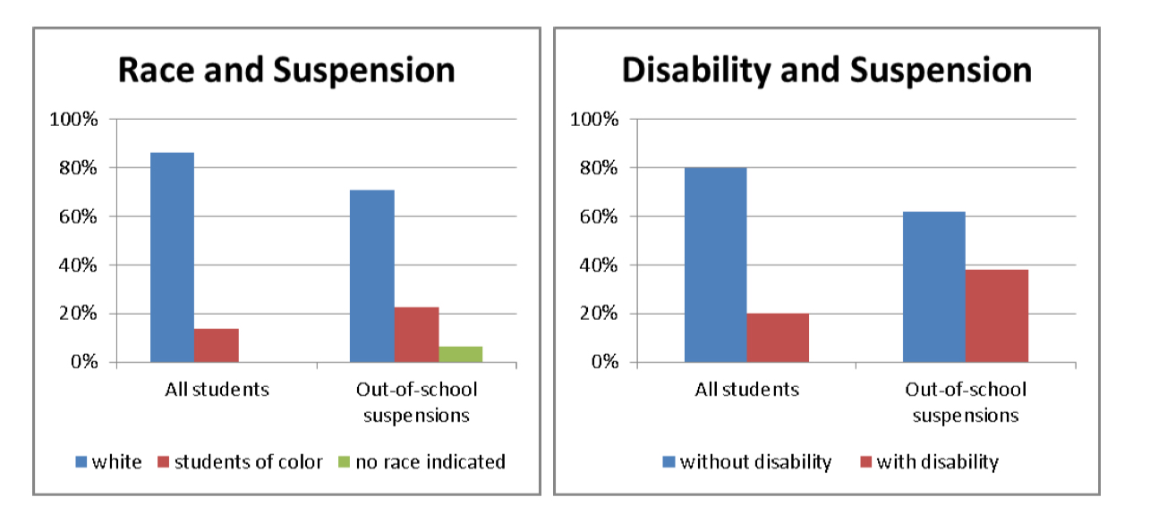
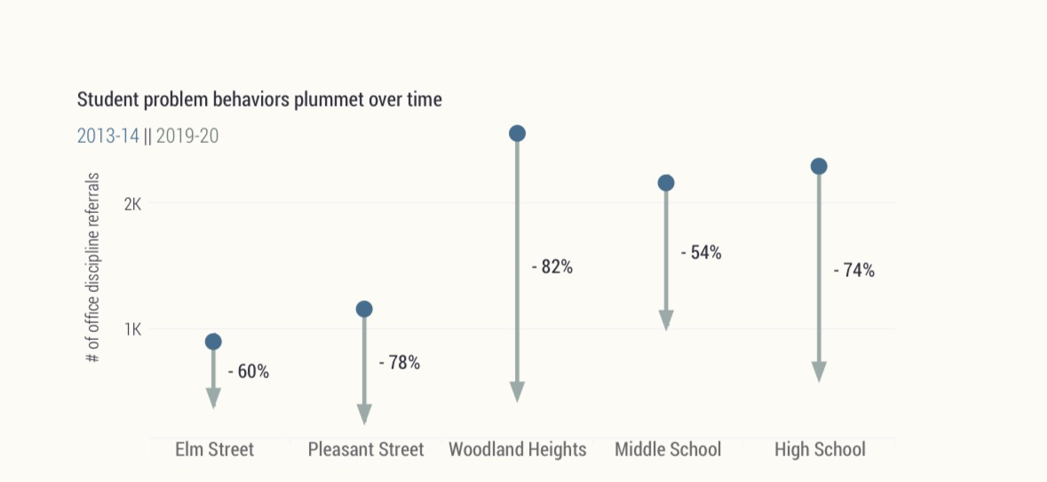

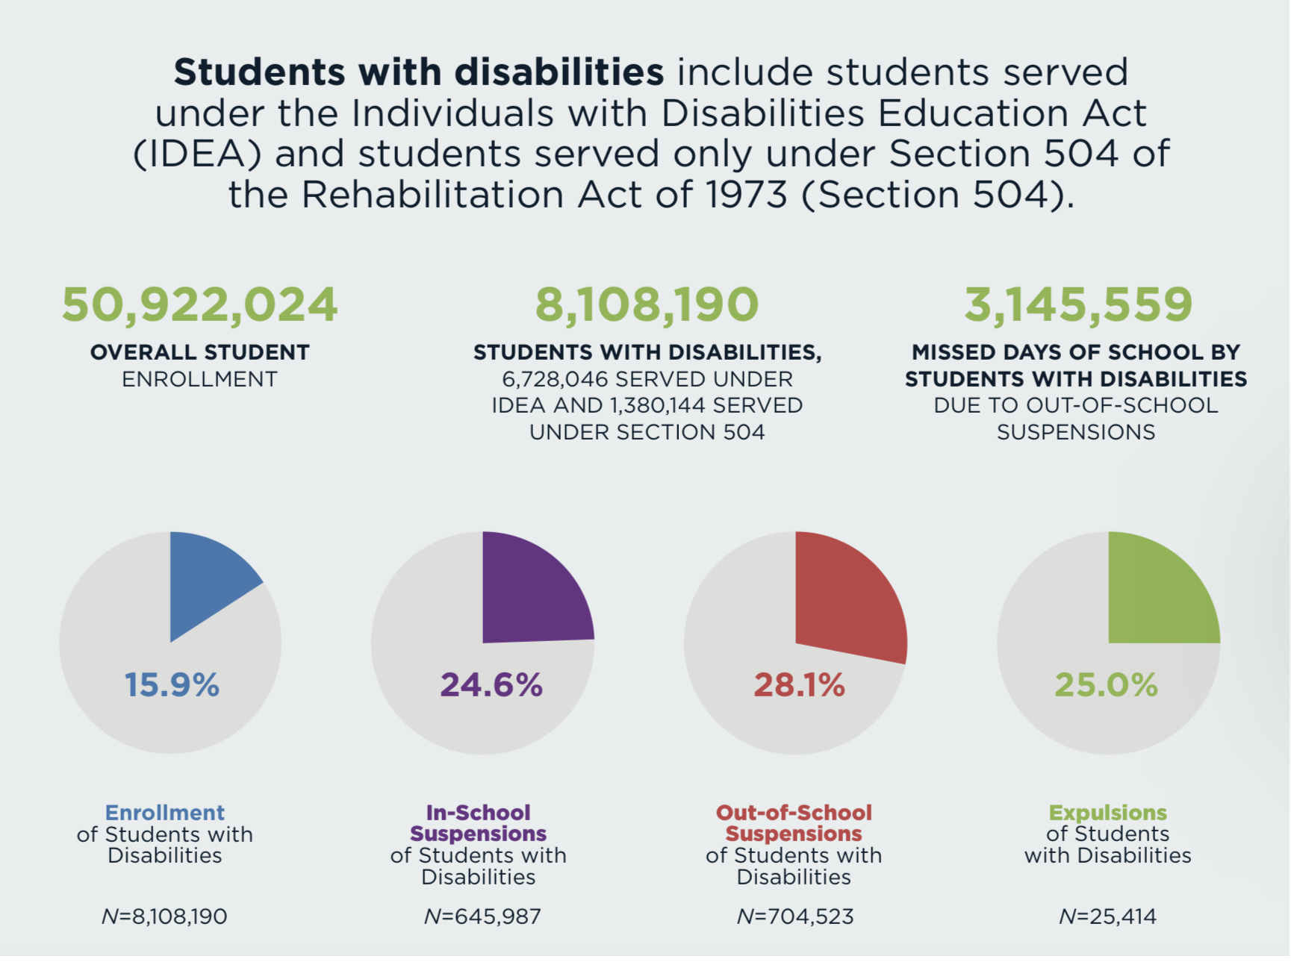
Disproportionate Suspensions & Multi-Tiered Supports
Regan Lamphier, BA, Family Trainee
NH-ME LEND, Institute on Disability, University of New Hampshire
Introduction
Multi-Tiered Systems of Supports
NH Supports Today
The Disability Rights Center - NH protects the legal rights of people with disabilities – which are guaranteed in both federal and state law. Those who have disabilities may deal with discrimination throughout their lives. This project focuses on inequities in public education. Data shows that children with disabilities are suspended more often than non-disabled children at both the national and state level.
During the 2014-15 school year, 20.3% of the NH student population were identified as having a disability. Yet they accounted for 38% of out of school suspensions. Students of color are also affected disproportionately. In the same year, they made up 13.9% of our state’s student population but received 22.7% of out of school suspensions in NH (Juvenile Reform Project, 2019).
National data shows that Black students with disabilities face the greatest discrepancy of all. In 2017-18 nearly 1 in 5 of these children were suspended from school (Leung-Gagnè, 2022).
New Hampshire's Multi-Tiered System of Supports for Behavioral Health and Wellness (MTSS-B) was mandated by state law in 2020. It seeks to improve school climate, lessen disciplinary incidents, and enhance academic achievement.
Establishing a successful program begins with identifying the needs of the district and securing funding. The NH Department of Education was tasked with aligning federal funds, including IDEA, with the MTSS-B program.
Tier 1 provides support for all students. Tier 2 is targeted support for at risk students, and Tier 3 provides interventions for students with the highest needs.
In 2024, a summary of progress made by the NH MTSS-B program praised the Department of Education’s Office of Student and Educator Wellness for providing the technical assistance, coaching, and training needed to establish a quality multi-tiered system of support. At that time, 61 school districts and charter schools had received coaching through the program.
During the 2024 school year, a thriving Community of Practice for the MTSS-B program had grown to 154 members.
The success rate of school referrals to community mental health services in the 23-24 school year was 72%. Four school districts had begun universal screening for unmet needs.
In August of 2025, the MTSS-B Advisory Committee reported in their meeting minutes that four Office of Student and Educator Wellness positions were eliminated in the state budget.
During the 2026 legislative session, HB-1754-FN proposed the repeal of the statewide use of MTSS-B. Testimony in favor of the bill included fears around student privacy and the unfunded nature of the program.
HB-1754-FN was defeated. The MTSS-B program is still active, and the Department of Education hosts two Community of Practice meetings per month. Hope for more sustainable, long-term financial support continues.
Laconia: success of multi-tiered System
Your child's rights
Request an Individualized Education Program (IEP) meeting
Keep a written record. Track every time your student is excluded from classroom
Request a Functional Behavior Assessment and a Behavior Plan
Prepare for the Manifestation Determination Review. This is when the IEP team, including YOU, determine whether your child’s behavior was caused by their disability OR a result of the school’s failure to implement their IEP
Ask for a decision to be reviewed. You are the expert on your child, and the school district does not always have the final say
Add content here
References
Juvenile Reform Project. (2019) Keeping Kids in School: The Urgent Need for Reform of School Discipline in New Hampshire. Amazon Web Services.
Phillips, M., & Sauber,, N. (2021). A Whole-Student Approach: Laconia School District’s Multi-Tiered System of Supports for Behavioral Health and Wellness. Behavioral Health Improvement Institute, Keene State College.
Phillips, M. (2024). MTSS-B Coaching, Technical Assistance, and Evaluation Summary. Behavioral Health Improvement Institute, Keene State College.
Leung-Gagne, M., McCombs, J., Scott, C., Lasen, DJ., (2022) Pushed Out: Trends & Disparities in Out Of School Suspensions. Learning Policy Institute.
US Department of Education, An Overview of Exclusionary Discipline Practices in Public Schools for the 2017-18 School Year [Civil Rights Data Collection].

