Slide 1


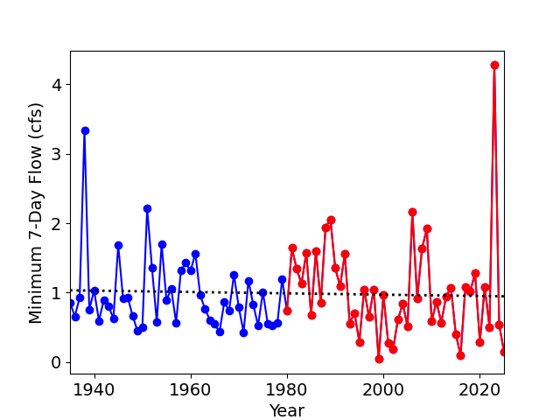
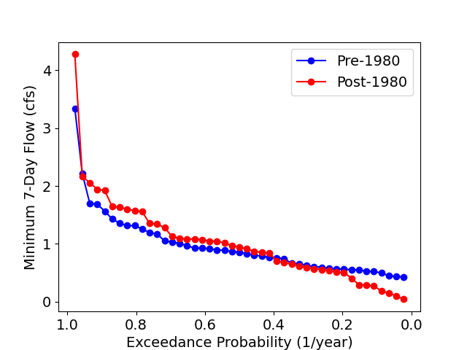
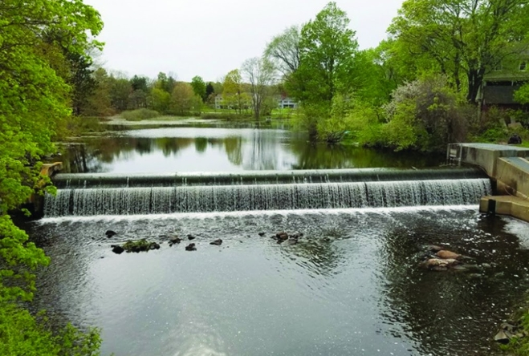
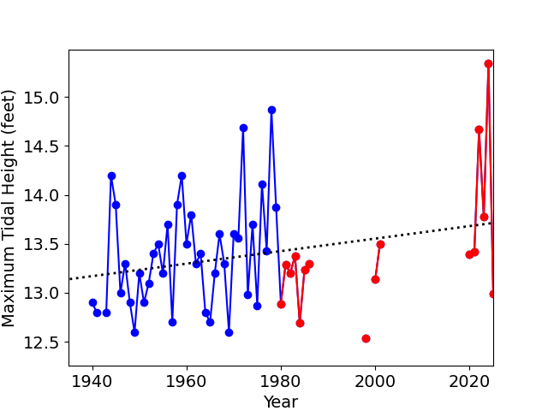
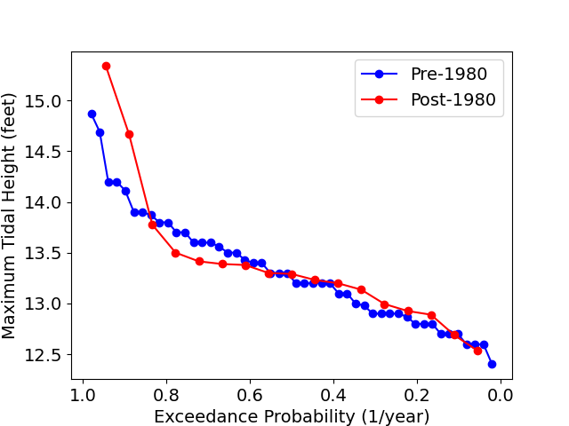
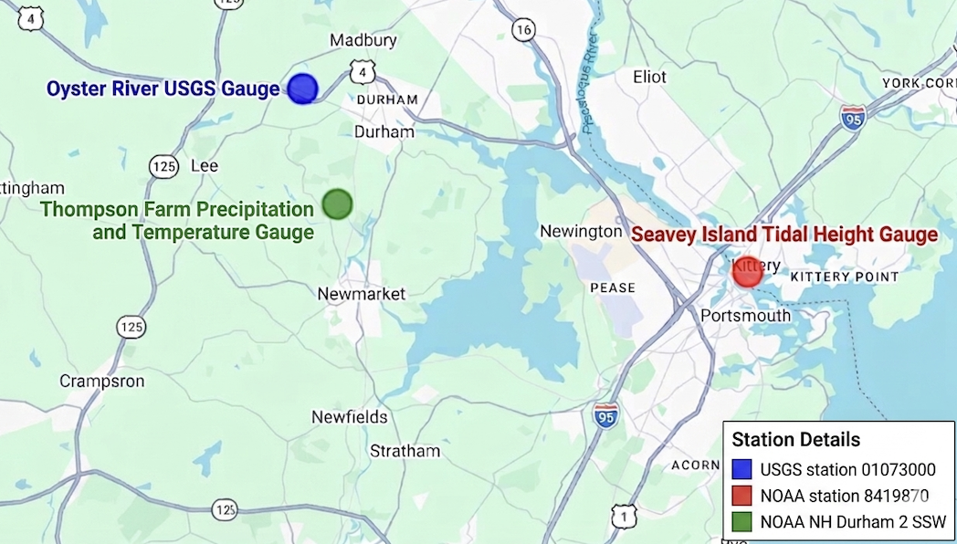
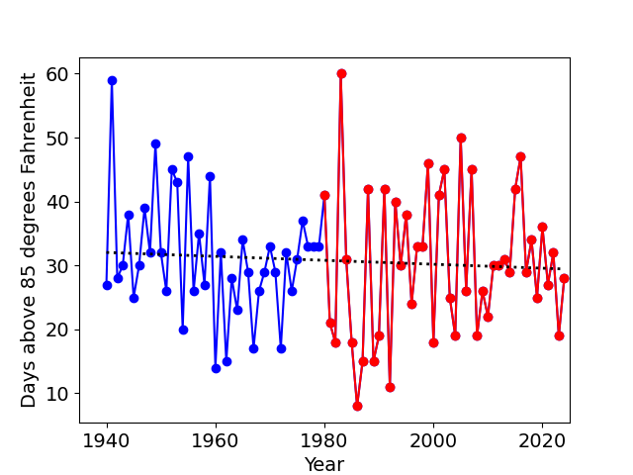
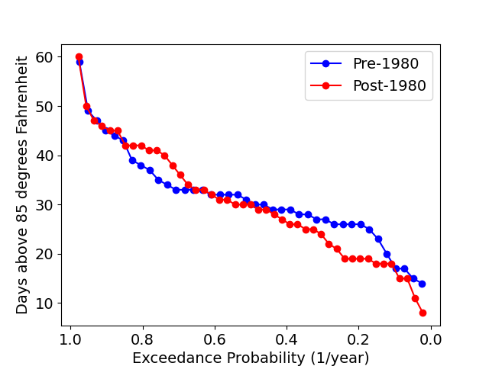
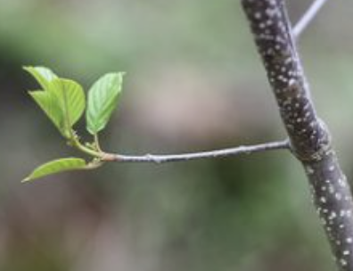
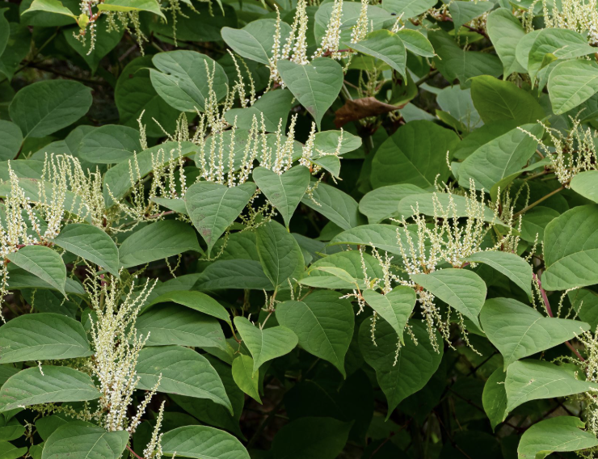
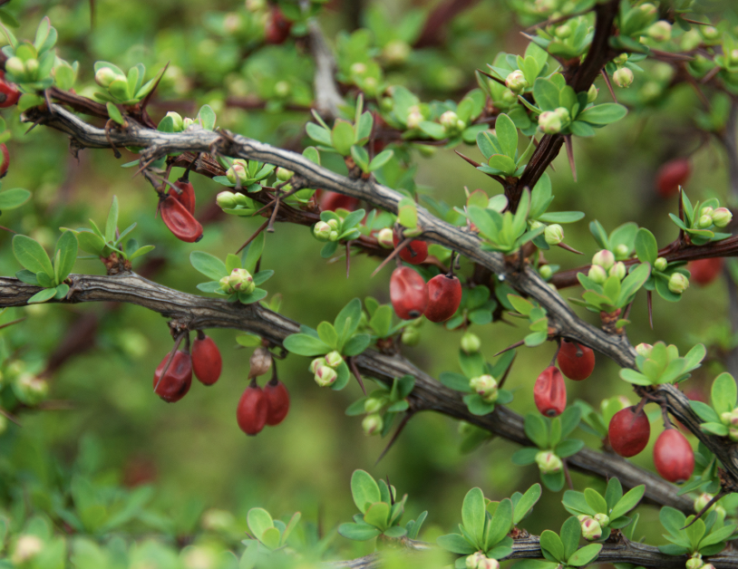
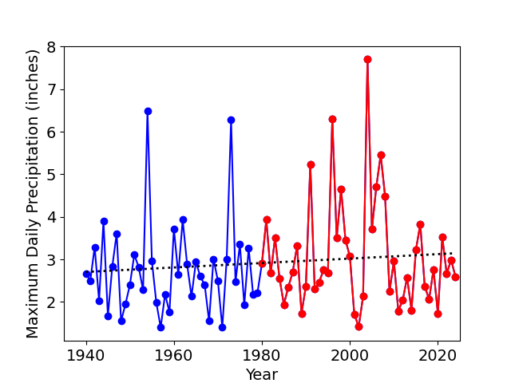
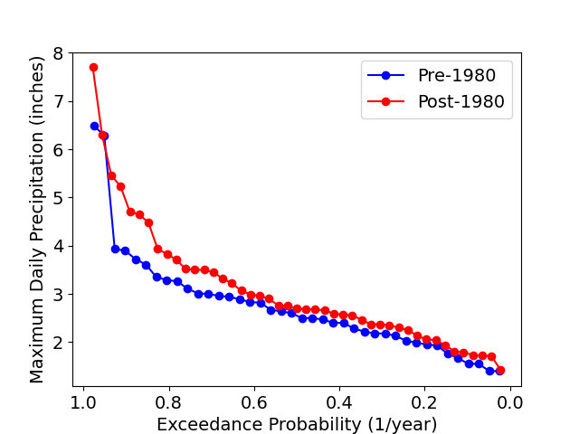
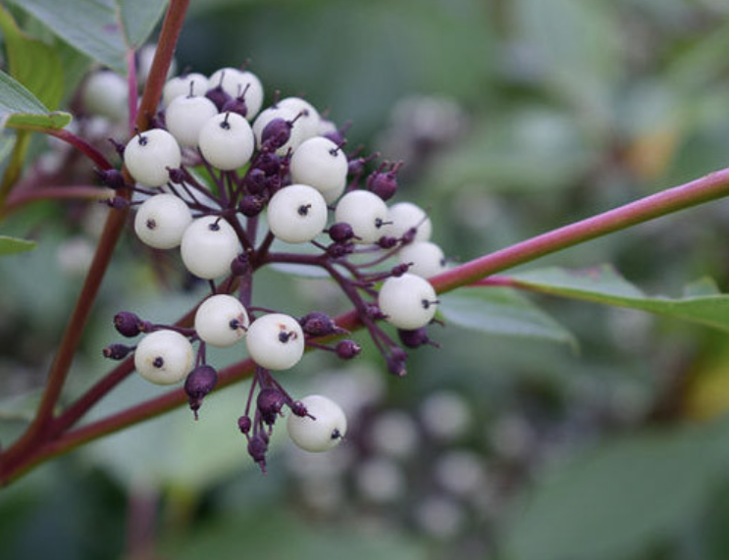
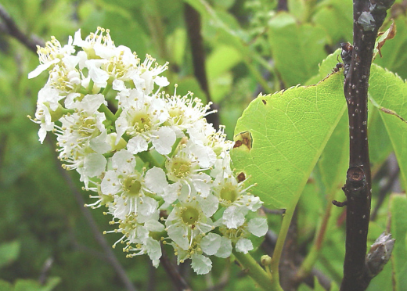
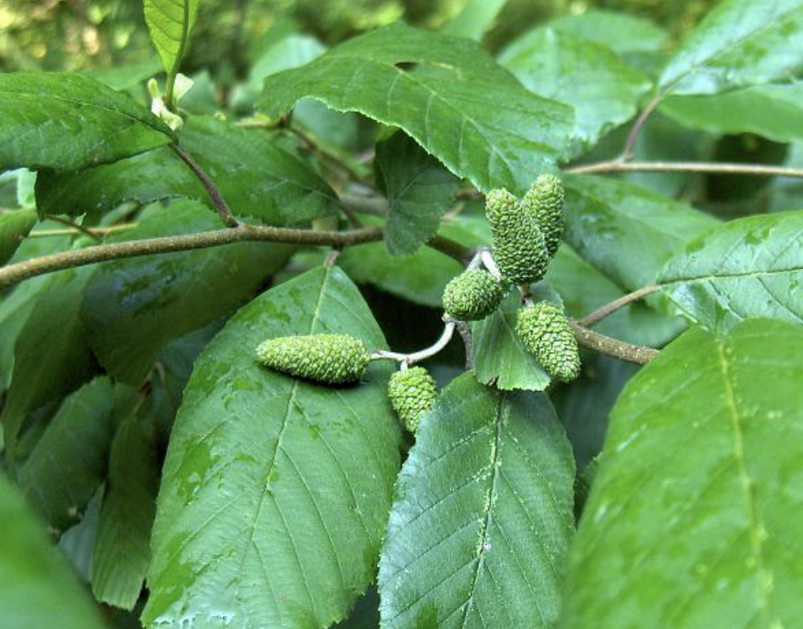
Integrated historical analysis of changing climatic conditions
that affect invasive species dynamics in the Oyster River Watershed
Sydney Vanasse (sydney.vanasse@unh.edu), Advisor: Anne Lightbody
Department of Earth Sciences, University of New Hampshire
Mill Pond Dam Removal
Historical Extremes
Methodology
Invasive species pose a risk in New England waterways especially when habitats are disturbed. Mill Pond Dam, Durham NH, will be removed this summer, exposing sediments and creating conditions that could favor fast spreading and tolerant invasive species over native plant species in the Oyster River watershed.
Compiled annual peak temperature, discharge, precipitation and tidal height data from observational datasets
Processed data using Python (Pandas, NumPy, SciPy) to calculate the number of days with air temperature above 85 F, maximum precipitation, maximum tidal height and minimum 7-day flow to evaluate trends over time
Generated exceedance probability curves for each climatic variable to evaluate shifts in environmental extremes, which may correspond to increased ecosystem stress and greater susceptibility to invasive species establishment
Figure 1. Mill Pond Dam, scheduled for removal summer of 2026.
Indigenous New Hampshire Collaborative
Data Acquisition Sites
Species Tolerance Chart
Table 1. Invasive species demonstrate broader tolerances ranges, allowing them to persist under less favorable conditions, which may give them an advantage as the climate changes. Data from USDA Plant Database
P value = 0.000078
Mill Pond Dam
Species | Type | Drought Tolerance | Salinity Tolerance | Temperature Range (F) | Flood Tolerance
Glossy Buckthorn | Invasive | Moderate | High | -50 to 100 | Moderate
Japanese Knotweed | Invasive | High | High | -50 to 100 | High
Japanese Barberry | Invasive | High | Low | -30 to 100 | High
Red Osier Dogwood | Native | Low | Low | -30 to 90 | High
Black Chokecherry | Native | High | High | -40 to 85 | High
Hazel Alder | Native | Low | Moderate | -40 to 85 | High
Figure 5. Geographic location of Mill Pond Dam and data acquisition sites used for regional environmental monitoring
Conclusions
Discharge: Recently, low flows have become even lower, increasing drought stress and favoring invasive species
Tidal Height: In recent years, the highest high tides have become increasingly higher, potentially leading to greater salinity intrusion and more frequent high-water conditions that may favor invasive species with broad environmental tolerances
Temperature: Increasing heat waves above 85 degrees promote invasive species expansion and stress native species
Precipitation: More frequent high intensity precipitation events increase runoff and erosion, creating favorable conditions for invasive species
Key Species Identification
Glossy Buckthorn (Invasive)
Japanese Knotweed (Invasive)
Japanese Barberry (Invasive)
Cisma-Suasco.Org/Invasive/Glossy-Buckthorn/
andoverma.gov/1387/Japanese-Knotweed-Fallopia-japonica
Gobotany.Nativeplanttrust.Org/Species/Prunus/Virginiana/.
Management Recommendations
Effective management should prioritize early detection and rapid response following sediment disturbance and extreme hydrological events, while promoting public engagement and residential-level invasive species control to reduce long-term costs and improve watershed-wide outcomes (VHB 2024)
Red Osier Dogwood (Native)
Chokecherry (Native)
Hazel Alder (Native)
www.gardenia.net/plant/cornus-sericea-red-osier-dogwood
Gobotany.Nativeplanttrust.Org/Species/Prunus/Virginiana/
www.inaturalist.org/taxa/56033-Alnus-serrulata
References
Figure 2. Representative native and invasive riparian plant species documented within the Oyster River watershed
Figure 3. Time series showing historical trends across environmental variables
Figure 4. Exceedance probability curves showing frequency of extreme events for time periods before and after 1980
USDA Plants Database. USDA Plants Database, plants.sc.egov.usda.gov
VHB 2024. “Oyster River Dam Removal at Mill Pond: Integrated Vegetation Management Plan” 46pp.

