Slide 1


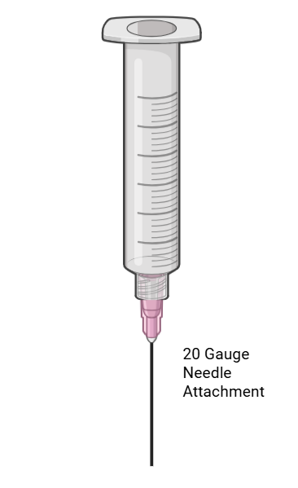
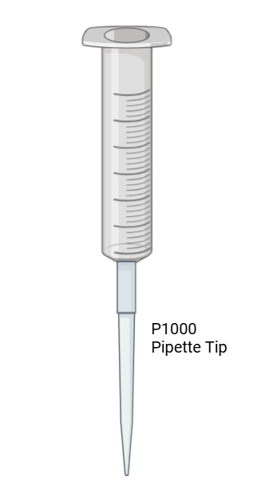
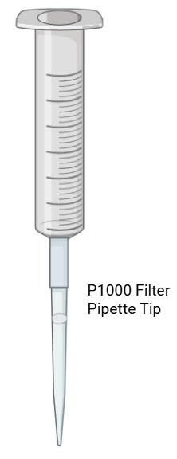
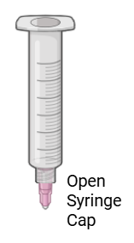
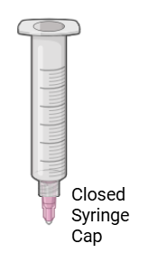
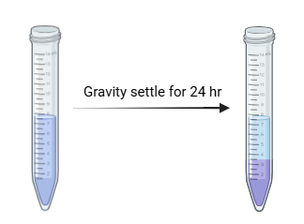
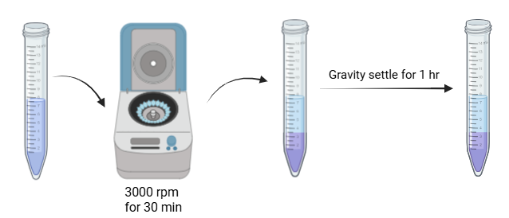
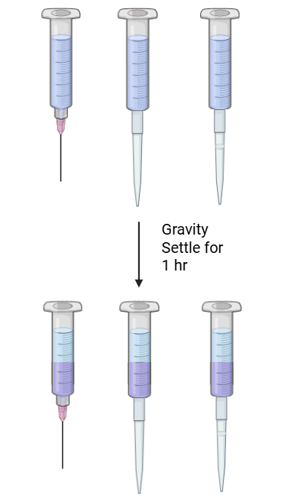
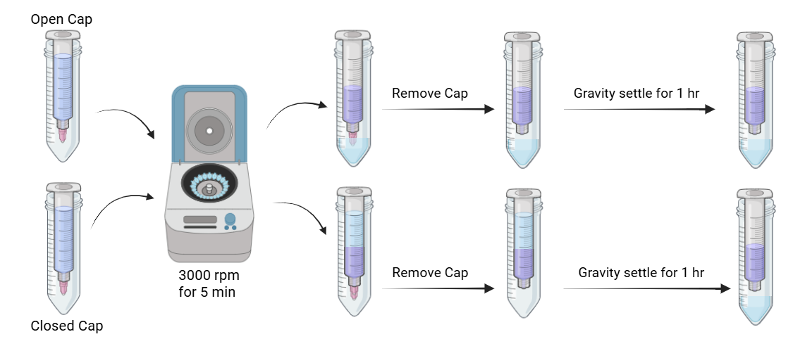
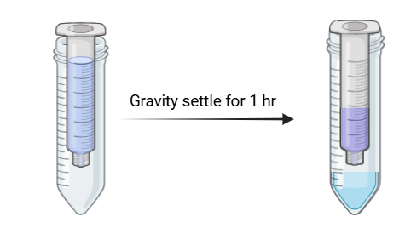
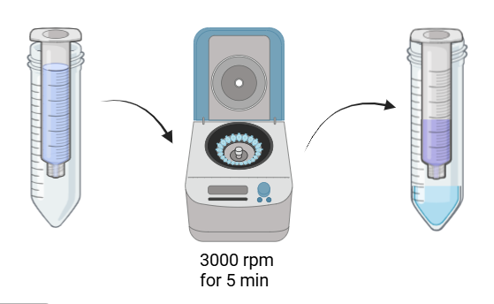
Innovating Resin Slurry Concentration Testing for
Biopharmaceutical Chromatographic Applications
Andrea Milani, Taylor Oster, Julia Groves, Nora Hartung
Department of Chemical Engineering and Bioengineering, University of New Hampshire
Introduction
Updated Designs
Discussion & Conclusions
Chromatography is downstream processing
Used to purify drugs and biological products by separating components based on physical or chemical properties
Essential for achieving high purity and quality product
Resin Slurry Concentration (RSC) Test
Measures the concentration of resin in a slurry before column packing
Ensures the correct amount of resin is used for optimal performance
Role in Column Packing
Support proper packing of stainless steel chromatography columns
Helps determine correct volume of resin or buffer for consistent flow and separation efficiency
Impact of Errors
Inaccurate RSC or poor packing can lead to uneven flow, reduced performance, and column issues
Results in delays, wasted materials and increased costs
PD10 Designs
Hybrid Designs
Preliminary Data
Centrifuge and Gravity Settling
WIFI buffer: Ideal settling across all resins
0.1M NaCl buffer:: Inconsistent settling across resins
PD10
WIFI buffer: Under packing displayed across all resins, most significant in MabSelect Sure and Capto S Impact
0.1M NaCl Buffer: Under packing displayed across all resins except CHT, most significant in Q Sepharose and MabSelect Sure
Hybrid
WIFI: MabSelect Sure displayed optimal settling, Q Sepharose overpacked, remaining resins under packed
0.1M NaCl: MabSelect Sure and CHT overpacked, remaining resins displayed under packing
Updated PD10 Designs
MabSelect Sure: displayed less under packing in the updated PD10 designs compared to the original PD10 design in both WIFI and 0.1 M NaCl buffers
CHT: displayed slight overpacking in needle tip PD10 device and roughly optimal packing in PD10 pipette tip device across both WIFI and 0.1 M NaCl buffers
Updated Hybrid Designs
MabSelect Sure: displayed significant overpacking in both WIFI and 0.1 M NaCl buffers in comparison to original hybrid method
CHT: Displayed increased underpacking in WIFI buffer when compared to the original hybrid method, displayed decreased levels of overpacking in 0.1 M NaCl buffer when compared to the original hybrid method
Original Methods & Designs
Updated Methods
24hr Settling
Centrifuge & Gravity Settling
PD10
Hybrid
PD10
Hybrid
Preliminary Data
Results
Acknowledgements
We would like to extend our sincere gratitude to John Csoros and Dave Peterson from Lonza for their invaluable support in making this project possible. We also wish to thank our project advisor, Linqing Li, for his guidance, insight, and continued mentorship throughout this work.
References
Lonza Biologics, 2016, Slurry Concentration Measurement by Centrifugation, Version 1, Lonza Biologics
Lonza Biologics, 2025, Bioengineering Student Capstone – Resin Slurry Concentration, Lonza Biologics

