Slide 1


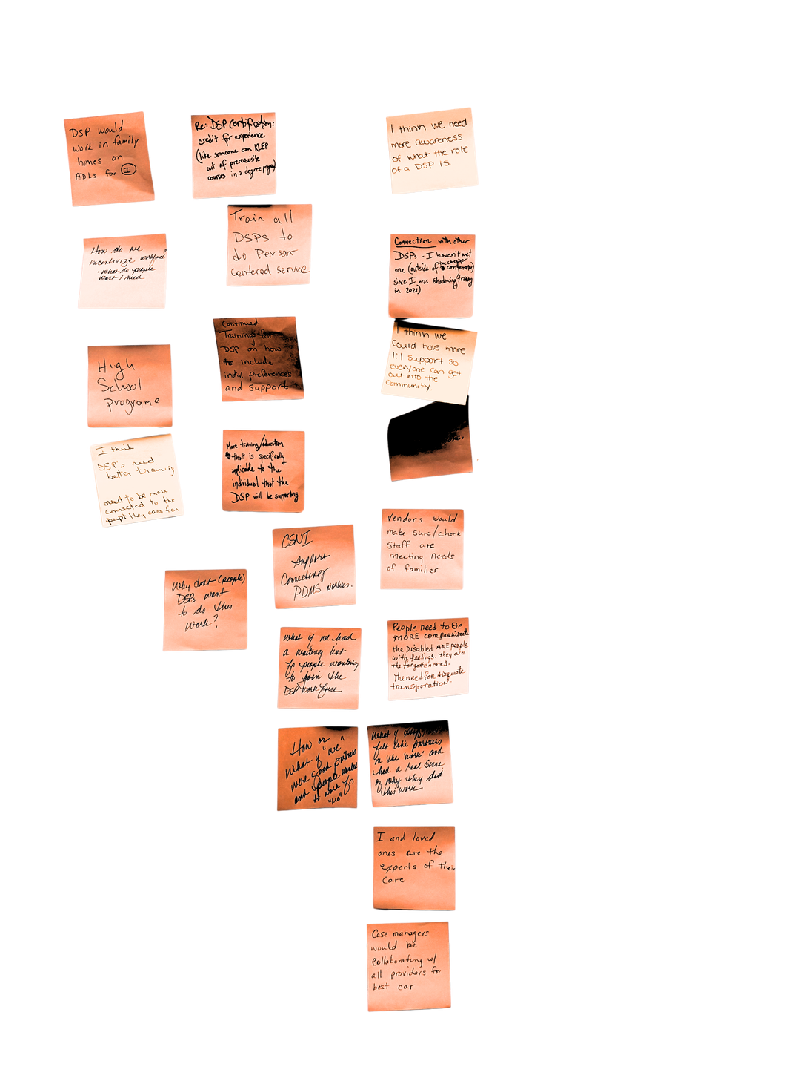
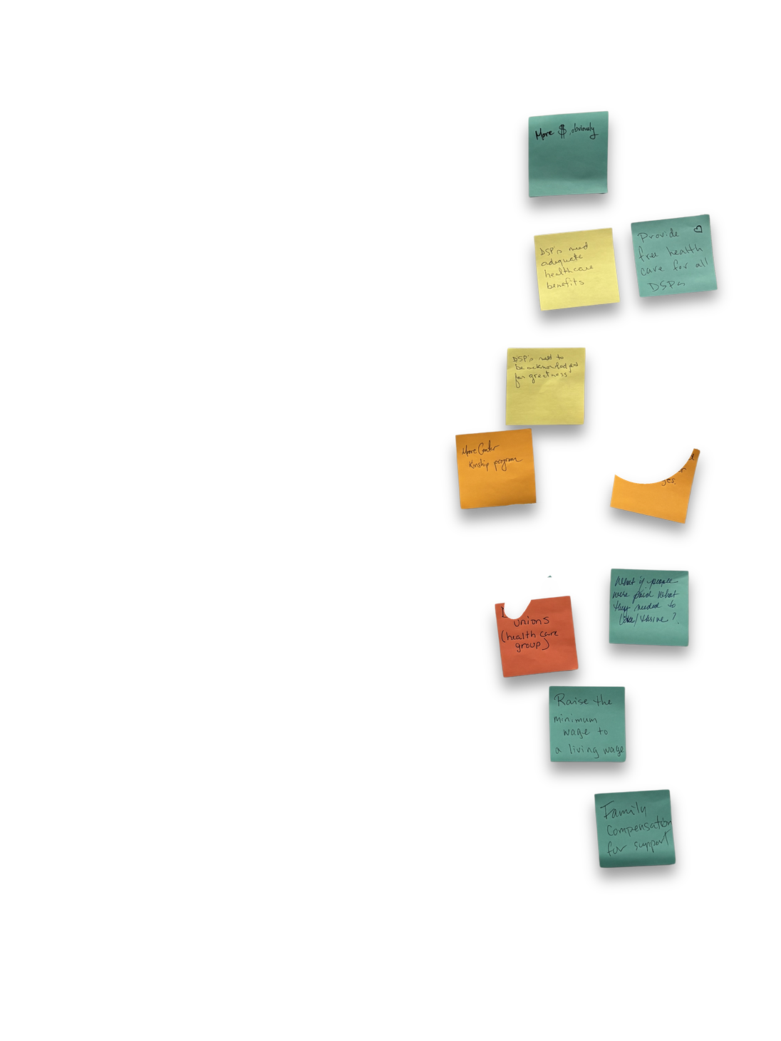

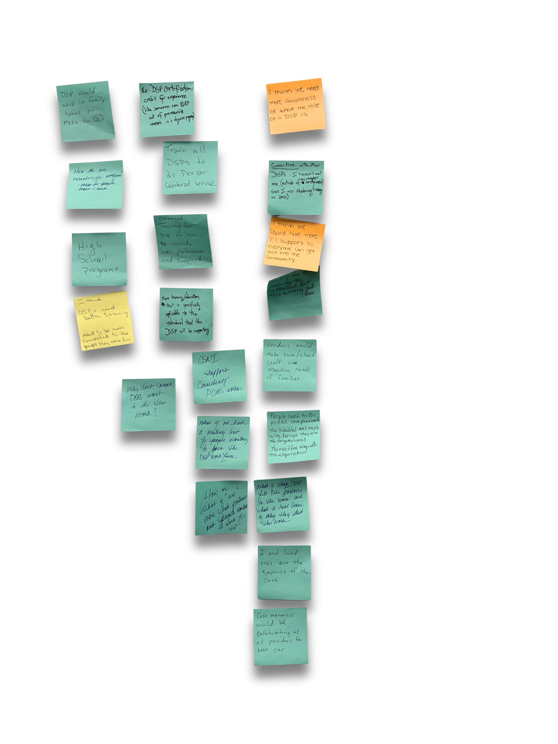


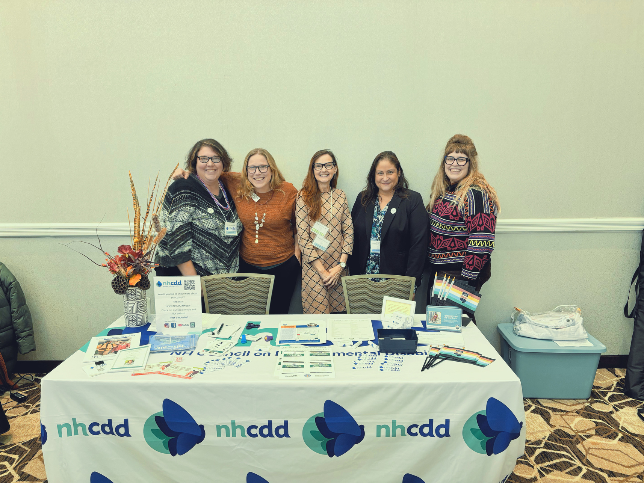




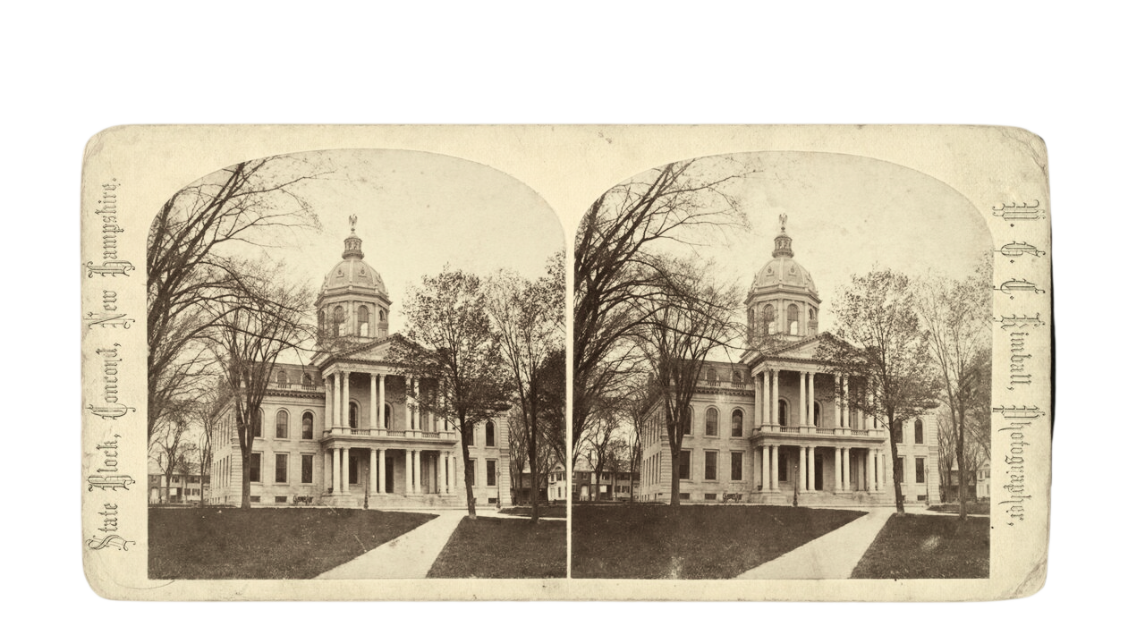



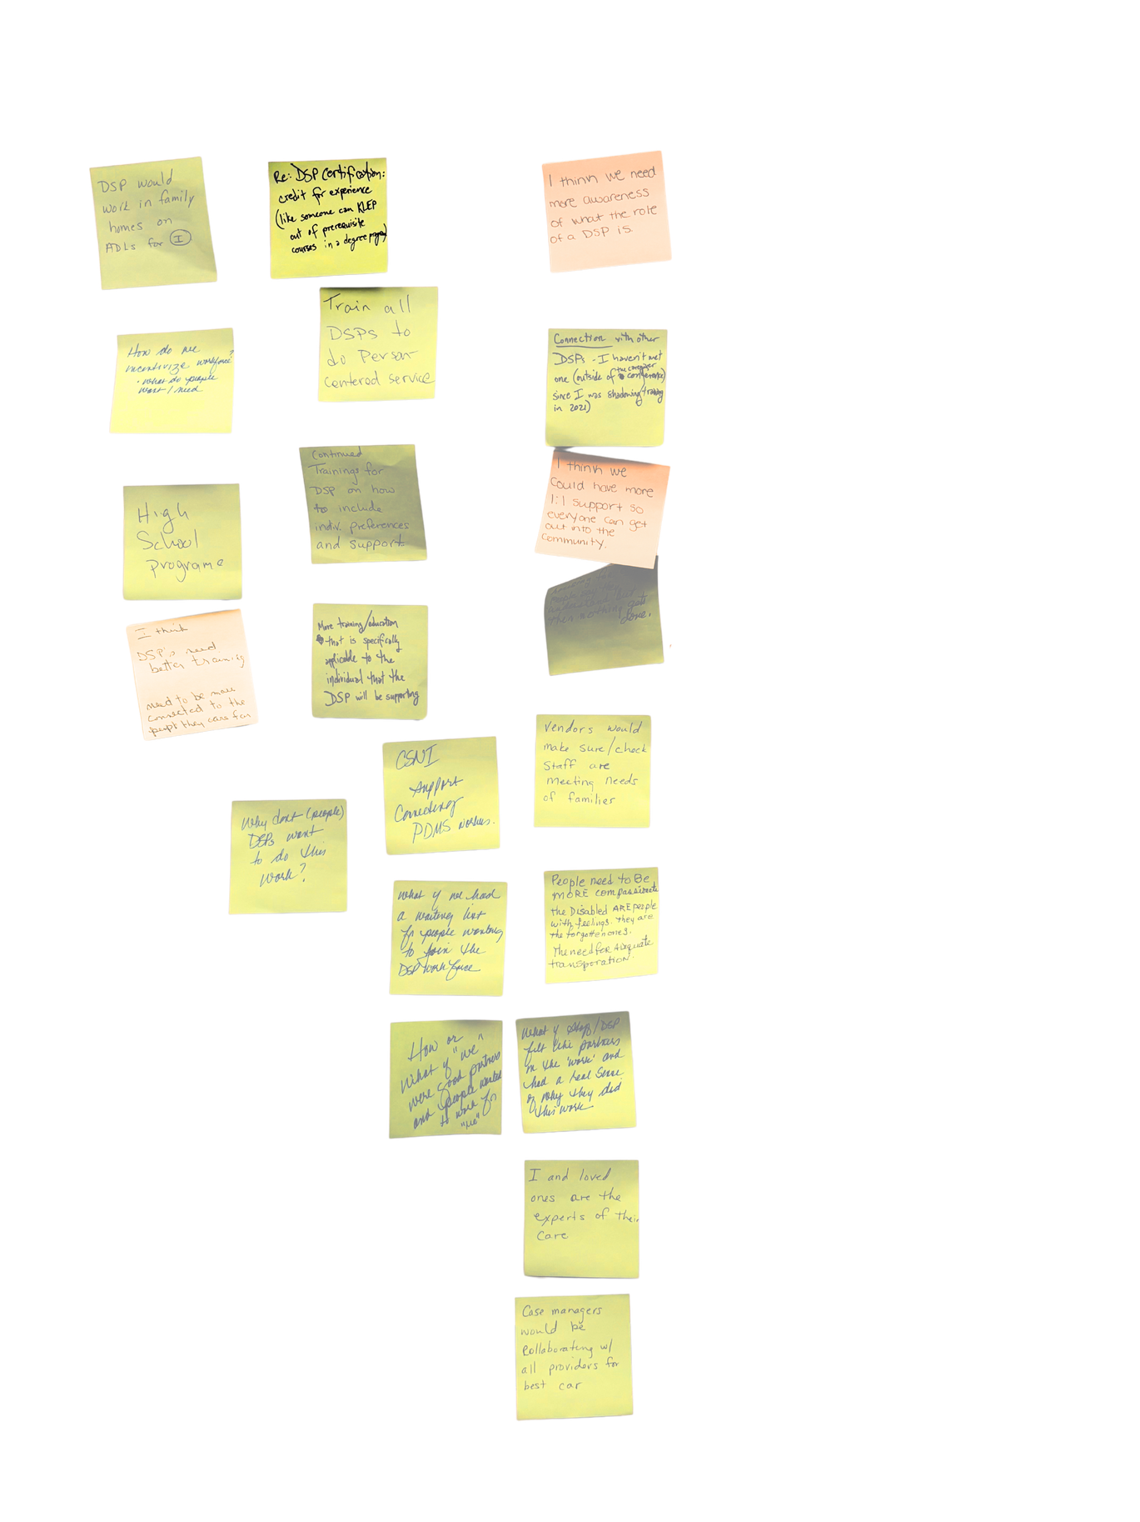

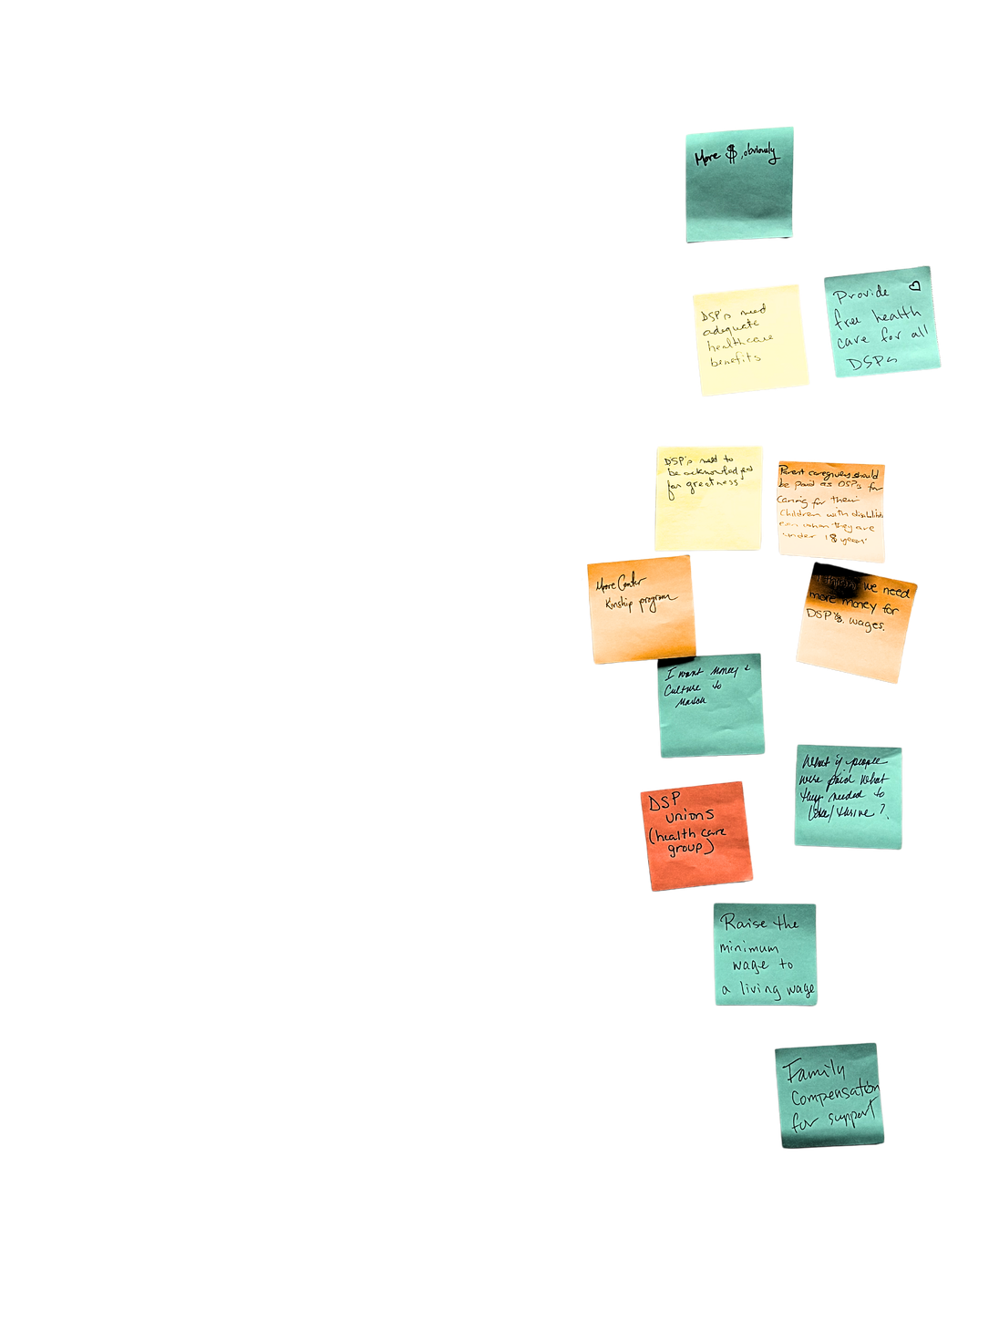
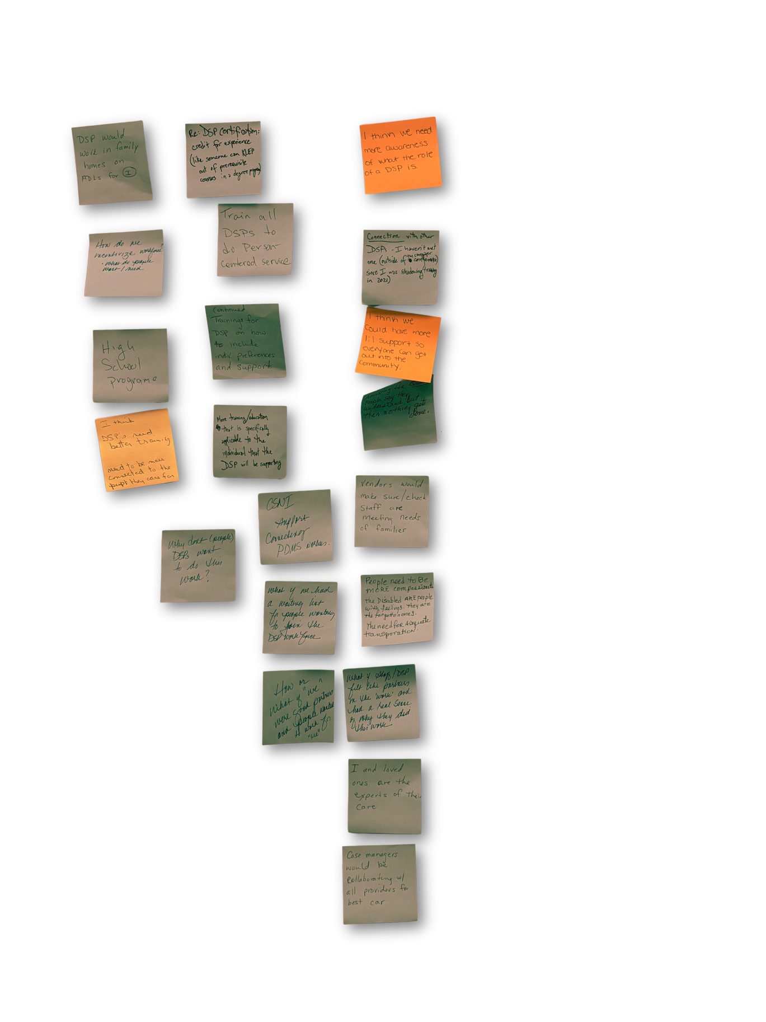
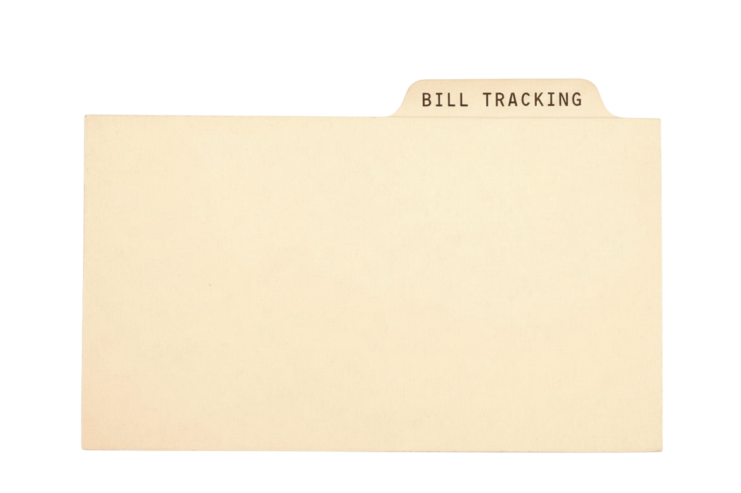










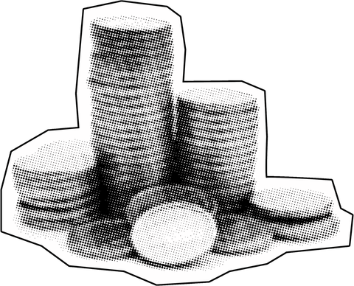













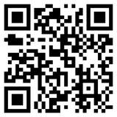
Elevating Lived Expertise In New Hampshire Policy
Cara E. Cabral, BFA, MSW Trainee
NH-ME LEND, Institute on Disability, University of New Hampshire
From Citizen Legislature to Unheard Voices
Unconference: Elevating Lived Expertise
New Hampshire’s legislature was designed as a “citizen legislature”—by and for the people.
  Run by everyday people
  Grounded in community voices
  Driven by public input
  Not dominated by career politicians
I’M AN
NH-ME LEND, Institute on Disability, University of New Hampshire
TRADITIONAL
CONFERENCES
UNCONFERENCE
MODEL
The Reality Today
Buttons given to
Unconference attendees
  Decisions shaped by individual
lawmakers & special interests
  Public testimony is mostly reactive
  Community influence is weakened
  Underrepresented voices are
least heard
“Expert”-led; power imbalance; one- way presentations
Participant-driven; collaborative agenda-setting; shared power
NHCDD Pilot Unconference
NH Caregiver’s Conference Workshop | November 2025
Focus: ”What do you hope for in the future of direct support professional (DSP) work?”
In March 2026, dozens of bills, including NHCDD priorities, “died”
without a vote because House leadership did not allocate time for them.
Two bills that I tracked failed to advance despite clear public support:
  HB 1593-FN: Would prohibit disability discrimination in publicly funded programs and allow individuals to challenge violations
305 support | 8 oppose*
  HB 1316: Would restrict state use of autism-related data,
requiring consent and strong privacy protections
446 support | 46 oppose*
*These numbers reflect remote testimony only.
In disability services, where
hierarchical systems often exclude key voices, the unconference model disrupts traditional power structures
to enable more inclusive,
responsive decision-making.
Facilitation Approach
Facilitators created a light structure and set the tone sharing experiences and generating solutions. Three steps guided the process:
  Dreaming Together: Participants shared solution-focused ideas on a “Dream Wall”
  Theme Sorting: Ideas were grouped and prioritized through voting
  Idea Harvest: Small groups explored barriers, stakeholders, and initial steps they could take
Principles of Unconferences
Major Themes Identified
Factors Limiting Impact of Input
Center voices of those most impacted
Share knowledge;
solve problems
together
Generate community-
driven ideas
Open structure invites creative solutions to complex issues
Respect &
Recognition
Pay &
Benefits
Training &
Connection
Awareness &
Recruitment
Quality
Supervision
PARTISAN
DYNAMICS
ONLINE
TESTIMONY
TIME
LIMITS
PROCEDURAL
CONSTRAINTS
Future Directions Identified
Conclusion
  Increase awareness of DSP roles and public engagement
  Support peer networks and culture change initiatives
The gap between public participation and policy outcomes is a challenge
in NH.
The unconference model shows that centering lived experience and collaboration generates innovative, experience-driven ideas that can meaningfully shape outcomes.
Extending these principles into policymaking creates a more responsive, inclusive, and effective system.
When participation shapes decisions, the citizen legislature fulfills
its promise.
Pilot Feedback & Reflections
Outweigh
community
dynamics
Expands access,
but rarely changes
outcome
Restrict meaningful
debate
Limit engagement with complex rules
  Qualitative: “Very collaborative and safe space”
“Excellent brainstorming”
“Everyone made me feel welcome”
NH Council on Developmental Disabilities (NHCDD) is a federally funded state agency dedicated to working alongside NH residents with intellectual and developmental disabilities to strengthen access and expand choices for all people in New Hampshire communities.
  Evaluation (1–10): Recommend: 9.6 | Learned skills: 9.5
Format fit: 9.6 | Gained understanding: 9.2
  What Worked: Participants felt valued; format generated diverse
ideas
\
  Challenges: Small group size limited diverse perspectives;
time constraints
References available on request.
NH-ME LEND is supported by a grant (#T73MC33246) from the Maternal and Child Health Bureau, Health Resources and Services Administration (HRSA), U.S. Department of Health and Human Services and administered by the Association of University Centers on Disabilities (AUCD).
iod.unh.edu/nh-me-lend

